Slide 1
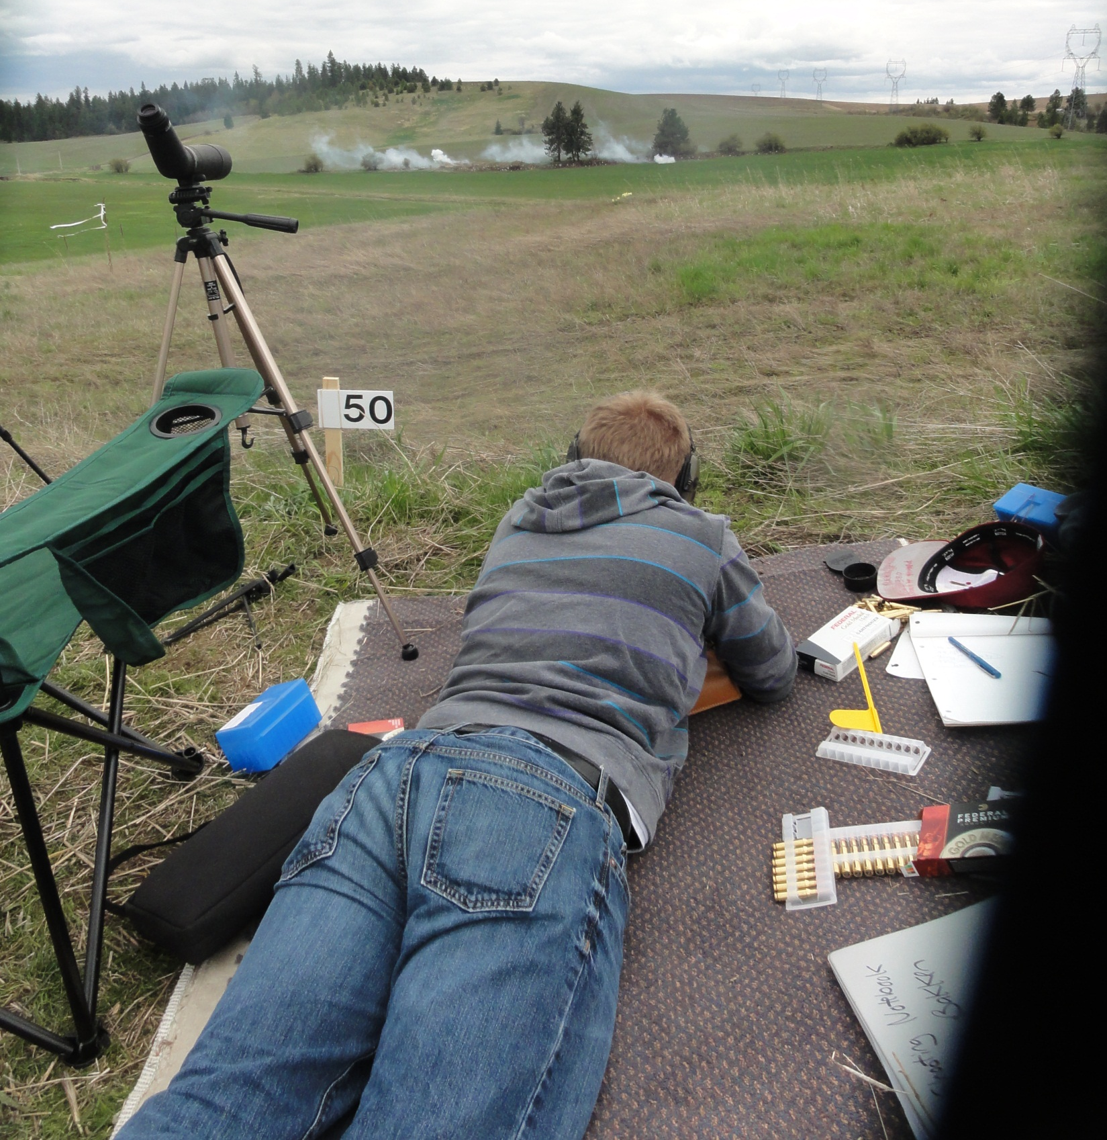
Sam Bakken exploding 7x7 inch targets at 385 yards. He also shot someone’s competition rifle (Savage Long Range Precision 6.5mm Creedmor) and hit 3 times of 3, the last two being on man-sized targets at 700 yards. This was at Boomershoot 2012, see www.boomershoot.org for more fun.

