Slide 1
Instruction Set Principles
(Appendix B)

Slide 2
Instruction Set Architecture (ISA)
S o f t w a r e
i n s t r u c t i o n s e t
Hardware

Slide 3
Interface Design (ISA)
A good interface:
Lasts through many implementations (portability, compatibility)
Is used in many different ways (generality)
Provides convenient functionality to higher levels
Permits an efficient implementation at lower levels
use
imp 1
time
Interface
use
I S A
imp 2
use
imp 3

Slide 4
Classification of ISAs
Stack Architecture
Only data structure: Stack
Accumulator Architecture
Only one register: Accumulator
General Purpose Register (GPR) Architecture
Set or Registers (Register File)
3 sub-architectures:
Reg-Reg (Load/Store)
Reg-Mem or Mem-Reg
Mem-Mem

Slide 5
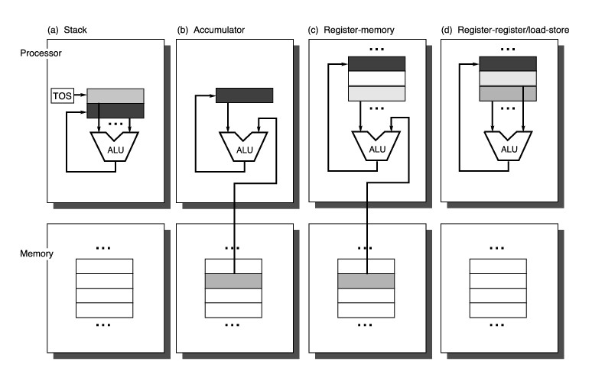
Operand location for ISAs

Slide 6
Example: MIPS
r0
r1
°
°
°
r31
0
Programmable storage
2^32 x bytes
31 x 32-bit GPRs (R0=0)
32 x 32-bit FP regs (paired DP)
HI, LO, PC
PC
lo
hi
unsigned
Set Less Than
Arithmetic logical
Add, AddU, Sub, SubU, And, Or, Xor, Nor, SLT, SLTU,
AddI, AddIU, SLTI, SLTIU, AndI, OrI, XorI, LUI
SLL, SRL, SRA, SLLV, SRLV, SRAV
Memory Access
LB, LBU, LH, LHU, LW,
SB, SH, SW,
Control
J, JAL, JR, JALR
BEq, BNE, BLEZ,BGTZ,BLTZ,BGEZ,BLTZAL,BGEZAL
immediate
Shift left logical
Shift right arithm.
32-bit instructions on word boundary

Slide 7
CISC vs. RISC
First computers were RISC
Cray supercomputers were RISC
Complexity was added in the 70s and 80s
Return to simplicity in 80’s and 90’s

Slide 8
Why Return to RISC?
CISC provides too many possibilities
Compilers can’t choose optimal encoding
70 instructions = 99% of code
50 instructions = 95% of code

Slide 9
Why Did CISC Happen?
Fetch- Execute cycle
Limited memory
Reduce fetches and memory by packing multiple ops into each instruction
Observe common sequences of ops and turn them into instructions

Slide 10
CISC Features
Memory accesses and address arithmetic are tightly bound to instructions
Rely on few registers, more memory references
Note that memory hasn’t kept pace with processor clock rate

Slide 11
Reduced Instruction Set Computers (Cocke, IBM; Patterson, UC Berkeley; Hennessy, Stanford)
Compilers have difficulty using complex instructions
VAX: 60% of microcode for 20% of instructions, only responsible for 0.2% execution time
IBM retargets 370 compiler to use ISA subset - generated code faster!
Simple instruction sets do not need microcode
Use fast memory near processor as cache, not microcode storage
Design ISA for simple pipelined implementation
Fixed length, fixed format instructions
Load/store architecture with up to one memory access/instruction
Few addressing modes, synthesize others with code sequence
Register-register ALU operations
Delayed branch

Slide 12
Benefits of RISC
Reduced CPI (cycles per instruction)
Reduced decoding delay
Simpler core design enables more chip area to be used for performance
But today, CISC architectures like Intel use a RISC core for a subset of instructions
Why are RISC designs still faster?

Slide 13
Code Expansion
RISC does less with each instruction
Large code size (1.3 to 1.6 X)
Larger number of memory fetches
Partly alleviated by larger cache
Still generates more memory traffic than CISC
Compressed instruction blocks?

Slide 14
Common RISC Features
Load/ Store designs
Few addressing modes
Fixed instruction size
Few instruction formats
Few operand sizes
Use more registers, separate memory operations

Slide 15
MIPS R2000 (One of first commercial RISCs, 1986)
Load/Store architecture
32x32-bit GPR (R0 is wired), HI & LO SPR (for multiply/divide)
74 instructions
Fixed instruction size (32 bits), only 3 formats
PC-relative branches, register indirect jumps
Only base+displacement addressing mode
No condition bits, compares write GPRs, branches test GPRs
Delayed loads and branches
Five-stage instruction pipeline
Fetch, Decode, Execute, Memory, Write Back
CPI of 1 for register-to-register ALU instructions
8 MHz clock
Tightly-coupled off-chip FP accelerator (R2010)

Slide 16
RISC/CISC Comparisons
R2000 vs VAX 8700 [Bhandarkar and Clark, ‘91]
R2000 has ~2.7x advantage with equivalent technology
Intel 80486 vs Intel i860 (both 1989)
Same company, same CAD tools, same process
i860 2-4x faster - even more on some floating-point tasks
DEC nVAX vs Alpha 21064 (both 1992)
Same company, same CAD tools, same process
Alpha 2-4x faster

Slide 17
A "Typical" RISC
32-bit fixed format instruction (3 formats)
32 32-bit GPR (R0 contains zero, DP take pair)
3-address, reg-reg arithmetic instruction
Single address mode for load/store: base + displacement
no indirection
Simple branch conditions
Delayed branch
See: SPARC, MIPS, HP PA-Risc, DEC Alpha, IBM PowerPC,
CDC 6600, CDC 7600, Cray-1, Cray-2, Cray-3

Slide 18
Example: MIPS
Register-Register
31
26
25
21
20
16
15
11
10
6
5
0
Op
Rs1
Rs2
Rd
Opx
Register-Immediate
31
26
25
21
20
16
15
0
Op
Rs1
Rd
immediate
Branch
31
26
25
21
20
16
15
0
Op
Rs1
Rs2/Opx
immediate
Jump / Call
31
26
25
0
Op
target

