Slide 1
Computer Architecture
A Quantitative Approach, Fifth Edition
Chapter 2
Memory Hierarchy Design

Slide 2
Introduction
Introduction
Programmers want very large memory with low latency
Fast memory technology is more expensive per bit than slower memory
Solution: organize memory system into a hierarchy
  Entire addressable memory space available in largest, slowest memory
  Incrementally smaller and faster memories, each containing a subset of the memory below it, proceed in steps up toward the processor
Temporal and spatial locality insures that nearly all references can be found in smaller memories
  Gives the allusion of a large, fast memory being presented to the processor

Slide 3
Memory Hierarchy
Processor
L1 Cache
L2 Cache
L3 Cache
Main Memory
Hard Drive or Flash
Latency
Capacity (KB, MB, GB, TB)

Slide 4
PROCESSOR
L1:
I-Cache
D-Cache
L2:
I-Cache
D-Cache
L2:
U-Cache
L3:
U-Cache
Main:
Main Memory

Slide 5
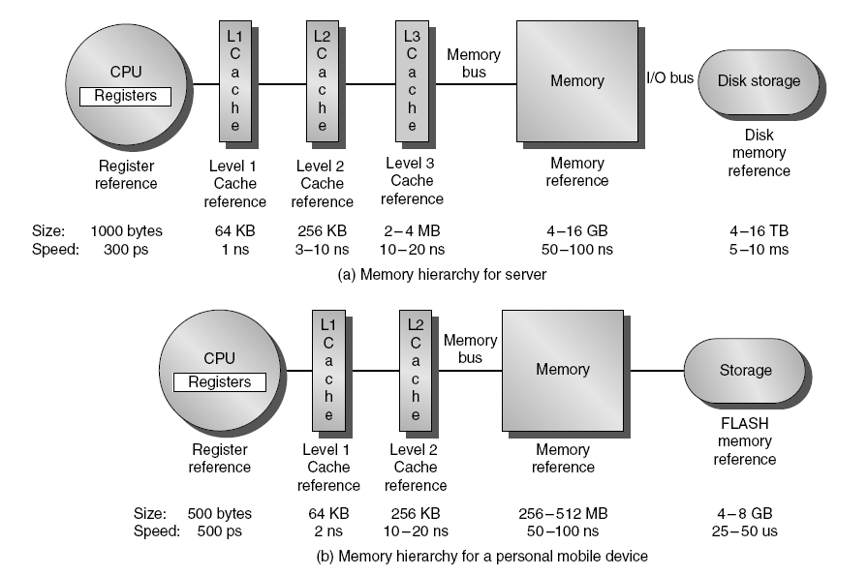
Memory Hierarchy
Introduction

Slide 6
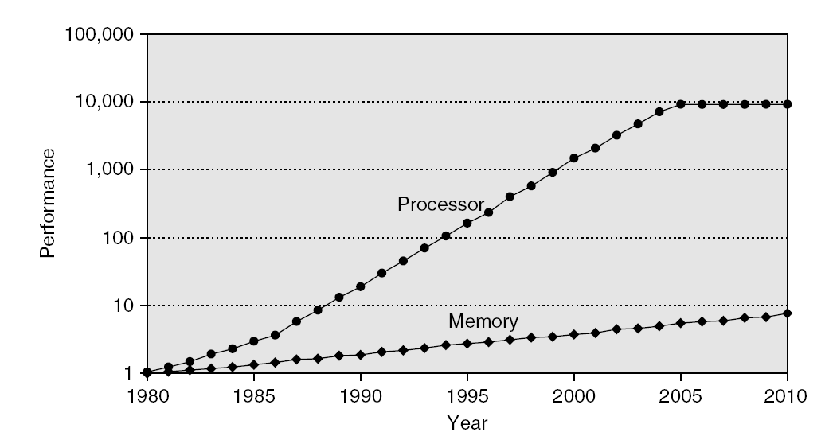
Memory Performance Gap
Introduction

Slide 7
Memory Hierarchy Design
Introduction
Memory hierarchy design becomes more crucial with recent multi-core processors:
  Aggregate peak bandwidth grows with # cores:
    Intel Core i7 can generate two references per core per clock
    Four cores and 3.2 GHz clock
      25.6 billion 64-bit data references/second +
      12.8 billion 128-bit instruction references
      = 409.6 GB/s!
    DRAM bandwidth is only 6% of this (25 GB/s)
    Requires:
      Multi-port, pipelined caches
      Two levels of cache per core
      Shared third-level cache on chip

Slide 8
Intel Processors (3rd Generation Intel Core)
Intel Core i7
  4 cores 8 threads
  2.5-3.5 GHz (Normal); 3.7 or 3.9GHz (Turbo)
Intel Core i5
  4 cores 4 threads (or 2 cores 4 threads)
  2.3-3.4GHz (Normal); 3.2-3.8Ghz (Turbo)
Intel Core i3
  2 cores 4 threads
  3.3 or 3.4 GHz

Slide 9
Performance and Power
Introduction
High-end microprocessors have >10 MB on-chip cache
  Consumes large amount of area and power budget

Slide 10
Memory Hierarchy Basics
Introduction
When a word is not found in the cache, a miss occurs:
  Fetch word from lower level in hierarchy, requiring a higher latency reference
  Lower level may be another cache or the main memory
  Also fetch the other words contained within the block
    Takes advantage of spatial locality
  Place block into cache in any location within its set, determined by address
    block address MOD number of sets

Slide 11
Placement Problem
Main Memory
Cache Memory

Slide 12
Placement Policies
WHERE to put a block in cache
Mapping between main and cache memories.
Main memory has a much larger capacity than cache memory.

Slide 13
Fully Associative Cache
Memory
0
1
2
3
4
5
6
7
8
9
10
11
12
13
14
15
16
17
18
19
20
21
22
23
24
25
26
27
28
29
30
31
0
1
2
3
4
5
6
7
Block number
Block can be placed in any location in cache.

Slide 14
Direct Mapped Cache
Memory
0
1
2
3
4
5
6
7
8
9
10
11
12
13
14
15
16
17
18
19
20
21
22
23
24
25
26
27
28
29
30
31
0
1
2
3
4
5
6
7
Block number
(Block address) MOD (Number of blocks in cache)
12 MOD 8 = 4
Block can be placed ONLY in a single location in cache.

Slide 15
Set Associative Cache
Memory
0
1
2
3
4
5
6
7
8
9
10
11
12
13
14
15
16
17
18
19
20
21
22
23
24
25
26
27
28
29
30
31
Set no.
0
1
2
3
4
5
6
7
0
1
2
3
Block number
Block number
(Block address) MOD (Number of sets in cache)
12 MOD 4 = 0
Block can be placed in one of n locations in n-way set associative cache.

Slide 16
Memory Hierarchy Basics
Introduction
n sets => n-way set associative
  Direct-mapped cache => one block per set
  Fully associative => one set
Writing to cache: two strategies
  Write-through
    Immediately update lower levels of hierarchy
  Write-back
    Only update lower levels of hierarchy when an updated block is replaced
  Both strategies use write buffer to make writes asynchronous

Slide 17
Dirty bit(s)
Indicates if the block has been written to.
  No need in I-caches.
  No need in write through D-cache.
  Write back D-cache needs it.

Slide 18
Write back
C P U
D
cache
Main memory

Slide 19
Write through
C P U
cache
Main memory

Slide 20
Memory Hierarchy Basics
Introduction
Miss rate
  Fraction of cache access that result in a miss
Causes of misses (Three Cs)
  Compulsory
    First reference to a block
  Capacity
    Blocks discarded and later retrieved
  Conflict
    Program makes repeated references to multiple addresses from different blocks that map to the same location in the cache

Slide 21
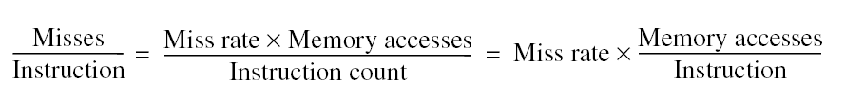
Memory Hierarchy Basics
Introduction
Note that speculative and multithreaded processors may execute other instructions during a miss
  Reduces performance impact of misses

Slide 22
Cache organization
CPU
address
Data
<21> <8> <5>
Tag
Index
blk
Valid Tag Data
<1> <21> <256>
:
:
=
MUX

Slide 23
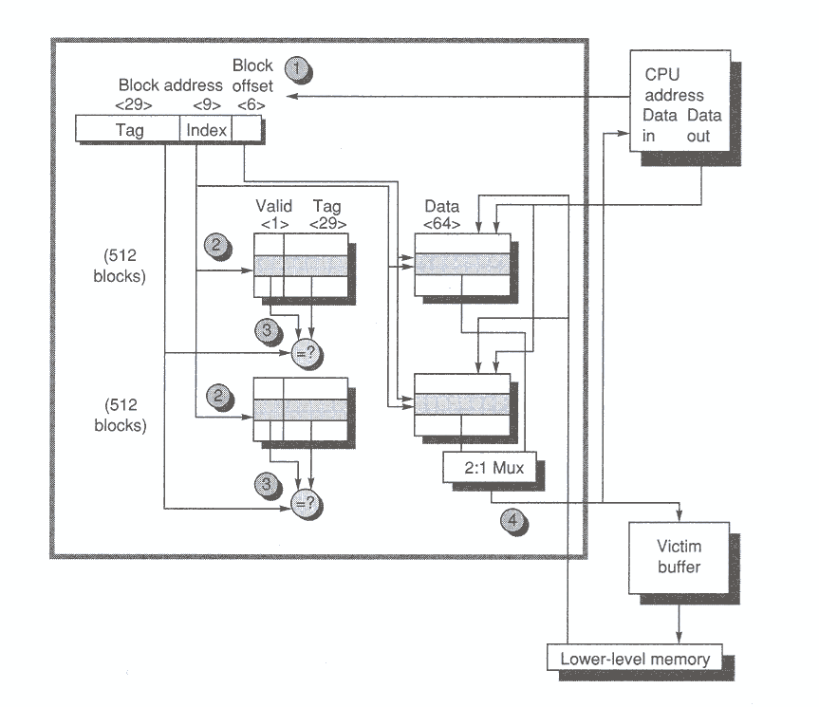
Two-way cache (Alpha)

Slide 24
Memory Hierarchy Basics
Introduction
Six basic cache optimizations:
  Larger block size
    Reduces compulsory misses
    Increases capacity and conflict misses, increases miss penalty
  Larger total cache capacity to reduce miss rate
    Increases hit time, increases power consumption
  Higher associativity
    Reduces conflict misses
    Increases hit time, increases power consumption
  Higher number of cache levels
    Reduces overall memory access time
  Giving priority to read misses over writes
    Reduces miss penalty
  Avoiding address translation in cache indexing
    Reduces hit time

Slide 25
Ten Advanced Optimizations
Advanced Optimizations
Metrics:
  Reducing the hit time
  Increase cache bandwidth
  Reducing miss penalty
  Reducing miss rate
  Reducing miss penalty or miss rate via parallelism

Slide 26
1) Small and simple L1 caches
Critical timing path:
  addressing tag memory, then
  comparing tags, then
  selecting correct set
Direct-mapped caches can overlap tag compare and transmission of data
Lower associativity reduces power because fewer cache lines are accessed

Slide 27
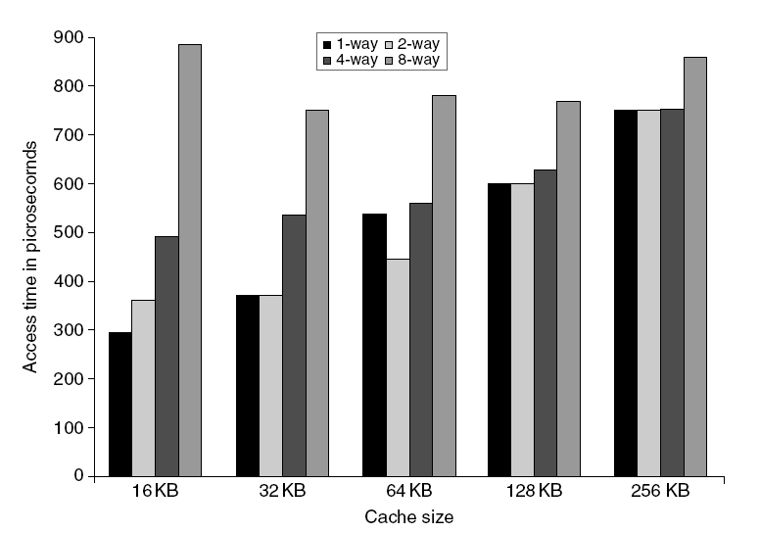
L1 Size and Associativity
Advanced Optimizations
Access time vs. size and associativity

Slide 28
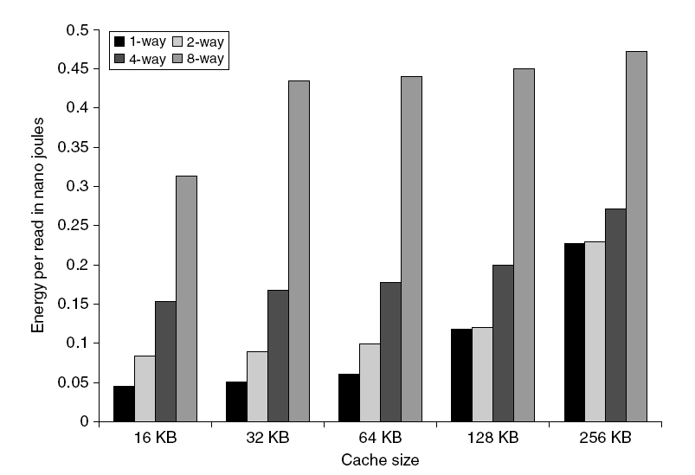
L1 Size and Associativity
Advanced Optimizations
Energy per read vs. size and associativity

Slide 29
2) Way Prediction
To improve hit time, predict the way to pre-set mux
  Mis-prediction gives longer hit time
  Prediction accuracy
    > 90% for two-way
    > 80% for four-way
    I-cache has better accuracy than D-cache
  First used on MIPS R10000 in mid-90s
  Used on ARM Cortex-A8
Extend to predict block as well
  “Way selection”
  Increases mis-prediction penalty
Advanced Optimizations

Slide 30
3) Pipelining Cache
Pipeline cache access to improve bandwidth
  Examples:
    Pentium: 1 cycle
    Pentium Pro – Pentium III: 2 cycles
    Pentium 4 – Core i7: 4 cycles
Increases branch mis-prediction penalty
Makes it easier to increase associativity
Advanced Optimizations

Slide 31
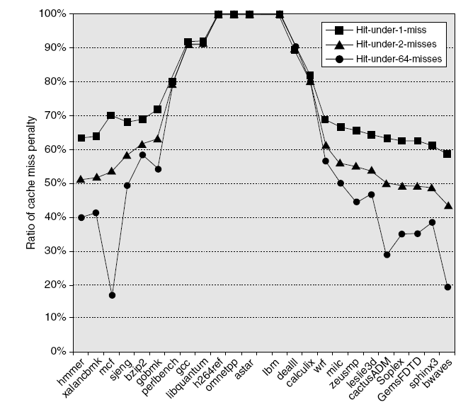
4) Nonblocking Caches
Allow hits before previous misses complete
  “Hit under miss”
  “Hit under multiple miss”
L2 must support this
In general, processors can hide L1 miss penalty but not L2 miss penalty
Advanced Optimizations

Slide 32
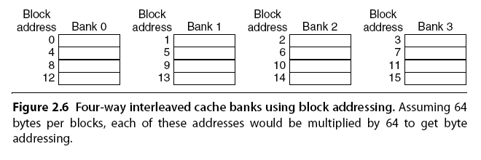
5) Multibanked Caches
Organize cache as independent banks to support simultaneous access
  ARM Cortex-A8 supports 1-4 banks for L2
  Intel i7 supports 4 banks for L1 and 8 banks for L2
Interleave banks according to block address
Advanced Optimizations

Slide 33
6) Critical Word First, Early Restart
Critical word first
  Request missed word from memory first
  Send it to the processor as soon as it arrives
Early restart
  Request words in normal order
  Send missed work to the processor as soon as it arrives
Effectiveness of these strategies depends on block size and likelihood of another access to the portion of the block that has not yet been fetched
Advanced Optimizations

Slide 34
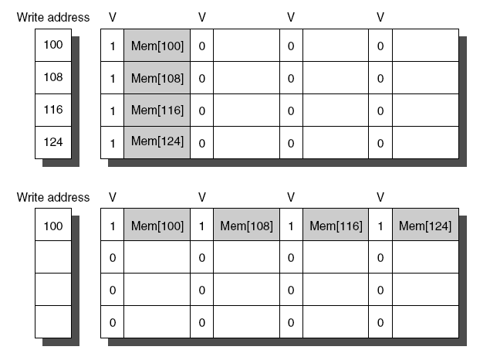
7) Merging Write Buffer
When storing to a block that is already pending in the write buffer, update write buffer
Reduces stalls due to full write buffer
Do not apply to I/O addresses
Advanced Optimizations
No write buffering
Write buffering

Slide 35
8) Compiler Optimizations
Loop Interchange
  Swap nested loops to access memory in sequential order
Blocking
  Instead of accessing entire rows or columns, subdivide matrices into blocks
  Requires more memory accesses but improves locality of accesses
Advanced Optimizations

Slide 36
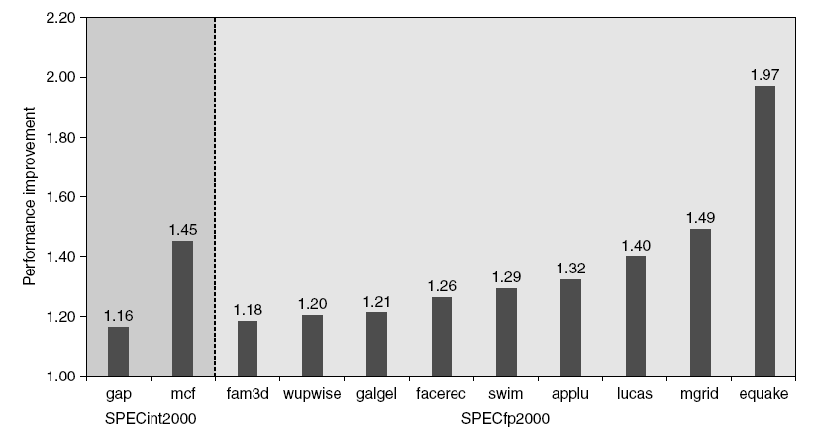
9) Hardware Prefetching
Fetch two blocks on miss (include next sequential block)
Advanced Optimizations
Pentium 4 Pre-fetching

Slide 37
10) Compiler Prefetching
Insert prefetch instructions before data is needed
Non-faulting: prefetch doesn’t cause exceptions
Register prefetch
  Loads data into register
Cache prefetch
  Loads data into cache
Combine with loop unrolling and software pipelining
Advanced Optimizations

Slide 38
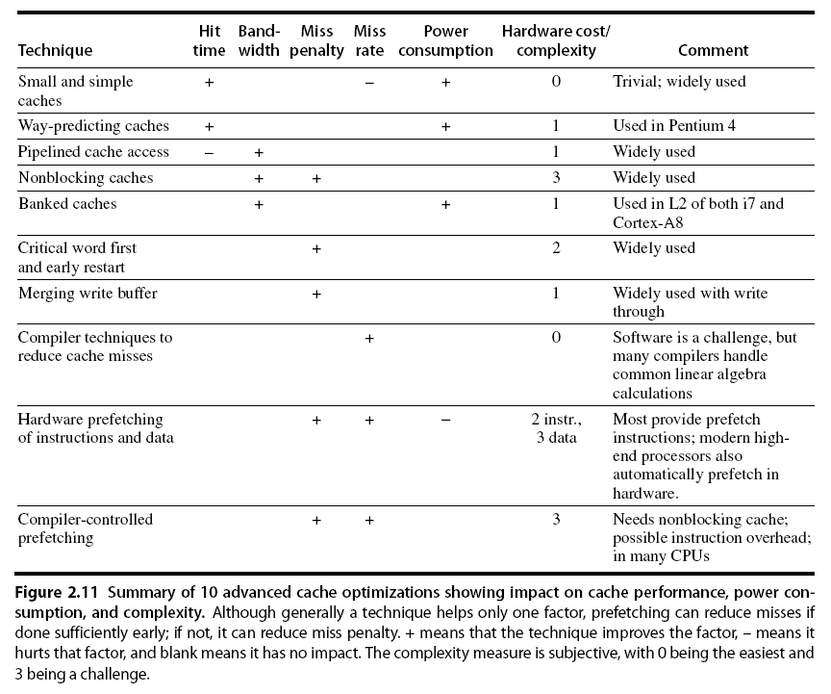
Summary
Advanced Optimizations

Slide 39
3rd Generation Intel Core i7
Core 0
Core 1
Core 2
Core 3
L1
L2
L3
I D
I D
I D
I D
I: 32KB 4-way
D: 32KB 4-way
256KB
8MB

Slide 40
Memory Technology
Memory Technology
Performance metrics
  Latency is concern of cache
  Bandwidth is concern of multiprocessors and I/O
  Access time
    Time between read request and when desired word arrives
  Cycle time
    Minimum time between unrelated requests to memory
DRAM used for main memory, SRAM used for cache

Slide 41
Memory Technology
SRAM
  Requires low power to retain bit
  Requires 6 transistors/bit
DRAM
  Must be re-written after being read
  Must also be periodically refreshed
    Every ~ 8 ms
    Each row can be refreshed simultaneously
  One transistor/bit
  Address lines are multiplexed:
    Upper half of address: row access strobe (RAS)
    Lower half of address: column access strobe (CAS)
Memory Technology

Slide 42
Memory Technology
Memory Technology
Amdahl:
  Memory capacity should grow linearly with processor speed
  Unfortunately, memory capacity and speed has not kept pace with processors
Some optimizations:
  Multiple accesses to same row
  Synchronous DRAM
    Added clock to DRAM interface
    Burst mode with critical word first
  Wider interfaces
  Double data rate (DDR)
  Multiple banks on each DRAM device

Slide 43
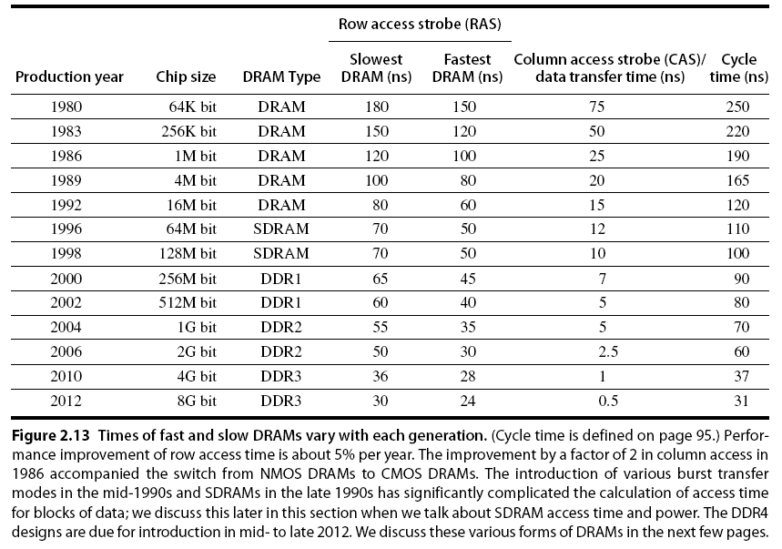
Memory Optimizations
Memory Technology

Slide 44
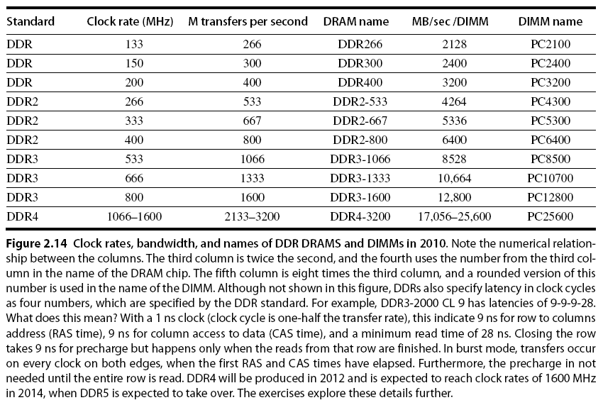
Memory Optimizations
Memory Technology

Slide 45
Memory Optimizations
Memory Technology
DDR:
  DDR2
    Lower power (2.5 V -> 1.8 V)
    Higher clock rates (266 MHz, 333 MHz, 400 MHz)
  DDR3
    1.5 V
    800 MHz
  DDR4
    1-1.2 V
    1600 MHz
GDDR5 is graphics memory based on DDR3

Slide 46
Memory Optimizations
Memory Technology
Graphics memory:
  Achieve 2-5 X bandwidth per DRAM vs. DDR3
    Wider interfaces (32 vs. 16 bit)
    Higher clock rate
      Possible because they are attached via soldering instead of socketted DIMM modules
Reducing power in SDRAMs:
  Lower voltage
  Low power mode (ignores clock, continues to refresh)

Slide 47
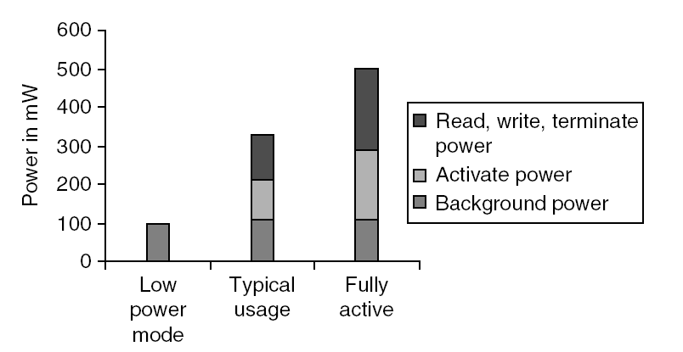
Memory Power Consumption
Memory Technology

Slide 48
Flash Memory
Memory Technology
Type of EEPROM
Must be erased (in blocks) before being overwritten
Non volatile
Limited number of write cycles
Cheaper than SDRAM, more expensive than disk
Slower than SRAM, faster than disk

Slide 49
Memory Dependability
Memory Technology
Memory is susceptible to cosmic rays
Soft errors: dynamic errors
  Detected and fixed by error correcting codes (ECC)
Hard errors: permanent errors
  Use sparse rows to replace defective rows
Chipkill: a RAID-like error recovery technique
  (Hamming codes)

Slide 50
Virtual Memory
Protection via virtual memory
  Keeps processes in their own memory space
Role of architecture:
  Provide user mode and supervisor mode
  Protect certain aspects of CPU state
  Provide mechanisms for switching between user mode and supervisor mode
  Provide mechanisms to limit memory accesses
  Provide TLB to translate addresses
Virtual Memory and Virtual Machines

Slide 51
Virtual Machines
Supports isolation and security
Sharing a computer among many unrelated users
Enabled by raw speed of processors, making the overhead more acceptable
Allows different ISAs and operating systems to be presented to user programs
  “System Virtual Machines”
  SVM software is called “virtual machine monitor” or “hypervisor”
  Individual virtual machines run under the monitor are called “guest VMs”
Virtual Memory and Virtual Machines

Slide 52
Impact of VMs on Virtual Memory
Each guest OS maintains its own set of page tables
  VMM adds a level of memory between physical and virtual memory called “real memory”
  VMM maintains shadow page table that maps guest virtual addresses to physical addresses
    Requires VMM to detect guest’s changes to its own page table
    Occurs naturally if accessing the page table pointer is a privileged operation
Virtual Memory and Virtual Machines

