Slide 1
Dynamic Scheduling in PowerPC 604 and Pentium Pro
Parameter PPC PPro
Max. instructions issued/clock 4 3
Max. instr. complete exec./clock 6 5
Max. instr. commited/clock 6 3
Window (Instrs in reorder buffer) 16 40
Number of reservations stations 12 20
Number of rename registers 8int/12FP 40
No. integer functional units (FUs) 2 2
No. floating point FUs 1 1
No. branch FUs 1 1
No. complex integer FUs 1 0
No. memory FUs 1 1 load +1 store

Slide 2
Dynamic Scheduling in Pentium Pro
PPro doesn’t pipeline 80x86 instructions
PPro decode unit translates the Intel instructions into 72-bit micro-operations (­ DLX -MIPS)
Sends micro-operations to reorder buffer & reservation stations
Takes 1 clock cycle to determine length of 80x86 instructions + 2 more to create the micro-operations
12-14 clocks in total pipeline (­ 3 state machines)
Many instructions translate to 1 to 4 micro-operations
Complex 80x86 instructions are executed by a conventional microprogram (8K x 72 bits) that issues long sequences of micro-operations

Slide 3
Getting CPI < 1: Issuing
Multiple Instructions/Cycle
Two variations
  Superscalar: varying no. instructions/cycle (1 to 8), scheduled by compiler or by HW (Tomasulo)
    IBM PowerPC, Sun UltraSparc, DEC Alpha, HP 8000
  (Very) Long Instruction Words (V)LIW:
  fixed number of instructions (4-16) scheduled by the compiler; put ops into wide templates
    Joint HP/Intel agreement in 1999/2000
    Intel Architecture-64 (IA-64) 64-bit address
    Style: “Explicitly Parallel Instruction Computer (EPIC)”
Anticipated success lead to use of
Instructions Per Clock cycle (IPC) vs. CPI

Slide 4
Getting CPI < 1: Issuing
Multiple Instructions/Cycle
Superscalar DLX: 2 instructions, 1 FP & 1 anything else
  – Fetch 64-bits/clock cycle; Int on left, FP on right
  – Can only issue 2nd instruction if 1st instruction issues
  – More ports for FP registers to do FP load & FP op in a pair
Type Pipe Stages
Int. instruction IF ID EX MEM WB
FP instruction IF ID EX MEM WB
Int. instruction IF ID EX MEM WB
FP instruction IF ID EX MEM WB
Int. instruction IF ID EX MEM WB
FP instruction IF ID EX MEM WB
1 cycle load delay expands to 3 instructions in SS
  instruction in right half can’t use it, nor instructions in next slot

Slide 5
Superscalar
IF
IF
ID
ID
IF
IF
EX
EX
ID
ID
IF
IF
M
M
EX
EX
ID
ID
IF
IF
WB
WB
M
M
EX
EX
ID
ID
IF
IF
WB
WB
M
M
EX
EX
ID
ID
WB
WB
M
M
EX
EX
WB
WB
M
M
WB
WB

Slide 6
Review: Unrolled Loop that Minimizes Stalls for Scalar
1 Loop: LD F0,0(R1)
2 LD F6,-8(R1)
3 LD F10,-16(R1)
4 LD F14,-24(R1)
5 ADDD F4,F0,F2
6 ADDD F8,F6,F2
7 ADDD F12,F10,F2
8 ADDD F16,F14,F2
9 SD 0(R1),F4
10 SD -8(R1),F8
11 SD -16(R1),F12
12 SUBI R1,R1,#32
13 BNEZ R1,LOOP
14 SD 8(R1),F16 ; 8-32 = -24
14 clock cycles, or 3.5 per iteration
LD to ADDD: 1 Cycle
ADDD to SD: 2 Cycles

Slide 7
Loop Unrolling in Superscalar
Integer instruction FP instruction Clock cycle
Loop: LD F0,0(R1) 1
LD F6,-8(R1) 2
LD F10,-16(R1) ADDD F4,F0,F2 3
LD F14,-24(R1) ADDD F8,F6,F2 4
LD F18,-32(R1) ADDD F12,F10,F2 5
SD 0(R1),F4 ADDD F16,F14,F2 6
SD -8(R1),F8 ADDD F20,F18,F2 7
SD -16(R1),F12 8
SD -24(R1),F16 9
SUBI R1,R1,#40 10
BNEZ R1,LOOP 11
SD -32(R1),F20 12
Unrolled 5 times to avoid delays (+1 due to SS)
12 clocks, or 2.4 clocks per iteration (1.5X)

Slide 8
Multiple Issue Challenges
Integer/FP split is simple for HW, get CPI of 0.5 only for programs /w:
  Exactly 50% FP operations
  No hazards
If more instructions issue at same time, greater difficulty of decode and issue
  Even 2-scalar => examine 2 opcodes, 6 register specifiers, & decide if 1 or 2 instructions can issue
VLIW: tradeoff instruction space for simple decoding
  The very long instruction word (VLIW) has room for many operations
  By definition, all the operations the compiler puts in the long instruction word are independent → they can be executed in parallel
  E.g., 2 integer operations, 2 FP ops, 2 Memory refs, 1 branch
    16 to 24 bits per field => 7*16 or 112 bits to 7*24 or 168 bits wide
  Need compiling technique that schedules across several branches

Slide 9
VLIW
Mem. ref. 1 Mem. ref. 2 FP op. 1 FP op. 2 inst branch

Slide 10
Loop Unrolling in VLIW
Memory Memory FP FP Int. op/ Clock
reference 1 reference 2 operation 1 op. 2 branch
LD F0,0(R1) LD F6,-8(R1) 1
LD F10,-16(R1) LD F14,-24(R1) 2
LD F18,-32(R1) LD F22,-40(R1) ADDD F4,F0,F2 ADDD F8,F6,F2 3
LD F26,-48(R1) ADDD F12,F10,F2 ADDD F16,F14,F2 4
ADDD F20,F18,F2 ADDD F24,F22,F2 5
SD 0(R1),F4 SD -8(R1),F8 ADDD F28,F26,F2 6
SD -16(R1),F12 SD -24(R1),F16 7
SD -32(R1),F20 SD -40(R1),F24 SUBI R1,R1,#48 8
SD -0(R1),F28 BNEZ R1,LOOP 9
Unrolled 7 times to avoid delays
7 results in 9 clocks, or 1.3 clocks per iteration (1.8X)
Average: 2.5 ops per clock, 50% efficiency
Note: Need more registers in VLIW (15 vs. 6 in SS)

Slide 11
Trace Scheduling
Parallelism across IF branches vs. LOOP branches
Two steps:
  Trace Selection
    Find likely sequence of basic blocks (trace)
    of (statically predicted or profile predicted)
    long sequence of straight-line code
  Trace Compaction
    Squeeze trace into few VLIW instructions
    Need bookkeeping code in case prediction is wrong
Compiler undoes bad guess
(discards values in registers)
Subtle compiler bugs mean wrong answer
vs. poor performance; no hardware interlocks

Slide 12
Advantages of HW (Tomasulo) vs. SW (VLIW) Speculation
HW determines address conflicts
HW better branch prediction
HW maintains precise exception model
HW does not execute bookkeeping instructions
Works across multiple implementations
SW speculation is much easier for HW design

Slide 13
Superscalar vs. VLIW
Smaller code size
Binary compatability across generations of hardware
Simplified Hardware for decoding, issuing instructions
No Interlock Hardware (compiler checks?)
More registers, but simplified Hardware for Register Ports (multiple independent register files?)

Slide 14
Intel/HP IA-64 “Explicitly Parallel Instruction Computer (EPIC)”
IA-64: instruction set architecture
128 64-bit integer regs + 128 82-bit floating point regs
  Not separate register files per functional unit as in old VLIW
Hardware checks dependencies
(interlocks => binary compatibility over time)
Predicated execution (select 1 out of 64 1-bit flags)
=> 40% fewer mispredictions?
Itanium™ was first implementation (2001)
  Highly parallel and deeply pipelined hardware at 800MHz
  6-wide, 10-stage pipeline at 800Mhz on 0.18 µ process
Itanium 2™ is name of 2nd implementation (2005)
  6-wide, 8-stage pipeline at 1666MHz on 0.13 µm process
  Caches: 32 KB I, 32 KB D, 128 KB L2I, 128 KB L2D, 9216 KB L3

Slide 15
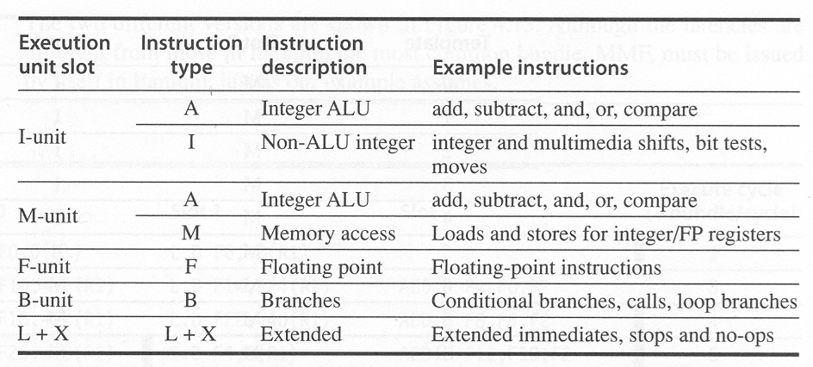
Execution units

Slide 16
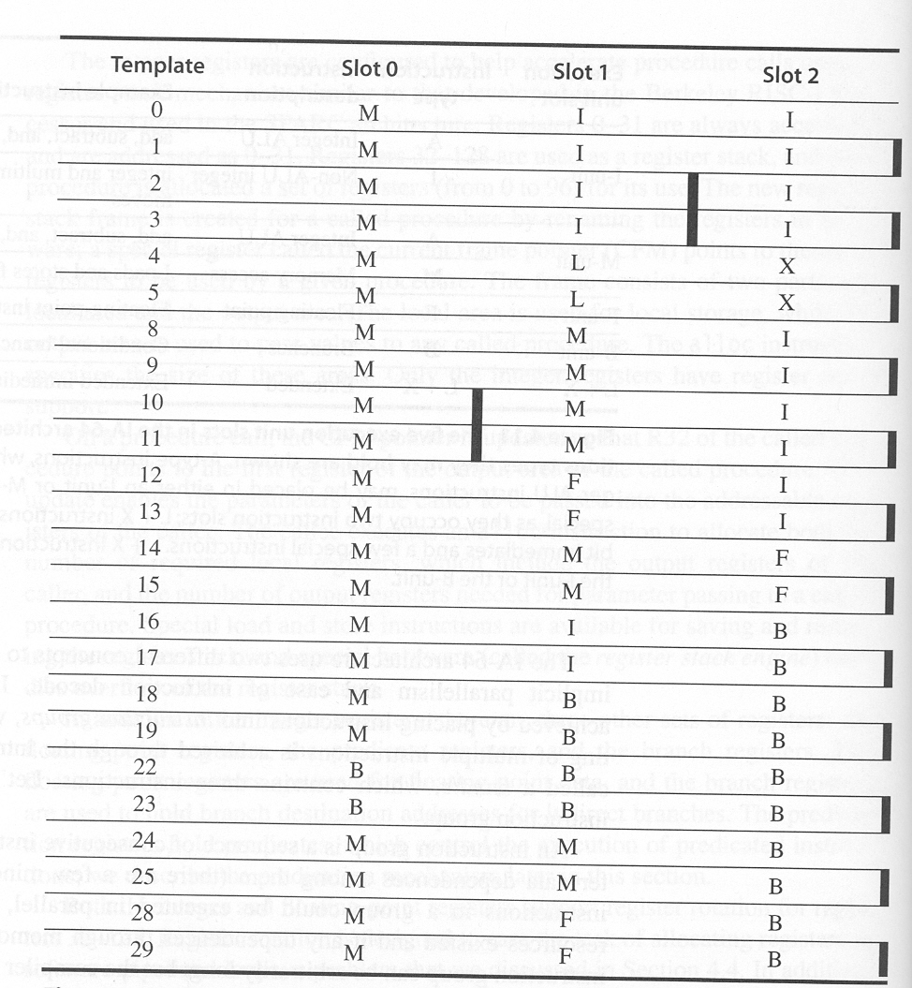

Slide 17
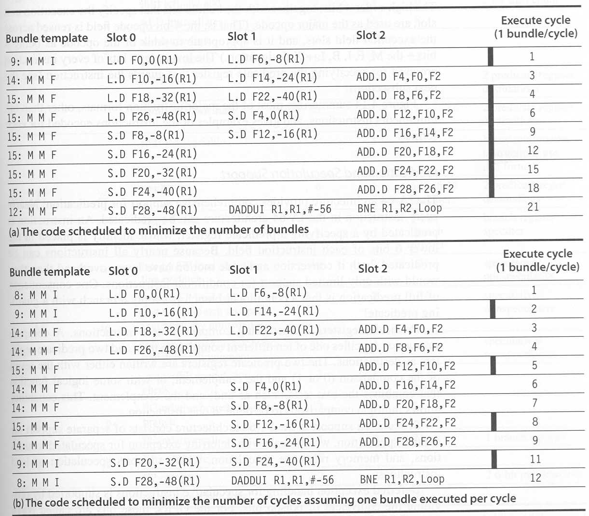

Slide 18
Bundle Slot 0 Slot 1 Slot 2 EX
9: MMI LD F0, 0(R1) LD F6,-8(R1) 1
14: MMF LD F10,-16(R1) LD F14,-24(R1) ADD F4,F0,F2 3
15: MMF LD F18,-32(R1) LD F22,-40(R1) ADD F8,F6,F2 4
15: MMF LD F26,-48(R1) SD F4,0(R1) ADD F12,F10,F2 6
15: MMF SD F8,-8(R1) SD F12,-16(R1) ADD F16,F14,F2 9
15: MMF SD F16,-24(R1) ADD F20,F18,F2 12
15: MMF SD F20,-32(R1) ADD F24,F22,F2 15
15: MMF SD F24,-40(R1) ADD F28,F26,F2 18
17: MIB SD F28,-48(R1) ADD R1,R1,#-56 BNE R1,R2,Loop 21

Slide 19
Bundle Slot 0 Slot 1 Slot 2 EX
8: MMI LD F0, 0(R1) LD F6,-8(R1) 1
9: MMI LD F10,-16(R1) LD F14,-24(R1) 2
14: MMF LD F18,-32(R1) LD F22,-40(R1) ADD F4,F0,F2 3
14: MMF LD F26,-48(R1) ADD F8,F6,F2 4
15: MMF ADD F12,F10,F2 5
14: MMF SD F4,0(R1) ADD F16,F14,F2 6
14: MMF SD F8,-8(R1) ADD F20,F18,F2 7
15: MMF SD F12,-16(R1) ADD F24,F22,F2 8
14: MMF SD F16,-24(R1) ADD F28,F26,F2 9
9: MMI SD F20,-32(R1) SD F24,-40(R1) 11
17: MIB SD F28,-48(R1) ADD R1,R1,#-56 BNE R1,R2,Loop 12

Slide 20
(Mis) Speculation on Pentium 4
% of micro-ops not used
Misspeculation Fraction
vzip
vpr
gcc
mcf
crafty
wupsise
swim
mgrid
applu
mesa
Integer
Floating Point

Slide 21
More Instruction Fetch Bandwidth
Integrated branch prediction branch predictor is part of instruction fetch unit and is constantly predicting branches
Instruction prefetch Instruction fetch units prefetch to deliver multiple instructions per clock, integrating it with branch prediction
Instruction memory access and buffering Fetching multiple instructions per cycle:
  May require accessing multiple cache blocks (prefetch to hide cost of crossing cache blocks)
  Provides buffering, acting as on-demand unit to provide instructions to issue stage as needed and in quantity needed

Slide 22
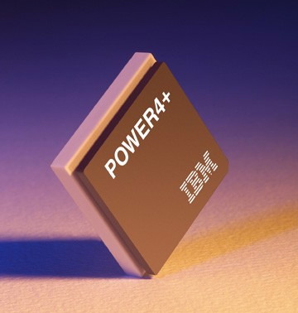
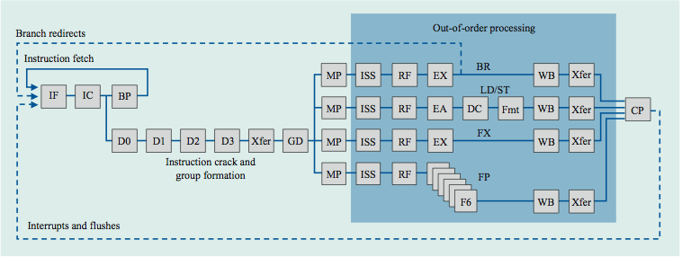
Power 4
Single-threaded predecessor to Power 5. 8 execution units in
out-of-order engine, each may
issue an instruction each cycle.
IF = instruction fetch, IC = instruction cache, BP = branch predict, D0 = decode stage 0, Xfer=transfer,
GD = group dispatch, MP = mapping, ISS =instruction issue, RF =register file read, EX = execute,
EA = compute address, DC = data caches, F6 = six-cycle floating-point execution pipe,
Fmt = data format, WB = write back, and CP = group commit

Slide 23
Limits to ILP
RX ←
← RX
Initial HW Model here; MIPS compilers.
Assumptions for ideal/perfect machine to start:
1. Register renaming – infinite virtual registers
=> all register WAW & WAR hazards are avoided
2. Branch prediction – perfect; no mispredictions
3. Jump prediction – all jumps perfectly predicted (returns, case statements)
2 & 3 ⇒ no control dependencies; perfect speculation & an unbounded buffer of instructions available
4. Memory-address alias analysis – addresses known & a load can be moved before a store provided addresses not equal; 1&4 eliminates all but RAW
Also: perfect caches; 1 cycle latency for all instructions (FP *,/); unlimited instructions issued/clock cycle;

Slide 24
Limits to ILP HW Model comparison
 | New Model | Model | Power 5
Instructions Issued per clock | 64 (no restrictions) | Infinite | 4
Instruction Window Size | Infinite vs. 256, 128, 64, 32 | Infinite | 200
Renaming Registers | 64 Int + 64 FP | Infinite | 48 integer + 40 Fl. Pt.
Branch Prediction | 1K 2-bit | Perfect | Tournament
Cache | Perfect | Perfect | 64KI, 32KD, 1.92MB L2, 36 MB L3
Memory Alias | HW disambiguation | Perfect | Perfect

Slide 25
Realistic HW: Window Impact
(Figure 3.7)
Perfect disambiguation (HW), 1K Selective Prediction, 16 entry return, 64 registers, issue as many as window
FP: 8 - 45
IPC
Integer: 6 - 12
Infinite
256
128
64
32
16
8
4

Slide 26
HW v. SW to increase ILP
Memory disambiguation: HW best
Speculation:
  HW best when dynamic branch prediction better than compile time (static) prediction
  Exceptions easier for HW
  HW doesn’t need bookkeeping code or compensation code
  Very complicated to get right
Scheduling: SW can look ahead to schedule better
Compiler independence: does not require new compiler, recompilation to run better

Slide 27
Performance beyond single thread ILP
There can be much higher natural parallelism in some applications (e.g., Database or Scientific codes)
Explicit Thread Level Parallelism or Data Level Parallelism
Thread: process with own instructions and data
  thread may be a process part of a parallel program of multiple processes, or it may be an independent program
  Each thread has all the state (instructions, data, PC, register state, and so on) necessary to allow it to execute
Data Level Parallelism: Perform identical operations on data, and lots of data

Slide 28
Thread Level Parallelism (TLP)
Instruction Level Parallelism
ILP exploits implicit parallel operations within a loop or straight-line code segment
TLP explicitly represented by the use of multiple threads of execution that are inherently parallel
Goal: Use multiple instruction streams to improve
  Throughput of computers that run many programs
  Execution time of multi-threaded programs
TLP could be more cost-effective to exploit than ILP

Slide 29
New Approach: Mulithreaded Execution
Multithreading: multiple threads to share the functional units of 1 processor via overlapping
  processor must duplicate independent state of each thread e.g., a separate copy of register file, a separate PC, and for running independent programs, a separate page table
  memory shared through the virtual memory mechanisms, which already support multiple processes
  HW for fast thread switch; much faster than full process switch ≈ 100s to 1000s of clocks
When switch?
  Alternate instruction per thread (fine grain)
  When a thread is stalled, perhaps for a cache miss, another thread can be executed (coarse grain)

Slide 30
Fine-Grained Multithreading
Switches between threads on each instruction, causing the execution of multiples threads to be interleaved
Usually done in a round-robin fashion, skipping any stalled threads
CPU must be able to switch threads every clock
Advantage is it can hide both short and long stalls, since instructions from other threads executed when one thread stalls
Disadvantage is it slows down execution of individual threads, since a thread ready to execute without stalls will be delayed by instructions from other threads
Used on Sun’s Niagara

Slide 31
Course-Grained Multithreading
Switches threads only on costly stalls, such as L2 cache misses
Advantages
  Relieves need to have very fast thread-switching
  Doesn’t slow down thread, since instructions from other threads issued only when the thread encounters a costly stall
Disadvantage is hard to overcome throughput losses from shorter stalls, due to pipeline start-up costs
  Since CPU issues instructions from 1 thread, when a stall occurs, the pipeline must be emptied or frozen
  New thread must fill pipeline before instructions can complete
Because of this start-up overhead, coarse-grained multithreading is better for reducing penalty of high cost stalls, where pipeline refill << stall time
Used in IBM AS/400

Slide 32
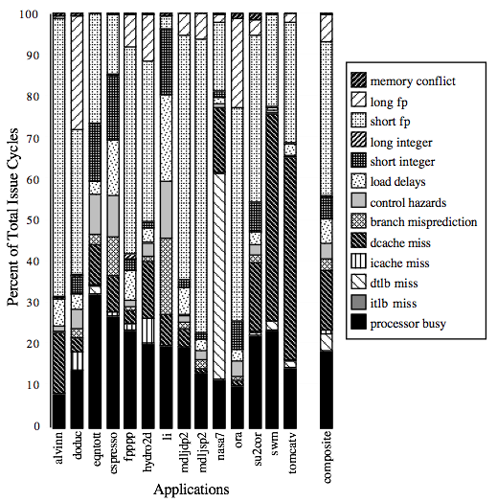
For most apps, most execution units lie idle
For an 8-way superscalar.
From: Tullsen, Eggers, and Levy,
“Simultaneous Multithreading: Maximizing On-chip Parallelism, ISCA 1995.

Slide 33
Do both ILP and TLP?
TLP and ILP exploit two different kinds of parallel structure in a program
Could a processor oriented at ILP to exploit TLP?
  functional units are often idle in data path designed for ILP because of either stalls or dependences in the code
Could the TLP be used as a source of independent instructions that might keep the processor busy during stalls?
Could TLP be used to employ the functional units that would otherwise lie idle when insufficient ILP exists?

Slide 34
Simultaneous Multi-threading ...
One thread, 8 units
Two threads, 8 units
Cycle
M
M
FX
FX
FP
FP
BR
CC
Cycle
M
M
FX
FX
FP
FP
BR
CC
1
2
3
4
5
6
7
8
9
1
2
3
4
5
6
7
8
9
M = Load/Store, FX = Fixed Point, FP = Floating Point, BR = Branch, CC = Condition Codes

Slide 35
Simultaneous Multithreading (SMT)
Simultaneous multithreading (SMT): insight that dynamically scheduled processor already has many HW mechanisms to support multithreading
  Large set of virtual registers that can be used to hold the register sets of independent threads
  Register renaming provides unique register identifiers, so instructions from multiple threads can be mixed in datapath without confusing sources and destinations across threads
  Out-of-order completion allows the threads to execute out of order, and get better utilization of the HW
Just adding a per thread renaming table and keeping separate PCs
  Independent commitment can be supported by logically keeping a separate reorder buffer for each thread
Source: Micrprocessor Report, December 6, 1999
“Compaq Chooses SMT for Alpha”

Slide 36
Multithreaded Categories
Simultaneous
Multithreading
Time (processor cycle)
Superscalar
Fine-Grained
Coarse-Grained
Multiprocessing
Thread 1
Thread 3
Thread 5
Thread 2
Thread 4
Idle slot

Slide 37
Design Challenges in SMT
Since SMT makes sense only with fine-grained implementation, impact of fine-grained scheduling on single thread performance?
  A preferred thread approach sacrifices neither throughput nor single-thread performance?
  Unfortunately, with a preferred thread, the processor is likely to sacrifice some throughput, when preferred thread stalls
Larger register file needed to hold multiple contexts
Not affecting clock cycle time is a challenge, especially in
  Instruction issue - more candidate instructions need to be considered
  Instruction completion - choosing which instructions to commit may be challenging
Ensuring that cache and TLB conflicts generated by SMT do not degrade performance
Table Lookaside Buffer

Slide 38
Power 4
Single-threaded predecessor to Power 5. 8 execution units in
out-of-order engine, each may
issue an instruction each cycle.
IF = instruction fetch, IC = instruction cache, BP = branch predict, D0 = decode stage 0, Xfer=transfer,
GD = group dispatch, MP = mapping, ISS =instruction issue, RF =register file read, EX = execute,
EA = compute address, DC = data caches, F6 = six-cycle floating-point execution pipe,
Fmt = data format, WB = write back, and CP = group commit

Slide 39
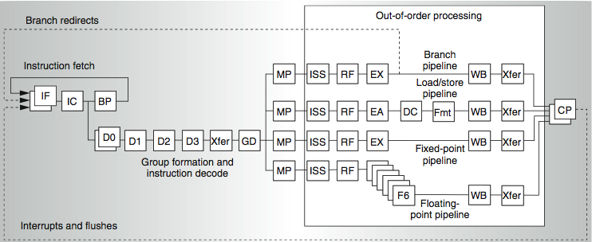
Power 4
IF = instruction fetch, IC = instruction cache, BP = branch predict, D0 = decode stage 0, Xfer = transfer, GD = group dispatch, MP = mapping, ISS = instruction issue, RF = register file read, EX = execute, EA = compute address, DC = data caches, F6 = six-cycle floating-point execution pipe, Fmt = data format, WB = write back, and CP = group commit
2 commits (architected register sets)
Power 5
2 fetch (PC),
2 initial decodes

Slide 40
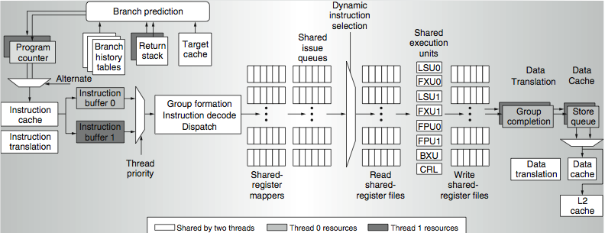
Power 5 data flow ...
TLB_{I}
TLB_{D}
Why only 2 threads? With 4, one of the shared resources (physical registers, cache, memory bandwidth) would be prone to bottleneck

Slide 41
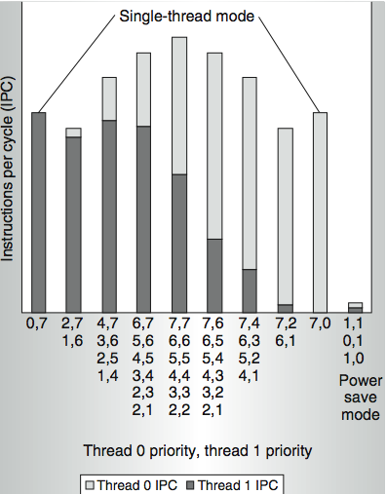
Power 5 thread performance ...
Relative priority of each thread controllable in hardware.
For balanced operation, both threads run slower than if they “owned” the machine.

Slide 42
Changes in Power 5 to support SMT
Increased associativity of L1 instruction cache and the instruction address translation buffers
Added per thread load and store queues
Increased size of the L2 (1.92 vs. 1.44 MB) and L3 caches
Added separate instruction prefetch and buffering per thread
Increased the number of virtual registers from 152 to 240
Increased the size of several issue queues
The Power5 core is about 24% larger than the Power4 core because of the addition of SMT support

Slide 43
Initial Performance of SMT
Pentium 4 Extreme SMT yields 1.01 speedup for SPECint_rate benchmark and 1.07 for SPECfp_rate
  Pentium 4 is dual threaded SMT
  SPECRate requires that each SPEC benchmark be run against a vendor-selected number of copies of the same benchmark
Running on Pentium 4 each of 26 SPEC benchmarks paired with every other (26² runs) speed-ups from 0.90 to 1.58; average was 1.20
Power 5, 8 processor server 1.23 faster for SPECint_rate with SMT, 1.16 faster for SPECfp_rate
Power 5 running 2 copies of each app speedup between 0.89 and 1.41
  Most gained some
  Fl.Pt. apps had most cache conflicts and least gains

Slide 44
Head to Head ILP competition
Processor | Micro architecture | Fetch / Issue / Execute | FU | Clock Rate (GHz) | Transis-tors Die size | Power
Intel Pentium 4 Extreme | Speculative dynamically scheduled; deeply pipelined; SMT | 3/3/4 | 7 int. 1 FP | 3.8 | 125 M 122 mm² | 115 W
AMD Athlon 64 FX-57 | Speculative dynamically scheduled | 3/3/4 | 6 int. 3 FP | 2.8 | 114 M 115 mm² | 104 W
IBM Power5 (1 CPU only) | Speculative dynamically scheduled; SMT; 2 CPU cores/chip | 8/4/8 | 6 int. 2 FP | 1.9 | 200 M 300 mm² (est.) | 80W (est.)
Intel Itanium 2 | Statically scheduled VLIW-style | 6/5/11 | 9 int. 2 FP | 1.6 | 592 M 423 mm² | 130 W

Slide 45
Normalized Performance: Efficiency
Rank | I tanium2 | Pen t I um4 | A t h l on | Powe r 5
Int/Trans | 4 | 2 | 1 | 3
FP/Trans | 4 | 2 | 1 | 3
Int/area | 4 | 2 | 1 | 3
FP/area | 4 | 2 | 1 | 3
Int/Watt | 4 | 3 | 1 | 2
FP/Watt | 2 | 4 | 3 | 1

Slide 46
No Silver Bullet for ILP
No obvious over all leader in performance
The AMD Athlon leads on SPECInt performance followed by the Pentium 4, Itanium 2, and Power5
Itanium 2 and Power5, which perform similarly on SPECFP, clearly dominate the Athlon and Pentium 4 on SPECFP
Itanium 2 is the most inefficient processor both for Fl. Pt. and integer code for all but one efficiency measure (SPECFP/Watt)
Athlon and Pentium 4 both make good use of transistors and area in terms of efficiency,
IBM Power5 is the most effective user of energy on SPECFP and essentially tied on SPECINT

Slide 47
Limits to ILP
Doubling issue rates above today’s 3-6 instructions per clock, say to 6 to 12 instructions, probably requires a processor to
  issue 3 or 4 data memory accesses per cycle,
  resolve 2 or 3 branches per cycle,
  rename and access more than 20 registers per cycle, and
  fetch 12 to 24 instructions per cycle.
The complexities of implementing these capabilities is likely to mean sacrifices in the maximum clock rate
  E.g, widest issue processor is the Itanium 2, but it also has the slowest clock rate, despite the fact that it consumes the most power!

Slide 48
Limits to ILP
Most techniques for increasing performance increase power consumption
The key question is whether a technique is energy efficient: does it increase power consumption faster than it increases performance?
Multiple issue processors techniques all are energy inefficient:
  Issuing multiple instructions incurs some overhead in logic that grows faster than the issue rate grows
  Growing gap between peak issue rates and sustained performance
Number of transistors switching = f(peak issue rate), and performance = f( sustained rate),
growing gap between peak and sustained performance
⇒ increasing energy per unit of performance

