Slide 1
HW support for More ILP
Speculation: allow an instruction to issue that is dependent on branch predicted to be taken without any consequences (including exceptions) if branch is not actually taken (“HW undo”); called “boosting”
Combine branch prediction with dynamic scheduling to execute before branches resolved
Separate speculative bypassing of results from real bypassing of results
When instruction no longer speculative, write boosted results (instruction commit) or discard boosted results
execute out-of-order but commit in-order to prevent irrevocable action (update state or exception) until instruction commits

Slide 2
HW support for More ILP
Need HW buffer for results of uncommitted instructions: reorder buffer
3 fields: instr, destination, value.
Reorder buffer can be operand source → more registers like RS.
Use reorder buffer number instead of reservation station when execution completes.
Supplies operands between execution complete & commit.
Once operand commits, result is put into register.
Instructions commit in order.
As a result, its easy to undo speculated instructions on mispredicted branches or on exceptions.
Reorder
Buffer
FP
Op
Queue
FP Regs
Res Stations
Res Stations
FP Adder
FP Mult

Slide 3
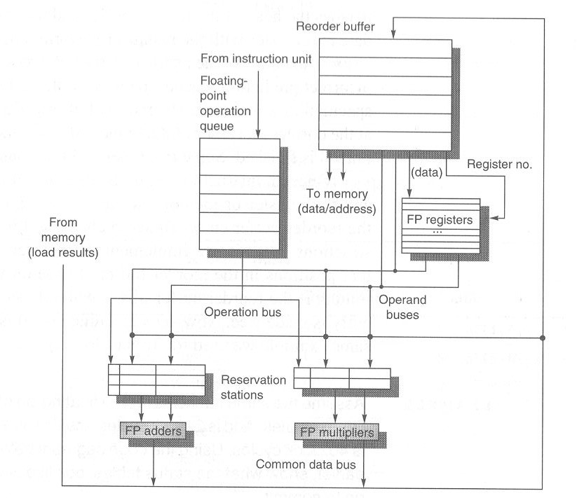
Load unit

Slide 4
Four Steps of Speculative Tomasulo Algorithm
1. Issue—get instruction from FP Op Queue
If reservation station and reorder buffer slot free, issue instr & send operands & reorder buffer no. for destination (this stage sometimes called “dispatch”)
2. Execution—operate on operands (EX)
When both operands ready then execute; if not ready, watch CDB for result; when both in reservation station, execute; checks RAW (sometimes called “issue”)
3. Write result—finish execution (WB)
Write on Common Data Bus to all awaiting FUs & reorder buffer; mark reservation station available.
4. Commit—update register with reorder result
When instr. at head of reorder buffer & result present, update register with result (or store to memory) and remove instr from reorder buffer. Mispredicted branch flushes reorder buffer (sometimes called “graduation”)

Slide 5
Tomasulo With Reorder buffer:
Done?
FP Op
Queue
ROB7
ROB6
ROB5
ROB4
ROB3
ROB2
ROB1
Newest
Reorder Buffer
Oldest
F0
LD F0,10(R2)
N
Registers
To
Memory
Dest
Dest
from
Memory
Dest
Reservation
Stations
1 10+R2
FP adders
FP multipliers
Notes:
Resolve RAW memory conflict? (address in memory buffers)
Integer unit executes in parallel

Slide 6
Tomasulo With Reorder buffer:
Done?
FP Op
Queue
ROB7
ROB6
ROB5
ROB4
ROB3
ROB2
ROB1
Newest
Reorder Buffer
F10
ADDD F10,F4,F0
N
Oldest
F0
LD F0,10(R2)
N
Registers
To
Memory
Dest
Dest
from
Memory
2 ADDD R(F4),ROB1
Dest
Reservation
Stations
1 10+R2
FP adders
FP multipliers
Notes:
Resolve RAW memory conflict? (address in memory buffers)
Integer unit executes in parallel

Slide 7
Tomasulo With Reorder buffer:
Done?
FP Op
Queue
ROB7
ROB6
ROB5
ROB4
ROB3
ROB2
ROB1
Newest
Reorder Buffer
F2
DIVD F2,F10,F6
N
F10
ADDD F10,F4,F0
N
Oldest
F0
LD F0,10(R2)
N
Registers
To
Memory
Dest
Dest
from
Memory
2 ADDD R(F4),ROB1
3 DIVD ROB2,R(F6)
Dest
Reservation
Stations
1 10+R2
FP adders
FP multipliers
Notes:
Resolve RAW memory conflict? (address in memory buffers)
Integer unit executes in parallel

Slide 8
Tomasulo With Reorder buffer:
Done?
FP Op
Queue
ROB7
ROB6
ROB5
ROB4
ROB3
ROB2
ROB1
Newest
F0
ADDD F0,F4,F6
N
F4
LD F4,0(R3)
N
Reorder Buffer
--
BNE F2,<…>
N
F2
DIVD F2,F10,F6
N
F10
ADDD F10,F4,F0
N
Oldest
F0
LD F0,10(R2)
N
Registers
To
Memory
Dest
Dest
from
Memory
2 ADDD R(F4),ROB1
6 ADDD ROB5, R(F6)
3 DIVD ROB2,R(F6)
Dest
Reservation
Stations
1 10+R2
5 0+R3
FP adders
FP multipliers
Notes:
Resolve RAW memory conflict? (address in memory buffers)
Integer unit executes in parallel

Slide 9
Tomasulo With Reorder buffer:
Done?
FP Op
Queue
--
ROB5
ST 0(R3),F4
N
ROB7
ROB6
ROB5
ROB4
ROB3
ROB2
ROB1
Newest
F0
ADDD F0,F4,F6
N
F4
LD F4,0(R3)
N
Reorder Buffer
--
BNE F2,<…>
N
F2
DIVD F2,F10,F6
N
F10
ADDD F10,F4,F0
N
Oldest
F0
LD F0,10(R2)
N
Registers
To
Memory
Dest
Dest
from
Memory
2 ADDD R(F4),ROB1
6 ADDD ROB5, R(F6)
3 DIVD ROB2,R(F6)
Dest
Reservation
Stations
1 10+R2
5 0+R3
FP adders
FP multipliers
Notes:
Resolve RAW memory conflict? (address in memory buffers)
Integer unit executes in parallel

Slide 10
Tomasulo With Reorder buffer:
Done?
FP Op
Queue
--
M[10]
ST 0(R3),F4
Y
ROB7
ROB6
ROB5
ROB4
ROB3
ROB2
ROB1
Newest
F0
ADDD F0,F4,F6
N
F4
M[10]
LD F4,0(R3)
Y
Reorder Buffer
--
BNE F2,<…>
N
F2
DIVD F2,F10,F6
N
F10
ADDD F10,F4,F0
N
Oldest
F0
LD F0,10(R2)
N
Registers
To
Memory
Dest
Dest
from
Memory
2 ADDD R(F4),ROB1
6 ADDD M[10],R(F6)
3 DIVD ROB2,R(F6)
Dest
Reservation
Stations
1 10+R2
FP adders
FP multipliers
Notes:
Resolve RAW memory conflict? (address in memory buffers)
Integer unit executes in parallel

Slide 11
Tomasulo With Reorder buffer:
Done?
FP Op
Queue
--
M[10]
ST 0(R3),F4
Y
ROB7
ROB6
ROB5
ROB4
ROB3
ROB2
ROB1
Newest
F0
<val2>
ADDD F0,F4,F6
Ex
F4
M[10]
LD F4,0(R3)
Y
Reorder Buffer
--
BNE F2,<…>
N
F2
DIVD F2,F10,F6
N
F10
ADDD F10,F4,F0
N
Oldest
F0
LD F0,10(R2)
N
Registers
To
Memory
Dest
Dest
from
Memory
2 ADDD R(F4),ROB1
3 DIVD ROB2,R(F6)
Dest
Reservation
Stations
1 10+R2
FP adders
FP multipliers
Notes:
Resolve RAW memory conflict? (address in memory buffers)
Integer unit executes in parallel

Slide 12
Tomasulo With Reorder buffer:
Done?
FP Op
Queue
--
M[10]
ST 0(R3),F4
Y
ROB7
ROB6
ROB5
ROB4
ROB3
ROB2
ROB1
Newest
F0
<val2>
ADDD F0,F4,F6
Ex
F4
M[10]
LD F4,0(R3)
Y
Reorder Buffer
--
BNE F2,<…>
N
F2
DIVD F2,F10,F6
N
F10
ADDD F10,F4,F0
N
Oldest
What about memory
hazards???
F0
LD F0,10(R2)
N
Registers
To
Memory
Dest
Dest
from
Memory
2 ADDD R(F4),ROB1
3 DIVD ROB2,R(F6)
Dest
Reservation
Stations
1 10+R2
FP adders
FP multipliers
Notes:
Resolve RAW memory conflict? (address in memory buffers)
Integer unit executes in parallel

Slide 13
Renaming Registers
Common variation of speculative design
Reorder buffer keeps instruction information but not the result
Extend register file with extra renaming registers to hold speculative results
Rename register allocated at issue; result into rename register on execution complete; rename register into real register on commit
Operands read either from register file (real or speculative) or via Common Data Bus
Advantage: operands are always from single source (extended register file)

Slide 14
Renaming Registers
Reorder
Buffer
Renaming Registers
FP
Op
Queue
FP Regs
Registers
Res Stations
Res Stations
FP Adder
FP Mult

Slide 15
Dynamic Scheduling in PowerPC 604 and Pentium Pro
Both processors have:
In-order Issue,
Out-of-order execution,
In-order Commit

Slide 16
Exceptions and Interrupts
Technique for both precise interrupts/exceptions and speculation: in-order completion and in-order commit
If we speculate and are wrong, need to back up and restart execution to point at which we predicted incorrectly
This is exactly same as need to do with precise exceptions
Exceptions are handled by not recognizing the exception until instruction that caused it is ready to commit in ROB
If a speculated instruction raises an exception, the exception is recorded in the ROB
This is why reorder buffers in all new processors

Slide 17
Dynamic Scheduling in PowerPC 604 and Pentium Pro
Parameter PPC PPro
Max. instructions issued/clock 4 3
Max. instr. complete exec./clock 6 5
Max. instr. commited/clock 6 3
Window (Instrs in reorder buffer) 16 40
Number of reservations stations 12 20
Number of rename registers 8int/12FP 40
No. integer functional units (FUs) 2 2 No. floating point FUs 1 1 No. branch FUs 1 1 No. complex integer FUs 1 0 No. memory FUs 1 1 load +1 store

Slide 18
Dynamic Scheduling in Pentium Pro
PPro doesn’t pipeline 80x86 instructions
PPro decode unit translates the Intel instructions into 72-bit micro-operations (­ DLX)
Sends micro-operations to reorder buffer & reservation stations
Takes 1 clock cycle to determine length of 80x86 instructions + 2 more to create the micro-operations
12-14 clocks in total pipeline (­ 3 state machines)
Many instructions translate to 1 to 4 micro-operations
Complex 80x86 instructions are executed by a conventional microprogram (8K x 72 bits) that issues long sequences of micro-operations

Slide 19
Getting CPI < 1: Issuing Multiple Instructions/Cycle
Two variations
Superscalar: varying no. instructions/cycle (1 to 8), scheduled by compiler or by HW (Tomasulo)
IBM PowerPC, Sun UltraSparc, DEC Alpha, HP 8000
(Very) Long Instruction Words (V)LIW: fixed number of instructions (4-16) scheduled by the compiler; put ops into wide templates
Joint HP/Intel agreement in 1999/2000
Intel Architecture-64 (IA-64) 64-bit address
Style: “Explicitly Parallel Instruction Computer (EPIC)”
Anticipated success lead to use of Instructions Per Clock cycle (IPC) vs. CPI

Slide 20
Getting CPI < 1: Issuing Multiple Instructions/Cycle
Superscalar DLX: 2 instructions, 1 FP & 1 anything else
– Fetch 64-bits/clock cycle; Int on left, FP on right
– Can only issue 2nd instruction if 1st instruction issues
– More ports for FP registers to do FP load & FP op in a pair
Type Pipe Stages
Int. instruction IF ID EX MEM WB
FP instruction IF ID EX MEM WB
Int. instruction IF ID EX MEM WB
FP instruction IF ID EX MEM WB
Int. instruction IF ID EX MEM WB
FP instruction IF ID EX MEM WB
1 cycle load delay expands to 3 instructions in SS
instruction in right half can’t use it, nor instructions in next slot

Slide 21
Superscalar
IF
IF
ID
ID
IF
IF
EX
EX
ID
ID
IF
IF
M
M
EX
EX
ID
ID
IF
IF
WB
WB
M
M
EX
EX
ID
ID
IF
IF
WB
WB
M
M
EX
EX
ID
ID
WB
WB
M
M
EX
EX
WB
WB
M
M
WB
WB

Slide 22
Review: Unrolled Loop that Minimizes Stalls for Scalar
1 Loop: LD F0,0(R1)
2 LD F6,-8(R1)
3 LD F10,-16(R1)
4 LD F14,-24(R1)
5 ADDD F4,F0,F2
6 ADDD F8,F6,F2
7 ADDD F12,F10,F2
8 ADDD F16,F14,F2
9 SD 0(R1),F4
10 SD -8(R1),F8
11 SD -16(R1),F12
12 SUBI R1,R1,#32
13 BNEZ R1,LOOP
14 SD 8(R1),F16 ; 8-32 = -24
14 clock cycles, or 3.5 per iteration
LD to ADDD: 1 Cycle
ADDD to SD: 2 Cycles

Slide 23
Loop Unrolling in Superscalar
Integer instruction FP instruction Clock cycle
Loop: LD F0,0(R1) 1
LD F6,-8(R1) 2
LD F10,-16(R1) ADDD F4,F0,F2 3
LD F14,-24(R1) ADDD F8,F6,F2 4
LD F18,-32(R1) ADDD F12,F10,F2 5
SD 0(R1),F4 ADDD F16,F14,F2 6
SD -8(R1),F8 ADDD F20,F18,F2 7
SD -16(R1),F12 8
SD -24(R1),F16 9
SUBI R1,R1,#40 10
BNEZ R1,LOOP 11
SD -32(R1),F20 12
Unrolled 5 times to avoid delays (+1 due to SS)
12 clocks, or 2.4 clocks per iteration (1.5X)

Slide 24
Multiple Issue Challenges
Integer/FP split is simple for HW, get CPI of 0.5 only for programs /w:
Exactly 50% FP operations
No hazards
If more instructions issue at same time, greater difficulty of decode and issue
Even 2-scalar => examine 2 opcodes, 6 register specifiers, & decide if 1 or 2 instructions can issue
VLIW: tradeoff instruction space for simple decoding
The very long instruction word (VLIW) has room for many operations
By definition, all the operations the compiler puts in the long instruction word are independent → they can be executed in parallel
E.g., 2 integer operations, 2 FP ops, 2 Memory refs, 1 branch
16 to 24 bits per field => 7*16 or 112 bits to 7*24 or 168 bits wide
Need compiling technique that schedules across several branches

Slide 25
VLIW
Mem. ref. 1 Mem. ref. 2 FP op. 1 FP op. 2 inst branch

Slide 26
Loop Unrolling in VLIW
Memory Memory FP FP Int. op/ Clock reference 1 reference 2 operation 1 op. 2 branch
LD F0,0(R1) LD F6,-8(R1) 1
LD F10,-16(R1) LD F14,-24(R1) 2
LD F18,-32(R1) LD F22,-40(R1) ADDD F4,F0,F2 ADDD F8,F6,F2 3
LD F26,-48(R1) ADDD F12,F10,F2 ADDD F16,F14,F2 4
ADDD F20,F18,F2 ADDD F24,F22,F2 5
SD 0(R1),F4 SD -8(R1),F8 ADDD F28,F26,F2 6
SD -16(R1),F12 SD -24(R1),F16 7
SD -32(R1),F20 SD -40(R1),F24 SUBI R1,R1,#48 8
SD -0(R1),F28 BNEZ R1,LOOP 9
Unrolled 7 times to avoid delays
7 results in 9 clocks, or 1.3 clocks per iteration (1.8X)
Average: 2.5 ops per clock, 50% efficiency
Note: Need more registers in VLIW (15 vs. 6 in SS)

Slide 27
Trace Scheduling
Parallelism across IF branches vs. LOOP branches
Two steps:
Trace Selection
Find likely sequence of basic blocks (trace) of (statically predicted or profile predicted) long sequence of straight-line code
Trace Compaction
Squeeze trace into few VLIW instructions
Need bookkeeping code in case prediction is wrong
Compiler undoes bad guess (discards values in registers)
Subtle compiler bugs mean wrong answer vs. poor performance; no hardware interlocks

Slide 28
Advantages of HW (Tomasulo) vs. SW (VLIW) Speculation
HW determines address conflicts
HW better branch prediction
HW maintains precise exception model
HW does not execute bookkeeping instructions
Works across multiple implementations
SW speculation is much easier for HW design

Slide 29
Superscalar vs. VLIW
Smaller code size
Binary compatability across generations of hardware
Simplified Hardware for decoding, issuing instructions
No Interlock Hardware (compiler checks?)
More registers, but simplified Hardware for Register Ports (multiple independent register files?)

Slide 30
Intel/HP IA-64 “Explicitly Parallel Instruction Computer (EPIC)”
IA-64: instruction set architecture
128 64-bit integer regs + 128 82-bit floating point regs
Not separate register files per functional unit as in old VLIW
Hardware checks dependencies (interlocks => binary compatibility over time)
Predicated execution (select 1 out of 64 1-bit flags) => 40% fewer mispredictions?
Itanium™ was first implementation (2001)
Highly parallel and deeply pipelined hardware at 800MHz
6-wide, 10-stage pipeline at 800Mhz on 0.18 µ process
Itanium 2™ is name of 2nd implementation (2005)
6-wide, 8-stage pipeline at 1666MHz on 0.13 µm process
Caches: 32 KB I, 32 KB D, 128 KB L2I, 128 KB L2D, 9216 KB L3

Slide 31
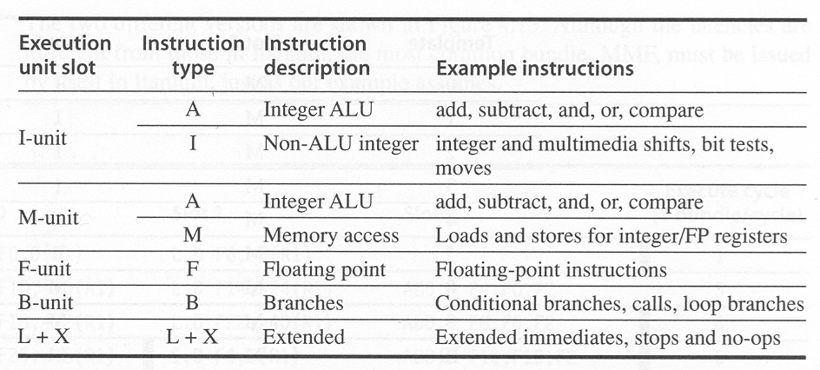
Execution units

Slide 32
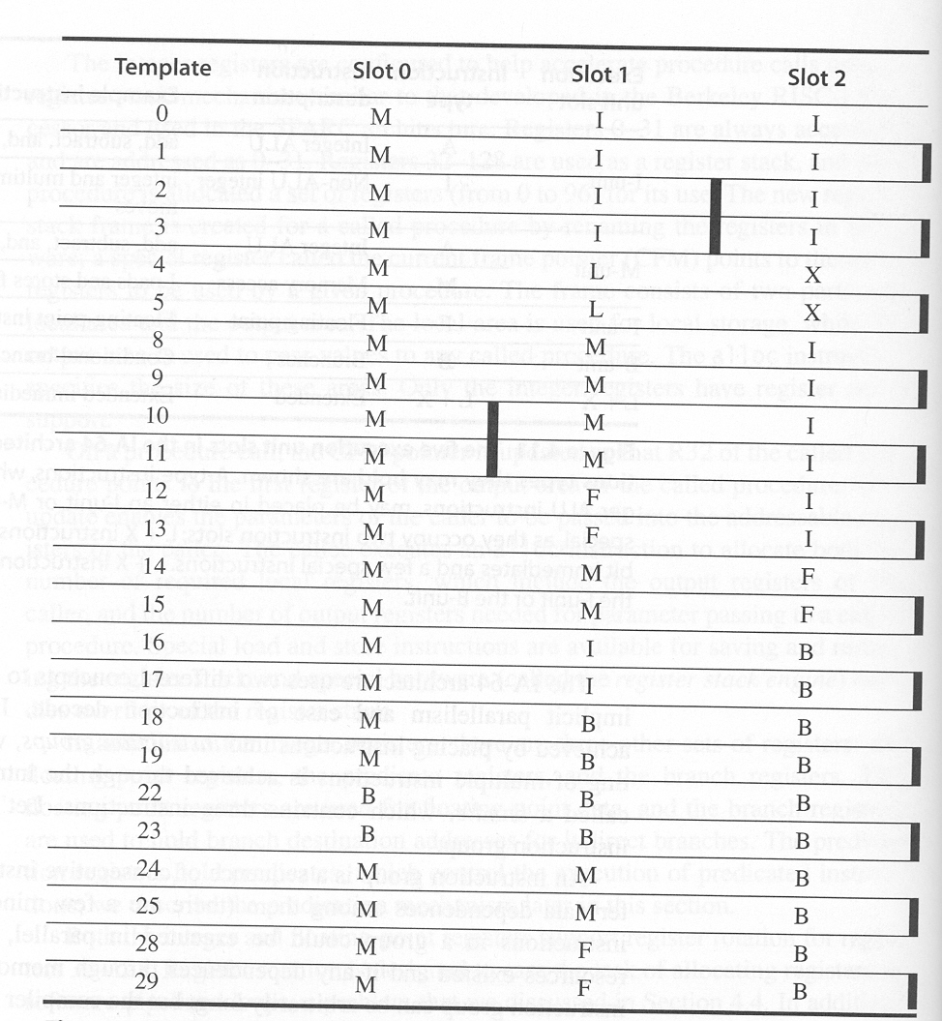

Slide 33
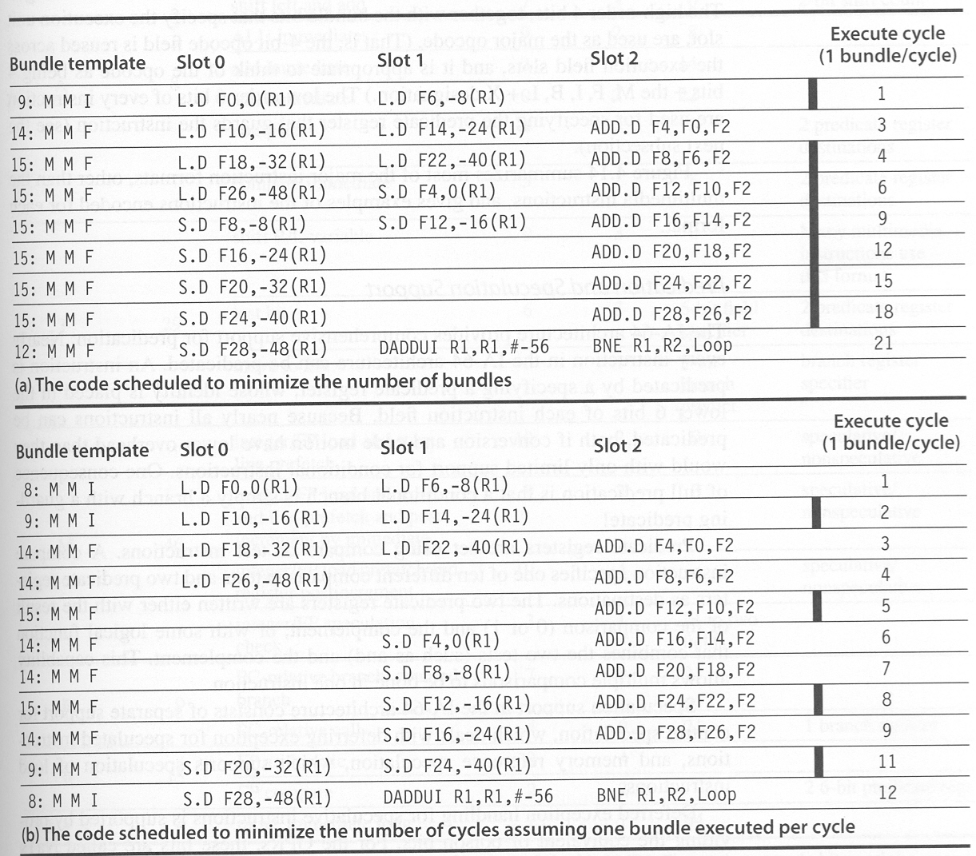

Slide 34
Bundle Slot 0 Slot 1 Slot 2 EX
9: MMI LD F0, 0(R1) LD F6,-8(R1) 1
14: MMF LD F10,-16(R1) LD F14,-24(R1) ADD F4,F0,F2 3
15: MMF LD F18,-32(R1) LD F22,-40(R1) ADD F8,F6,F2 4
15: MMF LD F26,-48(R1) SD F4,0(R1) ADD F12,F10,F2 6
15: MMF SD F8,-8(R1) SD F12,-16(R1) ADD F16,F14,F2 9
15: MMF SD F16,-24(R1) ADD F20,F18,F2 12
15: MMF SD F20,-32(R1) ADD F24,F22,F2 15
15: MMF SD F24,-40(R1) ADD F28,F26,F2 18
17: MIB SD F28,-48(R1) ADD R1,R1,#-56 BNE R1,R2,Loop 21

Slide 35
Bundle Slot 0 Slot 1 Slot 2 EX
8: MMI LD F0, 0(R1) LD F6,-8(R1) 1
9: MMI LD F10,-16(R1) LD F14,-24(R1) 2
14: MMF LD F18,-32(R1) LD F22,-40(R1) ADD F4,F0,F2 3
14: MMF LD F26,-48(R1) ADD F8,F6,F2 4
15: MMF ADD F12,F10,F2 5
14: MMF SD F4,0(R1) ADD F16,F14,F2 6
14: MMF SD F8,-8(R1) ADD F20,F18,F2 7
15: MMF SD F12,-16(R1) ADD F24,F22,F2 8
14: MMF SD F16,-24(R1) ADD F28,F26,F2 9
9: MMI SD F20,-32(R1) SD F24,-40(R1) 11
17: MIB SD F28,-48(R1) ADD R1,R1,#-56 BNE R1,R2,Loop 12

Slide 36
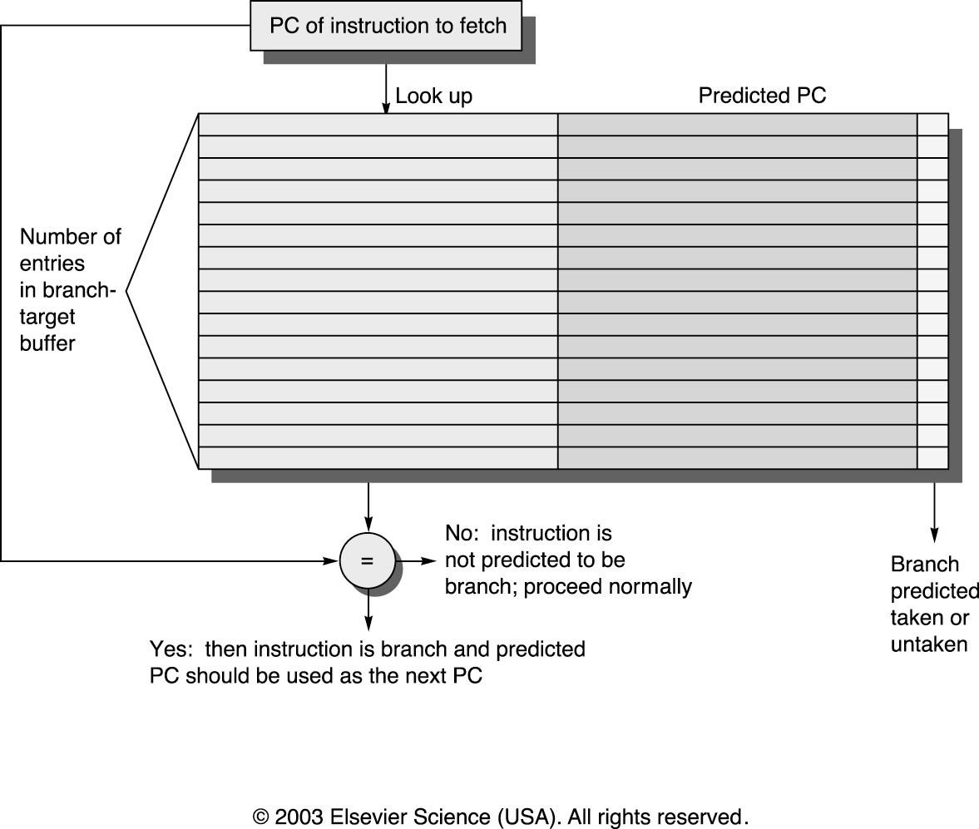
Increasing Instruction Fetch Bandwidth
Predicts next instruct address, sends it out before decoding instructuction
PC of branch sent to BTB
When match is found, Predicted PC is returned
If branch predicted taken, instruction fetch continues at Predicted PC
Branch Target Buffer (BTB)

Slide 37
Inst. Fetch Bandwidth: Return Address Predictor
Small buffer of return addresses acts as a stack
Caches most recent return addresses
Call ⇒ Push a return address on stack
Return ⇒ Pop an address off stack & predict as new PC

Slide 38
More Instruction Fetch Bandwidth
Integrated branch prediction branch predictor is part of instruction fetch unit and is constantly predicting branches
Instruction prefetch Instruction fetch units prefetch to deliver multiple instruct. per clock, integrating it with branch prediction
Instruction memory access and buffering Fetching multiple instructions per cycle:
May require accessing multiple cache blocks (prefetch to hide cost of crossing cache blocks)
Provides buffering, acting as on-demand unit to provide instructions to issue stage as needed and in quantity needed

Slide 39
(Mis) Speculation on Pentium 4
% of micro-ops not used
Misspeculation Fraction
vzip
vpr
gcc
mcf
crafty
wupsise
swim
mgrid
applu
mesa
Integer
Floating Point

Slide 40
Dynamic Scheduling in Superscalar
Dependencies stop instruction issue (w/o Tomasulo scheme)
Code compiler for old version will run poorly on newest version
May want code to vary depending on how superscalar

Slide 41
Dynamic Scheduling in Superscalar
How to issue two instructions and keep in-order instruction issue for Tomasulo?
Assume 1 integer + 1 floating point
1 Tomasulo control for integer, 1 for floating point
Issue 2X Clock Rate, so that issue remains in order
Only FP loads might cause dependency between integer and FP issue:
Replace load reservation station with a load queue; operands must be read in the order they are fetched
Load checks addresses in Store Queue to avoid RAW violation
Store checks addresses in Load Queue to avoid WAR,WAW
Called “decoupled architecture”

Slide 42
Performance of Dynamic SS
Iteration Instructions Issues Executes Writes result
no. clock-cycle number
1 LD F0,0(R1) 1 2 4
1 ADDD F4,F0,F2 1 5 8
1 SD 0(R1),F4 2 9
1 SUBI R1,R1,#8 3 4 5
1 BNEZ R1,LOOP 4 5
2 LD F0,0(R1) 5 6 8
2 ADDD F4,F0,F2 5 9 12
2 SD 0(R1),F4 6 13
2 SUBI R1,R1,#8 7 8 9
2 BNEZ R1,LOOP 8 9
­ 4 clocks per iteration; only 1 FP instr/iteration
Branches, Decrements issues still take 1 clock cycle
How get more performance?

