Slide 1
CptS 5 6 1 / E E 5 2 4 COMPUTER ARCHITECTURE
School of Electrical Engineering and Computer Science
WASHINGTON STATE UNIVERSITY
F A L L 2 0 1 2

Slide 2
Course Objectives
Students in this course will be able to:
Understand how modern computer systems work.
Perform quantitative analysis of computer systems.
Analyze at system level the impact of changes in the computer systems.
Estimate the performance of a computer system.
Recognize the need for further learning in this field (life-long learning).
Project
A study of a multi-core processor
Students will work on teams of 2 members

Slide 3
Grade

Slide 4
Conventional Wisdom in Comp. Architecture
Old Conventional Wisdom: Power is free, Transistors are expensive
New Conventional Wisdom: “Power wall” Power expensive, Transistors free (We can put more on chip than can afford to turn on)
Old CW: Sufficiently increasing Instruction Level Parallelism via compilers, innovation (Out-of-order, speculation, VLIW, …)
New CW: “ILP wall” law of diminishing returns on more HW for ILP

Slide 5
Conventional Wisdom in Comp. Architecture
Old CW: Multipliers are slow, Memory access is fast
New CW: “Memory wall” Memory slow, multiplies fast (200 clock cycles to DRAM memory, 4 clocks for multiply)
Old CW: Uniprocessor performance 2X / 1.5 yrs
New CW: Power Wall + ILP Wall + Memory Wall = Brick Wall
Uniprocessor performance now 2X / 5(?) yrs
⇒ Sea change in chip design: multiple “cores” (2X processors per chip / ~ 2 years)
More simpler processors that are more power efficient

Slide 6
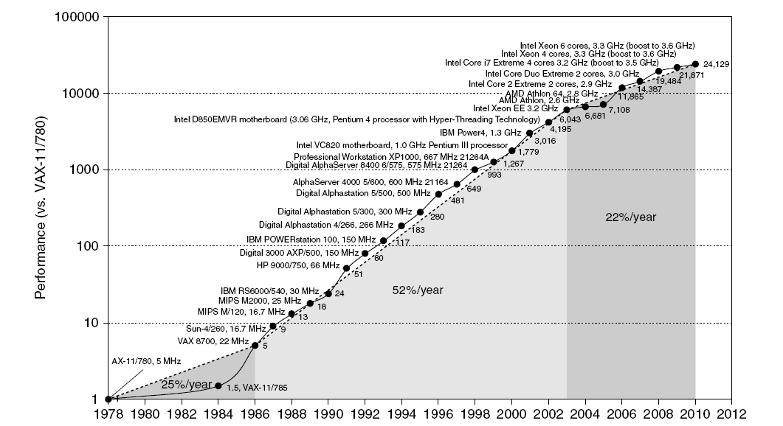
Single Processor Performance
Move to multi-processor
RISC

Slide 7
Current Trends in Architecture
Cannot continue to leverage Instruction-Level parallelism (ILP)
Single processor performance improvement ended in 2003
New models for performance:
Data-level parallelism (DLP)
Thread-level parallelism (TLP)
Request-level parallelism (RLP) -Data Centeres
These require explicit restructuring of the application

Slide 8
Classes of Computers
Personal Mobile Device (PMD)
e.g. start phones, tablet computers
Emphasis on energy efficiency and real-time
Desktop Computing
Emphasis on price-performance
Servers
Emphasis on availability, scalability, throughput
Clusters / Warehouse Scale Computers
Used for “Software as a Service (SaaS)”
Emphasis on availability and price-performance
Sub-class: Supercomputers, emphasis: floating-point performance and fast internal networks
Embedded Computers
Emphasis: price

Slide 9
Parallelism
Classes of parallelism in applications:
Data-Level Parallelism (DLP)
Task-Level Parallelism (TLP)
Classes of architectural parallelism:
Instruction-Level Parallelism (ILP)
Vector architectures/Graphic Processor Units (GPUs)
Thread-Level Parallelism

Slide 10
Flynn’s Taxonomy
Single instruction stream, single data stream (SISD)
Single instruction stream, multiple data streams (SIMD)
Vector architectures
Multimedia extensions
Graphics processor units
Multiple instruction streams, single data stream (MISD)
No commercial implementation
Multiple instruction streams, multiple data streams (MIMD)
Tightly-coupled MIMD
Loosely-coupled MIMD

Slide 11
Defining Computer Architecture
“Old” view of computer architecture:
Instruction Set Architecture (ISA) design
i.e. decisions regarding:
registers, memory addressing, addressing modes, instruction operands, available operations, control flow instructions, instruction encoding
“Real” computer architecture:
Specific requirements of the target machine
Design to maximize performance within constraints: cost, power, and availability
Includes ISA, microarchitecture, hardware

Slide 12
Tracking Technology Performance Trends
Drill down into 4 technologies:
Disks
Memory
Network
Processors
Compare ~1980 Archaic (Nostalgic) vs. ~2000 Modern (Newfangled)
Performance Milestones in each technology
Compare for Bandwidth vs. Latency improvements in performance over time
Bandwidth: number of events per unit time
E.g., M bits / second over network, M bytes / second from disk
Latency: elapsed time for a single event
E.g., one-way network delay in microseconds, average disk access time in milliseconds

Slide 13
Disks: Archaic(Nostalgic) v. Modern(Newfangled)
CDC Wren I, 1983
3600 RPM
0.03 GBytes capacity
Tracks/Inch: 800
Bits/Inch: 9550
Three 5.25” platters
Bandwidth: 0.6 MBytes/sec
Latency: 48.3 ms
Cache: none
Seagate 373453, 2003
15000 RPM (4X)
73.4 GBytes (2500X)
Tracks/Inch: 64000 (80X)
Bits/Inch: 533,000 (60X)
Four 2.5” platters (in 3.5” form factor)
Bandwidth: 86 MBytes/sec (140X)
Latency: 5.7 ms (8X)
Cache: 8 MBytes

Slide 14
Latency Lags Bandwidth (for last ~20 years)
Performance Milestones
Disk: 3600, 5400, 7200, 10000, 15000 RPM (8x, 143x)
(latency = simple operation w/o contention
BW = best-case)
Notes:
Disk: 33X BW, 6X latency

Slide 15
Memory: Archaic (Nostalgic) v. Modern (Newfangled)
1980 DRAM (asynchronous)
0.06 Mbits/chip
64,000 xtors, 35 mm²
16-bit data bus per module, 16 pins/chip
13 Mbytes/sec
Latency: 225 ns
(no block transfer)
2000 Double Data Rate Synchr. (clocked) DRAM
256 Mbits/chip (4000X)
256,000,000 xtors, 204 mm²
64-bit data bus per DIMM, 66 pins/chip (4X)
1600 Mbytes/sec (120X)
Latency: 52 ns (4X)
Block transfers (page mode)

Slide 16
Latency Lags Bandwidth (last ~20 years)
Performance Milestones
Memory Module: 16bit plain DRAM, Page Mode DRAM, 32b, 64b, SDRAM, DDR SDRAM (4x,120x)
Disk: 3600, 5400, 7200, 10000, 15000 RPM (8x, 143x)
(latency = simple operation w/o contention
BW = best-case)
Notes:
DRAM: 120X BW, 4X latency
Jog between 3rd and 4th point is because a lot of time between 32b Fast page mode and 64b

Slide 17
LANs: Archaic (Nostalgic)v. Modern (Newfangled)
Ethernet 802.3
Year of Standard: 1978
10 Mbits/s link speed
Latency: 3000 μsec
Shared media
Coaxial cable
Ethernet 802.3ae
Year of Standard: 2003
10,000 Mbits/s (1000X) link speed
Latency: 190 μsec (15X)
Switched media
Category 5 copper wire
"Cat 5" is 4 twisted pairs in bundle
Coaxial Cable:
Plastic Covering
Twisted Pair:
Braided outer conductor
Insulator
Copper core
Copper, 1mm thick, twisted to avoid antenna effect

Slide 18
Latency Lags Bandwidth (last ~20 years)
Performance Milestones
Ethernet: 10Mb, 100Mb, 1000Mb, 10000 Mb/s (16x,1000x)
Memory Module: 16bit plain DRAM, Page Mode DRAM, 32b, 64b, SDRAM, DDR SDRAM (4x,120x)
Disk: 3600, 5400, 7200, 10000, 15000 RPM (8x, 143x)
(latency = simple operation w/o contention
BW = best-case)
Notes:
Network: 1000X BW, 13X Latency

Slide 19
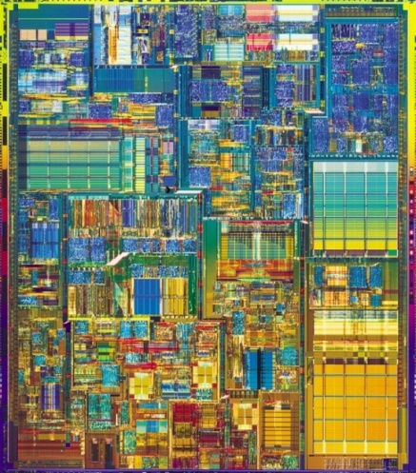
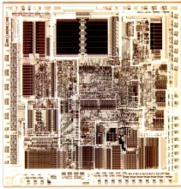
CPUs: Archaic (Nostalgic) v. Modern (Newfangled)
1982 Intel 80286
12.5 MHz
2 MIPS (peak)
Latency 320 ns
134,000 xtors, 47 mm²
16-bit data bus, 68 pins
Microcode interpreter, separate FPU chip
(no caches)
2001 Intel Pentium 4
1500 MHz (120X)
4500 MIPS (peak) (2250X)
Latency 15 ns (20X)
42,000,000 xtors, 217 mm²
64-bit data bus, 423 pins
3-way superscalar, Dynamic translate to RISC, Superpipelined (22 stage), Out-of-Order execution
On-chip 8KB Data caches, 96KB Instr. Trace cache, 256KB L2 cache

Slide 20
Latency Lags Bandwidth (last ~20 years)
Performance Milestones
Processor: ‘286, ‘386, ‘486, Pentium, Pentium Pro, Pentium 4 (21x,2250x)
Ethernet: 10Mb, 100Mb, 1000Mb, 10000 Mb/s (16x,1000x)
Memory Module: 16bit plain DRAM, Page Mode DRAM, 32b, 64b, SDRAM, DDR SDRAM (4x,120x)
Disk : 3600, 5400, 7200, 10000, 15000 RPM (8x, 143x)
CPU high,
Memory low (“Memory Wall”)
Notes:
Processor: 2250X, 22X Latency

Slide 21
Trends in Technology
Integrated circuit technology
Transistor density: 35%/year
Die size: 10-20%/year
Integration overall: 40-55%/year
DRAM capacity: 25-40%/year (slowing)
Flash capacity: 50-60%/year
15-20X cheaper/bit than DRAM
Magnetic disk technology: 40%/year
15-25X cheaper/bit then Flash
300-500X cheaper/bit than DRAM

Slide 22
Bandwidth and Latency
Bandwidth or throughput
Total work done in a given time
10,000-25,000X improvement for processors
300-1200X improvement for memory and disks
Latency or response time
Time between start and completion of an event
30-80X improvement for processors
6-8X improvement for memory and disks

Slide 23
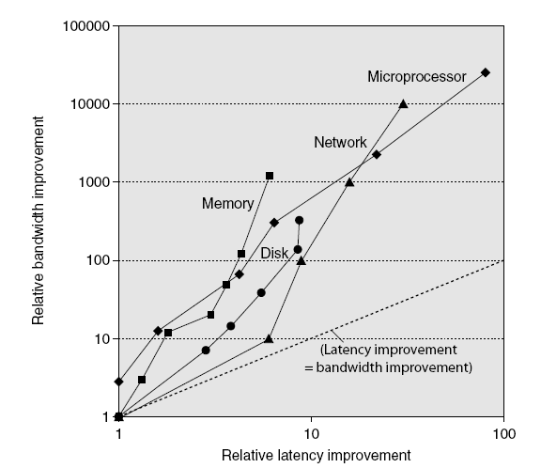
Bandwidth and Latency
Log-log plot of bandwidth and latency milestones

Slide 24
Rule of Thumb for Latency Lagging BW
In the time that bandwidth doubles, latency improves by no more than a factor of 1.2 to 1.4
(and capacity improves faster than bandwidth)
Stated alternatively: Bandwidth improves by more than the square of the improvement in Latency

Slide 25
Six Reasons Latency Lags Bandwidth
1. Moore’s Law helps BW more than latency
Faster transistors, more transistors, more pins help Bandwidth
MPU Transistors: 0.130 vs. 42 M xtors (300X)
DRAM Transistors: 0.064 vs. 256 M xtors (4000X)
MPU Pins: 68 vs. 423 pins (6X)
DRAM Pins: 16 vs. 66 pins (4X)
Smaller, faster transistors but communicate over (relatively) longer lines: limits latency
Feature size: 1.5 to 3 vs. 0.18 micron (8X,17X)
MPU Die Size: 35 vs. 204 mm² (ratio sqrt ⇒ 2X)
DRAM Die Size: 47 vs. 217 mm² (ratio sqrt ⇒ 2X)

Slide 26
6 Reasons Latency Lags Bandwidth (cont’d)
2. Distance limits latency
Size of DRAM block ⇒ long bit and word lines ⇒ most of DRAM access time
Speed of light and computers on network
1. & 2. explains linear latency vs. square BW?
3. Bandwidth easier to sell (“bigger=better”)
E.g., 10 Gbits/s Ethernet (“10 Gig”) vs. 10 μsec latency Ethernet
4400 MB/s DIMM (“PC4400”) vs. 50 ns latency
Even if just marketing, customers now trained
Since bandwidth sells, more resources thrown at bandwidth, which further tips the balance

Slide 27
6 Reasons Latency Lags Bandwidth (cont’d)
4. Latency helps BW, but not vice versa
Spinning disk faster improves both bandwidth and rotational latency
3600 RPM ⇒ 15000 RPM = 4.2X
Average rotational latency: 8.3 ms ⇒ 2.0 ms
Things being equal, also helps BW by 4.2X
Lower DRAM latency ⇒ More access/second (higher bandwidth)
Higher linear density helps disk BW (and capacity), but not disk Latency
9,550 BPI ⇒ 533,000 BPI ⇒ 60X in BW

Slide 28
6 Reasons Latency Lags Bandwidth (cont’d)
5. Bandwidth hurts latency
Queues help Bandwidth, hurt Latency (Queuing Theory)
Adding chips to widen a memory module increases Bandwidth but higher fan-out on address lines may increase Latency
6. Operating System overhead hurts latency more than Bandwidth
Long messages amortize overhead; overhead bigger part of short messages

Slide 29
Transistors and Wires
Feature size
Minimum size of transistor or wire in x or y dimension
10 microns in 1971 to .032 microns in 2011 (.022 micron FinFET 2012)
Transistor performance scales linearly
Wire delay does not improve with feature size!
Integration density scales quadratically

Slide 30
Power and Energy
Problem: Get power in, get power out
Thermal Design Power (TDP)
Characterizes sustained power consumption
Used as target for power supply and cooling system
Lower than peak power, higher than average power consumption
Clock rate can be reduced dynamically to limit power consumption
Energy per task is often a better measurement

Slide 31
Dynamic Energy and Power
Dynamic energy
Transistor switch from 0 -> 1 or 1 -> 0
½ x Capacitive load x Voltage²
Dynamic power
½ x Capacitive load x Voltage² x Frequency switched
Reducing clock rate reduces power, not energy

Slide 32
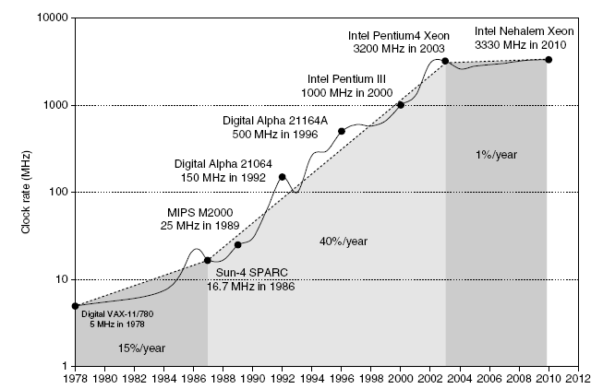
Power
Intel 80386 consumed ~ 2 W
3.3 GHz Intel Core i7 consumes 130 W
Heat must be dissipated from 1.5 x 1.5 cm chip
This is the limit of what can be cooled by air

Slide 33
Reducing Power
Techniques for reducing power:
Do nothing well (dark silicon)
Dynamic Voltage-Frequency Scaling
Low power state for DRAM, disks
Overclocking, turning off cores
Static Power
Static power consumption
Current_{static} x Voltage
Scales with number of transistors
To reduce: power gating

Slide 34
Trends in Cost
Cost driven down by learning curve
Yield
DRAM: price closely tracks cost
Microprocessors: price depends on volume
10% less for each doubling of volume

Slide 35
Measuring Performance
Typical performance metrics:
Response time
Throughput
Speedup of X relative to Y
Execution time_{Y} / Execution time_{X}
Execution time
Wall clock time: includes all system overheads
CPU time: only computation time
Benchmarks
Kernels (e.g. matrix multiply)
Toy programs (e.g. sorting)
Synthetic benchmarks (e.g. Dhrystone)
Benchmark suites (e.g. SPEC06fp, TPC-C)

Slide 36
Principles of Computer Design
Take Advantage of Parallelism
e.g. multiple processors, disks, memory banks, pipelining, multiple functional units
Principle of Locality
Reuse of data and instructions
Focus on the Common Case
Amdahl’s Law

Slide 37
Amdahl's Law
Speedup due to enhancement E:
ExTime w/o E Performance w/ E
Speedup(E) = ------------- = -------------------
ExTime w/ E Performance w/o E
Suppose that enhancement E accelerates a fraction F of the task by a factor S, and the remainder of the task is unaffected.
F

Slide 38
Amdahl’s Law
Floating point instructions improved to run 2X; but only 10% of actual instructions are FP
ExTime_{new} =
Speedup_{overall}
=

Slide 39
Principles of Computer Design
The Processor Performance Equation

Slide 40
Principles of Computer Design
Different instruction types having different CPIs

