Slide 1
The ideals reality of science
The pursuit of verifiable answers highly cited papers for your c.v.
The validation of our results by reproduction convincing referees who did not see your code or data
An altruistic, collective enterprise A race to outrun your colleagues in front of the giant bear of grant funding
  Credit: Fernando Pérez @ Pycon 2014

Slide 2
Voting on topics
Exercise 4
Final Project
Advanced RL class
Feedback on class presentations

Slide 3
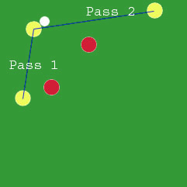
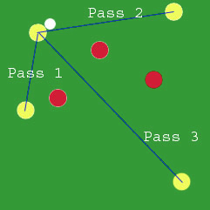
Inter-Task Transfer
Learning tabula rasa can be unnecessarily slow
Humans can use past information
  Soccer with different numbers of players
Agents leverage learned knowledge in novel tasks
  Bias learning : speedup method

Slide 4
Primary Questions
Source
S_{source}, A_{source}
Target
S_{target}, A _{Target}
Is it possible to transfer learned knowledge?
Possible to transfer without a providing a task mapping?
Only consider reinforcement learning tasks
  Lots of work in supervised settings

Slide 5
Value Function Transfer
Source Task
ρ(Q_{S} (S_{S}, A_{S})) = Q_{T} (S_{T}, A_{T})
Action-Value function transferred
ρ is task-dependant:
relies on inter-task mappings
Q not defined on S_{T} and A_{T}
Environment
Action_{S}
State_{S}
Reward_{S}
Agent
Q_{S}: S_{S}×A_{S}→ℜ
ρ
Target Task
Q_{T}: S_{T}×A_{T}→ℜ
Environment
Action_{T}
State_{T}
Reward_{T}
Agent
Notes:
Counterintuitive – we’re doing low-level transfer

Slide 6
Enabling Transfer
Source Task
Environment
Action_{S}
State_{S}
Reward_{S}
Agent
Q_{S}: S_{S}×A_{S}→ℜ
Target Task
Q_{T}: S_{T}×A_{T}→ℜ
Environment
Action_{T}
State_{T}
Reward_{T}
Agent
Notes:
Counterintuitive – we’re doing low-level transfer

Slide 7
Inter-Task Mappings
Source
Target
Source
Target
Notes:
What for?
Why intuitive (mention preliminary assumption)

Slide 8
Inter-Task Mappings
χ_{x:} s_{target→}s_{source}
  Given state variable in target task (some x from s=x₁, x₂, … x_{n)}
  Return corresponding state variable in source task
χ_{A:} a_{target→}a_{source}
  Similar, but for actions
Intuitive mappings exist in some domains (Oracle)
Used to construct transfer functional
Source
Target
χ_{x}
S_{SOURCE}
S_{Target}
⟨x₁…x_{k}⟩
⟨x₁…x_{n}⟩
χ_{A}
A_{SOURCE}
A _{Target}
{a₁…a_{j}}
{a₁…a_{m}}
Notes:
What for?
Why intuitive (mention preliminary assumption)

Slide 9
Example
Cancer
Castle attack

Slide 10
Lazaric
Transfer can
  Reduce need for instances in target task
  Reduce need for domain expert knowledge
What changes
  State space, state features
  A, T, R, goal state
  learning method

Slide 11
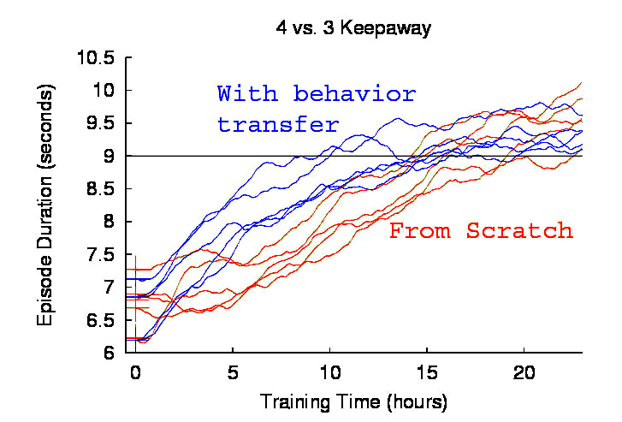
Transfer Evaluation Metrics
“Sunk Cost” is ignored
Source task(s) independently useful
AI Goal
Effectively utilize past knowledge
Only care about Target
Source Task(s) not useful
Engineering Goal
Minimize total training
Set a threshold performance
Majority of agents can achieve with learning
Threshold: 8.5
Two distinct scenarios:
1. Target Time Metric: Successful if target task learning time reduced
Performance
  2. Total Time Metric: Successful if total (source + target) time reduced
Target: no Transfer
Target: with Transfer
Target + Source:
with Transfer
Target: no transfer
Target: with Transfer

Slide 12
Previous was “learning speed improvement”
Can also have
  Asymptotic improvement
  Jumpstart improvement

Slide 13
Value Function Transfer:
Time to threshold in 4 vs. 3
No Transfer
Target Task Time
Total Time
}
Notes:
Each data point represents 25+ independent trials

Slide 14
Results: Scaling up to 5 vs. 4
47% of
no transfer
All statistically significant when compared to no transfer
Notes:
Note that using CMUnited players here

Slide 15
Problem Statement
Humans can selecting a training sequence
Results in faster training / better performance
Meta-planning problem for agent learning
  Known vs. Unknown final task?
MDP
MDP
MDP
MDP
MDP
MDP
MDP
?

Slide 16
TL vs. multi-task vs. lifelong learning vs. generalization vs. concept drift
Learning from Easy Missions
Changing length of cart pole

Slide 17
Keepaway
[Stone, Sutton, and Kuhlmann 2005]
Goal: Maintain possession of ball
5 agents
3 (stochastic) actions
13 (noisy & continuous) state variables
K₂
K₁
T₁
K₃
T₂
Keeper with ball may hold ball or pass to either teammate
4 vs. 3:
7 agents
4 actions
19 state variables
Both takers move towards player with ball

Slide 18
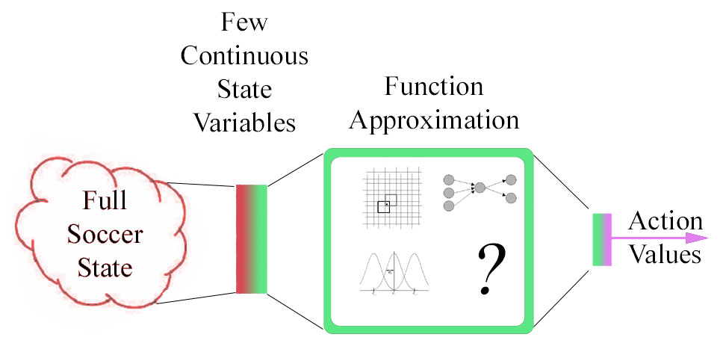
Learning Keepaway
Sarsa update
  CMAC, RBF, and neural network approximation successful
Q^{π}(s,a): Predicted number of steps episode will last
  Reward = +1 for every timestep
Notes:
Only update when ball is kickable by someone
o a little slower: more details
Tile coding: allows generalization as well as fine distinctions

Slide 19
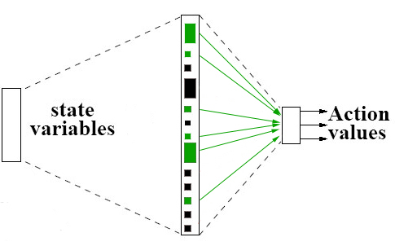
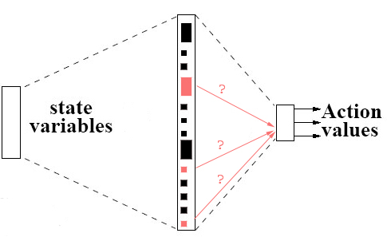
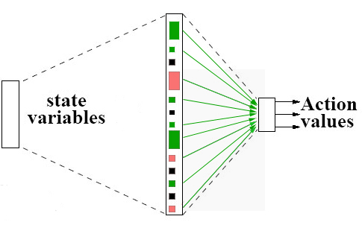
ρ’s Effect on CMACs
For each weight in 4 vs. 3 function approximator:
  Use inter-task mapping to find corresponding 3 vs. 2 weight
ρ
3 vs. 2
4 vs. 3
Notes:
Learning wts: not human readable.
Less rigid b/c we can consider the state variable level rather than just numbers.
Final step: put average value into all other weights

Slide 20
Keepaway Hand-coded χ_{A}
Actions in 4 vs. 3 have “similar” actions in 3 vs. 2
Hold_{4v3} → Hold_{3v2}
Pass1_{4v3} → Pass1_{3v2}
Pass2_{4v3} → Pass2_{3v2}
Pass3_{4v3} → Pass2_{3v2}

Slide 21
Value Function Transfer:
Time to threshold in 4 vs. 3
No Transfer
Target Task Time
Total Time
}
Notes:
Each data point represents 25+ independent trials

Slide 22
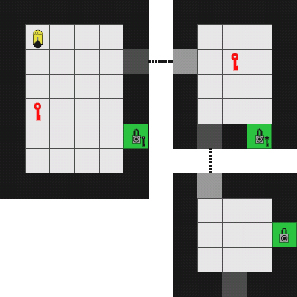
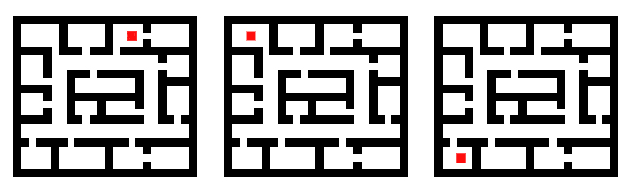
Example Transfer Domains
Series of mazes with different goals [Fernandez and Veloso, 2006]
Mazes with different structures [Konidaris and Barto, 2007]

Slide 23
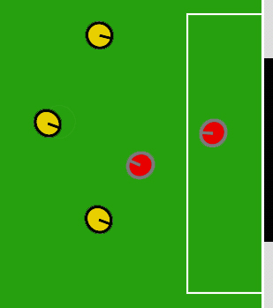
Example Transfer Domains
Series of mazes with different goals [Fernandez and Veloso, 2006]
Mazes with different structures [Konidaris and Barto, 2007]
Keepaway with different numbers of players [Taylor and Stone, 2005]
Keepaway to Breakaway [Torrey et al, 2005]
Notes:
Kwy -> Kwy:
Soni & Singh 2006
Talvitie & Singh, 2007

Slide 24
Example Transfer Domains
Series of mazes with different goals [Fernandez and Veloso, 2006]
Mazes with different structures [Konidaris and Barto, 2007]
Keepaway with different numbers of players [Taylor and Stone, 2005]
Keepaway to Breakaway [Torrey et al, 2005]
All tasks are drawn from the same domain
  Task: An MDP
  Domain: Setting for semantically similar tasks
What about Cross-Domain Transfer?
  Source task could be much simpler
  Show that source and target can be less similar

Slide 25
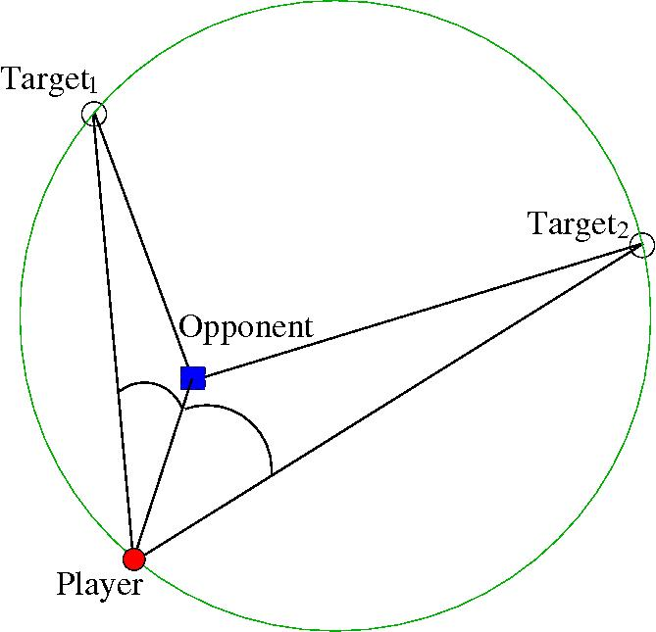
Source Task: Ringworld
K₂
K₁
T₁
Opponent moves directly towards player
Player may stay or run towards a pre-defined location
K₃
T₂
Ringworld
Goal: avoid being tagged
2 agents
3 actions
7 state variables
Fully Observable
Discrete State Space (Q-table with ~8,100 s,a pairs)
Stochastic Actions
3 vs. 2 Keepaway
Goal: Maintain possession of ball
5 agents
3 actions
13 state variables
Partially Observable
Continuous State Space
Stochastic Actions
Notes:
Roughly 8,065 states seen during 25,000 episode learning trial

Slide 26
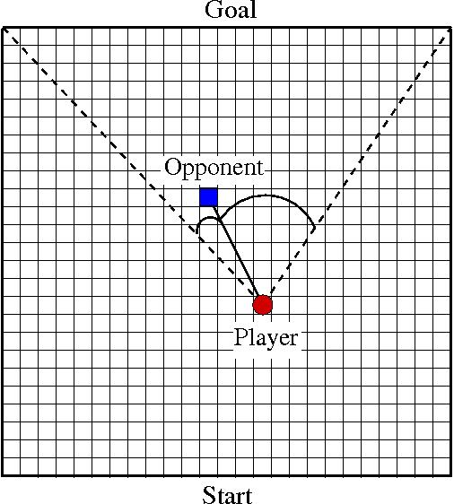
Source Task: Knight’s Joust
K₂
K₁
Opponent moves directly towards player
T₁
Player may move North, or take a knight jump to either side
K₃
T₂
Knight’s Joust
Goal: Travel from start to goal line
2 agents
3 actions
3 state variables
Fully Observable
Discrete State Space (Q-table with ~600 s,a pairs)
Deterministic Actions
3 vs. 2 Keepaway
Goal: Maintain possession of ball
5 agents
3 actions
13 state variables
Partially Observable
Continuous State Space
Stochastic Actions
Notes:
601 distinct states over 50,000 episode learning trial

Slide 27
Rule Transfer Overview
Learn π
Learn D_{source}
Translate (D_{source}) → D_{target}
Use D_{target}
Learn a policy (π : S → A) in the source task
  TD, Policy Search, Model-Based, etc.
Learn a decision list, D_{source}, summarizing π
Translate (D_{source}) → D_{target} (applies to target task)
  State variables and actions can differ in two tasks
Use D_{target} to learn a policy in target task
Allows for different learning methods and function approximators in source and target tasks
Notes:
Allow for different function approximators and/or parameterizations

Slide 28
Rule Transfer Details
Learn π
Learn D_{source}
Translate (D_{source}) → D_{target}
Use D_{target}
In this work we use Sarsa
  Q : S × A → Return
Other learning methods possible
Source Task
Environment
Action
State
Reward
Agent

Slide 29

Rule Transfer Details
Learn π
Learn D_{source}
Translate (D_{source}) → D_{target}
Use D_{target}
Use learned policy to record S, A pairs
Use JRip (RIPPER in Weka) to learn a decision list
IF s₁ < 4 and s₂ > 5 → a₁
ELSEIF s₁ < 3 → a₂
ELSEIF s₃ > 7 → a₁
…
Environment
Action
Action
State
State
Reward
State
Action
Agent
…
…
Notes:
Could be other rule-learning techniques as well

Slide 30
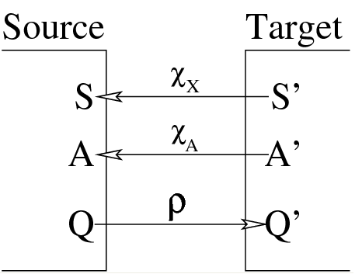
Rule Transfer Details
Learn π
Learn D_{source}
Translate (D_{source}) → D_{target}
Use D_{target}
Inter-task Mappings
χ_{x:} s_{target}→s_{source}
  Given state variable in target task (some x from s = x₁, x₂, … x_{n})
  Return corresponding state variable in source task
χ_{A:} a_{target}→a_{source}
  Similar, but for actions
χ _{x}
χ _{A}
translate
rule
rule’

Slide 31
Rule Transfer Details
Learn π
Learn D_{source}
Translate (D_{source}) → D_{target}
Use D_{target}
K₁
K₂
T₁
K₃
T₂
Stay Hold Ball
Run_{Near} Pass to K₂
Run_{Far} Pass to K₃
χ_{A}
χ_{x}
dist(Player, Opponent) dist(K₁,T₁)
… …
IF dist(Player, Opponent) > 4 → Stay
IF dist(K₁,T₁) > 4 → Hold Ball

Slide 32
Rule Transfer Details
Learn π
Learn D_{source}
Translate (D_{source}) → D_{target}
Use D_{target}
Many possible ways to use D_{target}
  Value Bonus
  Extra Action
  Extra Variable
Assuming TD learner in target task
  Should generalize to other learning methods
(shaping)
(initially force agent to select)
(initially force agent to select)
Evaluate agent’s 3 actions in state s = s₁, s₂
Q(s₁, s₂, a₁) = 5
Q(s₁, s₂, a₂) = 3
Q(s₁, s₂, a₃) = 4
Evaluate agent’s 3 actions in state s = s₁, s₂
Q(s₁, s₂, a₁) = 5
Q(s₁, s₂, a₂) = 3
Q(s₁, s₂, a₃) = 4
Q(s₁, s₂, a₄) = 7 (take action a₂)
Evaluate agent’s 3 actions in state s = s₁, s₂
Q(s₁, s₂, s₃, a₁) = 5
Q(s₁, s₂, s₃, a₂) = 3
Q(s₁, s₂, s₃, a₃) = 4
Evaluate agent’s 3 actions in state s = s₁, s₂
Q(s₁, s₂, a₂, a₁) = 5
Q(s₁, s₂, a₂, a₂) = 9
Q(s₁, s₂, a₂, a₃) = 4
D_{target}(s) = a₂
+ 8
Notes:
TODO: talk about biasing

Slide 33
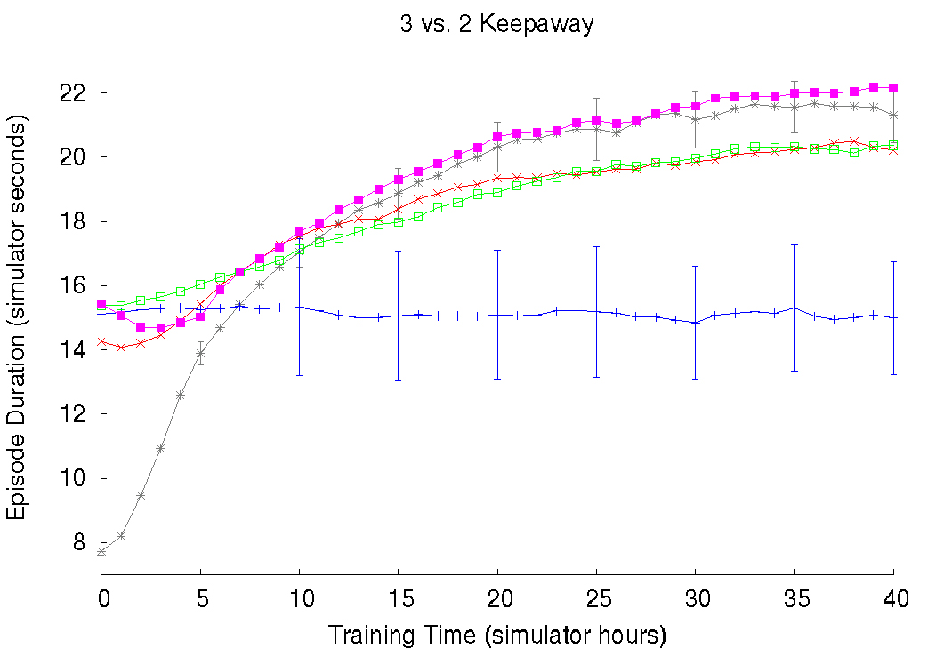
Comparison of Rule Transfer Methods
Rules from 5 hours of training
Value Bonus
Extra Action
Extra Variable
Without Transfer
Only Follow Rules

Slide 34
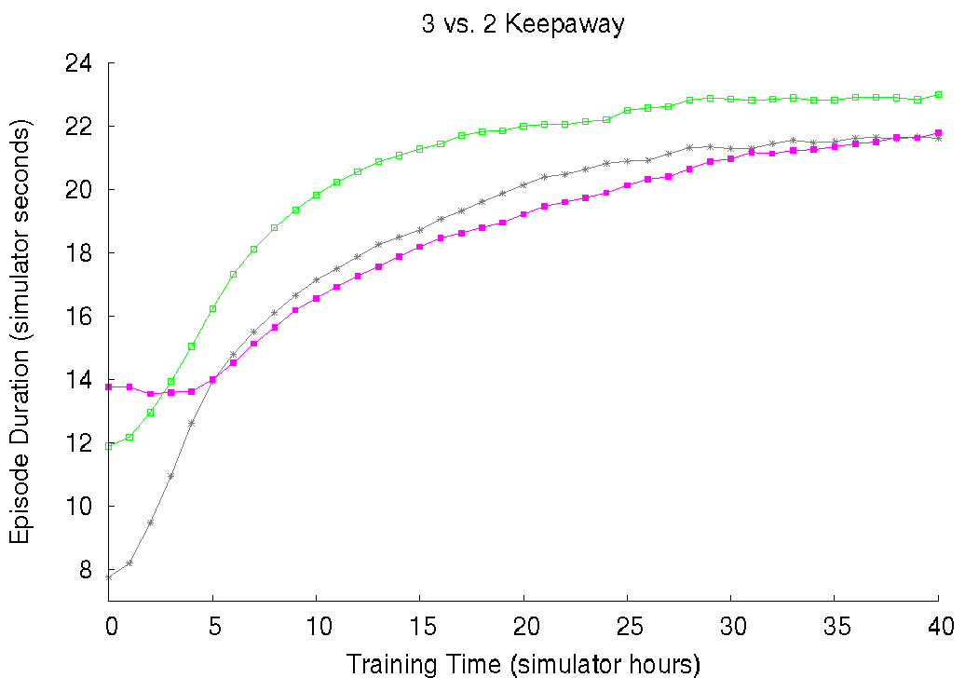
Results: Extra Action
Ringworld: 20,000 episodes
Knight’s Joust: 50,000 episodes
Without Transfer

