Slide 2
Josh: Tic-tac-toe

Slide 3
Where might you find bandit problems?

Slide 4
Clinical Trials
Feynman: restaurants
E-advertising (Yahoo, MSFT)
Rewards to users (Diabetes study, DMN)

Slide 5
Utility functions

Slide 6
Action-Value Methods
ε-greedy
Vs. running update?

Slide 7
Action-Value Methods
ε-greedy
Vs. running update?

Slide 8
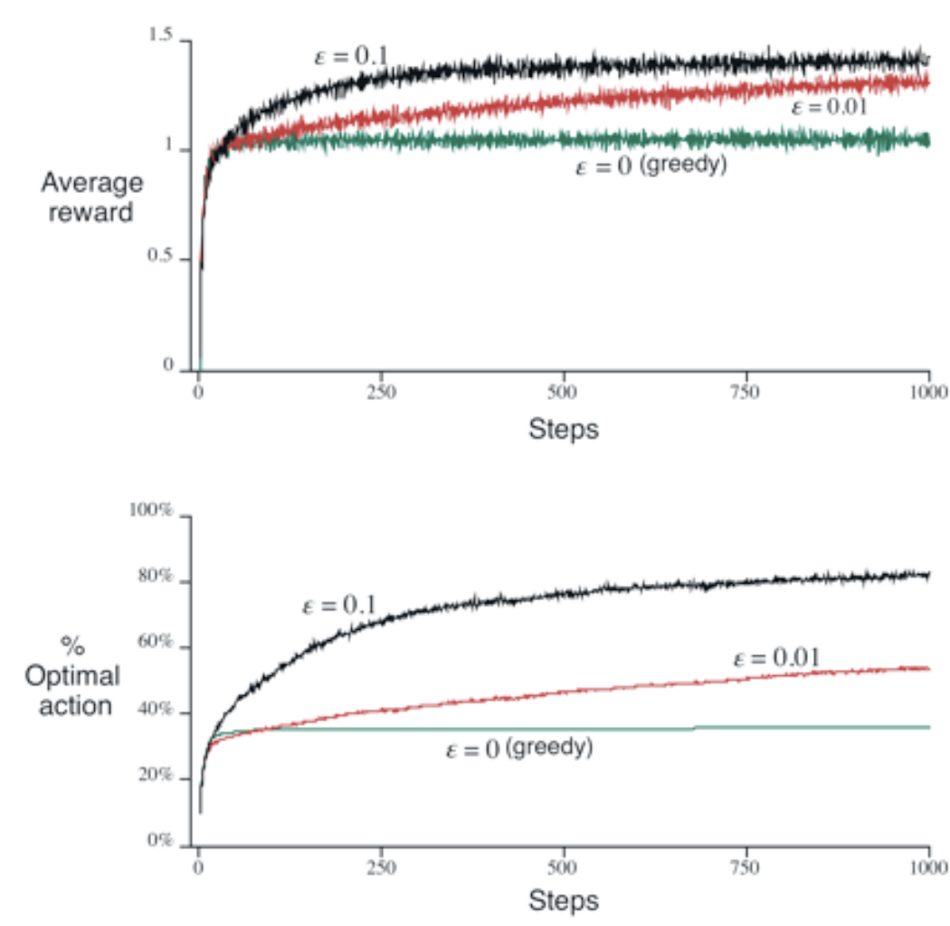
Which is best?

Slide 9
Softmax
Gibbs / Boltzmann distribution
Action a on t^{th} play
Temperature goes to zero
(may be harder to set)

Slide 10
Nonstationary
Exponential, recency-weighted average
Learning rate can vary per step
Why?

Slide 11
Nonstationary
Exponential, recency-weighted average
Learning rate can vary per step
Why?
How do you know if the task is stationary?

Slide 12
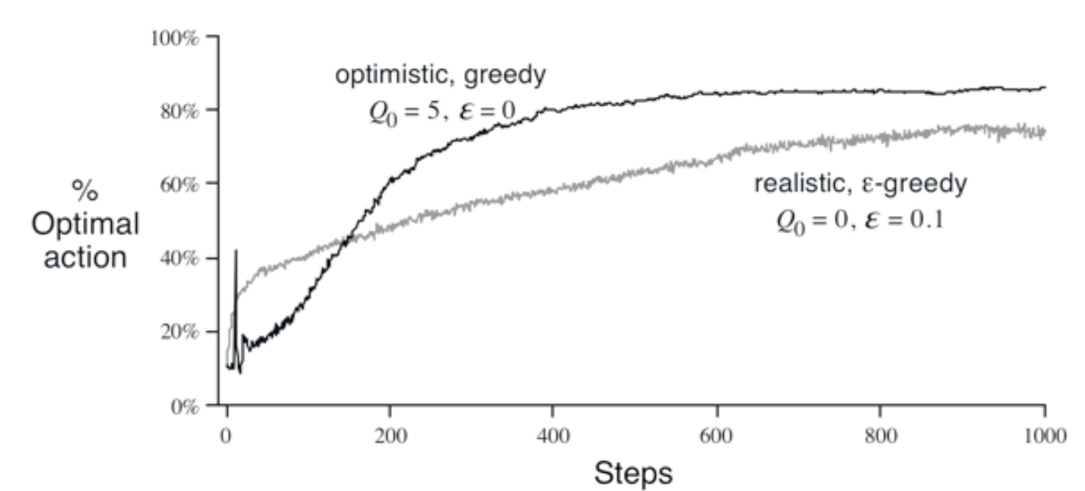
Initialization
Optimistic
Pessimistic
Something else?

Slide 13
Teaching
http://www.youtube.com/watch?v=VTbbYLvhDSM

Slide 14
N-armed bandit
Multiple n-armed bandits (contextual bandit)
Bei’s research problem
Reinforcement Learning

Slide 15
Unfortunately, interval estimation methods are problematic in practice because of the complexity of the statistical methods used to estimate the confidence intervals.
There is also a well-known algorithm for computing the Bayes optimal way to balance exploration and exploitation. This method is computationally intractable when done exactly, but there may be efficient ways to approximate it.

Slide 16
Bandit Algorithms
Goal: minimize regret
Regret: defined in terms of average reward
Average reward of best action is μ* and any other action j as μ_{j}. There are K total actions. T_{j}(n) is # times tried action j during our n executed actions.

Slide 17
UCB1
Calculate confidence intervals (leverage Chernoff-Hoeffding bound)
For each action j, record average reward x_{j} and the number of times we’ve tried it as n_{j}. n is the total number of actions we’ve tried.
Try the action that maximizes
x_{j}+

Slide 18
UCB1 regret

Slide 19
UCB1 - Tuned
Can compute sample variance for each action, σ_{j}
Easy hack for non-stationary environments?

Slide 20
Adversarial Bandits
Optimism can be naïve
Reward vectors must be fixed in advance of the algorithm running.
Payoffs can depend adversarially on the algorithm the player decides to use.
Ex: if the player chooses the strategy of always picking the first action, then the adversary can just make that the worst possible action to choose.
Rewards cannot depend on the random choices made by the player during the game.

Slide 21
Why can’t the adversary just make all the payoffs zero? (or negative!)

Slide 22
Why can’t the adversary just make all the payoffs zero? (or negative!)
In this event the player won’t get any reward, but he can emotionally and psychologically accept this fate. If he never stood a chance to get any reward in the first place, why should he feel bad about the inevitable result?
What a truly cruel adversary wants is, at the end of the game, to show the player what he could have won, and have it far exceed what he actually won. In this way the player feels regret for not using a more sensible strategy, and likely returns to the casino to lose more money.
The trick that the player has up his sleeve is precisely the randomness in his choice of actions, and he can use its objectivity to partially overcome even the nastiest of adversaries.

Slide 23
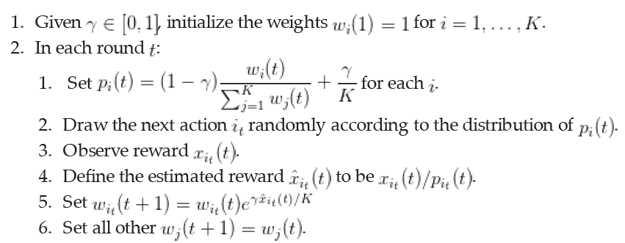
Exp3: Exponential-weight algorithm for Exploration and Exploitation

Slide 24
k-Meterologists Problem
ICML-09, Diuk, Li, and Leffler
Imagine that you just moved to a new town that has multiple (k) radio and TV stations. Each morning, you tune in to one of the stations to find out what the weather will be like. Which of the k different meteorologists making predictions every morning is the most trustworthy? Let us imagine that, to decide on the best meteorologist, each morning for the first M days you tune in to all k stations and write down the probability that each meteorologist assigns to the chances of rain. Then, every evening you write down a 1 if it rained, and a 0 if it didn’t. Can this data be used to determine who is the best meteorologist?
Related to expert algorithm selection

Slide 25
PAC Subset Selection in Stochastic Multi-armed Bandits
ICML-12
Select best subset of m arms out of n possible arms

Slide 26
Next chapter: RL
Discount factor: γ
Discounted Return:
=

Slide 27
Action-value function

