Slide 1
Schedule for presentations

Slide 2
6.1: Chris?
The agent is driving home from work from a new work location, but enters the freeway from the same point. Thus, the second leg of our drive home is the same as it was before. But say traffic is significantly worse on the first leg of this drive than it was on the first leg before the change in work locations. With a MC approach, we'd be modifying our estimates of the time it takes to make the second leg of the drive based solely on the fact that the entire drive took longer. With a TD method, we'd only be modifying our estimates based on the next state, so this method would be able to learn that the first leg of the drive is taking longer and our estimates would reflect that. The second leg would be unaffected.

Slide 3
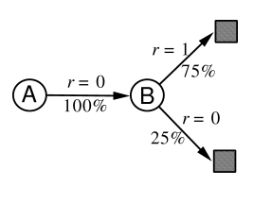
Ex. 6.4
V(B) = ¾
V(A) = 0? Or ¾?

Slide 4
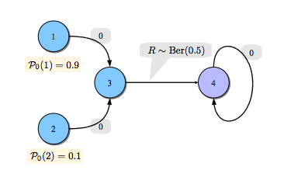
4 is terminal state
V(3) = 0.5
TD(0) here is better than MC. Why?

Slide 5
The above example illustrates a general difference between the estimates found by batch TD(0) and batch Monte Carlo methods. Batch Monte Carlo methods always find the estimates that minimize mean-squared error on the training set, whereas batch TD(0) always finds the estimates that would be exactly correct for the maximum-likelihood model of the Markov process. In general, the maximum-likelihood estimate of a parameter is the parameter value whose probability of generating the data is greatest. In this case, the maximum-likelihood estimate is the model of the Markov process formed in the obvious way from the observed episodes: the estimated transition probability from to is the fraction of observed transitions from that went to , and the associated expected reward is the average of the rewards observed on those transitions. Given this model, we can compute the estimate of the value function that would be exactly correct if the model were exactly correct. This is called the certainty-equivalence estimate because it is equivalent to assuming that the estimate of the underlying process was known with certainty rather than being approximated. In general, batch TD(0) converges to the certainty-equivalence estimate.
This helps explain why TD methods converge more quickly than Monte Carlo methods. In batch form, TD(0) is faster than Monte Carlo methods because it computes the true certainty-equivalence estimate. This explains the advantage of TD(0) shown in the batch results on the random walk task (Figure 6.8). The relationship to the certainty-equivalence estimate may also explain in part the speed advantage of nonbatch TD(0) (e.g., Figure 6.7). Although the nonbatch methods do not achieve either the certainty-equivalence or the minimum squared-error estimates, they can be understood as moving roughly in these directions. Nonbatch TD(0) may be faster than constant-$\alpha$ MC because it is moving toward a better estimate, even though it is not getting all the way there. At the current time nothing more definite can be said about the relative efficiency of on-line TD and Monte Carlo methods.
Finally, it is worth noting that although the certainty-equivalence estimate is in some sense an optimal solution, it is almost never feasible to compute it directly. If is the number of states, then just forming the maximum-likelihood estimate of the process may require memory, and computing the corresponding value function requires on the order of computational steps if done conventionally. In these terms it is indeed striking that TD methods can approximate the same solution using memory no more than and repeated computations over the training set. On tasks with large state spaces, TD methods may be the only feasible way of approximating the certainty-equivalence solution.

Slide 6
maximum-likelihood models, certainty-equivalence estimates
Josh: while TD and MC use very similar methods for computing the values of states they will converge to a different values. It surprises me, I actually had to read the chapter a couple of times to come to grips with it. Example 6.4 in section 6.3 is what finally convinced me however I had to go over it several times

Slide 7
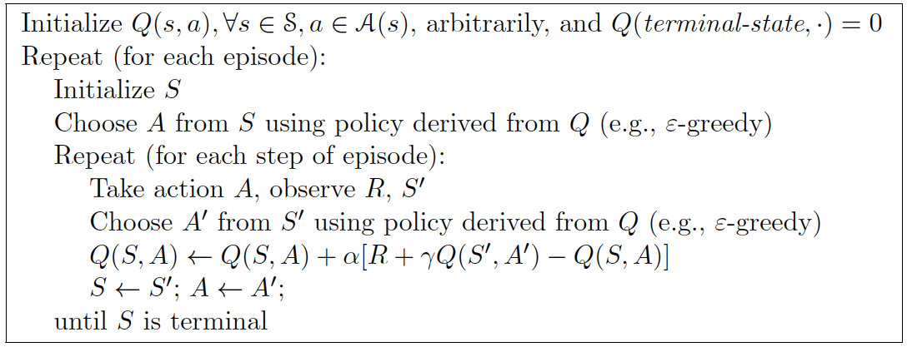
Sarsa

Slide 8
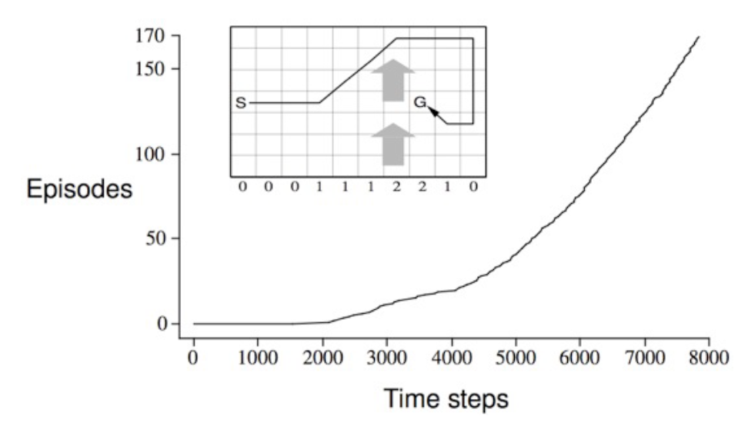
Why could this be a challenge for MC?
How could you solve this task with MC?

Slide 9
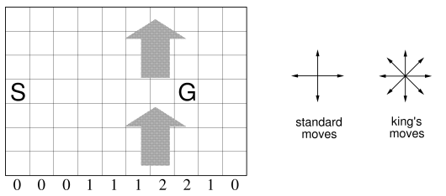
Ex 6.6: Resolve the windy gridworld task assuming eight possible actions, including the diagonal moves, rather than the usual four. How much better can you do with the extra actions? Can you do even better by including a ninth action that causes no movement at all other than that caused by the wind?

Slide 10
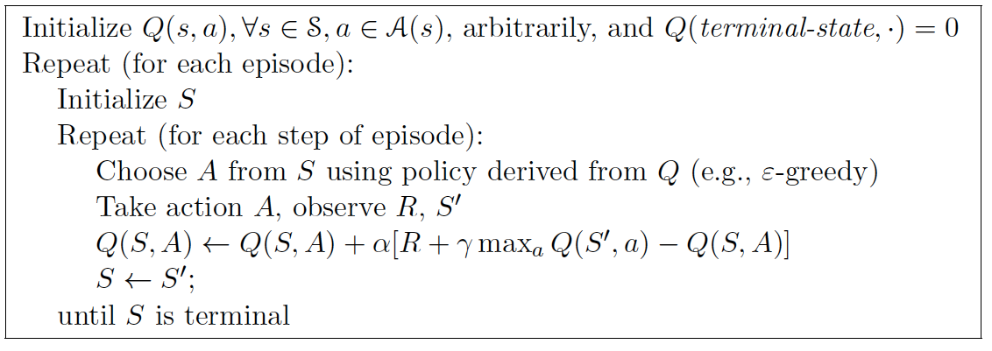
Q-Learning

Slide 11
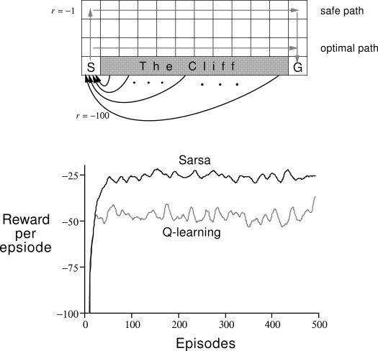
On- vs. Off-Policy Learning

Slide 12
TD(0) prediction
Sarsa, On-policy learning
Q-Learning, Off-policy learning
(Note that neither Sarsa or Q-learning have an explicit policy….)

Slide 13
When would you use one vs. the others?
TD(0) prediction
Sarsa, On-policy learning
Q-Learning, Off-policy learning
(Note that neither Sarsa or Q-learning have an explicit policy….)

Slide 14
Modified update
On- or Off-policy?
How do you think it’d do on the cliff world?

Slide 15
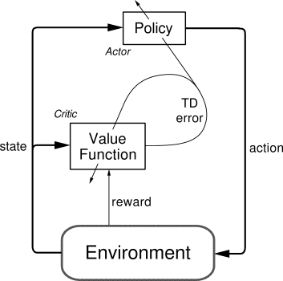
Actor-Critic
On-policy learning
Critic: Value function
If result is better than I thought it’d be, take that action more often
Actor: Explicit policy
Policy evaluation / improvement
Sound familiar?

Slide 16
Actor-Critic

Slide 17
Actor-Critic

Slide 18
Policy Improvement
R.S. Sutton, D. McAllester, S. Singh, and Y. Mansour. Policy gradient methods for reinforcement learning with function approximation. In NIPS, 2000
Policy gradient improvement
θ is vector of policy parameters
ρ is the policy performance (e.g., average reward per step)
α is learning rate
Can (usually) be assured to converge
Small changes to θ can cause only small changes to policy / state-visitation distribution
Approximate gradient via experience
Also: V. Konda and J. Tsitsiklis. Actor-critic algorithms. In NIPS, 2000

Slide 19
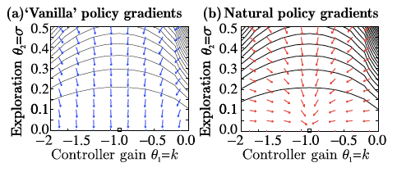
Natural Actor-Critic: Peters and Schaal, 2008
Vanilla policy gradient follow gradient of the expected return function J(θ)
Often gets stuck in plateaus

Slide 20
Natural Actor-Critic: Peters and Schaal, 2008
Natural gradients avoid this problem
Does not follow steepest direction in parameters space, but steepest direction w.r.t. Fisher metric:
G(θ) is Fisher information matrix
amount of information that an observed random variable X carries about an unknown parameter θ, upon which P(X) depends)
Depends on choice of coordinate system
Convergence to next local optimum is assured

Slide 21
Actor-critic advantage
Combine different methods for policy improvement with methods for policy evaluation
E.g., Least-Squares Temporal Difference (LSTD)

Slide 22
Ergodic process: nonzero probability of reaching any state from any other under any policy

Slide 23
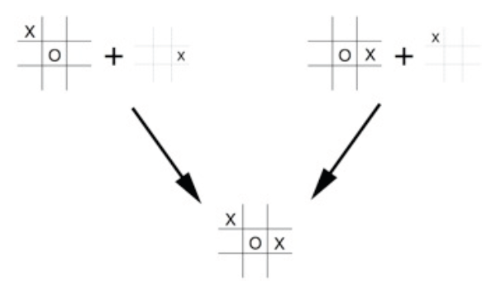
Afterstates
Where else would these be useful?

Slide 24
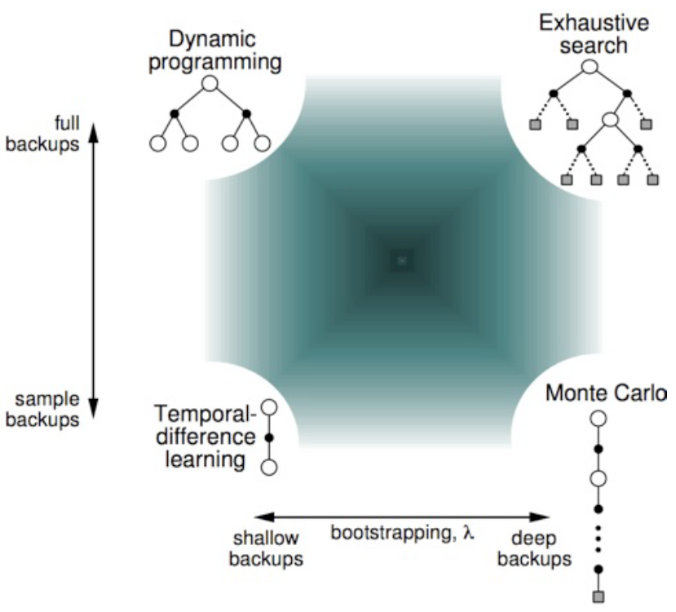
Unified View

Slide 25
Quiz!
If a policy is greedy w.r.t. the value function for the equiprobable random policy, then it is an optimal policy. Why or why not?
If a policy π is greed w.r.t. its own value function, V^{π}, then it is an optimal policy. Why or why not?
When would you use TD(0), Sarsa, or Q-Learning (vs. the other 2 algorithms listed)

