Slide 1
Elements of Network Science: CptS 580-04 / EE 582-03
Assefaw Gebremedhin
Washington State University
School of Electrical Engineering and Computer Science
assefaw@eecs.wsu.edu
http://www.eecs.wsu.edu/~assefaw
Spring 2016

Slide 2
Big Picture

Slide 3
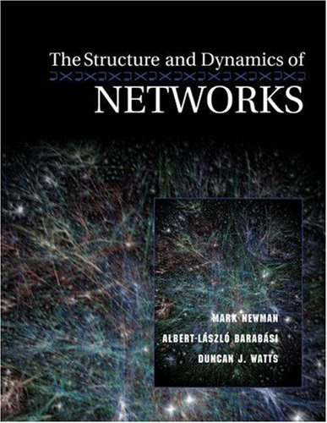
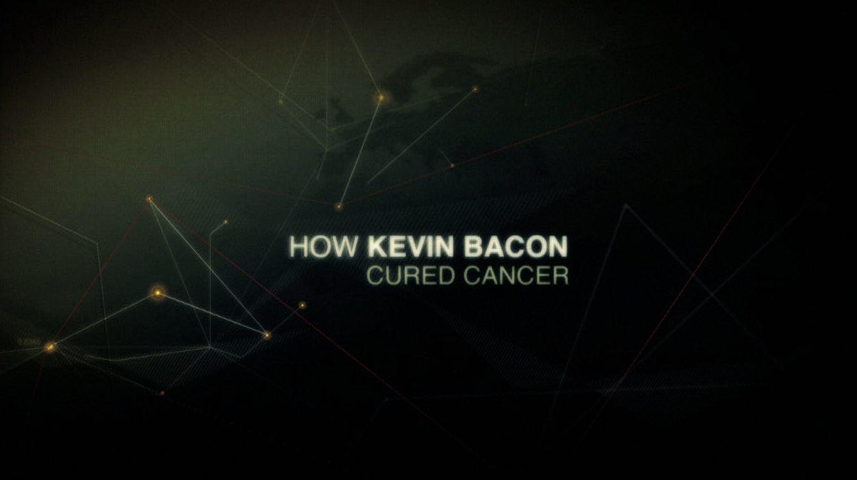
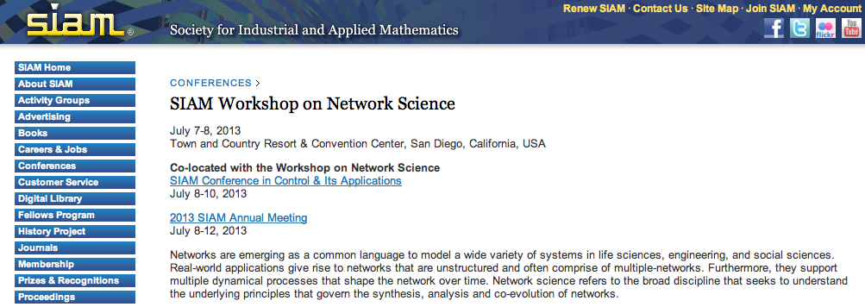
Who’s talking networks?

Slide 4
Complex connectedness is everywhere!
The social interconnections we have
The information we consume
The technological systems we use
The economic systems we live in
The political systems we operate in
The organizations we work at
The institutions we belong to
The ecological systems around us
Ourselves (cell, brain)
….

Slide 5
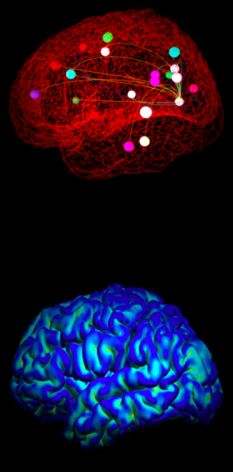
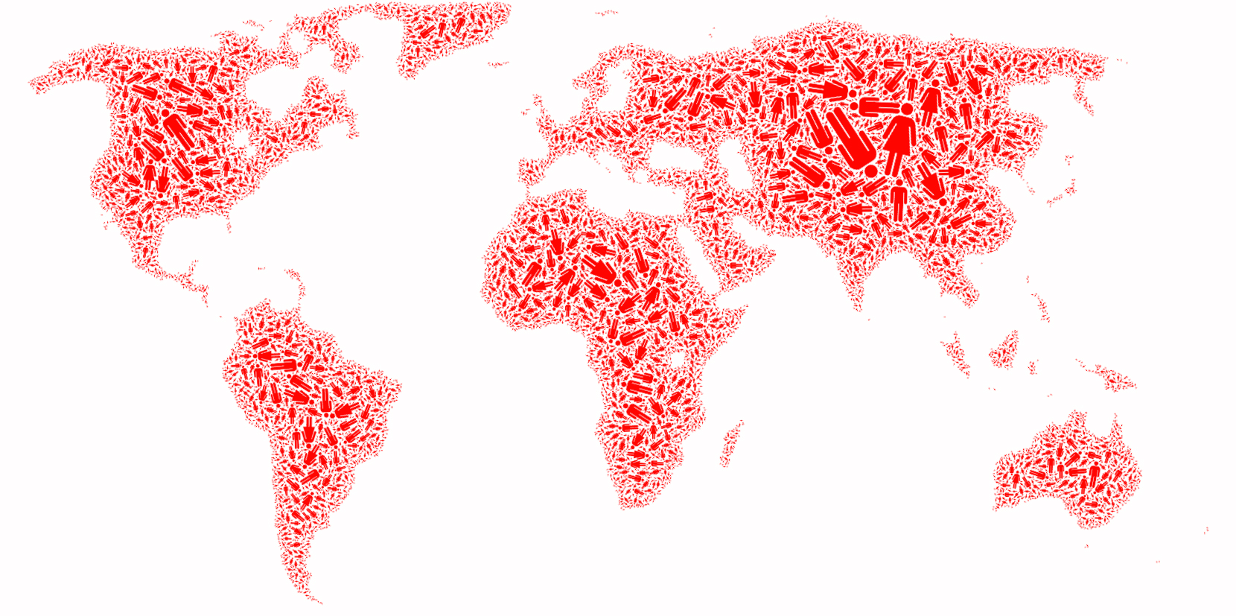
Complex connectedness is everywhere (in pic)
(Pictures here and elsewhere, unless stated otherwise, are courtesy of Barabasi et al, Network Science Course, NEU,
http://barabasilab.neu.edu/courses/phys5116/.)
Human cell
World economy
Society
Brain
domain2
domain1
Internet
router
...and many more
domain3

Slide 6
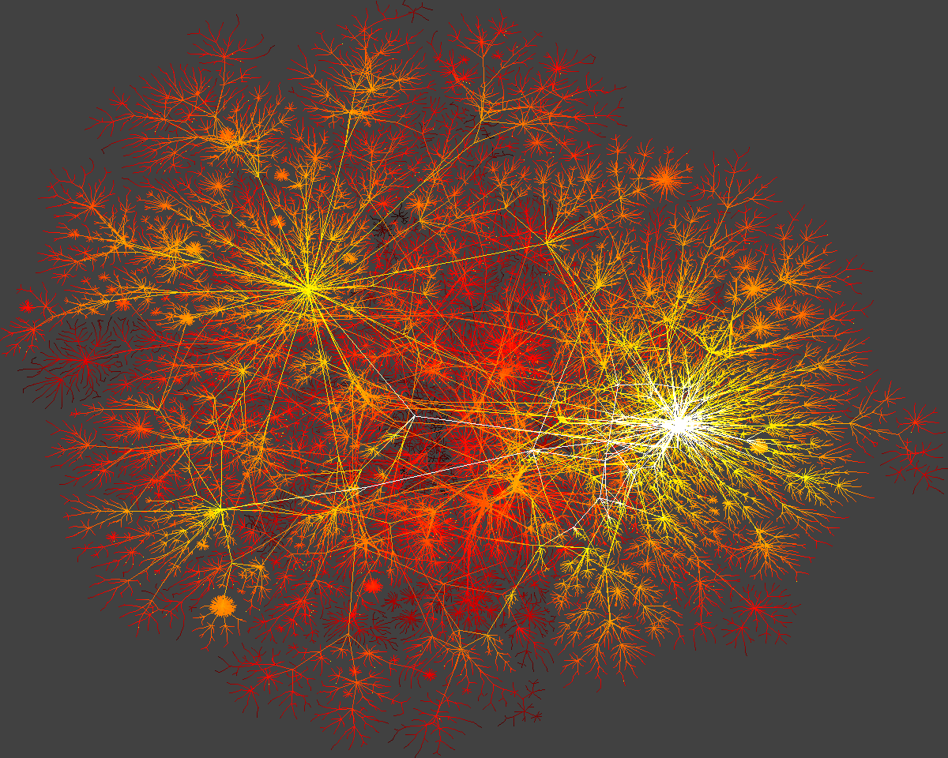
An underlying feature:
Behind each such system there is an intricate wiring diagram,
network, that encodes the interactions between the components.
And to understand the systems, we must understand the networks behind!

Slide 7
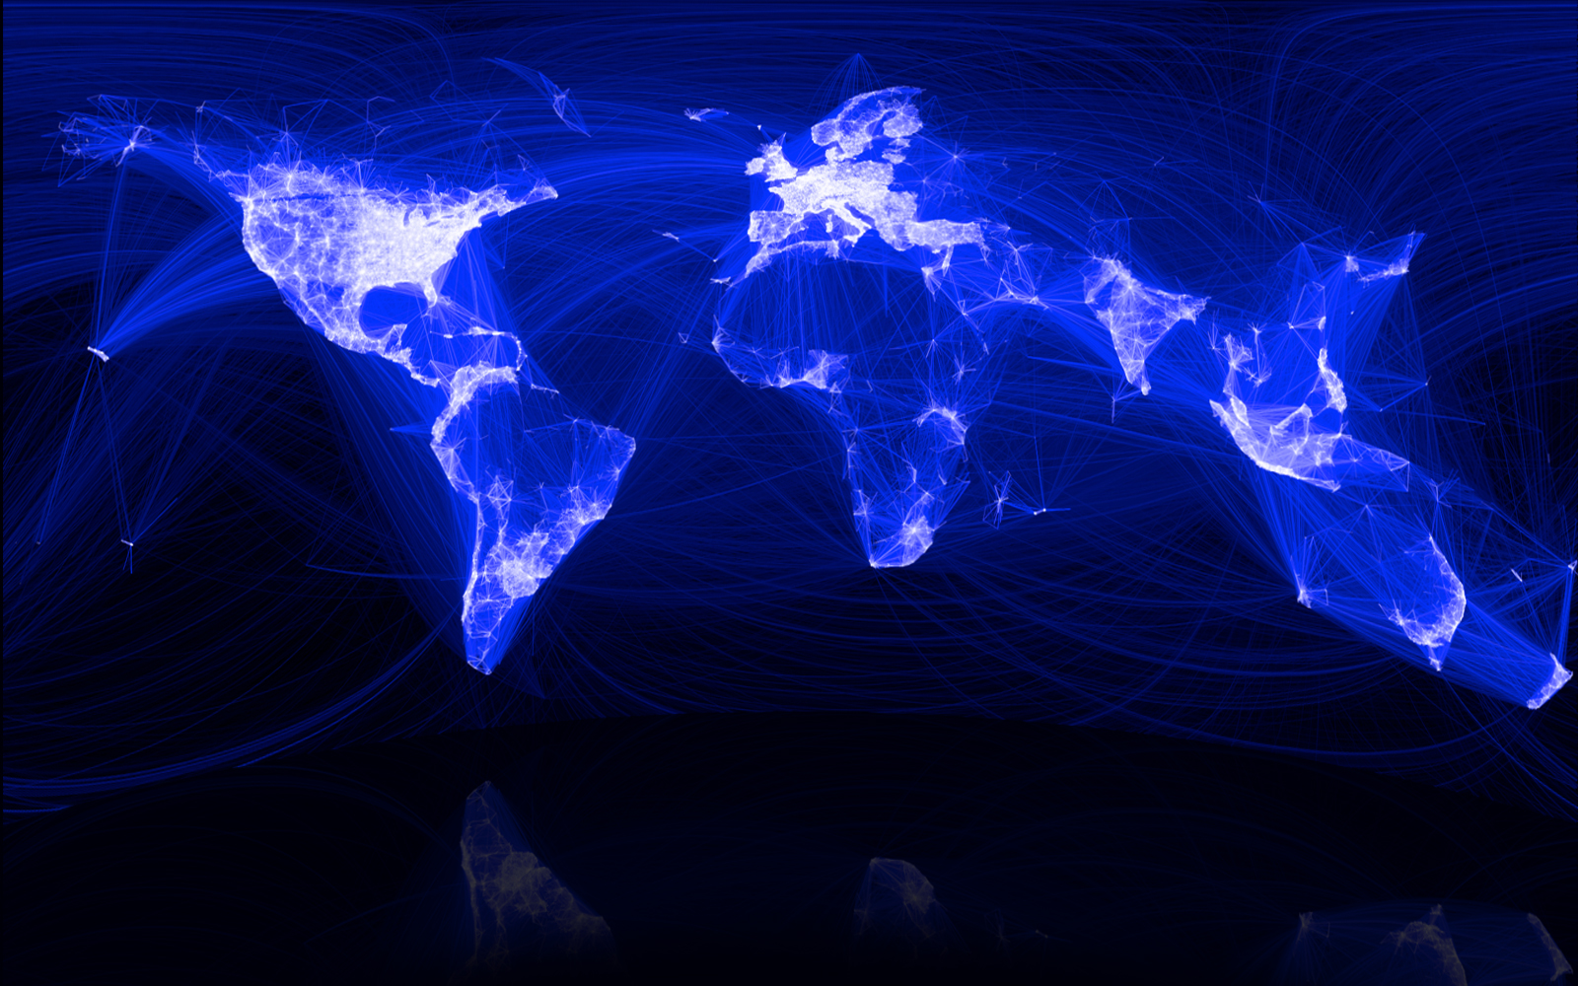
Networks: Social
The “Social Graph” behind Facebook

Slide 8
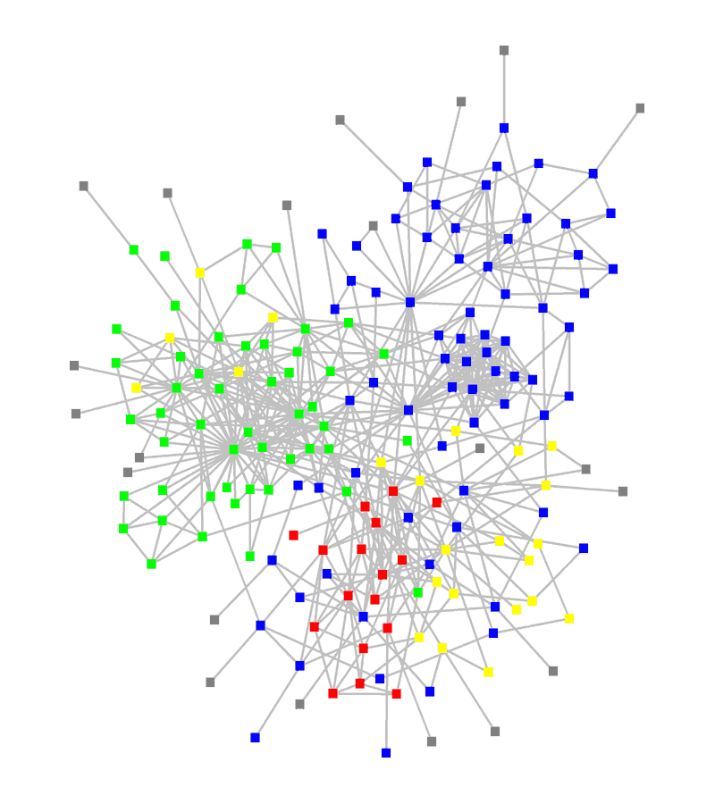
Networks: structure of an organization
: departments
: consultants
: external experts
www.orgnet.com

Slide 9
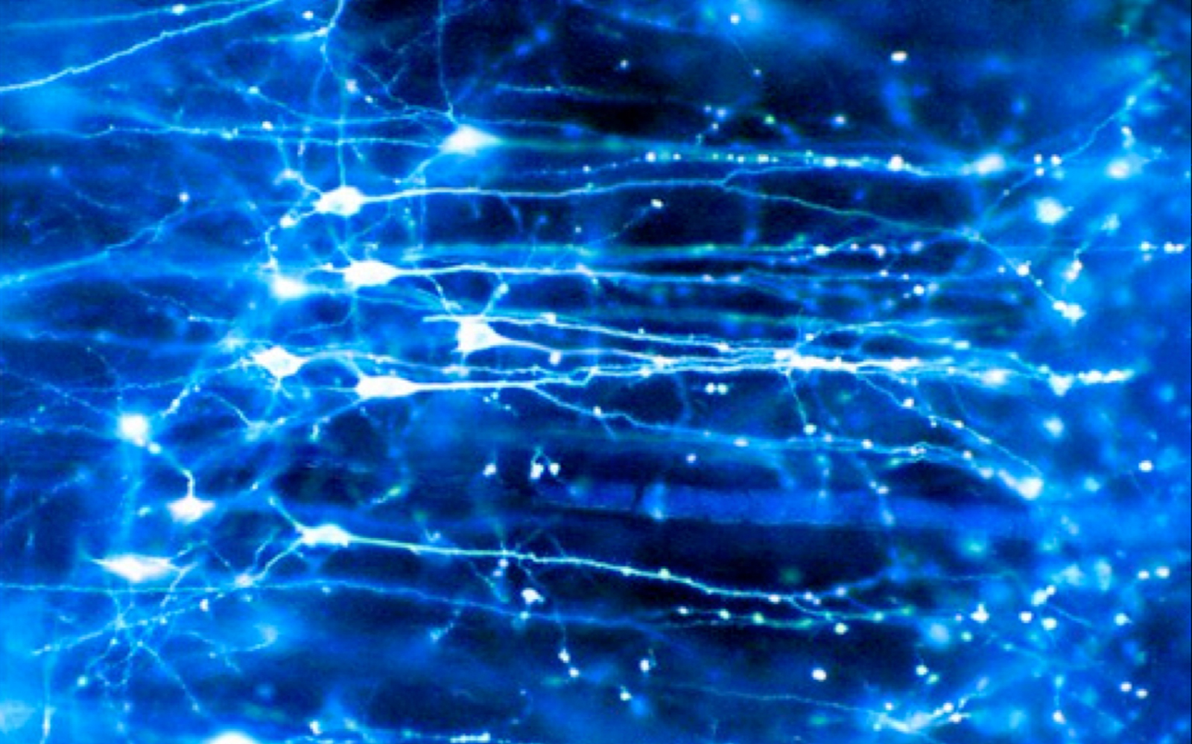
Networks: Brain
Human Brain has between
10-100 billion neurons.
http://barabasilab.neu.edu/courses/phys5116/

Slide 10
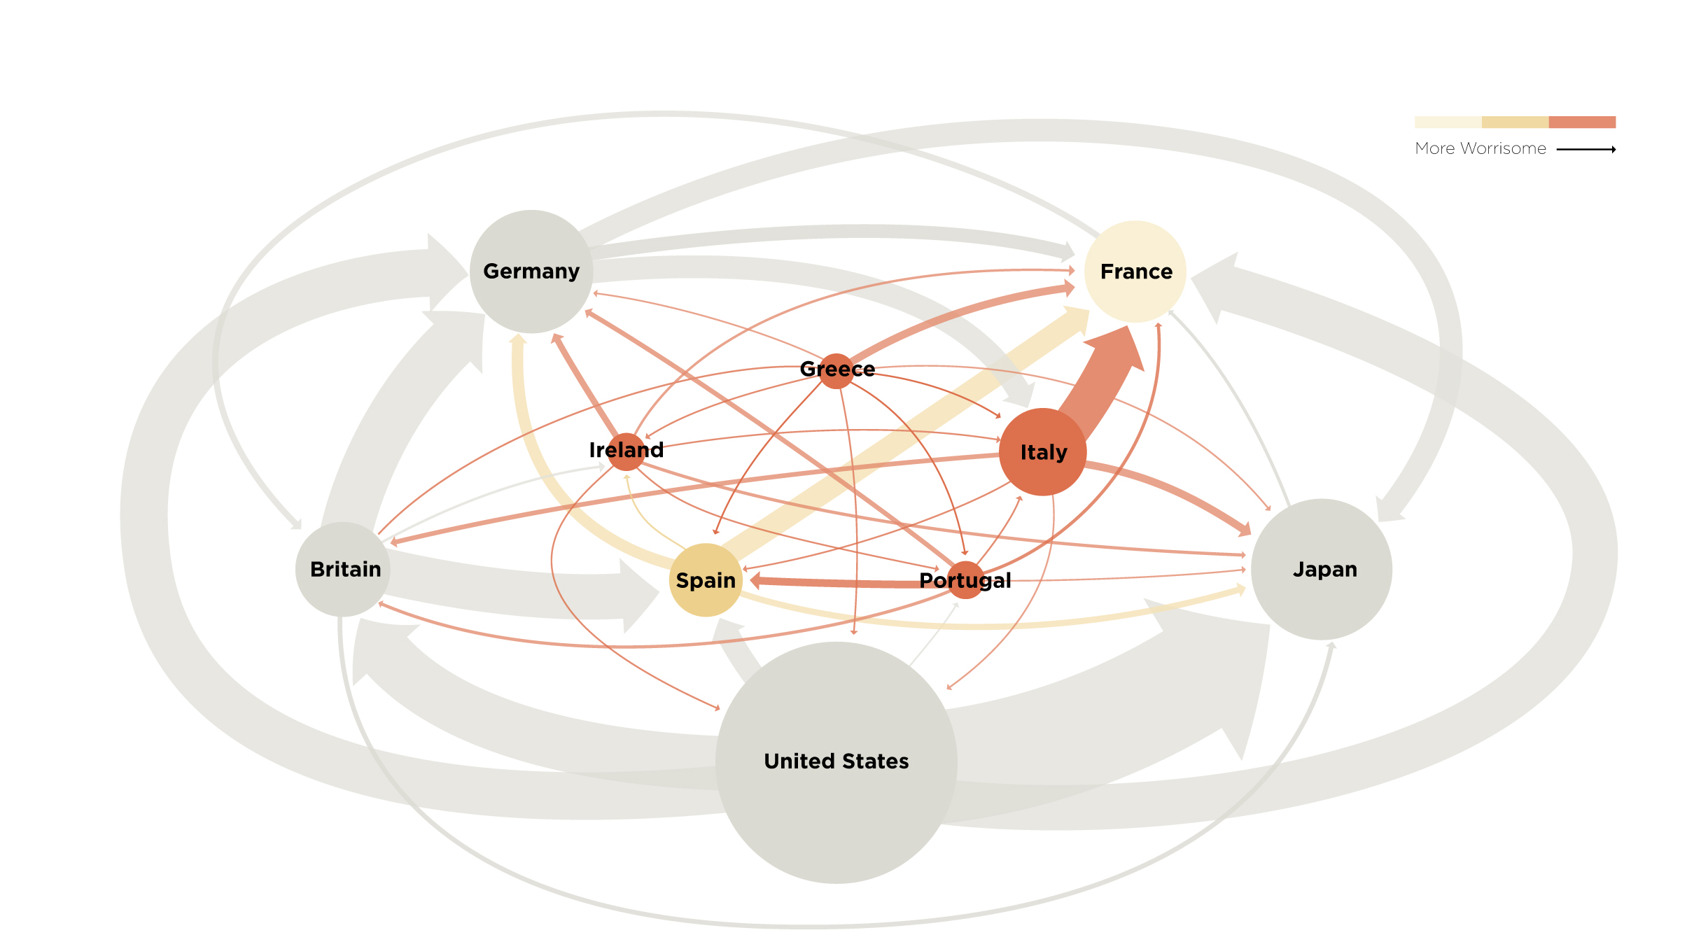
Networks: Financial
http://barabasilab.neu.edu/courses/phys5116/
Notes:
{\bf The subtle networks behind the economy.}
A credit card, selected as the 99th object in the popular exhibition by the British Museum, entitled {\it The History of the World in 100 Objects.} This card demonstrates the interconnected nature of the modern economy, creating subtle linkages that one normally does not even think of. The card was issued in the United Arab Emirates in 2009 by the Hong Kong and Shanghai Banking Corporation, commonly known HSBC, a London based bank. The card functions through protocols provided by VISA, an USA based credit association. Yet, the card adheres to Islamic banking principles, which operates in accordance with Fiqhal-Muamalat (Islamic rules of transactions), most notably the elimination of interest or {\it riba}. The card is not limited to Muslims in the United Arab Emirates, but it is also offered to Muslim minorities in non-Muslim countries, and it is also used by many non-Muslims who agree with its strict ethical guidelines

Slide 11
Networks: Business ties in US Bio-tech industry
Nodes:
Companies
Investment
Pharma
Research Labs
Public
Biotechnology
Links:
Collaborations
Financial
R&D
http://ecclectic.ss.uci.edu/~drwhite/Movie
http://barabasilab.neu.edu/courses/phys5116/

Slide 12
Reasoning about networks
Study aspects
Structure and Evolution
Behavior and Dynamics
Full understanding requires synthesis of ideas from various disciplines, including
Computer science
Applied mathematics
Natural sciences
Statistics
Economics
Sociology

Slide 13
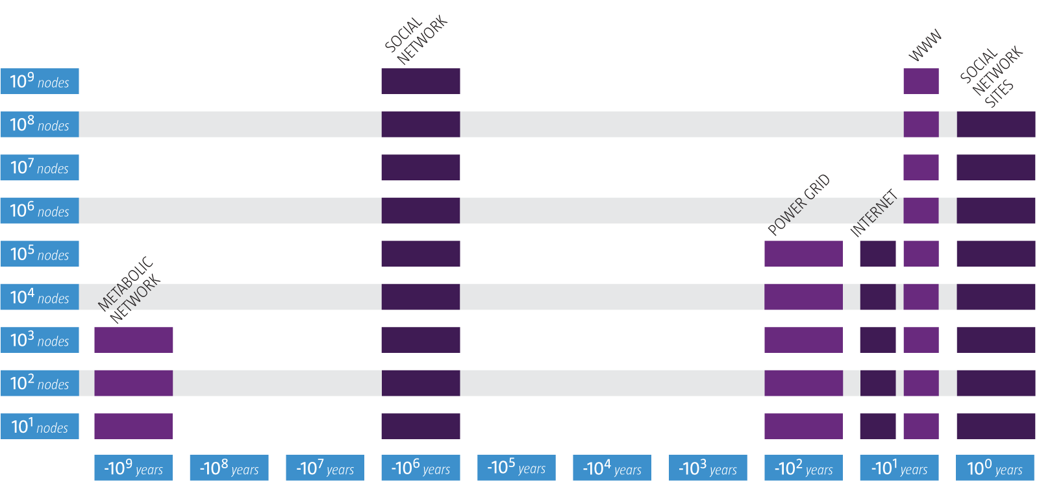
Networks, why now?
http://barabasilab.neu.edu/courses/phys5116/

Slide 14
Catalysts for emergence of network science
Availability of network “maps”
The Internet, cheap digital storage, and computational technologies made it possible to collect, assemble, share, and analyze data pertaining to real networks.
Recurring similarity
Networks from science, nature, and technology are more similar than one would expect
Confluence of ideas and tools
Newer ways of reasoning about interconnectedness are being born by integration of ideas and tools from various disciplines

Slide 15
Impact of network science
Economic
Web search
Social networking
Health
Drug design
Metabolic engineering
Security
Fighting terrorism (net-war)
Epidemics
Epidemic prediction (biological, electronic viruses)
Halting spread
Brain Science
In 2010 NIH initiated the Connectcome project, aimed at developing a neuron-level map of mammalian brains
Management
Uncovering the internal structure of an organization

Slide 16
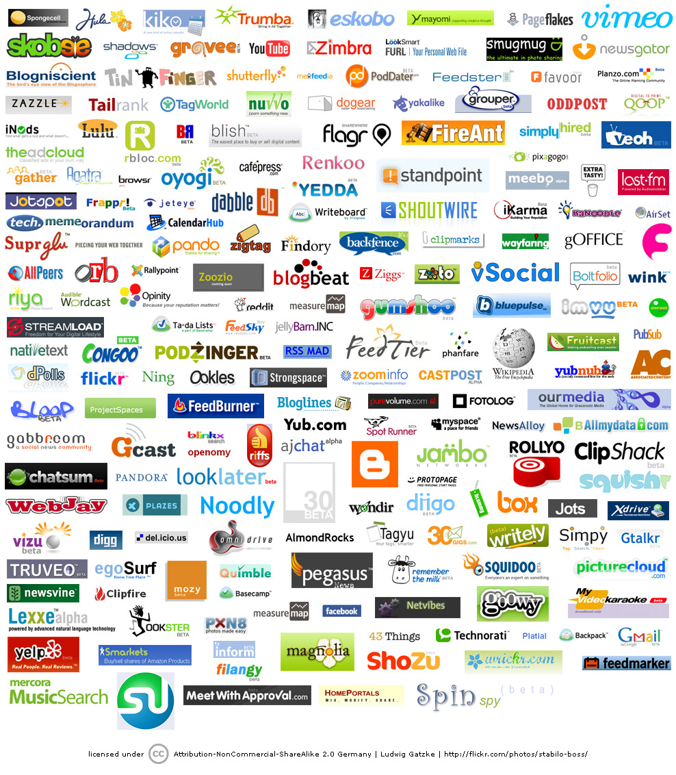
Economic Impact
Google
Market Cap(2010 Jan 1):
$189 billion
Cisco Systems
networking gear Market cap (Jan 1, 2919):
$112 billion
Facebook
market cap:
$50 billion
www.bizjournals.com/austin/news/2010/11/15/facebooks... - Cached

Slide 17
Military impact
http://www.slate.com/id/2245232

Slide 18
EPIDEMIC FORECAST Predicting the H1N1 pandemic
Real
Projected
http://barabasilab.neu.edu/courses/phys5116/

Slide 19
Thex
MOST IMPORTANT Networks Really Matter
If you were to understand the spread of diseases, can you do it without networks?
If you were to understand the WWW structure, searchability, etc, hopeless without invoking the Web’s topology.
If you want to understand human diseases, it is hopeless without considering the wiring diagram of the cell.
http://barabasilab.neu.edu/courses/phys5116/

Slide 20
This course
in focus

Slide 21
Goals
Students will be introduced to select
mathematical and computational methods used to analyze networks
models used to understand and predict behavior of networked systems
theories used to reason about network dynamics
And students will apply what they learn by completing a semester project and three assignments

Slide 22
Tentative list of topics*
Network structure and modeling
Graph theory
Basic network properties
Random graphs
Centrality
Similarity
Homophily
Signed networks
Network algorithms
Link analysis (PageRank, Hubs and Authorities)
Spectral analysis
Community identification
Network dynamics
Cascading behaviors
Information diffusion
Influence maximization
Kleinberg’s Decentralized Search model
Temporal networks
Models
Algorithms
Applications
*: Final list to be determined after completion of survey

Slide 23
Books
Primary reference:
Easley and Kleinberg, Networks, Crowds and Markets, Cambridge Univ. Press, 2010
Other/related references
M.E. J. Newman, Networks: An Introduction, Oxford University Press, 2010
U. Brandes and T. Erlebach (Eds.), Network Analysis: Methodological Foundations, Springer 2005
A. Barabasi, Network Science, e-book

Slide 24
Software
We will use igraph as the primary software tool for network analysis
Igraph
http://igraph.org
networkX
http://networkx.github.io

Slide 25
Expectation
Basic knowledge of:
Algorithms
(Graph theory)
Linear algebra
Probability
Reasonable programming experience.
Please fill and return the background survey.
Your input will to a degree define the course!

Slide 26
Course work
Three assignments
Individual
One semester project
Collaborative (a team of two)
Final Grade:
Project: 50%
Critique paper 5%,
Project proposal 5%
Presentation 10%
Final report 30%
Assignments: 40%
In-class quizzes: 5%
Class participation: 5%

Slide 27
Project:
Could take one of several forms:
Experimental analysis of an interesting dataset using existing methods and software
Theoretical analysis of a model/an algorithm in a specific application
Implementation of a new method
Students required to work in teams of two

Slide 28
Lecture material and resources
Course website: http://www.eecs.wsu.edu/~assefaw/CptS580-04/
Slides, reading materials, announcements, and other resources will be posted via OSBLE and the course website. OSBLE will be used to handle assignment and project submissions.
The Easley & Kleinberg reference book is available on-line
Check the course website and your OSBLE account regularly for info and updates

Slide 29
An extra slide

Slide 30
Characteristics of Network Science
Interdisciplinary
Common language for interaction
Cross-fertilization of ideas and tools
Empirical, data driven
Focuses on data and utility
Quantitative and Mathematical
Graph theory (to deal with graphs)
Statistical physics (to deal with randomness and universal organizing principles)
Engineeting + control + information theory + statistics + data mining (to deal with extracting information from incomplete and noisy data)
Computational
Size of networks and nature of data result in formidable computational challenges
Algorithms, database mgmt., data mining

