Slide 1
Digital Systems for the Smart Grid
Computation Segment Lecture 1:
Control center structure & software; Utility ICT infrastructures
Dr. Anurag K. Srivastava,
Dr. Carl Hauser,
Dr. Dave Bakken,
Dr. Min Sik Kim
Washington State University

Slide 2
Schedule for This Segment
Lecture 1: Utility IT infrastructures; control center structure & software;
Lecture 2: CIMs, IEC 61850 and 61970
Lecture 3: fault-tolerant computing basics
Lecture 4: distributed computing basics
Lecture 5: distributed computing architectures; middleware
Lecture 6: WAMS data delivery requirements and mechanisms, including NASPInet and GridStat

Slide 3
Caveats on the big picture
On our generalized architectural descriptions:
  “All generalizations are false, including this one.” Pascal
  Result: NERC functional model
  Power industry moves very, very slowly…… esp. on information and communication technologies (ICT)
  Use of advanced ICT in the power grid is way behind that in other industries
    E.g., middleware “best practices” in other industries for 15-20 years, barely used in the electricity sector
  “Utilities are trying hard to be first to be second”
      engineer from a US national energy lab
  “Utilities are quite willing to use the latest technology, so long as every other utility has used it for 30 years”
      anonymous pessimist

Slide 4
Reading for Computation Segment
Felix F. Wu, Khosrow Moslehi, and Anjan Bose. Power System Control Centers: Past, Present, and Future. Proceedings of the IEEE, 93(11), Nov. 2005, 1890-1908. Sec 1-4, 6, 8.
EPRI, Common Information Model Primer, 1ed, 2011. Sec 4+5.
IEC 61850, http://en.wikipedia.org/wiki/IEC_61850
CDKB5: George Coulouris, Jean Dollimore, Tim Kindberg and Gordon Blair, Distributed Systems: Concepts and Design Fifth Edition, published by Addison Wesley, May 2011 (Chapters 1-2). WSU bookstore; www.cdk5.net
D. Bakken, R. Schantz, and R. Tucker. “Smart Grid Communications: QoS Stovepipes or QoS Interoperability?”, Grid-Interop 2009 (best “connectivity” paper), Denver, November 18, 2009.
J. Waldo, G. Wyant, A. Wollrath, and S. Kendall. “A Note on Distributed Computing”. Sun Labs Technical Report TR-94-29, November 1994.
M. Armbrust et al. “Above the Clouds: A Berkeley View of Cloud Computing”, Technical Report No. UCB/EECS-2009-28, February 2010.
D. Bakken, A. Bose, C. Hauser, D. Whitehead, and G. Zweigle. “Smart Generation and Transmission with Coherent, Real-Time Data”. Proceedings of the IEEE (Special Issue on Smart Grids), 99(6), June 2011, 928-951. Preprint (if IEEE paper not accessible).
Notes: #1-2,5-8 are available online with the course: Assignments/Reading; #6-8 optional but may be useful and/or interesting.

Slide 5
Today’s Content
Quick review of earlier big picture & Intro (I)
Control Center Evolution (II)
Conventional Control Centers (III)
Changing Environment (IV)
Modern Distributed Control Centers (VI)
Future Control Centers (VIII)
Note: Skipping cause in rest of this segment and others:
  Enabling [ICT] Technologies (V)
  Emerging [ICT] Technologies (VII)

Slide 6

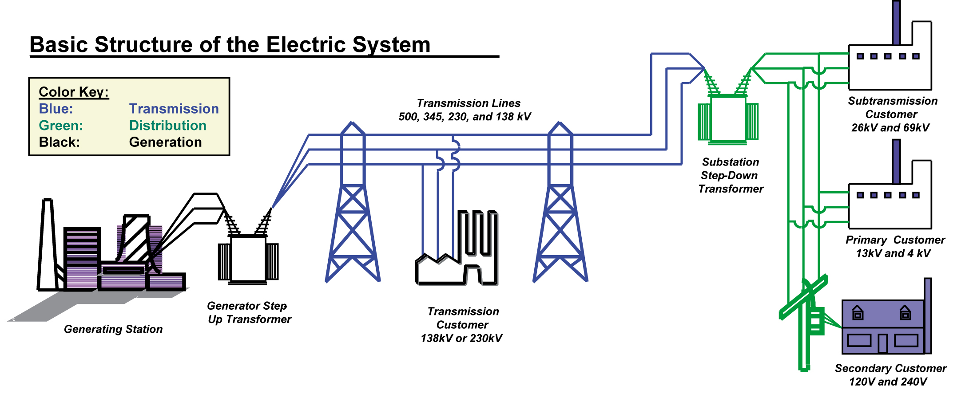
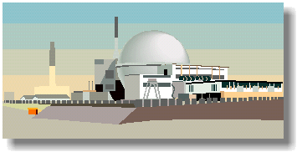

Power System Structure
Hydro
Gas or CC
Nuclear
Coal
Credit: Jim McCally, Iowa State
http://tcip.mste.illinois.edu/

Slide 7
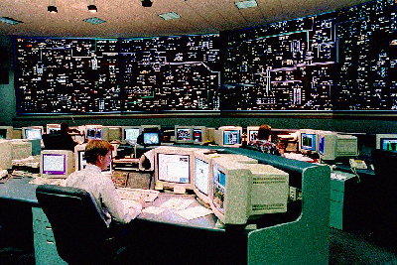
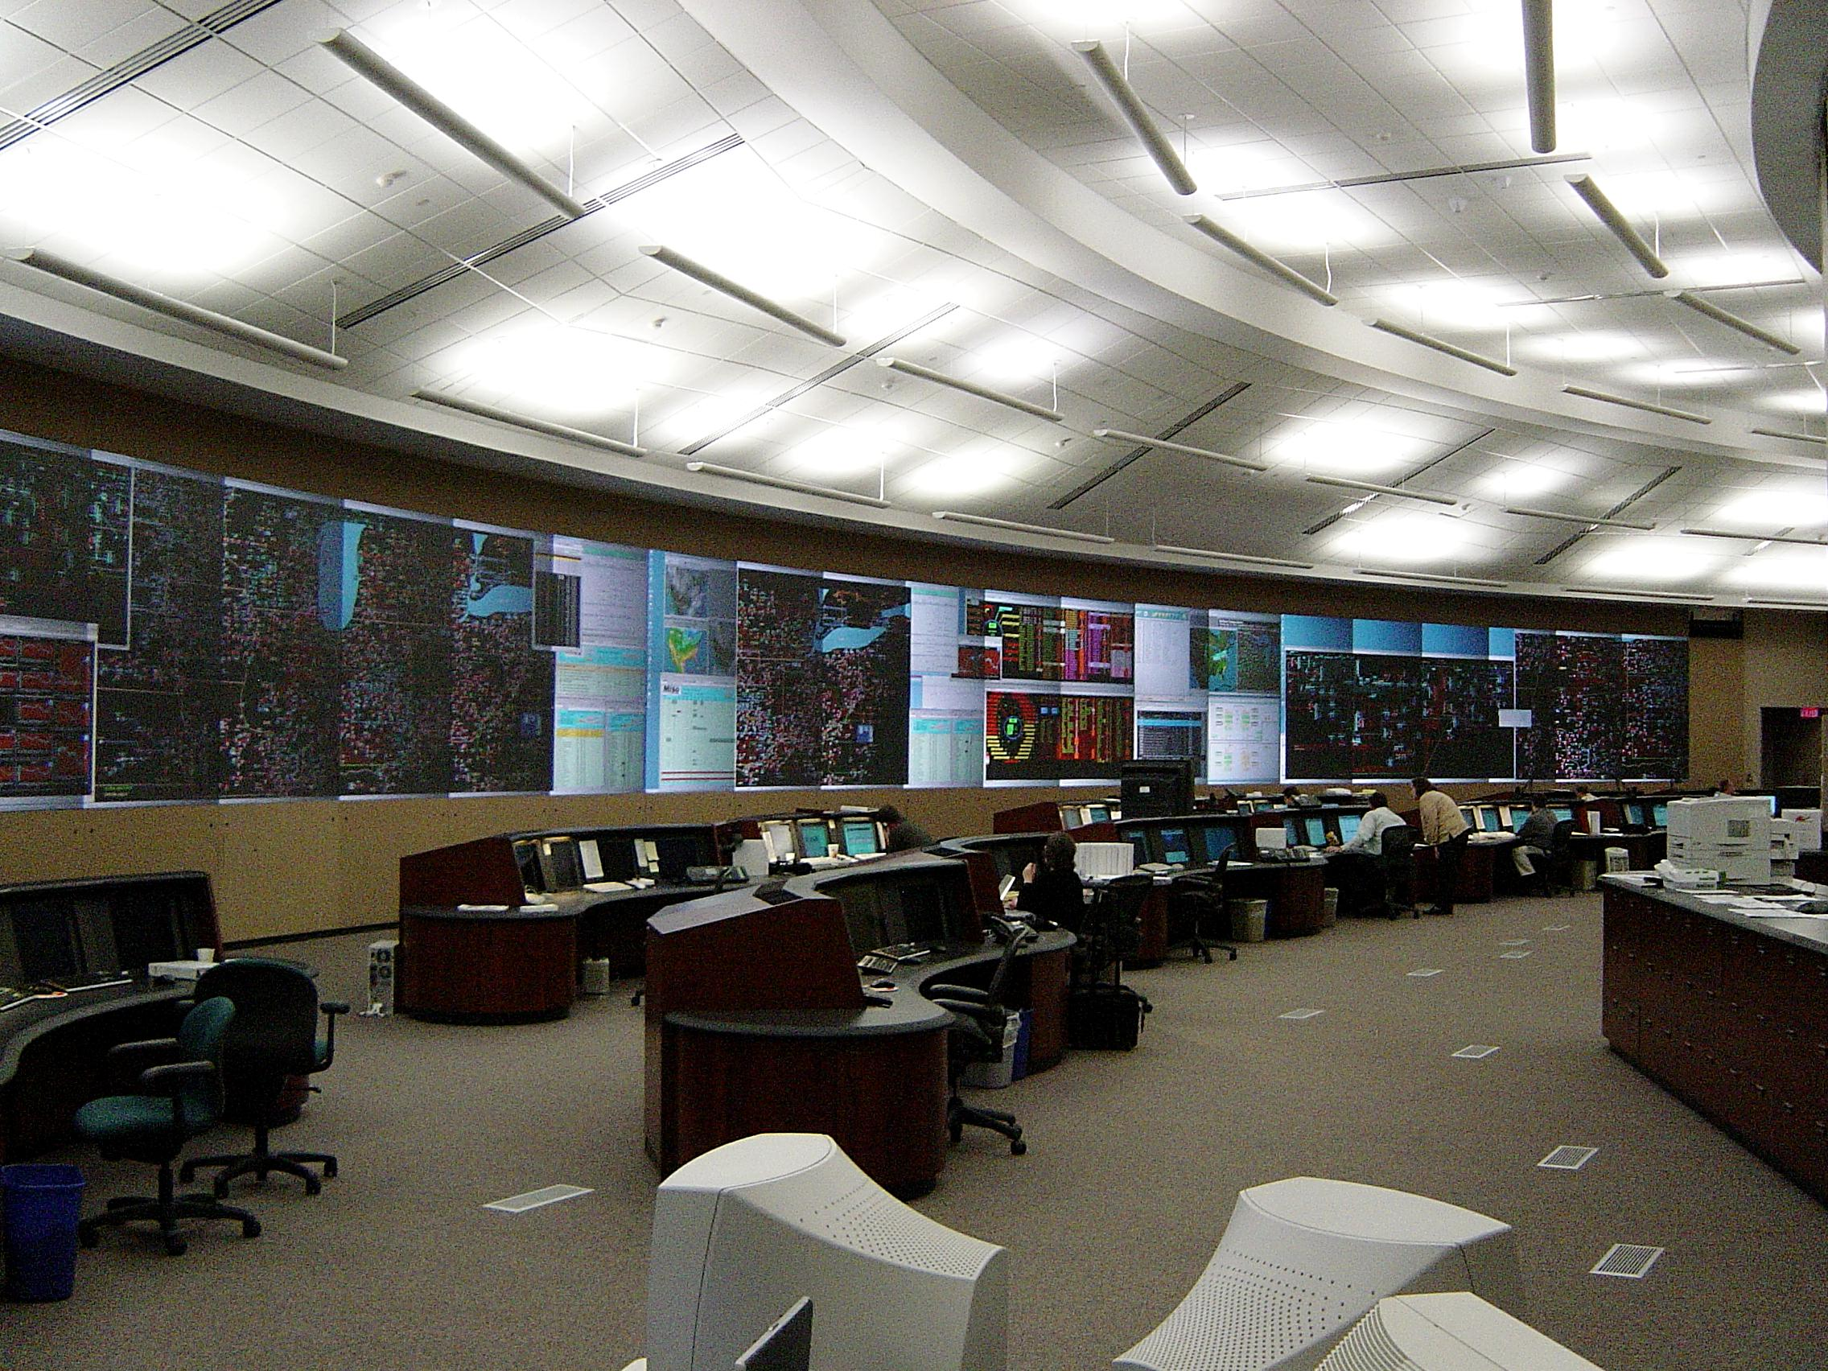
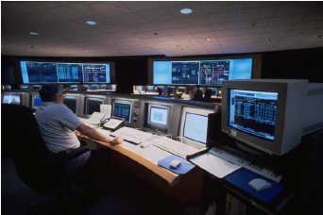
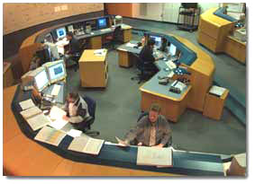
control centers

Slide 8
Introduction (I)
Impetus to have control centers came from big 1965 blackout in northeastern US
Energy Management System (EMS) resulted
  Fairly crude ICT by 1980s standards
  Core largely obsolete by 2000 ICT standards
Likely future: cloud-based infrastructure (“grid services” in paper)
  Very fast and reliable data acquisition
  Many more apps, with intelligence pushed in or towards substations
  Much more sharing of data between apps and between utilities and others (?DHS)

Slide 9
Control Center Evolution (II)
1950s: analog communications deliver “analogs” to analog computers
  Load frequency control (LFC) and economic dispatch (ED)
    Unit commitment (UC): schedules start/top for generators
1960s: SCADA and RTUs slowly begin to be used
1965 blackout recommendation: use digital computers more extensively and effectively for RT
1970s: power system “security”/reliability: ability of system to withstand disturbances/contingencies.
  Custom computers ➔ general purpose computers running EMS
  SCADA installed in substations and distribution feeders ➔ distribution management systems (DMS)
  SCED: security-constrained economic dispatch

Slide 10
Control Center Evolution (cont.)
Host of supporting functions in grid to ensure reliability
  Real power reserves
  Ancillary services: additional capabilities (often inter-utility) to help ensure reliability (e.g., load following)

Slide 11
Control Center Evolution (cont.)
Deregulation (of generation): mid-90s
  Old: vertically-integrated utility w/all 3 fund. roles in its territory
  New
    Competition for generation
    LSE: load serving entity
    ISO/RTO to run transmission markets for LSEs
    CC expanded from reliability-based EMS to also include economic/business functionality
    Two-level structure of CCs in market…
Two types of markets (complex, balance in RT!):
  Bilateral contracts between suppliers and consumers
  Auction market: generators submit bids
  Also markets for day-ahead, real-time balancing (5min), and ancillary services

Slide 12
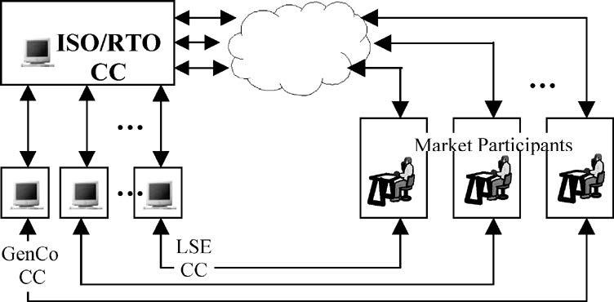
Control Centers (CC) in the Market Environment
  BMS: business management systems
  ISO/RTO operates market
    MOS: market operations system
  Market participants: Gencos, Trancos, LSEs, ISO/RTO, etc

Slide 13
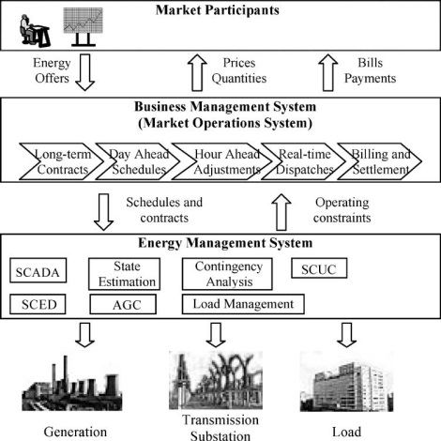
EMS and BMS Interactions
  SCUC: security-constrained unit commit ~ 5min
  SCED: security-constrained economic dispatch

Slide 14
Conventional Control Centers (III)
Looking from two angles: functions and architecture
Functionality provided by power system application programs (“apps”)
Two main kinds of functions:
  Extensions of the first EMSs: reliability
    Data acquisition
    Generation control: NERC role balancing authority (BA)
    Network (security) analysis and control: NERC role reliability authority
      State estimation
      Contingency analysis / security analysis
  BMSs for market operations: economics
    (skipping details …. BMSs are not the focus of this overview)

Slide 15
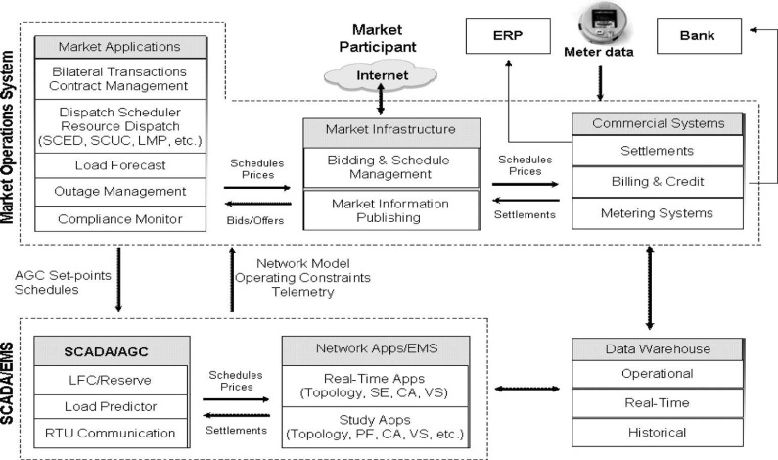
Control Center Functions
Note: ERP and Data Warehouse discussed later

Slide 16
Control Center Architecture
SCADA designed for vertically-integrated utilities and very little useful data in substations
  Star topology feeding into one computer: inflexible
Today: substation automation adds many IEDs that could be quite useful
Lots of data starting to be used by many different applications (historically in proprietary formats)
  Different subsets used by different apps
  Multiple copies have to be coordinated, synchronized, merged into DBs
  CIMs to the rescue (next lecture)

Slide 17
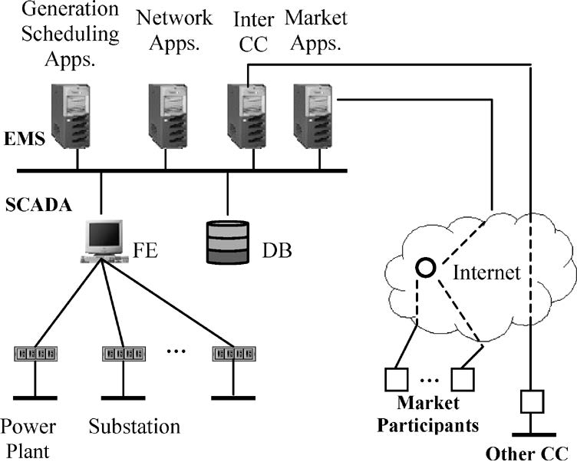
Conventional Control Center Architecture
  Substations have LANs connecting IEDs to RTU
    Formerly: wires!
    61850 ….
  RTU P2P network link to front end (FE) to CC LAN

Slide 18
Changing Environment (IV)
Very dynamic situation
  Vertically-oriented utility to deregulation
  Divestitures, mergers, acquisitions
  Control centers with non-contiguous territories
  New participants coming, some disappear
  ➔ “all generalizations are false”
  But now all control centers have to cope with changing business architecture (ouch!) above, below, and with peers
Coarsely-integrated EMS, SCADA, DA, … morphs towards a coherent enterprise architecture
➔ Need flexibility in many dimensions and at many levels of the EA’s components…. modularity …. scalability, … expandability.

Slide 19
Changing Environment (cont.)
Control center’s sensor and derived data contain (literally) a wealth of information
  Key issue: how to cleanly integrate (again, CIMs help here)
Part of soln: sophisticated SW from other domains
ERP: enterprise resource planning
  AKA enterprise resource management (ERM)
  Manages all aspects of business: production planning, material purchasing, maintaining inventories, supplier interactions, payroll, customer service, etc.
Data warehouse: carefully integrated (and scalable) collection of utility’s data
  Bundled with statistical tools, e.g. SAS
  Can repackage easily for other subsets, applications, etc

Slide 20
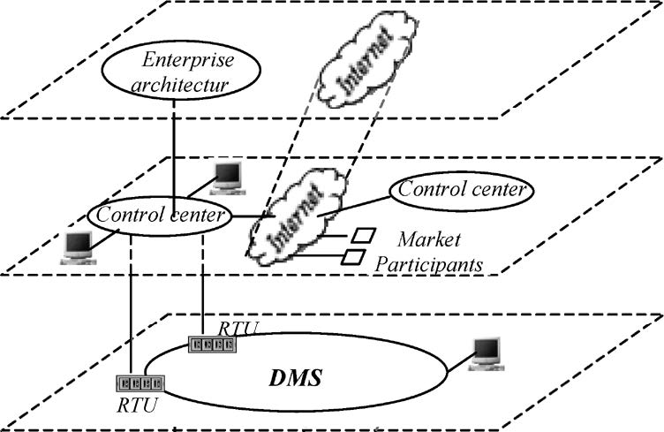
Integration Needs of Control Centers
  CCs have to integrate in new ways
    Vertically (both above and below)
    Horizontally (new!)
  E.g., NASPI (North American Synchrophasor Initiative) and similar emerging

Slide 21
Modern Distributed Control Centers (VI)
Distributed Computing System: system where apps and services are spread out over multiple computers that communicate only via message passing
  I.e., no shared memory
  A centralized EMS and BMS suite in one room matches (oops)
Better definition/term: decentralized
  E.g., distributed control logic pushed out of substation
  E.g., RAS/SPS/SIPS not in CC or otherwise centralized
Current trends in distributed control systems
  Separation of “SCADA” (data acquisition), EMS, and BMS
  IP-based distributed SCADA (DNP3)
  Standard (CIM)-based distributed data processing
  Middleware-based distributed EMS and BMS apps

Slide 22
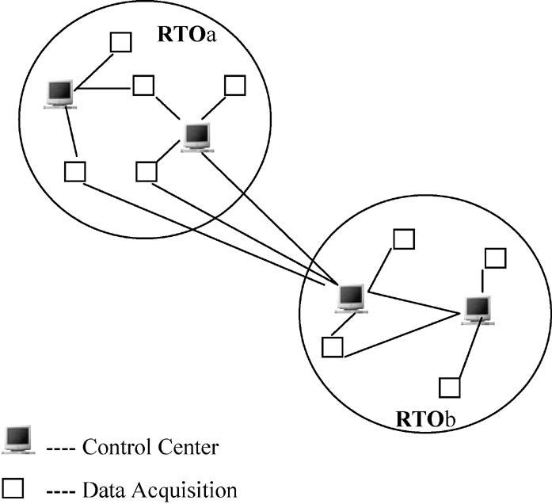
Distributed Data Acquisition
  Data acquisition not tightly coupled with EMS
    Now: IP/DNP3 “SCADA”
    Soon: NASPInet

Slide 23
Future Control Centers (VIII)
Data acquisition: much higher amount & range of
  Rate of collection
    DFRs: 720+ Hz
    F/Net: 1440 Hz
    Some home sensor apps ~5K Hz; broader uses?
  Latency required
  Criticality of application
  Quantity of data Geographic distance shared over
  Degree of sharing (#subscribers) per sensor
➔ Far from “one size fits all” data acquisition and delivery!

Slide 24
Future Control Centers (cont.)
Security monitoring and control (SE, contingency analysis, etc) based on steady-state models
  Reason: inadequate data acquisition (mainly) and computational power in CCs
  Result: only preventative control
  Possible: analytical tool for emergency control by system operators (or DHS/NERC?) ….

Slide 25

Future Control Centers (cont.)
This (and much more) possible by
  Cleanly decomposed and packaged application logic
  Separate management of data acquisition, managing computational resources, information security, etc.
    Cloud computing (“grid services” in paper)
    New ARPA-E project GridCloud with Cornell and WSU
  Let the power folks and ICT folks both do what they are good at!
    Clean separation enables new tech. (apps & ICT) to developed faster)
    It worked for the internet!
      Though it now needs QoS+ at the waist
email WWW phone...
SMTP HTTP RTP...
TCP UDP…
IP
ethernet PPP…
CSMA async sonet...
copper fiber radio...

Slide 26

The Brave New World
Cloud computing (IF made mission critical!) enables
  Greatly expanded applications (and app providers)
  Federations of enterprise grids, ancillary services, …
  Dynamic sharing of computational resources of all IEDS
  Distributed services for data acquisition and data processing (aggregation, error collection, etc)
  Distributed control center apps expressed in terms of layers and services (~SOA)
  Use of standard cloud computing architectures and tools to manage ICT resources
  “I don’t think we’re in Kansas anymore, Toto.” - Dorothy
“I don’t think we’re in Kansas
anymore, Toto!”
Opportunities abound for a lot of fun and impact for newly-minted EE and CS grads working in this field!

