Slide 1
Critical Infrastructure Security: The Emerging Smart Grid In Class: Cpt S 580-03, Cpt S 483-01, EE 582-02, EE 483-01 Online or Tri-Cities: Cpt S 580-03, Cpt S 483-01, Cpt S 483-02, EE 582-01, EE 483-01
Dr. Anurag K. Srivastava, Dr. Carl Hauser, Dr. Dave Bakken,
and Dr. Min Sik Kim
Computation Lecture 4: Overview of Distributed Computing (1/2)

Slide 2
Today’s Content
Administrivia
Intro to Distributed Computing
Example Local vs. Remote Procedure Call
Examples (1.2)
Trends (1.3)
Focus on Resource Sharing (1.4)

Slide 3
Administrivia
Computation segment HW coming out very soon

Slide 4
Today’s Content
Administrivia
Intro to Distributed Computing
Example Local vs. Remote Procedure Call
Examples (1.2)
Trends (1.3)
Focus on Resource Sharing (1.4)

Slide 5
Introduction
A distributed system is “one in which hardware or software components located at networked computers communicate and coordinate their actions only by message passing”
Very broad definition
Lots of examples
Lots of kinds
Abbreviations
“Distributed System” by “DS”,
“Distributed Computing” is “DC”
“You know you have one when the crash of a computer you’ve never heard of stops you from getting any work done.” Leslie Lamport

Slide 6
Advantages of Distributed Systems
Share resources (key)
Share devices
Better hardware cost/performance than supercomputers, multiprocessors
Allows access from many remote users using their simple PCs (and mobile devices)
Allows for incremental growth (if done right)
Increases reliability and availability (if done right)
Some applications and services are inherently distributed
Can spread the load of a given service much more easily
Can potentially increase security (!!!???)

Slide 7
Consequences of Distributed Systems
Concurrency
Concurrent use of low-level resources: processing, storage (memory+disk), communications
Mutual exclusion and other synchronization required
Access to resources for a given user often best-effort
No global clock
Cannot often know the exact ordering of events: which happened first
Independent failures
No longer “all or none” failures for your program!
Some computers still running, while others failed or partitioned
Failure of a component you are using may not be a clean failure
Variability
Performance of resources (network, CPU, storage) may vary widely across a remote call chain

Slide 8
Today’s Content
Administrivia
Intro to Distributed Computing
Example Local vs. Remote Procedure Call
Examples (1.2)
Trends (1.3)
Focus on Resource Sharing (1.4)

Slide 9
Example Local Call
Callee:
// declare and init stuff
int util:sort(int [] a, int max) {
// implementation of sort...
return status;
}
Caller:
// declare and init stuff
x = new int [100];
y = new util;
flag = y.sort(x, 100);
Potential assumptions:
Procedure call conventions between caller (“client”) and callee
In same address space (on same computer)
In same programming language (usually)
Written by same programmer (often, not always)
Same operating system for both caller and callee
Same CPU type for both caller and callee
Can transfer data and control quickly, effectively in zero time
Both fail, or neither do (for the most part)
None of these assumptions are always true in a distributed system!

Slide 10
Example Remote Call
Callee:
// declare and init stuff
int util_impl:sort(int[] a, int max){
// implementation of sort
return status;
}
Caller:
// declare and init stuff
x = new int [100];
Y = new util.bind();
Flag = y.sort(x, 100);
…
// “proxy” or “stub”
// generated by middleware
int util:sort(int [] a, int max){
// put a[], max into struct
// send message with struct
// “skeleton” generated
// by middleware compiler
…
// receive message with struct
// copy from struct to a[], max
flag = z.sort(a, max)
// receive message w/ struct
// copy from struct to a[],
// status
return status;
}
// copy a[], flag into struct
// send message with struct
…

Slide 11
Many Local Call Assumptions do not Hold!
Not a local procedure call, so need more help
Not in same programming language (can’t assume this)
Not written by same programmer
Not running same operating system for caller and callee
Not same CPU type for caller and callee
Not always in the same administrative domain
Latency for transfer of control and data can be large and, worse, unpredictable
Partial failures
Membership of the system (the computers in its collection) can change
Unreliable or insecure communication

Slide 12
Bottom Line on Distributed Systems
I don’t think we are in Kansas anymore, Toto!
Goal of this segment: fully understand of:
How and why you are no longer in Kansas
Where to dig more to find info about what you can do about it!

Slide 13
Today’s Content
Administrivia
Intro to Distributed Computing
Example Local vs. Remote Procedure Call
Examples (1.2)
Trends (1.3)
Focus on Resource Sharing (1.4)

Slide 14
Figure 1.1 Selected app domains and associated networked apps
Finance and commerce | eCommerce e.g. Amazon and eBay, PayPal, online banking and trading
The information society | Web information and search engines, ebooks, Wikipedia; social networking: Facebook and MySpace.
Creative industries and entertainment | online gaming, music and film in the home, user-generated content, e.g. YouTube, Flickr
Healthcare | health informatics, on online patient records, monitoring patients
Education | e-learning, virtual learning environments; distance learning
Transport and logistics | GPS in route finding systems, map services: Google Maps, Google Earth
Science | The Grid as an enabling technology for collaboration between scientists
Environmental management | sensor technology to monitor earthquakes, floods or tsunamis
Instructor’s Guide for Coulouris, Dollimore, Kindberg and Blair, Distributed Systems: Concepts and Design Edn. 5 © Pearson Education 2012

Slide 15
E.g., Google Infrastructure
Underlying physical infrastructure: huge number of networked computers at data centers all over the world
Distributed file system
Designed for very large files
Heavily optimized for style of usage by google apps (high rates)
Associated structured distributed storage system: fast access to very large datasets
Lock service: distributed locks and agreement
Programming model supporting managing very large parallel distributed computations across infrastructure

Slide 16
Massive Multiplayer Online Games (MMOGs)
Widely-spread users interacting via a persistent virtual world
Huge challenge to engineer
Fast response times for a user’s actions
Scalability
Propagating updates to other users
Consistency
Number of solution kinds
Client-server: single state in one location (clever server)
Distributing state to many servers (allocate users by usage patterns)
Research into more radical: peer-to-peer

Slide 17
Financial Trading
HUGE amount of money traded automatically
Ergo on the cutting edge of distributed systems technology
E.g., share prices, trends, economic and political development, …
Subscribe to items of interest, an event
Publish-subscribe
Distributed event-based systems

Slide 18
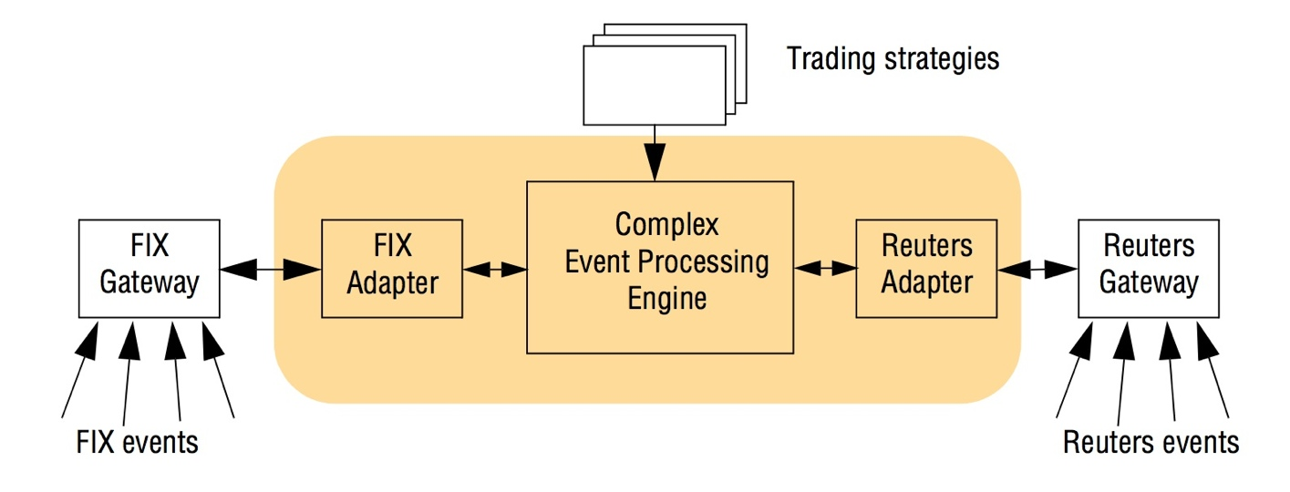
Fig. 1.2 An example financial trading system
CEP: compose event occurrences into logical, temporal, or spatial patterns
Trading strategies NOT hard coded into the architecture!
Looking for patterns that indicate a trading opportunity
Instructor’s Guide for Coulouris, Dollimore, Kindberg and Blair, Distributed Systems: Concepts and Design Edn. 5 © Pearson Education 2012

Slide 19
Trading strategies example
WHEN
MSFT price moves outside 2% of MSFT Moving Avg
FOLLOWED-BY (
MyBasket moves up by 0.5%
AND
HPQ’s price moves up by 5%
OR
MSFT’s price moves down by 2%
)
)
ALL WITHIN
any 2 minute time period
THEN
BUY MSFT; SELL HPQ

Slide 20
Today’s Content
Administrivia
Intro to Distributed Computing
Example Local vs. Remote Procedure Call
Examples (1.2)
Trends (1.3)
Focus on Resource Sharing (1.4)

Slide 21
Mobile and ubiquitous computing
Computing devices smaller and smaller…
Laptops
Handhelds
Wearable & implantable devices
Embedded in appliances
Mobile computing: performing tasks when not at “home”
Includes location-aware or context-aware
Ubiquitous computing: harnessing lotsa small and cheap devices in user’s environment
Useful only when they can communicate!
Some overlap, but distinct areas mostly

Slide 22
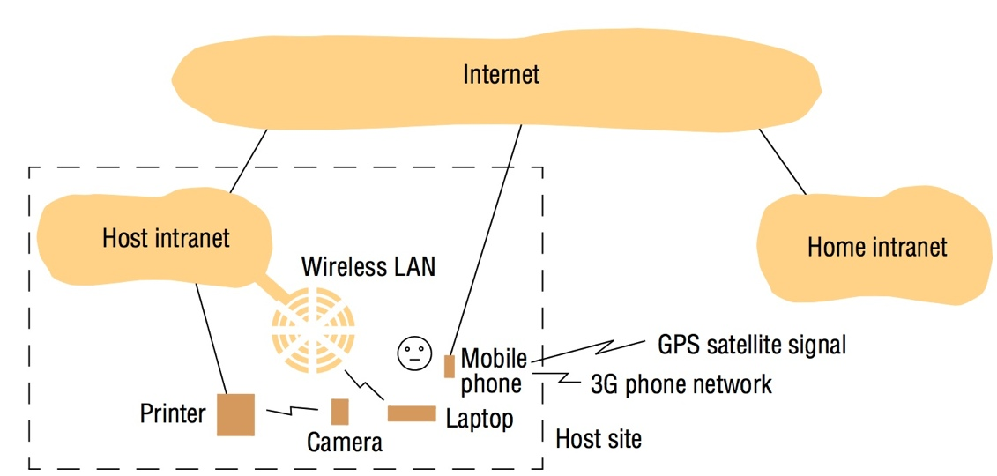
Figure 1.4 Portable and handheld devices in a distributed system
With right toys, can get lotsa work done away from “home”
Support spontaneous interaction! Service discovery
Instructor’s Guide for Coulouris, Dollimore, Kindberg and Blair, Distributed Systems: Concepts and Design Edn. 5 © Pearson Education 2012

Slide 23
Distributed multimedia systems
DEFN: Support range of media types in integrated manner
Always includes a temporal dimension & preserving relationships (“continuous media”)
Access to huge amount of rich info (compared to text/html)
Places huge demands on distributed infrastructure:
Support extensible range of encoding and encryption formats
Provide range of mechanisms to meet user’s quality of service (QoS)
Provide appropriate resource management strategies incl. sched.
Provide adaptation strategies when QoS cannot be met

Slide 24
Distributed computing as a utility
Grid Computing (e.g., Globus) ➔ Cloud computing
Tries to tread distributed resources as a commodity or utility
Analogies from power grid, networking cloud
Applies to
Physical resources: storage, processing …. Often virtualized
Software services: email, calendars,
(Seehttp://blogs.computerworld.com/18768/cloud_computing_philosophy)
Clouds usually implemented on (huge) clusters
Example: Quincy, Washington & Grand County PUD

Slide 25
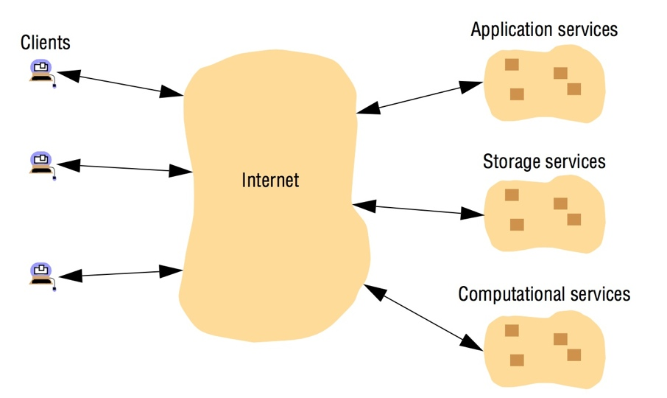
Figure 1.5 Cloud computing
Instructor’s Guide for Coulouris, Dollimore, Kindberg and Blair, Distributed Systems: Concepts and Design Edn. 5 © Pearson Education 2012

Slide 26
Today’s Content
Administrivia
Intro to Distributed Computing
Example Local vs. Remote Procedure Call
Examples (1.2)
Trends (1.3)
Focus on Resource Sharing (1.4)

Slide 27
Focus in resource sharing
Users (and app programmers) want to share higher-level resources, not lower-level ones
Computer-supported cooperative work (CSCW): docs
Service: distinct part of a computer system that
Manages a collection of related resources
Presents their functionality to users & apps (restricted access)
Server: a running program (or computer) on a network that
Accepts requests from programs on other computers
Performs a service
Responds accordingly
Client (object), server (obj), client-server, remote invocation
Calls can be nested!

Slide 28
Today’s Content
Administrivia
Intro to Distributed Computing
Example Local vs. Remote Procedure Call
Examples (1.2)
Trends (1.3)
Focus on Resource Sharing (1.4)
Bonus (if time): Parallel vs. Distributed computing

Slide 29
Comparison: DC and Parallel Computing
(Note: material from: Claudia Leopold, Parallel and Distributed Computing: A Survey of Models, Paradigms, and Approaches, John Wiley and Sons, 2001)
Common characteristics
Multiple processors are used
Processors interconnected by some “network”
Multiple computational activities (processes) are in progress at the same time and cooperate with each other
Some consider parallel computing a subfield of DC!
Very different….. (e.g., 1995 Kuwait PDC panel)
Parallel computing splits an application up into tasks that are executed at the same time, whereas distributed computing splits an application up into tasks that are executed at different locations using different resources.

Slide 30
Differences: DC and Parallel Computing
Parallel Computing puts emphasis on the following:
An application is split into subtasks that are solved simultaneously, often in a “tightly coupled” manner
One application is considered at a time, with the goal of speeding up the processing of that single application
Programs are generally run on homogeneous architectures, which typically have shared memory
Fault tolerance and security are not generally considered

Slide 31
Differences: DC and Parallel Computing (cont.)
Distributed Computing puts emphasis on the following:
Computation uses multiple resources physically separated: processors, memory, disk, databases
Multiple applications run at a time for many users
Heterogenous systems, open and dynamic
No shared memory, at least not in hardware
Fault tolerance and security must be dealt with (in some manner)
Sometimes the emphasis is on hiding system internals in a manner that the distributed system looks like a single large machine. Feature called a single system image, used in cluster computing.

Slide 32
Convergence of DC and Parallel Computing (maybe, eventually)
Architectures (vaguely) approaching each other
Fast network technologies allow cluster computing
Parallel machines increasingly used as servers in a DS
Parallelism and distribution are closely related
Main differences in distribution: variable delays and partial failures
Some joint meetings of parallel and distributed researchers

