Slide 1
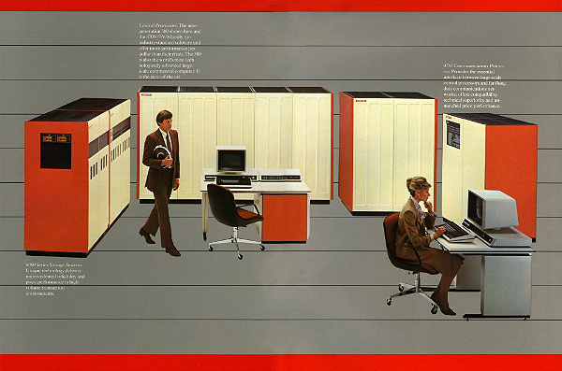
Unix access in the 1970s-1980s
Each monitor+keyboard directly connected to server HW (serial line)
Multi-user
Program on mainframe that lets you “talk” to Unix via your keyboard is “shell”
Monitor is very low level
No graphics at all
Just displays characters
(Courtesy Amdahl Corp)

Slide 2
Unix Access today: ssh program
Takes input from your keyboard and sends to shell process on Linux machine
Displays characters sent to it by the shell process
Communicates via standard TCP/IP network protocol
Talks via a server-side piece of ssh that connects it to a shell process (probably creating one at beginning)

