Slide 1
VIM - Vi IMproved
Bryce Handerson
Notes:
Hello, I’m Bryce Handerson, I am treasurer of the LUG and a senior CS major.

Slide 2
History
VI - 1976
Bill Joy
Vim - 1991
Bram Moolenaar
Charityware
Ugandan children
Notes:
So Vim all started from VI vi was released in 1976 as part of freeBSD to replace ed which was written for teletypes so that they could use display terminals
Bram Moolenaar wrote it to be a more full featured text editor and allow pretty much any customizable thing you can think of to work
He released it in 1991 as charityware with the charity being donations to Ugandan children

Slide 3
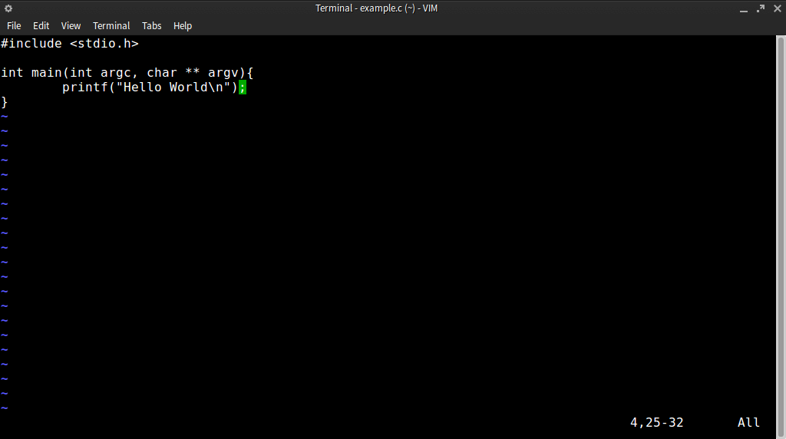
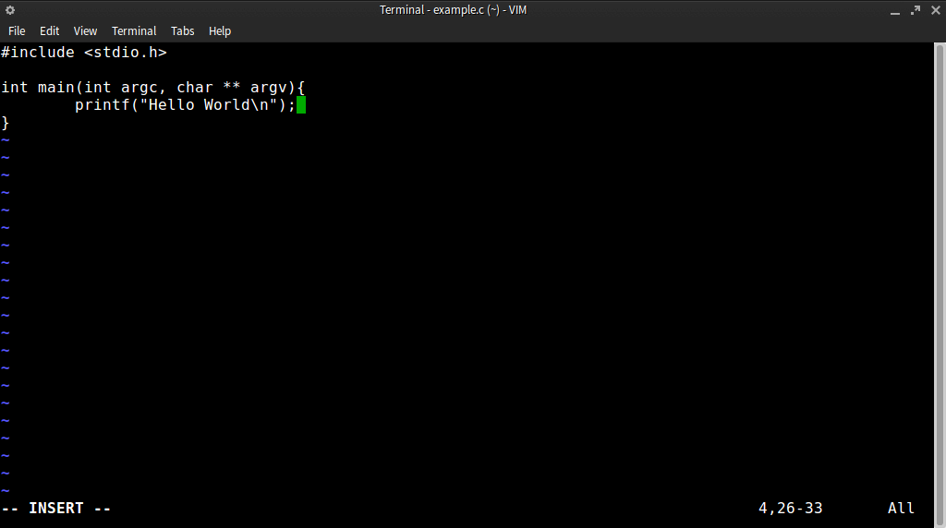
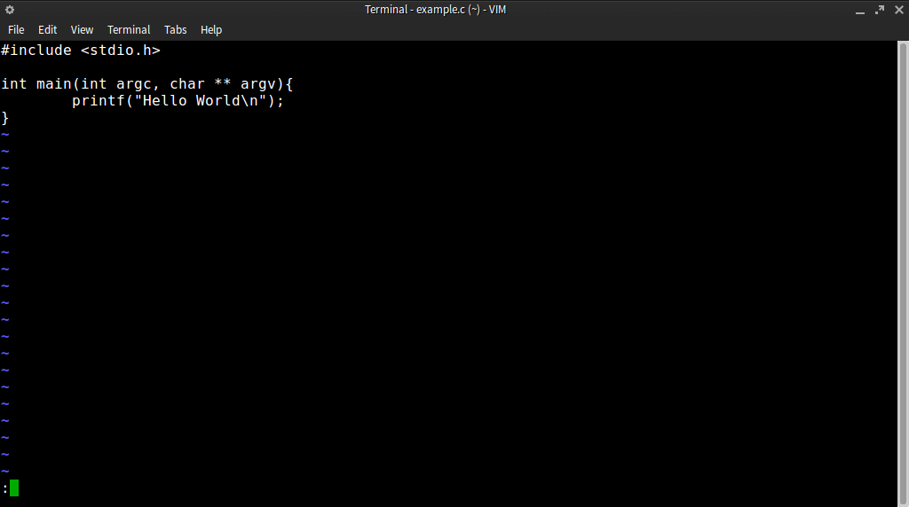
Modes
Normal
Insert
Command
Notes:
Unline other text editors like Notepad++ emacs and sublime, Vi and VIM are mode based text editors
there are essentially three different modes the user can be in to accomplish certain tasks.
Normal mode is where you navigate around the file and can run basic keyboard bindings
Insert mode is exactly like you would think it is, you insert text like you would in a non mode text editor
Command mode is where you run non keyboard bound commands such as help or quit and any other command.

Slide 4
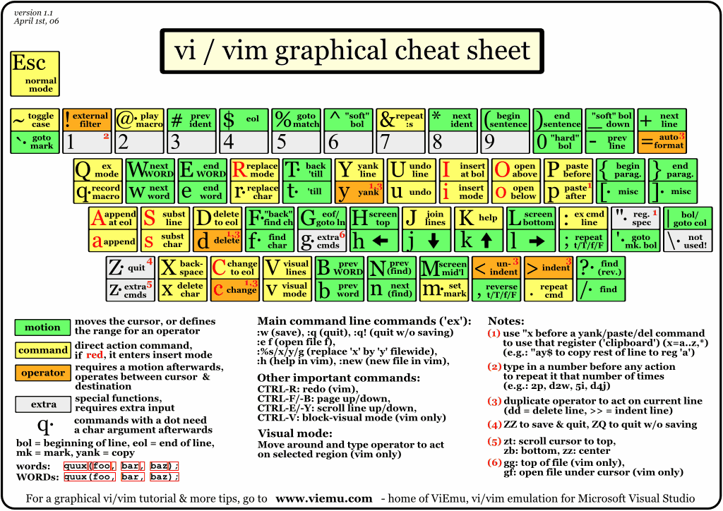
Why three modes?
Notes:
Because there are so many cool things about vim there isn’t enough room in one mode to store it all the whole point of vim is to keep your fingers on the keyboard and not have to move very much at all
If you have ever spent a whole day writing code you will know that after awhile your wrists and forearms get sore, this can lead to other problems such as carpal tunnel and rsi

Slide 5
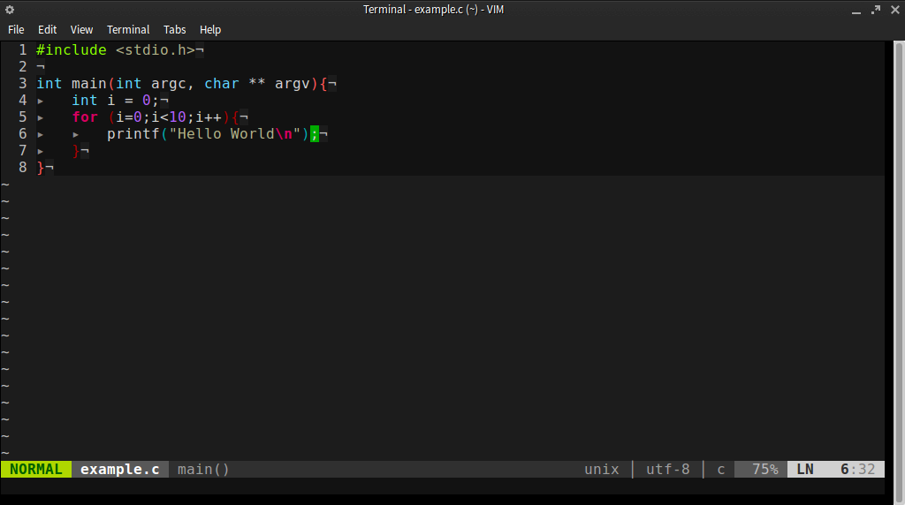
Vimrc file
Notes:
With your vimrc file you can turn boring white text into a clean easy to read colorful informative text editor

Slide 6
What can I do with my vimrc
Vimscript
Plugins
Bundling
Bindings
Shortcuts
Auto formatting
Colors!

Slide 7
Package manager
vim-addon-manager
Pathogen
Vundle (my favorite)
Notes:
Vim - addon - manager is a command line plugin manager ran outside of vim
Pathogen is an older manager which finds the plugins in a certain directory and adds them
Vundle is a plugin in itself where you just put which plugins you want in your vimrc

Slide 8
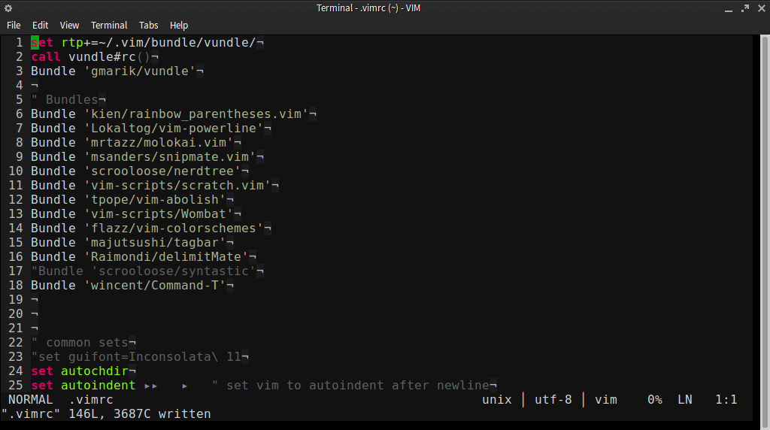
Vundle Bundles

Slide 9
Basic normal mode commands
<esc>
i and I
a and A
u and U
<ctrl> r
Notes:
escape is how to get out of a mode you are in, you cannot leave normal mode this is the default mode
lowercase i is insert where your cursor is exactly
Uppercase I is insert at the beginning of the text on the line
lowercase a is insert after the character you are hovering over with your cursor
uppercase A is insert at end of line this can be useful to find bad whitespace if you don’t highlight it
u is undo last action
U is undo last action on that line only
ctrl r is redo

Slide 10
Tour through my .vimrc

Slide 11
lug.wsu.edu
lug-announce@lists.wsu.edu
These Slides: http://goo.gl/VzwoIC
Making The Switch, Linux http://goo.gl/EazMA
http://github.com/bhanderson/dotfiles

