Slide 1
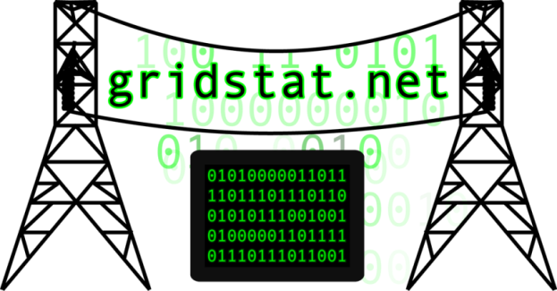

Towards More Effective & Resilient Power Apps
Exploiting Better Comms. & Computation
Prof. Dave Bakken
School of Electrical Engineering and Computer Science
Washington State University
Pullman, Washington, USA
Grenoble INP
Grenoble, France
16 December 2019
Notes:
1

Slide 2

Big Picture
Electric grids are getting more stressed each year
  Transmission line growth inadequate
  New kinds of generation to integrate (solar, wind, …)
  Semi-independent microgrids
  “Prosumers” producing electricity at the distribution edges
  Chance or cyber or physical attacks
  Imperfect/incomplete modeling everywhere
Better Comms & Computation can greatly mitigate the above

Slide 3
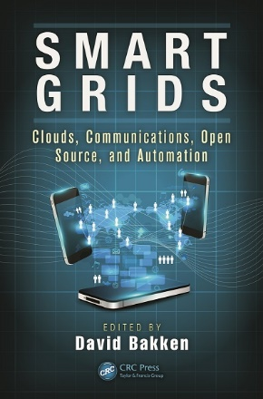
Context
IANAPP (power person): Computer Scientist
  Core background: fault-tolerant distributed computing
  Research lab experience (BBN) with wide-area middleware with QoS, resilience, security, …. for DARPA/military
  Working with Anjan Bose since 1999 on wide-area data delivery issues appropriate for RAS and closed-loop applications
    GridStat (1999-present)
    GridSim (2009-2014)
    GridCloud (2012-present)
    DCBlocks (2014-present)
May, 2014 | ISBN: 1482206110

Slide 4
So what do I REALLY do?
From my too-long, smart aleck email .signature:
WSU GridStat Project: Since 1999, cheerfully and audaciously dragging the wide-area data delivery services of the electric power grid -- kicking and screaming -- into the mid-1990s. ETA: 2020-2025 for 10% penetration of mid-90s technology & 2045 for 50% penetration of (then) some half-century-old ICT technology.

Slide 5
Sources of Info (1)
D. Bakken, A. Bose, C. Hauser, D. Whitehead, and G. Zweigle. “Smart Generation and Transmission with Coherent, Real-Time Data. Proceedings of the IEEE, 99(6), June 2011.
David E. Bakken, Richard E. Schantz, and Richard D. Tucker. “Smart Grid Communications: QoS Stovepipes or QoS Interoperability”, in Proceedings of Grid-Interop 2009, GridWise Architecture Council, Denver, Colorado, November 17-19, 2009. Online http://gridstat.net/publications/TR-GS-013.pdf.
  Best Paper Award for “Connectivity” track. This is the official communications/interoperability meeting for the pseudo-official “smart grid” community in the USA, namely DoE/GridWise and NIST/SmartGrid.

Slide 6
Sources of Info (2)
ToSG-Workshop.org
Chapters in D. Bakken and K. Iniewski, ed. Smart Grids: Clouds, Communications, Open Source, and Automation, CRC Press, May 2014, ISBN 9781482206111.
  G. Zweigle, “Emerging Wide-Area Power Applications with Mission Critical Data Delivery Requirements”.
  D. Bakken et. al. “GridStat: High Availability, Low Latency and Adaptive Sensor Data Delivery for Smart Generation and Transmission.”
  T. Gamage et. al. “Power Application Possibilities with Mission Critical Cloud Computing.”

Slide 7
Outline
Questions for Power Engineers & Researchers
WAN Apps with Extreme Comms Requirements
IT Guidelines for Achieving these Requirements
GridStat: Industrial Internet for Electricity (IIE)
GridStat Cyber-Physical Example
Cyber-Security for Closed-Loop Apps
Optional Backup
  GridSim & GridControl Brief Overviews
  Killer Apps for Cloud Computing
  A Distributed Computing Critique of Some Power Protocols: IEC 61850(-90-5), MPLS, …
  Why Middleware is Needed for IIE

Slide 8
A Crucial and Wide Open Issue
How do anomalies in ICT affect power “stability”?
Wide open: almost completely unstudied ☹
  Lars Nordstöm of KTH best power researcher at this
  Still a huge opportunity for research topics!
Trying here to plant seeds to break chicken-egg
  Power researchers can assume much “better” data delivery to come up with “better” apps
  Computer scientists can come up with even better data delivery but need to know killer app requirements and acceptable tradeoffs (there are always tradeoffs!)
  Data Analytics scientists can come up with better analytics given the tradeoffs and assumptions above

Slide 9
Comms Baseline: You Can Assume
Data delivery over WAN can be (with GridStat etc):
  Very fast: less than ~1 msec added to the underlying network layers across an entire grid
    Even in the presence of failures!.....
  Very available: think in terms of up to 5+ 9s (multiple redundant paths, each with the low latency guarantees)
  Very cyber-secure: for long-lived embedded devices and won’t add too much to the low latencies
    E.g., RSA adds >>60 msec so not for RAS or closed-loop
    Shared keys (61850-90-5): subscriber can spoof publisher ☹
    GridStat solution not vulnerable and only adds ~1msec
  Tightly managed for very strong guarantees (MPLS)
  Adaptive: can change pre-computed subscriptions ~INSTANTLY (and dynamic requests FAST)

Slide 10
Questions to Ask Yourself
So how can power researchers exploit this better communications infrastructure?
What rate and latency and data availability does my power app really need for remote data?
  Why fundamentally does it need that?
  How sensitive is it to occasional longer delays, periodic drops (maybe a few in a row), or data blackouts for longer periods of time?
Can I formulate & test hypotheses for the above?

Slide 11
Beyond Steady-State-Only Thinking
Previous is just for steady state: different in some contingency/mode situations?
How important is my app in that given contingency/mode, compared to other apps?
  E.g., simple “importance” number [0,10]
  How much worse QoS+ (latency, rate, availability) can I live with in steady state and in given contingencies?
    But would still get strong guarantees at that lower quality
    How much benefit do different levels really give me?
  Can I program my app to run at different rates, or is there a fundamental reason it has to run at one?
What extra data feeds (or higher rates etc) could I use in a contingency/mode (could get in << 1sec)

Slide 12
Bad Data
How vulnerable is my power app to bad data?
  State estimation obviously has handed for many decades
But
  How much bad data
  Does how much bad (grammar alert!)
  In what circumstances?
E.g. can I specify assumptions about bad data?
  Number: absolute or (better) as a function of the problem size (state/configuration/#PMUs/etc)
  Location and timing: randomly distributed or worst case?
  Error degree: randomly off (what probability distribution) or worst case (from an adversary)?

Slide 13
Bad Manners
How vulnerable is my power app or RAS scheme or stability assumptions to worst-case malicious behavior?
E.g. not just false data (which may be able to be detected) but taking over command of a relay or other devices
  How many of these, and of what kind, could cause problems?
Thinking cyber-physical here
  What are some worst case combinations of a physical attack (rifle, chaff, modifying sensors, ..) and a cyber attack (colluding customer meters, taking over relays, DDOS to throttle delivery of sensor data and commands,
  And worst case under what situations?

Slide 14
Bad Manners (cont.)
“The event I fear most is a physical attack in a successful cyber-attack in conjunction with responders' 911 system or on the power grid,”
  Ronald Dick, director of the FBI's National Infrastructure Protection Center, Washington Post, Front Page Article, June 27 2002, (emphasis added)

Slide 15
A Cloudy Forecast
What could I do with cloud computing, assuming it is made mission critical, i.e.:
  Keeps same fast throughput
  Does not allow deliberate “inconsistencies”
    e.g., a replica does a state update never received by others
  Is much more predictable with CPU perf., ramp-up time, …
  (BTW, ARPA-E GridCloud proj. w/Cornell+WSU doing for >2 years)
    Pilot starting with ISO-New England, likely others soon
  Not all CPUs in datacenter, some (managed) in substations… (Cisco Fog?)
How could I use
  Tens/Hundreds of processors in steady state
  >>Thousands when approaching/reaching contingencies
  Data from ALL participants in a grid enabled quickly when approaching a crisis
More in the “Killer Apps” discussion in the backup slides

Slide 16
CIP-Managed Compute+Comms+Security
Computations + communications + security can be
  Mission critical to power grid specs
    Closed-loop WAN app requirements WAY harder than air traffic control, railways, military, …
  Changed rapidly in a coordinated manner
    Providing app developers much higher-level building blocks
  Managed in a network operations center 24x7
    Much like a power control center!!!
    Needed if power grid stability really does depend on comms and computation and cyber-security
    No more hard-coded and unmonitored comms infrastructures causing headaches when glitches occur!

Slide 17
Outline
Questions for Power Engineers & Researchers
WAN Apps with Extreme Comms Requirements
IT Guidelines for Achieving these Requirements
GridStat: Industrial Internet for Electricity (IIE)
GridStat Cyber-Physical Example
Cyber-Security for Closed-Loop Apps
Optional Backup
  GridSim & GridControl Brief Overviews
  Killer Apps for Cloud Computing
  A Distributed Computing Critique of Some Power Protocols: IEC 61850(-90-5), MPLS, …
  Why Middleware is Needed for IIE

Slide 18
Wide Range of QoS+ Requirements
QoS+:
  network/middleware “QoS” (latency, rate), availability/criticality
  Also things an implementer/deployer of WAMS-DD¹ needs to know: geographic scope, quantity.
Comparing Apples and Apples:
  Normalize each from 1 (very easy) to 5 (very hard)
Wide ranges
  Across application families
  Sometimes within them (each configuration is different)
¹WAMS-DD≡WAMS Data Delivery

Slide 19
Normalized Values of Parameters
Difficulty (5 is hardest) | Latency (ms) | Rate (Hz) | Criticality/ Availability | Quantity | Geography
5 | 5-20 | >240 | Ultra | Very High | Across grid or multiple ISOs/RTOs
4 | 20-50 | 120- 240 | Very High | High | With an ISO/RTO
3 | 50-100 | 30- 120 | High | Medium | Between a few utilities
2 | 100-1000 | 1-30 | - | Low | Within a utility
1 | >1000 | - | - | Very Low | Within sub.

Slide 20
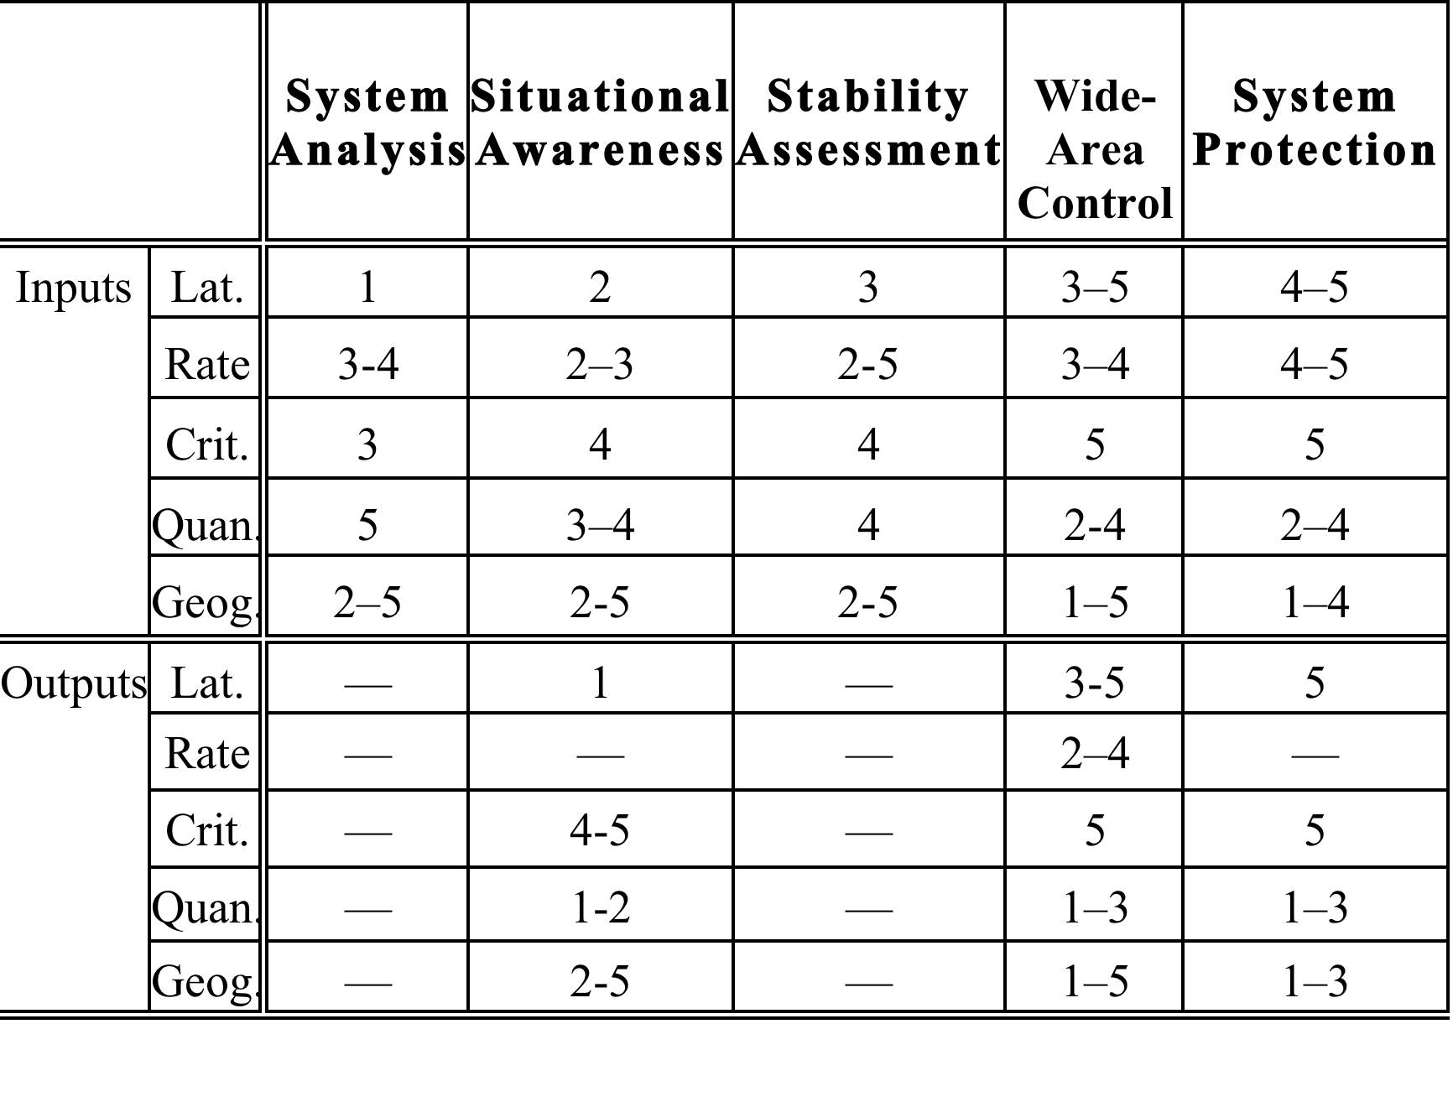
Diversity of Extreme Apps

Slide 21
Outline
Questions for Power Engineers & Researchers
WAN Apps with Extreme Comms Requirements
IT Guidelines for Achieving these Requirements
GridStat: Industrial Internet for Electricity (IIE)
GridStat Cyber-Physical Example
Cyber-Security for Closed-Loop Apps
Optional Backup
  GridSim & GridControl Brief Overviews
  Killer Apps for Cloud Computing
  A Distributed Computing Critique of Some Power Protocols: IEC 61850(-90-5), MPLS, …
  Why Middleware is Needed for IIE

Slide 22
Internet vs. NASPInet/WAMS-DD
Characteristic | Internet | NASPInet/WAMS-DD
Network Size | ~10⁹ hosts worldwide | 10⁵ hosts on a grid, 10³⁻⁴ “routers”
Per-Flow State | Death (RIP RSVP) | Very feasible
Network Design Goal | Best-effort delivery for any user and purpose | Strong guarantees of QoS+ in several dimensions for grid-specific users and purposes
Admission Cntl Perimeter | None | Complete
Fraction of Managed Traffic | None/Very Little | Almost all. All traffic subject to policing. >>90% periodic.
Central Knowledge of Topology | Not attempted: large scale and dynamicity | Feasible: small scale and relatively slow changes
Topology changes (w/o failures) | Often & without warning | Not often & virtually always with warning
Frequency of Route Changes | Frequent; can converge slowly | Infrequent ➔ use static topo.

Slide 23
Internet vs. NASPInet/… (cont.)
Characteristic | Internet | NASPInet/WAMS-DD
Latency Achievable | Slow to Medium | Very fast
Latency Predictability | Poor | Very Good to Excellent
Recovery Delay after dropped packet (with “reliable” delivery)¹ | High (timeout waiting for data or acknowledgement; then two one-way msgs) | Zero (redundant copies sent over disjoint paths arrives virtually at same time) ➔ DO NOT USE post-error recovery, be proactive!
Forwarding Unit | Uninterpreted packet | Update of a sensor variable
Traffic Predictability | Low | Very High
Elasticity of QoS requirements | None/Low | Potentially Medium-High (if power apps programmed per previous questions)
¹I.e., latency in the case of a failure, which is what ultimately needs to be “guaranteed”

Slide 24
Other IT Guidelines for WAMS-DD
Don’t depend on priority-based “guarantees” (including “fairness”) for hard real-time
  They really don’t guarantee anything!
  This rules out MPLS (but 6 classes is worse for MPLS…)
Exploit a priori knowledge of traffic
Optimize for rate-based sensor updates
Use static, not dynamic, routing
  Can still have adaptations to update routing tables
Reject unauthorized messages quickly & locally
Provide per-subscriber QoS+ (IP Multicast)
Don’t over-design consistency and (re)ordering

Slide 25
Outline
Questions for Power Engineers & Researchers
WAN Apps with Extreme Comms Requirements
IT Guidelines for Achieving these Requirements
GridStat: Industrial Internet for Electricity (IIE)
GridStat Cyber-Physical Example
Cyber-Security for Closed-Loop Apps
Optional Backup
  GridSim & GridControl Brief Overviews
  Killer Apps for Cloud Computing
  A Distributed Computing Critique of Some Power Protocols: IEC 61850(-90-5), MPLS, …
  Why Middleware is Needed for IIE

Slide 26
Middleware in One Slide
Middleware == “A layer of software above the operating system but below the application program that provides a common programming abstraction across a distributed system”
Middleware exists to help manage the complexity and heterogeneity inherent in distributed systems
Middleware provides higher-level building blocks (“abstractions”) for programmers than the OS provides
  Can make code much more portable
  Can make them much more productive
  Can make the resulting code have fewer errors
  Programming analogy — MW:sockets ≈ HOL¹:assembler
Considered best practices in other industries for 15-20 years! (Ouch!)
¹HOL≡Higher Order Language

Slide 27
What is GridStat?
Bottom-up re-thinking of how and why the power grid’s real-time data delivery monitoring services need to be
Comprehensive, ambitious WAMS-DD middleware for power grid in coding since 2001
  Rate-based publish-subscribe middleware with
    Predictably low latency
    Predictably high availability
    Predictable adaptation
  Different subscribers to same variable can get different QoS+ {rate, latency, #paths}
Influencing (glacial) NASPInet “effort”
Notes:
9

Slide 28
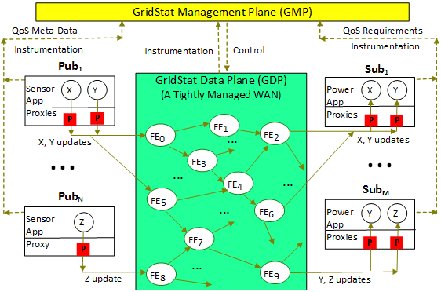
GridStat: Rate-Based Forwarding
Note: GMP, not programmer, finds paths

Slide 29
What Really is GridStat?
GridStat at two layers
  APIs & services (including management, monitoring, …) at edges (e.g., last DNMTT comment)
    I.e., Middleware overlay with mechanisms only at edges (P2P)
  Augmented with core software defined network (SDN) utilizing rate-based, in-network router-like Layer-3 forwarding engines (FEs)
    Also then richer management that exploits them
Even with only 10% penetration of FEs you have much more control and monitoring over data delivery, and at fine granularity
Notes:
9

Slide 30
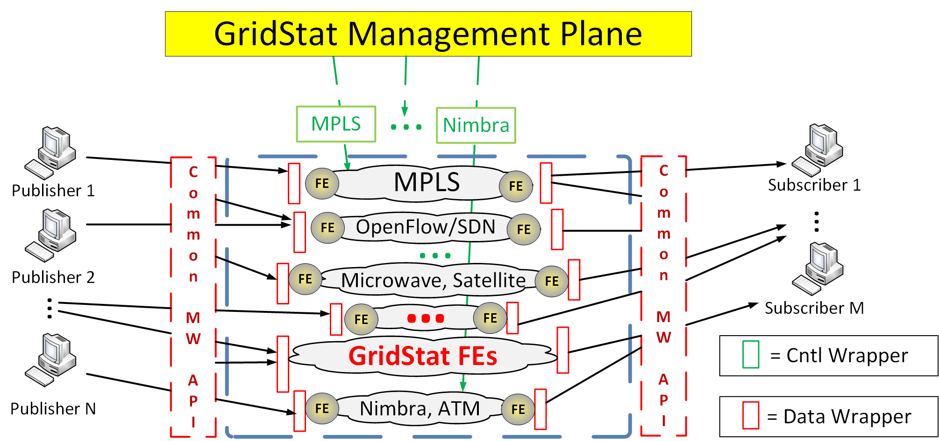
Overlay Middleware Integrating Legacy (Sub)Systems
Flow start (publisher) could also be RTU, substation router, OpenPDC, etc. i.e. not just a single sensor.
GS subscriber could be RTU, substation router, OpenPDC, …
GridStat is
Real-Time
Overlay (sometimes)
Middleware
“…” could be BPL/PLC, 4G teleco, 801.1TSN, even best-effort internet, etc.

Slide 31
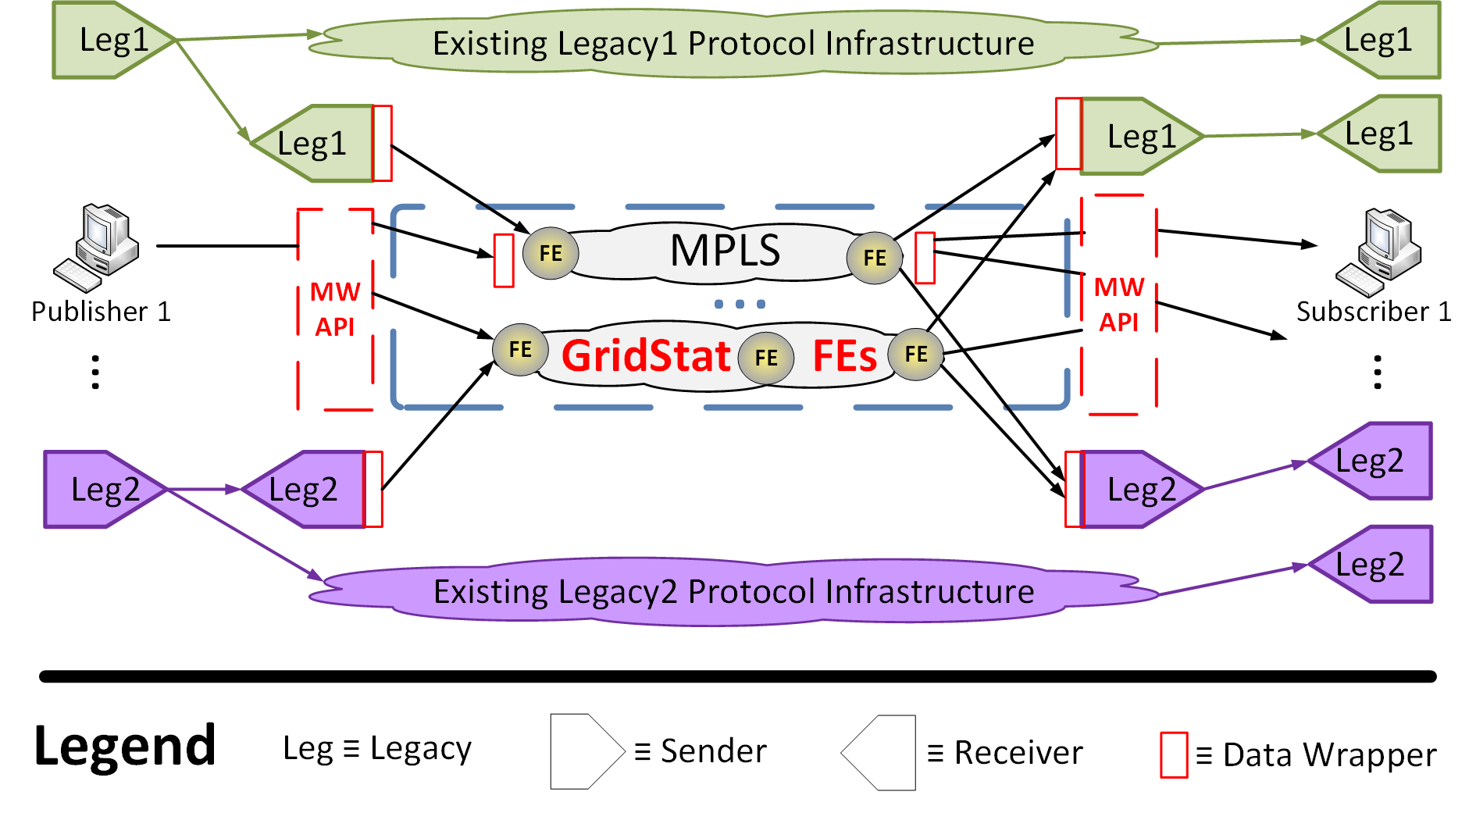
Getting There from Here
Issue: how to integrate existing legacy protocols and transition to newer ones and not break apps’ data delivery?

Slide 32
Overview of GridStat Implementation & Perf.
Coding started 2001, demo 2002, real data 2003, inter-lab demo 2007-8
  But power industry moves very, very slowly……
    “Utilities are trying hard to be first to be second” Jeff Dagle, PNNL
    “Utilities are quite willing to use the latest technology, so long as every other utility has used it for 30 years” unknown
  And NASPI is pretty dysfunctional in a number of dimensions
Implementations
  Java: < 0.05 msec/forward, 500k+ forwards/sec
    Adds less than 1 msec over underlay network (fiber, etc) over entire grid
  C version should be 10X-20X faster (efficient I/O0
  Network processor: 2003 HW ~.01 msec/forward, >1M fwds/sec
    Current network processors are ~10x better, and you can use >1 …
  Future: ASIC (on a chip)
    Should be competitive w/IP routers in scale: doing much less, on purpose!
    Note: no need to use IP for core …… (ssshhhhh!): less jitter and likely more bullet-proof (no IP vulnerabilities)

Slide 33
Outline
Questions for Power Engineers & Researchers
WAN Apps with Extreme Comms Requirements
IT Guidelines for Achieving these Requirements
GridStat: Industrial Internet for Electricity (IIE)
GridStat Cyber-Physical Example
Cyber-Security for Closed-Loop Apps
Optional Backup
  GridSim & GridControl Brief Overviews
  Killer Apps for Cloud Computing
  A Distributed Computing Critique of Some Power Protocols: IEC 61850(-90-5), MPLS, …
  Why Middleware is Needed for IIE

Slide 34
GridStat Modes
Observation
  Path allocation algorithms complex, not for a crisis 10³+
  But power grid adaptations planned way ahead of time
GridStat supports operational modes
  Can switch (preloaded) forwarding tables very fast
  Avoids overloading subscription service in a crisis
  Can have modes for different contingencies/modes/etc
Notes:
28

Slide 35
Data Load Shedding
Electric Utilities can do load shedding (I call power load shedding) in a crisis (but can really hurt/annoy customers)
GridStat enables Data Load Shedding
  Subscriber’s desired & worst-acceptable QoS+ (rate, latency, redundancy) are already captured; can easily extend to add priorities (e.g., [0,10] above)
  In a crisis, can shed data load: move most subscribers from their desired QoS to worst case they can tolerate (based on priority, and eventually maybe also the kind of disturbance)
  Works very well using GridStat’s operational modes
  Note: this can prevent data blackouts, and also does not irritate subscribers
Example research needed: systematic study of data load shedding possibilities in order to prevent data blackouts in contingencies and disturbances, including what priorities different power apps can/should have…
Enables critical infrastructures: adapt data comms infrastructure to benign IT failures, cyber-attacks, power anomalies, changing req, …
Notes:
29

Slide 36
Multi-Level Contingency Planning & Adapting
Electricity example: Applied R&D on coordinated
    Power dynamics contingency planning
    Switching modes to get new data for contingency
    New visualization window specific for the contingency and its new sensor data
involving contingencies with
    Power anomalies
    IT failures
    Cyber-attacks
State of art and practice today: 1 & A only, offline
Very possible: {1,2,3} X {A,B,C} and online
Notes:
28

Slide 37
Outline
Questions for Power Engineers & Researchers
WAN Apps with Extreme Comms Requirements
IT Guidelines for Achieving these Requirements
GridStat: Industrial Internet for Electricity (IIE)
GridStat Cyber-Physical Example
Cyber-Security for Closed-Loop Apps
Optional Backup
  GridSim & GridControl Brief Overviews
  Killer Apps for Cloud Computing
  A Distributed Computing Critique of Some Power Protocols: IEC 61850(-90-5), MPLS, …
  Why Middleware is Needed for IIE

Slide 38
A Note on Closed-Loop Cyber-Security
Extra low added latency crucial for closed-loop apps
  Otherwise delivery latency too high to work
RSA is too slow (~60 msec on 2012-era PC)
Using shared key (publisher and its subscribers) has a serious security vulnerability publicized by WSU
  Nothing prevents a subscriber from spoofing a publisher
  Shared keys (and RSA) are the choices for IEC 61850-9005
  Example from 61850 workshop: presenter ducked out of next session after my pointing above out ☹
Real-time multicast authentication is an extremely hard problem (much harder than point-point)
Notes:
29

Slide 39
Overview of GridStat Cyber-Security
GridStat has been a founding member of TCIP and TCIPG centers for cyber-security for the grid, 2005+.
  Over $20M invested from NSF, DHS, DOE (also UIUC, others)
Stackable and changeable security modules at pubs and subs (2007)
  Long-lived required ability to change modules as crypto technology evolves
  Modules for encryption & authentication & obfuscation of data
Authentication of management plane entities pairwise (2009, 2011+)
Node security protecting data in management plane nodes (2012)
  Secure key storage (quorum based, Byzantine fault-tolerant, …) ProFokus
Notes:
29

Slide 40
GridStat Multicast Authentication
Researchers: Prof. Carl Hauser and Kelsey Cairns
Started with TV-OTS (Illinois), an experimental data authentication protocol that appears to fit PMU data delivery needs:
  Safe with Multicast (one-to-many) environments
  Low Latency
  Independently verifiable signatures
  Optimized for rate based communication (but not nearly fast enough for closed-loop apps with original TV-OTS)
Achieved by probabilistic security (not perfect security)
Notes:
29

Slide 41
GridStat Multicast Authentication (cont.)
DETERLab experiments:
  Measure signing and verification latency
  Test achieved security with Security Analyzer node
Low latency signing, lower latency verifying
Lossy network has negligible effect
Given message forgery probability ranging from 1.2e-7 to 9.6e-17
  Faster cases less secure
In tightly-controlled WAMS-DD: ~1 msec added
  Ergo GridStat+Security ≤ ~2 msec over fiber/underlay!
Notes:
29

Slide 42
Final Thoughts on GridStat Security
Would be very hard for an adversary to inject unauthorized traffic anyway even without authentication
  Has to know exactly where to insert
  Almost always would get dropped by next FE because not in forwarding table
Recent MS thesis (patented) on rate-based monitoring can make adversary’s job even harder
Notes:
29

Slide 43
Conclusions
Requirements for wide-area communications in the power grid is the most extreme of any critical inftastructure
GridStat is real-time pub-sub middleware designed to meet these needs
Power grid is great opportunity for computer scientists to have impact
  Takes many years of learning curve ☹
Notes:
29

Slide 44
Outline
Optional Backup
    GridSim & GridControl Brief Overviews
  Killer Apps for Cloud Computing
  A Distributed Computing Critique of Some Power Protocols: IEC 61850(-90-5), MPLS, …
  Why Middleware is Needed for IIE
  Ratatoskr RPC/GridStat with tuneable timeliness, redundancy, safety

Slide 45
TSAT
GridSim Overall Architecture
Measurement Generator
Static Data Generator
Simulated Power
System
GridStat
C37.118 Generator
FE
FE
Substation OM
Substation N
FE
FE
Substation OM
Substation Gateway
Substation SE
Substation OM
Substation Gateway
FE
Substation
Level
Simulation
Substation SE
FE
Substation OM
Substation Gateway
Substation 1
Substation SE
Substation OM
Substation Gateway
Substation 1
Substation SE
Substation 1
Substation Gateway
Substation SE
Substation 1
Substation 1
Oscillation Monitor
State Estimator
Control
Center
Level

Slide 46
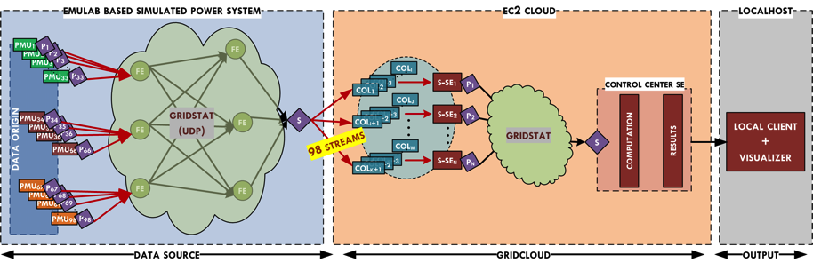
2013: Updated Cloud Architecture (1 Replica)
WSU Code Cornell Code WSU Code

Slide 47
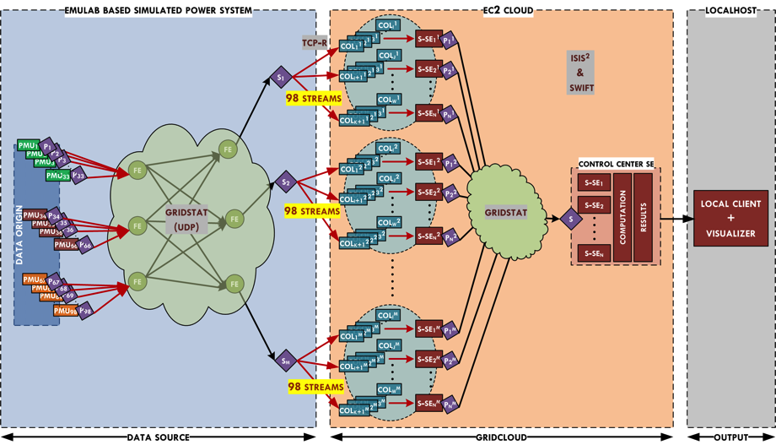
Current Cloud Architecture (3 Replica)

Slide 48
Outline
Optional Backup
    GridSim & GridControl Brief Overviews
    Killer Apps for Cloud Computing
  A Distributed Computing Critique of Some Power Protocols: IEC 61850(-90-5), MPLS, …
  Why Middleware is Needed for IIE
  Ratatoskr RPC/GridStat with tuneable timeliness, redundancy, safety

Slide 49
Cloud Computing: The “Next New Thing”
Big data centers (probably hosted by power industry vendors or NERC or DHS/DoE, not Amazon or Google)
These permit “consolidation”
  10x or better reductions in cost of operation
  Far better equipment utilization and management
  New styles of elastic computing, potential to compute directly on massive data collections
  Adds up to a new way of computing that forces us to undertake new kinds of thinking
But deliberately designed to trade off consistency for scalability

Slide 50
GridControl
Combining GridStat plus Cornell cloud computing technology (GridCloud)
  See slides from NASPI meeting February 2012
  GridStat+GridCloud+ (replicated) Anjan’s LHSE in EC2 for 2+ years
  ISO New England is starting a pilot project with GridCloud (then also GridStat)
Challenging questions with highly elastic apps
  Rapid elasticity at scale
  Predictability of such elasticity
  Consistency with such elasticity
Now outlining 8 killer apps that GridCloud enables

Slide 51
#1: Mitigation Control
Rare combination of events do happen
  Have lead to many blackouts when not mitigated!
E.g., N-3 contingency (3 failures) never planned for
  Infrequent but hugely expensive to analyze
  GridCloud commissions thousands of nodes analyzing candidate mitigation steps in parallel
  Best approach (actionable steps) is given to operators
Acknowledgements: Prof. Mani Venkatasubramanian (WSU)

Slide 52
#2: Oscillation Alarm Processing
Grids oscillate between regions
  Negatively damping can lead to blackout
  E.g., Oregon/California in USA July 1996: 0.3 Hz (!!)
GridCloud commissions massive parallel computations exploring huge permutation space
  Looking for trends and correlations of alarm data
  Also huge number of model-based simluations too
  Finds root cause much faster than possible today in much broader set of conditions
Acknowledgements: Prof. Mani Venkatasubramanian (WSU)

Slide 53
#3: Post-Tripping Fault Diagnosis
Protection scheme trips a relay, but why?
  Underlying cause must be ascertained post facto
GridCloud commissions massive computations to identify the fault(s) that provoked the trip(s)
  Many different kinds of fault diagnosis algorithms, all could be run in parallel
  Possible integration candidate: openFLE (fault location engine) from Grid Protection Alliance
Acknowledgements: Prof. Anuraug Srivastava (WSU)

Slide 54
#4: Multi-Resolution Frequency Disturbance Visualization
Grid operates in very narrow range unless stressed
  Frequency excursions outside this give clues to problems
Frequency disturbance recorder (FDR): new device recording frequency disturbances at high rates
  E.g., internal sampling of FNET device (in our lab): 1440 Hz
GridCloud commissions thousands of parallel frequency rendering computations
  Provide operators a rich suite of visualizations with which to better understand nature and cause of present excursion
Acknowledgements: Prof. Yilu Liu (University of Tennessee, Knoxville)

Slide 55
#5: Multi-Dimensional Computations over Both Space and Time
Two existing GridSim apps can be combined in rich ways possible only with cloud computing
Hierarchical linear state estimation: rich coverage of (geographical) space
  At one snapshot in time
  Obvious extensions over more space with more PMUs
Oscillation monitoring
  Uses moving window of time (a few seconds typically)
  Over streaming data
  Produces a single number: damping factor
  Obvious parallel computations over different sets of data with different time windows and algorithms

Slide 56
#5: Multi-Dimensional Computations over Both Space and Time (cont.)
Combination: provide rich set of two-dimensional (space, time) data to any desired location
  Enables extremely powerful new families of applications operating coherently over both space and time
  At each location: different time windows, different algorithms, different sets of data
  If available, people would inevitably think of many uses for this data
  Note: in other contexts (not cloud), Prof. Santiago Grijalva argues for a 3rd dimension: contingency
Acknowledgements: Prof. Anjan Bose (WSU)

Slide 57
#6: Ultimate Scale: Tertiary Monitoring Centers
Balancing authorities (144 in North America) must have remote backup control centers
  Hot backups with same data and apps
TVA found great value in having a tertiary control center
  Limited to monitoring: control outputs computed but not used
  Obvious candidates for the cloud
  But this is barely scratching the surface here…

Slide 58
#6: Ultimate Scale: Tertiary Monitoring Centers (cont.)
Major problem today: balancing authorities have almost no visibility anywhere in grid except for a few places in a few neighbors
  “Flying blind”, The Economist, 2004
Why not just share more?
  Data stored at another utility is problematic for owner
Storing in cloud could alleviate this
  Only access a subset of data and/or derived info
  Access opened up when grid sufficiently stressed

Slide 59
#6: Ultimate Scale: Tertiary Monitoring Centers (cont.)
Above is static with default steady state
Could also drill down on demand with elastic computations
  Using higher-fidelity algorithms
  Using higher-resolution data
Acknowledgements: Russell Robertson (Grid Protection Alliance), for the TVA example (though not the cloud possibilities)

Slide 60
#7: Robust Adaptive Topology Control (RATC)
Use software to optimize grid topology switching as the control resource
Technology: use topology control to enhance operations and manage disruptions in grid
  Massively parallel computations to
  Detect, classify, and respond to grid disturbances
  Ensure the grid maintains efficient operations while guaranteeing reliability
Acknowledgements: Prof. Mladen Kezunivoc, Texas A&M University.
  Funded by the ARPA-E GENI program

Slide 61
#8: Prosumer-Based Distributed Autonomous
Cyber-Physical Architecture
Prosumer: An economically motivated power system participant that can consume, produce, store, or transport electricity
  Interact with other prosumers through services – generation, consumption, storage, and transportation
    E.g. A utility prosumer aggregating heterogeneous home user prosumers to provide consumption and storage services to a distribution ISO prosumer
  Drastically increased data acquisition rates, autonomy, distributed control capability

Slide 62
#8: Prosumer-Based Distributed Autonomous
Cyber-Physical Architecture (cont.)
GridCloud commissions massive parallel computations exploring huge permutation space
  Heterogeneous data aggregation for utility level device management that accounts for instantaneous interoperability
    Home users can change their strategies (e.g. local storage is not available)
  Scenario generators for prosumers at different level (in scale)
  Data organization and processing
Acknowledgements: Prof. Santiago Grijalva (Georgia Institute of Technology, Georgia)
  Funded by ARPA-E GENI program

Slide 63
Outline
Optional Backup
    GridSim & GridControl Brief Overviews
  Killer Apps for Cloud Computing
    A Distributed Computing Critique of Some Power Protocols: IEC 61850(-90-5), MPLS, …
  Why Middleware is Needed for IIE
  Ratatoskr RPC/GridStat with tuneable timeliness, redundancy, safety

Slide 64
Power Culture, not ICT Culture
Every person can only specialize in a few areas!
Engineers are confident problem solvers!
  Some knowledge of computer networking and programming
    “A little knowledge is a dangerous thing”, Thomas Huxley
  Their managers, regulators, & research funding personnel power not ICT
Middleware best practices in other industries, elec. sector its rare
Very often end up with
  Hard-coded solution that is very inflexible, has to be re-implemented for each new power application program for each utility
    “Application-level protocols” in network parlance
  Not utilizing the state of the practice in other industries
  Not handling the interoperability and building blocks necessary
Utility ICT staff unaware of cutting-edge data delivery or other relevant R&D (e..g, DARPA in 1990s), middleware, etc
  Ergo don’t push vendors to offer much better ☹
  Vendors generally not very aware either
Notes:
Before I describe this challenge, let me say that I think that power engineers and researchers are extremely intelligent people. But any one person can only specialize in a few areas…
Another large challenge in achieving better interoperability of application programs and sensors in the bulk power grid is not directly technical, but it is the technical culture. Electric utilities have a power engineering culture, not a culture of information and communications technology (ICT), which is very different. This applies to not only the engineers, but their managers, regulators, and research funding personnel. Power engineers also have a some knowledge of computer networking and programming. However, as Thomas Huxley said, “A little knowledge is a dangerous thing”. Further, engineers are usually confident problem solvers. As a result, they often are not aware of their limitations in ICT, and are generally very unaware of much better “best practices” in other industries.
Very often then, what results is a “hard-coded” data delivery solution that is very inflexible, and has to be re-implemented for each new power application program for each utility. It also does not utilize “best practices” in other industries. And it does not support the interoperability across different kinds of ICT resources that I described earlier.
One final problem involving the lack of an ICT culture is that ICT departments tend to be understaffed, sometimes quite severely. Additionally, it can be hard to attract and retain good programmers in such a non-ICT culture. Without top programmers with good experience in other industries, it is almost impossible to provide the kind of interoperability that I have described.

Slide 65
IP Multicast, Int-Serv Guaranteed Svc
IP Multicast (IPMC)
  Spams every “subscriber” at highest rate anyone wants it at
  Can cause address instability; banned from some cloud computing environments
    Dr. Multicast: Rx for Data Center Communication Scalability. Ymir Vigfusson, et al. ACM SIGOPS 2010, pp. 349-362.
Int-Serv
  Guaranteed Service only guarantees max, not average and does not handle jitter

Slide 66
OpenFlow (OF) & SW-Defined Net’s (SDN)
Good per-flow network QoS
But at net not MW level
  Need management layer and some APIs above OF
Incomplete: Still need to handle other non-network QoS+ properties: redundancy, confidentiality, authentication, ….
Can be a lowest-common-denominator approach
Interoperability and subsetting [see GridStat chap. of my book]
  S. McGillicuddy, “Not all OpenFlow Hardware is Created Equal: Understanding the Options”, Open Network Foundation, 25 September 2013, available via www.opennetworking.org.
No rate downsampling
Utilities often don’t have a green field opportunity: have to be able to integrate many non-OF network assets, too

Slide 67
MPLS
Weak statistical guarantees over {location, user, long time}
  Meant to help ISPs coarsely provision bandwidth w/QoS, not for providing specific QoS for given data variable
  E.g., Harris’ FAA network has 30 minute statistical guarantees
  Highly inappropriate (reckless) for closed-loop apps
Only 8 categories (3 bits) of QoS treatment, yet many (hundreds, ?thousands) of QoS combinations very useful
  Its not one size (or 8 sizes) fits all!
  Flow with higher priority may not get better treatment than lower
  Still have to track and manage ALL traffic if any hope
But widely used (with IPMC) by utilities lately, because you can buy it from a router vendor
  Because it has (some flavor of) QoS and 1→many superficially similar to what is needed!

Slide 68
IEC 61850: The Good (LOTS!)
HUGE benefit compared to wires in substation
Data model elegant
  Opens up a lot of opportunities to exploit this semantic information in conjunction with power models, data delivery topologies, adaptation, default configuration or QoS settings, ….
Substation Configuration Language (SCL) elegant

Slide 69
IEC 61850: The Bad
Complexity
  Far more complex than it has to be given the problem it is tackling
  Double the size/bandwidth of IEEE C37.118 with no extra useful info
  Feels to me like a spec doc by a 1975 Mechanical Engineer specifying HW not a 1995 (or later) SW Engineer specifying SW
Hype
  Almost sounds like it will cure cancer at times
    PJM engineer: 4 substations (ISO has ~30% of the USA footprint)

Slide 70
IEC 61850: The Bad (2)
Performance
  Subscriber apps have to be able to detect missing and duplicates (no sophisticated fault-tolerant multicast)
  GOOSE authentication via RSA signatures: way too expensive for many embedded devices
    UIUC paper (Jaianqing Zhang and Carl Gunter, IEEE SmartGridComm 2010)
    WSU paper (Hauser et al paper from HICS 45 (2012))
    Later shared key extensions allow subscriber to spoof publisher ☹
  GOOSE messages very CPU-intensive with ASN.1 integer fields etc, expensive for many embedded devices
  Have to be careful that the multicast (Ethernet broadcast) does not overload small embedded devices
  Note: 61850-90-5 is NOT middleware (not even close)

Slide 71
IEC 61850: The Bad (3)
Misc
  $3K just to read the spec
  Design by Committee before Full Implementation
  Way better standardization models: IETF and OMG
        "We reject: kings, presidents, and voting.
        We believe in: rough consensus and running code."
      David Clark, Internet pioneer
        “Any time you standardize beyond the state of the practice you are in trouble.”
      Richard Schantz, father of middleware

Slide 72
IEC 61850: The Bad (4)
Misc (cont.)
  PMUs often need many:one (to a PDC) not 1:many communication
  Lack of a reference implementation and reference test suite
    Have to test devices pairwise
    Standard so huge many vendors don’t implement all of it; most vendors violate the standard in some way

Slide 73
IEC 61850: The Ugly
Data Model is portable, but no configuration and other tools that are vendor-agnostic ☹
  Can you spell this: V-E-N-D-O-R L-O-C-K-I-N ???
  But it’s a “standard” so the suits and MBAs want it
WANs are very different from LANs: partial failures & widely-varying performance (incl. network jitter)
61850 assumes the same interface for a LAN will magically work in a WAN
  Known by distributed computing practitioners and applied researchers to be false since <= 1990
    See the “A Note on Distributed Computing” by Waldo et al

Slide 74
IEC 61850: The Ugly (2)
61850-90-5 is the WAN extension
  Dec 2010 draft says communications redundancy is “crucial”
  But the draft has less than one page on it (Sec 8.8) that has no meaningful details
  IETF RFC 2991 it relies on has nothing about end-to-end latency, availability, exploiting a more controllable utility infrastructure, tradeoffs below, etc
  Advanced multicast is hard, fault-tolerant is harder, real-time is harder yet, with security (not ruining perf.) worse
  Wide range of properties could trade off, incl. latency, jitter, consistency, throughput, resource consumption, availability, ...
  Do implementers (or drafters) know what this space of possible properties is, what tradeoffs their given implementations make? Very unlikely…
  Do utilities/ISOs know what tradeoffs they are being sold, and how appropriate they are for them? Unlikelier!

Slide 75
IEC 61850: The Ugly (3)
Bottom line: a lead control engineer from a large utility (with very forward-thinking, advanced ICT) to me
  2009: “No way in hell am I letting it [61850] outside my substations”
  2011: (ruefully) “I was overruled from above, because its ‘a standard’.”
    But a standard for doing what? With what properties traded off?

Slide 76
Email from that Same Utility
[Emphasis is mine…. There are standards, and then there are STANDARDS …..]
I have little insight into the particulars, but I've been involved in conversations about aligning the IEC 61850 with the CIM (an elusive goal), plus some sidebar conversations on the "immaturity" of the standard (although its been kicking around for 10 years). I think the underlying reason for this perception is the vendor equipment-specific configuration tools for 61850 and how each vendor cherry-picks the standard with little regard to its impact on the overall substation configuration problem faced by a utility.
There is a need for a vendor-agnostic toolset that mirrors the utility engineering process for constructing (or upgrading) a substation, and the long-term maintenance of the substation configuration. This process goes through several hands over several years, starting with a substation designer and ending with project engineers. The designer typically has templates to follow for the design, necessarily at a high level to explain (and sell) the design. The electrical equipment vendors associated with the utility at the beginning of the design may not be the same when the time comes to purchase equipment. [… continued]

Slide 77
Email from that Same Utility (2)
[… continued] Thus the need for the vendor-agnostic toolset to support the design process and "seamlessly" transition to vendor-specific 61850 implementations as purchase orders are cut. Having all the tools CIM compliant would be a nice touch, but the two standards are not easily made compatible. There is much work to be done to solve the 61850 design/maintenance tool problem.
There are a lot of communication protocols in the electric grid domain, each reflecting the needs (and IT maturity state) of the time - from Modbus to DNP3 to 61850 to GridStat. Unfortunately a utility cannot green-field a new grid as each new protocol is developed, it has to ensure its deployed assets remain useful while trying to realize the benefits offered by maturing Information and Communications Technologies. That is a major driver behind the XYZ Advanced Lab - to determine which technologies have the potential to improve the XYZ grid's "ities" : reliability, stability, profitability, etc.

Slide 78
Outline
Optional Backup
    GridSim & GridControl Brief Overviews
  Killer Apps for Cloud Computing
  A Distributed Computing Critique of Some Power Protocols: IEC 61850(-90-5), MPLS, …
    Why Middleware is Needed for IIE
  Ratatoskr RPC/GridStat with tuneable timeliness, redundancy, safety

Slide 79
Middleware (MW) Integrating Legacy (Sub)Systems
Flow start (publisher) could also be RTU, substation router, OpenPDC, etc. i.e. not just a single sensor.
GS subscriber could be RTU, substation router, OpenPDC, …
GridStat is
Real-Time
Overlay (sometimes)
Middleware
“…” could be BPL/PLC, 4G teleco, best-effort internet, etc.

Slide 80
The “Smart Grid” Community Agrees
David E. Bakken, Richard E. Schantz, and Richard D. Tucker. “Smart Grid Communications: QoS Stovepipes or QoS Interoperability”, in Proceedings of Grid-Interop 2009, GridWise Architecture Council, Denver, Colorado, November 17-19, 2009. (shown earlier, with URL)
  Argued that, by the stated goals of the US “smart grid” leadership (GridWise and NIST), middlware is needed for WAMS-DD
  Argued that if you care about QoS, needed even more
  Best Paper Award for “Connectivity” track. This is the official communications/interoperability meeting for the pseudo-official “smart grid” community in the USA, namely DoE/GridWise and NIST/SmartGrid.
  Paper also describes what middleware is and how standardized

Slide 81
Other Reasons Middleware is Needed
Very hard problem for computer scientists to get right: combining mechanisms for network QoS and security and other QoS+ properties
  Almost impossible for non-expert to get right
  Without middleware, each application has to rewrite
  Much better to let middleware developer do this, and apps reuse
Future proofing: not locked into given mechanism
Only way to do monitoring/policing on a per-update per-sensor basis (rather than ~1.5 Mbps RTU-CC)
…. see Bakken book chapter on GridStat for 5 pages on this!

Slide 82
Outline
Optional Backup
    GridSim & GridControl Brief Overviews
  Killer Apps for Cloud Computing
  A Distributed Computing Critique of Some Power Protocols: IEC 61850(-90-5), MPLS, …
  Why Middleware is Needed for IIE
    Ratatoskr RPC/GridStat with tuneable timeliness, redundancy, safety

Slide 83
Ratatoskr RPC Mechanism
RPC mechanism targeted to set actuators in the Electric Power Grid, with tunable QoS for
  Timeliness
  Redundancy
  Safety
Uses a two-tiered architecture on top of a QoS managed publish-subscribe middleware
Tier 1
  Provides a 2 Way over Publish-Subscribe (2WoPS) communication protocol
Tier 2
  Provides RPC client and server functionality

Slide 84
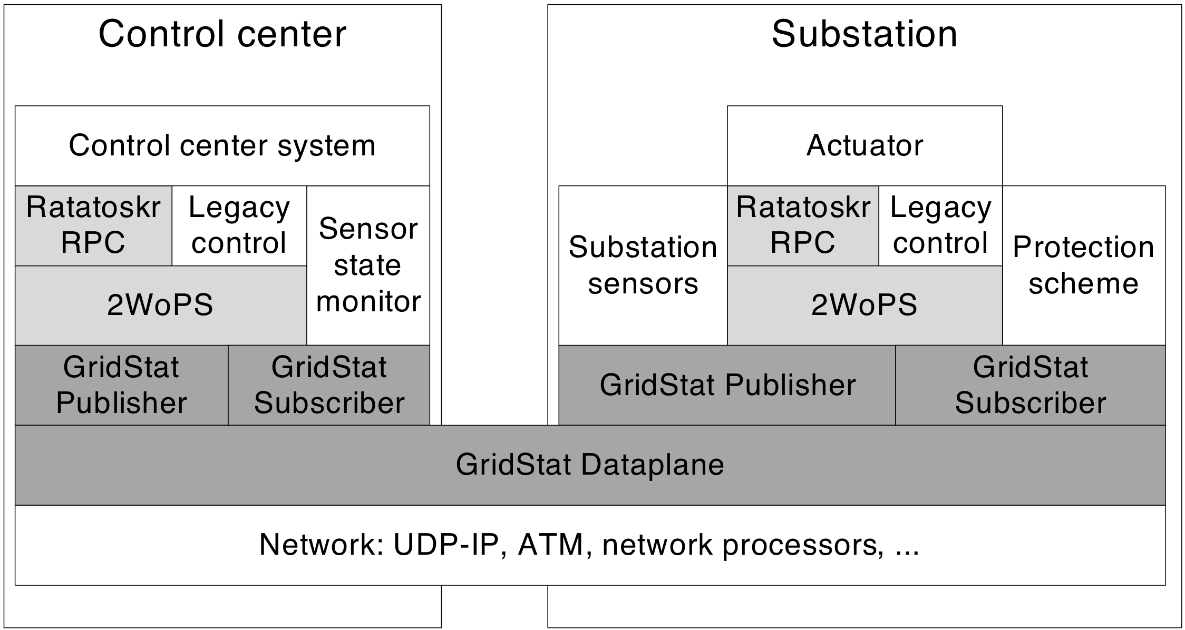
Ratatoskr Architecture
“Client” side of the Application
“Server” side of the Application
Application Layer
RPC
Client
RPC
Server
2 Way over
Pub-Sub
Pub Proxy &
Sub Proxy
QoS Managed
Pub-Sub Middleware
Underlying Network

Slide 85
Timeliness
Ratatoskr RPC mechanism requires an underlying QoS managed Pub-Sub middleware
One of the QoS dimension is end-to-end delay of a message delivery, hence timeliness
The timeliness guaranties that the Pub-Sub middleware provides are exposed to the RPC call interface
  User specifies the desired and required end-to-end delay when setting up the RPC “connection”

Slide 86
Redundancy
Three Redundancy Techniques provided
  Spatial Redundancy
    How many disjoint network paths should the messages be sent over
  Temporal Redundancy
    How many copies of the same message should be sent and with what delay between each send
  ACK/Resend
    Require an explicit ACK to be sent back to the sender
    Can specify how many resends of the message should be done if no ACK is received
The user can combine any of the techniques as needed by the application
  Use Spatial and Temporal for time delay sensitive application
  Use ACK/Resend for non time critical application
Notes:
a) Tunable techniques., while still providing predictable delivery times
1) Spatial Redundancy requires that the underlying network can provide this. This may be expensive to assume such a network, but for the power Grid it may be there.
Cost is use of bandwidth in the Network and processing times at routers
2) In case spatial redundancy is not available, Temporal Redundancy can be used to mask intermittent Network problems
Cost is use of bandwidth in the Network and processing times at routers, twice as much resources are being used.
3) ACK/Resend

Slide 87
Ratatoskr RPC Mechanism
RPC mechanism targeted to set actuators in the Electric Power Grid, with tunable QoS for
  Timeliness
  Redundancy
  Safety
Uses a two-tiered architecture on top of a QoS managed publish-subscribe middleware
Tier 1
  Provides a 2 Way over Publish-Subscribe (2WoPS) communication protocol
Tier 2
  Provides RPC client and server functionality

Slide 88
Ratatoskr Architecture
“Client” side of the Application
“Server” side of the Application
Application Layer
RPC
Client
RPC
Server
2 Way over
Pub-Sub
Pub Proxy &
Sub Proxy
QoS Managed
Pub-Sub Middleware
Underlying Network

Slide 89
Timeliness
Ratatoskr RPC mechanism requires an underlying QoS managed Pub-Sub middleware
One of the QoS dimension is end-to-end delay of a message delivery, hence timeliness
The timeliness guaranties that the Pub-Sub middleware provides are exposed to the RPC call interface
  User specifies the desired and required end-to-end delay when setting up the RPC “connection”

Slide 90
Redundancy
Three Redundancy Techniques provided
  Spatial Redundancy
    How many disjoint network paths should the messages be sent over
  Temporal Redundancy
    How many copies of the same message should be sent and with what delay between each send
  ACK/Resend
    Require an explicit ACK to be sent back to the sender
    Can specify how many resends of the message should be done if no ACK is received
The user can combine any of the techniques as needed by the application
  Use Spatial and Temporal for time delay sensitive application
  Use ACK/Resend for non time critical application
Notes:
a) Tunable techniques., while still providing predictable delivery times
1) Spatial Redundancy requires that the underlying network can provide this. This may be expensive to assume such a network, but for the power Grid it may be there.
Cost is use of bandwidth in the Network and processing times at routers
2) In case spatial redundancy is not available, Temporal Redundancy can be used to mask intermittent Network problems
Cost is use of bandwidth in the Network and processing times at routers, twice as much resources are being used.
3) ACK/Resend

Slide 91
Safety
In some large scale infrastructures the client may not have the latest “state/view” of the condition
  If an actuator is set wrongly serious consequences can occur
Similarly the effect of setting an actuator may not be what was intended
Pre-and Post conditions are built into the call semantic
  Pre-conditions are conditional expressions that are evaluated at the server side before the execution of the RPC call
    In case the condition evaluates to false, call is aborted
  Post-condition are conditional expressions that are evaluated after (delay user defined) the RPC call is executed
    In case the condition evaluates to false, this is reported back to the application through an exception

Slide 92
Safety
In some large scale infrastructures the client may not have the latest “state/view” of the condition
  If an actuator is set wrongly serious consequences can occur
Similarly the effect of setting an actuator may not be what was intended
Pre-and Post conditions are built into the call semantic
  Pre-conditions are conditional expressions over GridStat-updated varaibles that are evaluated at the server side before the execution of the RPC call
    In case the condition evaluates to false, call is aborted
  Post-condition are conditional expressions over GridStat-updated variables that are evaluated after (user-defined failure) the RPC call is executed
    In case the condition evaluates to false, this is reported back to the application through an exception
    Idea here is condition gives some physical end-to-end confirmation that the call succeeded and that the actuator had not failed

