Slide 1
Chapter 4
The Processor

Slide 2
The Main Control Unit
Control signals derived from instruction
R-type
0
rs
rt
rd
shamt
funct
31:26
25:21
20:16
15:11
10:6
5:0
Load/ Store
35 or 43
rs
rt
address
31:26
25:21
20:16
15:0
Branch
4
rs
rt
address
31:26
25:21
20:16
15:0
opcode
always read
read, except for load
write for R-type and load
sign-extend and add

Slide 3
Implementing Jumps
Jump
2
address
31:26
25:0
Jump uses word address
Update PC with concatenation of
Top 4 bits of old PC
26-bit jump address
00
Need an extra control signal decoded from opcode

Slide 4
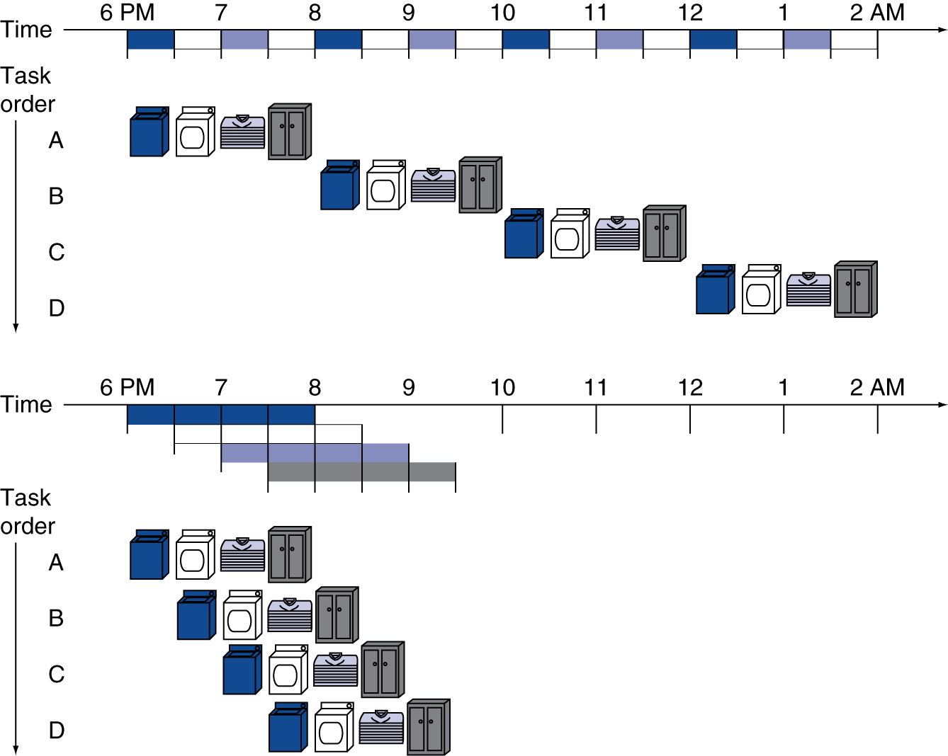
Pipelining Analogy
Pipelined laundry: overlapping execution
Parallelism improves performance
Four loads:
Speedup = 8/3.5 = 2.3
Non-stop (loads=n):
Speedup = 2n/(0.5n+1.5) ≈ 4 = number of stages

Slide 5
MIPS Pipeline
Five stages, one step per stage
IF: Instruction fetch from memory
ID: Instruction decode & register read
EX: Execute operation or calculate address
MEM: Access memory operand
WB: Write result back to register

Slide 6
Pipeline Performance
Assume time for stages is
100ps for register read or write
200ps for other stages
Compare pipelined datapath with single-cycle datapath
Instr | Instr fetch | Register read | ALU op | Memory access | Register write | Total time
lw | 200ps | 100 ps | 200ps | 200ps | 100 ps | 800ps
sw | 200ps | 100 ps | 200ps | 200ps |  | 700ps
R-format | 200ps | 100 ps | 200ps |  | 100 ps | 600ps
beq | 200ps | 100 ps | 200ps |  |  | 500ps

Slide 7
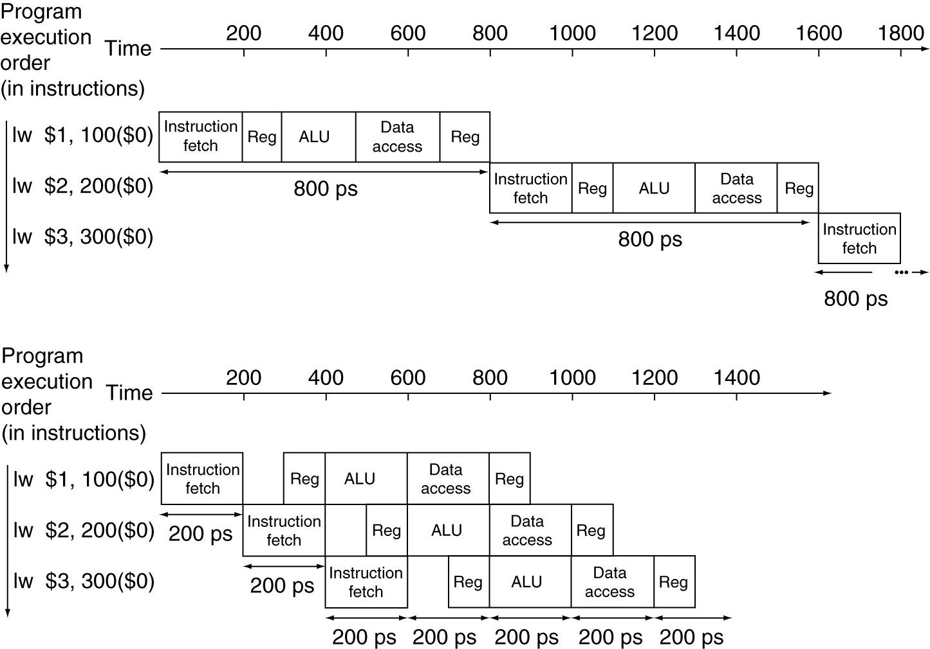
Pipeline Performance
Single-cycle (T_{c}= 800ps)
Pipelined (T_{c}= 200ps)

Slide 8
Pipeline Speedup
If all stages are balanced
i.e., all take the same time
Time between instructions_{pipelined} = Time between instructions_{nonpipelined} Number of stages
If not balanced, speedup is less
Speedup due to increased throughput
Latency (time for each instruction) does not decrease

Slide 9
Pipelining and ISA Design
MIPS ISA designed for pipelining
All instructions are 32-bits
Easier to fetch and decode in one cycle
x86: 1- to 17-byte instructions
Few and regular instruction formats
Can decode and read registers in one step
Load/store addressing
Can calculate address in 3rd stage, access memory in 4th stage
Alignment of memory operands
Memory access takes only one cycle

Slide 10
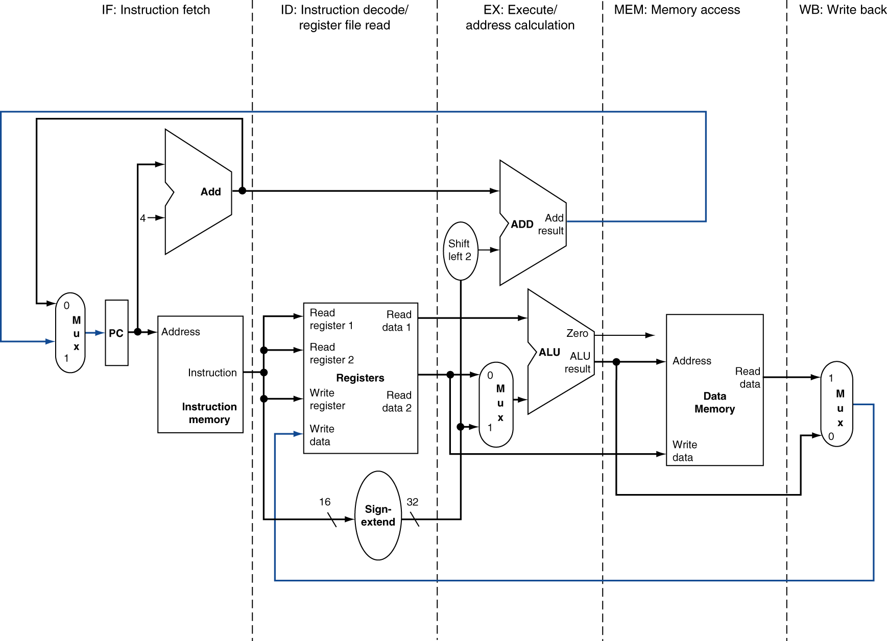
MIPS Pipelined Datapath
MEM
Right-to-left flow leads to hazards
WB

Slide 11
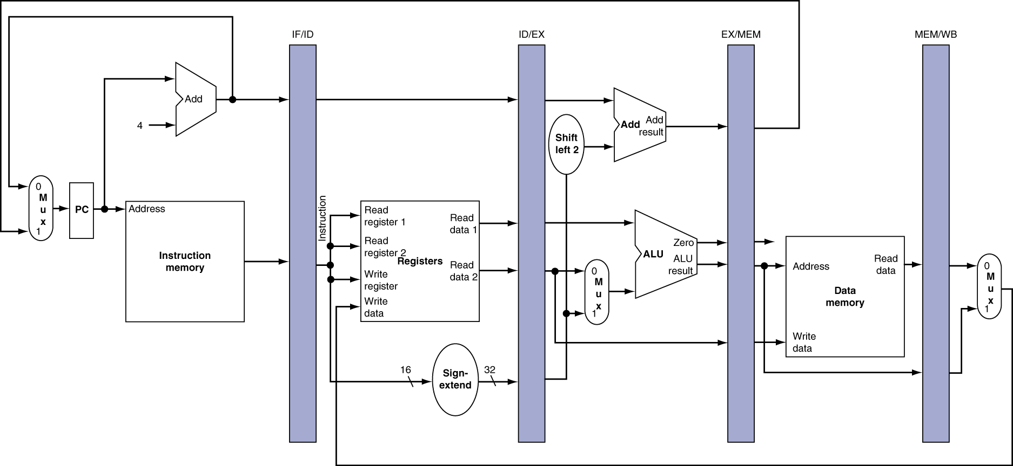
Pipeline registers
Need registers between stages
To hold information produced in previous cycle

Slide 12
Pipeline Operation
Cycle-by-cycle flow of instructions through the pipelined datapath
“Single-clock-cycle” pipeline diagram
Shows pipeline usage in a single cycle
Highlight resources used
“multi-clock-cycle” diagram
Graph of operation over time
We’ll look at “single-clock-cycle” diagrams for load & store

Slide 13
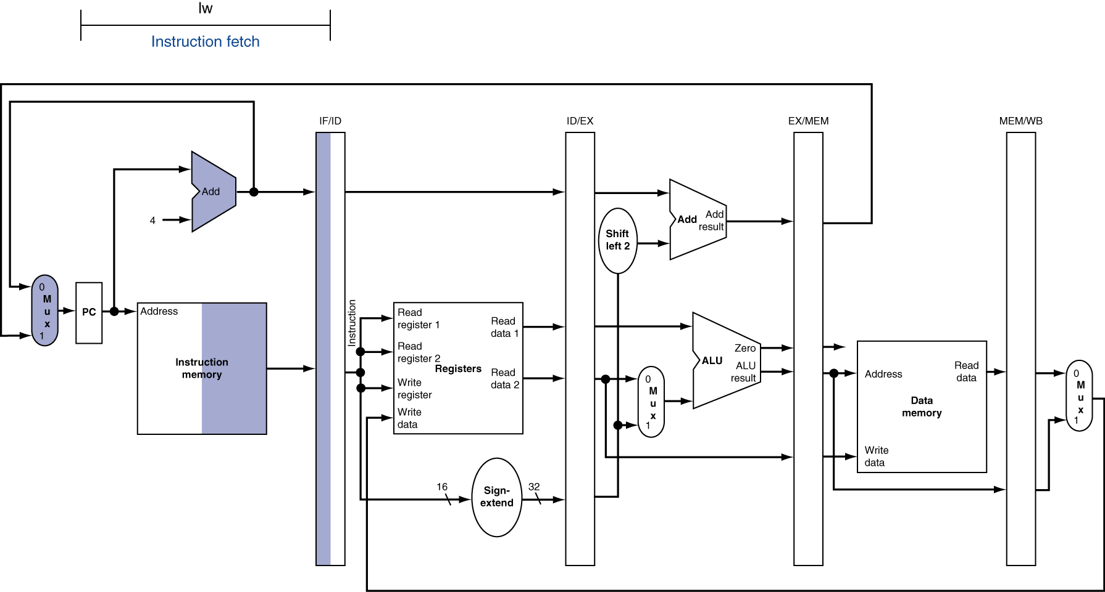
IF for Load, Store, …

Slide 14
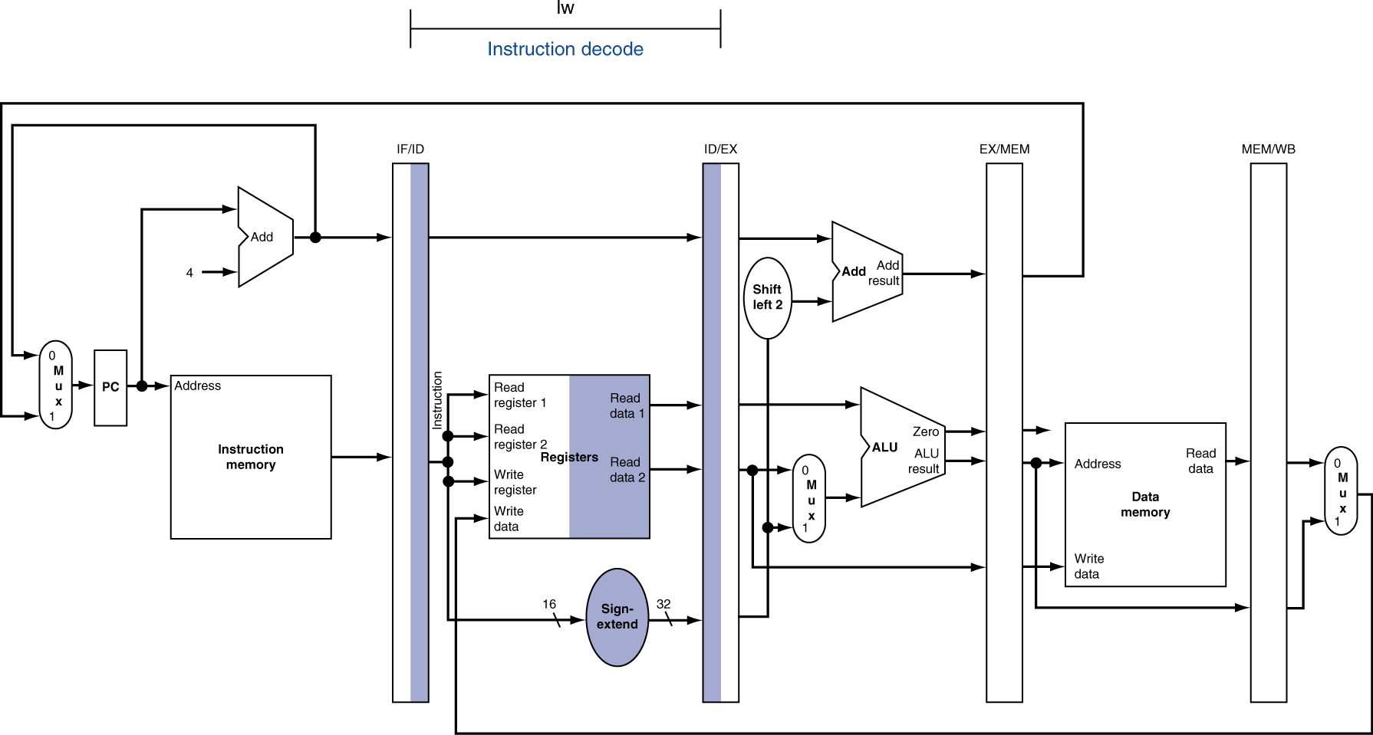
ID for Load, Store, …

Slide 15
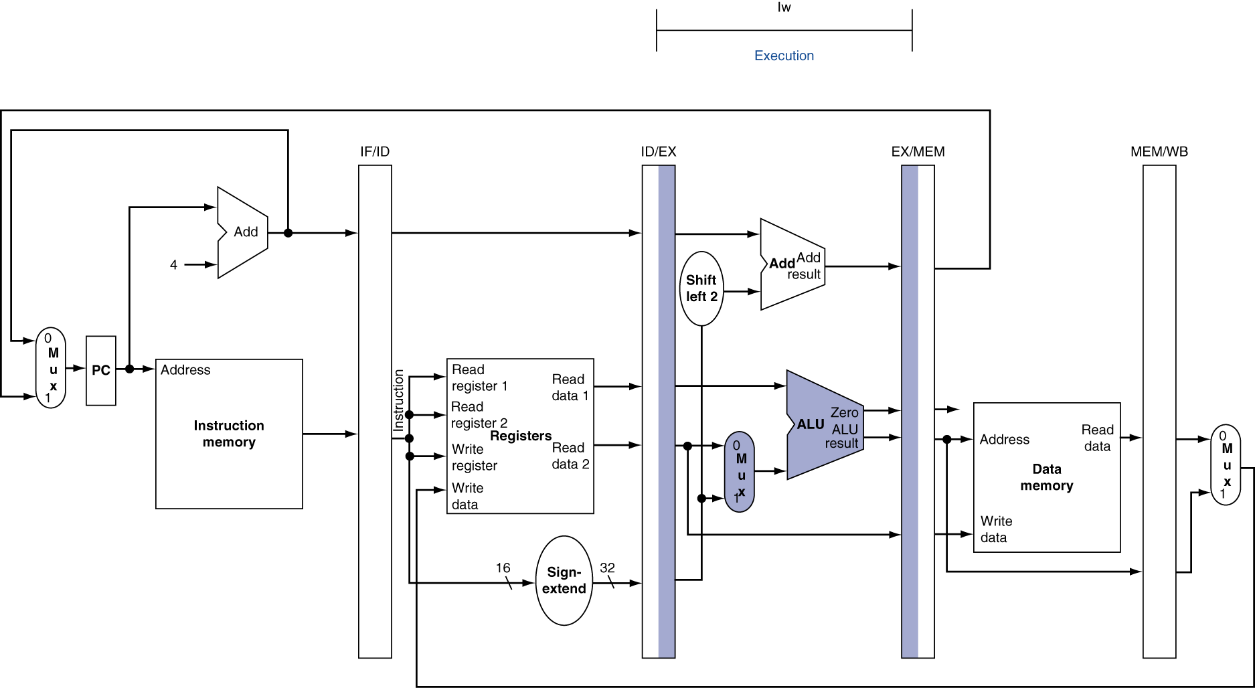
EX for Load

Slide 16
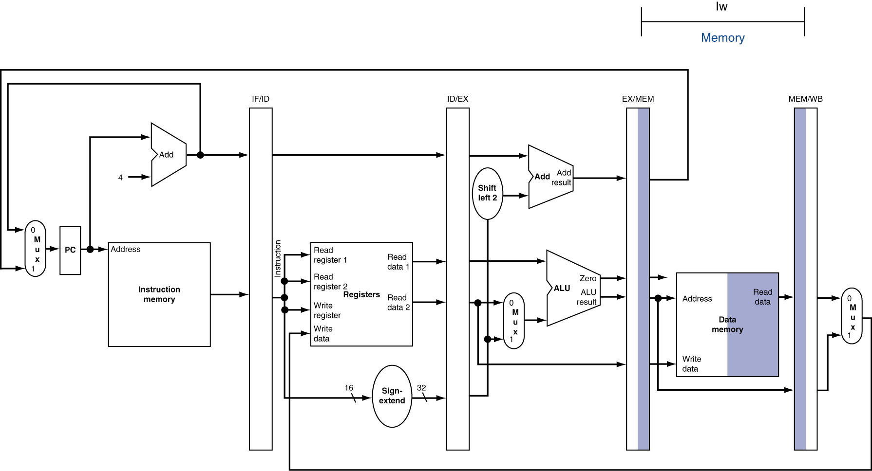
MEM for Load

Slide 17
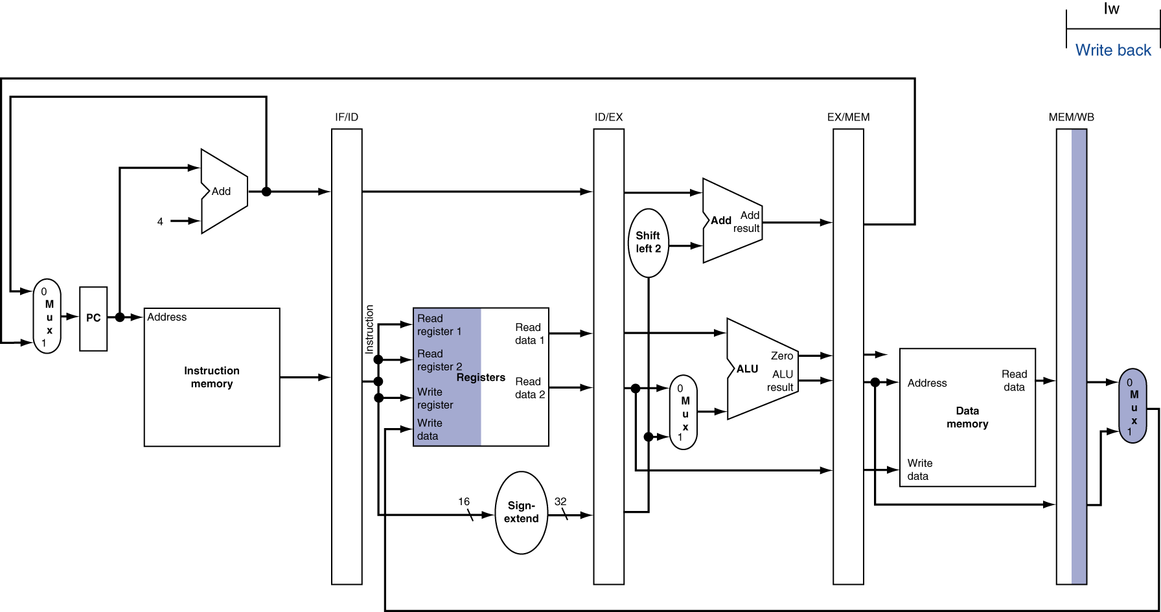
WB for Load
Wrong register number

Slide 18
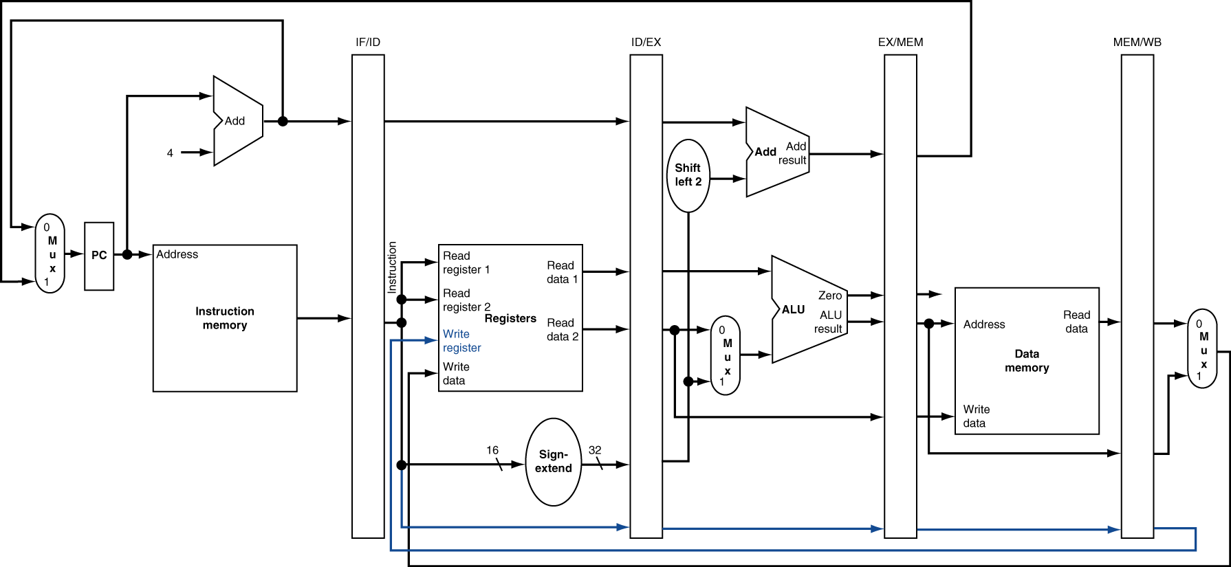
Corrected Datapath for Load

Slide 19
EX for Store

Slide 20
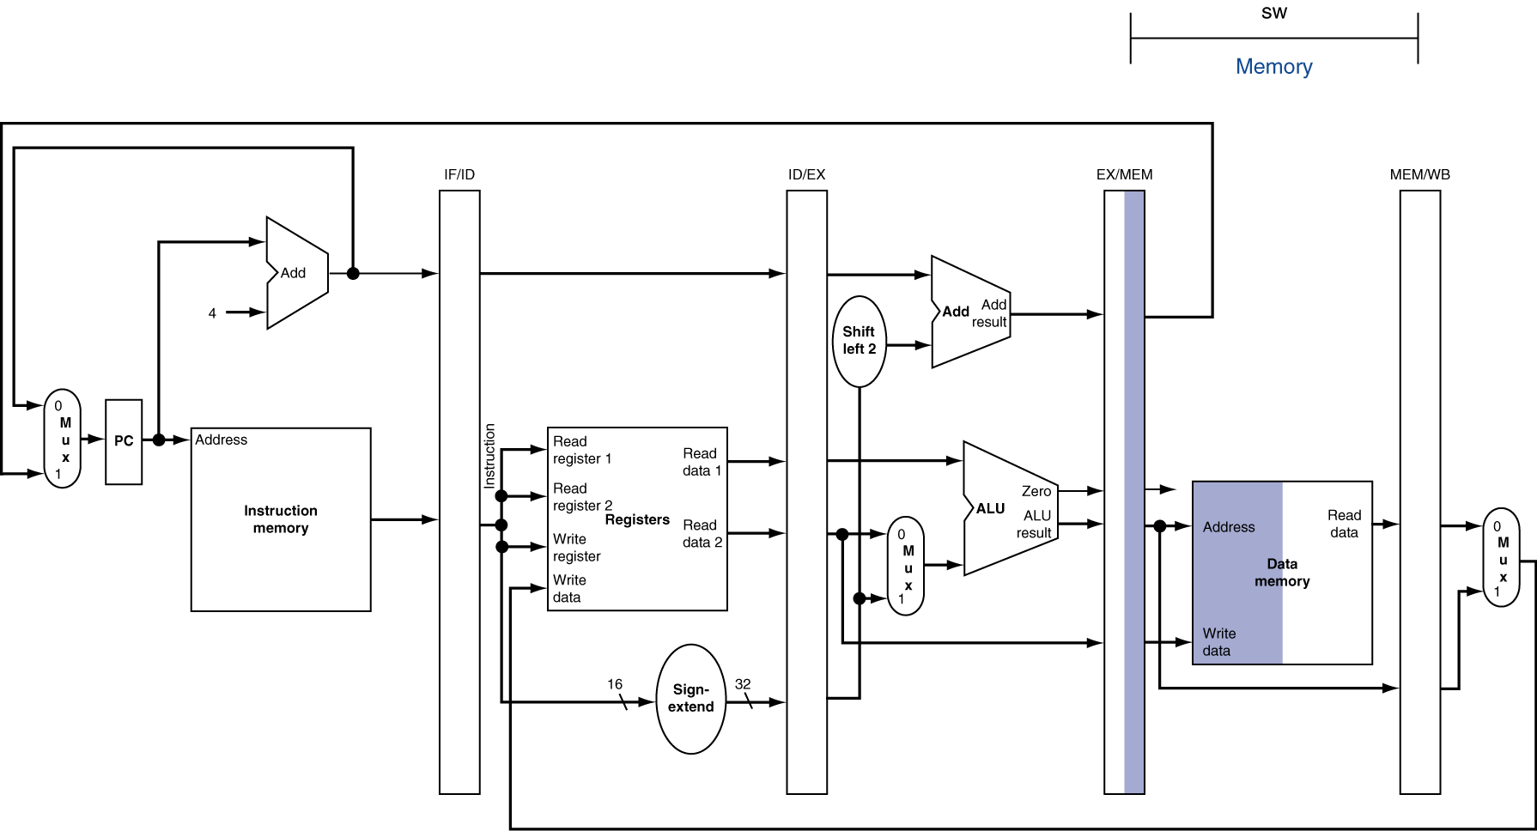
MEM for Store

Slide 21
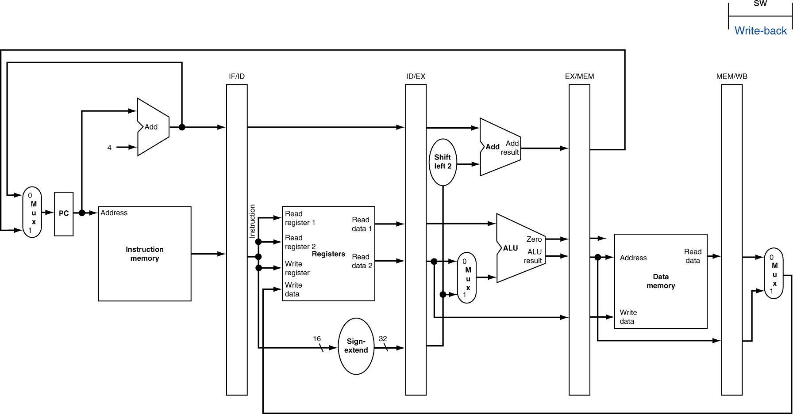
WB for Store

Slide 22
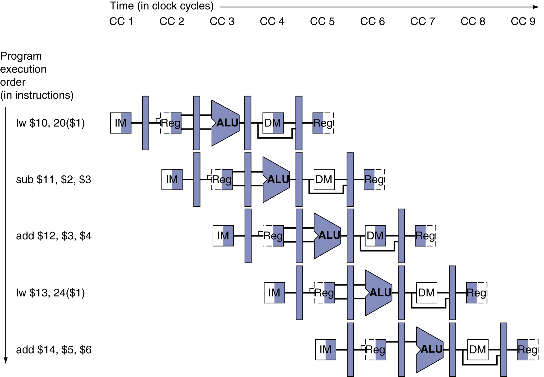
Multi-Cycle Pipeline Diagram
Form showing resource usage

Slide 23
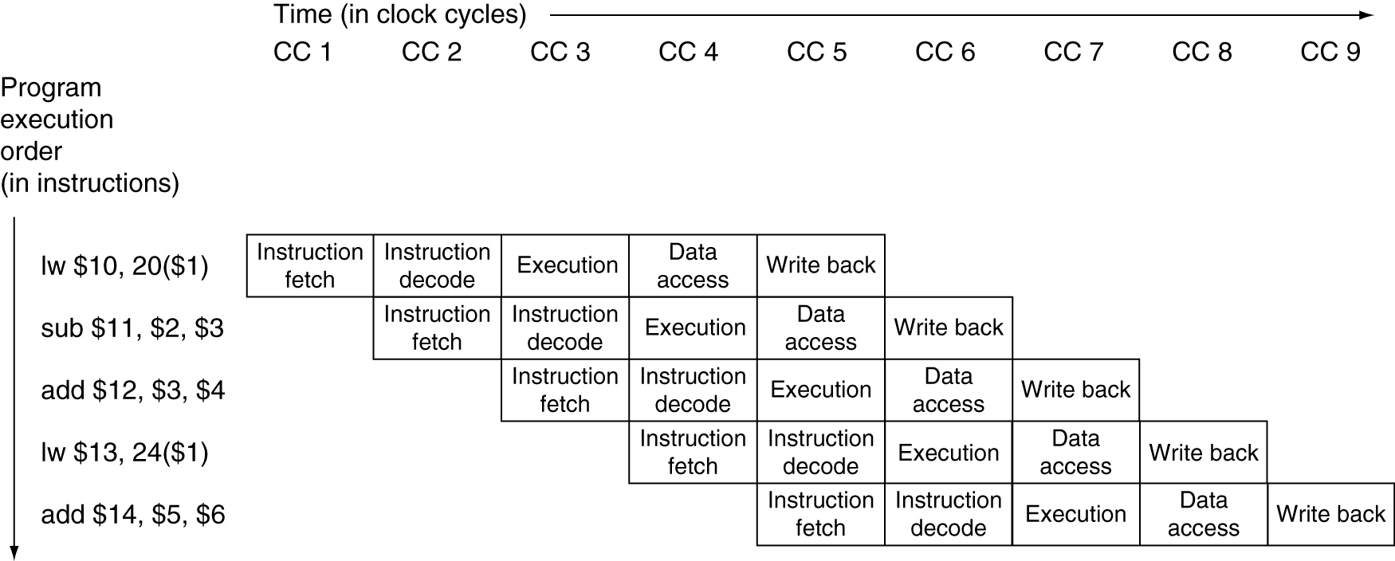
Multi-Cycle Pipeline Diagram
Traditional form

Slide 24
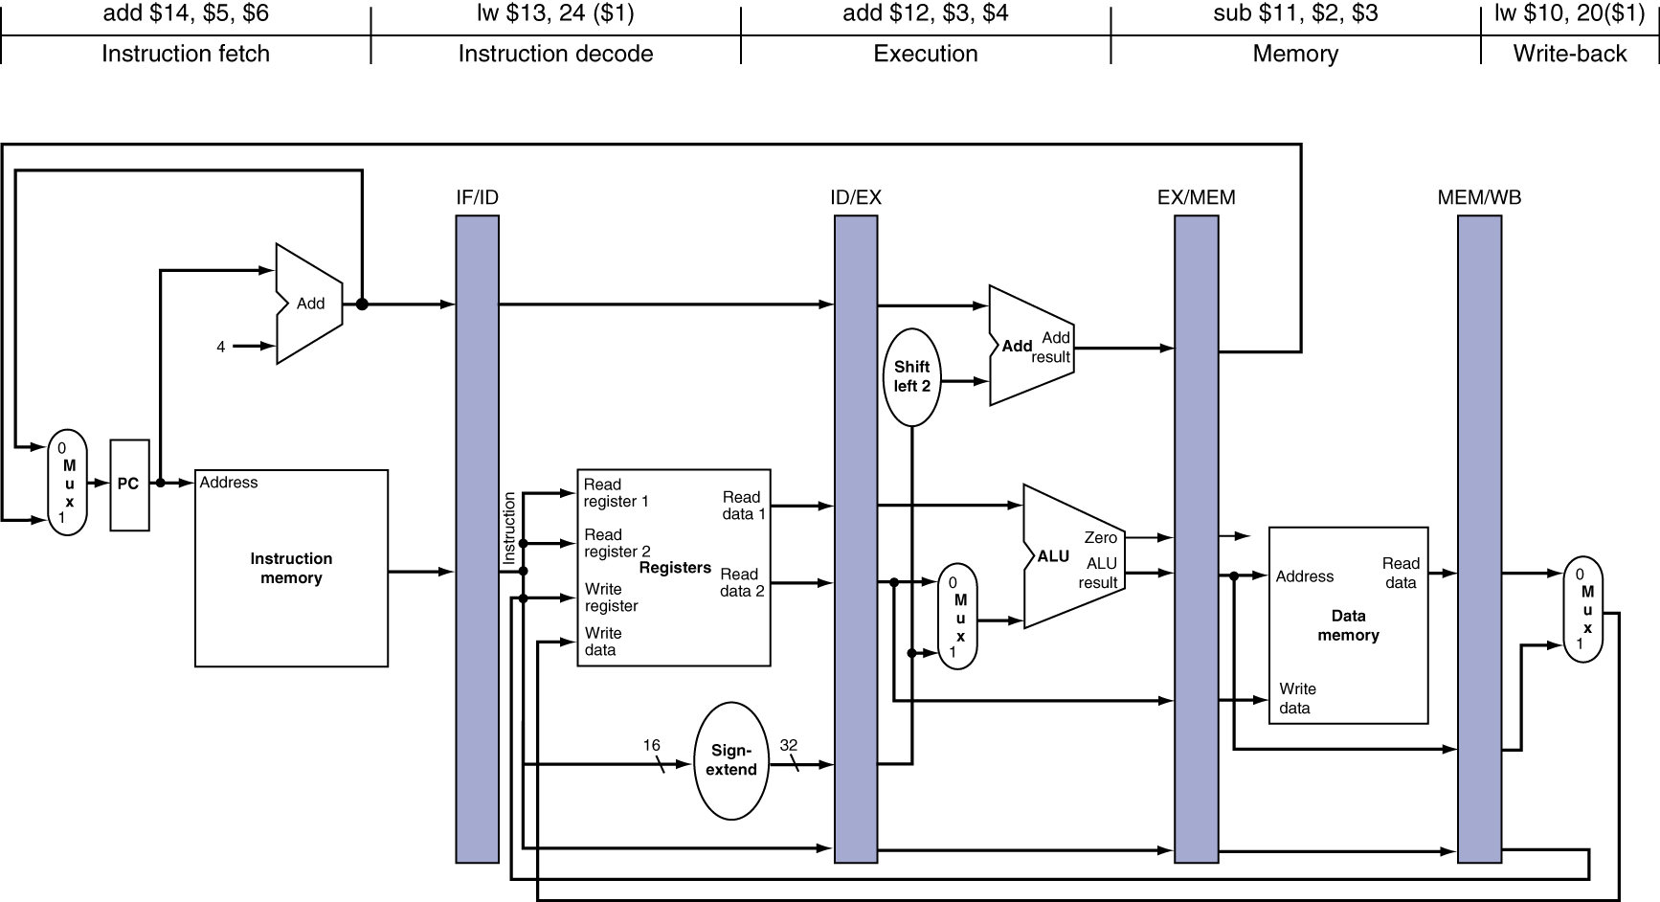
Single-Cycle Pipeline Diagram
State of pipeline in a given cycle

Slide 25
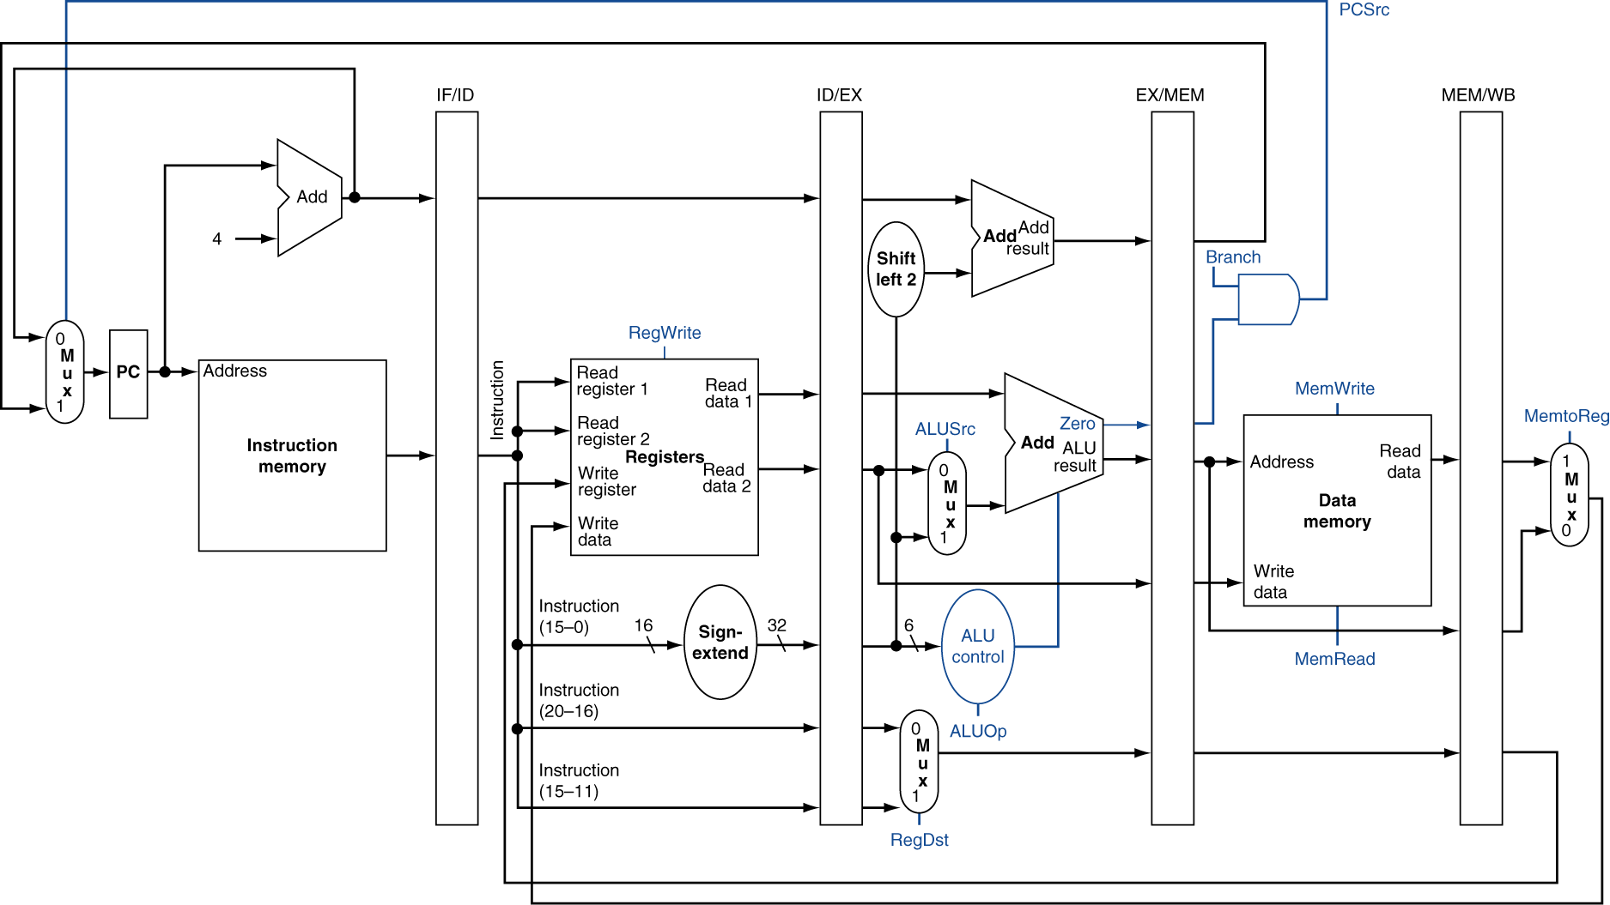
Pipelined Control (Simplified)

Slide 26
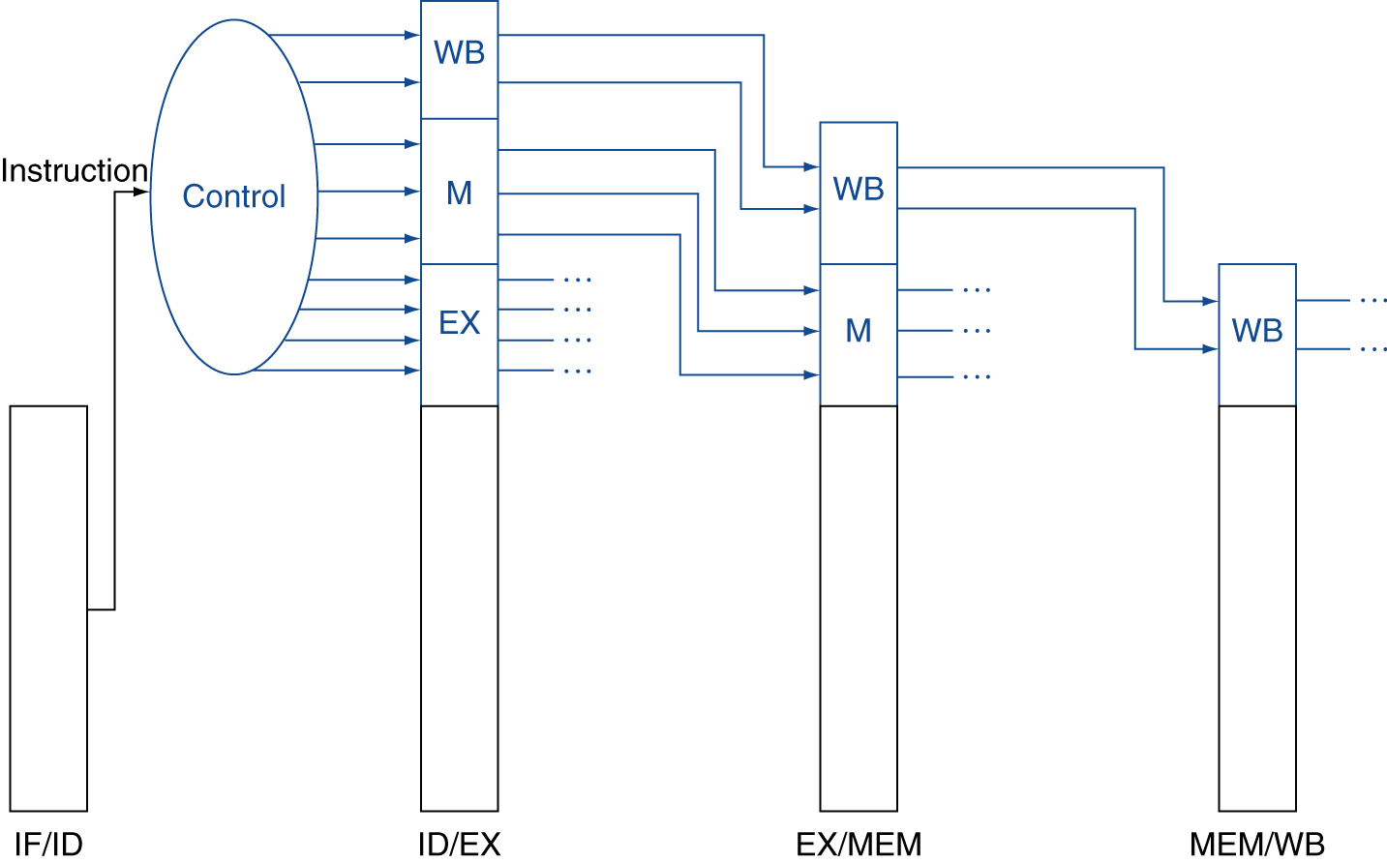
Pipelined Control
Control signals derived from instruction
As in single-cycle implementation

Slide 27
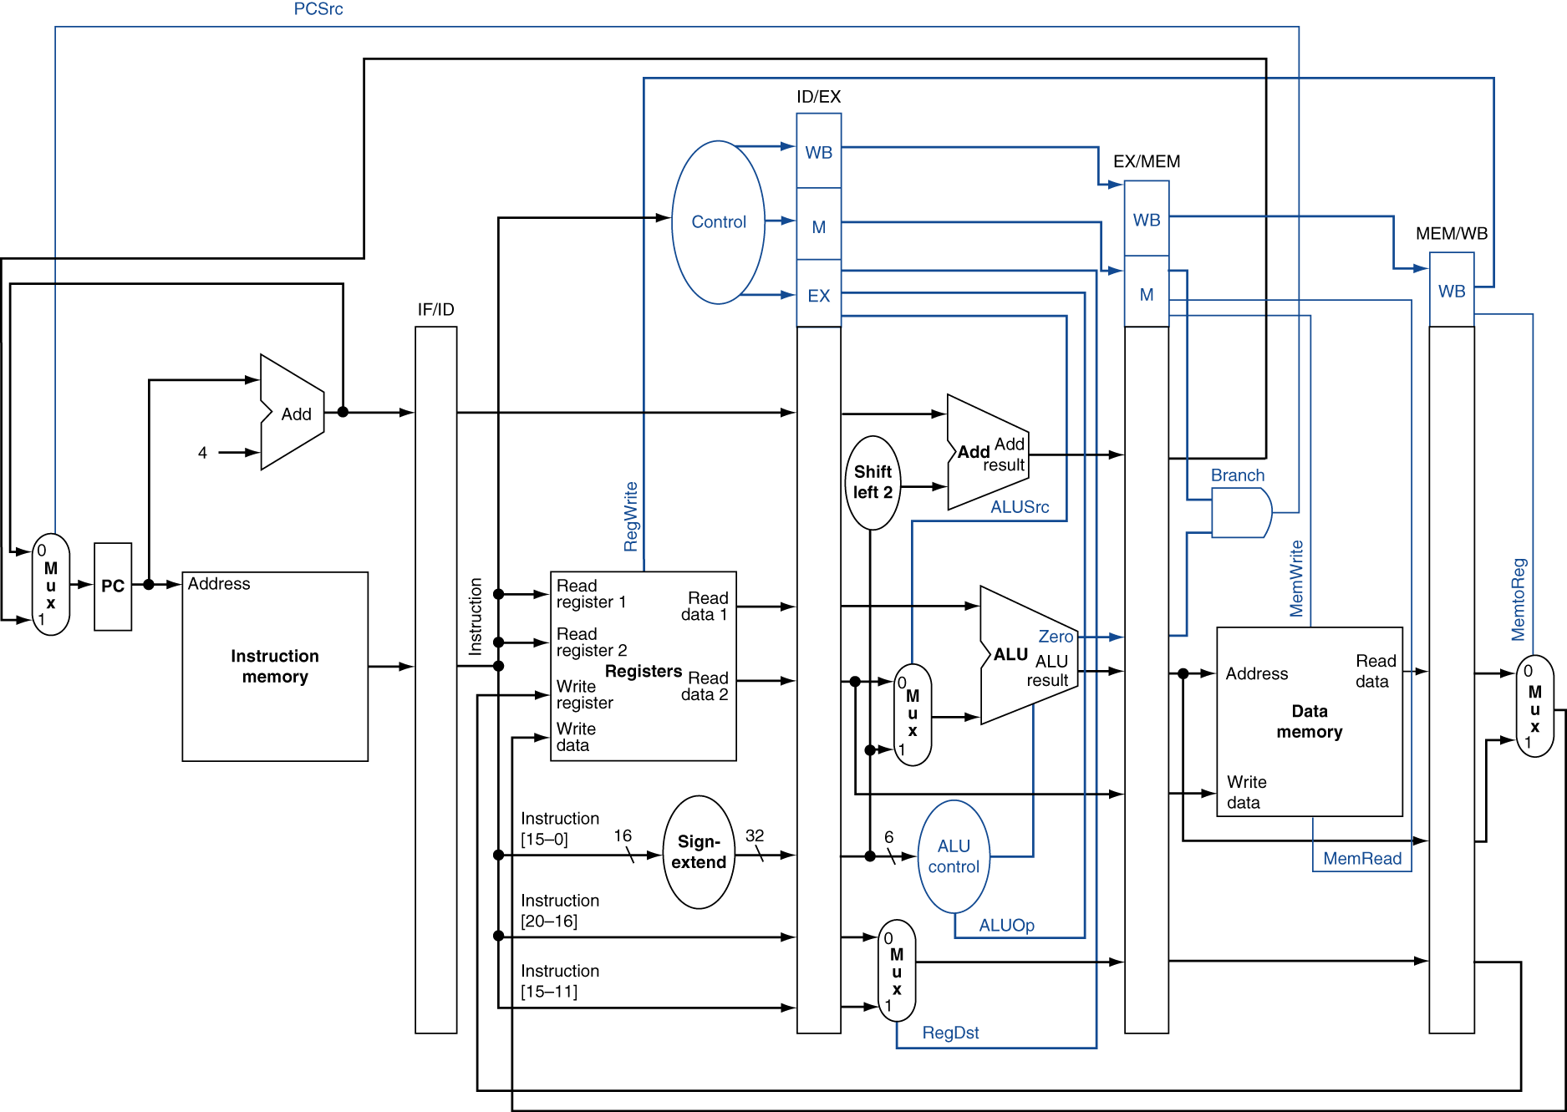
Pipelined Control

Slide 28
Hazards
Situations that prevent starting the next instruction in the next cycle
Structure hazards
A required resource is busy
Data hazard
Need to wait for previous instruction to complete its data read/write
Control hazard
Deciding on control action depends on previous instruction

Slide 29
Structure Hazards
Conflict for use of a resource
In MIPS pipeline with a single memory
Load/store requires data access
Instruction fetch would have to stall for that cycle
Would cause a pipeline “bubble”
Hence, pipelined datapaths require separate instruction/data memories
Or separate instruction/data caches

Slide 30
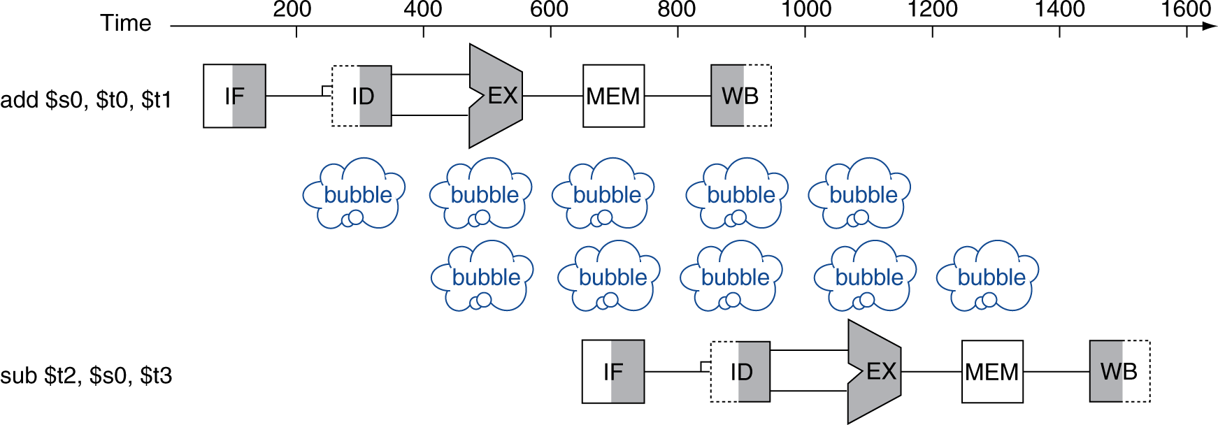
Data Hazards
An instruction depends on completion of data access by a previous instruction
add $s0, $t0, $t1 sub $t2, $s0, $t3

Slide 31
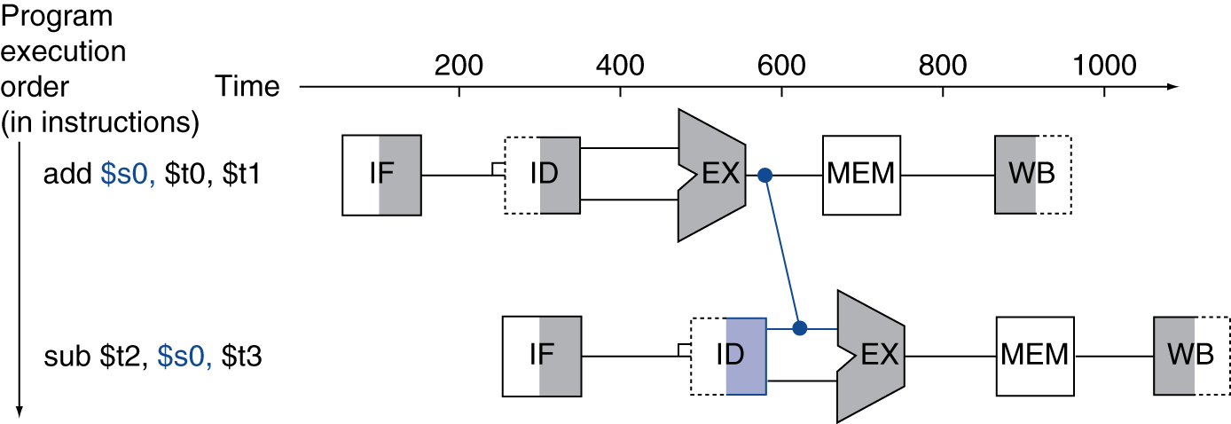
Forwarding (aka Bypassing)
Use result when it is computed
Don’t wait for it to be stored in a register
Requires extra connections in the datapath

Slide 32
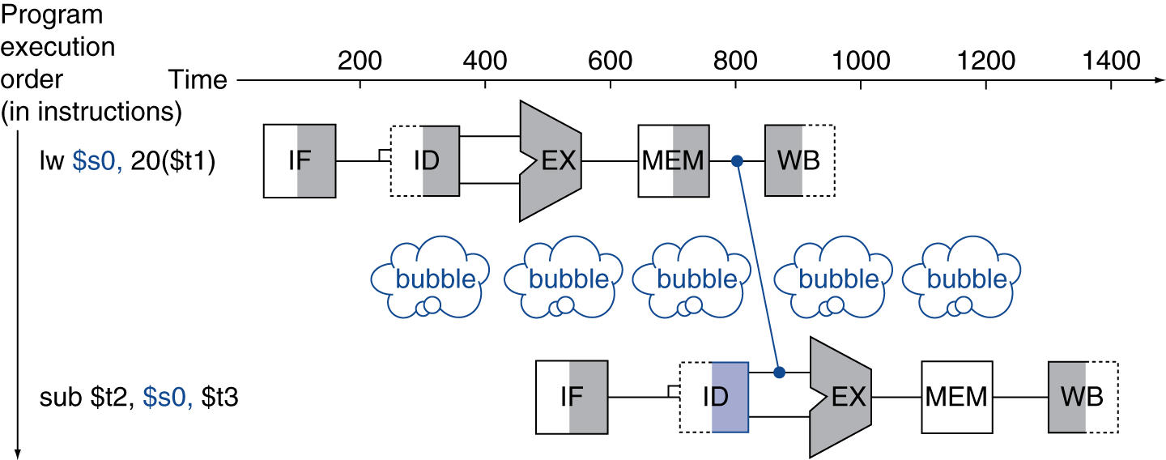
Load-Use Data Hazard
Can’t always avoid stalls by forwarding
If value not computed when needed
Can’t forward backward in time!

Slide 33
Code Scheduling to Avoid Stalls
Reorder code to avoid use of load result in the next instruction
C code for A = B + E; C = B + F;
lw $t1, 0($t0)
lw $t2, 4($t0)
add $t3, $t1, $t2
sw $t3, 12($t0)
lw $t4, 8($t0)
add $t5, $t1, $t4
sw $t5, 16($t0)
lw $t1, 0($t0)
lw $t2, 4($t0)
lw $t4, 8($t0)
add $t3, $t1, $t2
sw $t3, 12($t0)
add $t5, $t1, $t4
sw $t5, 16($t0)
stall
stall
13 cycles
11 cycles

Slide 34
Data Hazards in ALU Instructions
Consider this sequence:
sub $2, $1,$3 and $12,$2,$5 or $13,$6,$2 add $14,$2,$2 sw $15,100($2)
We can resolve hazards with forwarding
How do we detect when to forward?
§4.7 Data Hazards: Forwarding vs. Stalling

Slide 35
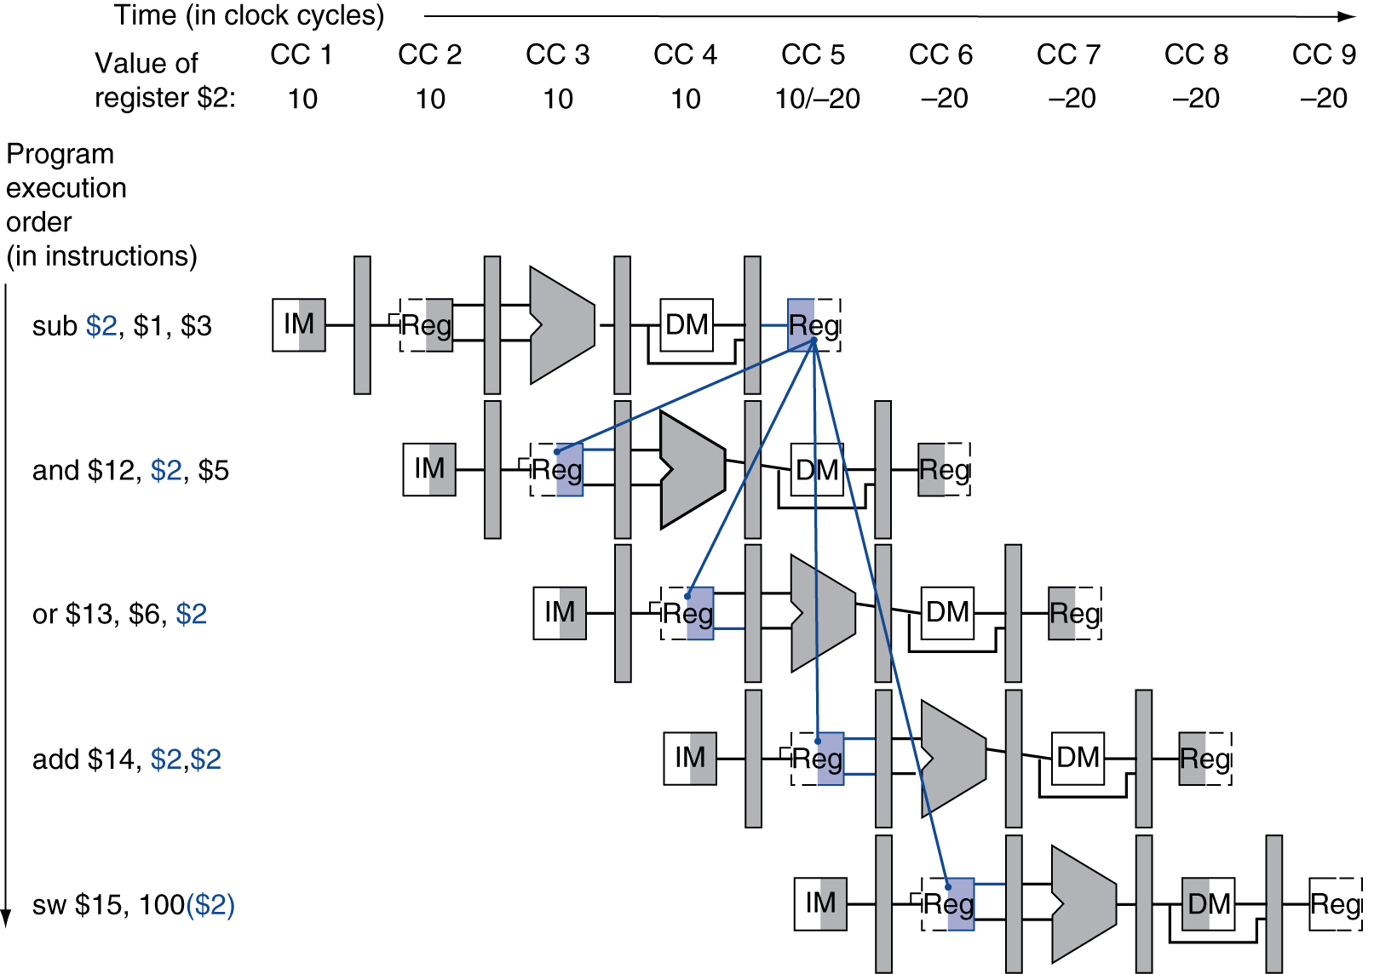
Dependencies & Forwarding

Slide 36
Detecting the Need to Forward
Pass register numbers along pipeline
e.g., ID/EX.RegisterRs = register number for Rs sitting in ID/EX pipeline register
ALU operand register numbers in EX stage are given by
ID/EX.RegisterRs, ID/EX.RegisterRt
Data hazards when
1a. EX/MEM.RegisterRd = ID/EX.RegisterRs
1b. EX/MEM.RegisterRd = ID/EX.RegisterRt
2a. MEM/WB.RegisterRd = ID/EX.RegisterRs
2b. MEM/WB.RegisterRd = ID/EX.RegisterRt
Fwd from EX/MEM pipeline reg
Fwd from MEM/WB pipeline reg

Slide 37
Detecting the Need to Forward
But only if forwarding instruction will write to a register!
EX/MEM.RegWrite, MEM/WB.RegWrite
And only if Rd for that instruction is not $zero
EX/MEM.RegisterRd ≠ 0, MEM/WB.RegisterRd ≠ 0

Slide 38
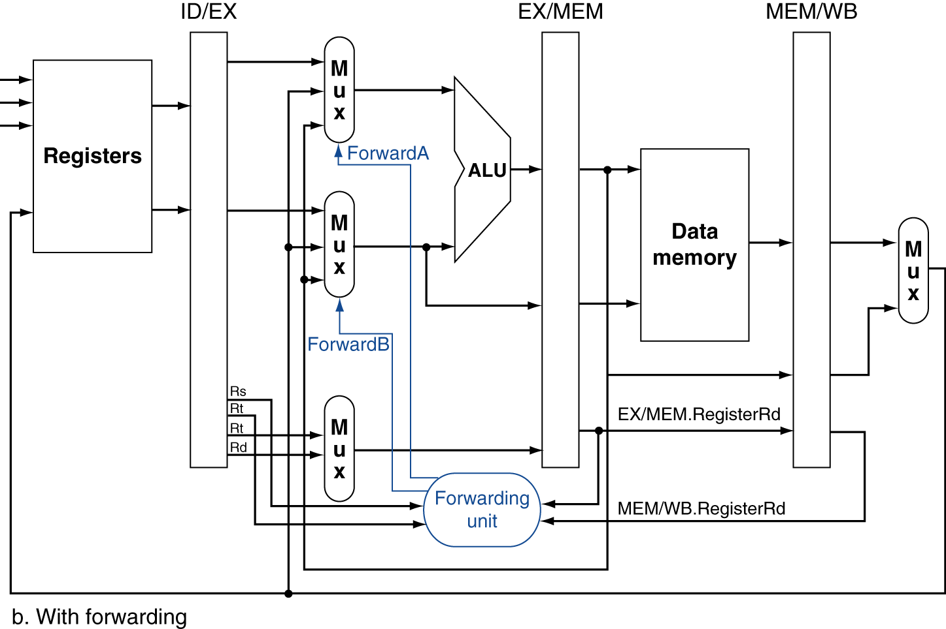
Forwarding Paths

Slide 39
Forwarding Conditions
EX hazard
if (EX/MEM.RegWrite and (EX/MEM.RegisterRd ≠ 0) and (EX/MEM.RegisterRd = ID/EX.RegisterRs)) ForwardA = 10
if (EX/MEM.RegWrite and (EX/MEM.RegisterRd ≠ 0) and (EX/MEM.RegisterRd = ID/EX.RegisterRt)) ForwardB = 10
MEM hazard
if (MEM/WB.RegWrite and (MEM/WB.RegisterRd ≠ 0) and (MEM/WB.RegisterRd = ID/EX.RegisterRs)) ForwardA = 01
if (MEM/WB.RegWrite and (MEM/WB.RegisterRd ≠ 0) and (MEM/WB.RegisterRd = ID/EX.RegisterRt)) ForwardB = 01

Slide 40
Double Data Hazard
Consider the sequence:
add $1,$1,$2 add $1,$1,$3 add $1,$1,$4
Both hazards occur
Want to use the most recent
Revise MEM hazard condition
Only fwd if EX hazard condition isn’t true

Slide 41
Revised Forwarding Condition
MEM hazard
if (MEM/WB.RegWrite and (MEM/WB.RegisterRd ≠ 0) and not (EX/MEM.RegWrite and (EX/MEM.RegisterRd ≠ 0) and (EX/MEM.RegisterRd = ID/EX.RegisterRs)) and (MEM/WB.RegisterRd = ID/EX.RegisterRs)) ForwardA = 01
if (MEM/WB.RegWrite and (MEM/WB.RegisterRd ≠ 0) and not (EX/MEM.RegWrite and (EX/MEM.RegisterRd ≠ 0) and (EX/MEM.RegisterRd = ID/EX.RegisterRt)) and (MEM/WB.RegisterRd = ID/EX.RegisterRt)) ForwardB = 01

Slide 42
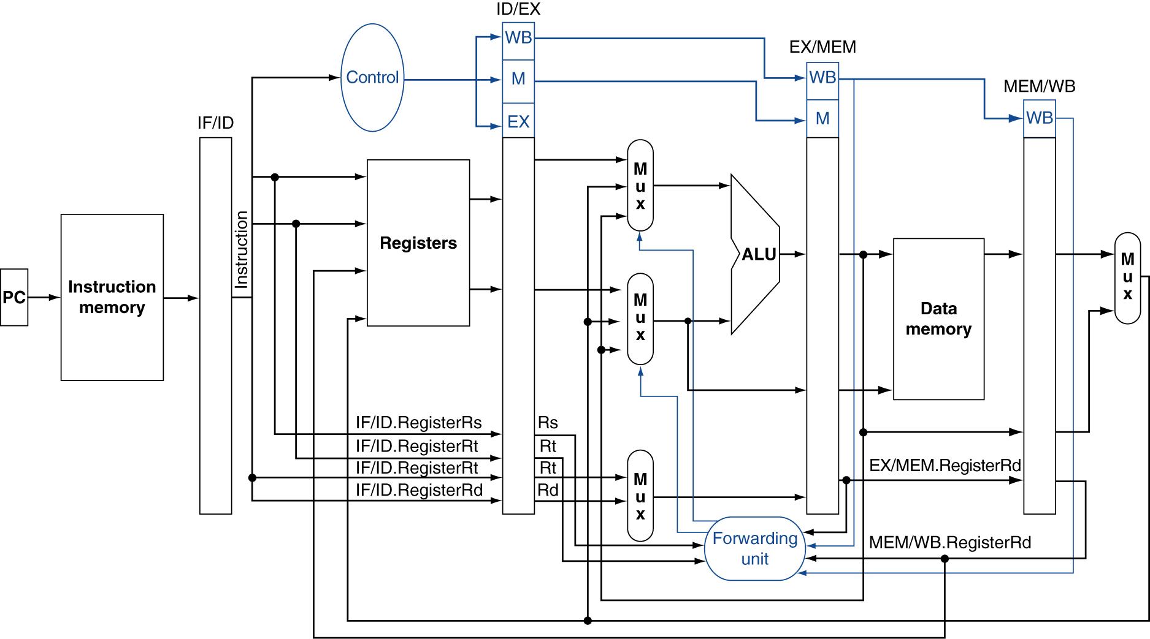
Datapath with Forwarding

Slide 43
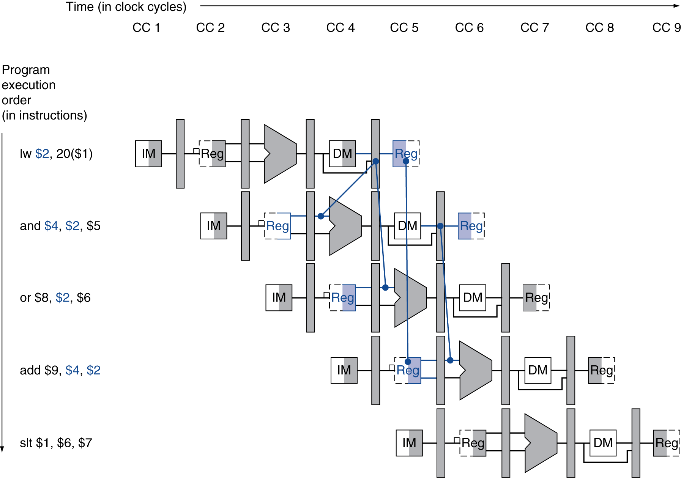
Load-Use Data Hazard
Need to stall for one cycle

Slide 44
Load-Use Hazard Detection
Check when using instruction is decoded in ID stage
ALU operand register numbers in ID stage are given by
IF/ID.RegisterRs, IF/ID.RegisterRt
Load-use hazard when
ID/EX.MemRead and ((ID/EX.RegisterRt = IF/ID.RegisterRs) or (ID/EX.RegisterRt = IF/ID.RegisterRt))
If detected, stall and insert bubble

Slide 45
How to Stall the Pipeline
Force control values in ID/EX register to 0
EX, MEM and WB do nop (no-operation)
Prevent update of PC and IF/ID register
Using instruction is decoded again
Following instruction is fetched again
1-cycle stall allows MEM to read data for lw
Can subsequently forward to EX stage

Slide 46
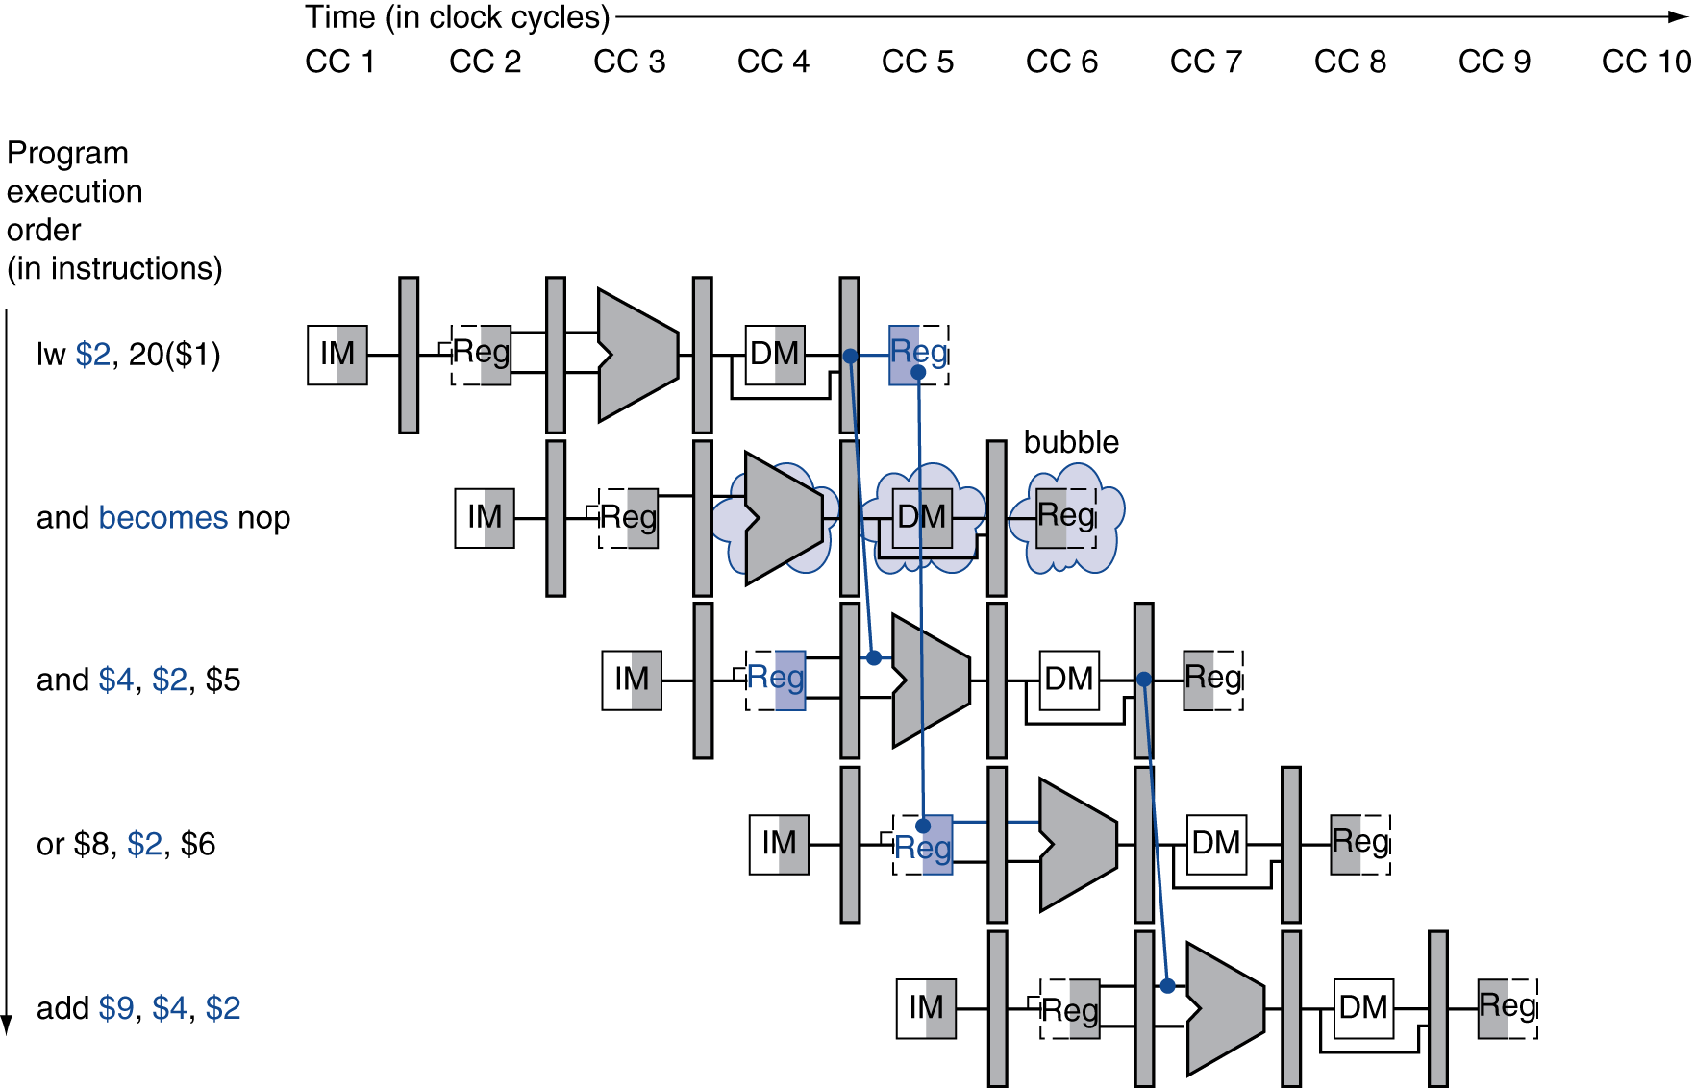
Stall/Bubble in the Pipeline
Stall inserted here

Slide 47
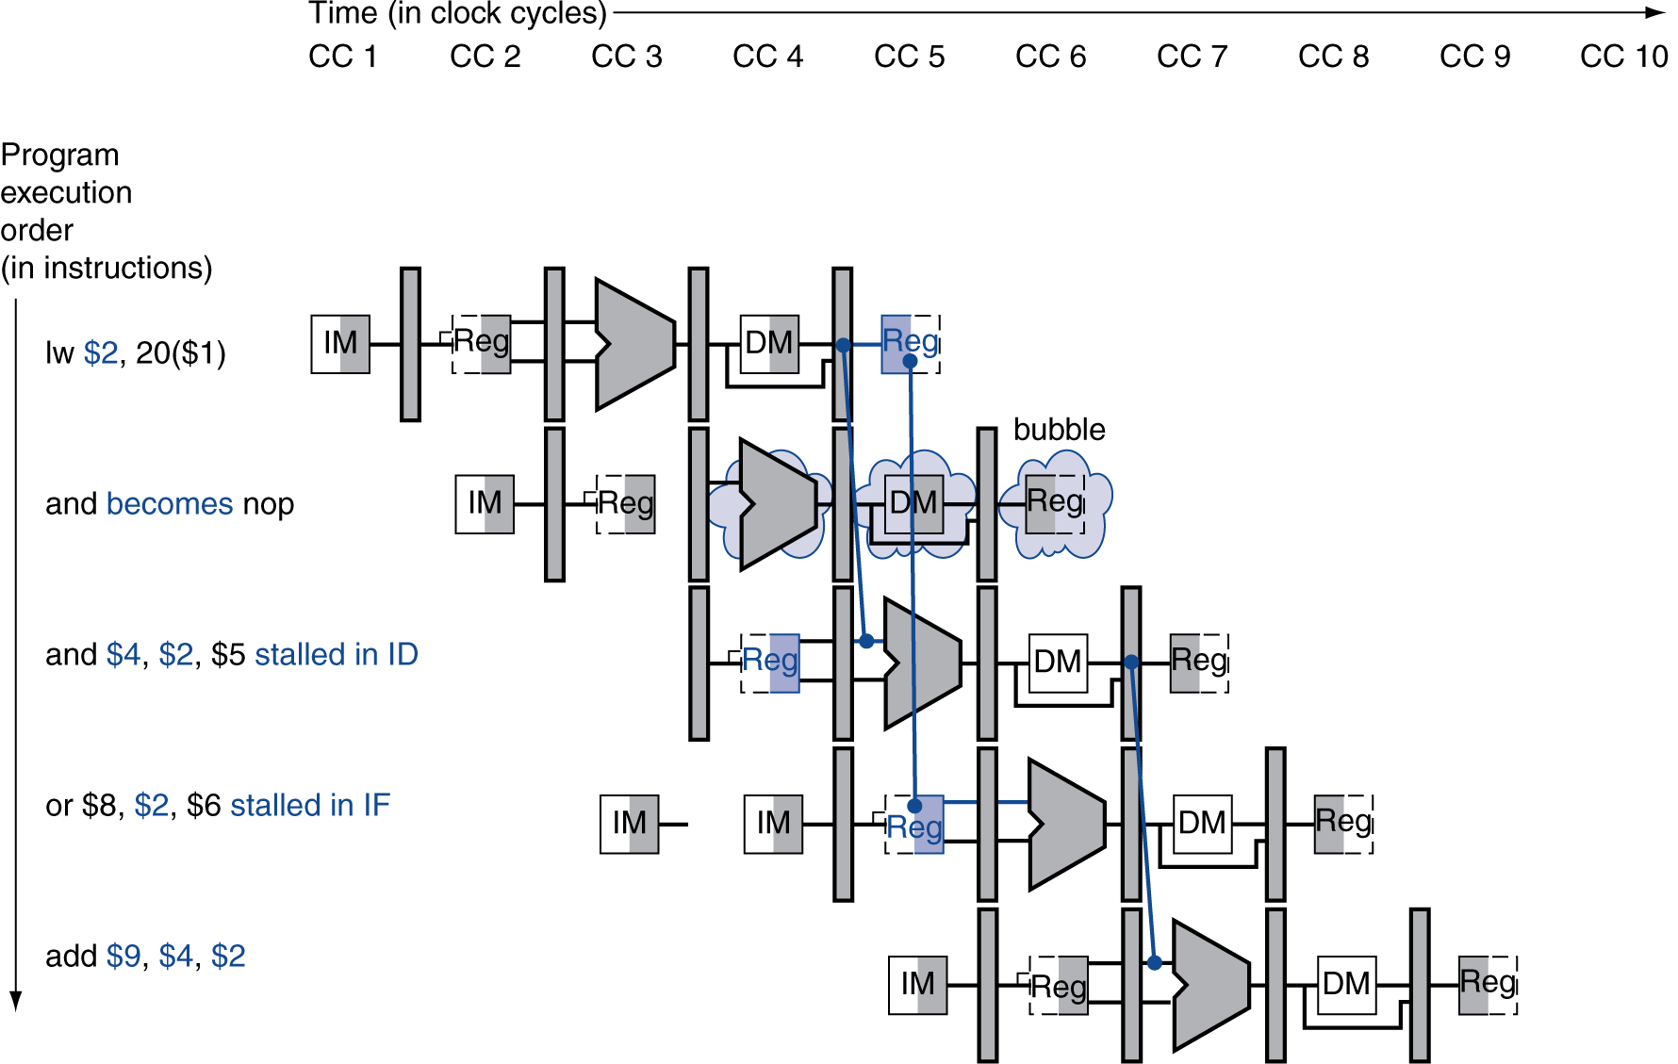
Stall/Bubble in the Pipeline
Or, more accurately…

Slide 48
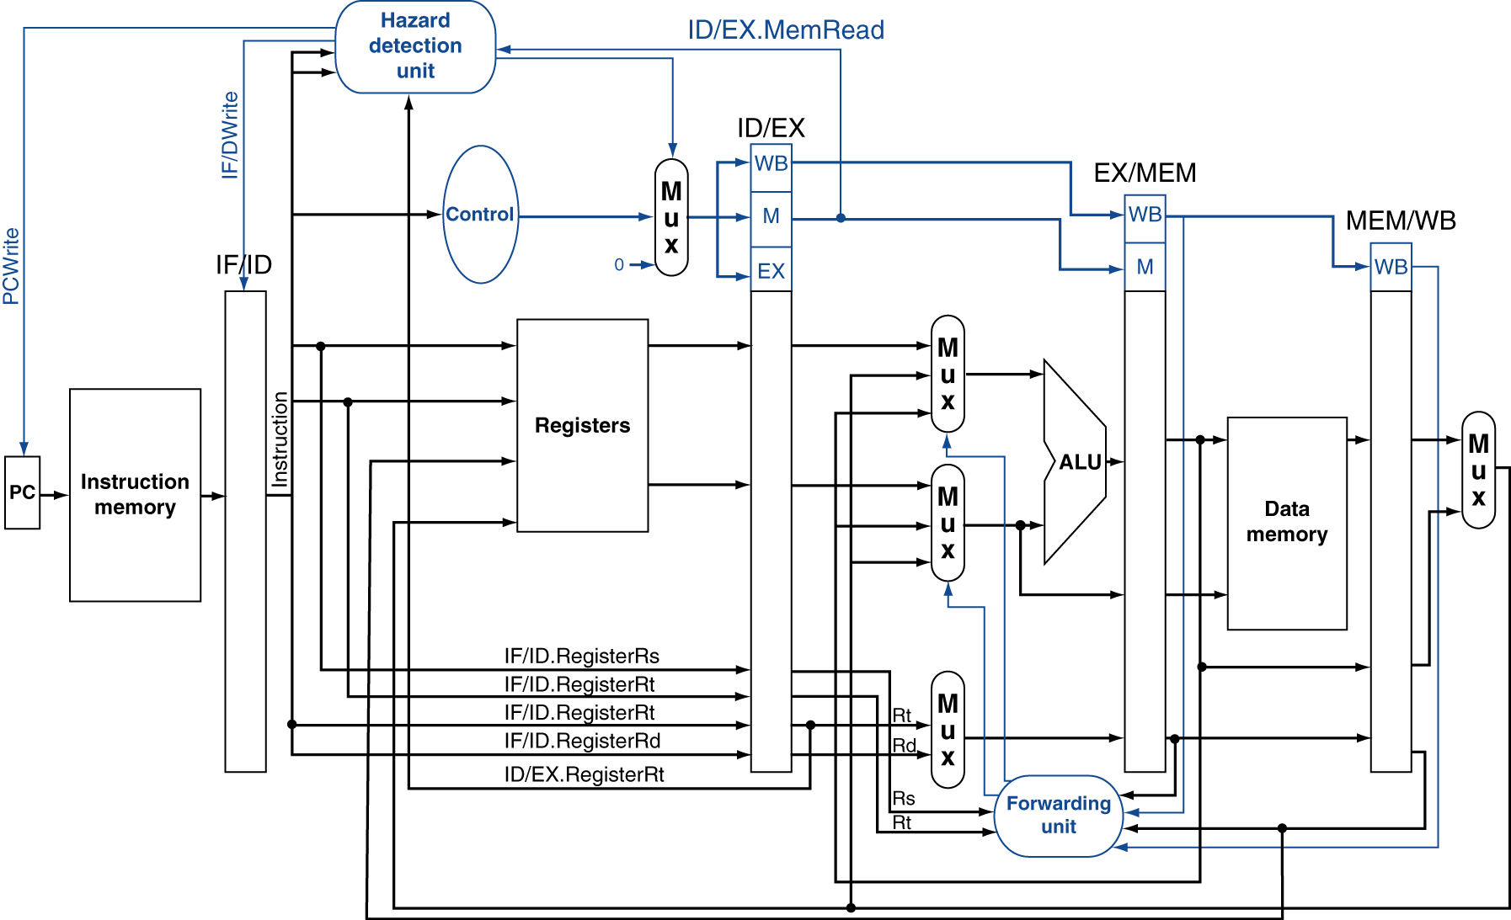
Datapath with Hazard Detection

Slide 49
Stalls and Performance
The BIG Picture
Stalls reduce performance
But are required to get correct results
Compiler can arrange code to avoid hazards and stalls
Requires knowledge of the pipeline structure

Slide 50
Control Hazards
Branch determines flow of control
Fetching next instruction depends on branch outcome
Pipeline can’t always fetch correct instruction
Still working on ID stage of branch
In MIPS pipeline
Need to compare registers and compute target early in the pipeline
Add hardware to do it in ID stage

Slide 51
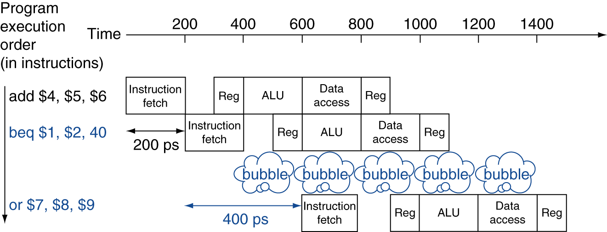
Stall on Branch
Wait until branch outcome determined before fetching next instruction

Slide 52
Branch Prediction
Longer pipelines can’t readily determine branch outcome early
Stall penalty becomes unacceptable
Predict outcome of branch
Only stall if prediction is wrong
In MIPS pipeline
Can predict branches not taken
Fetch instruction after branch, with no delay

Slide 53
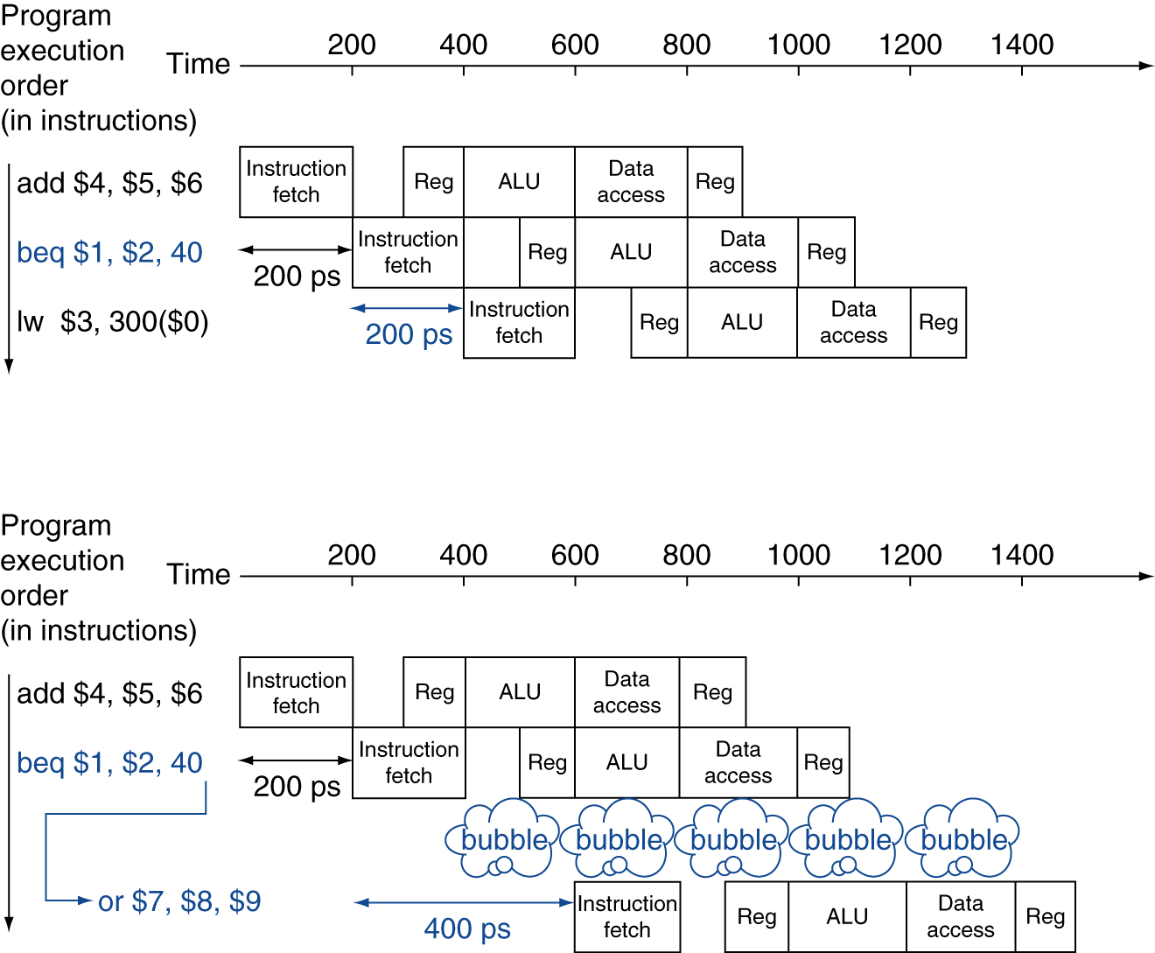
MIPS with Predict Not Taken
Prediction correct
Prediction incorrect

Slide 54
More-Realistic Branch Prediction
Static branch prediction
Based on typical branch behavior
Example: loop and if-statement branches
Predict backward branches taken
Predict forward branches not taken
Dynamic branch prediction
Hardware measures actual branch behavior
e.g., record recent history of each branch
Assume future behavior will continue the trend
When wrong, stall while re-fetching, and update history

Slide 55
Pipeline Summary
The BIG Picture
Pipelining improves performance by increasing instruction throughput
Executes multiple instructions in parallel
Each instruction has the same latency
Subject to hazards
Structure, data, control
Instruction set design affects complexity of pipeline implementation

Slide 56
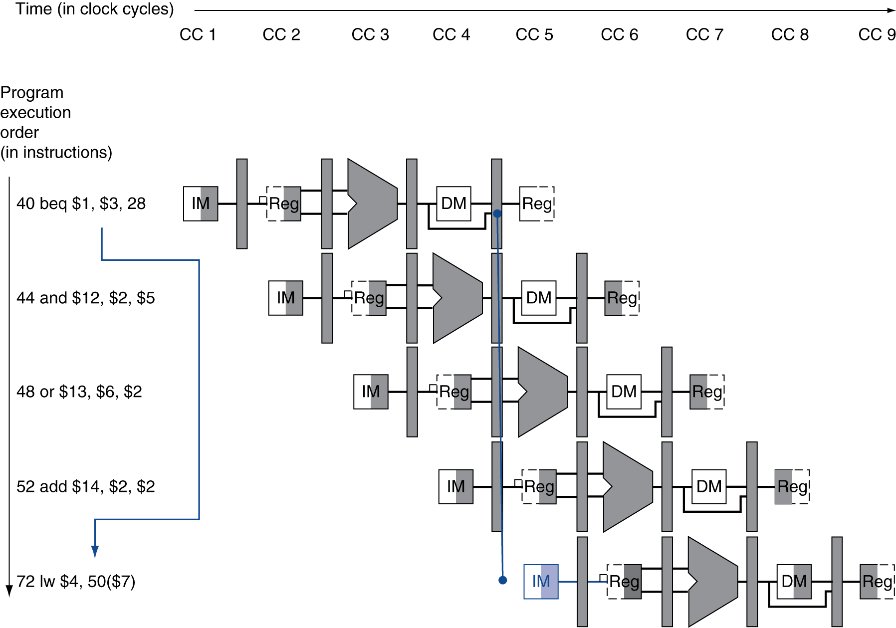
Branch Hazards
§4.8 Control Hazards
If branch outcome determined in MEM
Flush these instructions
(Set control values to 0)
PC

Slide 57
Reducing Branch Delay
Move hardware to determine outcome to ID stage
Target address adder
Register comparator
Example: branch taken
36: sub $10, $4, $8 40: beq $1, $3, 7 44: and $12, $2, $5 48: or $13, $2, $6 52: add $14, $4, $2 56: slt $15, $6, $7 ... 72: lw $4, 50($7)

Slide 58
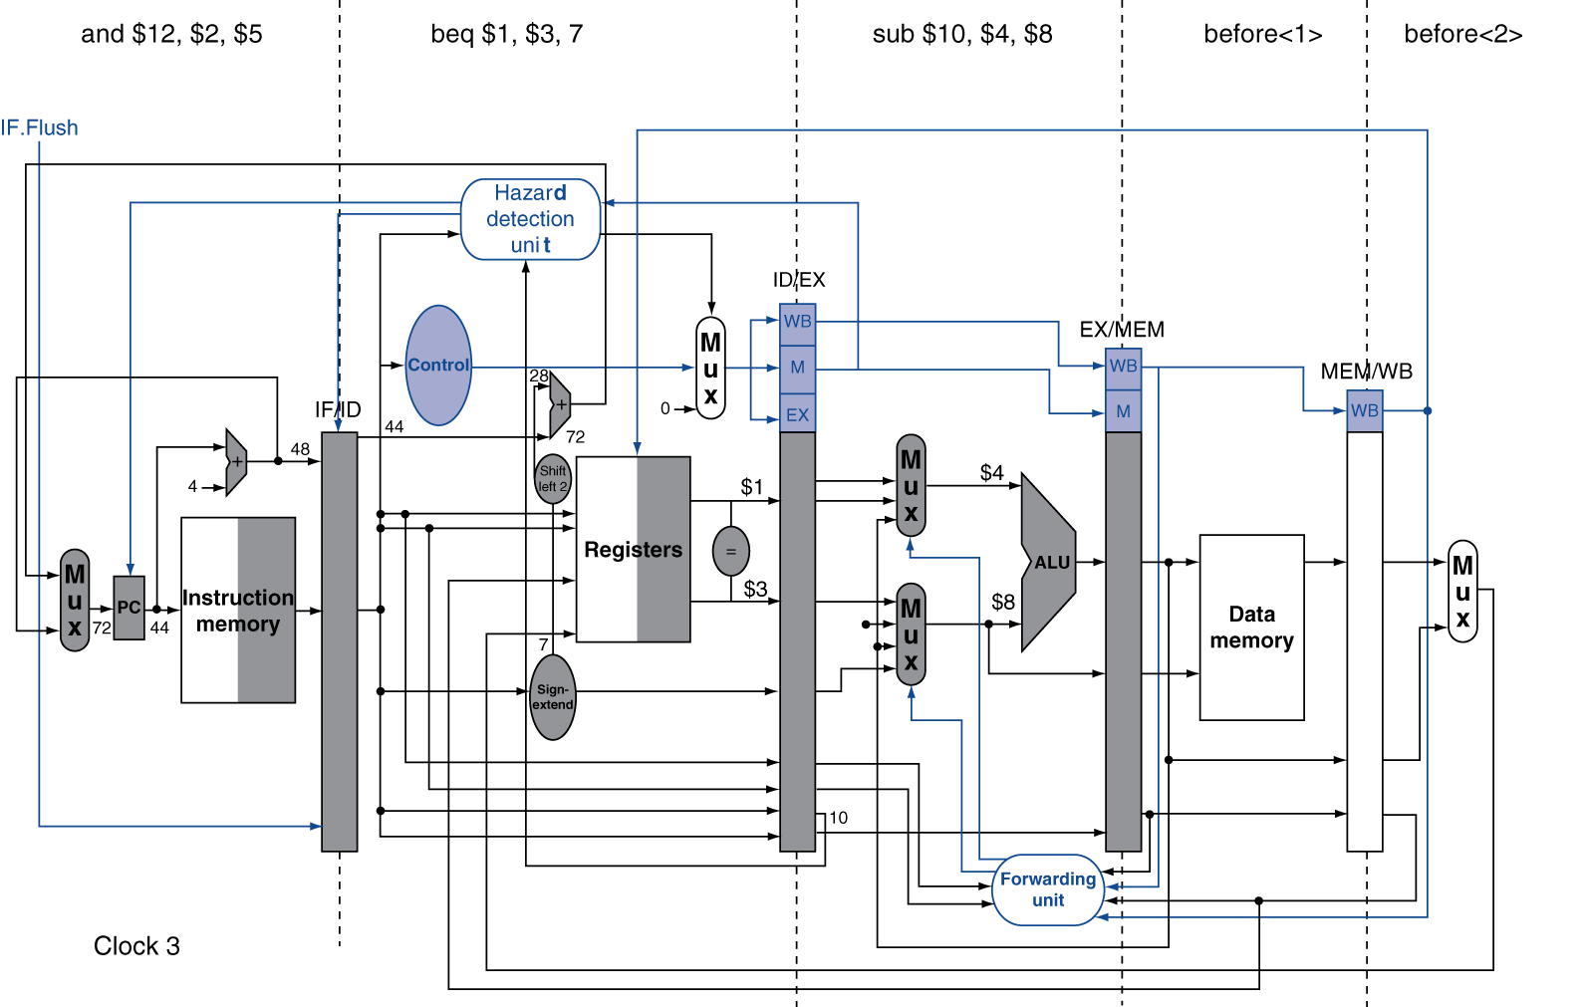
Example: Branch Taken

Slide 59
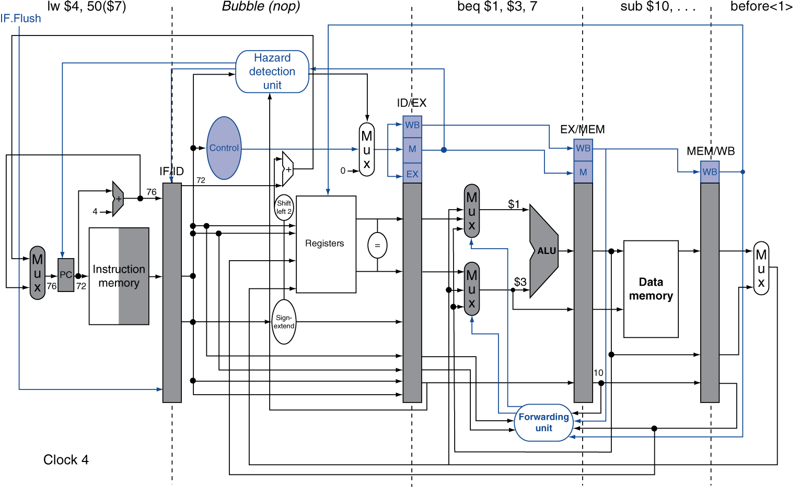
Example: Branch Taken

Slide 60
Data Hazards for Branches
If a comparison register is a destination of 2nd or 3rd preceding ALU instruction
add $1, $2, $3
IF
ID
EX
MEM
WB
add $4, $5, $6
IF
ID
EX
MEM
WB
…
IF
ID
EX
MEM
WB
beq $1, $4, target
IF
ID
EX
MEM
WB
Can resolve using forwarding

Slide 61
Data Hazards for Branches
If a comparison register is a destination of preceding ALU instruction or 2nd preceding load instruction
Need 1 stall cycle
lw $1, addr
IF
ID
EX
MEM
WB
add $4, $5, $6
IF
ID
EX
MEM
WB
beq stalled
IF
ID
beq $1, $4, target
ID
EX
MEM
WB

Slide 62
Data Hazards for Branches
If a comparison register is a destination of immediately preceding load instruction
Need 2 stall cycles
lw $1, addr
IF
ID
EX
MEM
WB
beq stalled
IF
ID
beq stalled
ID
beq $1, $0, target
ID
EX
MEM
WB

Slide 63
Dynamic Branch Prediction
In deeper and superscalar pipelines, branch penalty is more significant
Use dynamic prediction
Branch prediction buffer (aka branch history table)
Indexed by recent branch instruction addresses
Stores outcome (taken/not taken)
To execute a branch
Check table, expect the same outcome
Start fetching from fall-through or target
If wrong, flush pipeline and flip prediction

Slide 64
1-Bit Predictor: Shortcoming
Inner loop branches mispredicted twice!
outer: … … inner: …
…
beq …, …, inner … beq …, …, outer
Mispredict as taken on last iteration of inner loop
Then mispredict as not taken on first iteration of inner loop next time around

Slide 65
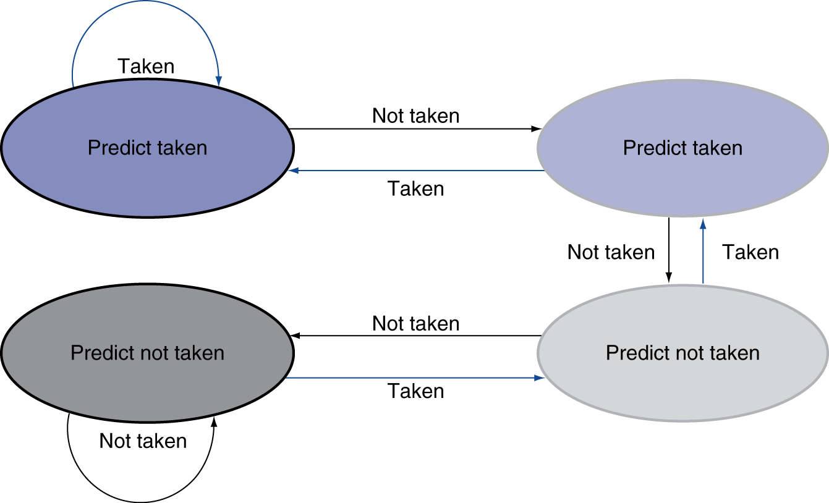
2-Bit Predictor
Only change prediction on two successive mispredictions

Slide 66
Calculating the Branch Target
Even with predictor, still need to calculate the target address
1-cycle penalty for a taken branch
Branch target buffer
Cache of target addresses
Indexed by PC when instruction fetched
If hit and instruction is branch predicted taken, can fetch target immediately

Slide 67
Exceptions and Interrupts
§4.9 Exceptions
“Unexpected” events requiring change in flow of control
Different ISAs use the terms differently
Exception
Arises within the CPU
e.g., undefined opcode, overflow, syscall, …
Interrupt
From an external I/O controller
Dealing with them without sacrificing performance is hard

Slide 68
Handling Exceptions
In MIPS, exceptions managed by a System Control Coprocessor (CP0)
Save PC of offending (or interrupted) instruction
In MIPS: Exception Program Counter (EPC)
Save indication of the problem
In MIPS: Cause register
We’ll assume 1-bit
0 for undefined opcode, 1 for overflow
Jump to handler at 8000 00180

Slide 69
An Alternate Mechanism
Vectored Interrupts
Handler address determined by the cause
Example:
Undefined opcode: C000 0000
Overflow: C000 0020
…: C000 0040
Instructions either
Deal with the interrupt, or
Jump to real handler

Slide 70
Handler Actions
Read cause, and transfer to relevant handler
Determine action required
If restartable
Take corrective action
use EPC to return to program
Otherwise
Terminate program
Report error using EPC, cause, …

Slide 71
Exceptions in a Pipeline
Another form of control hazard
Consider overflow on add in EX stage
add $1, $2, $1
Prevent $1 from being clobbered
Complete previous instructions
Flush add and subsequent instructions
Set Cause and EPC register values
Transfer control to handler
Similar to mispredicted branch
Use much of the same hardware

Slide 72
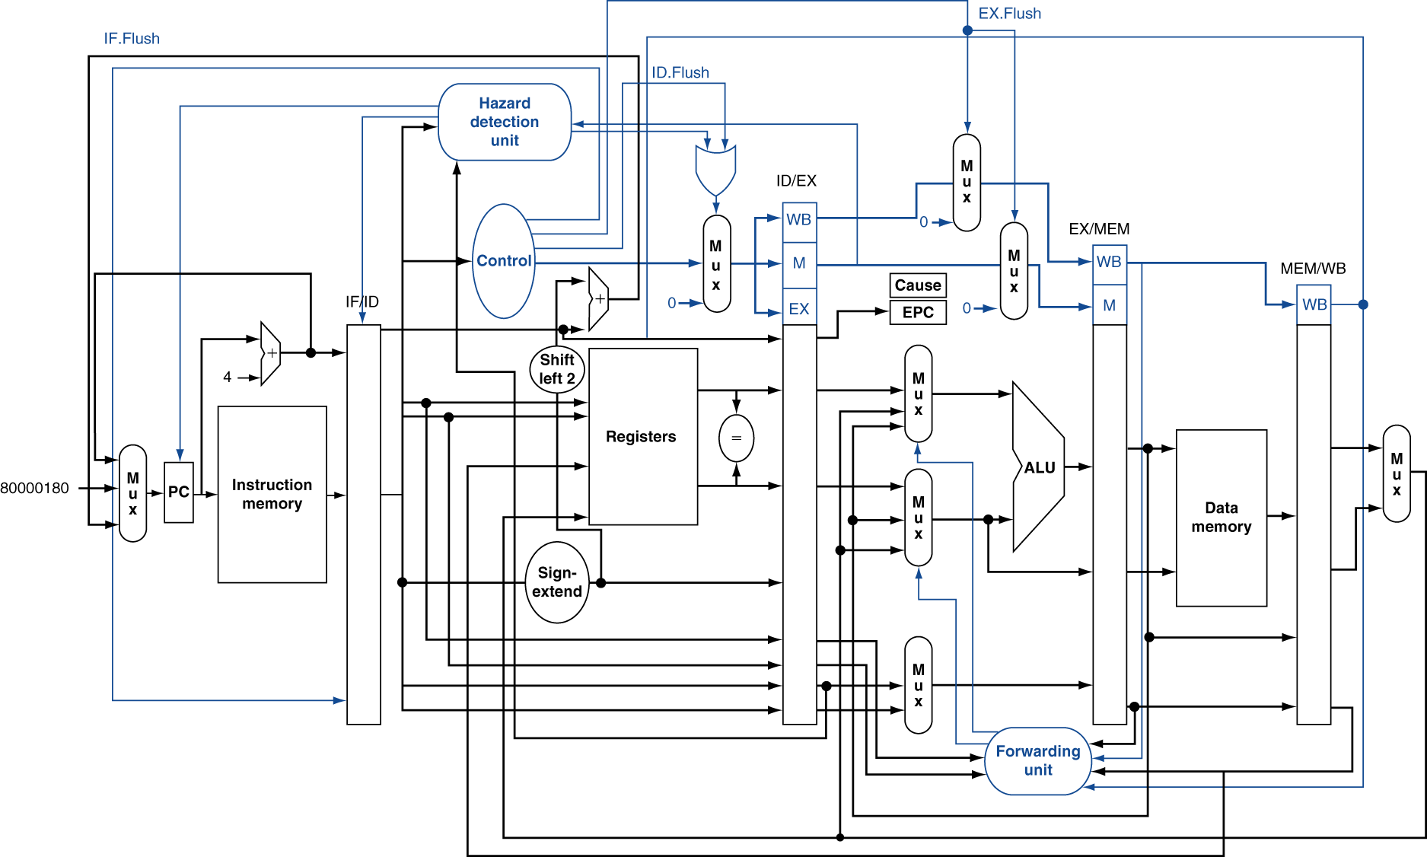
Pipeline with Exceptions

Slide 73
Exception Properties
Restartable exceptions
Pipeline can flush the instruction
Handler executes, then returns to the instruction
Refetched and executed from scratch
PC saved in EPC register
Identifies causing instruction
Actually PC + 4 is saved
Handler must adjust

Slide 74
Exception Example
Exception on add in
40 sub $11, $2, $4 44 and $12, $2, $5 48 or $13, $2, $6 4C add $1, $2, $1 50 slt $15, $6, $7 54 lw $16, 50($7) …
Handler
80000180 sw $25, 1000($0) 80000184 sw $26, 1004($0) …

Slide 75
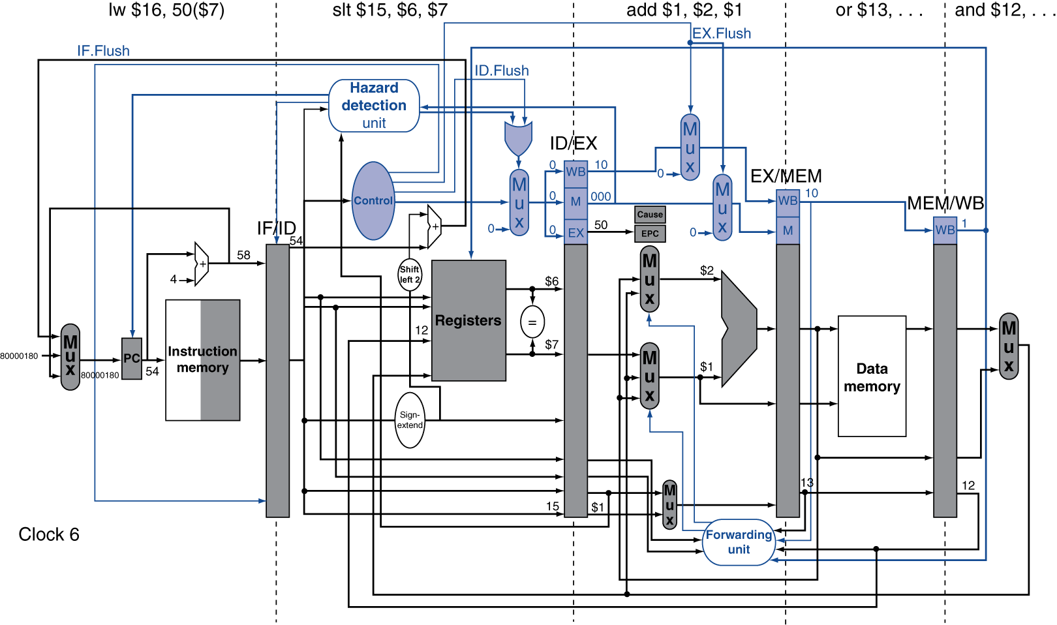
Exception Example

Slide 76
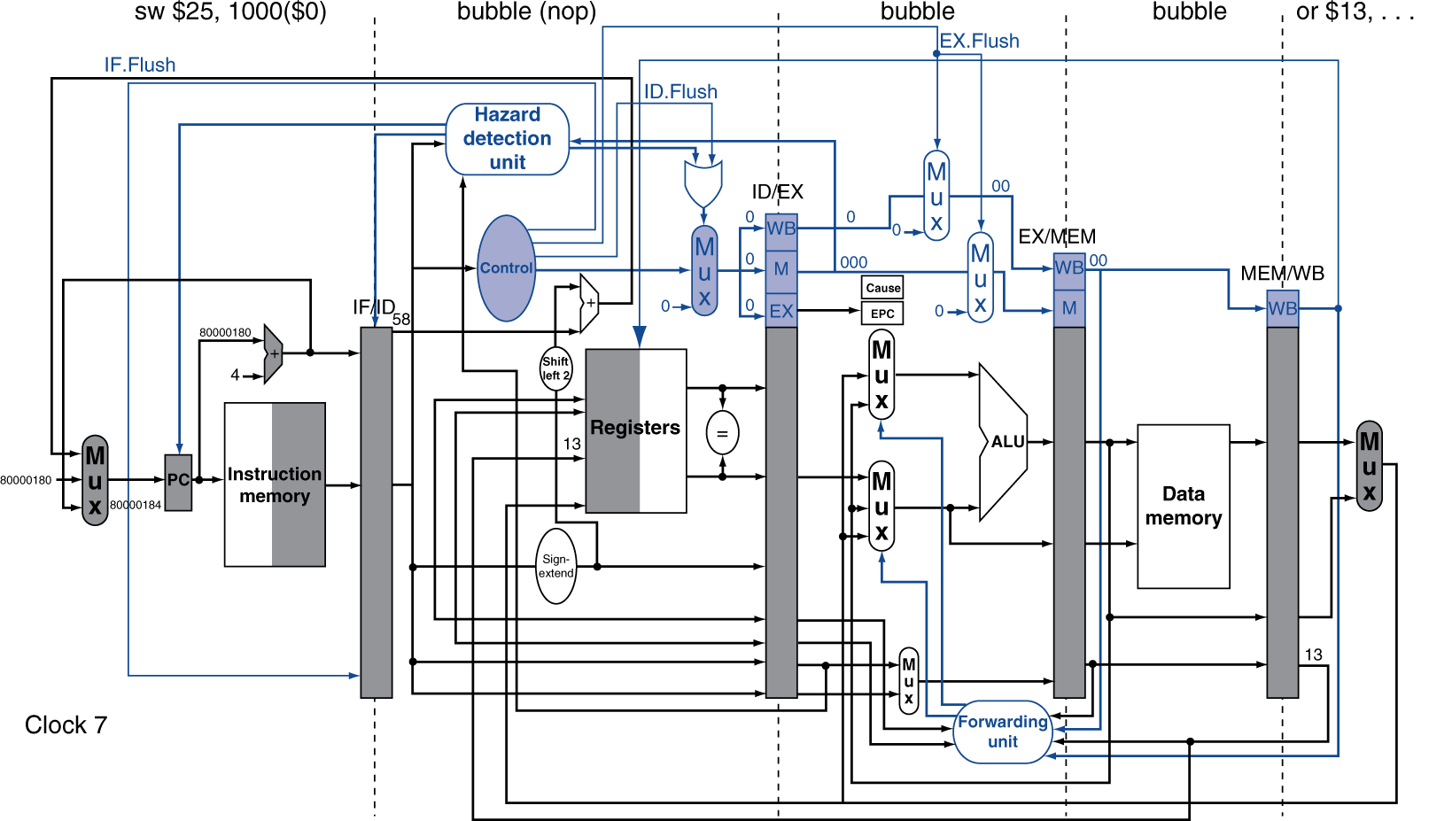
Exception Example

Slide 77
Multiple Exceptions
Pipelining overlaps multiple instructions
Could have multiple exceptions at once
Simple approach: deal with exception from earliest instruction
Flush subsequent instructions
“Precise” exceptions
In complex pipelines
Multiple instructions issued per cycle
Out-of-order completion
Maintaining precise exceptions is difficult!

Slide 78
Imprecise Exceptions
Just stop pipeline and save state
Including exception cause(s)
Let the handler work out
Which instruction(s) had exceptions
Which to complete or flush
May require “manual” completion
Simplifies hardware, but more complex handler software
Not feasible for complex multiple-issue out-of-order pipelines

Slide 79
Instruction-Level Parallelism (ILP)
Pipelining: executing multiple instructions in parallel
To increase ILP
Deeper pipeline
Less work per stage ⇒ shorter clock cycle
Multiple issue
Replicate pipeline stages ⇒ multiple pipelines
Start multiple instructions per clock cycle
CPI < 1, so use Instructions Per Cycle (IPC)
E.g., 4GHz 4-way multiple-issue
16 BIPS, peak CPI = 0.25, peak IPC = 4
But dependencies reduce this in practice
§4.10 Parallelism and Advanced Instruction Level Parallelism

Slide 80
Multiple Issue
Static multiple issue
Compiler groups instructions to be issued together
Packages them into “issue slots”
Compiler detects and avoids hazards
Dynamic multiple issue
CPU examines instruction stream and chooses instructions to issue each cycle
Compiler can help by reordering instructions
CPU resolves hazards using advanced techniques at runtime

Slide 81
Speculation
“Guess” what to do with an instruction
Start operation as soon as possible
Check whether guess was right
If so, complete the operation
If not, roll-back and do the right thing
Common to static and dynamic multiple issue
Examples
Speculate on branch outcome
Roll back if path taken is different
Speculate on load
Roll back if location is updated

Slide 82
Compiler/Hardware Speculation
Compiler can reorder instructions
e.g., move load before branch
Can include “fix-up” instructions to recover from incorrect guess
Hardware can look ahead for instructions to execute
Buffer results until it determines they are actually needed
Flush buffers on incorrect speculation

Slide 83
Speculation and Exceptions
What if exception occurs on a speculatively executed instruction?
e.g., speculative load before null-pointer check
Static speculation
Can add ISA support for deferring exceptions
Dynamic speculation
Can buffer exceptions until instruction completion (which may not occur)

Slide 84
Static Multiple Issue
Compiler groups instructions into “issue packets”
Group of instructions that can be issued on a single cycle
Determined by pipeline resources required
Think of an issue packet as a very long instruction
Specifies multiple concurrent operations
⇒ Very Long Instruction Word (VLIW)

Slide 85
Scheduling Static Multiple Issue
Compiler must remove some/all hazards
Reorder instructions into issue packets
No dependencies with a packet
Possibly some dependencies between packets
Varies between ISAs; compiler must know!
Pad with nop if necessary

Slide 86
MIPS with Static Dual Issue
Two-issue packets
One ALU/branch instruction
One load/store instruction
64-bit aligned
ALU/branch, then load/store
Pad an unused instruction with nop
Address | Instruction type | Pipeline Stages
n | ALU/branch | IF | ID | EX | MEM | WB
n + 4 | Load/store | IF | ID | EX | MEM | WB
n + 8 | ALU/branch |  | IF | ID | EX | MEM | WB
n + 12 | Load/store |  | IF | ID | EX | MEM | WB
n + 16 | ALU/branch |  |  | IF | ID | EX | MEM | WB
n + 20 | Load/store |  |  | IF | ID | EX | MEM | WB

Slide 87
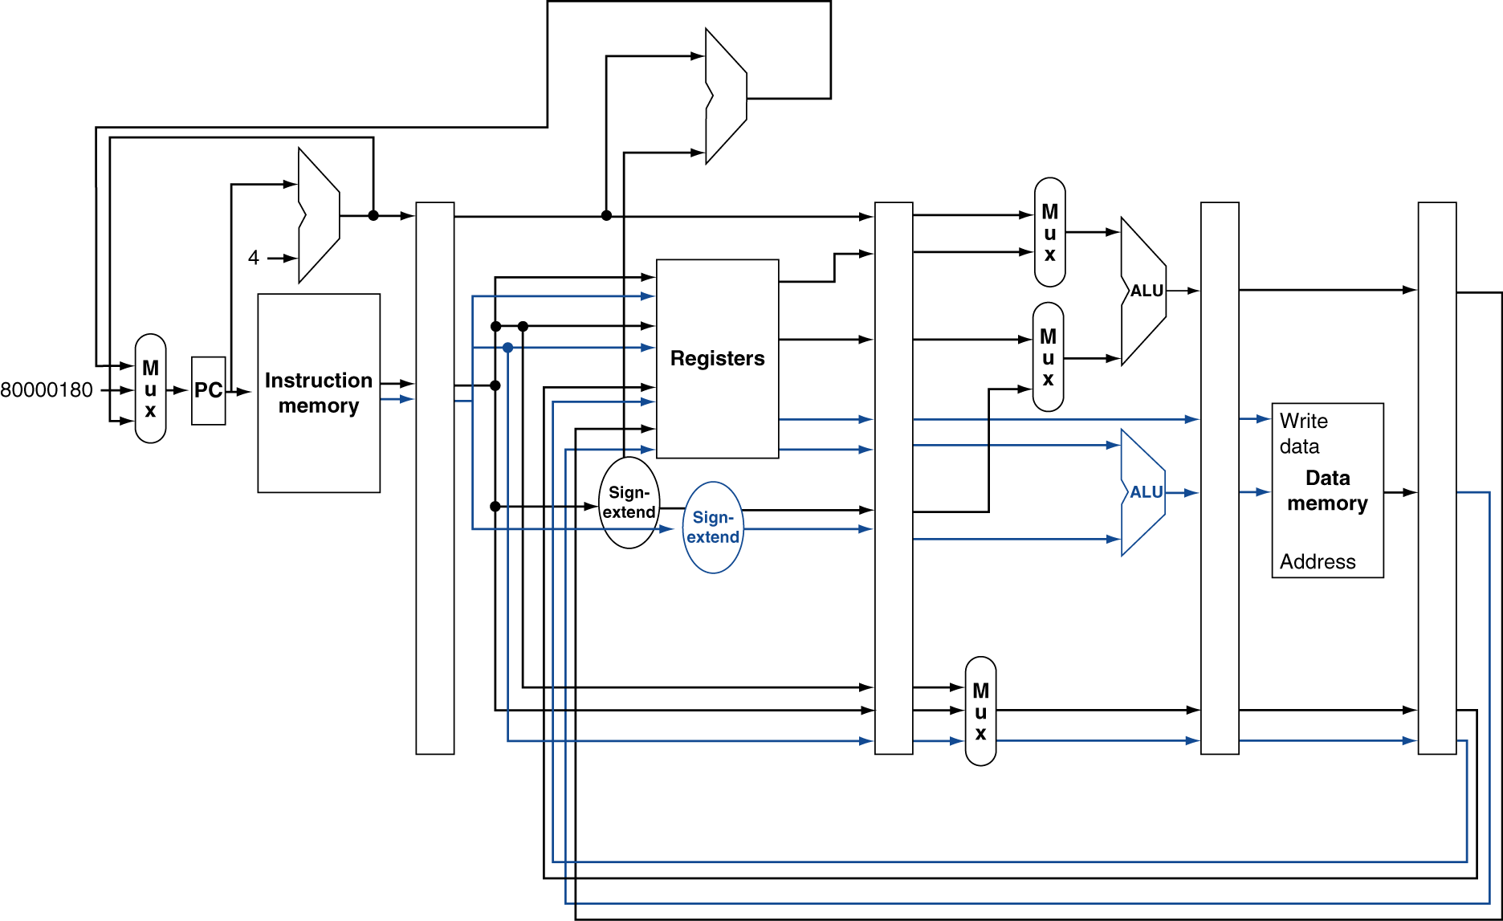
MIPS with Static Dual Issue

Slide 88
Hazards in the Dual-Issue MIPS
More instructions executing in parallel
EX data hazard
Forwarding avoided stalls with single-issue
Now can’t use ALU result in load/store in same packet
add $t0, $s0, $s1 load $s2, 0($t0)
Split into two packets, effectively a stall
Load-use hazard
Still one cycle use latency, but now two instructions
More aggressive scheduling required

Slide 89
Scheduling Example
Schedule this for dual-issue MIPS
Loop: lw $t0, 0($s1) # $t0=array element addu $t0, $t0, $s2 # add scalar in $s2 sw $t0, 0($s1) # store result addi $s1, $s1,–4 # decrement pointer bne $s1, $zero, Loop # branch $s1!=0
 | ALU/branch | Load/store | cycle
Loop: | nop | lw $t0, 0($s1) | 1
 | addi $s1, $s1,–4 | nop | 2
 | addu $t0, $t0, $s2 | nop | 3
 | bne $s1, $zero, Loop | sw $t0, 4($s1) | 4
IPC = 5/4 = 1.25 (c.f. peak IPC = 2)

Slide 90
Loop Unrolling
Replicate loop body to expose more parallelism
Reduces loop-control overhead
Use different registers per replication
Called “register renaming”
Avoid loop-carried “anti-dependencies”
Store followed by a load of the same register
Aka “name dependence”
Reuse of a register name

Slide 91
Loop Unrolling Example
 | ALU/branch | Load/store | cycle
Loop: | addi $s1, $s1,–16 | lw $t0, 0($s1) | 1
 | nop | lw $t1, 12($s1) | 2
 | addu $t0, $t0, $s2 | lw $t2, 8($s1) | 3
 | addu $t1, $t1, $s2 | lw $t3, 4($s1) | 4
 | addu $t2, $t2, $s2 | sw $t0, 16($s1) | 5
 | addu $t3, $t4, $s2 | sw $t1, 12($s1) | 6
 | nop | sw $t2, 8($s1) | 7
 | bne $s1, $zero, Loop | sw $t3, 4($s1) | 8
IPC = 14/8 = 1.75
Closer to 2, but at cost of registers and code size

Slide 92
Dynamic Multiple Issue
“Superscalar” processors
CPU decides whether to issue 0, 1, 2, … each cycle
Avoiding structural and data hazards
Avoids the need for compiler scheduling
Though it may still help
Code semantics ensured by the CPU

Slide 93
Dynamic Pipeline Scheduling
Allow the CPU to execute instructions out of order to avoid stalls
But commit result to registers in order
Example
lw $t0, 20($s2) addu $t1, $t0, $t2 sub $s4, $s4, $t3 slti $t5, $s4, 20
Can start sub while addu is waiting for lw

Slide 94
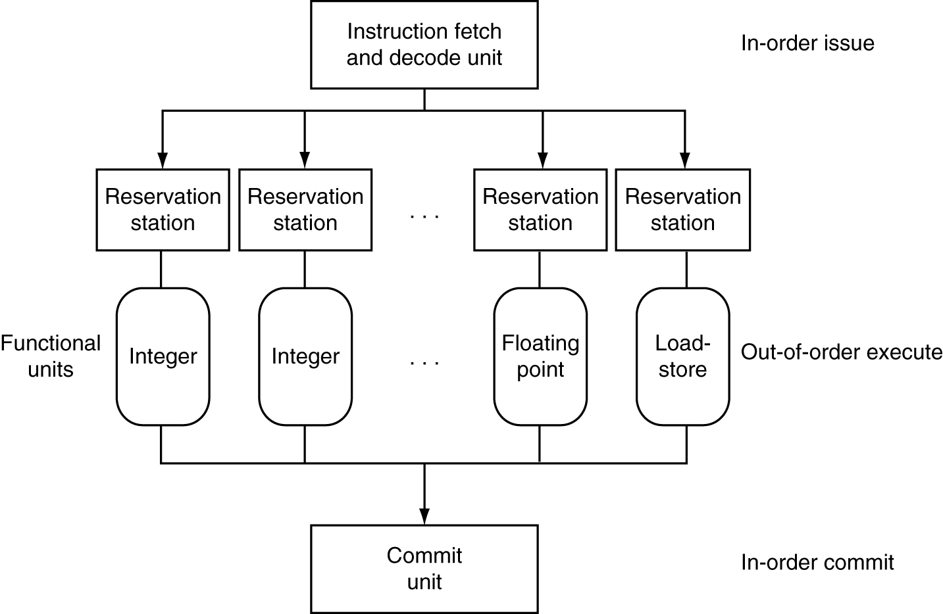
Dynamically Scheduled CPU
Preserves dependencies
Hold pending operands
Results also sent to any waiting reservation stations
Reorders buffer for register writes
Can supply operands for issued instructions

Slide 95
Register Renaming
Reservation stations and reorder buffer effectively provide register renaming
On instruction issue to reservation station
If operand is available in register file or reorder buffer
Copied to reservation station
No longer required in the register; can be overwritten
If operand is not yet available
It will be provided to the reservation station by a function unit
Register update may not be required

Slide 96
Speculation
Predict branch and continue issuing
Don’t commit until branch outcome determined
Load speculation
Avoid load and cache miss delay
Predict the effective address
Predict loaded value
Load before completing outstanding stores
Bypass stored values to load unit
Don’t commit load until speculation cleared

Slide 97
Why Do Dynamic Scheduling?
Why not just let the compiler schedule code?
Not all stalls are predicable
e.g., cache misses
Can’t always schedule around branches
Branch outcome is dynamically determined
Different implementations of an ISA have different latencies and hazards

Slide 98
Does Multiple Issue Work?
The BIG Picture
Yes, but not as much as we’d like
Programs have real dependencies that limit ILP
Some dependencies are hard to eliminate
e.g., pointer aliasing
Some parallelism is hard to expose
Limited window size during instruction issue
Memory delays and limited bandwidth
Hard to keep pipelines full
Speculation can help if done well

Slide 99
Power Efficiency
Complexity of dynamic scheduling and speculations requires power
Multiple simpler cores may be better
Microprocessor | Year | Clock Rate | Pipeline Stages | Issue width | Out-of-order/ Speculation | Cores | Power
i486 | 1989 | 25MHz | 5 | 1 | No | 1 | 5W
Pentium | 1993 | 66MHz | 5 | 2 | No | 1 | 10W
Pentium Pro | 1997 | 200MHz | 10 | 3 | Yes | 1 | 29W
P4 Willamette | 2001 | 2000MHz | 22 | 3 | Yes | 1 | 75W
P4 Prescott | 2004 | 3600MHz | 31 | 3 | Yes | 1 | 103W
Core | 2006 | 2930MHz | 14 | 4 | Yes | 2 | 75W
UltraSparc III | 2003 | 1950MHz | 14 | 4 | No | 1 | 90W
UltraSparc T1 | 2005 | 1200MHz | 6 | 1 | No | 8 | 70W

Slide 100
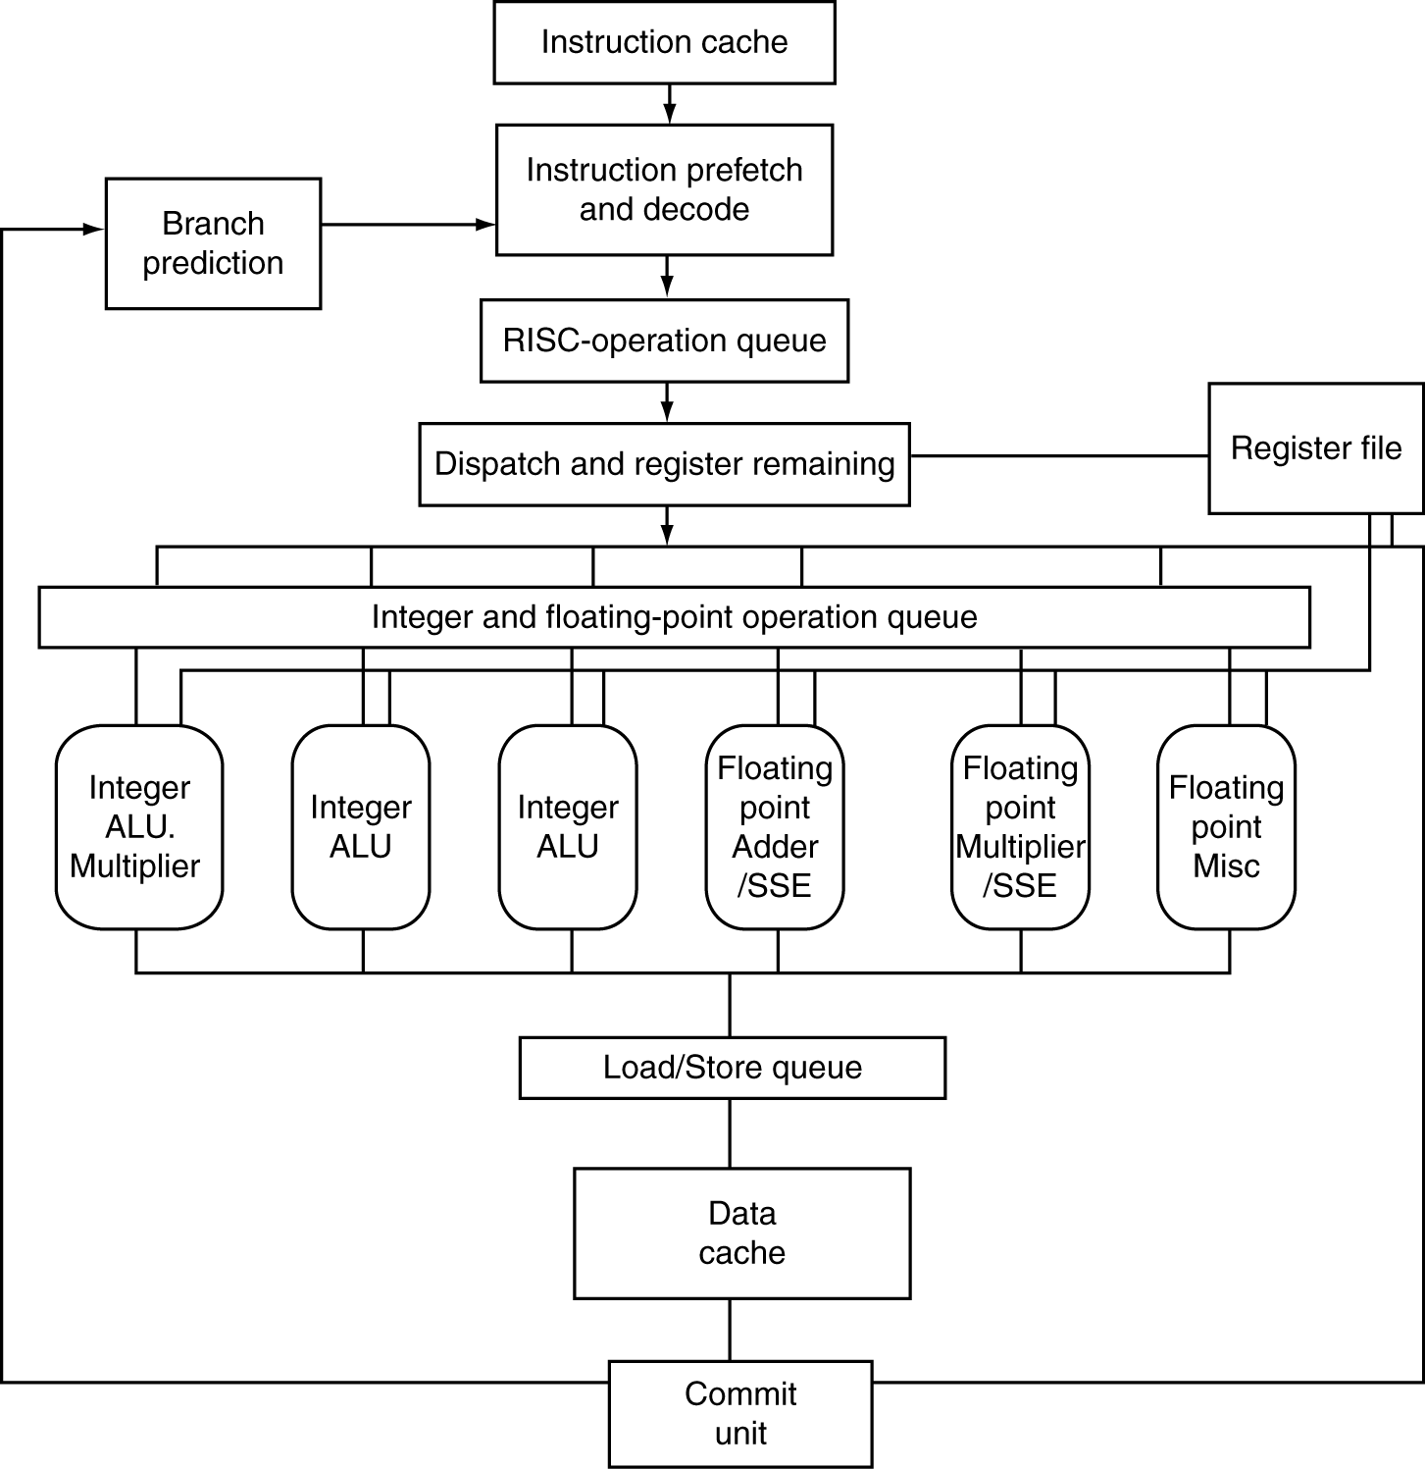
The Opteron X4 Microarchitecture
72 physical registers
§4.11 Real Stuff: The AMD Opteron X4 (Barcelona) Pipeline

Slide 101
The Opteron X4 Pipeline Flow
For integer operations
FP is 5 stages longer
Up to 106 RISC-ops in progress
Bottlenecks
Complex instructions with long dependencies
Branch mispredictions
Memory access delays

Slide 102
Fallacies
Pipelining is easy (!)
The basic idea is easy
The devil is in the details
e.g., detecting data hazards
Pipelining is independent of technology
So why haven’t we always done pipelining?
More transistors make more advanced techniques feasible
Pipeline-related ISA design needs to take account of technology trends
e.g., predicated instructions
§4.13 Fallacies and Pitfalls

Slide 103
Pitfalls
Poor ISA design can make pipelining harder
e.g., complex instruction sets (VAX, IA-32)
Significant overhead to make pipelining work
IA-32 micro-op approach
e.g., complex addressing modes
Register update side effects, memory indirection
e.g., delayed branches
Advanced pipelines have long delay slots

Slide 104
Concluding Remarks
ISA influences design of datapath and control
Datapath and control influence design of ISA
Pipelining improves instruction throughput using parallelism
More instructions completed per second
Latency for each instruction not reduced
Hazards: structural, data, control
Multiple issue and dynamic scheduling (ILP)
Dependencies limit achievable parallelism
Complexity leads to the power wall
§4.14 Concluding Remarks

