Slide 1
Engineering Design Rubric
Dimensions 1, 2 and 7

Slide 2
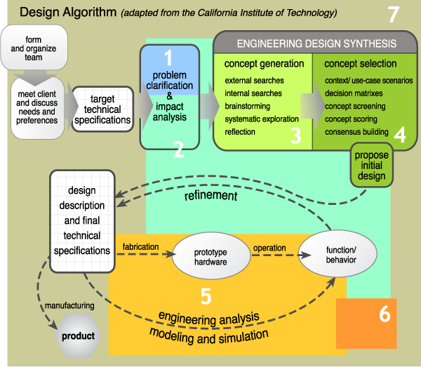

Slide 3
1 | Problem Clarification Clearly articulates the problem after a thorough exploration of multiple solution paths. Fully considers the needs of the client and the perspectives of other stakeholders during problem clarification. ABET 3e, 3j
2 | Impact Analysis Considers the impacts of the design in ethical, global, economic, societal, cultural, and environmental contexts. ABET 3c, 3f, 3h, 3i, 3j
3 | Design Synthesis: Concept Generation Uses multiple search strategies, both internal and external, to generate a variety of ideas and systematically explore possible solution paths. ABET 3a, 3c, 3d, 3i, 3k
4 | Design Synthesis: Concept Selection Methodically narrows down design choices in ways that refine concepts and lead to focusing on the most promising design solutions. ABET 3c, 3d, 3h, 3k
5 | Engineering Analysis Skillfully synthesizes the results of modeling, simulation, and prototyping to refine the design and/or reformulate the problem. ABET 3a, 3b, 3c, 3e, 3k
6 | Recommendations Proposes insightful recommendations for future design work that recognizes the limits and constraints of the current project. ABET 3f, 3i, 3j
7 | Communication Communicates in an organized and professional manner with multiple audiences, including clients, stakeholders, other team members, and professional reviewers. ABET 3d, 3f, 3g

Slide 4
Engineering Design Rubric
“Competencies are broad capabilities that extend well beyond the goals and objectives of a single course. They involve developing enduring knowledge, skills, attitudes, and experience in a sufficiently wide array of contexts that enable the graduate to reliably employ these strengths in problem solving in a professional environment. In addition, the development of competencies, like the development of proficiency in a new language, is a cumulative process, and should show growth over an extended period of time, measured in years.”
From Defining and Assessing the Competencies of Olin Graduates, Olin College of Engineering
Grade | Rubric scale
A | 5.0 – 6.0 | Mastering
B | 4.0 – 4.99 | Competent
C | 3.0 – 3.99 | Competent
C- | 2.5 – 2.99 | Emerging
D | 1.5 – 2.49 | Emerging
F | 0.0 – 1.49
For any final grade of C— or lower, students will be required to repeat the course.

Slide 5
Dimension 1: Problem Clarification
Clearly articulates the problem after a thorough exploration of multiple solution paths. Fully considers the needs of the client and the perspectives of other stakeholders during problem clarification.
ABET 3e, 3j

Slide 6
Dimension 1: Problem Clarification
Rubric scale
Emerging 1 – 2 | Problem clarification is cursory and non-methodical. The team does not consider client preferences. Initial technical specifications are partially targeted
Competent 3 – 4 | Client preferences are referenced and the problem is clarified, but some of the steps during the problem clarification process have been skipped or treated superficially. The primary initial specifications are targeted and consist of metrics and values.
Mastering 5 – 6 | The problem is reviewed and reformulated using a systematic approach. All necessary technical specifications consist of accurate and complete metrics and values.

Slide 7
Dimension 1: Problem Clarification
Rubric scale
Emerging 1 – 2 | Few, if any, stakeholder perspectives beyond the client are taken into consideration during problem clarification.
Competent 3 – 4 | The perspectives of most stakeholders have been considered, but only at a given point during problem clarification.
Mastering 5 – 6 | The needs of the client and the perspectives of all stakeholders have been carefully weighed throughout problem clarification.

Slide 8
Dimension 1: Problem Clarification
Rubric scale
Emerging 1 – 2 | Little or no evidence that related contemporary issues and/or professional challenges were taken into consideration.
Competent 3 – 4 | The problem is adequately articulated but teams may have not fully considered related contemporary issues or professional challenges.
Mastering 5 – 6 | The problem is clearly articulated with well-defined parameters that realistically consider contemporary issues, along with professional challenges.

Slide 9
Dimension 2: Impact Analysis
Considers the impacts of the design in ethical, global, economic, societal, cultural, and environmental contexts.
ABET 3c, 3f, 3h, 3i, 3j

Slide 10
Dimension 2: Impact Analysis
Rubric scale
Emerging 1 – 2 | Little or no evidence that use‐case scenarios were used to consider the impacts of the design.
Competent 3 – 4 | Some evidence that use‐case scenarios were used to consider some but not all of the potential impacts of the design.
Mastering 5 – 6 | Clear evidence is shown that use‐case scenarios were used to analyze the likely impacts of the design on multiple contexts: ethical, global, economic, societal/cultural and environmental.

Slide 11
Dimension 2: Impact Analysis
Rubric scale
Emerging 1 – 2 | No identification of related ethical considerations.
Competent 3 – 4 | Relevant ethical considerations are identified, but not addressed fully in the design.
Mastering 5 – 6 | Relevant ethical considerations are identified and addressed in the design.

Slide 12
Dimension 2: Impact Analysis
Rubric scale
Emerging 1 – 2 | Little or no consideration of the impact the design will have on contexts beyond meeting client needs.
Competent 3 – 4 | Some consideration of the impact the design will have on two or more relevant contexts.
Mastering 5 – 6 | Impacts of the design are examined and weighed in all relevant contexts.

Slide 13
Dimension 3: Concept Generation
Uses multiple search strategies, both internal and external, to generate a variety of ideas and systematically explore possible solution paths.
ABET 3a, 3c, 3d, 3i, 3k

Slide 14
Dimension 3: Concept Generation
Rubric scale
Emerging 1 – 2 | Little or no evidence that specific strategies have been used to generate concepts. External searches are frequently not current, relevant, and/or accurate. Little or no attention paid to source evaluation.
Competent 3 – 4 | Evidence that multiple search strategies were used to generate concepts, but the approach may not have been systematic. External searches are mostly current, relevant, and accurate. The team has not interviewed lead users or experts working in the discipline.
Mastering 5 – 6 | Search strategies, including both internal and external searches, are used to systematically generate and explore concepts. External searches are current, relevant, and accurate. Sources exhibit breadth and depth. The team has interviewed lead users and consulted closely with experts.

Slide 15
Dimension 3: Concept Generation
Rubric scale
Emerging 1 – 2 | Little or no evidence of problem decomposition.
Competent 3 – 4 | The team conducts a cursory problem decomposition process.
Mastering 5 – 6 | The team decomposes the problem into a set of sub functions; a set of subsystems; a sequence of actions; and/or the set of primary client preferences.

Slide 16
Dimension 3: Concept Generation
Rubric scale
Emerging 1 – 2 | Little or no evidence of organization in the concept exploration process.
Competent 3 – 4 | The team struggles to organize the exploration process in a way that best guides the creative energies and technical expertise of the team.
Mastering 5 – 6 | Strong evidence that the exploration process has been skillfully managed in ways that organize and guide the creative energies and technical expertise of the team.

Slide 17
Dimension 7: Communication
Communicates in an organized and professional manner with multiple audiences, including clients, stakeholders, other team members, and professional reviewers.
ABET 3d, 3f, 3g

Slide 18
Dimension 7: Communication
Rubric scale
Emerging 1 – 2 | The written document (informal or formal) inadequately captures and communicates the design process and product/s for identified audiences. Little attention is paid to accuracy.
Competent 3 – 4 | The written document (informal or formal) captures and communicates the design process and product/s accurately and clearly for identified audiences.
Mastering 5 – 6 | The written document (informal or formal) captures and communicates the design process and product/s accurately and clearly for both direct and indirect audiences.

Slide 19
Dimension 7: Communication
Rubric scale
Emerging 1 – 2 | Visuals (charts, tables, Gantt charts, diagrams, schematics and photos, etc.) are frequently inappropriate, difficult to decipher and may even detract from written communication.
Competent 3 – 4 | Visuals (charts, tables, Gantt charts, diagrams, schematics and photos, etc.) generally support the written component, but some may be overly complex/simplistic or unclear due to improper resolution.
Mastering 5 – 6 | Visuals (charts, tables, Gantt charts, diagrams, schematics and photos, etc.) are clear, concise, and have been chosen for their ability to support and extend the written component.

Slide 20
Dimension 7: Communication
Rubric scale
Emerging 1 – 2 | Frequent errors obscure and/or misrepresent the content.
Competent 3 – 4 | Errors exist, but do not distract from or misrepresent the content.
Mastering 5 – 6 | Writing is polished, professional, and virtually error free.

