Slide 1
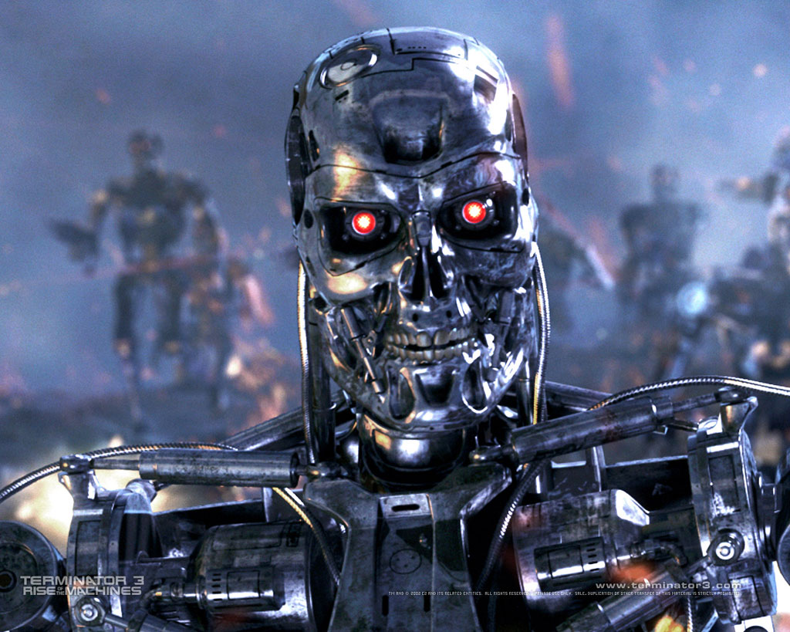
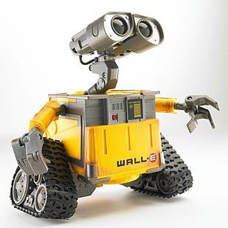
Cpt_S 483: Introduction to Robotics

Slide 2
Dana 3
RoboSub
Robot Club
Faunc Robot

Slide 3
Current or Proposed Robot Research
Effect of instructions on demonstrations
Robots learning from, and teaching, humans
UAS for Bird Protection
UAS for power line patrol
Home healthcare robot
Autonomous apple bin transport
Guardrail inspection
Notes:
98M per year to WA fruit growers

Slide 4
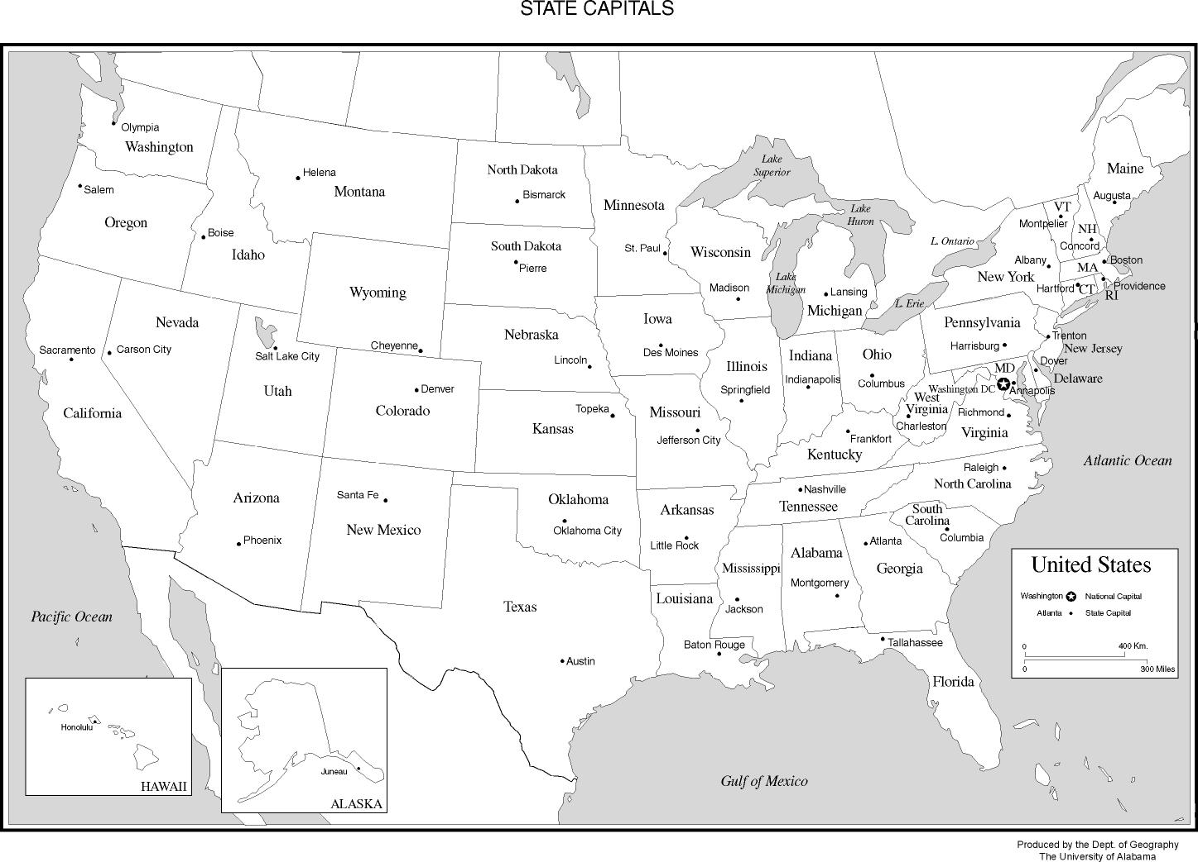
Born: VT
Raised: NH
High school: CT
College: MA
Worked: WI
Grad School: TX
Postdoc: CA
Prof.: PA
NOW: WA
Research Interests: intelligent agents, multi-agent systems, machine learning, robotics

Slide 5
Who are you?

Slide 6
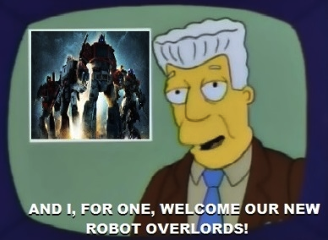
Autonomous Mobile Robotics
EE (Sensors, Actuators)
ME (Control of Quadcopters)
CS (AI)
Manufacturing
Teleoperation
Agriculture
PR2

Slide 7
(Some) Topics
ROS
Sensors and Vision
Locomotion, Kinematics, and Maneuverability
Localization and Mapping
Planning and Navigation
Robot Learning
Multi-robot coordination

Slide 8
Goals of Course
General Knowledge
Simulation vs. Physical
Final Project
Course Web Page
http://www.eecs.wsu.edu/~taylorm/14_483/index.html
Syllabus
Textbook
Office hours

Slide 9
Parrot ARDrone 2
HD Video (720p, 30fps, 92deg.)
3-axis gyroscope: orientation
3-axis accelerometer: measure acceleration movements
3-axis magnetometer: compass
Pressure sensor: vertical stability at height
Ultrasound sensors: ground altitude measurement
60fps 320x240 camera: downward pictures & speed measurement
28,500 RMP motors
Special trick!
Notes:
Find north

Slide 10
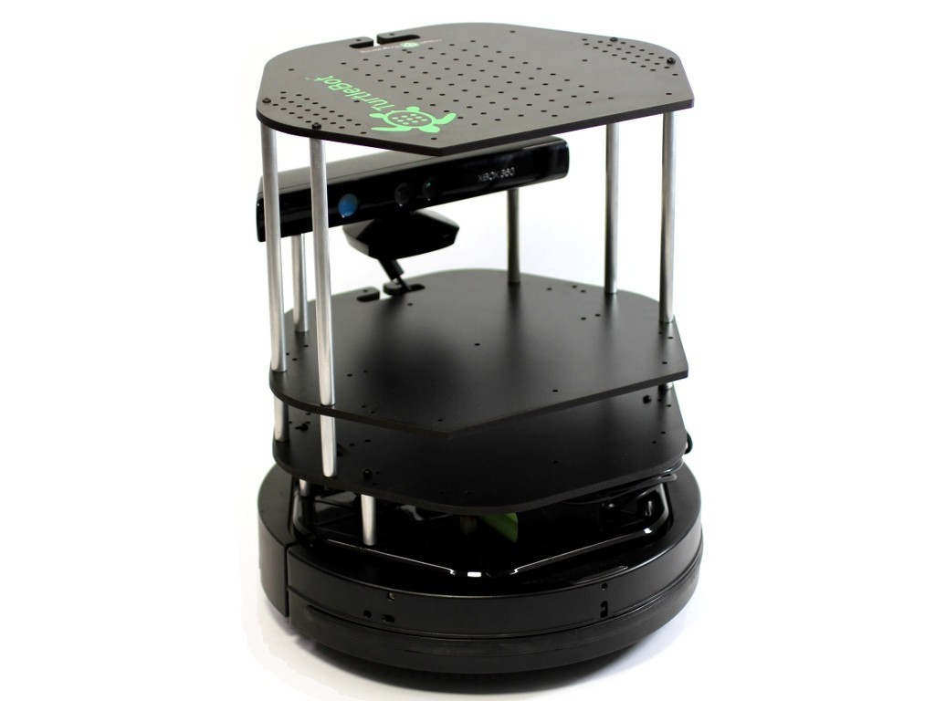
TurtleBot 2
Open source hardware and software
Kobuki base (formerly Create by iRobot)
25.6 in/s, 180 deg/s
3 forward bump sensors
3 cliff sensors
2 wheel drop sensors (picked up / stuck)
Odometry: 11.7 ticks / mm, 2578 ticks / wheel rev
Kinect Sensor: RGBD, can simulate laser
540x480px, 30fps
Depth: 0.5-4.0m
Onboard gyroscope
Netbook

Slide 11
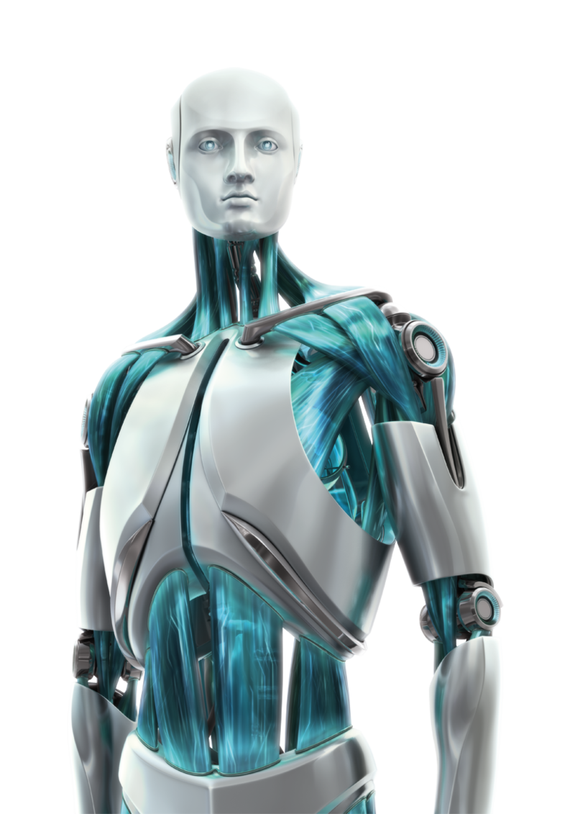
(Great) Expectations
Motivation (Robots are Awesome)
Robots are Awful
Looking up info
Course Languages
Linux

Slide 12
ALWAYS work
Even for photography
Cheetah
Big Dog

Slide 13
Why would this course be useful?
What comes next?
Notes:
EE/ME
Grasping
Perception/Vision
Control
S. Tellex: http://people.csail.mit.edu/stefie10/
A. Thomaz

Slide 14
What is a robot?
A robot may not injure a human being or, through inaction, allow a human being to come to harm.
A robot must obey the orders given to it by human beings, except where such orders would conflict with the First Law.
A robot must protect its own existence as long as such protection does not conflict with the First or Second Law.

