Slide 1
Lab 2
Late
No Videos
Lab 3
Late
Write up
Functions
150cm spiral
Homework
Labs 4-6
Final Project

Slide 2
Mid-semester feedback
What do you think of the balance of theoretical vs. applied work?
What’s been most useful to you (and why)?
What’s been least useful (and why)?
What could students do to improve the class?
What could Matt do to improve the class?

Slide 3
Example
Right

Slide 4
Kalman Filter (Section 5.6.8)
μ’=μ+u
σ²’=σ²+r²
Sense
Move
Gaussian:
μ, σ²
Initial Belief

Slide 5
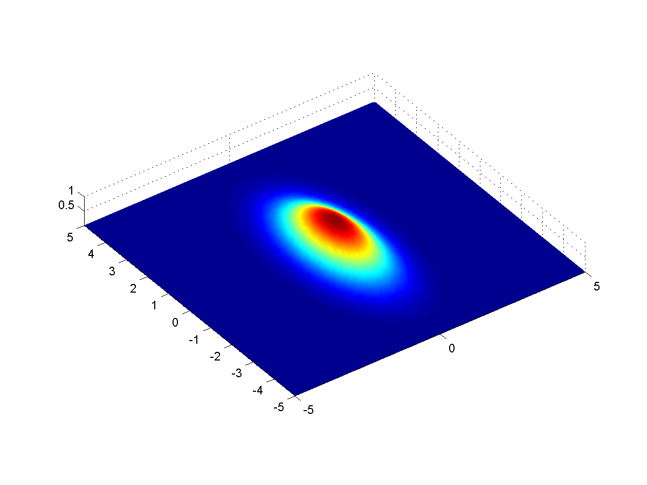
Kalman Filter in Multiple Dimensions
2D Gaussian

Slide 6
Implementing a Kalman Filter example
VERY simple model of robot movement:
What information do our sensors give us?

Slide 7
Implementing a Kalman Filter example
F
H
H = [1 0]

Slide 8
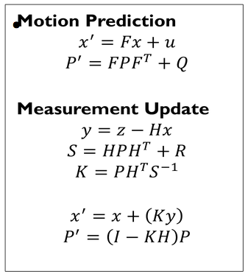
Implementing a Kalman Filter
Estimate
P’ uncertainty covariance
F state transition matrix
u motion vector
F motion noise
Measurement
measurement function
measurement noise
identity matrix

Slide 9
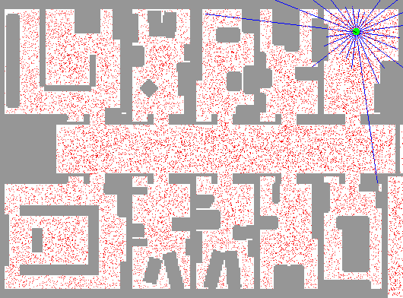
Particle Filter Localization (using sonar)
http://www.cs.washington.edu/ai/Mobile_Robotics//mcl/animations/global-floor-start.gif

Slide 10
Particles
Each particle is a guess about where the robot might be
x
y
θ

Slide 11
Robot Motion
move each particle according to the rules of motion
+
add random noise
$n$ particles
$n$ particles

Slide 12
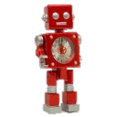
Incorporating Sensing

Slide 13
Incorporating Sensing

Slide 14
Incorporating Sensing
Difference between the
actual measurement
and the
estimated measurement
Importance weight

Slide 15
Importance weight python code
def Gaussian(self, mu, sigma, x):
# calculates the probability of x for 1-dim Gaussian with mean mu and var. sigma
return exp(- ((mu - x) ** 2) / (sigma ** 2) / 2.0) / sqrt(2.0 * pi * (sigma ** 2))
def measurement_prob(self, measurement):
# calculates how likely a measurement should be
prob = 1.0;
for i in range(len(landmarks)):
dist = sqrt((self.x - landmarks[i][0]) ** 2 + (self.y - landmarks[i][1]) ** 2)
prob *= self.Gaussian(dist, self.sense_noise, measurement[i])
return prob
def get_weights(self):
w = []
for i in range(N): #for each particle
w.append(p[i].measurement_prob(Z)) #set it’s weight to p(measurement Z)
return w

Slide 16
Importance weight pseudocode
Calculate the probability of a sensor measurement for a particle:
prob = 1.0;
for each landmark
d = Euclidean distance to landmark
prob *= Gaussian probability of obtaining a reading at
distance d for this landmark from this particle
return prob

Slide 17
Incorporating Sensing

Slide 18
Resampling
$n$ original particles
Importance Weight
0.2
0.6
0.2
0.8
0.8
0.2
Sum is 2.8

Slide 19
Resampling
$n$ original particles
Importance Weight | Normalized Probability
0.2 | 0.07
0.6 | 0.21
0.2 | 0.07
0.8 | 0.29
0.8 | 0.29
0.2 | 0.07
Sum is 2.8

Slide 20
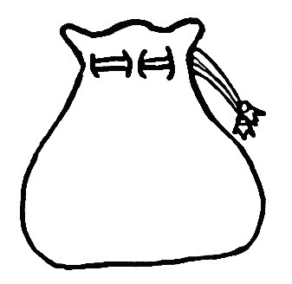
Resampling
$n$ original particles
Importance Weight | Normalized Probability
0.2 | 0.07
0.6 | 0.21
0.2 | 0.07
0.8 | 0.29
0.8 | 0.29
0.2 | 0.07
Sample n new particles from previous set
Each particle chosen with probability p, with replacement
Sum is 2.8

Slide 21
Resampling
Is it possible that one of the particles is never chosen?
Yes!
Is it possible that one of the particles is chosen more than once?
Yes!
$n$ original particles
Importance Weight | Normalized Probability
0.2 | 0.07
0.6 | 0.21
0.2 | 0.07
0.8 | 0.29
0.8 | 0.29
0.2 | 0.07
Sample n new particles from previous set
Each particle chosen with probability p, with replacement
Sum is 2.8

Slide 22
Resampling
What is the probability that this particle is not chosen during the resampling of the six new particles?
$${\left(0.71\right)}^{6}=0.13$$
$n$ original particles
Importance Weight | Normalized Probability
0.2 | 0.07
0.6 | 0.21
0.2 | 0.07
0.8 | 0.29
0.8 | 0.29
0.2 | 0.07
Sample n new particles from previous set
Each particle chosen with probability p, with replacement
Sum is 2.8
Notes:
.71 ^ 6 = 12.8%

Slide 23
Resampling
What is the probability that this particle is not chosen during the resampling of the six new particles?
$${\left(0.93\right)}^{6}=.65$$
$n$ original particles
Importance Weight | Normalized Probability
0.2 | 0.07
0.6 | 0.21
0.2 | 0.07
0.8 | 0.29
0.8 | 0.29
0.2 | 0.07
Sample n new particles from previous set
Each particle chosen with probability p, with replacement
Sum is 2.8

Slide 24
Question
What happens if there are no particles near the correct robot location?

Slide 25
Question
What happens if there are no particles near the correct robot location?
Possible solutions:
Add random points each cycle
Add random points each cycle, where is proportional to the average measurement error
Add points each cycle, located in states with a high likelihood for the current observations

Slide 26
Summary
Kalman Filter
Continuous
Unimodal
Harder to implement
More efficient
Requires a good starting guess of robot location
Particle Filter
Continuous
Multimodal
Easier to implement
Less efficient
Does not require an accurate prior estimate

Slide 27
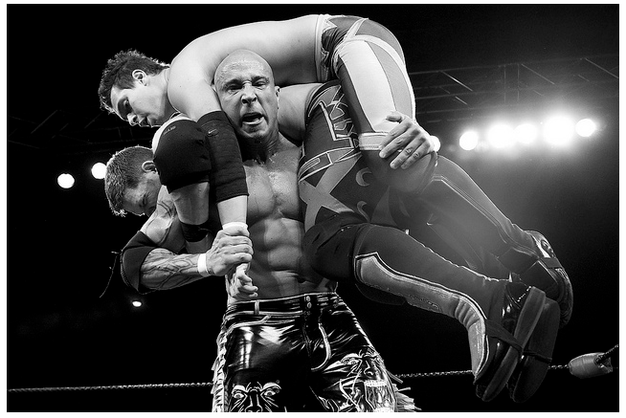
SLAM
Simultaneous localization and mapping:
Is it possible for a mobile robot to be placed at an unknown location in an unknown environment and for the robot to incrementally build a consistent map of this environment while simultaneously determining its location within this map?
http://flic.kr/p/9jdHrL

Slide 28
Three Basic Steps
The robot moves
increases the uncertainty on robot pose
need a mathematical model for the motion
called motion model

Slide 29
Three Basic Steps
The robot discovers interesting features in the environment
called landmarks
uncertainty in the location of landmarks
need a mathematical model to determine the position of the landmarks from sensor data
called inverse observation model

Slide 30
Three Basic Steps
The robot observes previously mapped landmarks
uses them to correct both self localization and the localization of all landmarks in space
uncertainties decrease
need a model to predict the measurement from predicted landmark location and robot localization
called direct observation model

Slide 31
How to do SLAM

Slide 32
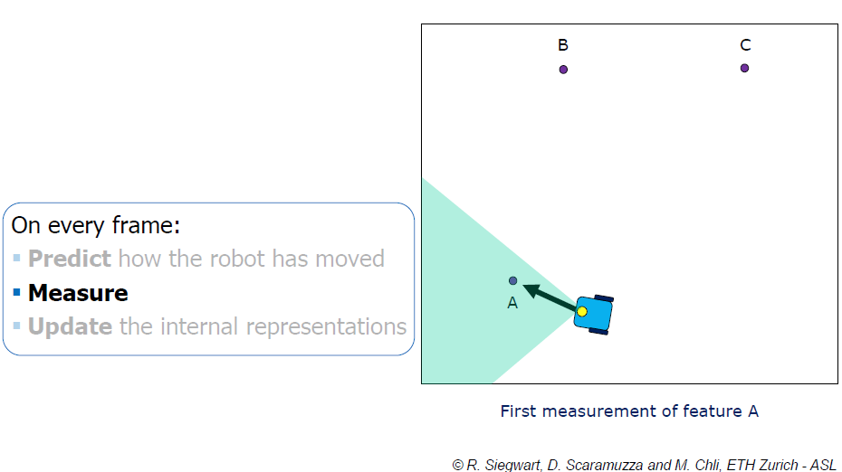
How to do SLAM

Slide 33
How to do SLAM

Slide 34
How to do SLAM

Slide 35
How to do SLAM

Slide 36
How to do SLAM

Slide 37
How to do SLAM

Slide 38
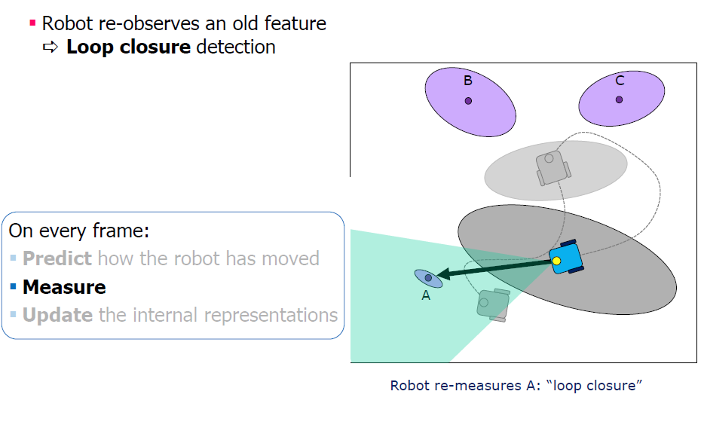
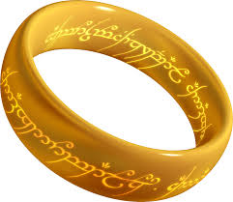
How to do SLAM

Slide 39
How to do SLAM

Slide 40
The Essential SLAM Problem

Slide 41
SLAM Paradigms
Some of the most important approaches to SLAM:
Extended Kalman Filter SLAM (EKF SLAM)
Particle Filter SLAM (FAST SLAM)
GraphSLAM

Slide 42
EKF Slam
Keep track of combined state vector at time t:
x, y, θ
m_{1,x}, m_{1,y}, s₁
…
m_{N,x}, m_{N,y}, s_{N}
m = estimated coordinates of a landmark
s = sensor’s signature for this landmark
Very similar to EKF localization, starting at origin

Slide 43
EKF-SLAM
Grey: Robot Pose Estimate
White: Landmark Location Estimate

Slide 44
Visual Slam
Single Camera
What’s harder?
How could it be possible?
Notes:
angle

Slide 45
GraphSLAM
SLAM can be interpreted as a sparse graph of nodes and constraints between nodes.

Slide 46
GraphSLAM
SLAM can be interpreted as a sparse graph of nodes and constraints between nodes.
nodes: robot locations and map-feature locations
edges: constraints between
consecutive robot poses (given by the odometry input u)
robot poses and the features observed from these poses.

Slide 47
GraphSLAM
Key property: constraints are not to be thought as rigid constraints but as soft constraints
Constraints acting like springs
Solve full SLAM by relaxing these constraints
get the best estimate of the robot path and the environment map by computing the state of minimal energy of this spring mass network

Slide 48
GraphSLAM

Slide 49
GraphSLAM

Slide 50
GraphSLAM

Slide 51
GraphSLAM
Build graph
Inference: solve system of linear equations to get map and path

Slide 52
GraphSLAM
The update time of the graph is constant.
The required memory is linear in the number of features.
Final graph optimization can become computationally costly if the robot path is long.
Impressing results with even hundred million features.
Notes:
End of 483_13

