Slide 1
`
Robot Competition for “Dummies”
https://www.youtube.com/watch?v=46ivFpsmEVQ#t=356

Slide 2
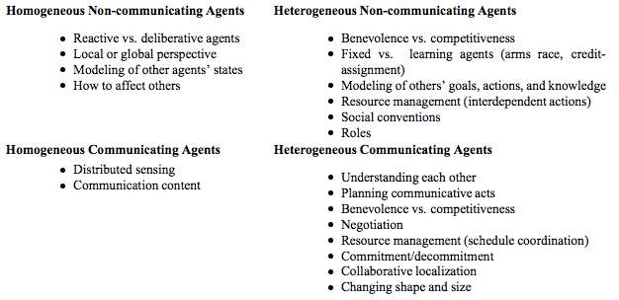
Multi-Robot (Multi-Agent) Systems
Homogenous / Heterogeneous
Communicating / Non-Communicating
Cooperative / Competitive

Slide 3
Multi-Robot Systems
Example 1: Target Capture
Drone finds a target
Turtlebot needs to go to the target
Why is this much harder than either of the individual tasks?
What are the risks / challenges?
Notes:
Communication, errors compound, failure rate doubles

Slide 4
Risks / Challenges?
Drone’s hovering? Landing? FIRE?!?
Trust human vs. other robot
Obstacles the turtlebot can’t get around? Path planning is very different for two robots
Shared map?
Different requirements for different vehicles
Lots of data (point cloud)

Slide 5
Multi-Robot Systems
Example 1: Target Capture
Drone finds a target
Turtlebot needs to go to the target
Why is this much harder than either of the individual tasks?
What are the risks / challenges?
What if it’s a drone and a human? How do things change?
What if it’s a human and a turtlebot?
Notes:
Communication, errors compound, failure rate doubles

Slide 6
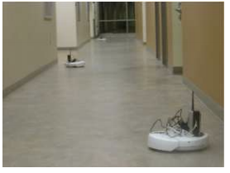
Example 2: Ad-hoc networking
Robots can communicate
5 mobile ad-hoc network stations
Want to maximize network strength, but can only take small scale movements
How could we optimize this?
Centralized / Decentralized
Model based / free
Backtracking?
Notes:
DCEE / DCOP

Slide 7
Example 3: Robot Patrol
1 robot
2 robots
n robots
Notes:
Game theory

Slide 8
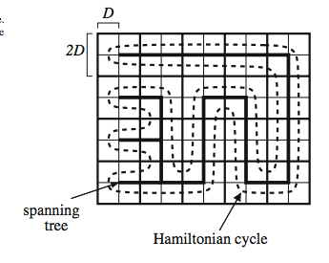
Example 3: Robot Patrol
1 robot
2 robots
n robots
Notes:
Game theory

Slide 9
Example 3: Robot Patrol
1 robot
2 robots
n robots
Different value targets?
Different robot capabilities?
What if could be observed?
Notes:
Game theory

Slide 10
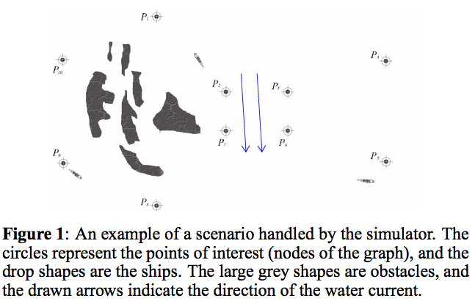
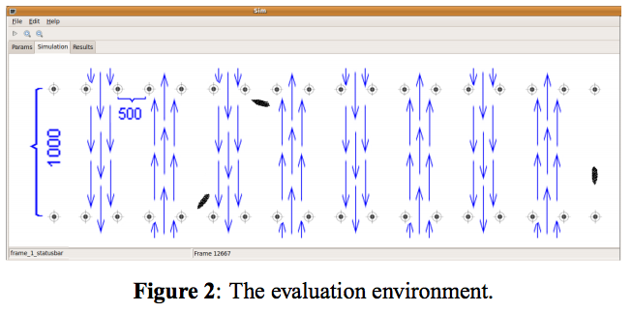
Notes:
Game theory

Slide 11
How Engineers use Tinder
https://www.youtube.com/watch?v=Qgnxb-O-CBQ

Slide 12
Example 4: Hide and seek
“Hider” is stationary
Solution techniques?
Notes:
Opponent Modeling

Slide 13
Example 4: Hide and seek
“Hider” is stationary
Solution techniques?
What if “hider” is learning?
Notes:
Opponent Modeling

Slide 14
Example 4: Hide and seek
“Hider” is stationary
Solution techniques?
What if “hider” is learning?
Notes:
Opponent Modeling

Slide 15
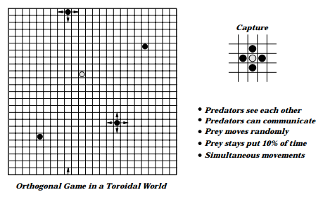
Example 5: Predator / Prey, without communication
1 fixed policy prey
4 learning predators
Need to surround the prey
Notes:
RL

Slide 16
Example 5: Predator / Prey, with communication
1 fixed policy prey
4 learning predators
Need to surround the prey
Notes:
DEC-MDP

Slide 17
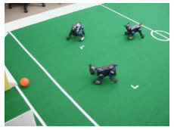
Example 5: Predator / Prey, with communication
1 fixed policy prey
4 learning predators
Need to surround the prey
Notes:
DEC-MDP
BDI, plans

