Slide 1
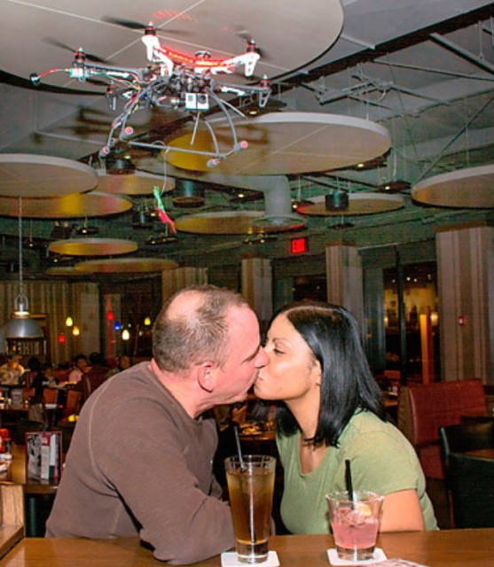
TGI Friday’s Mistletoe Drone

Slide 2
www.uasvision.com/2014/12/10/mistletoe-quadcopter-draws-blood/

Slide 3
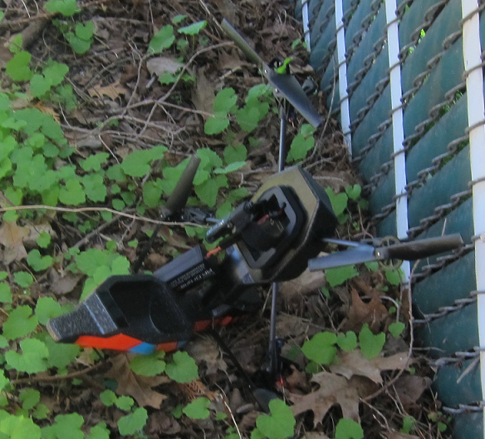
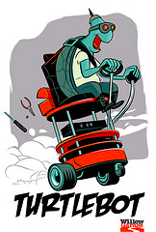
ROS

Slide 4
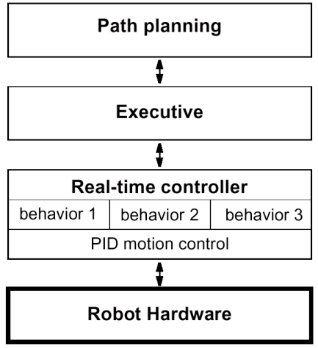
Example
Tiered mobile robot architecture based on a temporal decomposition
Strategic-level decision making
Controls the activation of behaviors based on commands from planner
Low level behaviors

Slide 5
Real World Environment
Motion Control
Perception
Path
Environment Model, Local Map
Cognition
Position
Global Map
Localization

Slide 6
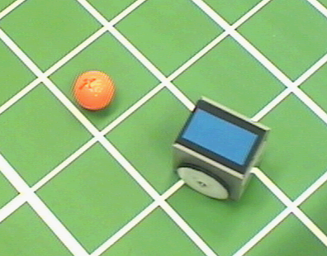
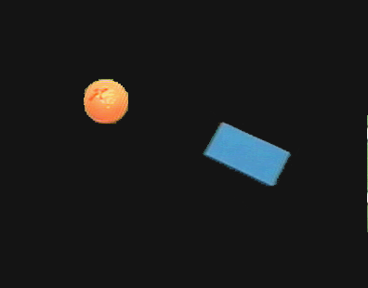
Color Tracking Sensors
4.1.8
Motion estimation of ball and robot for soccer playing using color tracking

Slide 7
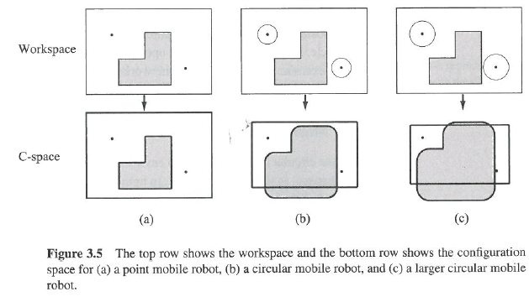

Slide 8
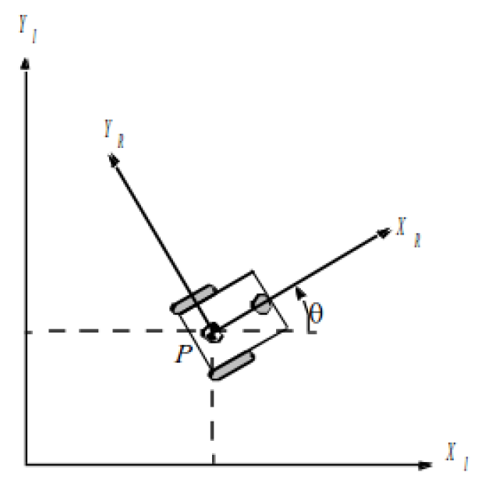
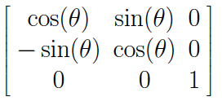
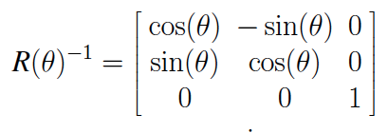
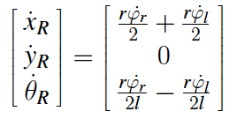
Robot Position: ξ_{I}=[x_{I},y_{I},θ_{I}]^{T}
Mapping between frames
ξ_{R}=R(θ)ξ_{I}, ξ_{I}=R(θ)⁻¹ξ_{R}
R(θ)=
Each wheel contributes to speed: rφ/2
For rotation, right wheel contributes:
ω_{r}=rφ/2l
Notes:
Nick

Slide 9
Compute Path
Smooth it and satisfy differential constraints
Design a feedback control law that tracks the trajectory
Design a trajectory (velocity function) along the path
Model of the world
Execute

Slide 10
Occupancy Grid, accounting for C-Space
start
goal

Slide 11
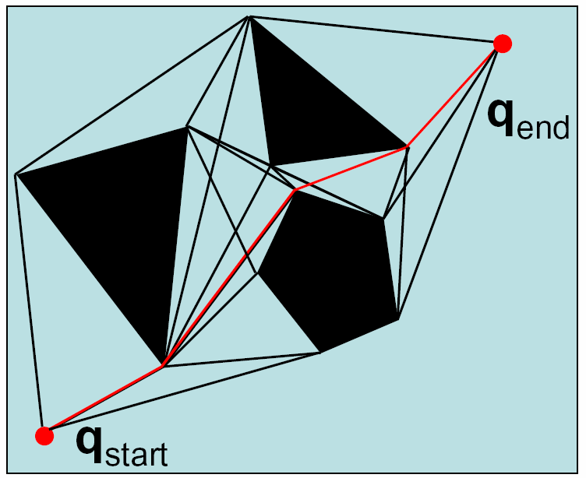
Visibility Graph

Slide 12
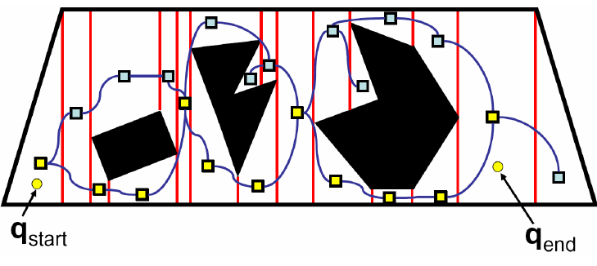
Exact Cell Decomposition
Plan over this graph
How can we improve the path?

Slide 13
Matching
®
Where am I on the global map?
Local Map
obstacle
Global Map















®


…

®


…








…


















Examine different possible robot positions.

Slide 14
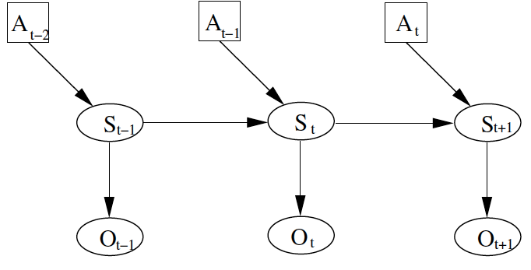
General approach:
A: action
S: pose
O: observation
Position at time t depends on position previous position and action, and current observation

Slide 15
Localization
Gain Information
Lose
Information
Sense
Move
Initial Belief

Slide 16
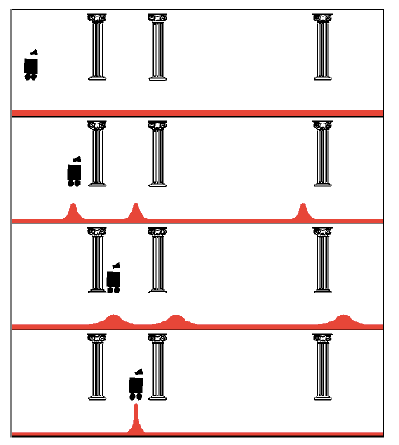
Uniform Prior
Observation: see pillar
Action: move right
Observation: see pillar

Slide 17
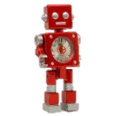
Example 2
0.2 | 0.2 | 0.2 | 0.2 | 0.2
Probability should go down.
Robot senses yellow.
Probability should go up.

Slide 18
Kalman Filter
μ’=μ+u
σ²’=σ²+r²
Sense
Move
Gaussian:
μ, σ²
Initial Belief

Slide 19
Particle Filter

Slide 20
EKF-SLAM
Grey: Robot Pose Estimate
White: Landmark Location Estimate

Slide 21
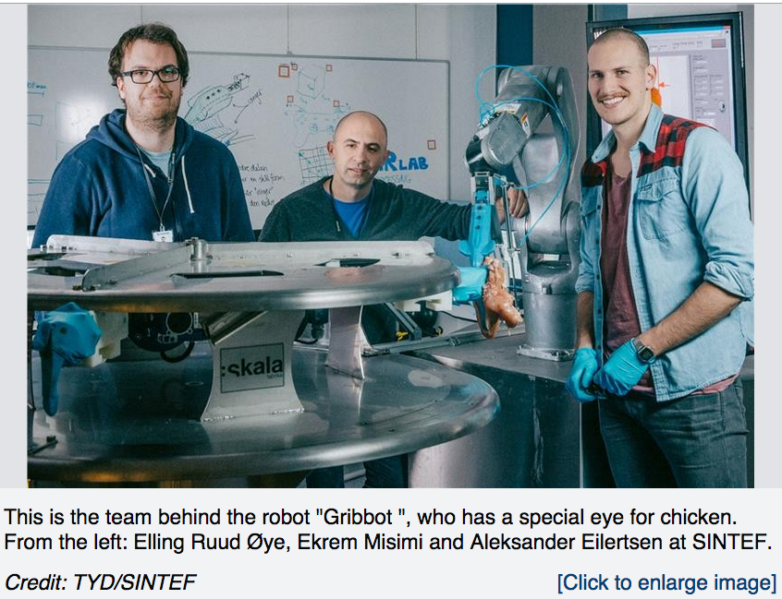
“Using robots to get more food from raw materials” = Chicken Chopping Robot!
http://www.sciencedaily.com/releases/2014/12/141209081648.htm

Slide 22
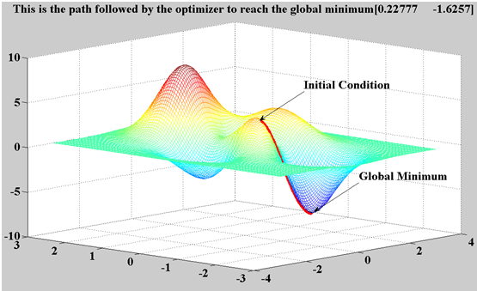
Gradient Descent
Minimum is found by following the slope of the function
“Like climbing Everest in thick fog with amnesia”

Slide 23
Genetic algorithms

Slide 24
Brainstorm
How could a human teach a robot?
What are the goals (why would this be useful)?
What would the human do?
How would the robot use this data?
Example applications
Flip a pancake
Play ping pong
Help build Ikea furniture

Slide 25
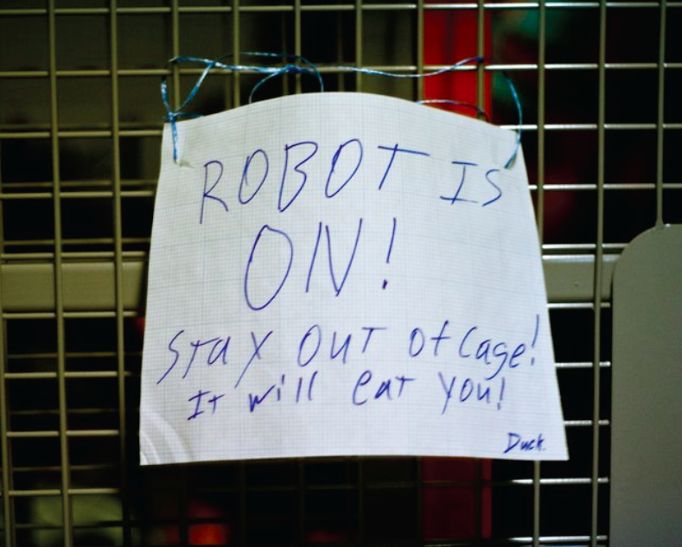
HRI
Acceptance
Dehumanize
Institutionalize
Enabling
Chair
Horse
Autonomy
Passive
Consent
Privacy
Cameras
Security

Slide 26
Robots: an ME’s perspective

Slide 27
Robots for Gerontechnology

Slide 28
DARPA robotics Challenge

Slide 29
Learning & Vision

Slide 30
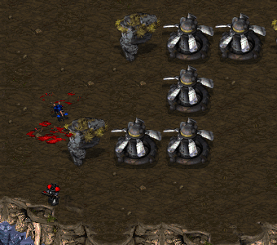

Slide 31
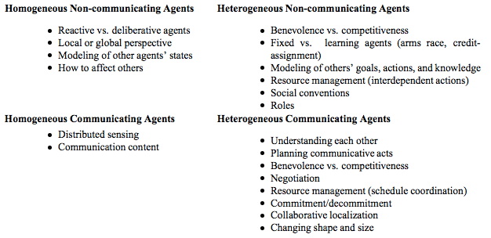
Multi-Robot (Multi-Agent) Systems
Homogenous / Heterogeneous
Communicating / Non-Communicating
Cooperative / Competitive

Slide 32
Going Forward
Robots are becoming:
More common
More powerful
Less expensive

