Slide 1
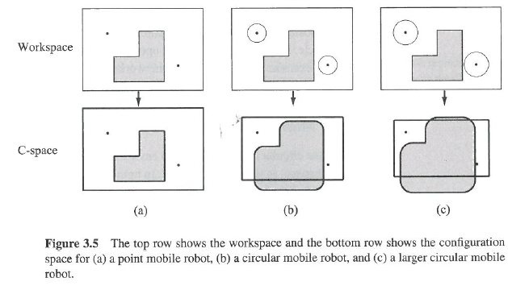

Slide 2
Beyond trial and error….
Establish mathematically how robot should move
Kinematics: how robot will move given motor inputs
Inverse-kinematics: how to move motors to get robot to do what we want

Slide 3
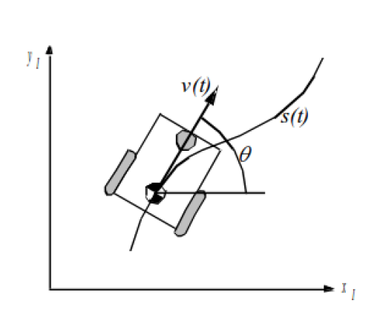
Robot is at (initial frame)
x_{I},y_{I},θ_{I}
Wants to get to some
location but can’t control
x_{I},y_{I},θ_{I} directly

Slide 4
Robot can know
Speeds of wheels: φ₁…φ_{n}
Steering angle of steerable wheels: β₁…β_{m}
Speed with which steering angles are changing:
β₁…β_{m}
These define the forward motion of the robot, the forward kinematics:
f(φ₁…φ_{n,} β₁…β_{m,} β₁…β_{m})=[x_{I},y_{I},θ_{I}]^{T}

Slide 5
Want we want
Reverse Kinematics
[φ₁…φ_{n,} β₁…β_{m,} β₁…β_{m}] ^{T}=f(x_{I},y_{I},θ_{I})

Slide 6
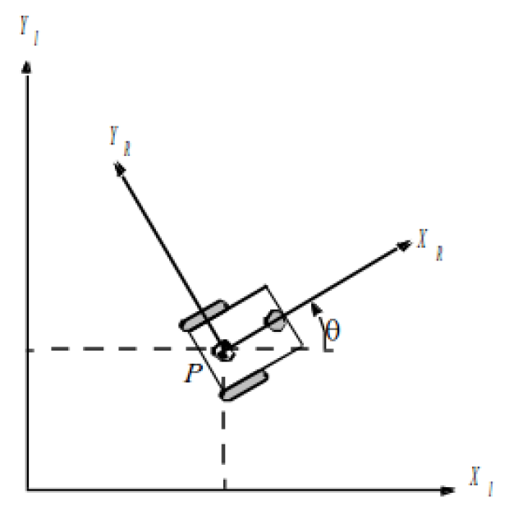
Robot
Robot knows how it moves relative to center of rotation
Not the same as knowing how it moves in the world
Initial Frame
Robot Frame

Slide 7
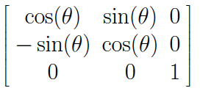
Robot Position: ξ_{I}=[x_{I},y_{I},θ_{I}]^{T}
Mapping between frames
ξ_{R}=R(θ)ξ_{I}
=R(θ)[x_{I},y_{I},θ_{I}]^{T}
where
R(θ)=

Slide 8
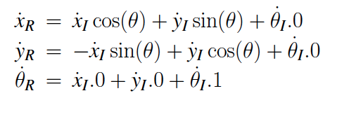

Slide 9
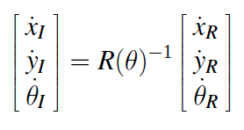
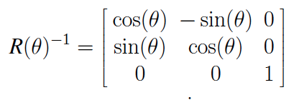
ξ_{R}=R(θ)ξ_{I}
Still isn’t what we want… we want the reverse kinematic model
ξ_{I}=R(θ)⁻¹ξ_{R}

Slide 11
If we know the relative changes in x, y, and θ, we can find the global position. How do we know what these values are?

Slide 12
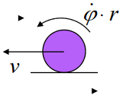
Speed of the wheels
Constraints
Movement on a horizontal plane
Point contact of wheels
Wheels are not deformable
Pure rolling: velocity is 0 at contact point
No friction for rotation
Steering axes orthogonal to surface
Wheels connected by rigid frame

Slide 13
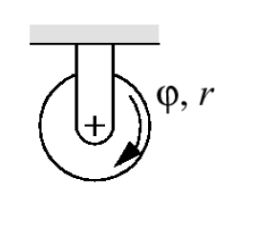
Differential Drive
Wheels rotate at φ
Each wheel contributes
rφ/2
to motion of center of rotation
Speed = sum of two wheels
Rotation due to right wheel is
ω_{r}=rφ/2l
Counterclockwise about left wheel
l is distance between wheels

Slide 14
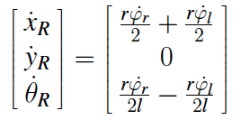
Differential Drive
Rotation due to left wheel:
ω_{l}=-rφ/2l
Counterclockwise about right wheel
Combining components:

Slide 15
Example 1/3
θ=π/2
r=1
l=1
φ_{l}=4, φ_{r}=2
sin(π/2)=1, cos(π/2)=0

Slide 16
Example 2/3
θ=π/4
r_{l}=2, r_{r}=3
l=5
φ_{l}= φ_{r} =6
sin(π/4)=1/√2, cos(π/4)=1/√2

Slide 17
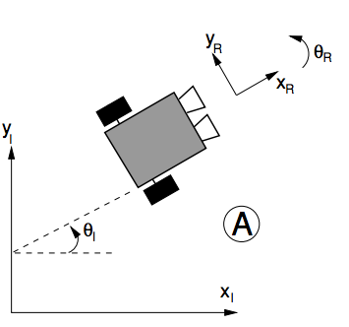
Example 3/3
A Create robot has wheels with a 5 cm radius which are 30 cm apart. Both wheels rotating clockwise at 1 rad per second. What are[x_{R},y_{R},θ_{R}]^{T} in m/s and rad/s? What are[x_{I},y_{I},θ_{I}]^{T} in m/s and rad/s?

Slide 18
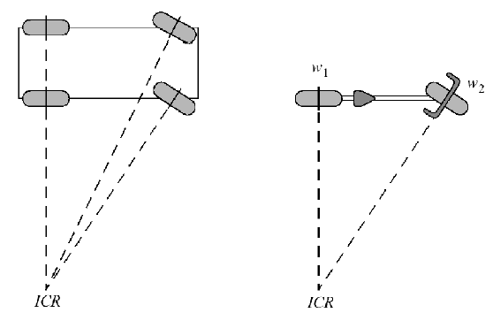
Sliding constraint
Standard wheel has no lateral motion
Move in circle whose center is on “zero motion line” through the axis
Instantaneous Center of Rotation

Slide 19
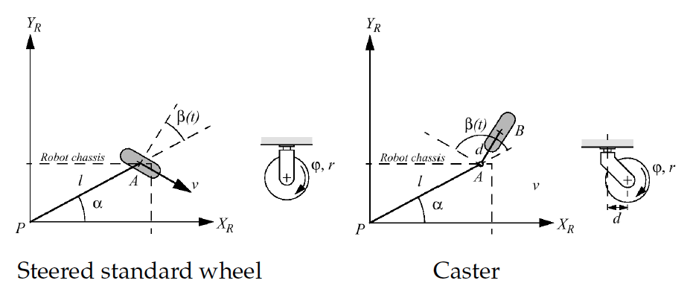
More complex
Steered standard wheel
Caster wheel
More parameters

Slide 20
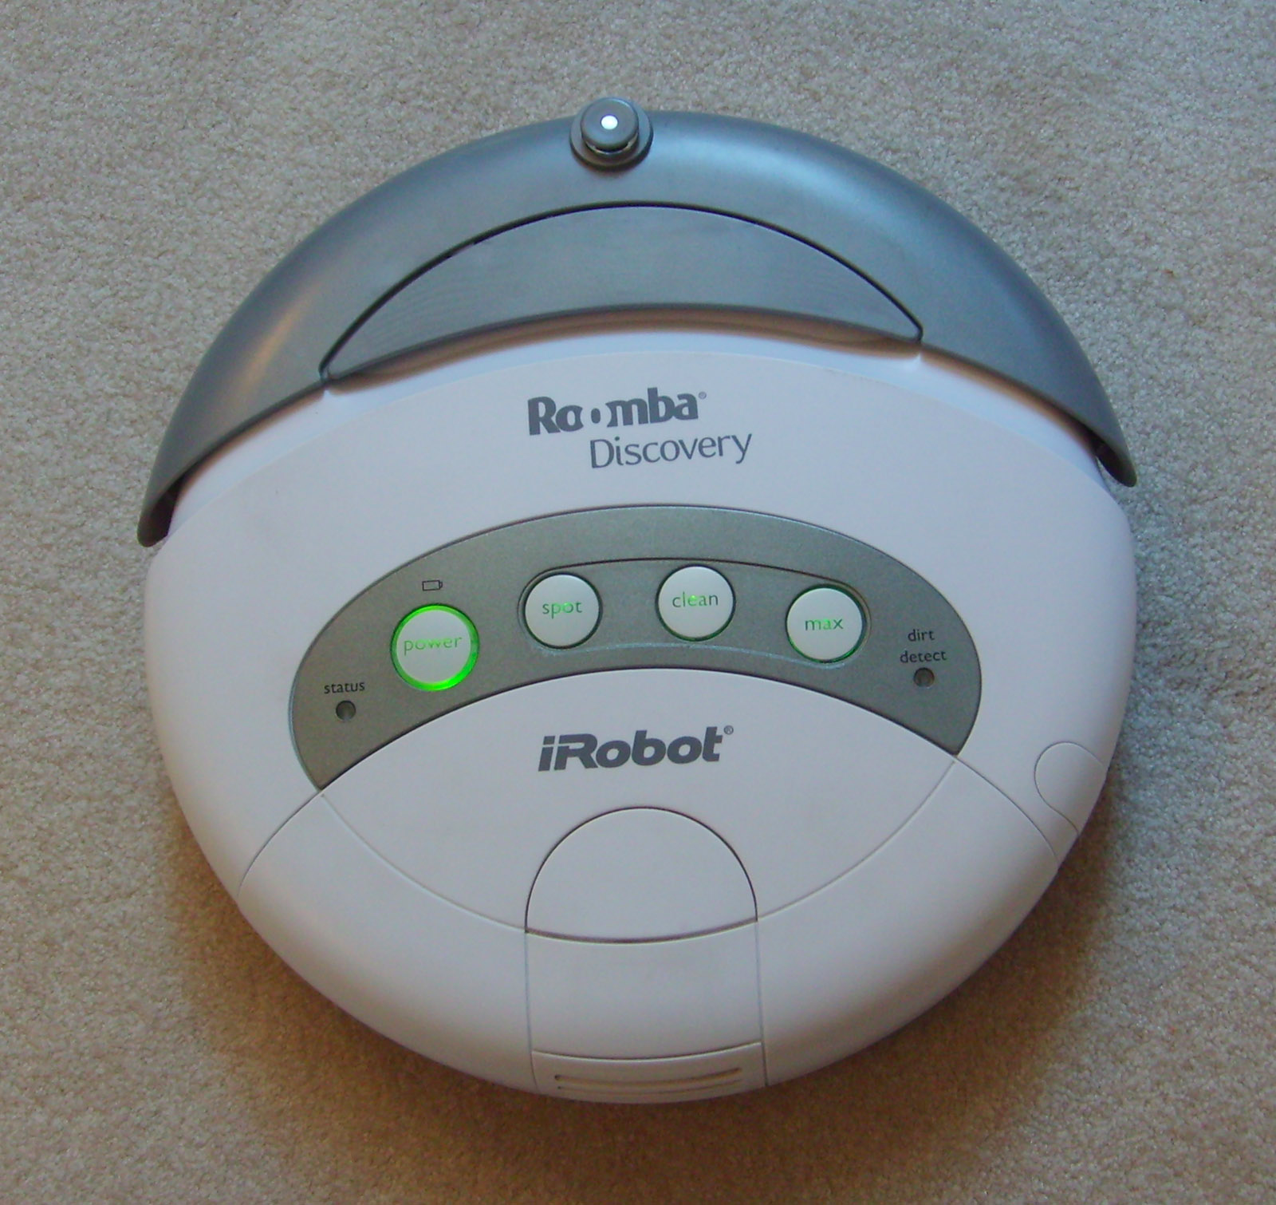
Differential drive
Rotation not constrained
Can move in any circle it wants to
Easy to move around

Slide 21
Mobile Robot Locomotion
Instantaneous center of rotation (ICR) or Instantaneous center of curvature (ICC)
A cross point of all axes of the wheels

Slide 22
Degree of Mobility
Degree of mobility
The degree of freedom of the robot motion
Cannot move anywhere (No ICR)
Fixed arc motion (Only one ICR)
Degree of mobility : 0
Degree of mobility : 1
Fully free motion
( ICR can be located at any position)
Variable arc motion (line of ICRs)
Degree of mobility : 2
Degree of mobility : 3

Slide 23
Degree of Steerability
Degree of steerability
The number of centered orientable wheels that can be steered independently in order to steer the robot
No centered orientable wheels
Degree of steerability : 0
One centered orientable wheel
Two mutually dependent centered orientable wheels
Two mutually independent centered orientable wheels
Degree of steerability : 1
Degree of steerability : 2

Slide 24
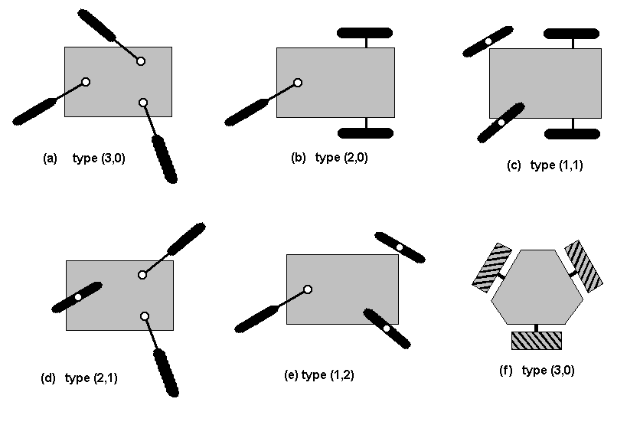
Degree of Maneuverability
The overall degrees of freedom that a robot can manipulate:
Degree of Mobility 3 2 2 1 1
Degree of Steerability 0 0 1 1 2
Examples of robot types (degree of mobility, degree of steerability)

Slide 25
Degree of Maneuverability

Slide 26
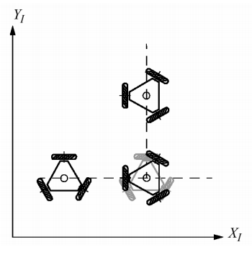
Holonomic Robots
Holonomic kinematic constraint can be expressed as explicit function of position variables only
Non-holonomic constraint requires addition information
Fixed/steered standard wheels impose non-holonomic constraints

Slide 27
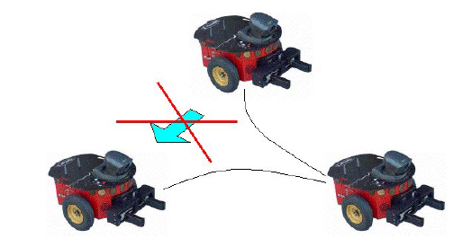
Non-holonomic constraint
A non-holonomic constraint is a constraint on the feasible velocities of a body
So what does that mean? Your robot can move in some directions (forward
and backward), but not others (sideward)
The robot can instantly
move forward and backward,
but can not move sideward
Parallel parking,
Series of maneuvers

Slide 28
Kinematic model for car-like robot
Control Input
Driving type: Forward wheel drive
Y
ϕ
: forward vel
: steering vel
θ
X

Slide 29
Kinematic model for car-like robot
Y
ϕ
θ
non-holonomic constraint:
X
: forward velocity
: steering velocity

Slide 30
Dynamic Model
Dynamic model
Y
ϕ
θ
X

