Slide 1
https://www.youtube.com/watch?v=INyVbf-yG7s#t=15

Slide 2
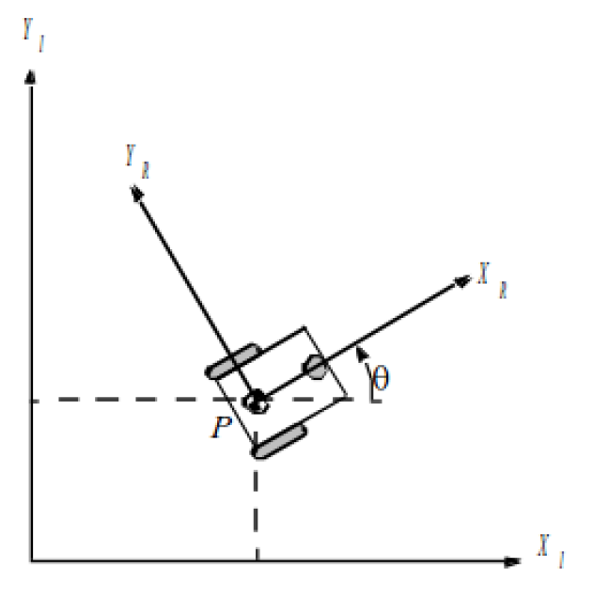
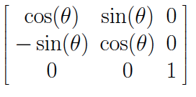
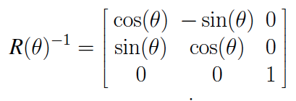
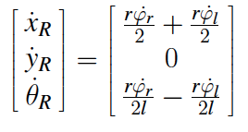
Robot Position: ξ_{I}=[x_{I},y_{I},θ_{I}]^{T}
Mapping between frames
ξ_{R}=R(θ)ξ_{I}, ξ_{I}=R(θ)⁻¹ξ_{R}
R(θ)=
Each wheel contributes to speed: rφ/2
For rotation, right wheel contributes:
ω_{r}=rφ/2l
Notes:
Nick

Slide 3
Example
θ=π/4
r_{l}=2, r_{r}=3
l=5
φ_{l}= φ_{r} =6
sin(π/4)=1/√2, cos(π/4)=1/√2
1) What is ξ_{R}?
2) What is ξ_{I}?

Slide 4
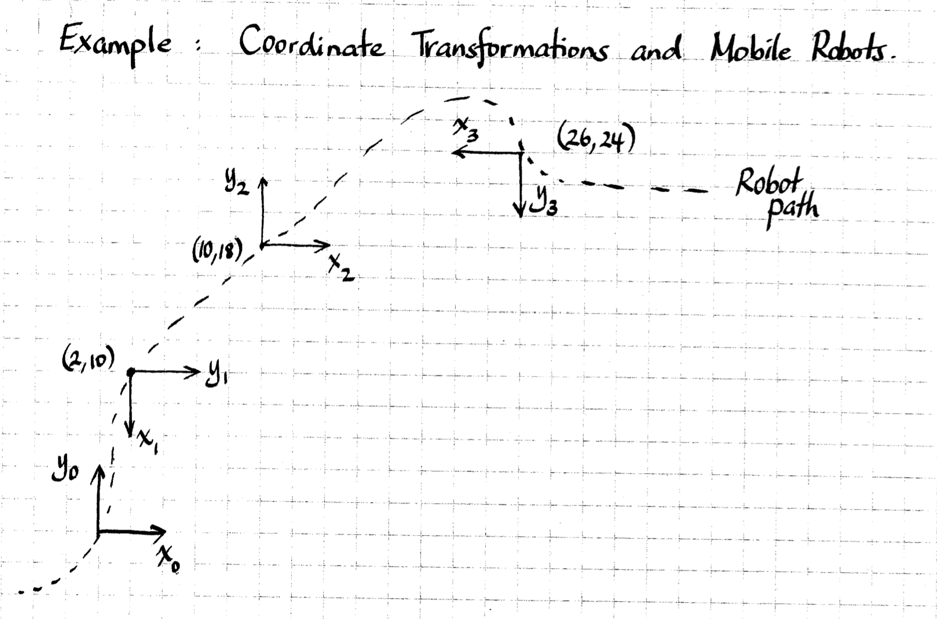

Note: Piazza post
Note: Lab 3, Lab 4, lecture

Slide 5
There is no ideal drive configuration that simultaneously maximizes stability, maneuverability, and controllability
Example: typically inverse correlation between controllability and maneuverability

Slide 6
Holonomicity
If the controllable degrees of freedom is equal to the total degrees of freedom then the robot is said to be holonomic.
  Holonomic constraints reduce the number of degrees of freedom of the system
If the controllable degrees of freedom are less than the total degrees of freedom it is non-holonomic
A robot is considered to be redundant if it has more controllable degrees of freedom than degrees of freedom in its task space

Slide 7
Why study holonomic constraints?
How many independent motions can our turtlebot robot produce?
  2 at the most
How many DOF in the task space does the robot need to control?
  3 DOF
The difference implies that our system has holonomic constraints

Slide 8
Open loop control vs. Closed loop control
Car’s cruse control

Slide 9
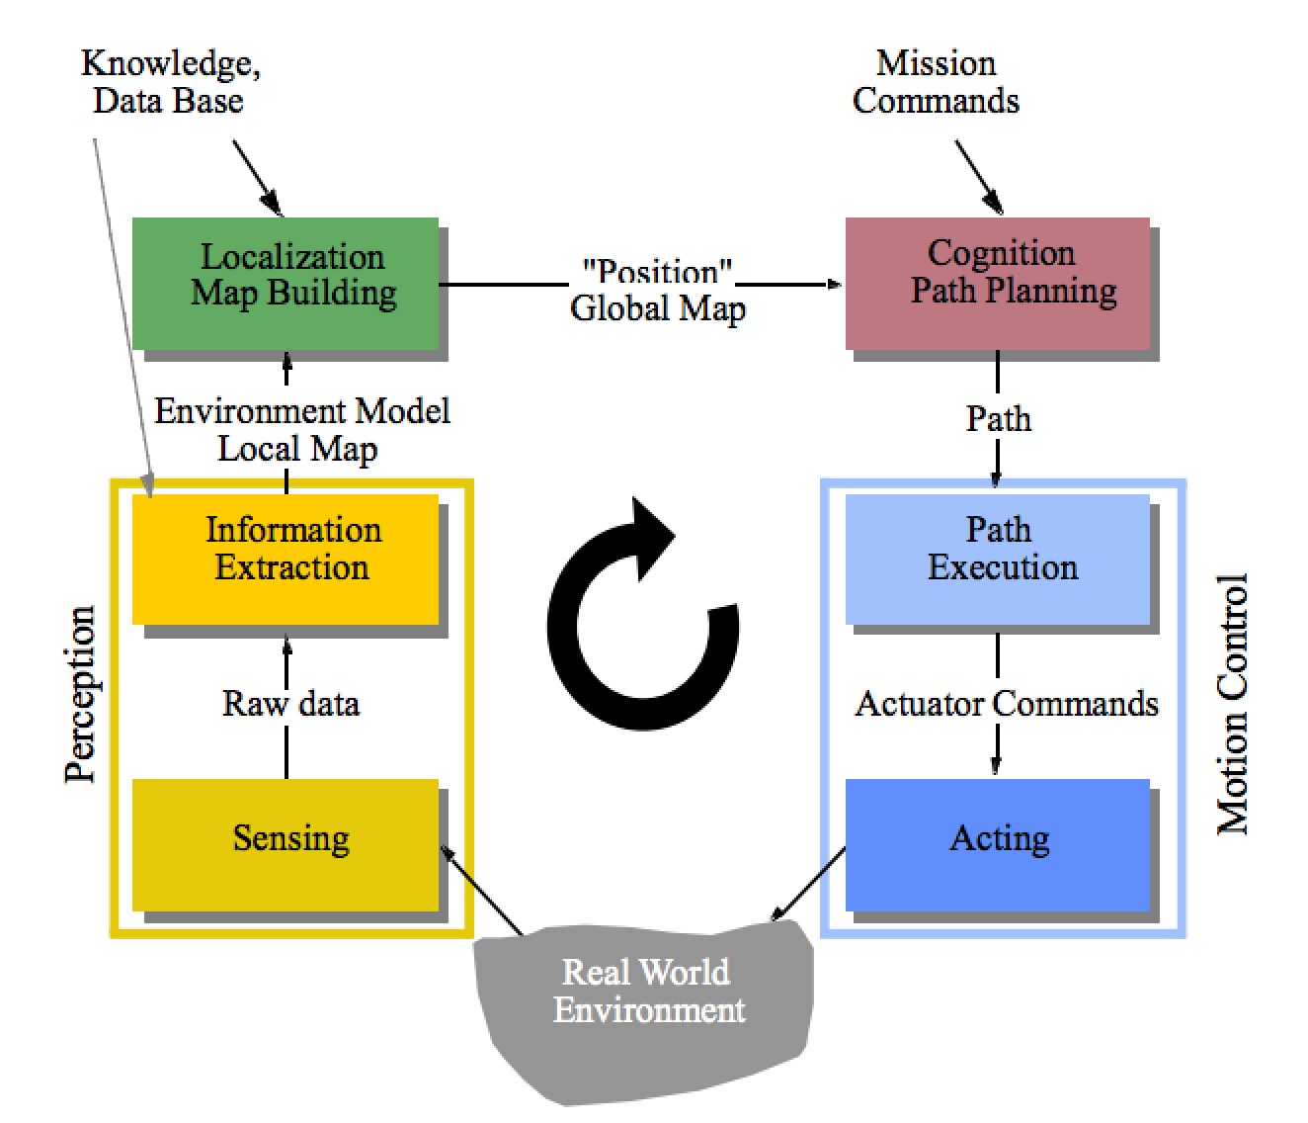
Open loop control vs. Closed loop control
Recap
  Control Architectures
  Sensors & Vision
  Control & Kinematics

Slide 10
Core AI Problem
Mobile robot path planning: identifying a trajectory that, when executed, will enable the robot to reach the goal location
Representation
  State (state space)
  Actions (operators)
  Initial and goal states
Plan:
  Sequence of actions/states that achieve desired goal state

Slide 11


Slide 12
Compute Path
Smooth it and satisfy differential constraints
Design a feedback control law that tracks the trajectory
Design a trajectory (velocity function) along the path
Model of the world
Execute

Slide 13
Fundamental Questions
How is a plan represented?
How is a plan computed?
What does the plan achieve?
How do we evaluate a plan’s quality?

Slide 14
1) World is known, goal is not

Slide 15

2) Goal is known, world is not

Slide 16
3) World is known, goal is known

Slide 17
4) Finding shortest path?

Slide 18
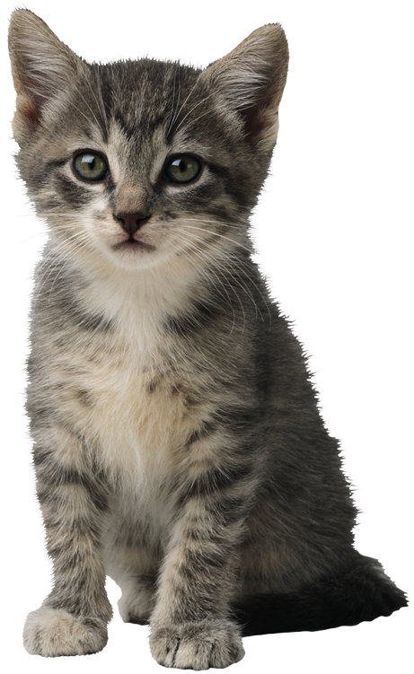
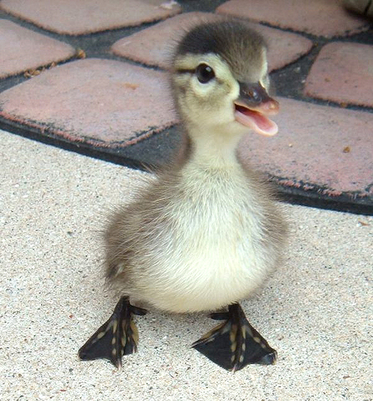
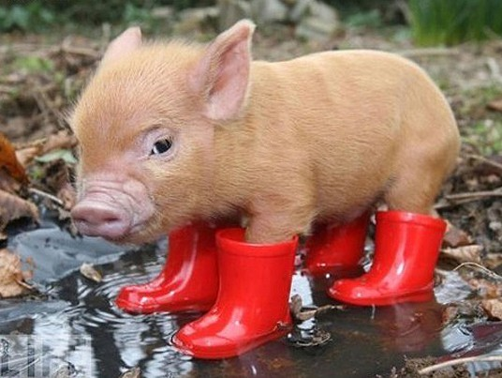
5) Finding shortest path with costs

Slide 19
The World consists of...
Obstacles
  Places where the robot can’t (shouldn’t) go
Free Space
  Unoccupied space within the world
  Robots “might” be able to go here
    There may be unknown obstacles
    The state may be unreachable

Slide 20
Configuration Space (C-Space)
Configuration Space: the space of all possible robot configurations.
  Data structure that allows us to represent occupied and free space in the environment

Slide 21
Configuration Space
Point robot (no constraints)
C
C_{free}
q_{goal}
C_{obs}
q_{init}
For a point robot moving in 2-D plane, C-space is

Slide 22

What if the robot is not a point?

Slide 23
What if the robot is not a point?
Expand obstacle(s)
Reduce robot

Slide 24
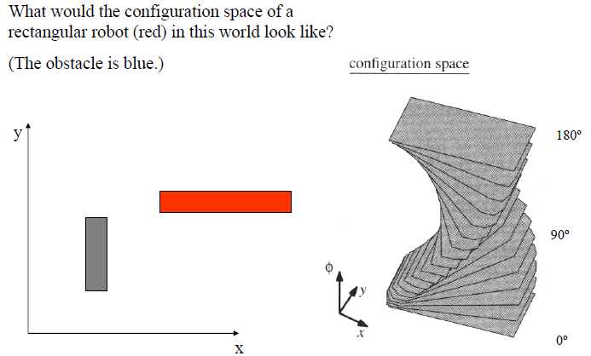
What if we want to preserve the angular component?

Slide 25
If we want to preserve the angular component…

Slide 26
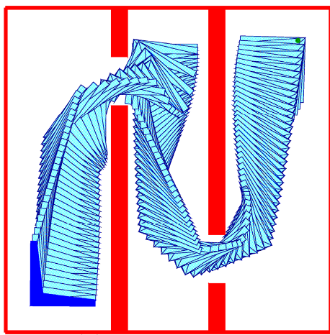
Rigid Body Planning

Slide 27
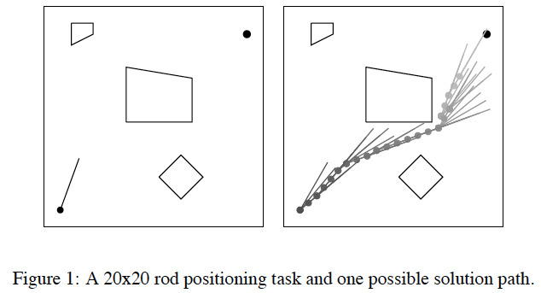
Transfer in Reinforcement Learning via Shared Features: Konidaris, Scheidwasser, and Barto, 2012

Slide 28
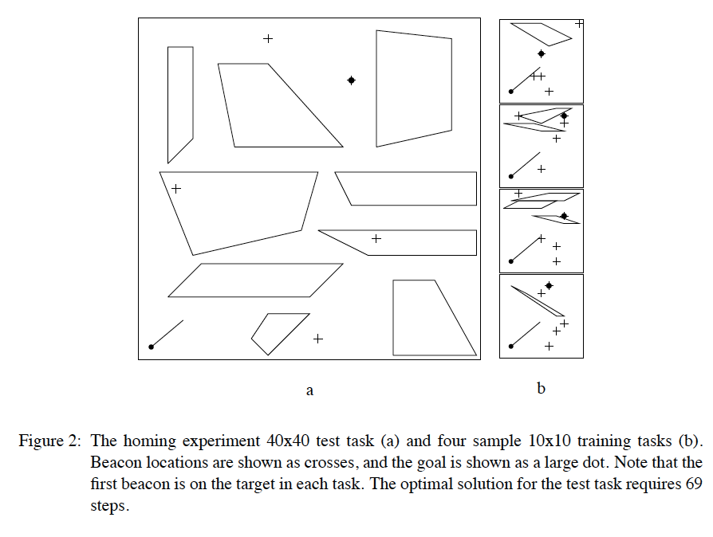

Slide 29
Back to Path Planning…
Typical simplifying assumptions for indoor mobile robots:
  2 DOF for representation
  robot is round, so that orientation doesn’t matter
  robot is holonomic, can move in any direction

Slide 30
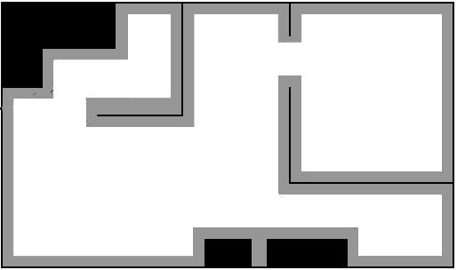

Back to Path Planning…
Now lets assume that someone gave us a map. How do we plan a path from $q_{init}$ to $q_{goal}?$
q_{init} to q_{goal}?
start
Fundamental Questions
goal
How is a plan represented?
How is a plan computed?
What does the plan achieve?
How do we evaluate a plan’s quality?

Slide 31
Discretize
start
goal

Slide 32
Occupancy Grid
start
goal

Slide 33
Occupancy Grid, accounting for C-Space
start
goal

Slide 34
Occupancy Grid, accounting for C-Space
start
goal
Slightly larger grid size can make the goal unreachable.
Problem if grid is “too small”?

Slide 35
4) Finding shortest path

Slide 36
General Tree Search
Important ideas:
  Fringe
  Expansion
  Exploration strategy
Main question: which fringe nodes to explore?

Slide 37
Review: Depth First Search
a
G
Strategy: expand deepest node first
Implementation: Fringe is a LIFO stack
a
c
b
c
b
e
d
e
d
f
f
S
h
h
p
p
r
q
r
q
S
d
e
p
b
c
e
h
r
q
a
a
h
r
p
q
f
p
q
f
q
c
G
q
c
G
a
a

Slide 38
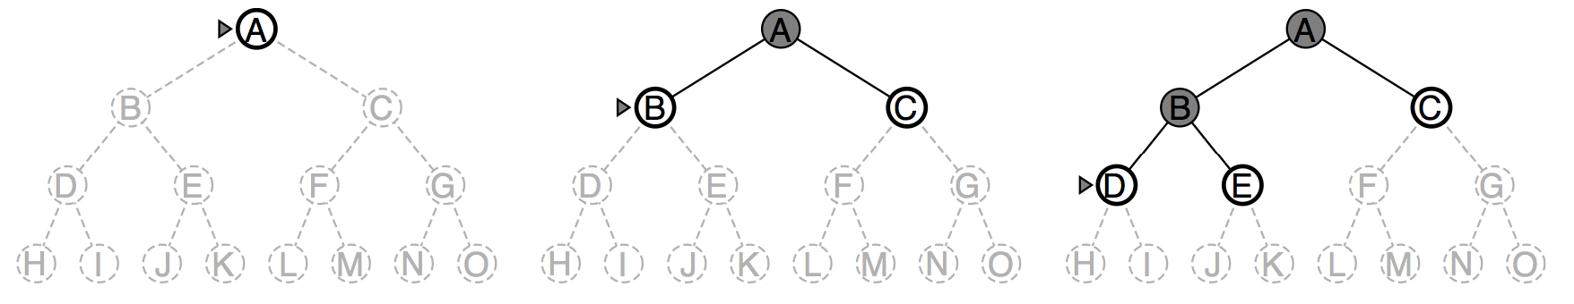
Depth-first search
Expand deepest unexpanded node
Implementation:
  fringe = LIFO queue, i.e., put successors at front
  (i.e. a stack)

Slide 39
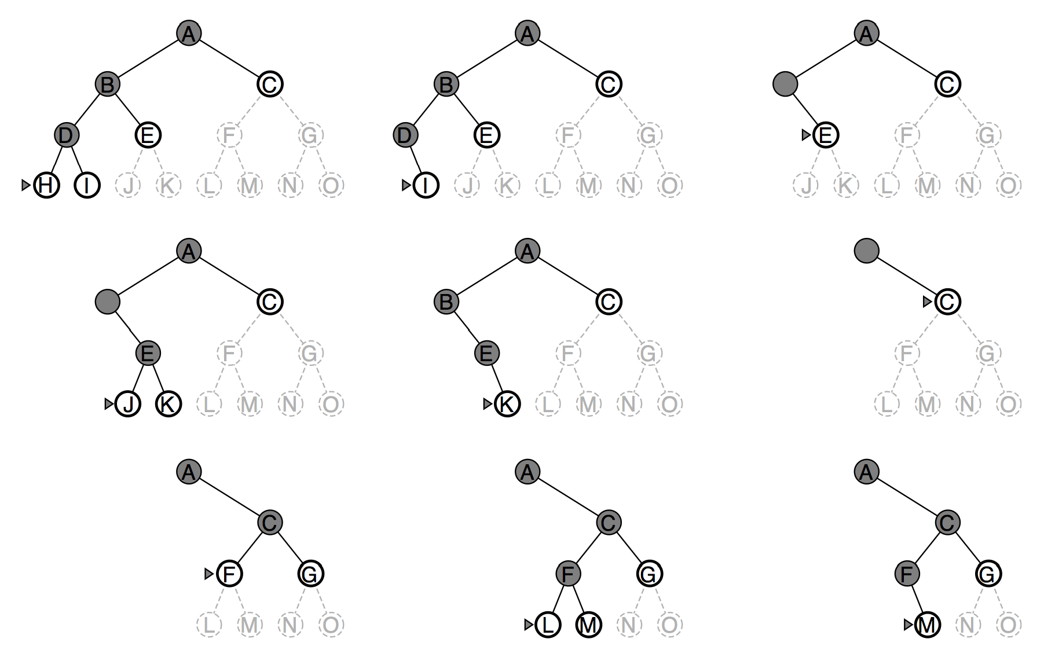
Depth-first search
DEMOS
Notes:
cd /Users/taylorm/Documents/pacman/published/demos
python pacman.py -l contoursMaze -p SearchAgent -a fn=dfs --frameTime -1
python pacman.py -p SearchAgent -a fn=dfs -l smallMaze --frameTime -1

Slide 40
Review: Breadth First Search
Strategy: expand shallowest node first
Implementation: Fringe is a FIFO queue
a
G
b
c
d
e
f
S
h
p
q
r
S
d
e
p
Search
Tiers
b
c
e
h
r
q
a
a
h
r
p
q
f
p
q
f
q
c
G
q
c
G
a
a

Slide 41
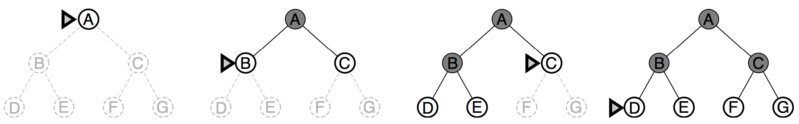
Breadth-first search
Expand shallowest unexpanded node
Implementation:
  Fringe is a FIFO queue, i.e., new successors go at end
DEMOS
Notes:
cd /Users/taylorm/Documents/pacman/published/demos
python pacman.py -l contoursMaze -p SearchAgent -a fn=bfs --frameTime -1
python pacman.py -p SearchAgent -a fn=bfs -l smallMaze --frameTime -1

Slide 42
DFS
Algorithm |  | Complete | Optimal | Time | Space
DFS | Depth First Search | N | N | O(B^{LMAX}) | O(LMAX)
N
N
Infinite
Infinite
b
START
a
GOAL
Infinite paths make DFS incomplete…
How can we fix this?

Slide 43
DFS
With cycle checking, DFS is complete.*
1 node
b
…
b nodes
b² nodes
m tiers
b^{m} nodes
Algorithm |  | Complete | Optimal | Time | Space
DFS | w/ Path Checking
Y
N
O(b^{m+1})
O(bm)
* Or with graph search version of DFS

Slide 44
BFS
When is BFS optimal?
Algorithm |  | Complete | Optimal | Time | Space
DFS | w/ Path Checking
BFS
Y
N
O(b^{m+1})
O(bm)
Y
N*
O(b^{s+1})
O(b^{s})
1 node
b
…
b nodes
s tiers
b² nodes
b^{s} nodes
b^{m} nodes

Slide 45
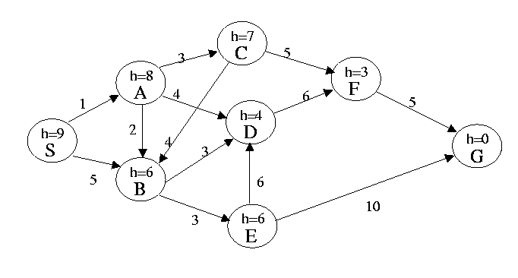
In this problem the start state is S, and the goal state is G. IGNORE the heuristic estimate, h, and the transition costs next to the edges. Assume that ordering is defined by, and ties are always broken by, choosing the state that comes first alphabetically.
What is the order of states expanded using Depth First Search? Assume DFS terminates as soon as it reaches G.
What is the order of states expanded using Breadth First Search? Assume BFS terminates as soon as it reaches G.
Notes:
SABDFG
SABCDEFG

