Slide 1
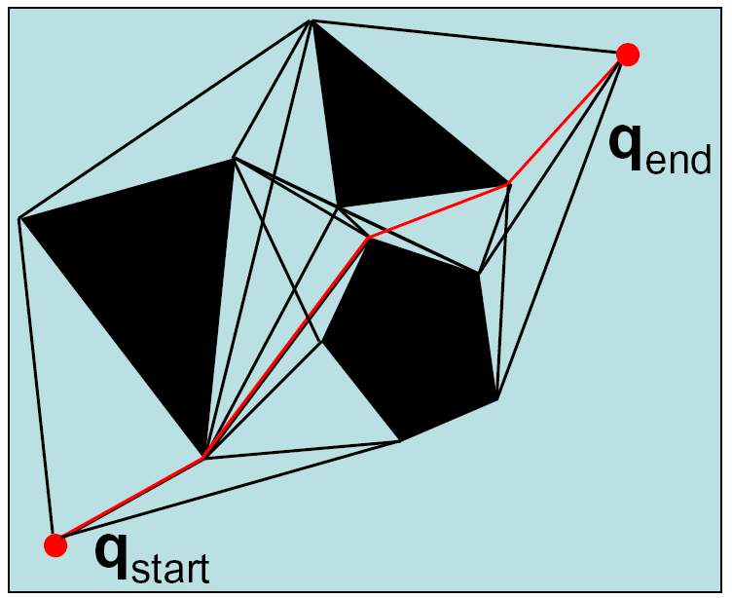
Visibility Graph

Slide 2
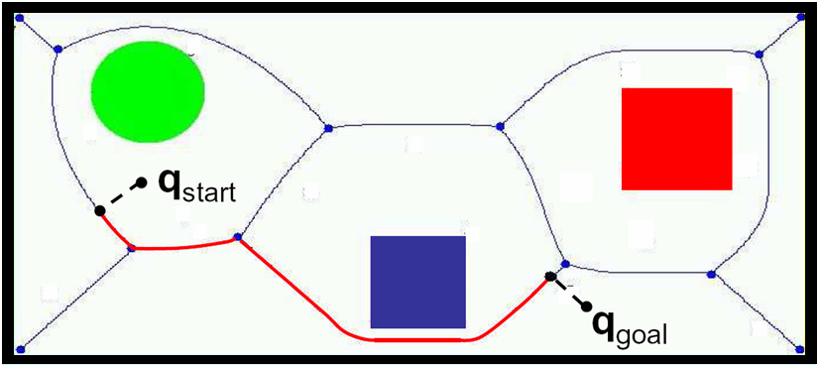
Voronoi Diagram
Control is easy: stay equidistant away from closest obstacles

Slide 3
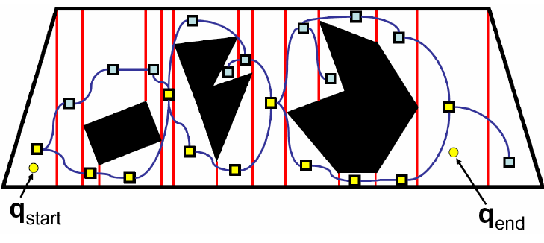
Exact Cell Decomposition
Plan over this graph

Slide 4
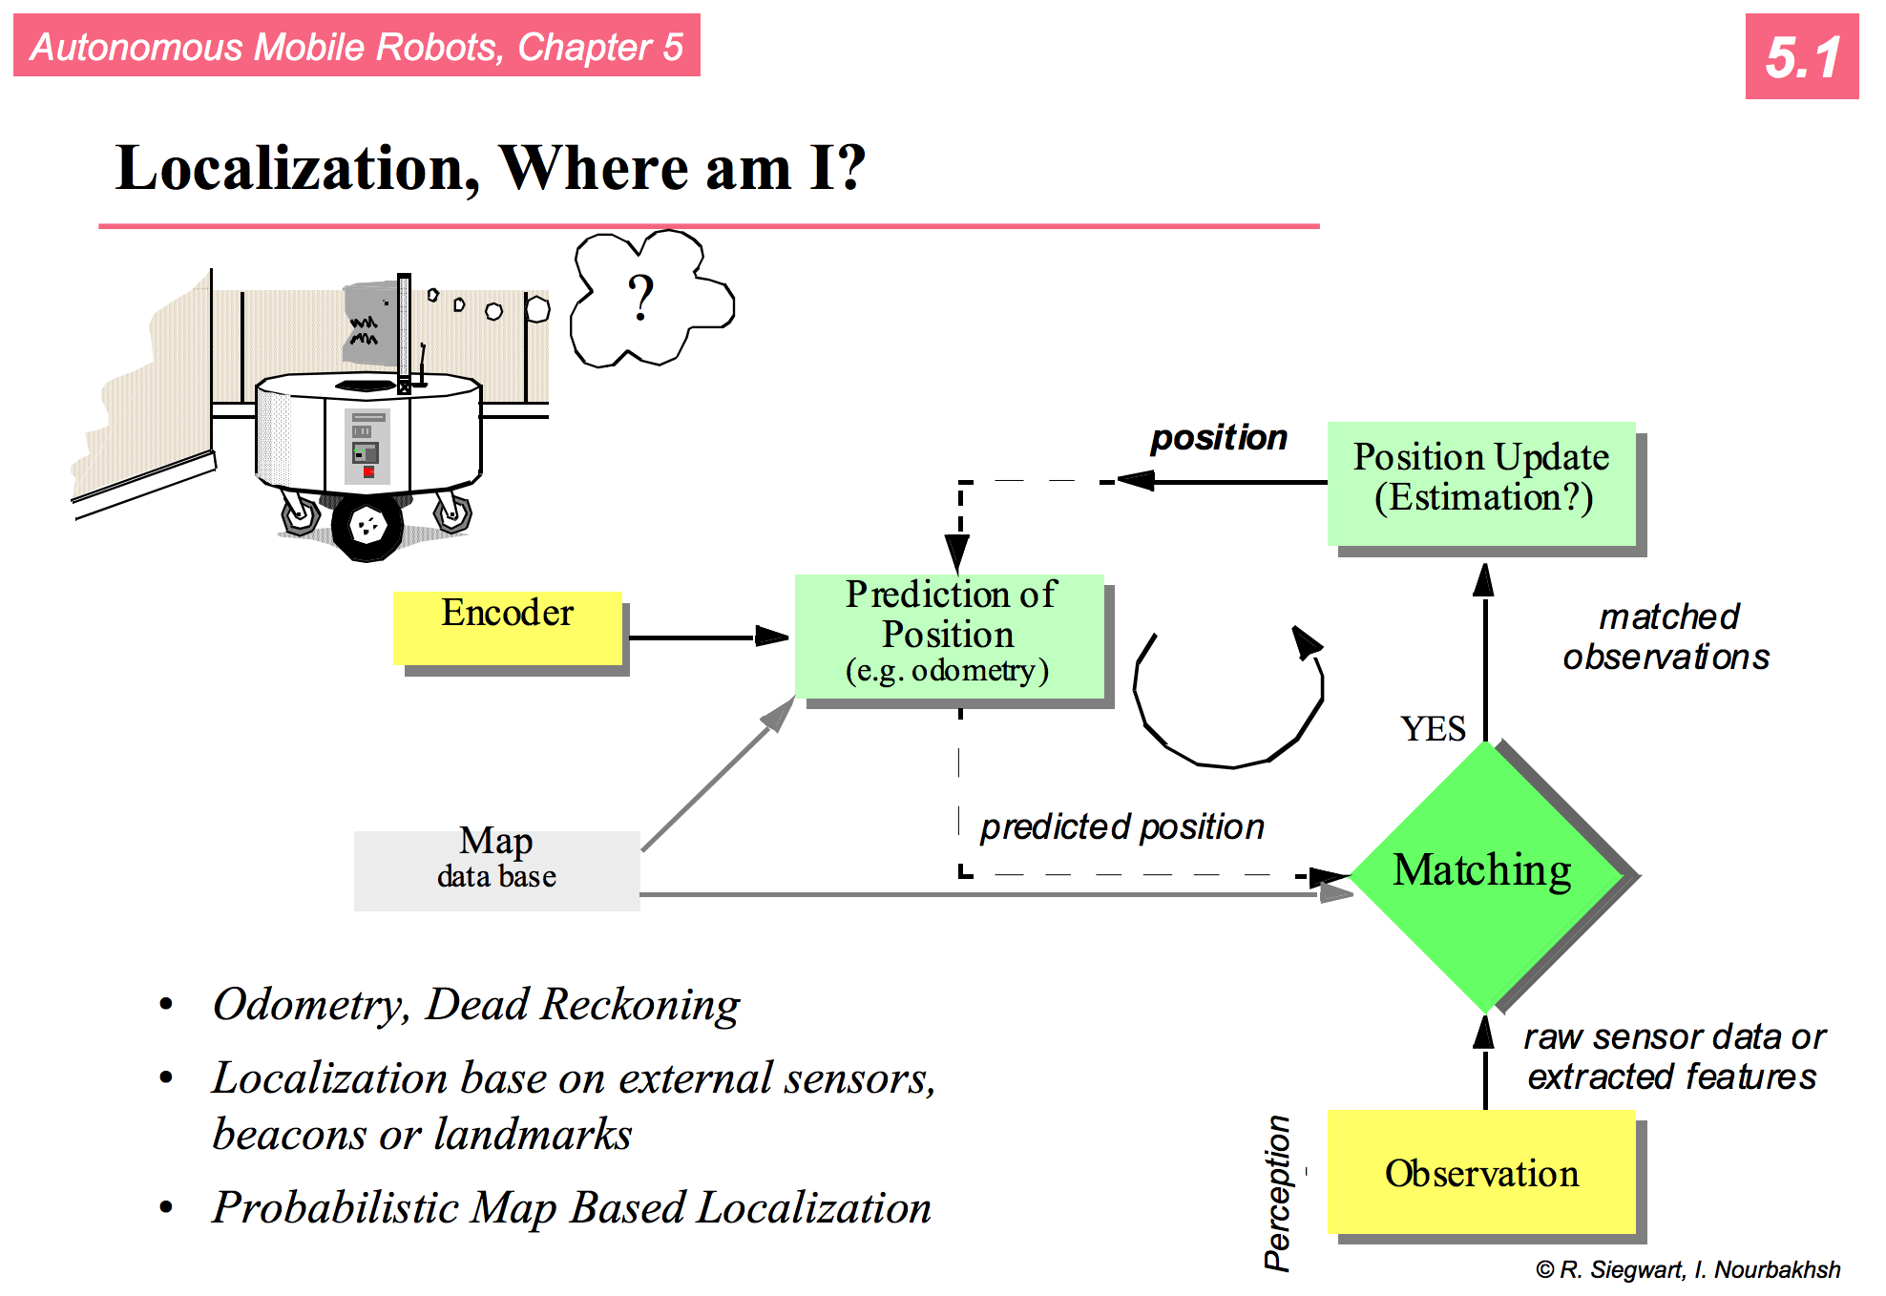

Slide 5
Localization
Two types of approaches:
  Iconic : use raw sensor data directly. Match current sensor readings with what was observed in the past
  Feature-based : extract features of the environment, such as corners and doorways. Match current observations

Slide 6
Continuous Localization and Mapping
Time
Initial Map
Global Map

Slide 7
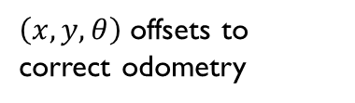
Continuous Localization and Mapping
Time
Sensor Data
Local Map
Global Map
Matching
Registration
$\left(x,y,θ\right)$ offsets to correct odometry

Slide 8
Continuous Localization and Mapping
Time
Local Map
Global Map
Matching
Registration
$\left(x,y,θ\right)$ offsets to correct odometry

Slide 9
Continuous Localization and Mapping
register
global map
match and score
sensor data
construct local map
local map
best pose

Slide 10
Continuous Localization and Mapping
register
global map
match and score
sensor data
construct local map
local map
best pose
encoder data
pose estimation
k possible poses

Slide 11
Matching
X
Where am I?
Local Map
probabilities
Global Map

Slide 12
Matching
®
Where am I on the global map?
Local Map
obstacle
Global Map















®


…

®


…








…


















Examine different possible robot positions.

Slide 13
This sounds hard, do we need to localize?
https://www.youtube.com/watch?v=6KRjuuEVEZs

Slide 14
Matching and Registration
Collect sensor readings and create a local map
Estimate poses that the robot is likely to be in given distance traveled from last map update
  In theory k is infinite
  Discretize the space of possible positions (e.g., consider errors in increments of 5º)
  Try to model the likely behavior of your robot. Try to account for systematic errors (e.g., robot tends to drift to one side)

Slide 15
Matching and Registration
Collect $n$ sensor readings and create a local map
Estimate $k$ poses $(x,y,θ)$ that the robot is likely to be in given the distance travelled from the last map update
For each pose $k$ score how well the local map matches the global map at this position
Choose the pose with the best score. Update the position of the robot to the corresponding $(x,y,θ)$ location.
What if you were tracking multiple possible poses.
How would you combine info from this with
previous estimate of global position + odometry?

Slide 16
Matching and Registration
Collect $n$ sensor readings and create a local map
Estimate $k$ poses $(x,y,θ)$ that the robot is likely to be in given the distance travelled from the last map update
For each pose $k$ score how well the local map matches the global map at this position
Choose the pose with the best score. Update the position of the robot to the corresponding $(x,y,θ)$ location.
Registration: update the global map. One possible way:$global\left[i\right]\left[j\right]=\frac{global\left[i\right]\left[j\right]+local\left[i\right][j]}{2}$

Slide 17
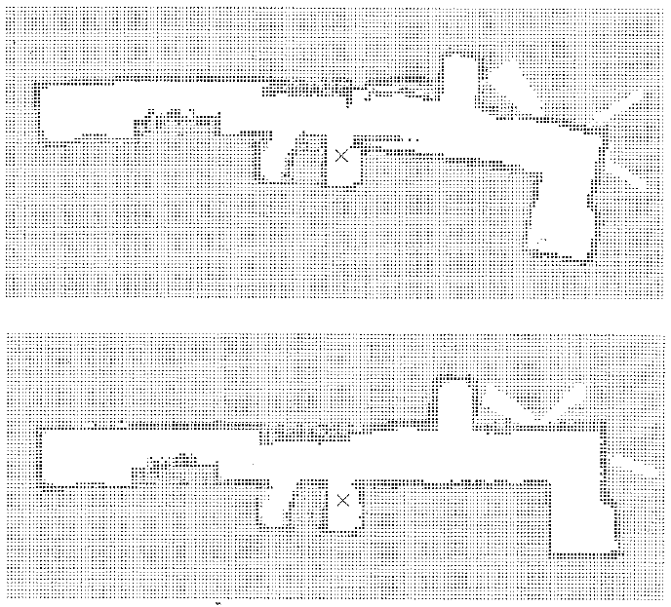

Slide 18
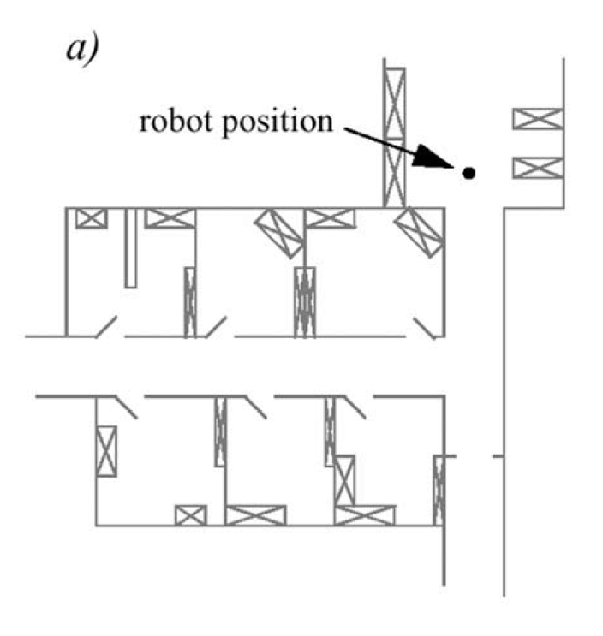
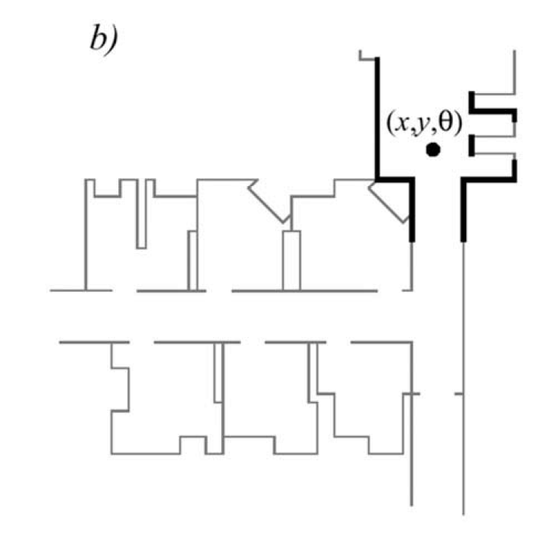
Representations
line-based map (~100 lines)

Slide 19
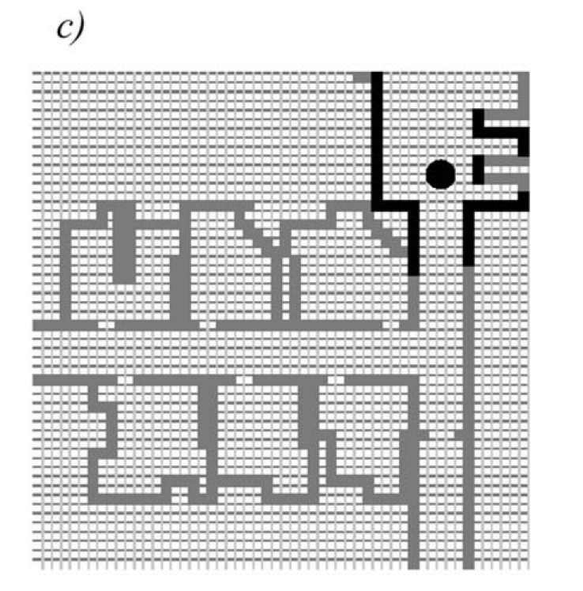
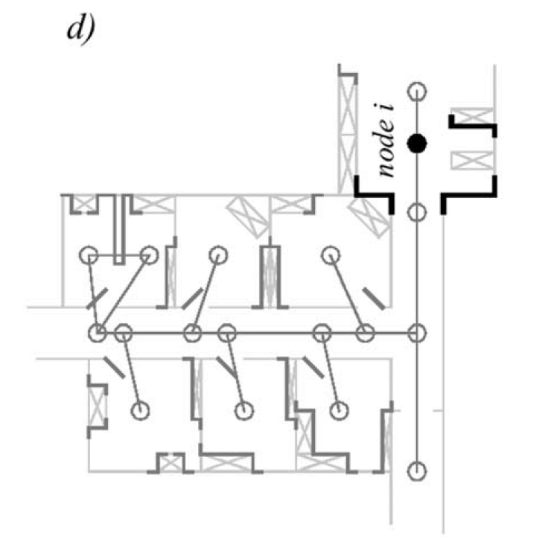
Representations
One location vs. location distribution
Grid-based map (3000 cells)
Topological map (50 features, 18 nodes)

Slide 20
Feature-Based Localization
Extract features such as doorways, corners and intersections
Either
  Use continuous localization to try and match features at each update
  Use topological information to create a graph of the environment

Slide 21
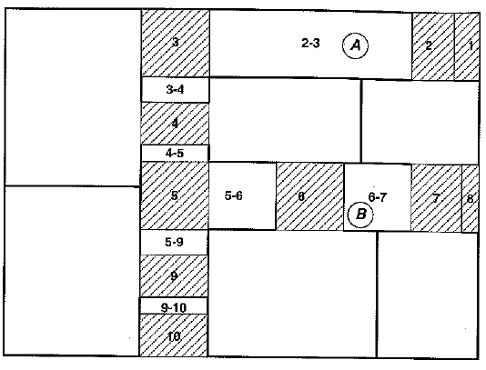
Topological Map of Office Building
The robot has identified 10 doorways, marked by single number.
Hallways between doorways labeled by gateway-gateway pairing.

Slide 22
Topological Map of Office Building
What if the robot is told it is at position A but it’s actually at B. How could it correct that information?

Slide 23
Localization Problem(s)
Position Tracking
Global Localization
Kidnapped Robot Problem
Multi-Robot Localization

Slide 24
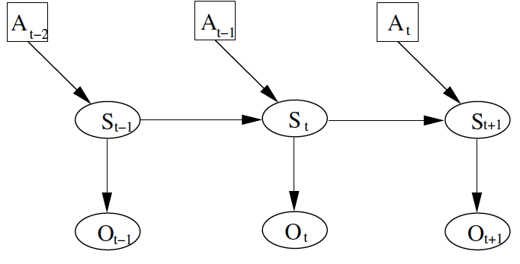
General approach:
A: action
S: pose
O: observation
Position at time t depends on position previous position and action, and current observation

Slide 25
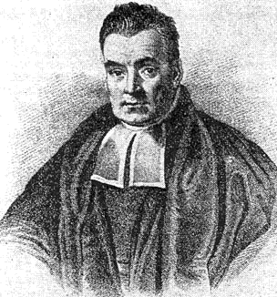
Pose at time t determines the observation at time t
If we know the pose, we can say what the observation is
But, this is backwards…
Hello Bayes!

Slide 26

Quiz!
If events a and b are independent,
    p(a, b) =
If events a and b are not independent,
  p(a, b) =
p(c|d) = ?
Mattel
1992

Slide 27
Quiz!
If events a and b are independent,
    p(a, b) = p(a) × p(b)
If events a and b are not independent,
  p(a, b) = p(a) × p(b|a) = p(b) × p (a|b)
p(c|d) = p (c , d) / p(d) = p((d|c) p(c)) / p(d)

Slide 28
Bayes Filtering
Want to have a way of representing uncertainty
Probability Distribution
  Could be discrete or continuous
  Prob. of each pose in set of all possible poses
Belief
Prior
Posterior

Slide 29
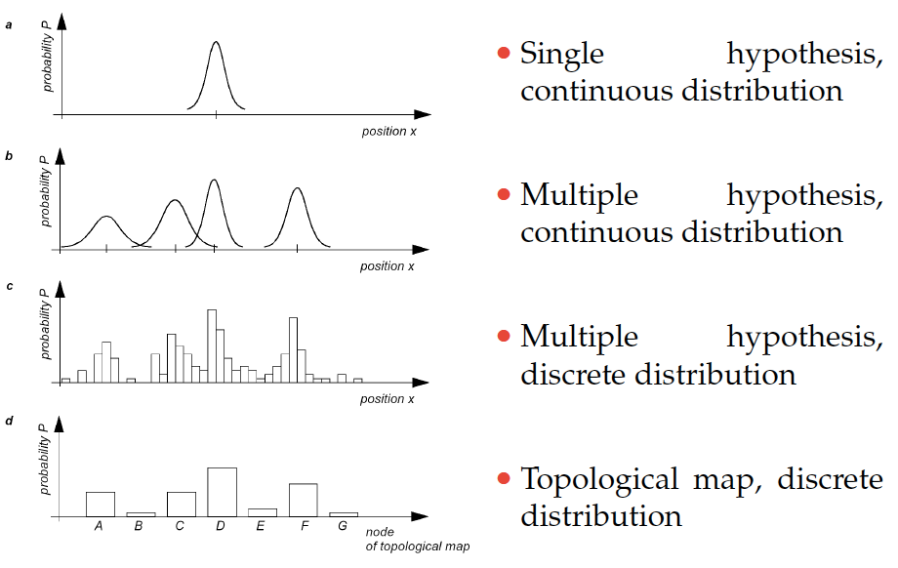
Models of Belief

Slide 30
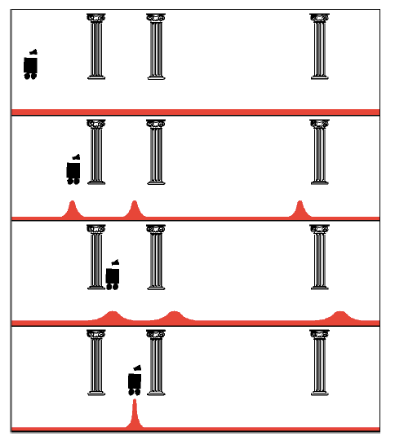
Uniform Prior
Observation: see pillar
Action: move right
Observation: see pillar

Slide 31
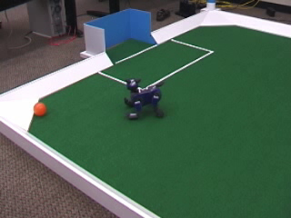
Modeling objects in the environment
http://www.cs.washington.edu/research/rse-lab/projects/mcl

Slide 32
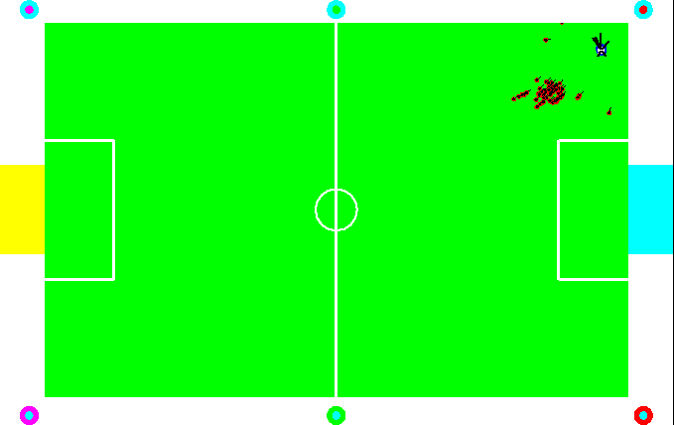
Modeling objects in the environment
http://www.cs.washington.edu/research/rse-lab/projects/mcl

Slide 33

Axioms of Probability Theory
$Pr⁡(A)$ denotes probability that proposition A is true.
$Pr⁡(¬A)$ denotes probability that proposition A is false.

Slide 34
A Closer Look at Axiom 3
B

Slide 35

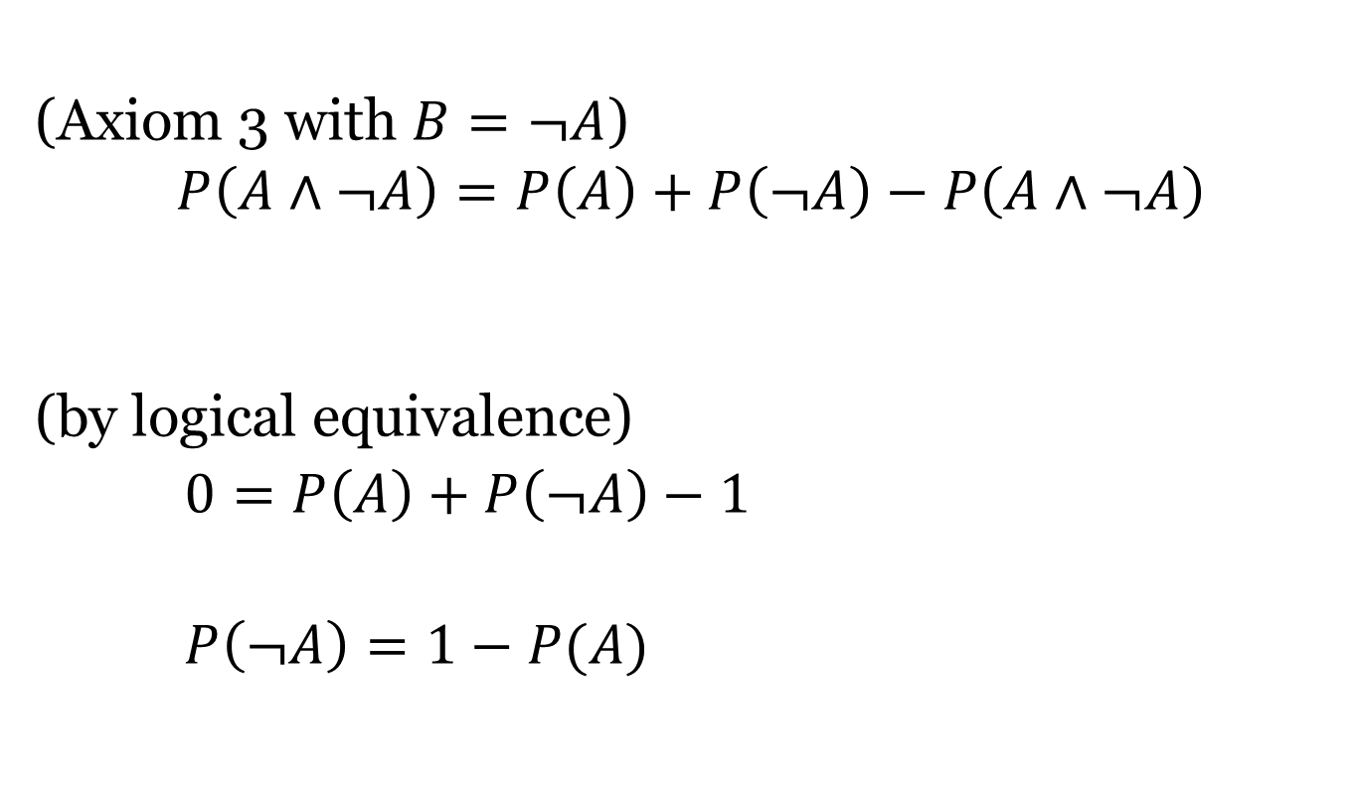
Using the Axioms to Prove $P\left(¬A\right)=1−P\left(A\right)$
(Axiom 3 with )
(by logical equivalence)
∨

Slide 36
Discrete Random Variables
X denotes a random variable.
X can take on a countable number of values in {x₁, x₂, …, x_{n}}.
P(X=x_{i}), or P(x_{i}), is the probability that the random variable X takes on value x_{i}.
P(x_{i}) is called probability mass function.
E.g.

Slide 37

Continuous Random Variables
$X$ takes on values in the continuum.
$p(X=x)$, or $p(x)$, is a probability density function.
E.g.
p(x)
x

Slide 38
Probability Density Function
Magnitude of curve could be greater than 1 in some areas. The total area under the curve must add up to 1.
p(x)
x
Since continuous probability functions are defined for an infinite number of points over a continuous interval, the probability at a single point is always 0.

Slide 39
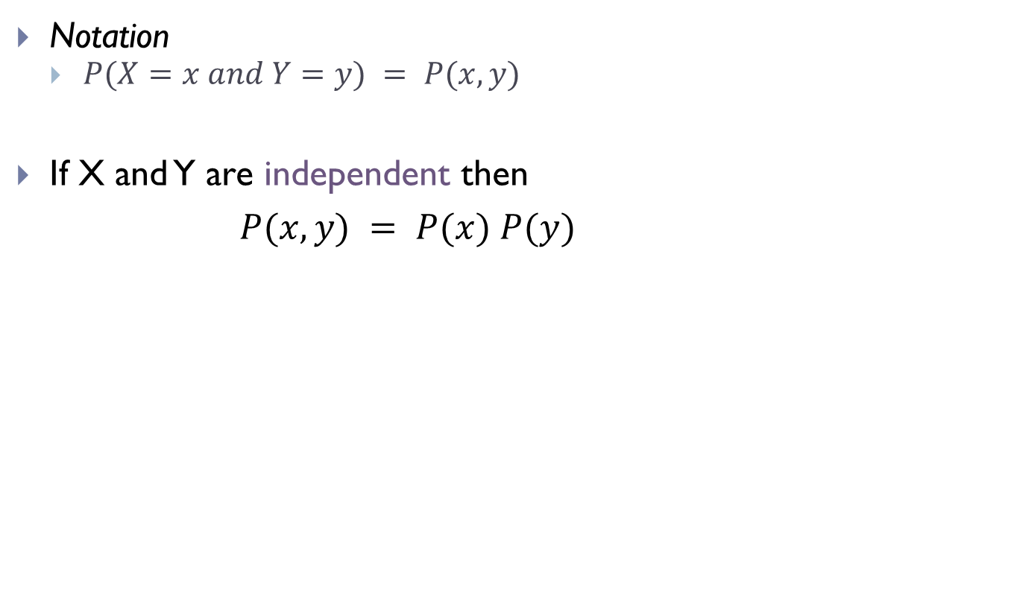
Joint Probability
Notation
  $P(X=x and Y=y) = P(x,y)$
If X and Y are independent then
$P(x,y) = P(x) P(y)$

Slide 40
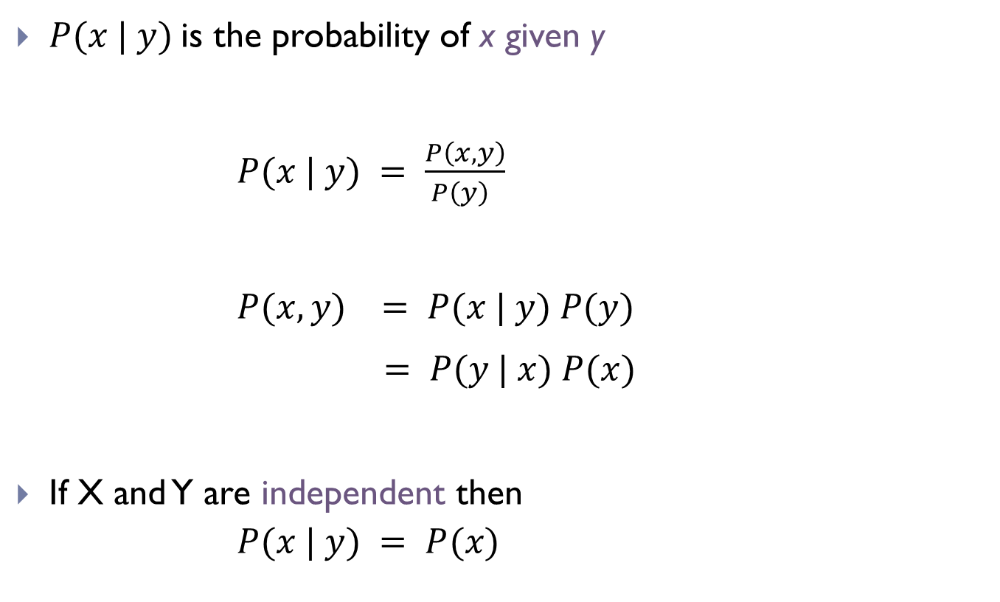
Conditional Probability
is the probability of x given y
If X and Y are independent then

Slide 41
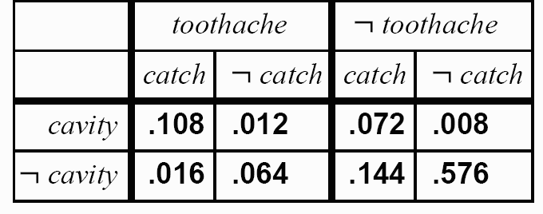

Inference by Enumeration
  $P\left(¬cavity \right|toothache)=\frac{P(¬cavity∧toothache)}{P(toothache)}$
$\frac{0.016+0.064}{0.108+0.012++0.016+0.064}$ =0.4

Slide 42
Law of Total Probability
Discrete case
Continuous case

Slide 43
Bayes Formula
If y is a new sensor reading:
→
Prior probability distribution
→
Posterior (conditional) probability distribution
→
Model of the characteristics of the sensor
→
Does not depend on x

Slide 44
Bayes Formula

Slide 45
Normalization
Algorithm:

Slide 46
Conditioning
Law of total probability:

Slide 47
Bayes Rule with Background Knowledge

Slide 48
Conditional Independence
equivalent to
and

Slide 49
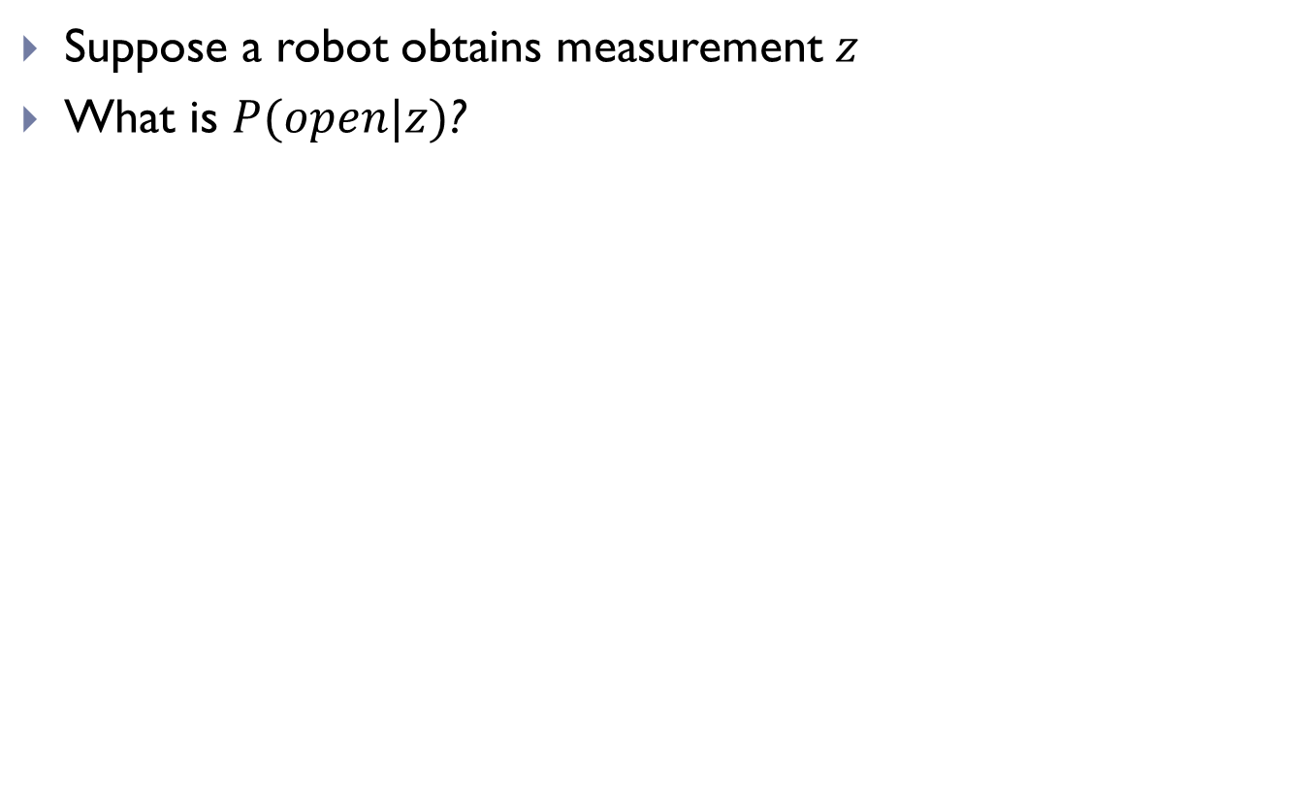
Simple Example of State Estimation
Suppose a robot obtains measurement $z$
What is $P(open|z)$?

Slide 50
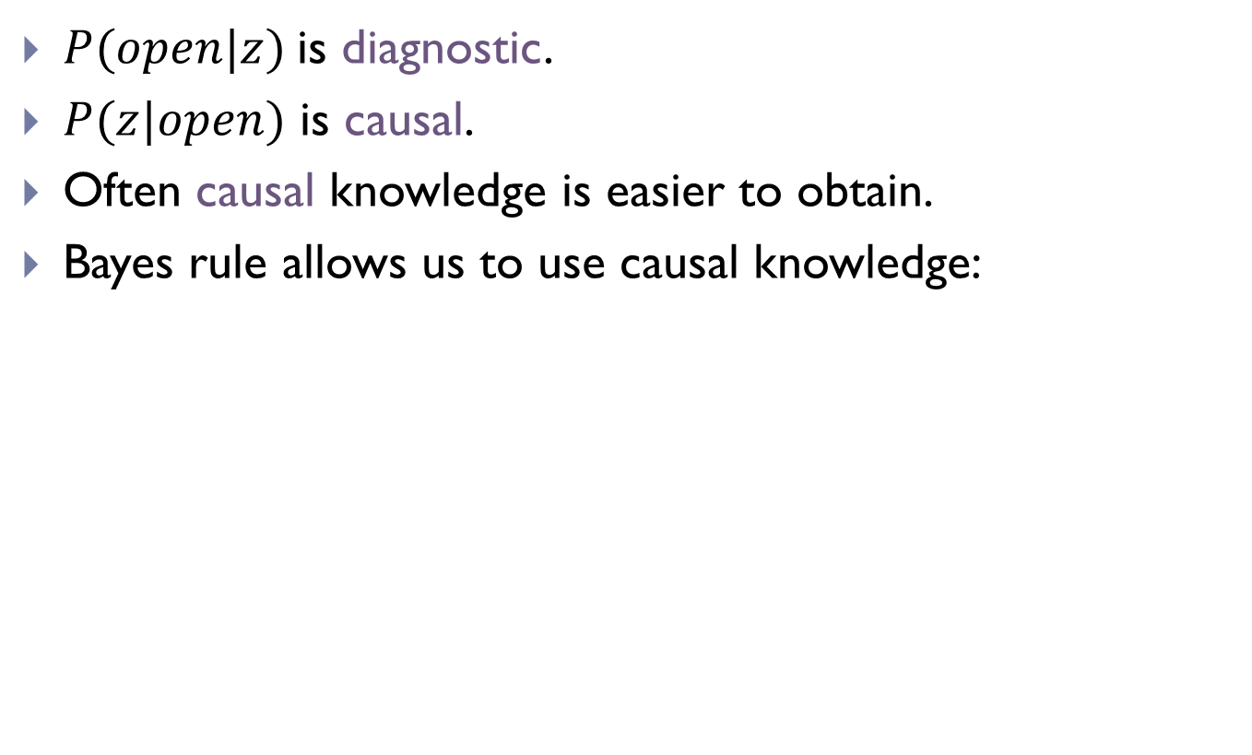
Causal vs. Diagnostic Reasoning
$P(open|z)$is diagnostic.
$P(z|open)$ is causal.
Often causal knowledge is easier to obtain.
Bayes rule allows us to use causal knowledge:
Comes from sensor model.

Slide 51
Example
P(z|open) = 0.6 P(z|¬open) = 0.3
P(open) = P(¬open) = 0.5
$z$ raises the probability that the door is open.

Slide 52

Combining Evidence
Suppose our robot obtains another observation z₂.
How can we integrate this new information?
More generally, how can we estimate
P(x| z₁...z_{n} )?

Slide 53
Recursive Bayesian Updating
Markov assumption: z_{n} is independent of z₁,...,z_{n-1} if we know x.

Slide 54
Example: 2nd Measurement
P(z₂|open) = 0.5 P(z₂|¬open) = 0.6
P(open|z₁)=2/3
$z2$lowers the probability that the door is open.

