Slide 1
TD(0) prediction
Sarsa, On-policy learning
Q-Learning, Off-policy learning

Slide 2
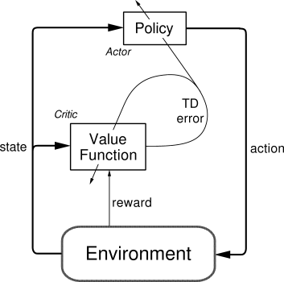
Actor-Critic

Slide 3
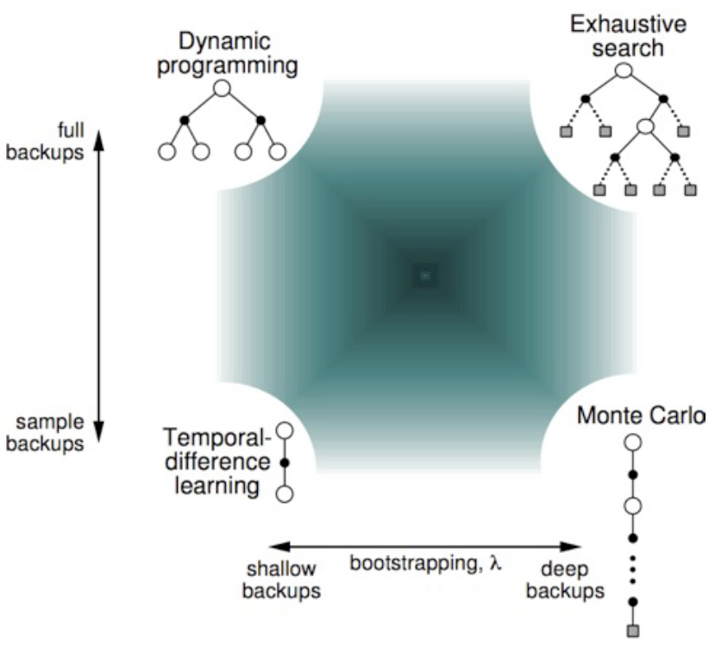
Unified View

Slide 4
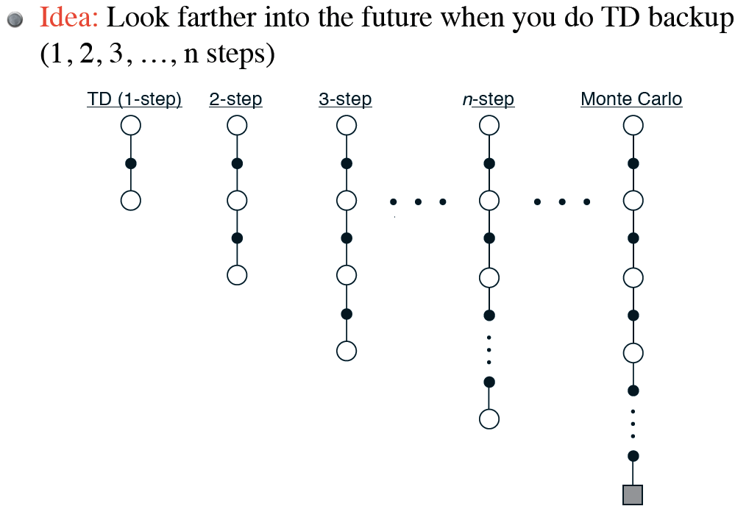
N-step TD Prediction

Slide 5
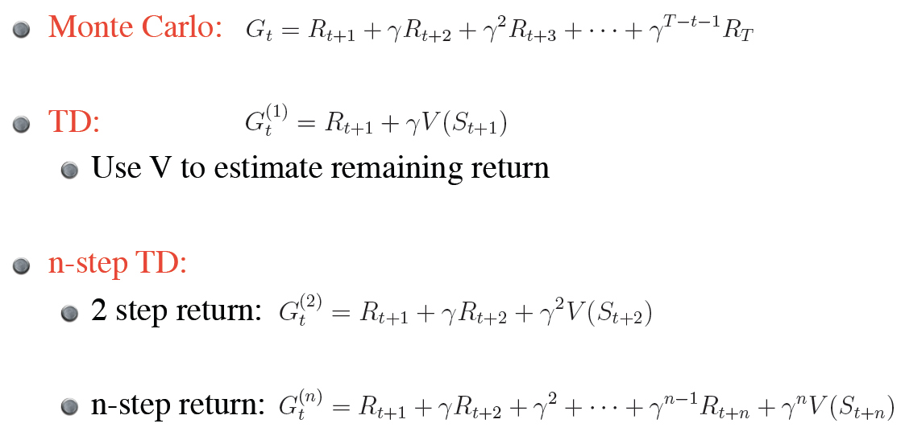

Slide 6
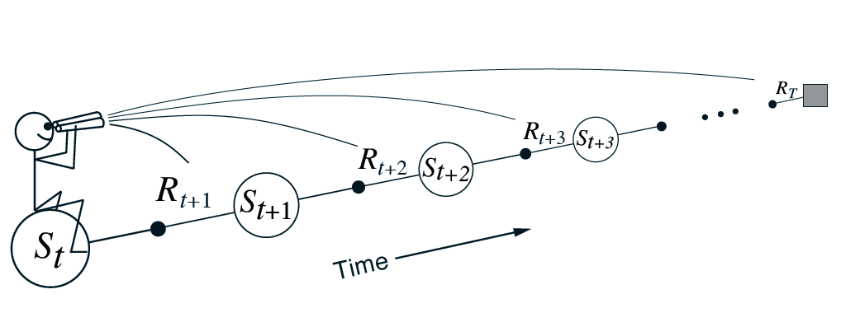
Forward View

Slide 7
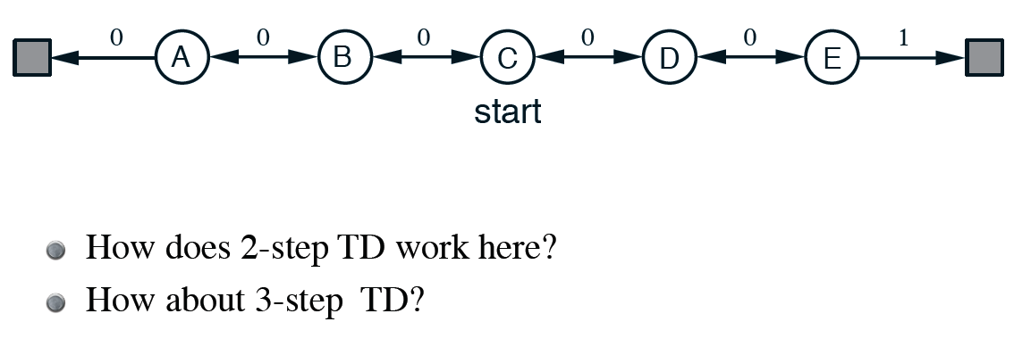
Random Walk

Slide 8
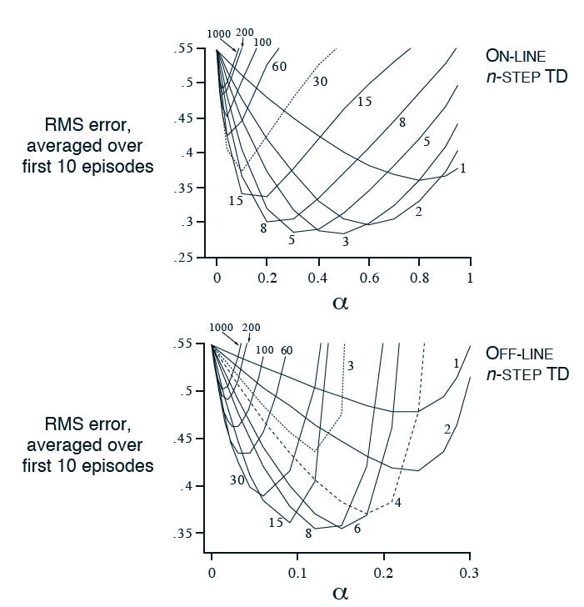
19-state random walk

Slide 9
n-step method is simple version of TD(λ)
Example: backup average of 2-step and 4-step returns

Slide 10
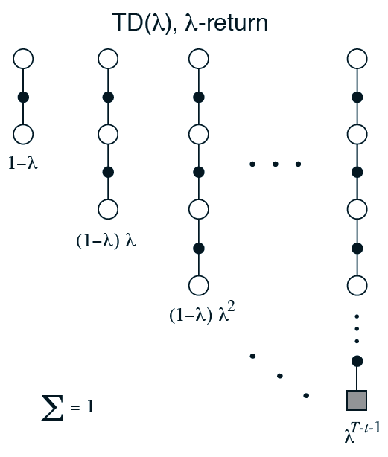
Forward View, TD(λ)
Weigh all n-step return backups by λ^{n-1}
(time since visitation)
λ-return:
Backup using λ-return:

Slide 11
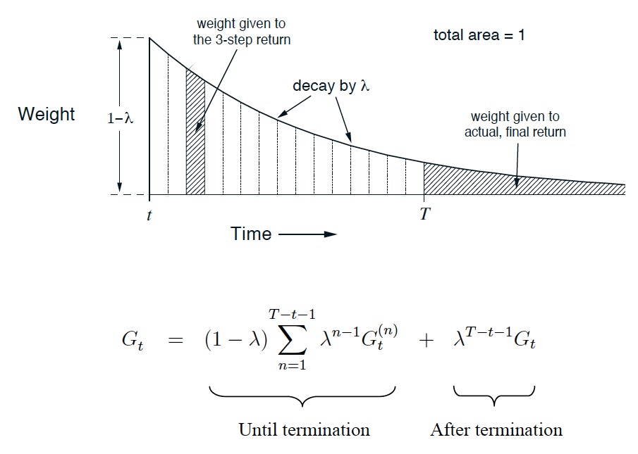
Weighting of λ-return

Slide 12
Relationship with TD(0) and MC

Slide 13
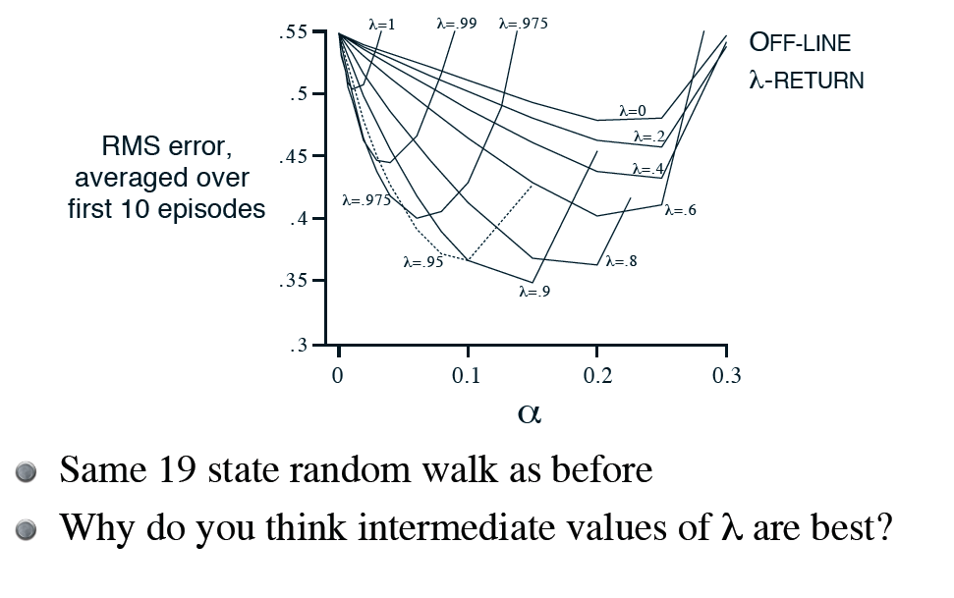

Slide 14
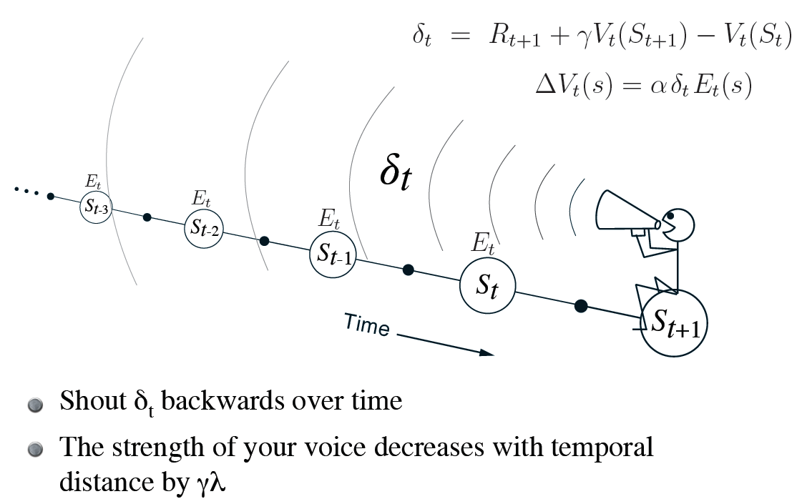
Backward View

Slide 15
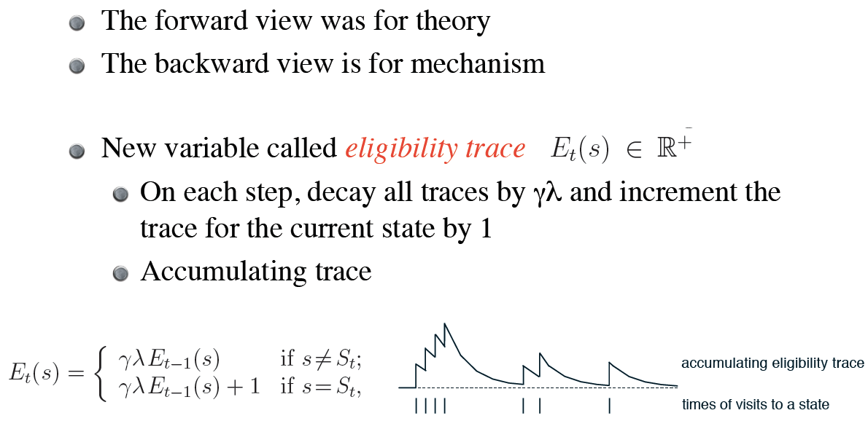
Book shows forward and backward views are actually equivalent

Slide 16
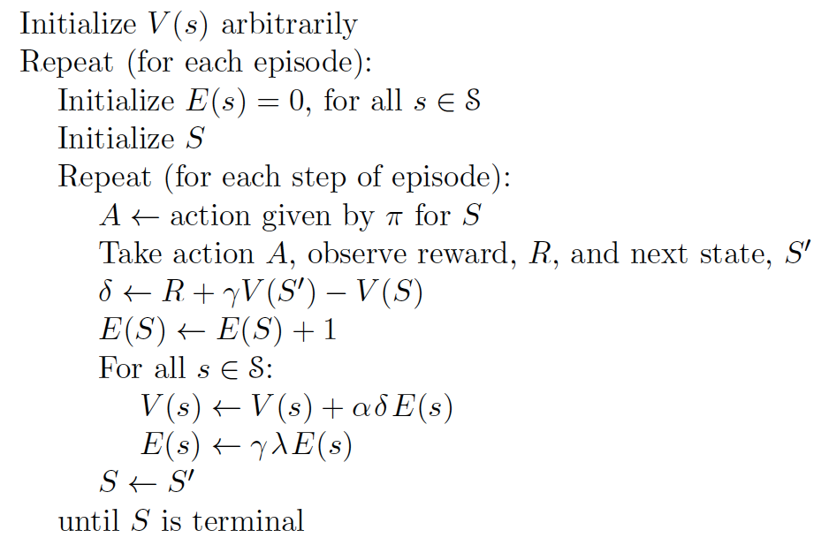
On-line, Tabular TD(λ)

Slide 17
Update rule:
As before, λ = 0 means TD(0)
Now, when λ = 1, you get MC, but
Can apply to continuing tasks
Works incrementally and on-line!

Slide 18
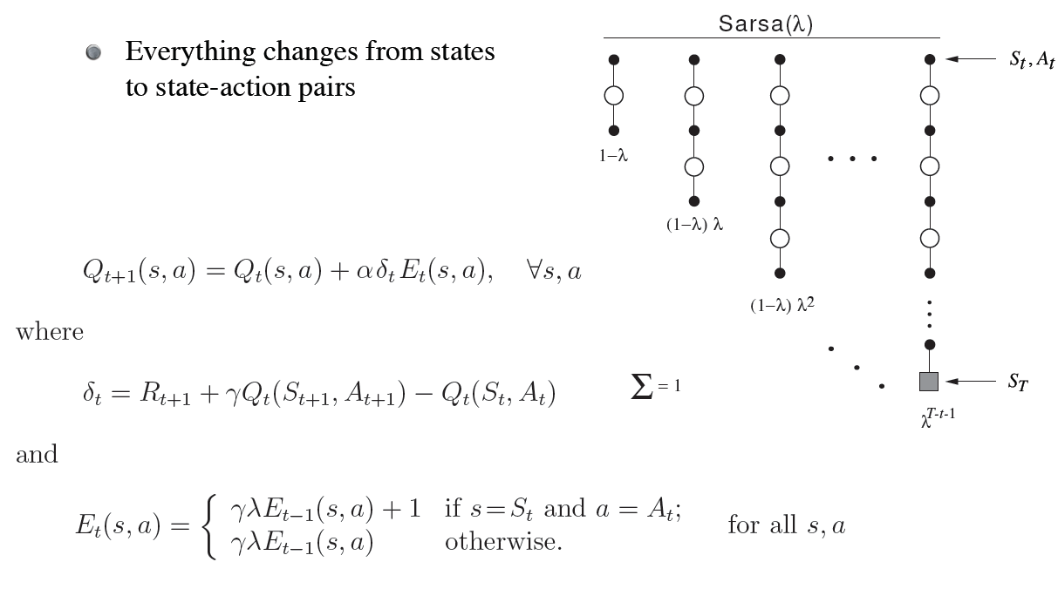
Control: Sarsa(λ)

Slide 19
Gridworld Example

Slide 20
Watkin’s Q(λ)
Why isn’t Q-learning as easy as Sarsa?

Slide 21
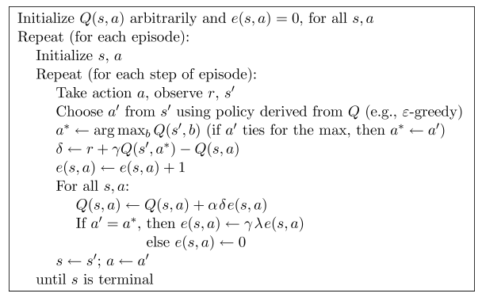
Watkin’s Q(λ)
Why isn’t Q-learning as easy as Sarsa?

Slide 22
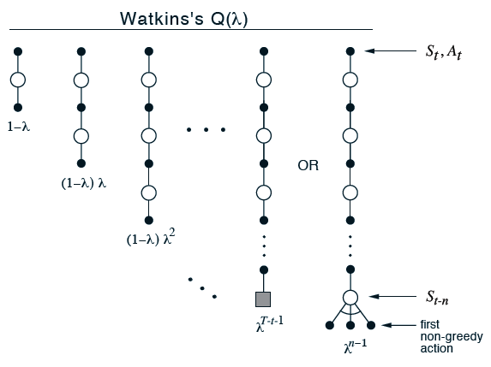
Watkin’s Q(λ)

Slide 23
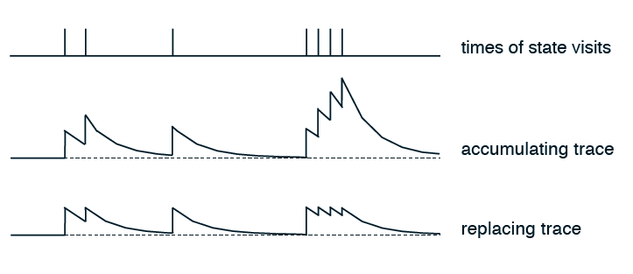
Accumulating traces
Eligibilities can be greater than 1
Could cause convergence problems
Replacing traces

Slide 24
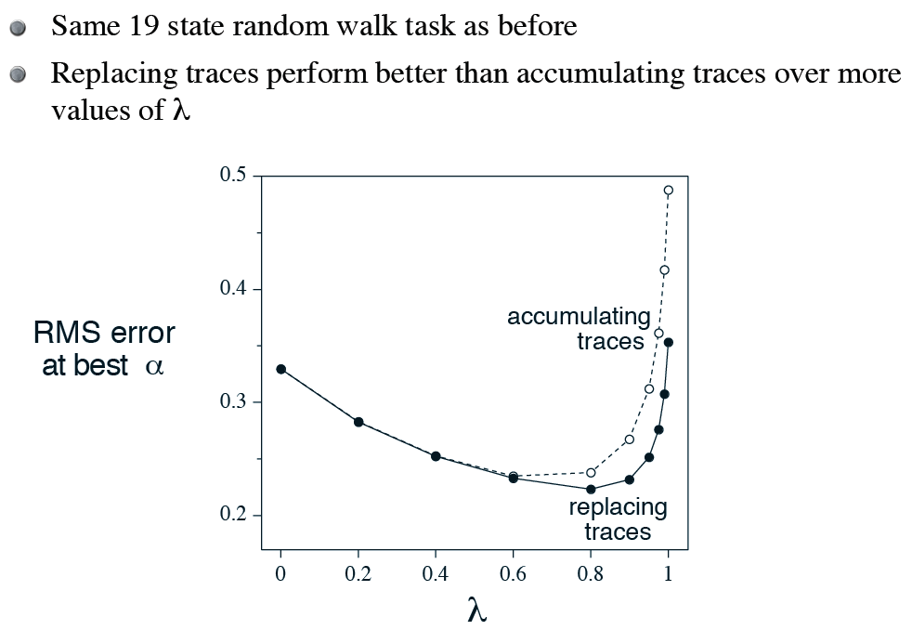

Slide 25
Example: why do accumulating traces do particularly poorly in this task?

Slide 26
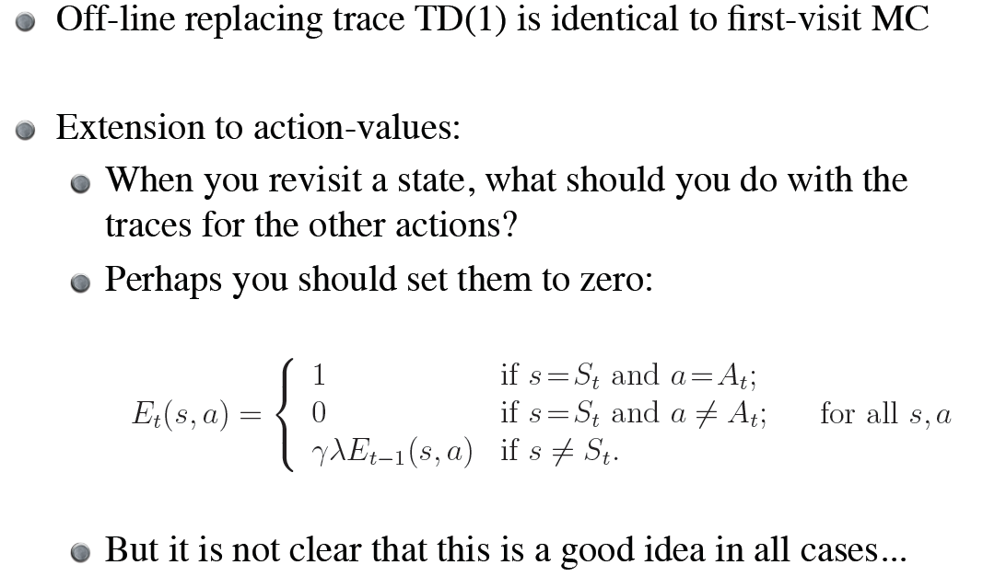

Slide 27
Implementation Issues
Could require significant amounts of computation
But most traces are very close to zero…
We can actually throw them out when they get very small
Will want to use some type of efficient data structure
In practice, increases computation only by a small multiple

Slide 28
AnonymousFeedback.net
Send to taylorm@eecs.wsu.edu
What’s been most useful to you (and why)?
What’s been least useful (and why)?
What could students do to improve the class?
What could Matt do to improve the class?

