Slide 1
http://www.youtube.com/watch?v=ucz3JpvDQjk

Slide 2
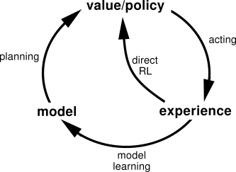
Learning: Uses experience
Planning: Use simulated experience

Slide 3
Prioritized Sweeping
Priority Queue over s,a pairs whose estimated value would change non-trivially
When processed, effect on predecessor pairs is computed and added
“All animals are equal, but some are more equal than others.”
George Orwell, Animal Farm

Slide 4
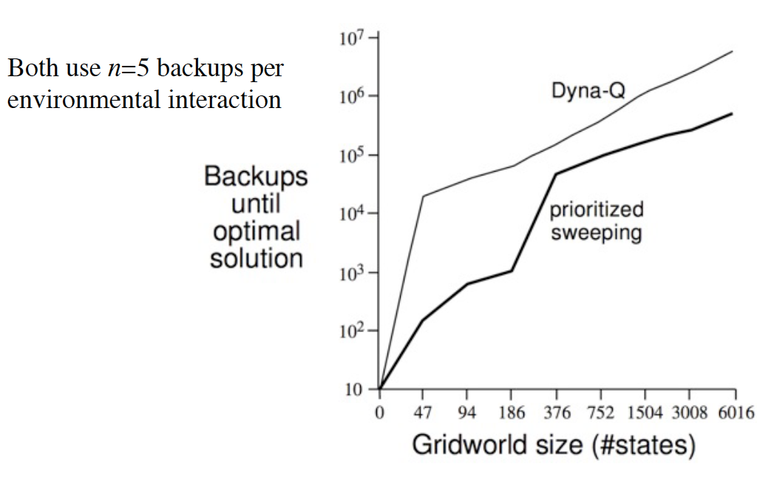
Prioritized Sweeping vs. Dyna-Q

Slide 5
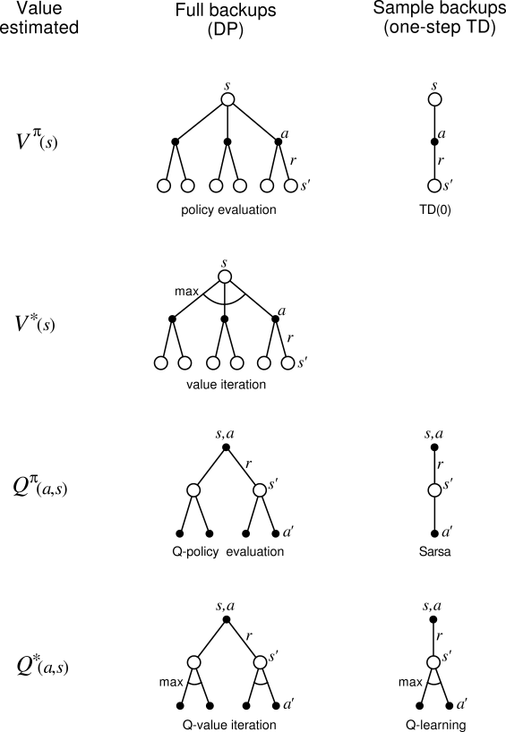

Slide 6
Trajectory sampling: perform backups along simulated trajectories
Samples from on-policy distribution
May be able to (usefully) ignore large parts of state space

Slide 7
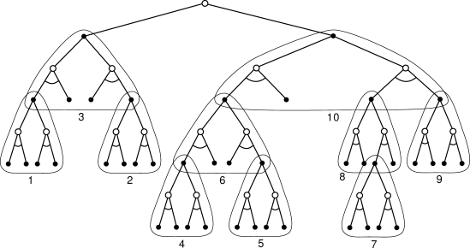
How to backup
Full vs. Sample
Deep vs. Shallow
Heuristic Search

Slide 8
R-Max
Questions?
What was interesting?

Slide 9
R-Max (1/2)
Stochastic games
Matrix: strategic form
Sequence of games from some set of games
More general than MDPs (how map to MDP?)
Implicit Exploration vs. Explicit Exploration?
Epsilon greedy, UCB1, optimistic value function initialization
What will a pessimistic initialization do?
Assumptions: recognize the state it’s in, and knows the actions/payoffs received
Maximin

Slide 10
R-Max (2/2)
Either optimal, or efficient learning
Mixing time
Smallest value of T after which π guarantees expected payoff of U(π) – ε
Approach optimal policy, in time polynomial in T, in 1/ε, and ln(1/δ)
PAC
Why K₁ updates needed?

Slide 11
Efﬁcient Reinforcement Learning with Relocatable Action Models
http://bit.ly/1mJ3KDU
RAM
Grid-World Experiment
Algorithm

