Slide 1
POMDPs: 5
Reward Shaping: 4
Intrinsic RL: 4
Function Approximation: 3

Slide 2
https://www.youtube.com/watch?v=ek0FrCaogcs

Slide 3
Evaluation Metrics
Asymptotic improvement
Jumpstart improvement
Speed improvement
  Total reward
  Slope of line
  Time to threshold

Slide 4
Time to Threshold
“Sunk Cost” is ignored
Source task(s) independently useful
Effectively utilize past knowledge
Only care about Target
Source Task(s) not useful
Minimize total training
Two distinct scenarios:
1. Target Time Metric: Successful if target task learning time reduced
  2. Total Time Metric: Successful if total (source + target) time reduced
Target: no Transfer
Target: with Transfer
Target + Source:
with Transfer

Slide 5
Keepaway
[Stone, Sutton, and Kuhlmann 2005]
Goal: Maintain possession of ball
5 agents
3 (stochastic) actions
13 (noisy & continuous) state variables
K₂
K₁
T₁
K₃
T₂
Keeper with ball may hold ball or pass to either teammate
4 vs. 3:
7 agents
4 actions
19 state variables
Both takers move towards player with ball

Slide 6
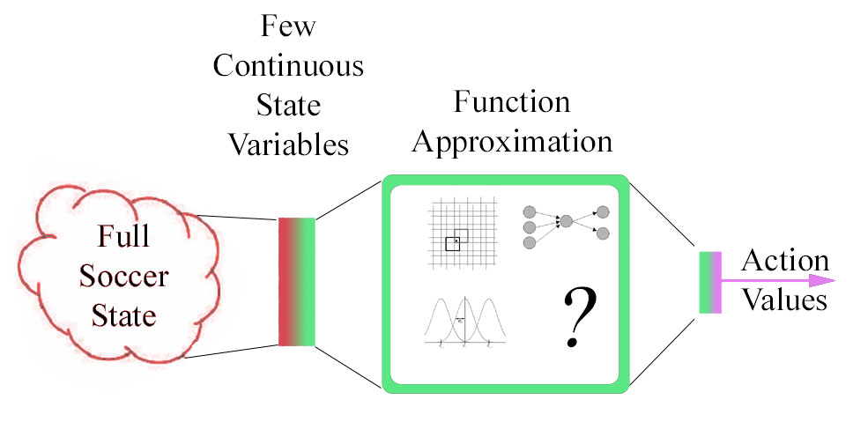
Learning Keepaway
Sarsa update
  CMAC, RBF, and neural network approximation successful
Q^{π}(s,a): Predicted number of steps episode will last
  Reward = +1 for every timestep
Notes:
Only update when ball is kickable by someone
o a little slower: more details
Tile coding: allows generalization as well as fine distinctions

Slide 7
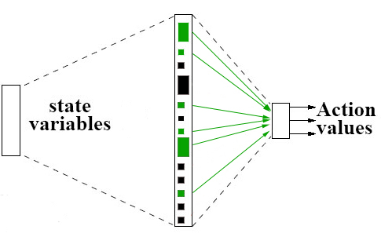
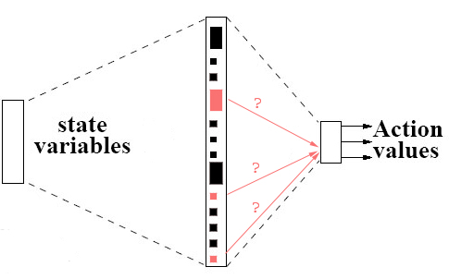
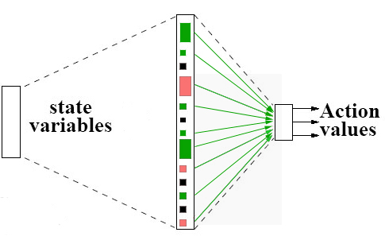
ρ’s Effect on CMACs
For each weight in 4 vs. 3 function approximator:
  Use inter-task mapping to find corresponding 3 vs. 2 weight
ρ
3 vs. 2
4 vs. 3
Notes:
Learning wts: not human readable.
Less rigid b/c we can consider the state variable level rather than just numbers.
Final step: put average value into all other weights

Slide 8
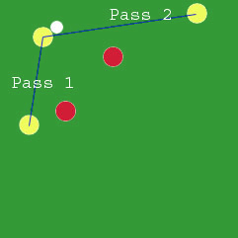
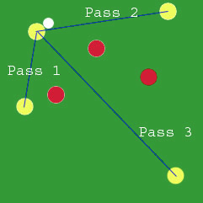
Keepaway Hand-coded χ_{A}
Actions in 4 vs. 3 have “similar” actions in 3 vs. 2
Hold_{4v3} → Hold_{3v2}
Pass1_{4v3} → Pass1_{3v2}
Pass2_{4v3} → Pass2_{3v2}
Pass3_{4v3} → Pass2_{3v2}

Slide 9
Value Function Transfer
Source Task
ρ(Q_{S} (S_{S}, A_{S})) = Q_{T} (S_{T}, A_{T})
Action-Value function transferred
ρ is task-dependant:
relies on inter-task mappings
Q not defined on S_{T} and A_{T}
Environment
Action_{S}
State_{S}
Reward_{S}
Agent
Q_{S}: S_{S}×A_{S}→ℜ
ρ
Target Task
Q_{T}: S_{T}×A_{T}→ℜ
Environment
Action_{T}
State_{T}
Reward_{T}
Agent
Notes:
Counterintuitive – we’re doing low-level transfer

Slide 10
Value Function Transfer:
Time to threshold in 4 vs. 3
No Transfer
Target Task Time
Total Time
}
Notes:
Each data point represents 25+ independent trials

Slide 11
For similar target task, the transferred knowledge … [can] significantly improve its performance.
But how do we define the similar task more specifically?
  Same state-action space
  similar objectives

Slide 12
Effects of Task Similarity
  Is transfer beneficial for a given pair of tasks?
    Avoid Negative Transfer?
    Reduce total time metric?
Source identical to Target
Source unrelated to Target
Transfer trivial
Transfer impossible
Notes:
Cross-Domain Knowledge Transfer Using Structured Representations
Samarth Swarup and Sylvian R. Ray

Slide 13
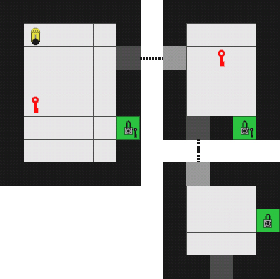
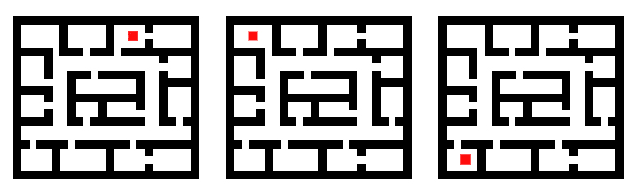
Example Transfer Domains
Series of mazes with different goals [Fernandez and Veloso, 2006]
Mazes with different structures [Konidaris and Barto, 2007]

Slide 14
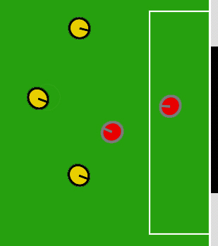
Example Transfer Domains
Series of mazes with different goals [Fernandez and Veloso, 2006]
Mazes with different structures [Konidaris and Barto, 2007]
Keepaway with different numbers of players [Taylor and Stone, 2005]
Keepaway to Breakaway [Torrey et al, 2005]
Notes:
Kwy -> Kwy:
Soni & Singh 2006
Talvitie & Singh, 2007

Slide 15
Example Transfer Domains
Series of mazes with different goals [Fernandez and Veloso, 2006]
Mazes with different structures [Konidaris and Barto, 2007]
Keepaway with different numbers of players [Taylor and Stone, 2005]
Keepaway to Breakaway [Torrey et al, 2005]
All tasks are drawn from the same domain
  Task: An MDP
  Domain: Setting for semantically similar tasks
What about Cross-Domain Transfer?
  Source task could be much simpler
  Show that source and target can be less similar

Slide 16
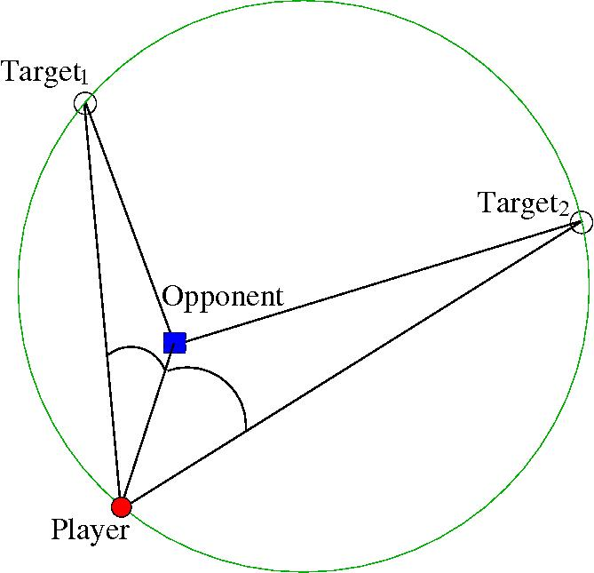
Source Task: Ringworld
K₂
K₁
T₁
Opponent moves directly towards player
Player may stay or run towards a pre-defined location
K₃
T₂
Ringworld
Goal: avoid being tagged
2 agents
3 actions
7 state variables
Fully Observable
Discrete State Space (Q-table with ~8,100 s,a pairs)
Stochastic Actions
3 vs. 2 Keepaway
Goal: Maintain possession of ball
5 agents
3 actions
13 state variables
Partially Observable
Continuous State Space
Stochastic Actions
Notes:
Roughly 8,065 states seen during 25,000 episode learning trial

Slide 17
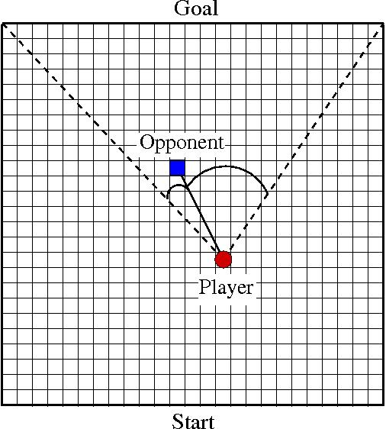
Source Task: Knight’s Joust
K₂
K₁
Opponent moves directly towards player
T₁
Player may move North, or take a knight jump to either side
K₃
T₂
Knight’s Joust
Goal: Travel from start to goal line
2 agents
3 actions
3 state variables
Fully Observable
Discrete State Space (Q-table with ~600 s,a pairs)
Deterministic Actions
3 vs. 2 Keepaway
Goal: Maintain possession of ball
5 agents
3 actions
13 state variables
Partially Observable
Continuous State Space
Stochastic Actions
Notes:
601 distinct states over 50,000 episode learning trial

Slide 18
Rule Transfer Overview
Learn π
Learn D_{source}
Translate (D_{source}) → D_{target}
Use D_{target}
Learn a policy (π : S → A) in the source task
  TD, Policy Search, Model-Based, etc.
Learn a decision list, D_{source}, summarizing π
Translate (D_{source}) → D_{target} (applies to target task)
  State variables and actions can differ in two tasks
Use D_{target} to learn a policy in target task
Allows for different learning methods and function approximators in source and target tasks
Notes:
Allow for different function approximators and/or parameterizations

Slide 19
Rule Transfer Details
Learn π
Learn D_{source}
Translate (D_{source}) → D_{target}
Use D_{target}
In this work we use Sarsa
  Q : S × A → Return
Other learning methods possible
Source Task
Environment
Action
State
Reward
Agent

Slide 20

Rule Transfer Details
Learn π
Learn D_{source}
Translate (D_{source}) → D_{target}
Use D_{target}
Use learned policy to record S, A pairs
Use JRip (RIPPER in Weka) to learn a decision list
IF s₁ < 4 and s₂ > 5 → a₁
ELSEIF s₁ < 3 → a₂
ELSEIF s₃ > 7 → a₁
…
Environment
Action
Action
State
State
Reward
State
Action
Agent
…
…
Notes:
Could be other rule-learning techniques as well

Slide 21
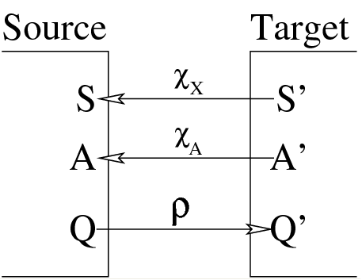
Rule Transfer Details
Learn π
Learn D_{source}
Translate (D_{source}) → D_{target}
Use D_{target}
Inter-task Mappings
χ_{x:} s_{target}→s_{source}
  Given state variable in target task (some x from s = x₁, x₂, … x_{n})
  Return corresponding state variable in source task
χ_{A:} a_{target}→a_{source}
  Similar, but for actions
χ _{x}
χ _{A}
translate
rule
rule’

Slide 22
Rule Transfer Details
Learn π
Learn D_{source}
Translate (D_{source}) → D_{target}
Use D_{target}
K₁
K₂
T₁
K₃
T₂
Stay Hold Ball
Run_{Near} Pass to K₂
Run_{Far} Pass to K₃
χ_{A}
χ_{x}
dist(Player, Opponent) dist(K₁,T₁)
… …
IF dist(Player, Opponent) > 4 → Stay
IF dist(K₁,T₁) > 4 → Hold Ball

Slide 23
Rule Transfer Details
Learn π
Learn D_{source}
Translate (D_{source}) → D_{target}
Use D_{target}
Many possible ways to use D_{target}
  Value Bonus
  Extra Action
  Extra Variable
Assuming TD learner in target task
  Should generalize to other learning methods
(shaping)
(initially force agent to select)
(initially force agent to select)
Evaluate agent’s 3 actions in state s = s₁, s₂
Q(s₁, s₂, a₁) = 5
Q(s₁, s₂, a₂) = 3
Q(s₁, s₂, a₃) = 4
Evaluate agent’s 3 actions in state s = s₁, s₂
Q(s₁, s₂, a₁) = 5
Q(s₁, s₂, a₂) = 3
Q(s₁, s₂, a₃) = 4
Q(s₁, s₂, a₄) = 7 (take action a₂)
Evaluate agent’s 3 actions in state s = s₁, s₂
Q(s₁, s₂, s₃, a₁) = 5
Q(s₁, s₂, s₃, a₂) = 3
Q(s₁, s₂, s₃, a₃) = 4
Evaluate agent’s 3 actions in state s = s₁, s₂
Q(s₁, s₂, a₂, a₁) = 5
Q(s₁, s₂, a₂, a₂) = 9
Q(s₁, s₂, a₂, a₃) = 4
D_{target}(s) = a₂
+ 8
Notes:
TODO: talk about biasing

Slide 24
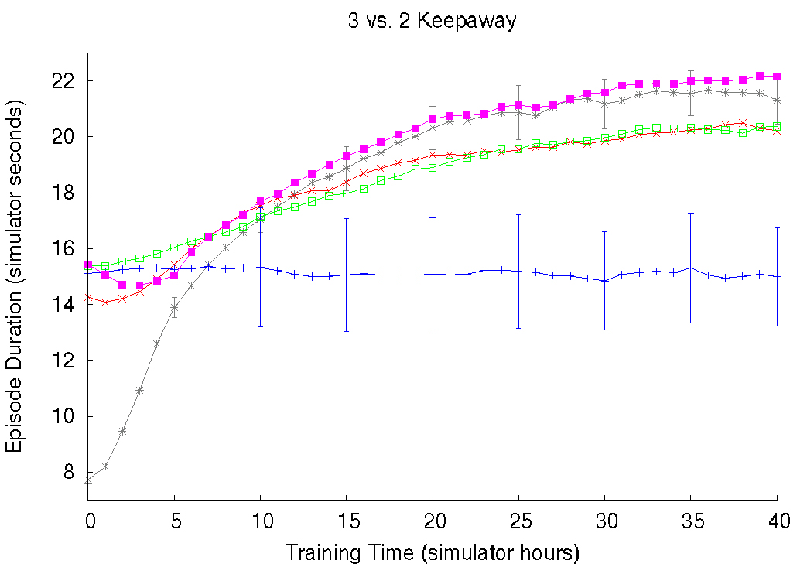
Comparison of Rule Transfer Methods
Rules from 5 hours of training
Value Bonus
Extra Action
Extra Variable
Without Transfer
Only Follow Rules

Slide 25
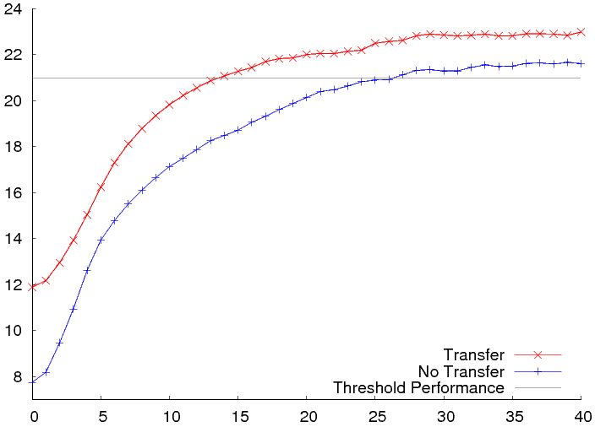
Inter-domain Transfer: Averaged Results
Ringworld: 20,000 episodes (~1 minute wall clock time)
Episode Duration (simulator seconds)
Success: Four types of transfer improvement!
Training Time (simulator hours)

Slide 26
Future Work
Theoretical Guarantees / Bounds
Avoiding Negative Transfer
Curriculum Learning
Autonomously selecting inter-task mappings
Leverage supervised learning techniques
Simulation to Physical Robots
Humans?

