Slide 1
https://www.youtube.com/watch?v=Qlqe1DXnJKQ#t=206

Slide 2
Survey
What were the best things about Matt making you lead one class discussion?
Good for presentation skills: 4
Good for presenter to learn a topic in depth: 5
Nice to see a selection of different topics: 1

Slide 3
Survey
What were the worst things?
Some presenters were not prepared enough: 2
Some topics were too advanced/technical for the point in the class or were hard to follow: 4

Slide 4
Survey
Do you think Matt should do this next year?
Yes: 7
Maybe: 1
Sure, why not?: 1
No: 0

Slide 5
Survey
If Matt does it next year, how could he change it?
Require handout with takeaways and resources: 1
Require more discussion / engagement: 3
Better scheduling: avoid jumping around, avoid duplication (or group together): 2
Be clear about using examples from exercises: 1
Give a short presentation to Matt a week before. This will improve presentations and get more suggested readings: 1

Slide 6
http://skylight.wsu.edu/s/11d19b5d-c8a7-4e69-93e3-2f110c2c6f07.srv

Slide 7
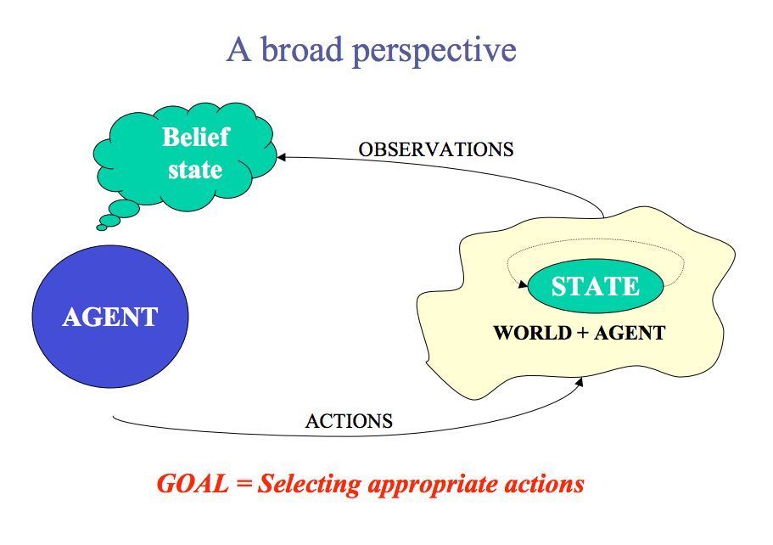

Slide 8
s in S
a in A
T(s,a,s’) = Pr(s’ | s,a)
R(s,a)
o in Ω
O(s’,a,o) = Pr(o | s’, a)

Slide 10
http://users.isr.ist.utl.pt/~mtjspaan/tutorialDMMS/tutorialAAMAS11.pdf

Slide 16
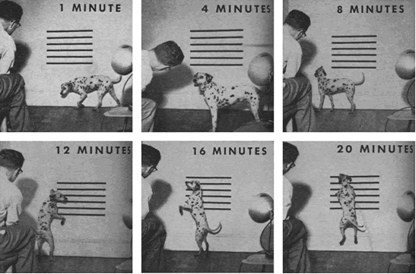
Behaviorist Psychology
B. F. Skinner’s operant conditioning
R+ | R-
P+ | P-

Slide 17
Behaviorist Psychology
B. F. Skinner’s operant conditioning / behaviorist shaping
Reward schedule
Frequency
Randomized
R+ | R-
P+ | P-

Slide 18
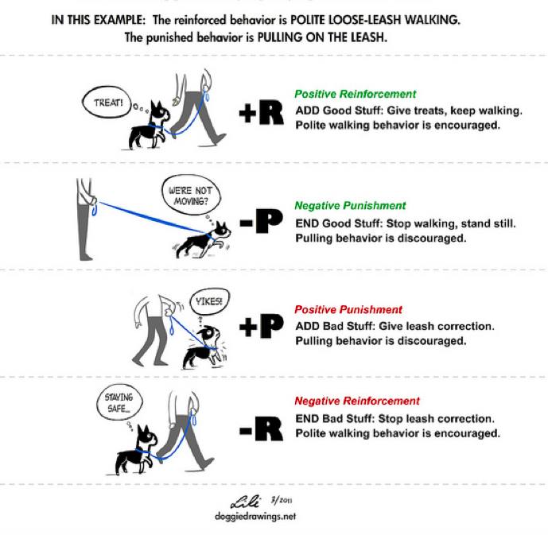

Slide 19
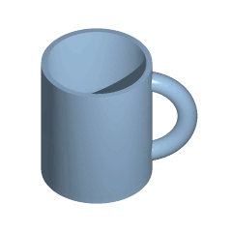
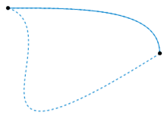
In topology, two continuous functions from one topological space to another are called homotopic if one can be "continuously deformed" into the other, such a deformation being called a homotopy between the two functions.
What does shaping mean for computational reinforcement learning? T. Erez and W. D. Smart, 2008

Slide 20
According to Erez and Smart, there are (at least) six ways of thinking about shaping from a homotopic standpoint. What can you come up with?

Slide 21
Modify Reward: successive approximations, subgoaling
Dynamics: physical properties of environment or of agent: changing length of pole, changing amount of noise
Internal parameters: simulated annealing, schedule for learning rate, complexification in NEAT
Initial state: learning from easy missions
Action space: infants lock their arms, abstracted (simpler) space
Extending time horizon: POMDPs, decrease discount factor, pole balancing time horizon

Slide 22
The infant development timeline and its application to robot shaping. J. Law+, 2011
Bio-inspired vs. Bio-mimicking vs. Computational understanding
Robot clicker training

Slide 23
Reward Shaping
Potential-based shaping: A. Ng, ’99
Shaping for transfer learning: G. Konidaris, 2006
Multi-agent shaping: S. Devlin, 201
Plan-based reward shaping: M. Grez, 2008

