Slide 1
Final Project Rubric
5: Update presentation to class on Thursday, 5/1
20: Fully explained idea or question addressed (Why is it interesting? What’s the payoff if it works?)
20: Experiments and/or theoretical work adequately addresses idea/question
20: Background & Related Work (Is it clear how this work is related to other things in the field? Is it clear what is novel?)
15: Conclusion and discussion of future work (What are the next steps for you, or others, who are interested in this?)
10: Writing quality (scaled)
10: Presentation quality (Does this look like something you’d submit to a conference?)

Slide 2
Some Comments on Exercises
Error bars
Statistical significance
Need to show data!
Label axes
Averaging over episodes

Slide 3
"Intrinsic motivation occurs when we act without any obvious external rewards. We simply enjoy an activity or see it as an opportunity to explore, learn, and actualize our potentials."
(Coon & Mitterer, 2010)
"Intrinsic motivation refers to the reason why we perform certain activities for inherent satisfaction or pleasure; you might say performing one of these activities in reinforcing in-and-of itself."
(Brown, 2007)

Slide 4
The overall objective is to develop a theory and algorithms for building agents that can achieve a level of competence and mastery over their environment considerably greater than currently possible in machine learning and artificial intelligence. The basic approach is to have an extended developmental period during which an autonomous agent can learn collections of reusable skills that will be useful for a wide range of later challenges. While this basic idea has been explored by a number of researchers, past efforts in this direction have been mostly exploratory in nature and have not yet produced significant advances. Furthermore, they have not yet led to the kind of rigorous formulation needed to bring powerful mathematical methods to bear, a pre-requisite for engaging the largest part of the machine learning research community. At the core of our research in this topic are recent theoretical and algorithmic advances in computational reinforcement learning. We will also build on recent advances in the neuroscience of brain reward systems as well as classical and contemporary psychological theories of motivation.
The methods we will develop, if successful, will give artificial learning systems the ability to extend their abilities, in a generative and potentially unlimited way, through the accumulation of deep hierarchical repertoires of reusable skills. We will demonstrate this success on a succession of simulated and robotic agents.

Slide 5
Intrinsically Motivated Reinforcement Learning. Singh, Barto, and Chentanez
Slides modified from:
A. Barto, Hierarchical Organization of Behavior, NIPS 2007 Workshop

Slide 6
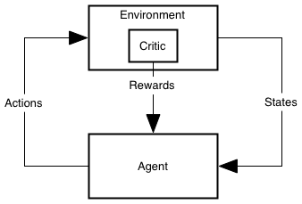
The Usual View of RL
PrimaryCritic

Slide 7
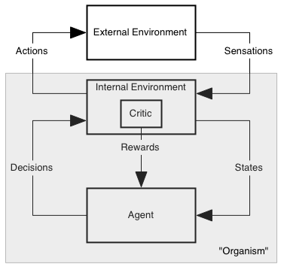
The Less Misleading View
PrimaryCritic

Slide 8
Motivation
“Forces” that energize an organism to act and that direct its activity.
Extrinsic Motivation: being moved to do something because of some external reward ($$, a prize, etc.).
Intrinsic Motivation: being moved to do something because it is inherently enjoyable.
Curiosity, Exploration, Manipulation, Play, Learning itself . . .
Examples of intrinsic motivation?
How/Why useful?

Slide 9
Robert White’s famous 1959 paper
“Motivation Reconsidered: The Concept of Competence”
Psychological Review, Vol. 66, pp. 297–333, 1959.
Critique of Hullian and Freudian drive theories that all behavior is motivated by biologically primal needs (food, drink, sex, escape, …)
(either directly or through secondary reinforcement).
Competence: an organism’s capacity to interact effectively with its environment
Cumulative learning: significantly devoted to developing competence

Slide 10
What is Intrinsically Rewarding?
novelty
surprise
salience
incongruity
manipulation
“being a cause”
mastery: being in control
curiosity
exploration
…
D. E. Berlyne’s writings are a rich source of data and suggestions

Slide 11
An Example of Intrinsically Motivated RL
Rich Sutton, “Integrated Architectures for Learning, Planning and Reacting based on Dynamic Programming” In Machine Learning: Proceedings of the Seventh International Workshop, 1990.
For each state and action, add a value to the usual immediate reward called the exploration bonus.
… a function of the time since that action was last executed in that state. The longer the time, the greater the assumed uncertainty, the greater the bonus.
Facilitates learning of environment model

Slide 12
What are features of IR?
IR depends only on internal state components
These components track aspects of agent’s history
IR can depend on current Q, V, π, etc.
IR is task independent (where task is defined by extrinsic reward)(?)
IR is transient: e.g. based on prediction error
…
Most have goal of efficiently building “world model”

Slide 13
Where do Options come from?
Many can be hand-crafted from the start (and should be!)
How can an agent create useful options for itself?
Notes:
This is a difficult task:
unknown how humans create abstractions
temporal and structural credit assignment problem
hard for humans to introspect to the robot’s sensory set
As an example, consider a robot on the moon or mars that needs to perform some task, such as building a human habitat, in an efficient manner. The robot is not able to be fully pre-programmed because of the differences between the environments and it is not able to be fully tele-operated due to the time lag between Earth and Mars. If it can autonomously create abstractions to categorize its interactions with its environment, it will be better able to learn and plan and react to new situations. This greater autonomy will mean a more robust robot.
Don’t say “whatever”

Slide 14
Lots of Approaches
visit frequency and reward gradient [Digney 1998],
visit frequency on successful trajectories [McGovern & Barto 2001]
variable change frequency [Hengst 2002]
relative novelty [Simsek &Barto 2004]
salience [Singh et al. 2004]
clustering algorithms and value gradients [Mannor et al. 2004]
local graph partitioning [Simsek et al. 2005]
causal decomposition [Jonsson & Barto 2005]
exploit commonalities in collections of policies [Thrun & Schwartz 1995, Bernstein 1999, Perkins & Precup 1999, Pickett & Barto 2002]
Many of these involve identifying subgoals

Slide 15
Creating Task-Independent Subgoals
Our approach: learn a collection of reusable skills
Subgoals = intrinsically rewarding events

Slide 16
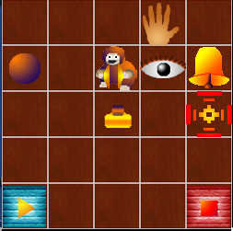
A not-quite-so-simple example: Playroom
Singh, Barto, & Chentanez 2005
Agent has eye, hand, visual marker
Actions:
move eye to hand
move eye to marker
move eye to random object
move hand to eye
move hand to marker
move marker to eye
move marker to hand
If both eye and hand are on object: turn on light, push ball, etc.

Slide 17
Playroom cont.
Switch controls room lights
Bell rings and moves one square if ball hits it
Press blue/red block turns music on/off
Lights have to be on to see colors
Can push blocks
Monkey laughs if bell and music both sound in dark room

Slide 18
Skills
To make monkey laugh:
Move eye to switch
Move hand to eye
Turn lights on
Move eye to blue block
Move hand to eye
Turn music on
Move eye to switch
Move hand to eye
Turn light off
Move eye to bell
Move marker to eye
Move eye to ball
Move hand to ball
Kick ball to make bell ring
Using skills (options)
Turn lights on
Turn music on
Turn lights off
Ring bell

Slide 19
Option Creation and Intrinsic Reward
Subgoals: events that are “intrinsically interesting”; here unexpected changes in lights and sounds
On first occurrence, create an option with that event as subgoal
Intrinsic reward generated whenever subgoal is achieved:
Proportional to the error in prediction of that event (“surprise”); so decreases with experience
Use a standard RL algorithm with R=IR+ER
Previously learned options are available as actions for learning policies of new options (Primitive actions always available too.)

Slide 20
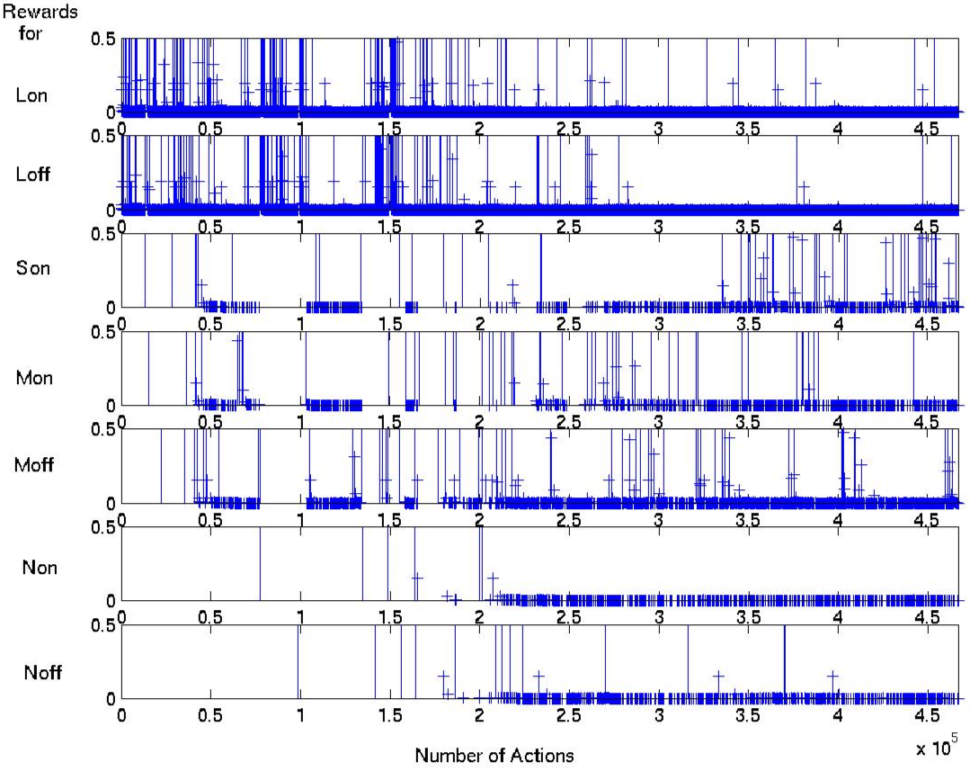
Reward for Salient Events
Lights
Sound
(bell)
Music
Monkey

Slide 21
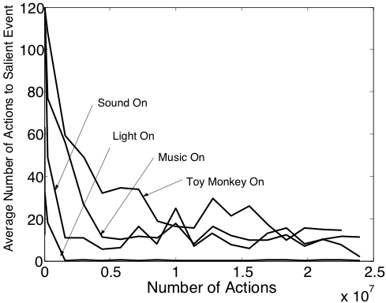
Speed of Learning Various Skills

Slide 22
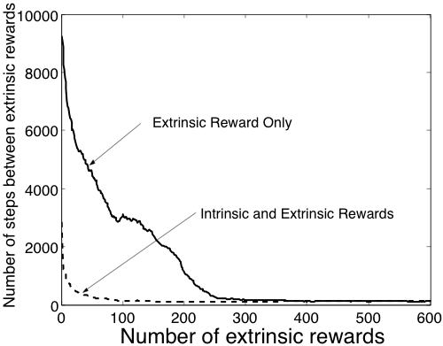
Learning to Make the Monkey Laugh

Slide 23
Shortcomings
Hand-crafted for our purposes
Pre-defined subgoals (based on “salience”)
Completely observable
Little state abstraction
Not very stochastic
No un-caused salient events
“Obsessive” behavior toward subgoals
Tries to use bad options
More

Slide 24
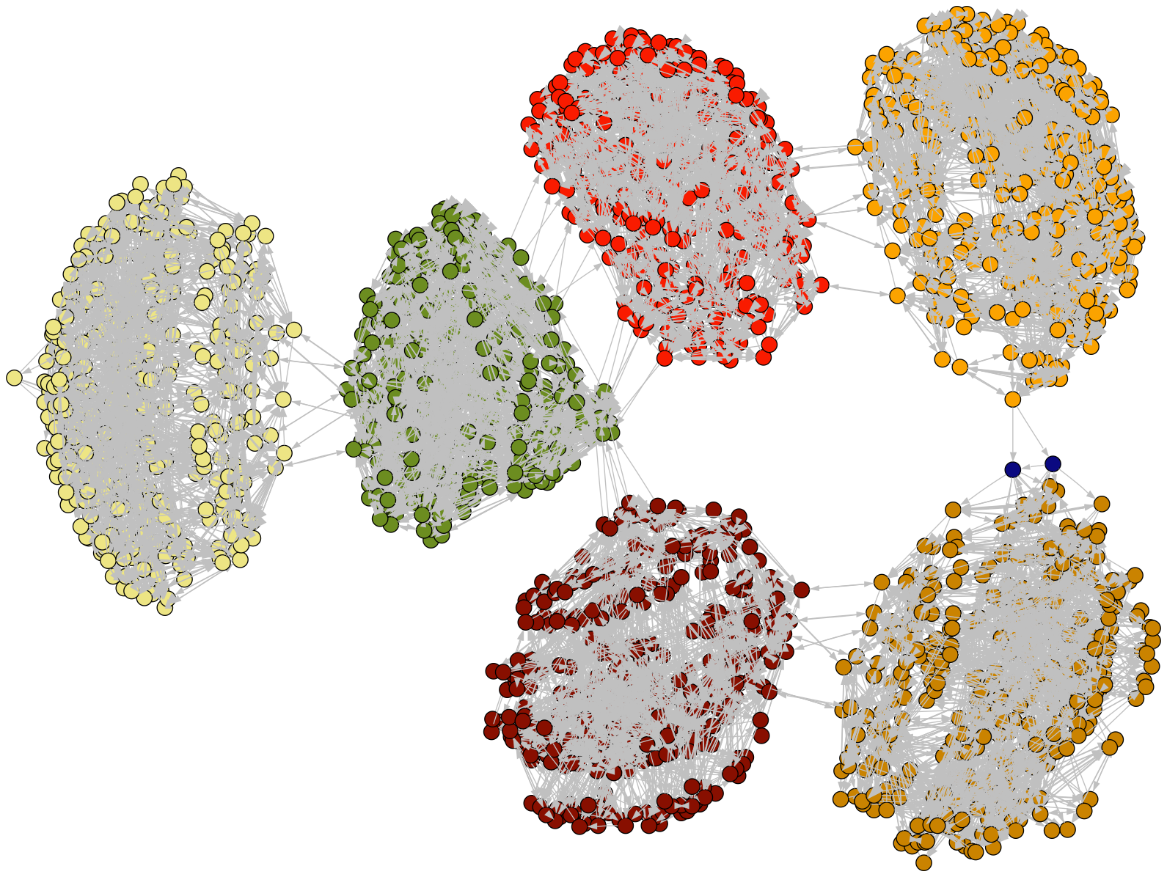
Connectivity of Playroom States
Özgür Şimşek
Light on
Music on
Noise off
Light off
Music on
Noise off
Light off
Music off
Noise off
Light on
Music off
Noise off
Light off
Music on
Noise on
Light on
Music on
Noise on

Slide 25
Conclusions
Need for smart adaptive generators
Adaptive generators grow hierarchically
Intrinsic motivation is important for creating behavioral building blocks
RL+Options+Intrinsic reward is a natural way to do this
Development!
Theory?
Behavior?
Neuroscience?

Slide 26
Intrinsically Motivated Reinforcement Learning: An Evolutionary Perspective. Singh, Lewis, Barto, and Sorg
Intrinsically Motivated Reinforcement Learning: A Promising Framework For Developmental Robot Learning. Stout, Konidaris, and Barto

Slide 28
Evolving Compiler Heuristics to Manage Communication and Contention
Matthew E. Taylor, Katherine E. Coons, Behnam Robatmili, Bertrand A. Maher, Doug Burger, and Kathryn S. McKinley
Parallel Architectures and Compilation Techniques (PACT)
October 2008

Slide 29
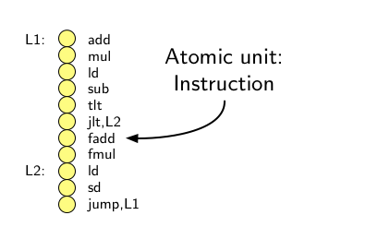
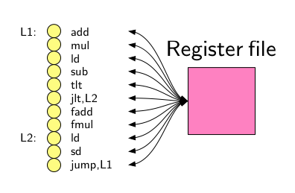
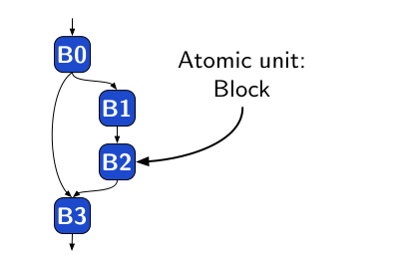
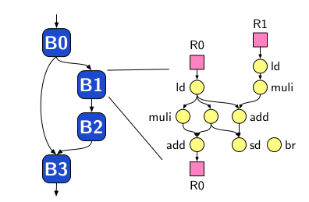
Background Motivation: Competing Instruction Set Architectures (ISAs)
Increase Speed: Parallelism
Move data “closer” to functional units
RISC
EDGE
Notes:
Explicit Data Graph Execution
Reduced Instruction Set Computer

Slide 30
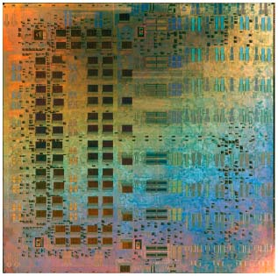
TRIPS Gebhart et al., “An Evaluation of the TRIPS Computer System”, ASPLOS 2009
Tera-op, Reliable, Intelligently adaptive Processing System
Fully functional silicon chip
Working compiler

Slide 31
TRIPS Scheduling Overview
Source
Code
Generic Functional Units
Not floating point, integer, etc.
Less idling
Reconfigurable!
R2
add
mul
initialize known anchor points
while (not all instructions scheduled) {
for (each instruction in open list, i) {
for (each available location, n) {
calculate placement cost for (i, n)
keep track of n with min placement cost
}
keep track of i with highest min placement cost
}
schedule i with highest min placement cost
}
}
br
ld
ld
ctrl
D0
D1
ctrl
R1
R2
mul
R1
R1
Dataflow
Graph
Scheduler
D0
add
mul
add
W1
D1
ld
mul
add
br
ctrl
R1
R2
R1
D0
Placement
D1
Legend
128! scheduling possibilities
Register
Topology
4×4 tiles, up to 8 instructions each
Total: 128 instructions
Data cache
Execution
Control
Notes:
Static placement, Dynamic Issue (Hyperblocks are formed and then dynamically scheduled by CPU)
Why so hard? 128 instructions, 128 spots, dependences between blocks, multiple bocks on the grid simultaneously, *very* complex problem

Slide 32
Motivation for this work
Scheduling is a key component for performance
Balance contention & communication
Performance depends on hard-to-tune heuristics
Function inlining, hyperblock formation, loop unrolling, instruction scheduling, register allocation, etc.
Machine learning can help

Slide 33
Overview
NEAT
Group blocks
Feature Selection
Initial feature set
Reduced feature set
Specialized solutions
Clustering
Lasso regression
General solutions
Correlation
Classifier solutions
Classification
Data mining
Genetic Algorithm
Unsupervised and supervised learning
Notes:
Explain what specialized solutions are

Slide 34
Spatial Path Scheduling: SPS (1/2)
Schedule (block, topology) {
initialize known anchor points
while (not all instructions scheduled) {
for (each instruction in open list, i) {
for (each available location, n) {
calculate placement cost for (i, n)
keep track of n with min placement cost
}
keep track of i with highest min placement cost
}
schedule i with highest min placement cost
}
}
calculate placement cost for (i, n)
Placement
cost
Heuristics
R2
add
mul
ctrl
R1
R2
br
ld
ld
R1
D0
add
mul
ctrl
D0
D1
Features
D1
ld
mul
add
mul
R1
br
add
W1

Slide 35
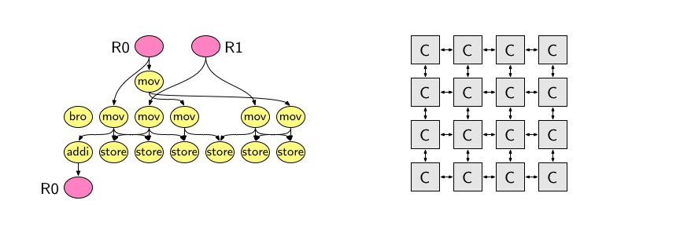
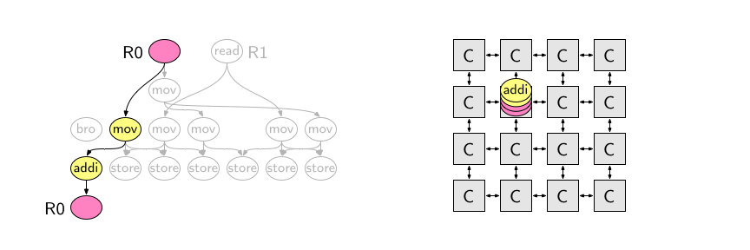
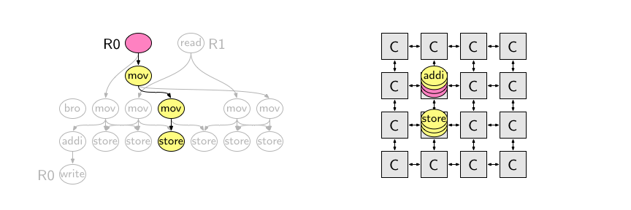
Spatial Path Scheduling: SPS (2/2) [Coons et al., ASPLOS ’06]
Greedily place most critical instruction at its best location
Heuristics determine “most critical” and “best location”
Minimize critical path length
Optimize loop-carried dependences
Exploit concurrency
Manage resource contention
Notes:
Critical path length
Loop-carried dependences
Exploit concurrency
Resource contention

Slide 36
NEAT [Stanley & Miikkulainen 2002]
Genetic algorithm that uses neural networks
Trains a population of networks
Modifies topology of network as well as weights
Standard crossover, mutation operators
Complexification operators
Legend
Output node
Hidden node
Input node
Add node
mutation
Add link
mutation

Slide 37
Why NEAT?
Large search spaces tractable
Complexification reduces training time (parsimony)
Relatively little parameter tuning required
Popular, publicly available, well-supported
Domain-independent
FS-NEAT [Whiteson et al. 2005]
Automatic feature selection
Evolves connections to input nodes
Notes:
Emphasis on little parameter tuning required is good
Also mention that you can’t try out many parameters because experiments are so slow

Slide 38
Training NEAT for Scheduling: One Generation
Schedule using
each network
Run program
Evolve population
Assign
Fitnesses:
speedup
ratio vs. SPS
Notes:
select the best network discovered and can use that to schedule.

Slide 39
Experimental Setup
All tests performed on TRIPS prototype system
64 features before feature selection, 11 features after
Population size = 264 networks
100 generations per NEAT run
Empirically plateaus
47 small benchmarks
SPEC2000 kernels
EEMBC benchmarks
Signal processing kernels from GMTI radar suite
Vector add, fast Fourier transform
Notes:
11 features + bias
All 2-features combinations times 4
Small benchmarks:
Training time small
2. Classification step
3. Scheduler has more of an impact with smaller benchmarks
Mix of compiler generated and hand coded
Wanted to keep training time small
SPEC2000 kernels, Lincoln Labs kernels, signal processing kernels from GMTI radar suite, 2 EEMBC benchmarks, matrix multiply, FFT, vector add, memset, prime number generator
We could have used larger benchmarks, but the blocks aren’t as full there, so scheduling doesn’t have as much of an effect on performance. Compiler tuned for smaller benchmarks, and they’re more representative of what we want to be able to schedule.

Slide 40
Per-Benchmark Scheduler
Speedup over programmer-designed heuristic
Multiple developers, years of tweaking
47 specialized solutions: 12% improvement
Speedup (ratio)

Slide 41
General Scheduler
Train 1 network for all 47 benchmarks
Fitness: geometric mean of speedup ratios
Not as impressive
Speedup (ratio)

Slide 42
Overview
NEAT
Group blocks
Feature Selection
Initial feature set
Reduced feature set
Specialized solutions
Clustering
Lasso regression
General solutions
Correlation
Classifier solutions
Classification
Data mining
Genetic Algorithm
Unsupervised and supervised learning
Notes:
Explain what specialized solutions are

Slide 43
Schedule per Cluster
Selected three clusters, trained per cluster
~5% speedup
Encouraging, but << 12%
Speedup (ratio)

Slide 44
Research Conclusions
NEAT useful for optimizing compiler heuristics
Little parameter tuning needed
Very useful for specialized solutions
More work needed to find good general solutions
Feature selection is critical
What can learned heuristics teach us?
Notes:
Limited by small feature set, Larger set of high quality blocks needed
Haven’t thoroughly studied the classification space
When space is this complicated, feature selection and classification may be useful.

Slide 45
Example Learned Network
Placement Cost
0.1
-1.2
-1.1
1.7
0.5
0.7
0.8
0.7
0.5
0.9
-4.1
Is load
Is store
Local inputs
Criticality
Tile utilization
Remote siblings
Critical path length
Loop-carried dependence
Notes:
Mention anti-correlation, what the weights actually mean
Emphasize that it is a function approximator - given n inputs, it produces an output

Slide 46
Take Home Message
Semantics for important features
Feature Selection + Evolution
Use to optimize future compilers?
Lots of exciting problems in compilers research
Constrained policy space (FS-NEAT)
Weeks to train, not hours
Extremely complex system
e.g., optimization level
Not yet an off-the-shelf package (think Weka)

