Slide 1
http://www.uasvision.com/2014/01/16/flir-brings-uas-sensor-technology-to-smartphones/

Slide 2
Sutton & Barto: Chapter 3
Defines the RL problem
Solution methods come next
what does it mean to solve an RL problem?

Slide 3
Reward vs. Return
“I think I have a misunderstanding about ‘Reward.’ We need to find way to distribute the final reward to each state otherwise it won't led us to global optimal which usually the reward of final step in games.”
Maze: 0/+1, -1/0
In exercise 3.5, the agent has no incentive to learn anything because it is not penalized for taking time to run through the maze. It is successful if, at any point in time, it finds the exit. It has no concept of time, and no information telling it to find the exit faster.
Internal vs. External rewards
Defining the boundary between the agent and environment
“anything that cannot be changed arbitrarily by the agent is considered to be outside of it and thus part of its environment."
Cart pole: http://www.youtube.com/watch?v=Lt-KLtkDlh8

Slide 4
Discounting
Discount factor: γ
Discounted Return:
t could go to infinity or γ could be 1, but not both… why?
What do values of γ at 0 and 1 mean?
Is γ pre-set or tuned?
=

Slide 5
Episodic vs. Continuing
=

Slide 6
Markov Property
One-step dynamics
Why useful? Where true?

Slide 7
Markov Property
One-step dynamics
Why useful? Where would it be true?

Slide 8
Side project: Chess
“~10^60 legitimate states”
Make the state Markov?
“Maybe a value function grid world that gives a big reward for getting to where the king is”

Slide 9
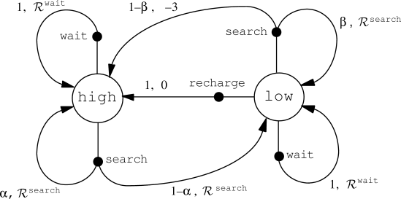
Recycling Robot Transition Graph

Slide 10
Value Functions
Maximize Return:
State value function:

Slide 11
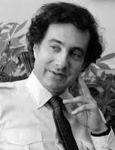
Value Functions
Maximize Return:
State value function:
If policy is deterministic:
Bellman Equation
for V^{π}

Slide 13
Value Functions
Maximize Return:
Action-value function

Slide 14
Value Functions
Maximize Return:
Action-value function
Deterministic Policy:
Bellman Equation
for Q^{π}

Slide 15
Value Functions
Maximize Return:
Action-value function
Deterministic Policy:
Bellman Equation
for Q^{π}

Slide 16
Optimal Value Functions
=
Bellman Optimality Equation
for V*

Slide 17
Optimal Value Functions
=
Bellman Optimality Equation
for V*

Slide 18
Optimal Value Functions
=
Bellman Optimality Equation
for V*
Bellman Optimality Equation
for Q*

Slide 19
Optimal Value Functions
=
Bellman Optimality Equation
for V*
Bellman Optimality Equation
for Q*

Slide 20
Next Up
How do we find V* and/or Q*?
Dynamic Programming
Monte Carlo Methods
Temporal Difference Learning

Slide 21
Policy Iteration
Policy Evaluation
For all states, improve estimate of V(s) based on policy
Policy Improvement
For all states, improve policy(s) by looking at next state values

