Slide 1
SLAM
Simultaneous Localization and Mapping

Slide 2
Map representation
Occupancy Grid
Feature Map
Localization
Particle filters
FastSLAM
Reinforcement learning to combine different map representations

Slide 3
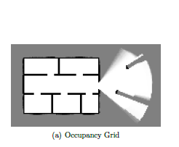
Occupancy grid / grid map
Simple black-white picture
Good for dense places

Slide 4
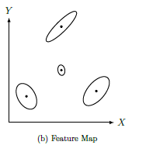
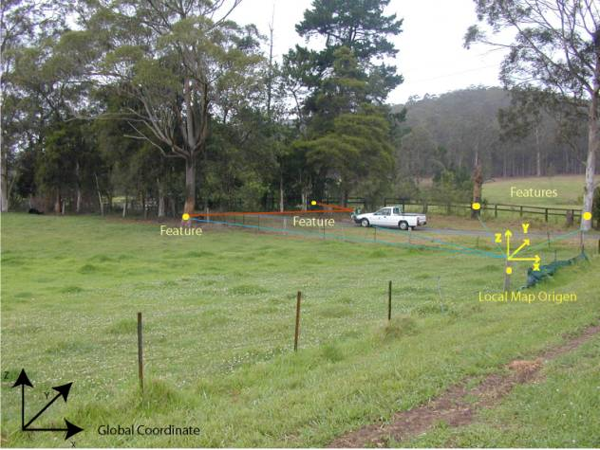
Feature map
Good for sparse places

Slide 5
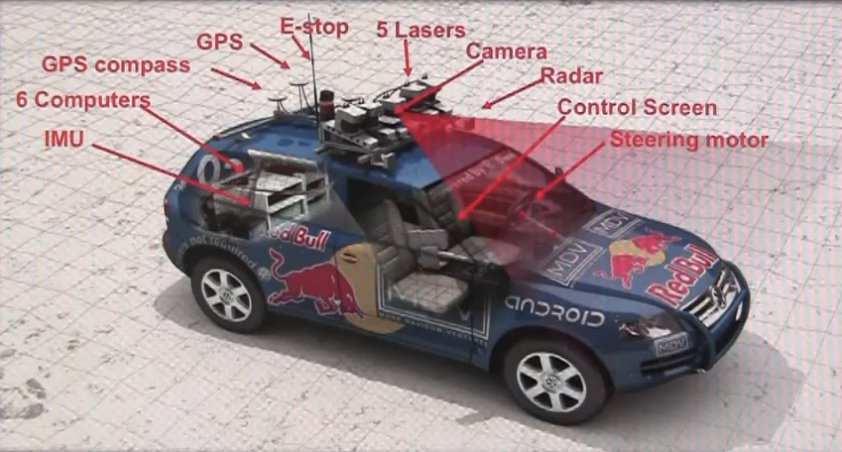
Localization
Map is known
sensors data and robots kinematics is known
Determine the position

Slide 6
Localization
Discrete time
$θ$ – landmarks position
$s_{t}$ - robots position
$u_{t}$ - control
$z_{t}$ - sensor information
$s_{1} u_{1} z_{1} →s_{2}$
$s_{2} u_{2} z_{2} →s_{3}$

Slide 7
Particle filter requirements
Motion model
$p\left(s_{t} \right|{u_{t}, s}_{t−1} )$
If current position is $(x,y)$ and the robot movement is $\left(dx, dy\right)$new coordinates are $(x+dx, y+dy)$ + noice
Usually the noise is Gaussian

Slide 8
Particle filter requirements
Measurement model
$p\left(z_{t} \right| s_{t}, θ, n_{t})$
$θ$ – collection of landmark position $\left(θ_{1}, θ_{2}, …θ_{K}\right)$
$n_{t}$- landmark observed at time $t$
In simple case each landmark is uniquely identifiable

Slide 9
Particle filter
We have N particles
Each particle is simply current position
For each particle:
Update its position using motion model
Assign a weight using measurement model
Normalize importance weights such that their sum is 1
Resample N particles with probabilities proportional to the weight

Slide 10
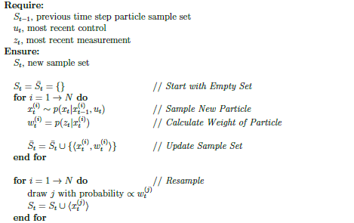
Particle filter code

Slide 11
SLAM
In SLAM problem we try to build a map.
Most common methods:
Kalman filters (Normal distribution in high-dimensional space)
Particle filter (what a particle represents here?)

Slide 12
FastSLAM
We try to determine robot and landmarks locations based on control and sensor data
N particles
Robot position
Gaussian distribution for each of K landmarks
Time complexity $O\left(N\log{K}\right)$
Space complexity - ?

Slide 13
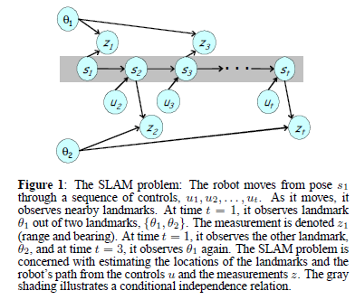
FastSLAM
If we know the path ($s_{1}…s_{t}$)
$θ_{1}$ and $θ_{2}$ are independent

Slide 14
FastSLAM
$p\left(s^{t}, θ\right|z^{t}, u^{t}, n^{t})=p\left(s^{t}\right|z^{t}, u^{t}, n^{t})∏ p\left(θ_{k}\right|s^{t}, z^{t}, u^{t}, n^{t})$
We have K+1 problems:
Estimation of the path
Estimation of landmarks location made using Kalman filter.

Slide 15
FastSLAM
Weights calculation:
Position of a landmark is modeled by Gaussian
$w_{t} \sim \frac{p\left(s^{t} \right|z^{t}, u^{t}, n^{t})}{p\left(s^{t} \right|z^{t−1}, u^{t}, n^{t−1})}\sim \int{p\left(z_{t}\right|θ_{n_{t}}, s_{t}, n_{t})p(θ_{n_{t}}) dθ_{n_{t}}}$

Slide 16
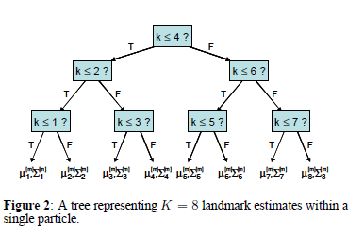
FastSLAM
FastSLAM saves landmark positions in a balanced binary tree.
Size of the tree is $O\left(K\right)$
Sampled particle differs from the previous one in only one leaf.

Slide 17
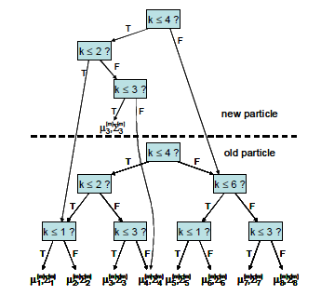
FastSLAM
We just create new tree on top of the previous one.
Complexity $O\left(\log{K}\right)$
Video 2

Slide 18
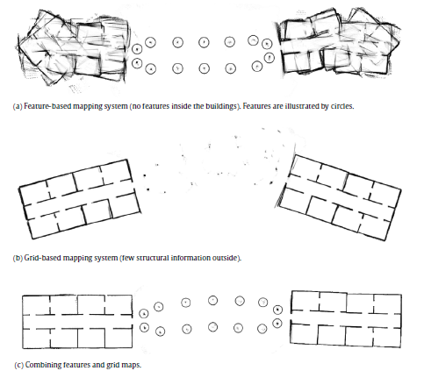
Combining different map representation
There are many ways
how we represent a map
How we can combine them?
Grid map
Feature map

Slide 19
Model selection
Map parameters:
Observation likelihood
For given particle we get likelihood of laser observation
Average for all particles $\overline{I}=\frac{1}{N}∑p(z_{t}|θ_{t}, {s_{t}, n}_{t})$
Between 0 and 1, large values mean good map
$N_{eff}$ - effective sample size
$N_{eff}= \frac{1}{∑w^{2}},$here we assume that $∑w=1$
It is a measure of variance in weight.
Suppose all weights are the same, what is $N_{eff}$?

Slide 20
Reinforcement learning for model selection
SARSA (State-Action-Reward-State-Action)
Actions: $\{a_{g}, a_{f}\}$ – use grid map of feature map
States S = $\left\{\overline{I}\right\}×\left\{N_{eff}^{f}<N_{eff}^{g}\right\}×\{feature detected\}$
$\overline{I}$ is divided into 7 intervals (0 0.15 0.30 0.45 0.6 0.75 0.9 1)
Feature detected – determines weather a feature was detected on current step.
$7×2×2=28$ states

Slide 21
Reinforcement learning for model selection
Reward:
For simulations correct robot position is known.
Deviation from the correct position gives negative reward.
$ε$-Greedy,
$ε=0.6$
Learning rate $α=0.001$
Discounting factor $γ=0.9$

Slide 22
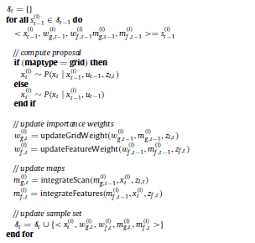
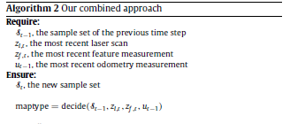
The algorithm

Slide 23
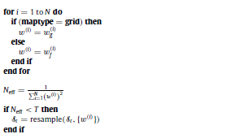
The algorithm

Slide 24
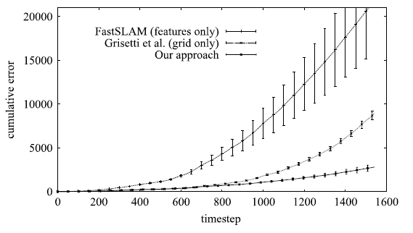
Results

Slide 25
Multi-robot SLAM
If the environment is large using only one robot is not enough
Centralized approach – the map is merged than the entire environment is explored
Decentralized approach – robots merge their maps than they meet each other

Slide 26
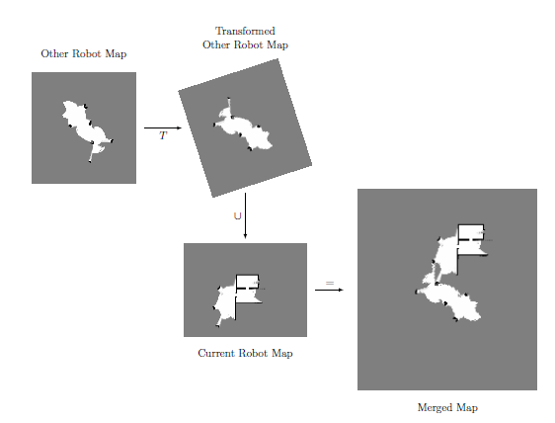
Multi-robot SLAM
We need to transform frame of references.

Slide 27
Reinforcement learning for model selection
Two robots meat each other and decide how they share their information
Actions
$a_{dm}$ - don’t merge maps
$a_{mi}$ - merge with simple transformation matrix
$a_{mg}$ – use grid-based heuristic to improve transformation matrix
$a_{mf}$ - use feature-based heuristic

Slide 28
Reinforcement learning for model selection
States
$\overline{I_{g}},\overline{I_{f}},N_{eff}^{c}<\frac{N}{2},N_{eff}^{o}<\frac{N}{2}$
$3×3×2×2=36$ states
$\overline{I_{g}}$ - confidence for the transformation matrix for grid-bases method, 3 intervals ($0\frac{1}{3}\frac{2}{3} 1$)

Slide 29
Reinforcement learning for model selection
Reward
For simulations correct robot position is known – we can get cumulative error for robot position
$r=E_{cum}^{μ}−E_{cum}$
$E_{cum}^{μ}$ - average cumulative error achieved by several runs where the robots immediately merge.
$ε$- Greedy policy
$ε=0.1$
$α=0.001$
$γ=0.9$

Slide 30
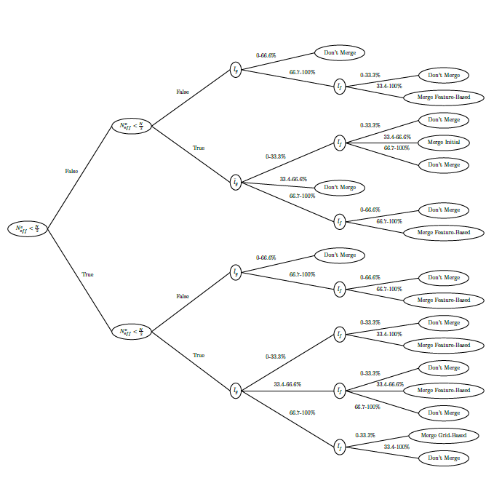
Results

Slide 31
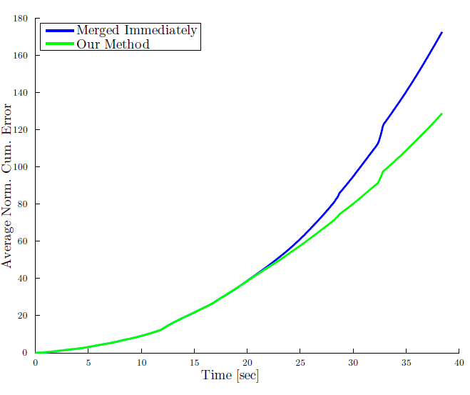

Slide 32
References
http://www.sce.carleton.ca/faculty/schwartz/RCTI/Seminar%20Day/Autonomous%20vehicles/theses/dinnissen-thesis.pdf
http://www.cs.cmu.edu/~mmde/mmdeaaai2002.pdf
http://www.sciencedirect.com/science/article/pii/S0921889009001481?via=ihub
http://www-personal.acfr.usyd.edu.au/nebot/publications/slam/IJRR_slam.htm

Slide 33
Questions

