Slide 2
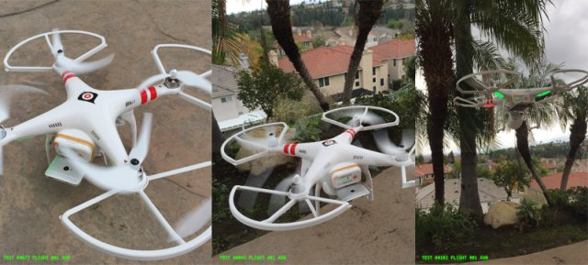
Drones Collecting Cell Phone Data in LA
AdNear had already been using methods on the ground to collect consumer behavior data by using bikes, cars and trains to profile more than 530 million users in Asia, according to the company.
In other words, collecting data with drones leads to more accurate insights for marketers and brands, but for consumers, this could mean that the next time you walk through a mall, the phone in your pocket might buzz with a push alert of an advertisement depending on where you’re standing.
http://www.uasvision.com/2015/02/25/drones-collecting-cell-phone-data-in-la

Slide 3
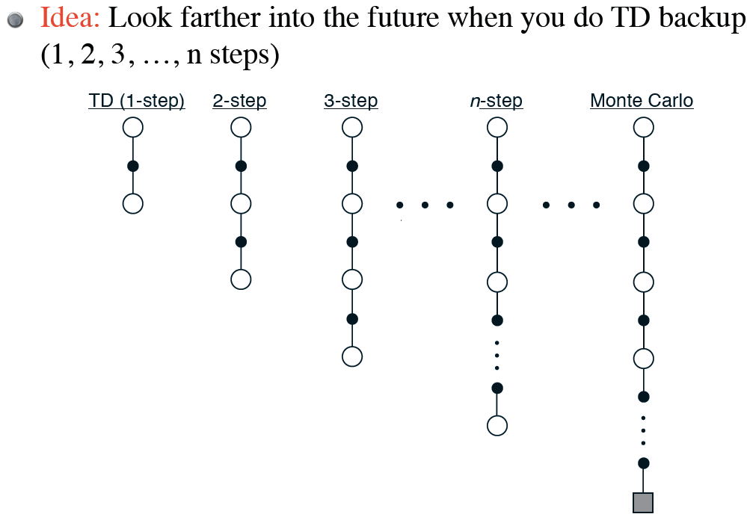
N-step TD Prediction

Slide 4
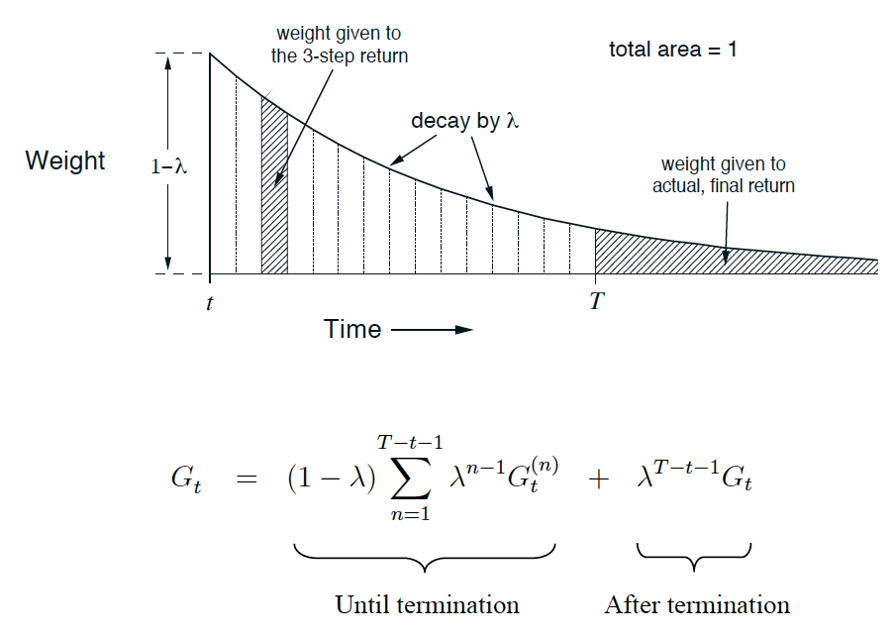
Weighting of λ-return

Slide 5
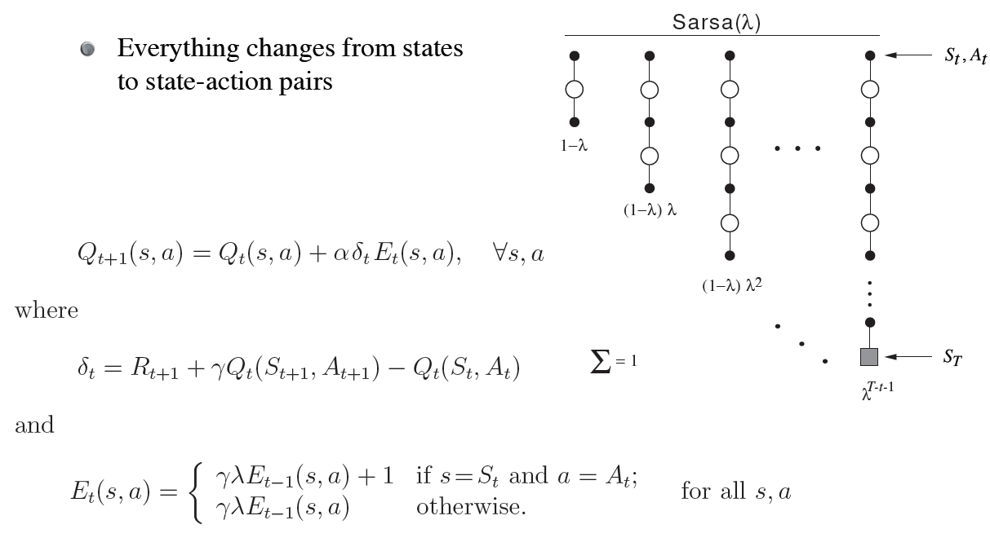
Control: Sarsa(λ)

Slide 6
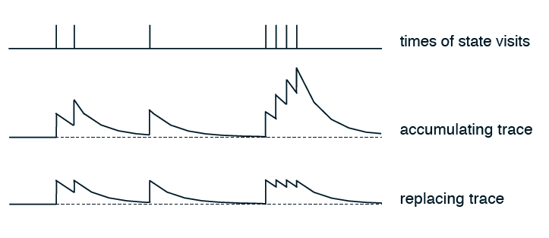
Accumulating traces
Eligibilities can be greater than 1
Could cause convergence problems
Replacing traces

Slide 7
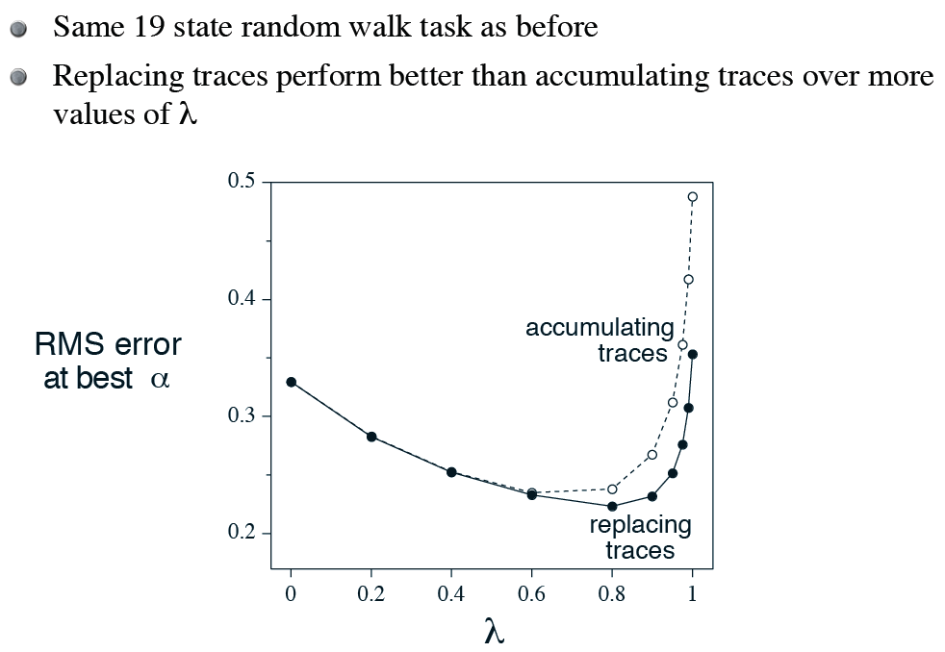

Slide 8
Example: why do accumulating traces do particularly poorly in this task?

Slide 9
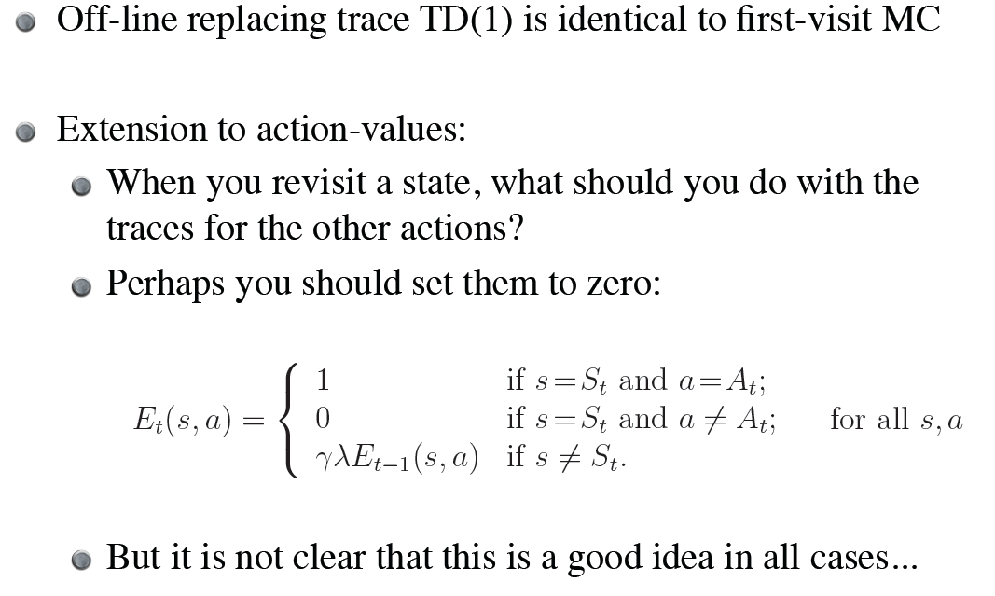

Slide 10
Implementation Issues
Could require significant amounts of computation
But most traces are very close to zero…
We can actually throw them out when they get very small
Will want to use some type of efficient data structure
In practice, increases computation only by a small multiple

Slide 11
Chapter 9: Generalization and Function Approximation
How does experience in parts of the state space help us act over the entire state space?
How can does function approximation (supervised learning) merge with RL?
Function approximator convergence

Slide 12
Chapter 9: Generalization and Function Approximation
How does experience in parts of the state space help us act over the entire state space?
How can does function approximation (supervised learning) merge with RL?
Function approximator convergence
“I read it and it mostly makes sense.”
“There are many methods to do [function approximation], most of which made very little sense as explained.”

Slide 13
Instead of lookup table for values of V at time t (V_{t}), consider some kind of weight vector w_{t}
E.g., w_{t} could be the weights in a neural network
Instead of one value (weight) per state, now we update this vector

Slide 14
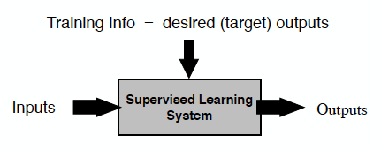
Insight: Steal from Existing Supervised Learning Methods!
Training = {X,Y}
Error = target output – actual output

Slide 15
TD Backups as Training Examples
Recall the TD(0) backup:
As a training example:
Input = Features of s_{t}
Target output = r_{t+1} + γV(s_{t+1})

Slide 16
What FA methods can we use?
In principle, anything!
Neural networks
Decision trees
Multivariate regression
Support Vector Machines
Gaussian Processes
Etc.
But, we normally want to
Learn while interacting
Handle nonstationarity
Not take “too long” or use “too much” memory
Etc.

Slide 17
Perceptron
Binary, linear classifier: Rosenblatt, 1957
Eventual failure of perceptron to do “everything” shifted field of AI towards symbolic representations
Sum = w₁x₁ + w₂x₂ + … + w_{n}x_{n}
Output is +1 if sum > 0, -1 otherwise
w_{j} = w_{j} + (target – output) x_{j}
Also, can use x₀ = 1 and w₀ is therefore a bias

Slide 18
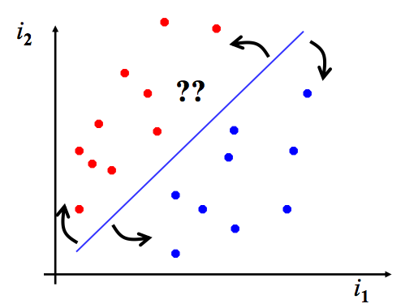
Perceptron
Consider Perceptron with 3 weights:
x, y, bias

Slide 19
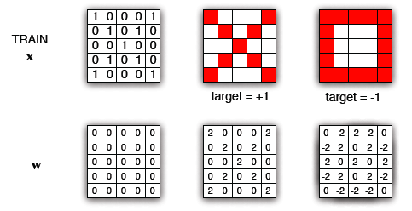
Spatial-based Perceptron Weights

