Slide 1
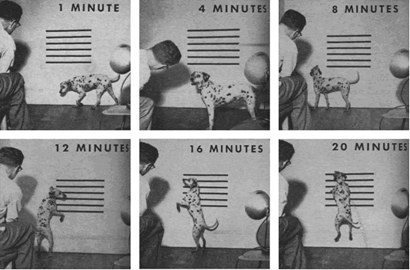
Behaviorist Psychology
B. F. Skinner’s operant conditioning
R+ | R-
P+ | P-

Slide 2
Behaviorist Psychology
B. F. Skinner’s operant conditioning / behaviorist shaping
Reward schedule
Frequency
Randomized
R+ | R-
P+ | P-

Slide 3
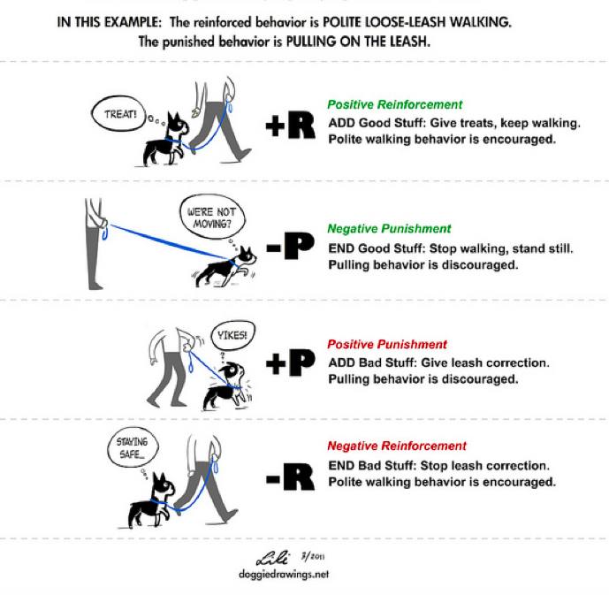

Slide 4
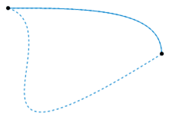
In topology, two continuous functions from one topological space to another are called homotopic if one can be “continuously deformed” into the other, such a deformation being called a homotopy between the two functions.
What does shaping mean for computational reinforcement learning? T. Erez and W. D. Smart, 2008

Slide 5
According to Erez and Smart, there are (at least) six ways of thinking about shaping from a homotopic standpoint. What can you come up with?

Slide 6
Modify Reward: successive approximations, subgoaling
Dynamics: physical properties of environment or of agent: changing length of pole, changing amount of noise
Internal parameters: simulated annealing, schedule for learning rate, complexification in NEAT
Initial state: learning from easy missions
Action space: infants lock their arms, abstracted (simpler) space
Extending time horizon: POMDPs, decrease discount factor, pole balancing time horizon

Slide 7
The infant development timeline and its application to robot shaping. J. Law+, 2011
Bio-inspired vs. Bio-mimicking vs. Computational understanding

Slide 8
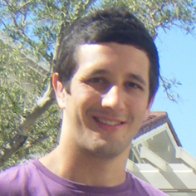
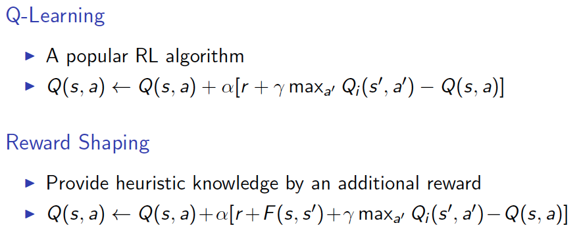
Potential-based reward shaping
Sam Devlin, http://swarmlab.unimaas.nl/ala2014/tutorials/pbrs-tut.pdf

Slide 9
Potential-based reward shaping
Sam Devlin, http://swarmlab.unimaas.nl/ala2014/tutorials/pbrs-tut.pdf

Slide 10
Potential-based reward shaping
Sam Devlin, http://swarmlab.unimaas.nl/ala2014/tutorials/pbrs-tut.pdf

Slide 11
Potential-based reward shaping
Sam Devlin, http://swarmlab.unimaas.nl/ala2014/tutorials/pbrs-tut.pdf

Slide 12
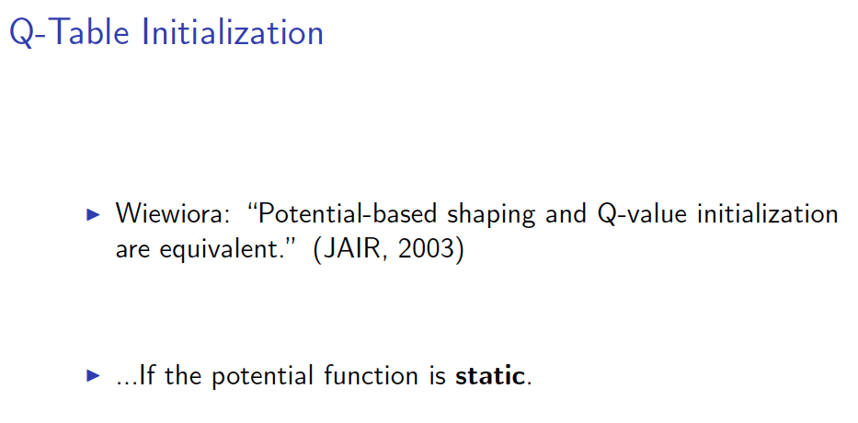
Potential-based reward shaping
Sam Devlin, http://swarmlab.unimaas.nl/ala2014/tutorials/pbrs-tut.pdf

Slide 13
Potential-based reward shaping
Sam Devlin, http://swarmlab.unimaas.nl/ala2014/tutorials/pbrs-tut.pdf

Slide 14
Potential-based reward shaping
Sam Devlin, http://swarmlab.unimaas.nl/ala2014/tutorials/pbrs-tut.pdf

Slide 15
Other recent advances
Harutyunyan, A., Devlin, S., Vrancx, P., & Nowe, A. Expressing Arbitrary Reward Functions as Potential-Based Advice. AAAI-15
Brys, T., Harutyunyan, A., Taylor, M. E., & Nowe, A. Policy Transfer using Reward Shaping. AAMAS-15
Harutyunyan, A., Brys, T., Vrancx, P., & Nowe, A. Multi-Scale Reward Shaping via an Off-Policy Ensemble. AAMAS-15
Brys, T., Nowé, A., Kudenko, D., & Taylor, M. E. Combining Multiple Correlated Reward and Shaping Signals by Measuring Confidence. AAAI-14

Slide 16
Learning from feedback (interactive shaping)
TAMER
Key insight: trainer evaluates behavior using a model of its long-term quality
Knox and Stone, K-CAP 2009
Notes:
We compare these two techniques because LfD is a popular, successful, and well-studied, and LfF is a promising method that is relatively unstudied and has received relatively limited testing.
Plus, of course, LfF is topic of personal importance, being the subject of my dissertation.

Slide 17
Learning from feedback (interactive shaping)
Learn a model of
human reinforcement
Directly exploit the model
to determine action
If greedy:
TAMER
Knox and Stone, K-CAP 2009

Slide 18
Learning from feedback (interactive shaping)
Or, could try to maximize R and H….
How would you combine them?
TAMER

Slide 19
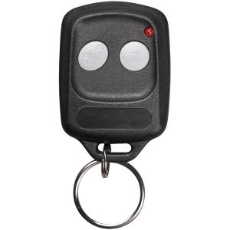
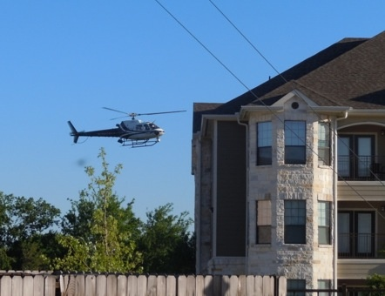
An a priori comparison
Demonstration more specifically points to the correct action
Interface
LfD interface may be familiar to video game players
LfF interface is simpler and task-independent
Task expertise
LfF - easier to judge than to control
Easier for human to increase expertise while training with LfD
Cognitive load - less for LfF
Notes:
- negative reinforcement endorses all actions other than the one taken; much less specific
- LfD’s familiar interface - throwing subjects into a teaching role with familiarizing them with the interface might work better for LfD
- LfF’s task-independent and simpler interface - one less component to reprogram for each task, no relearning controls for teacher

Slide 20
http://www.bradknox.net/human-reward/tamer/tamer-in-action/

Slide 21
Other recent work
Guangliang Li, Hayley Hung, Shimon Whiteson, and W. Bradley Knox. Using Informative Behavior to Increase Engagement in the TAMER Framework. AAMAS 2013

Slide 22
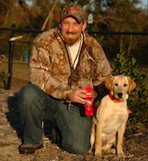
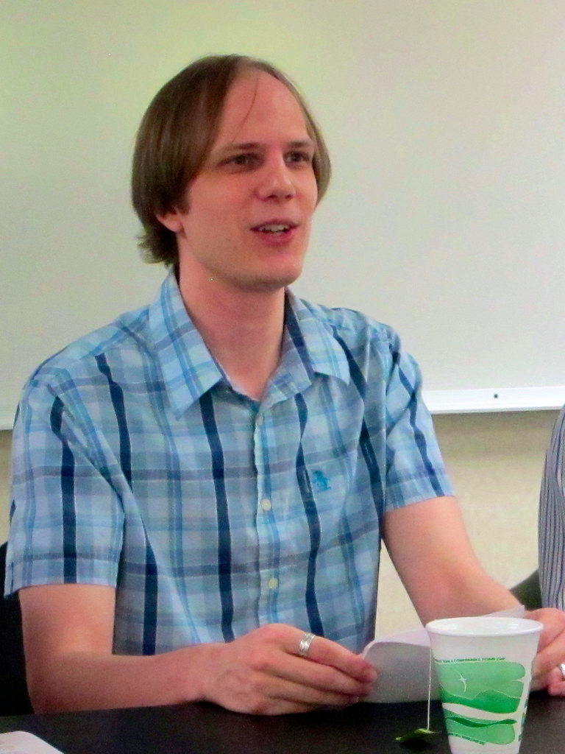
Bayesian Inference Approach
TAMER and COBOT
treat feedback as numeric rewards
Here, feedback is categorical
Use Bayesian approach
Find maximum a posteriori (MAP) estimate of target behavior

Slide 23
Goal
Human can give positive or negative feedback
Agent tries to learn policy λ*
Maps observations to actions
For now: think contextual bandit

Slide 24
Example: Dog Training
Teach dog to sit & shake
λ*
Mapping from observations to actions
Feedback: {Bad Dog, Good Boy}
“Sit” →
“Shake” →

Slide 25
History in Dog Training
Feedback history h
Observation: “sit”, Action: , Feedback: “Bad Dog”
Observation: “sit”, Action: , Feedback: “Good Boy”
…
Really make sense to assign numeric rewards to these?

Slide 26
Bayesian Framework
Trainer desires policy λ*
h_{t} is the training history at time t
Find MAP hypothesis of λ*:
Model of training process
Prior distribution over policies

Slide 27
Learning from Feedback
λ* is a mapping from observations to actions
At time t:
Agent observes o_{t}
Agent takes action a_{t}
Trainer gives feedback

Slide 28
l⁺ is positive feedback (reward)
l⁰ is no feedback (neutral)
l⁻ is negative feedback (punishment)
# of positive feedbacks for action a, observation o: p_{o,a}
# of negative feedbacks….: n_{o,a}
# of neutral feedbacks….: µ_{o,a}

Slide 29
Assumed trainer behavior
Decide if action is correct
Does λ*(o)=a ? Trainer makes an error with p(ε)
Decide if should give feedback
µ⁺, µ⁻ are probabilities of neutral feedback
If thinks correct, give positive feedback with p(1- µ⁺)
If thinks incorrect, give negative feedback with p(1- µ⁻)
Could depend on trainer

Slide 30
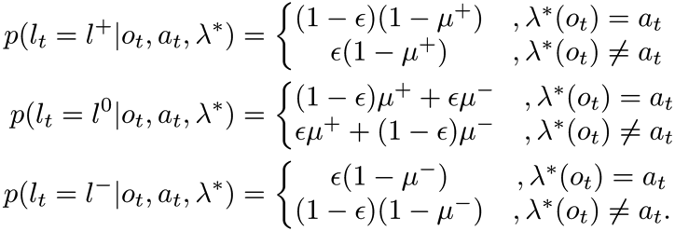
Feedback Probabilities
Probability of feedback l_{t} at time t is:

Slide 31
Fixed Parameter (Bayesian) Learning Algorithm
Assume µ⁺ = µ⁻ and is fixed
Neutral feedback doesn’t affect inference
Inference becomes:

Slide 32
Bayesian Algorithm
Initially, assume all policies are equally probable
Maximum likelihood hypothesis = maximum a posteriori hypothesis
Given training history up to time t, can get to equation on previous slide from the following general statement:
Action depends only on current observation
Error rate: Between 0 and 0.5 to cancel out
Notes:
Observations are separate
Treat µ⁺ and µ⁻ as hidden variables. Use EM!
0 error: singular
0.5: doesn’t give you info
All policies are equally probable
Given policy, feedbacks are independent

Slide 33
Inferring Neutral
Try to learn µ⁺ and µ⁻
Don’t assume they’re equal
Many trainers don’t use punishment
Neutral feedback could be punishment
Some don’t use reward
Neutral feedback could be reward

Slide 34
EM step
Where λ_{i} is ith estimate of maximum likelihood hypothesis
Can simplify this (eventually) to:
α has to do with the value of neutral feedback (relative to |β|)
β is negative when neutral implies punishment and positive when implies reward
Notes:
Using EM to infer policy where we consider mu+, mu- as hidden params
Here, maximization is the second line
Expectation kind of falls out (isn’t of anything meaningful… prob of policy and all possible mu+/mu-)
Full alpha and beta descriptions result in E/M steps

Slide 35
User Study

Slide 36
Comparisons
Sim-TAMER
Numerical reward function
Zero ignored
No delay assumed
Sim-COBOT
Similar to Sim-TAMER
Doesn’t ignore zero rewards

Slide 37
Categorical Feedback outperforms Numeric Feedback

Slide 38
Categorical Feedback outperforms Numeric Feedback

Slide 39
Leveraging Neutral Improves Performance

Slide 40
Leveraging Neutral Improves Performance

Slide 41
More recent work
Sequential tasks
Learn language simultaneously
How do humans create sequence of tasks?

Slide 42
Poll: What’s next?

