Slide 1
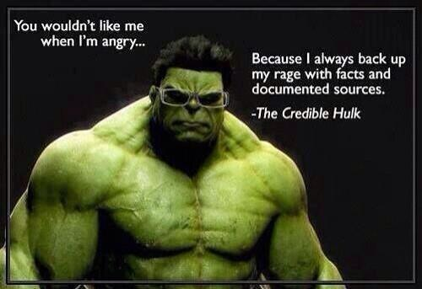

Slide 2
Questions?

Slide 3
Rewards
Delayed rewards
Consistent penalty
Hot Beach -> Bacon Beach
Sequence of rewards
Time to live
Stationary of preferences : getting rid of s0 on sequence for s1, s2 vs. s1’, s2’
Add rewards

Slide 4
Is there a chance that we could have some examples of code in class?
Array Lever[ 1,2,3,4,5,6,7,8,9,10 ] // Values for the lever
Array Actions[10][2] // Current knowledge of the game (average for this lever, //how many times it has been picked)
Int curValue // Total rewards from current game
for(i=0;i<1000;i++) // 1000 iterations of this game
{
if ( rand() == 0 ){ // Lets go exploring
pickRandom()
}else{
int choice = findBestAverage(); // Iterates over actions array and spits // out highest average reward
Action[choice][2] ++ // Increment the number of times we chose this lever
Action[ choice ][1] = Lever[choice] + Action[choice][1] / Action[choice][2] // Mathing some Average
}
}
return Action

Slide 5
The video mentioned a little about distinguish between supervised learning and reinforce learning. But not very clear. When combine the textbook, it seems the supervised learning judges the action correct or incorrect. But why do not judge is better than judge ?
Q_{t}(a) measures mean of previous rewards. Why not also track the standard deviation?

Slide 6
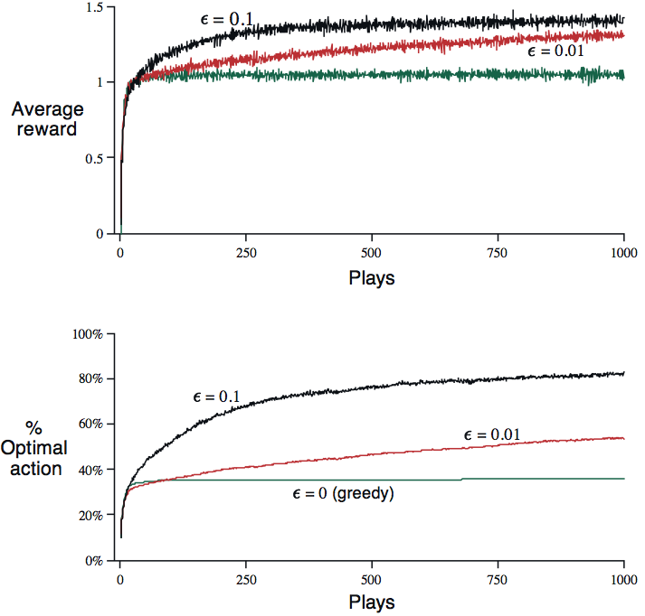
Epsilon = 0.01 is better than 0.1?

Slide 7
Step size: always less than 1.0?
Optimistic init vs. exploration
Static world vs. know when change vs. random change
Moving average
Weighting more recent more heavily

Slide 8
Utility functions

Slide 9
Action-Value Methods
ε-greedy
Vs. running update?

Slide 10
Action-Value Methods
ε-greedy
Vs. running update?

Slide 11
Softmax
Gibbs / Boltzmann distribution
Action a on t^{th} play
Temperature goes to zero
(may be harder to set)

Slide 12
Nonstationary
Exponential, recency-weighted average
Learning rate can vary per step
Why?

Slide 13
Nonstationary
Exponential, recency-weighted average
Learning rate can vary per step
Why?
For convergence:
Notes:
Met for alpha = 1/k, but not for constant alpha

Slide 14
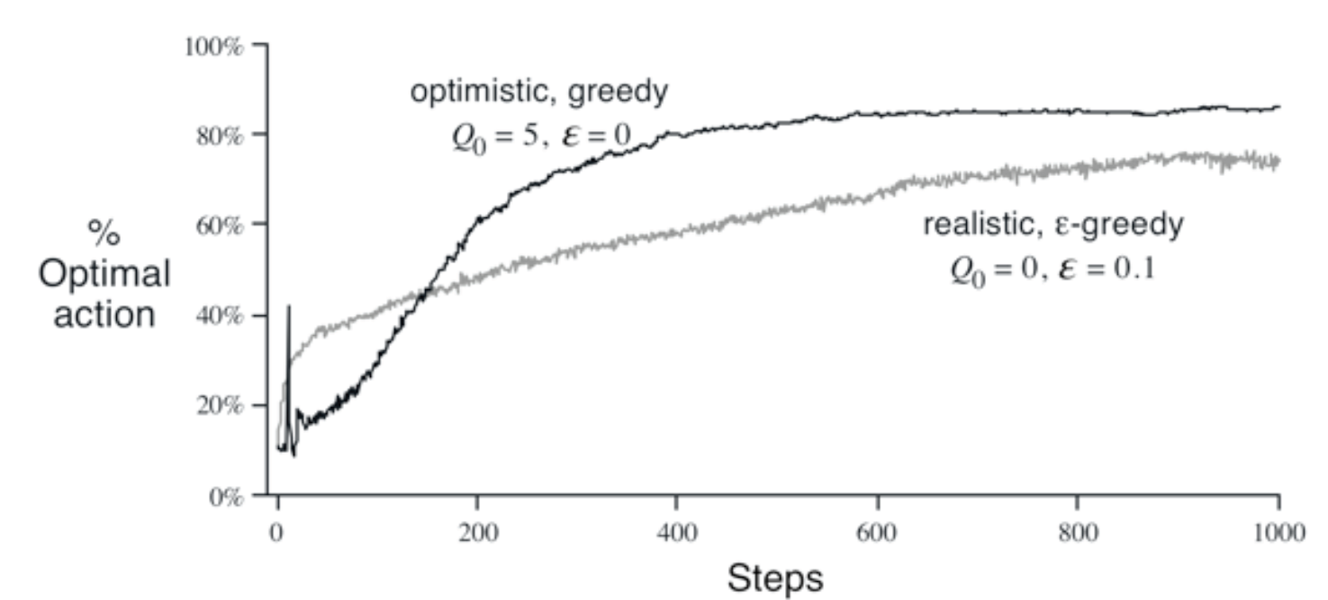
Initialization
Optimistic
Pessimistic
Something else?

Slide 15
Teaching
http://www.youtube.com/watch?v=VTbbYLvhDSM

Slide 16
N-armed bandit
Multiple n-armed bandits (contextual bandit)
Reinforcement Learning

