Slide 1
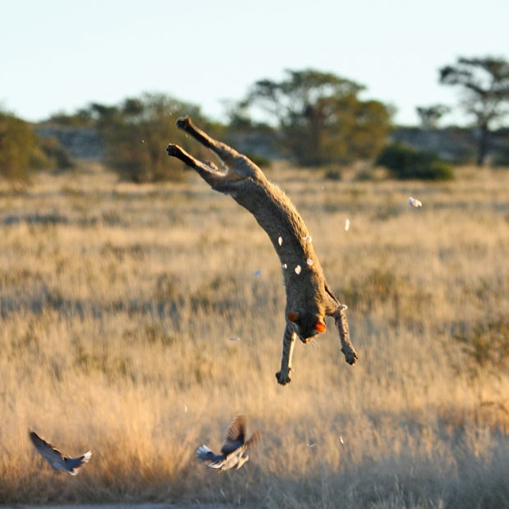
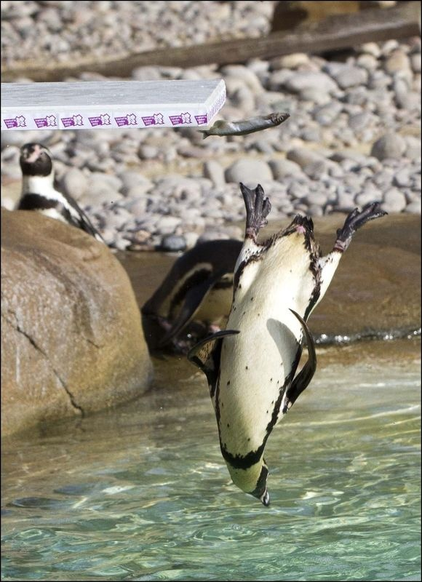
Flipped Classes

Slide 2
http://ais.informatik.uni-freiburg.de/teaching/ws13/mapping/index_en.php
For Thursday:
Watch (Extended) Kalman Filter (~45 min) and on Piazza write 1) A paragraph describing what this lecture is about and/or 2) Questions you had during the lecture. Please this info by 6am, Thursday the 31st.

Slide 3
Goal: Estimate state x of a system given observations z and controls u
P(x | z,u)

Slide 4
Notes:
Sequence of observations and controls

Slide 5
Notes:
Bayes’ Rule
… with Background Knowledge
Recursive Bayesian Updating

Slide 6
Bayes’ Rule
… with Background Knowledge
Recursive Bayesian Updating
Notes:
Bayes’ Rule
… with Background Knowledge
Recursive Bayesian Updating

Slide 7
Recursive Bayesian Updating
Markov assumption: z_{n} is independent of z₁,...,z_{n-1} if we know x.

Slide 8
Notes:
Estimate of where I am, based on almost all observations and all commands

Slide 9
Notes:
P(A) = int_b P(A|B) * P(B) dB -> p(A|B)p(B=true) + p(A|B)p(B=false)

Slide 12
Notes:
New belief is based on old belief, the command you take, and what you see

Slide 13
Sense
Move
Initial Belief

Slide 14
Notes:
Kalman gain: how confident am I? It’s a type of weighted mean

