Slide 1
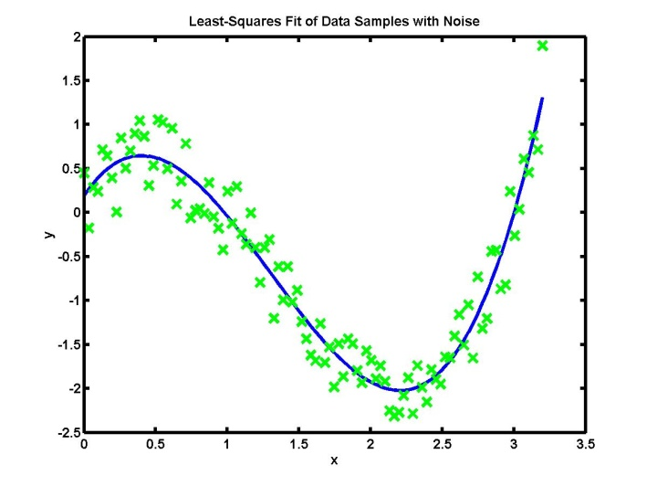
Noise Modeling of Sensors:
The Allan Variance Method

Slide 2
You should be able to answer these questions…
PART I: MOTIVATION
What is noise?
What is noise modeling and why is it required?
PART II: BASICS
How is noise characterized?
How is noise in sensors quantified?
PART III: ALLAN VARIANCE ANALYSIS
What is Allan Variance?
How can it be used to specify sensor characteristics?
Notes:
The students should be able to answer the following questions at the end of the class

Slide 3
Question…
MOTIVATION: WHAT IS NOISE?
What do you think is meant by noise?

Slide 4
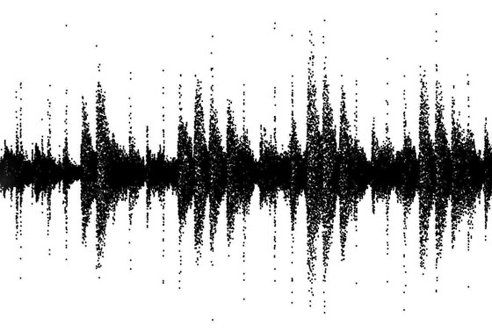
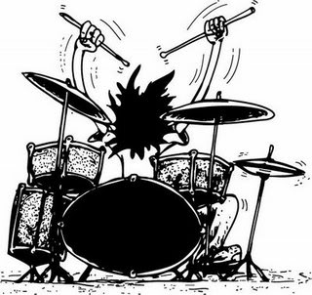
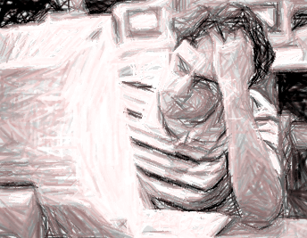
Noise is context-dependent
MOTIVATION: WHAT IS NOISE?
MUSIC/SIGNAL
OR
NOISE

Slide 5
Poles apart: What you want and what you get…
MOTIVATION: WHAT IS NOISE?

Slide 6
A key assumption is that you know what you want!
In signal processing, a “signal” is defined as anything that carries information.
  Music: a 1D signal, changes only with time
  Images: a 2D signal, depends on 2 spatial
  Movies: a 3D signal, depends on 2 space and time
You try…
  An x-ray?
  The orbital position of a satellite?
  An MRI scan?
MOTIVATION: WHAT IS NOISE?

Slide 7
Historical insights into the nature of noise…
Referred to as spontaneous fluctuations
Theoretical research in the early 20th century
  Work done by Einstein (1906), Schottky (1918), Ising (1925), Johnson and Nyquist (1928)
  Brownian Motion as a natural limit to all measuring processes; Barnes and Silverman (1934)
  Noise, Aldert van der Ziel; Prentice-Hall (1954)
MOTIVATION: WHAT IS NOISE?

Slide 8
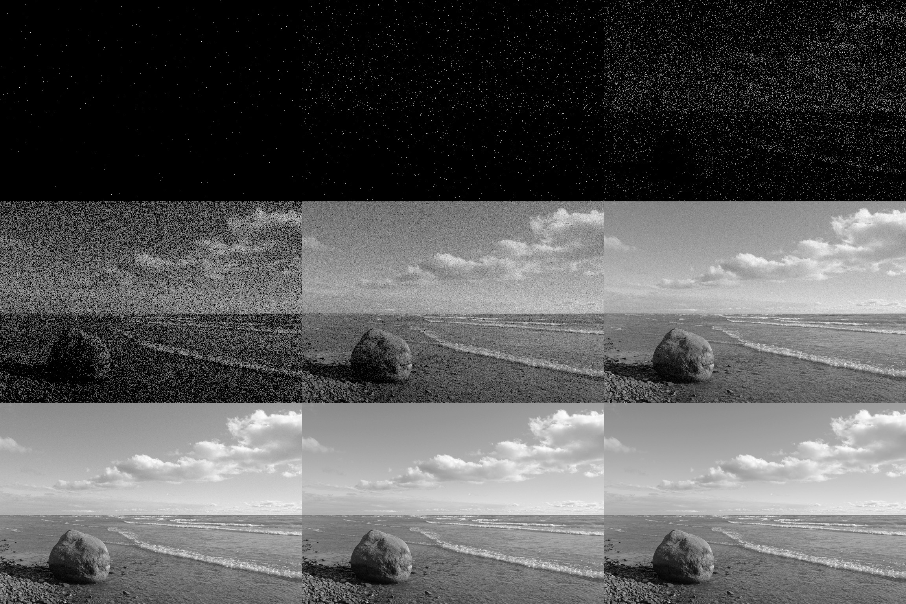
Early classification of noise was phenomenological
“Phenomenological” = classification by source
  Thermal noise: Random fluctuation of current carriers at equilibrium
  Shot noise: Noise in low intensity images, also “drift” of current carriers in depletion region
  Flicker noise: Slow fluctuations in conductivity
MOTIVATION: WHAT IS NOISE?
Random fluctuations of current carriers
Current carrier “drift” due to applied electric field in depletion region
Low frequency noise (vacuum tubes, heart beats, brain, stock markets)
?
Thermal noise
Shot noise
Flicker noise

Slide 9
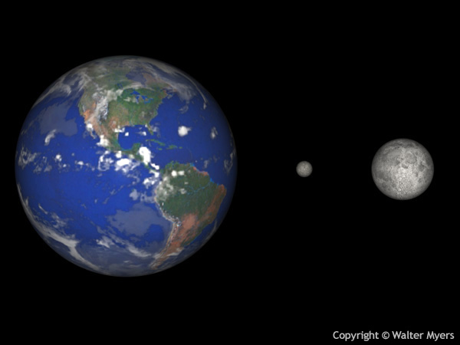
Not always clear what is noise or what is signal
The January 1, 1801 , an Italian monk, Giuseppe Piazzi (1746-1846), discovered a faint, nomadic object through his telescope in Palermo. Piazzi watched the object for 41 days but then fell ill, and shortly thereafter the wandering star star strayed into the halo of the Sun and was lost to observation.
So limited was the scope of the measurements that the dean of the French astrophysical establishment, Pierre-Simon Laplace (1749-1827), declared that it simply could not be done.
In Germany, the 24 year old German mathematician Carl Friedrich Gauss had considered that this type of problem – to determine a planet's orbit from a limited handful of observations – "commended itself to mathematicians by its difficulty and elegance.“
Gauss discovered a method for computing the planet's orbit using only three of the original observations and successfully predicted where Ceres might be found.
His paper on how he did this is considered the first example of regression, and is regarded as the birth of modern linear algebra.

Slide 10
Question…
What do you think is meant by noise modeling?
MOTIVATION: NOISE MODELING

Slide 11
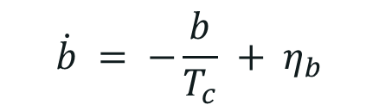
Noise models are functional representations of noise, often differential equations
Example: Bias instability or bias drift
$$\dot{b} = −\frac{b}{T_{c}} + η_{b}$$
MOTIVATION: NOISE MODELING
Parameters
MATLAB code
%% Bias drift
b(1) = 0;
Tc = 1000;
N = 10000;
for(i = 2:1:N)
bdot(i) = (-1/Tc)*b(i-1) + 0.01*randn(1);
b(i) = b(i-1) + bdot(i);
end
t = linspace(0,N,N);
plot(t,b,'Linewidth',3);
h = xlabel('Time (sec)');
set(h,'Fontsize',13);
h = ylabel('Noise magnitude (units)');
set(h,'Fontsize',13);
set(gca,'Fontsize',13);
grid on;

Slide 12
Question…
What do you think the potential applications for noise modeling could be?
MOTIVATION: NOISE MODELING

Slide 13
Noise models can be useful
Think of the sensing process
MOTIVATION: NOISE MODELING
Environment
(Phenomenon)
Environment
(Other phenomena)
Sensor
Output
(Sensed Signal)

Slide 14
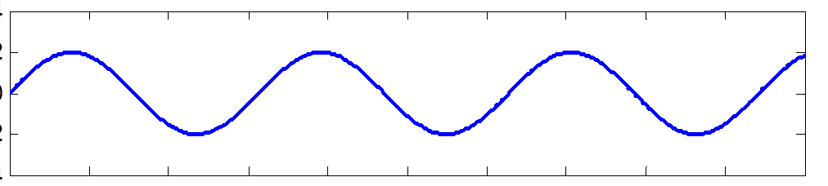
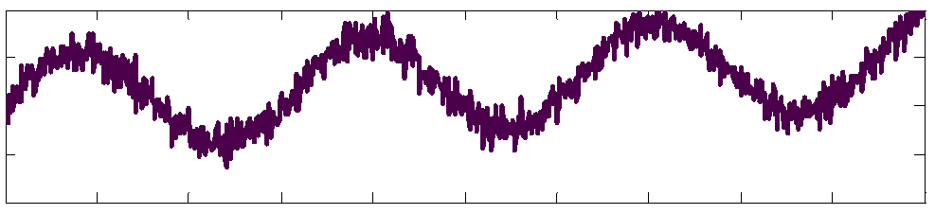
Noise models are useful in signal filtering
Signal filtering or recovery: E.g. Noise canceling hardware may utilize knowledge of noise models for signal filtering
MOTIVATION: NOISE MODELING
Environment
(Phenomenon)
Environment
(Other phenomena)
Sensor
Output
(Sensed Signal)
Perfect process
Process noise
Perfect sensor
Signal recovery
Noise due to extraneous signals
Signal processing

Slide 15
Noise models are useful in sensor selection
Sensor design, selection and performance mapping:
Identifying performance of various “virtual” sensors for a given sensing task requires knowledge of noise models
MOTIVATION: NOISE MODELING
Environment
(Phenomenon)
Environment
(Other phenomena)
Sensor 1
Output
(Sensed Signal)
Sensor 2
Sensor 3
Sensor N
Performance metric
Perfect process
Perfect environs
‘Virtual’ sensors
Varying degrees of measurement noise

Slide 16
You should be able to answer these questions…
PART I: MOTIVATION
What is noise?
What is noise modeling and why is it required?
PART II: BASICS
How is noise characterized?
How is noise in sensors quantified?
PART III: ALLAN VARIANCE ANALYSIS
What is Allan Variance?
How can it be used to specify sensor characteristics?

Slide 17
Question…
BASICS: NOISE CHARACTERIZATION
Can you think of some tools used to characterize noise?

Slide 18
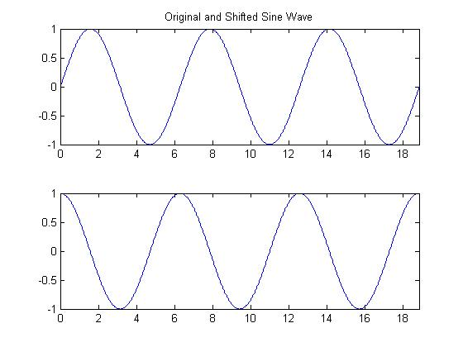
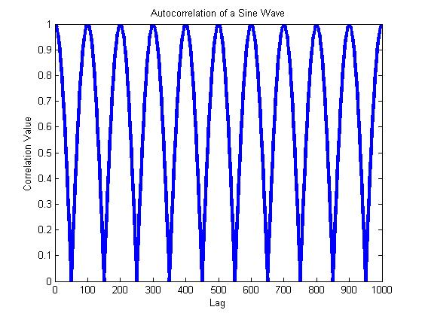
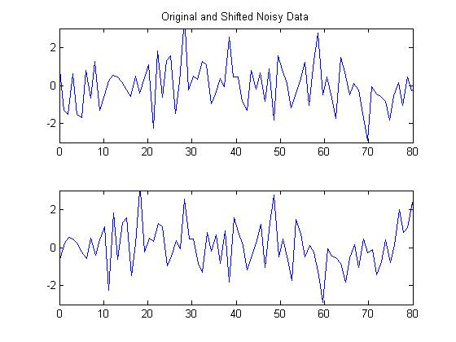
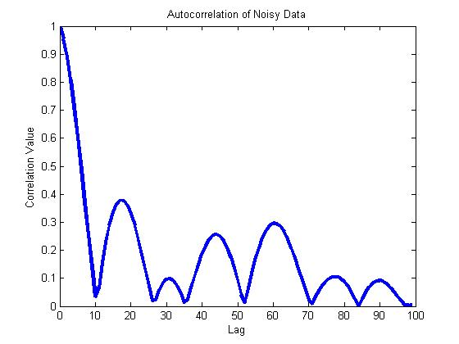
What is autocorrelation?
Infinite Perfect Correlations
As you change the data’s phase, how probable is correlation with the original data?
Only 1 Perfect Correlation

Slide 19

Noise characterization tools: Autocorrelation
Time-domain representation
Let $X(t)$ be a stochastic variable:
$$R_{XX}\left(t_{1}, t_{2}\right)=\frac{E\left[\left(X_{t}−μ_{t}\right)\left(X_{s}−μ_{s}\right)\right]}{σ_{t}σ_{s}}$$
$$R_{XX}\left(t_{1}, t_{2}\right)=\lim_{T→∞}{\frac{1}{2T}\int_{−T}^{T}{f\left(τ\right)\overline{f}\left(t−τ\right)dτ}}$$
BASICS: NOISE CHARACTERIZATION

Slide 20

Noise characterization tools: Autocorrelation
If $X(t)$ represents white noise, $R_{XX}\left(t_{1}, t_{2}\right)=δ(t_{1}−t_{2})$
BASICS: NOISE CHARACTERIZATION
Dirac delta function
MATLAB code
%% White noise autocorrelation
clear all
clc
close all
N = 10000;
w = randn(N,1);
t = linspace(0,N,N);
[c,lags] = xcorr(w,w);
plot(lags,abs(c./max(c)),'Linewidth',2);

Slide 21
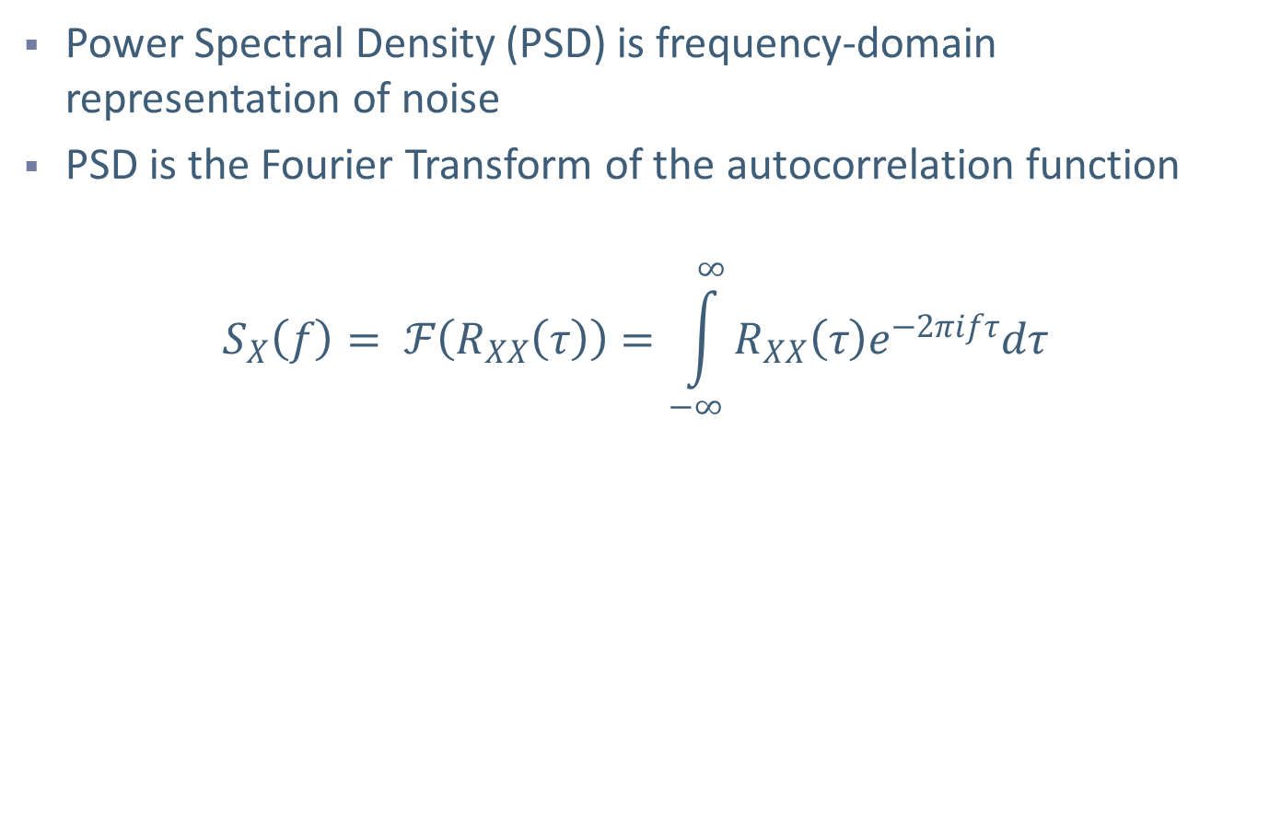
Noise characterization tools: PSD
Power Spectral Density (PSD) is frequency-domain representation of noise
PSD is the Fourier Transform of the autocorrelation function
$$S_{X}\left(f\right)= ℱ\left(R_{XX}\left(τ\right)\right)=\int_{−∞}^{∞}{R_{XX}\left(τ\right)e^{−2πifτ}dτ}$$
BASICS: NOISE CHARACTERIZATION

Slide 22

Noise characterization tools: PSD
If $X(t)$ represents white noise, $S_{X}\left(f\right)=N_{0}$
BASICS: NOISE CHARACTERIZATION
MATLAB code
%% Power Spectral density
N = 10000;
w = randn(N,1);
n = 256;
W = fft(w,n);
% Method 1
Pww = W.*conj(W)/n;
% Method 2
Pww_welch = pwelch(w);
% Method 3
Pww_cov = pcov(w,3);
% See Mathworks help for more details

Slide 23
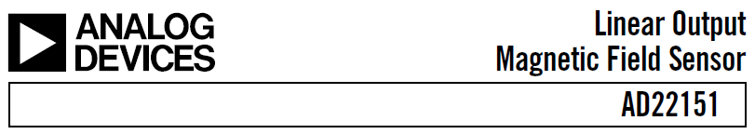
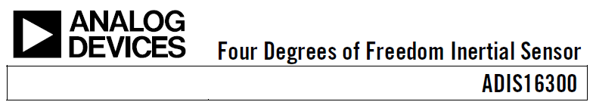



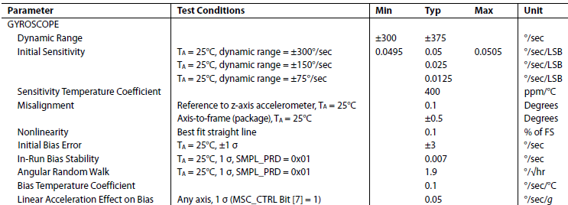
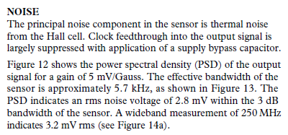
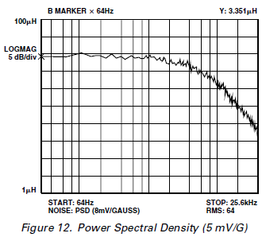
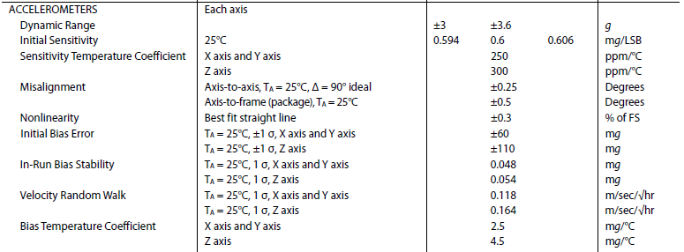
Sensor characterization: Check the datasheet!
BASICS: NOISE CHARACTERIZATION

Slide 24
You should be able to answer these questions…
PART I: MOTIVATION
What is noise?
What is noise modeling and why is it required?
PART II: BASICS
How is noise characterized?
How is noise in sensors quantified?
PART III: ALLAN VARIANCE ANALYSIS
What is Allan Variance?
How can it be used to specify sensor characteristics?

Slide 25
Make an educated guess…
Which of the following technologies in the 1950s necessitated the development of a new measure of variance, i.e. the Allan variance?
Solar-powered batteries
Precision atomic clocks
Leak-free ball point pens
Flexible optical fibers
ALLAN VAVRIANCE ANALYSIS: ORIGINS

Slide 26
Origins: Frequency stability of atomic clocks
1950s-1960s: Development of precise atomic clocks – issues pertaining to frequency stability arise
Preliminary work: D W Allan, “Statistics of Atomic Frequency Standards”, Proceedings of the IEEE, 1966
ALLAN VAVRIANCE ANALYSIS: ORIGINS

Slide 27
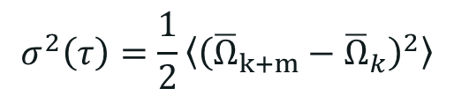
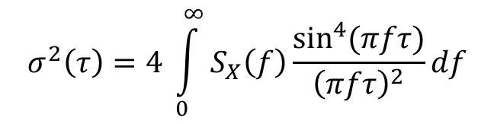
Allan Variance
Allan variance is defined as one half of the time average of the squares of the differences between successive readings of the frequency deviation sampled over the sampling period.
NOTE:
Allan variance analysis is always performed for zero input to the sensor. In this situation, any sensor output is due to noise arising from the sensor.
See next slide to understand variables in the equation
$$σ^{2}\left(τ\right)=\frac{1}{2}\left\langle {\left({\overline{Ω}}_{k+m}−{\overline{Ω}}_{k}\right)}^{2}\right\rangle$$
ALLAN VAVRIANCE ANALYSIS: DEFINITION
$$σ^{2}\left(τ\right)=4 \int_{0}^{∞}{S_{X}\left(f\right)\frac{\sin^{4}{(πfτ)}}{{\left(πfτ\right)}^{2}}}df$$

Slide 28
How is Allan Variance computed?
Allan Variance (σ²(m)) is a function of a parameter m.
Partition the data such that each section has ‘m’ samples
Ω_{k} is the mean of points in k^{th} partition
Compute the difference: Ω_{k} - Ω_{k-1}
For example: Choose m = 200
Compute the mean of data points in each partition
1
2
3
4
5
Evaluate difference of the means of adjacent sections
Square the value each difference
Ω₁
Ω₂
Ω₃
Ω₄
Ω₅
Compute the average of these squared values
Allan Variance: σ²(m) = ½(Average Value)
(Ω₂-Ω₁)²
(Ω₄-Ω₃)²
(Ω₃-Ω₂)²
(Ω₅-Ω₄)²
<(Ω_{i+1}-Ω_{i})²> = [(Ω₂-Ω₁)² + (Ω₂-Ω₁)² + (Ω₂-Ω₁)² + (Ω₂-Ω₁)²] /4
Also, known as the Expected value.
Repeat for different values of m
Notes:
Note: All partitions are of equal size, but, if data length is not a multiple of “m”, the last partition is not used in calculations .

Slide 29
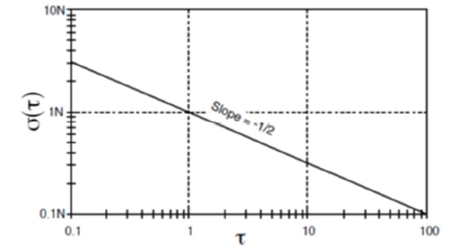
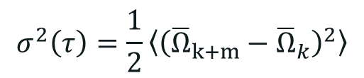
Allan Variance – Angle random walk
$$σ^{2}\left(τ\right)=\frac{1}{2}\left\langle {\left({\overline{Ω}}_{k+m}−{\overline{Ω}}_{k}\right)}^{2}\right\rangle$$
ALLAN VAVRIANCE ANALYSIS: DEFINITION
Simulated white noise
Correlation time = 10 seconds
Correlation time = 0.1 second
Correlation time = 1 second
Correlation time = 0.02 seconds
Notes:
Why was a new measure required? For noise sources other than white noise, the RMS value or the standard deviation is not stable as you try to calculate using ever more number of sample data points. Thus in order to be able to compare the performance of various atomic clocks with different

Slide 30
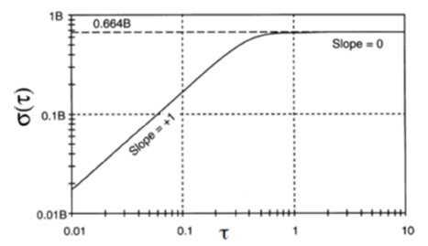
Allan Variance – Bias instability
What will the plot look like?
What will the plot look like?
$$σ^{2}\left(τ\right)=\frac{1}{2}\left\langle {\left({\overline{Ω}}_{k+m}−{\overline{Ω}}_{k}\right)}^{2}\right\rangle$$
ALLAN VAVRIANCE ANALYSIS: DEFINITION
Simulated bias instability
Notes:
Here, in bias instability we see that the variance of the differences between the means does not really change that much. Bias instability is consequently represented as a flat line on the Allan Variance plot.

Slide 31
The Bias Instability Parameter, σ_{b}
What is it?
A measure of noise; small bias parameter means small noise
How to get it?
By inspection from autocorrelation plot
OR
Calculate using least squares results

Slide 32
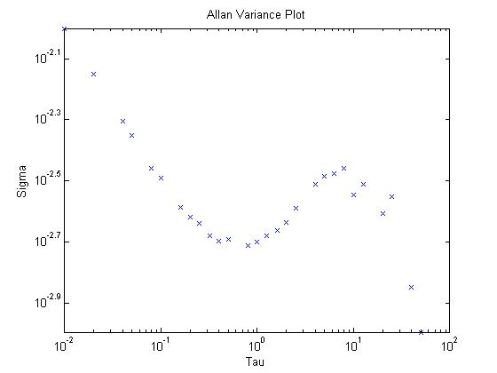
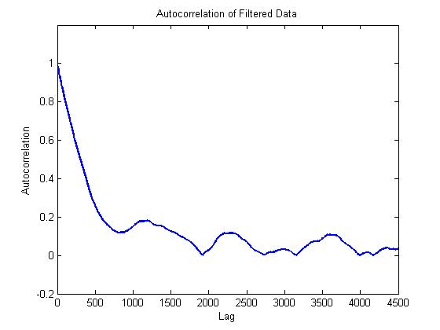

How do we find the autocorrelation?
Step 1) Plot the Allan Variance and find the cutoff frequency
Angle Random Walk Region
Bias Instability Region
Cutoff Frequency ω₀ = 1/$τ$
Step 2) Filter out the Angle Random Walk
MATLAB code
% lowpass filter the data
[b,a]=butter(2,wo); % 2nd order
% butterworth filter under cutoff
filterData = filtfilt(b,a,noisyData);
% filter the data
Step 3) Find the autocorrelation values
and plot it
MATLAB code
% correlate the data and plot
[c,lags] = xcorr(filterData,filterData);
% run correlation function
plot(lags,abs(c./max(c)),'linewidth',2)
% plot the normalized data

Slide 33
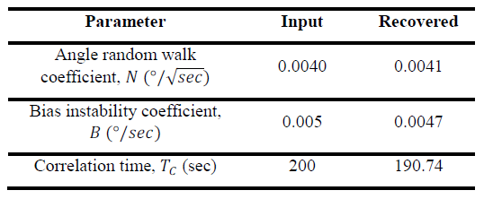
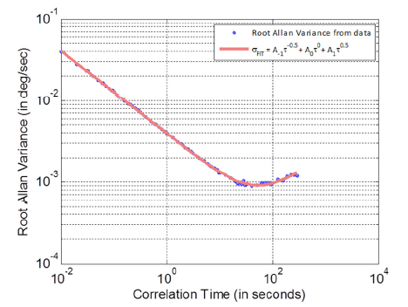
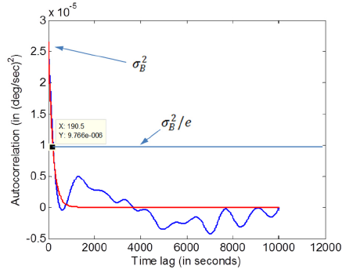
What is autocorrelation used for?
Allan variance and autocorrelation analysis can be used to recover/predict sensor specifications such as noise parameters
ALLAN VAVRIANCE ANALYSIS: USAGE

Slide 34
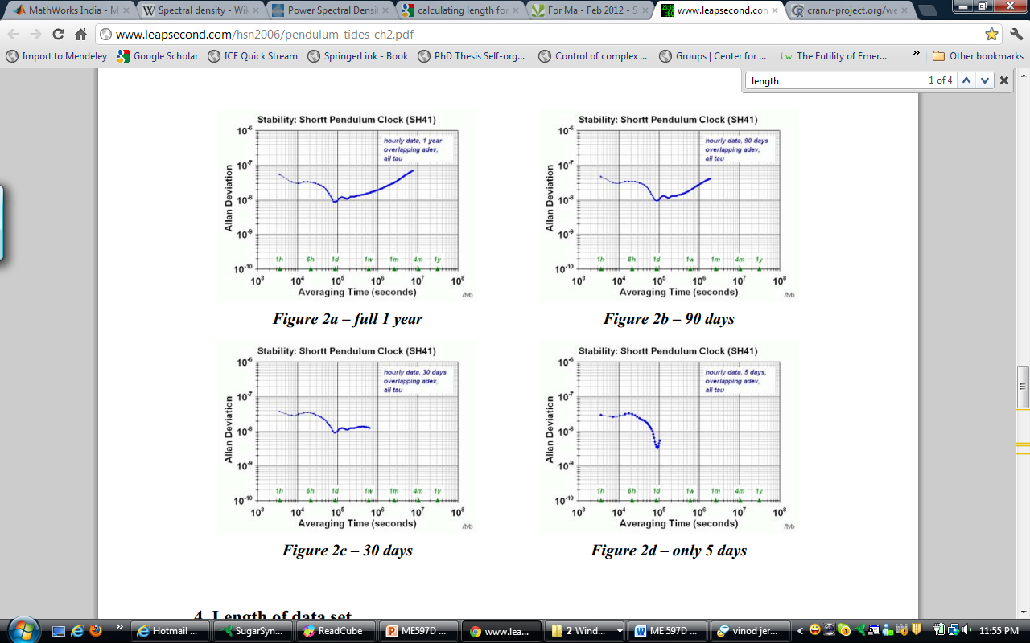


How much data should we collect?
5 days
1 year
Formula used:
$ε$ = admissible error in noise parameters
N = number of data points required (amount of data to collect)
K = number of data points per cluster
ALLAN VAVRIANCE ANALYSIS: DEFINITION
$$ε= \frac{1}{\sqrt{2\left(\frac{N}{K}−1\right)}}$$

Slide 35

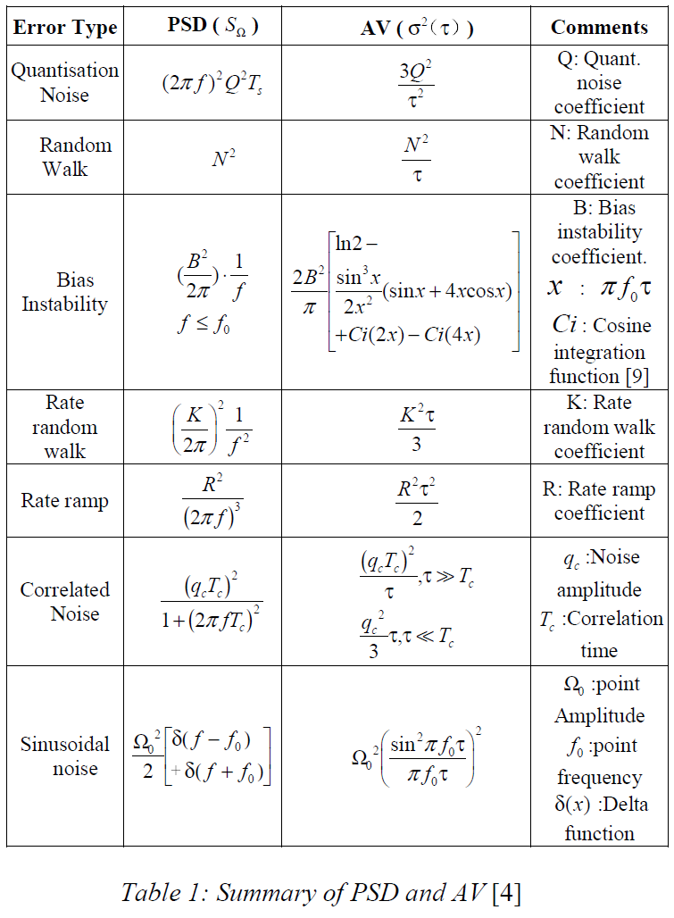
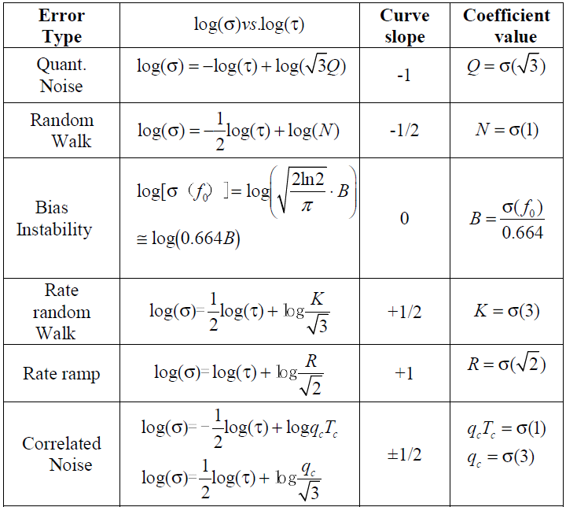
Allan Variance – Noise sources
ALLAN VAVRIANCE ANALYSIS: DEFINITION

Slide 36
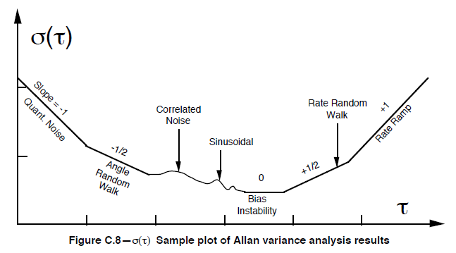
Allan Variance – Noise sources
NOTE:
Allan variance works because different noise sources operate in different frequency spectra.
ALLAN VAVRIANCE ANALYSIS: DEFINITION

Slide 37
Allan Variance Analysis: Usage
I now know how to calculate Allan variance.
So what can I do next?
ALLAN VAVRIANCE ANALYSIS: USAGE

Slide 38

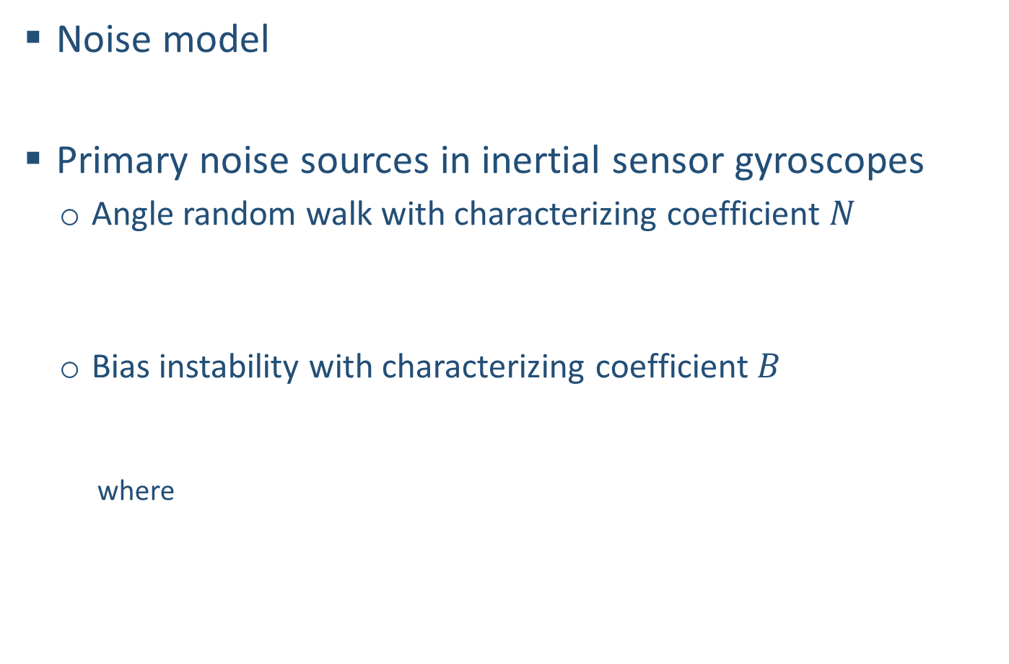




Simulating noisy data from our virtual sensor…
Noise model
Primary noise sources in inertial sensor gyroscopes
  Angle random walk with characterizing coefficient $N$
  Bias instability with characterizing coefficient $B$
    where
$$ω=ω_{TRUE}+b+η$$
ALLAN VAVRIANCE ANALYSIS: USAGE
$$E\left[η^{2}\right]=N^{2}$$
$$\dot{b}=−βb+η_{b}$$
$$E\left[η_{b}^{2}\right]=σ_{B}^{2}$$
$$β=1/T_{c}$$

Slide 39
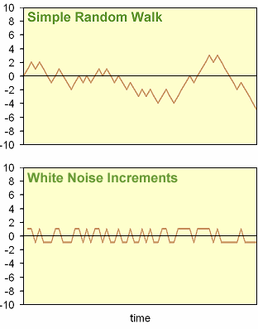
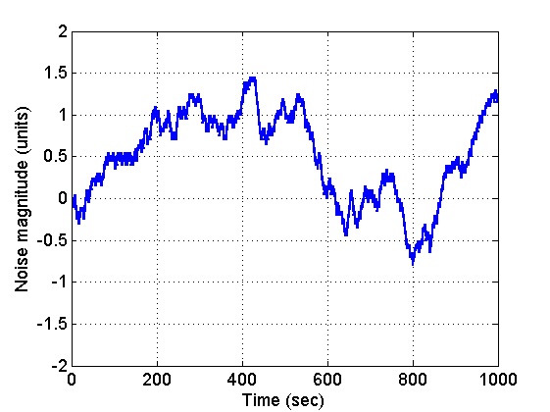
Simulating random walk noise
Random walk:
A random process consisting of a sequence of discrete steps of fixed length (N=0.05rad/sec).
Use white noise to determine when to ‘step’ (+ or – 0.05).
MATLAB code
%% Generating Random Walk
coeffN=0.05; %This is the N coefficient
sample_num=1000;
time = 0 : sample_num;
x2 = zeros(sample_num+1,1);
x2_max = zeros(sample_num+1,1);
x = 0;
for step = 1 : sample_num
r = rand ( );
% Take the step.
if ( r <= 0.5 )
x = x - coeffN;
else
x = x + coeffN;
end
% Update the values
x2(step+1) = x2(step+1) + x;
end
% Plot the results.
plot ( time, x2, 'LineWidth', 2 );
axis([0 1000 -2 2]);
h = xlabel('Time (sec)');
set(h,'Fontsize',13);
h = ylabel('Noise magnitude (units)');
set(h,'Fontsize',13);
set(gca,'Fontsize',13);
grid on;
Simulated random walk using MATLAB

Slide 40
Simulating bias instability drift
A first-order Gauss-Markov process is typically used as an approximation
Here is the correlation time which can be obtained from the auto-correlation plot and
is unit white noise that drives the bias, and is the flicker noise parameter.

Slide 41
Simulating bias instability drift
Simulated bias instability drift using MATLAB
MATLAB code
%% Bias drift
b(1) = 0;
Tc = 1000;
N = 10000;
for(i = 2:1:N)
bdot(i) = (-1/Tc)*b(i-1) + 0.01*randn(1);
b(i) = b(i-1) + bdot(i);
end
t = linspace(0,N,N);
plot(t,b,'Linewidth',3);
h = xlabel('Time (sec)');
set(h,'Fontsize',13);
h = ylabel('Noise magnitude (units)');
set(h,'Fontsize',13);
set(gca,'Fontsize',13);
grid on;

Slide 42
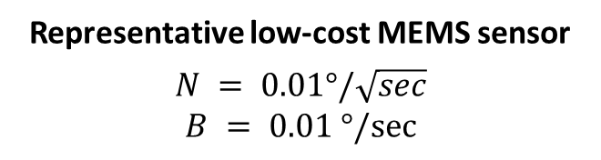
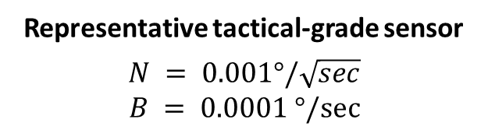
Noise coefficients are indicators of sensor quality
Simulated Sensor Pitch
ALLAN VAVRIANCE ANALYSIS: USAGE
Simulated Sensor Pitch
True Pitch
True Pitch
Representative tactical-grade sensor
$$N = 0.001°/\sqrt{sec}$$
$$B = 0.0001 °/sec$$
Representative low-cost MEMS sensor
$$N = 0.01°/\sqrt{sec}$$
$$B = 0.01 °/sec$$

Slide 43
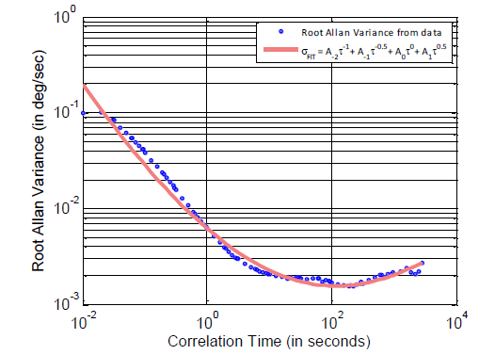
Linear regression can be used to recover noise coefficients
Allan variance analysis was performed on simulated noise
But how do we “fit” the noise model from Allan Variance?
Angle Random Walk
ALLAN VAVRIANCE ANALYSIS: USAGE
$$σ_{FIT}\left(τ\right)=A_{−2}τ^{−1}+A_{−1}τ^{−0.5}+A_{0}τ^{0}+A_{1}τ^{0.5}+A_{2}τ^{1}$$
Bias Instability

Slide 44
As Gauss would say: do a regression analysis!
We are interested in the representation of our data as a function of variables
Assume a model for the given data
Eg. y = mx
Arrange X values and Y values in column vector
Model
Mathematical mischief
x = (0:0.01:100)';
m = 2.73;
y = m*x + 10*randn(length(x),1);
plot(x,y);
xlabel('X')
ylabel('Y')
m = inv(x'*x)*x'*y;
yfit = m*x;
hold on;
plot(x,yfit,'r','LineWidth', 2)
hold off
One-step expression for m

Slide 45



What if we also have an intercept?
Assume a model for the given data
Eg. y = mx + c
Append a column of ones in X
Eg. y = mx + 1*c
$$\underset{X}{\underbrace{\left[\begin{matrix}x_{1} & 1 \\ ⋮ & ⋮ \\ x_{n} & 1\end{matrix}\right]}}\underset{cfs}{\underbrace{\left[\begin{matrix}m \\ c\end{matrix}\right]}}= \underset{Y}{\underbrace{\left[\begin{matrix}y_{1} \\ ⋮ \\ y_{n}\end{matrix}\right]}}$$
x = (0:0.01:100)';
m = 2.73;
c = 10;
y = m*x + c + 10*randn(length(x),1);
plot(x,y);
xlabel('X')
ylabel('Y')
X = [x ones(length(x),1)];
cfs = inv(X'*X)*X'*y
yfit = cfs(1)*x + cfs(2);
hold on;
plot(x,yfit,'r','LineWidth', 2)
hold off
cfs =
2.7417
9.7094
$$X_{n×2}.{cfs}_{2×1}=Y_{n×1}$$
$${cfs}_{2×1}=inv{{(X}^{T}.X)}_{2×2}.{{(X}^{T}.Y)}_{2×1}$$

Slide 46




What if the model was a polynomial?
Assume a model for the given data
Put together matrix X with columns of ones, x x² and x³
$$y=a_{0} {{+ a_{1}x+ a}_{2}x}^{2}+ {a_{3}x}^{3}$$
$$\underset{X}{\underbrace{\left[\begin{matrix}1 & x_{1} & x_{1}^{2} & x_{1}^{3} \\ ⋮ & .. & .. & .. \\ 1 & x_{n} & x_{n}^{2} & x_{n}^{3}\end{matrix}\right]}}\underset{cfs}{\underbrace{\left[\begin{matrix}a_{0} \\ a_{1} \\ a_{2} \\ a_{3}\end{matrix}\right]}}= \underset{Y}{\underbrace{\left[\begin{matrix}y_{1} \\ ⋮ \\ y_{n}\end{matrix}\right]}}$$
x = (0:0.01:100)';
a = [10000 -300 20 -1]
y = a(1) + a(2)*x ...
+ a(3)*x.^2 + a(4)*x.^3 ...
+ 10000*randn(length(x),1);
plot(x,y);
xlabel('X')
ylabel('Y')
hold on;
X = [ones(length(x),1) x x.^2 x.^3];
cfs = inv(X'*X)*X'*y
yfit = cfs(1) + cfs(2)*x ...
+ cfs(3)*x.^2 + cfs(4)*x.^3;
plot(x,yfit,'r','LineWidth', 2)
hold off
$$X_{n×4}.{cfs}_{4×1}=Y_{n×1}$$
$${cfs}_{4×1}=inv{{(X}^{T}.X)}_{4×4}.{{(X}^{T}.Y)}_{4×1}$$

Slide 47
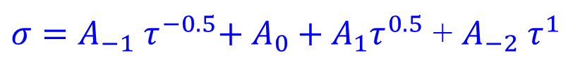
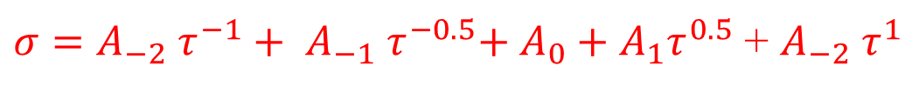

Application of Allan variance
$σ=A_{−2} τ^{−1}+ A_{−1} τ^{−0.5}{{+ A_{0}+A}_{1}τ}^{0.5}$ + $A_{−2} τ^{1}$
$$σ=A_{−1} τ^{−0.5}{{+ A_{0}+A}_{1}τ}^{0.5}$$
Being a log scale error down here doesn’t matter as much as error up here
$σ=A_{−1} τ^{−0.5}{{+ A_{0}+A}_{1}τ}^{0.5}$ + $A_{−2} τ^{1}$
The 4 term model (blue) gives nearly as much accuracy as the 5 term model (red) while the 3 term model (black) is insufficient
Know when to STOP

Slide 48
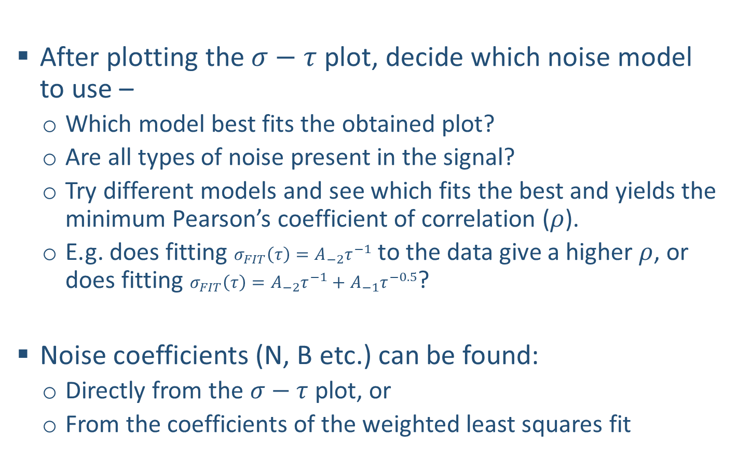
Choosing the correct noise model
After plotting the $σ−τ$ plot, decide which noise model to use –
  Which model best fits the obtained plot?
  Are all types of noise present in the signal?
  Try different models and see which fits the best and yields the minimum Pearson’s coefficient of correlation ($ρ$).
  E.g. does fitting $σ_{FIT}\left(τ\right)=A_{−2}τ^{−1}$ to the data give a higher $ρ$, or does fitting $σ_{FIT}\left(τ\right)=A_{−2}τ^{−1}+A_{−1}τ^{−0.5}$?
Noise coefficients (N, B etc.) can be found:
  Directly from the $σ−τ$ plot, or
  From the coefficients of the weighted least squares fit
$$σ_{FIT}\left(τ\right)=A_{−2}τ^{−1}+A_{−1}τ^{−0.5}+A_{0}τ^{0}+A_{1}τ^{0.5}+A_{2}τ^{1}$$
ALLAN VAVRIANCE ANALYSIS: USAGE

Slide 49

Identifying the noise coefficients
$$σ_{FIT}\left(τ\right)=A_{−2}τ^{−1}+A_{−1}τ^{−0.5}+A_{0}τ^{0}+A_{1}τ^{0.5}+A_{2}τ^{1}$$
Extrapolate lines to identify the coefficients OR perform weighted least squares
Both approaches are equivalent
  Quantization ($A_{−2}$= fit coefficient)
    $Q=A_{−2}/\sqrt{3}$ , = $σ(τ=\sqrt{3})$
  Angle random walk ($A_{−1}$= fit coefficient)
    $N=A_{−1}∙\sqrt{f_{s}}$ , where $f_{s}$ = sampling rate
  Bias instability ($A_{0}$= fit coefficient = $σ(zero slope)$)
    $B=A_{0}$/0.664 = $σ(zero slope)$/0.664
  Rate random walk ($A_{1}$= fit coefficient)
    $K={\sqrt{3}∙A}_{1}$ = $σ(τ=3)$
  Rate ramp ($A_{2}$= fit coefficient)
    $R={\sqrt{2}∙A}_{2}$ = $σ(τ=\sqrt{2})$
ALLAN VAVRIANCE ANALYSIS: USAGE

Slide 50
Research – Application of noise modeling
Okay, so how is this stuff useful?
ALLAN VAVRIANCE ANALYSIS: RESEARCH APPLICATION
Notes:
Sensor selection: Okay, so consider you have a sensor and some system in which it is installed. Let this sensor be an accelerometer and the system be a robotic arm that moves blocks from one location to another. The sensor provides state information that is used in estimating the final block position. Suppose you require a predefined block position accuracy. What kind of accelerometer would you choose for the task?
Sensor Design: You need to design a sensor that delivers a pre-specified final block position accuracy. What specifications should you use?

Slide 51


Some background – Terrain-based Tracking
Vehicle Tracking Performance
GPS Satellite
True Position
Current Position Estimate
Tracking Error
www.beaudaniels–illustration.com

Slide 52
Some background – Terrain-based Tracking
GPS-Free Vehicle Tracking Performance
True Position
Current Position Estimate
Tracking Error

Slide 53

Some background – Terrain-based Tracking
GPS-Free Terrain-based Vehicle Tracking Performance
True Position
Current Position Estimate
Pitch variations

Slide 54
Some background – Terrain-based Tracking
GPS-Free Terrain-based Vehicle Tracking Performance
Pre-recorded terrain database
(Look-up table)
True Position
Current Position Estimate
Pitch data
GPS coordinates
Pitch variations

Slide 55

Some background – Terrain-based Tracking
GPS-Free Terrain-based Vehicle Tracking Performance
as a function of Inertial Sensor Characteristics
True Position
Current Position Estimate
Previous Research¹
Tactical-grade sensors
Low-cost Sensors
[1] Dean, A J; Langelaan; J W; Brennan, S N; “Improvements in Terrain-based Road Vehicle Localization by Initializing an Unscented Kalman Filter Using Particle Filters”, Proceedings of the American Control Conference 2010, Baltimore, MD, June 30-July 02, 2010

Slide 56
Angle Random Walk has significant impact…
Mean tracking error and variance increase with increasing angle random walk noise in an approximately quadratic fashion.
ALLAN VAVRIANCE ANALYSIS: RESEARCH APPLICATION
B=0.01
B=0.006
B=0.008
B=0.001
B=0.004
B=0.002

Slide 57
But Bias Instability does not
Variance of tracking error varies approximately linearly with bias instability coefficients
ALLAN VAVRIANCE ANALYSIS: RESEARCH APPLICATION
N=0.01
N=0.008
N=0.006
N=0.01
N=0.004
N=0.002
N=0.001
N=0.008
N=0.006
N=0.004
N=0.002
N=0.001

Slide 58


Accuracy and Precision increase with cost…
Sensors considered for analysis
Sensor | Approximate Cost (in 2010 US dollars)
Analog Devices ADIS16367 | 700 | 0.033 | 0.013
Gladiator Technologies Landmark 10 | 3,000 | 0.014 | 0.007
Gladiator Technologies Landmark 30 | 6,000 | 0.01 | 0.003
Honeywell HG1700 | 20,000 | 0.0016 | 0.0003
ALLAN VAVRIANCE ANALYSIS: RESEARCH APPLICATION

Slide 59

But the law of diminishing returns kicks in…
Higher tracking precision comes at an increasingly larger investment
Tracking error variance is related to sensor cost by a power law:
$$Tracking Error Variance=6997.1 {\left(Cost\right)}^{−1.199}$$
ALLAN VAVRIANCE ANALYSIS: RESEARCH APPLICATION

Slide 60
References
[1] | "IEEE Standard Specification Format Guide and Test Procedure for Single-Axis Interferometric Fiber Optic Gyros," IEEE Std. 952-1997 1998.
[2] | D. W. Allan, "Statistics of Atomic Frequency Standards," Proceedings of the IEEE, vol. 54, no. 2, pp. 221-230, 1966.
[3] | L.C. Ng and D. J. Pines, "Characterization of Ring Laser Gyro Performance using the Allan Variance Method," Journal of Guidance, vol. 20, no. 1, 1996.
[4] | N. El-Sheimy, H. Hou, and X. Niu, "Analysis and Modeling of Inertial Sensors Using Allan Variance," IEEE Transactions on Instrumentation and Measurement, vol. 57, no. 1, pp. 140-149, 2008.
[5] | S., Wang, J., Knight, N. Han, "Using Allan Variance to determine the Calibration Model of Inertial Sensors for GPS/INS Integration," in Proceedings of the 6th International Symposium on Mobile Mapping Technology, Sau Paulo, Brazil, 2009.
[6] | A. Van der Ziel, “Noise”, Prentice-Hall. 1954

Slide 61
You should be able to answer these questions…
PART I: MOTIVATION
What is noise?
What is noise modeling and why is it required?
PART II: BASICS
How is noise characterized?
How is noise in sensors quantified?
PART III: ALLAN VARIANCE ANALYSIS
What is Allan Variance?
How can it be used to specify sensor characteristics?

Slide 62

You should be able to answer these questions…
PART I: MOTIVATION
What is noise? Noise is context-dependent

Slide 63

You should be able to answer these questions…
PART I: MOTIVATION
What is noise modeling and why is it required? Sensor design and selection; signal recovery
PART II: BASICS
How is noise characterized?
How is noise in sensors quantified?
PART III: ALLAN VARIANCE ANALYSIS
What is Allan Variance?
How can it be used to specify sensor characteristics?

Slide 64
You should be able to answer these questions…
PART II: BASICS
How is noise characterized?
Autocorrelation and PSD

Slide 65
You should be able to answer these questions…
PART II: BASICS
How is noise in sensors quantified?
Check datasheets for specs

Slide 66
You should be able to answer these questions…
PART III: ALLAN VARIANCE ANALYSIS
What is Allan Variance?
Time-averaged statistic for stability analysis

Slide 67

You should be able to answer these questions…
PART I: MOTIVATION
What is noise? Noise is context-dependent
What is noise modeling and why is it required? Sensor design and selection; signal recovery
PART II: BASICS
How is noise characterized? Autocorrelation and PSD
How is noise in sensors quantified? Check datasheets for specs
PART III: ALLAN VARIANCE ANALYSIS
What is Allan Variance? Time-averaged statistic for stability analysis
How can it be used to specify sensor characteristics? Identify noise coefficients from $σ−τ$ plot

