Slide 1
http://www.bbc.co.uk/news/technology-24427821

Slide 2
Midterm Grades
HW1
HW2
HW3
Lab 1
Lab 2
Lab 3
Lab 4
Lab 5
Lab6
Final Project
Midterm
Final

Slide 3

Speaking of Homework 2…
http://flic.kr/p/4suqQQ

Slide 4
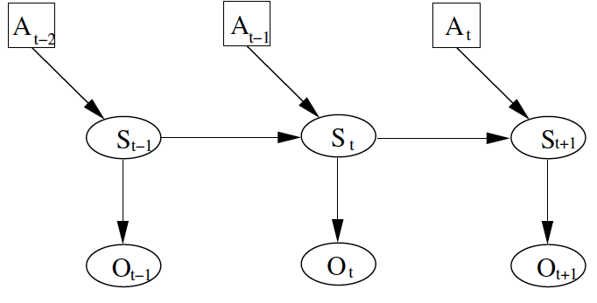
General approach:
A: action
S: pose
O: observation
Position at time t depends on position previous position and action, and current observation

Slide 5
The Problem
Localization: Where am I in the world?
  Sense in different directions
    Relate sensor data to a world model
    Compute location relative to model
  Assumes a perfect world model
Mapping: What is the world around me?
  Sense in different directions
  Integrate sensor data to produce a map
  Assumes perfect knowledge of position

Slide 6
World Modeling and Mapping
Methods for representing the environment of a mobile robot.
Challenges
  Compact representation
  Adaptability to the task and to the environment
  Accommodation of uncertainty

Slide 7
Sensor Data
…
…

Slide 8
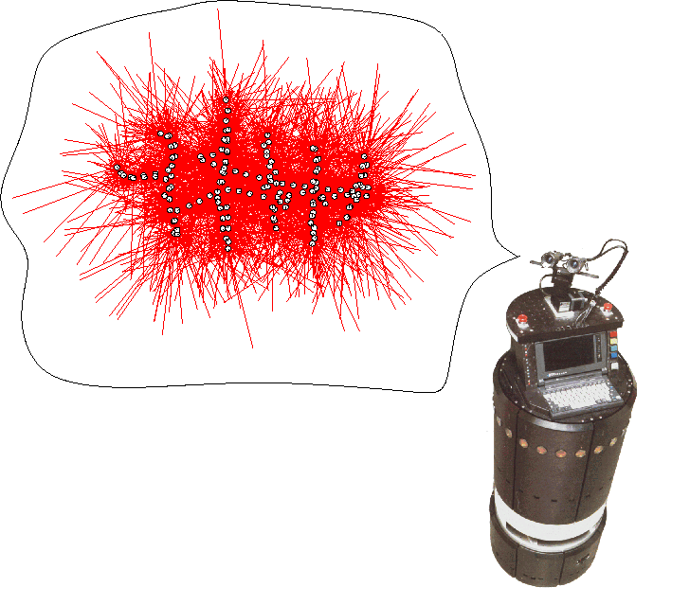
The Mapping Problem
What does the environment look like?

Slide 9
Occupancy Grids
Simplification: 2D grid
How would we build an occupancy grid with a distance sensor?

Slide 10
Occupancy Grids
Simplification: 2D grid
How would we build an occupancy grid with a distance sensor?
What if this sensor wasn’t perfect?

Slide 11
Indoor Mapping using Occupancy Grids
World can be modeled as vertical structures on reference ground planes.
  Simplification for representing the world as a 2D grid.
  Uncertainties → Probabilities of occupancy in the grid.
Assumption that indoor environments are highly structured
  Composed of points, lines and planes.

Slide 12
Occupancy Grids
Each grid cell labeled as
  Unknown
  Free
  Obstacle
Robot

Slide 13
Occupancy Grids
Each grid cell labeled as
  Unknown
  Free
  Obstacle
Robot

Slide 14
Occupancy Grids
Each grid cell labeled as
  Unknown
  Free
  Obstacle
Robot

Slide 15
Occupancy Grids
Each grid cell labeled as
  Unknown
  Free
  Obstacle
Robot

Slide 16
Occupancy Grids
Each grid cell labeled as
  Unknown
  Free
  Obstacle
Critical assumption: perfect sensors data!
Robot

Slide 17
Probabilistic Occupancy Grids
1
0

Slide 18
Probabilistic Occupancy Grids
The value of each grid in the map, , is equal to the probability of that grid cell being occupied:
Underlying assumption: grid cells are independent.
Same as:

Slide 19
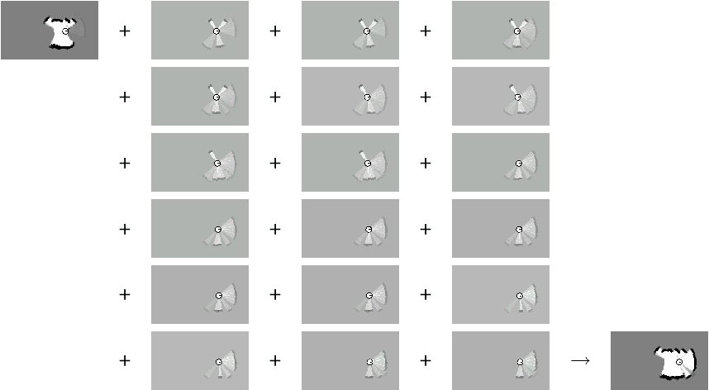

Slide 20

Occupancy Map

Slide 21
Maximum Likelihood Map
Occupancy Map
Maximum Likelihood Map
The maximum likelihood map is obtained by clipping the occupancy grid map at a threshold of 0.5

Slide 22
This assumes cell independence
What else must be assumed / what are the other open questions?

Slide 23
Properties of Occupancy Grids
Represents the environment of a mobile robot
  assumes robot location is known
Models each cell independently from all others
Efficient to learn but require a lot of memory
What grid size should be used?

Slide 24
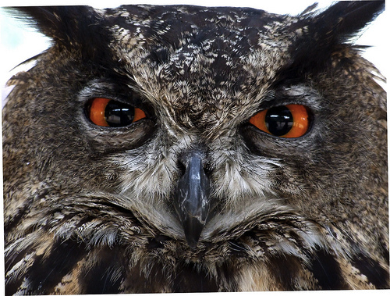
Properties of Occupancy Grids
When should we “forget” old data?
  What type of data structure would we need here?
http://flic.kr/p/6Q8dmH

Slide 25
What if we left the lab….
What’s different about outdoor environments?

Slide 26
Unstructured Outdoor Environments
What is no longer valid?
  cannot project the data in a 2D grid
  cannot describe the world adequately by a small set of geometric elements
Assuming there is a reference ground plane, the ground can be represented by a 2-1/2D grid
  Each cell contains the elevation.
Mobile robots operating in complex environments need a 3D grid

Slide 27
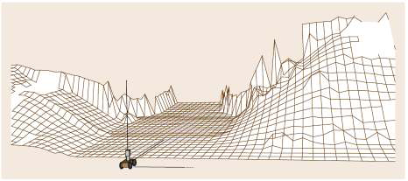
Elevation Maps

Slide 28
Videos
Kinect 3D mapping

Slide 29
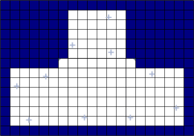
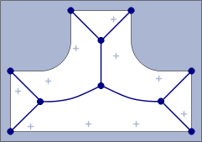
Map Models
Grid-based
  Collection of discrete obstacle/free pixels
  Grid size and resolution
Topological
  Collection of nodes and interconnections
  Minimal complexity

Slide 30
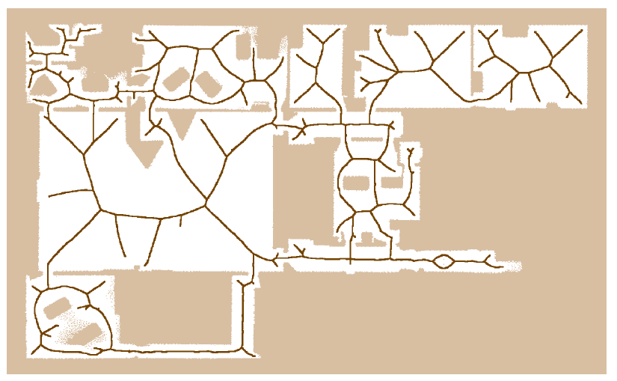
Voronoi Diagram

Slide 31
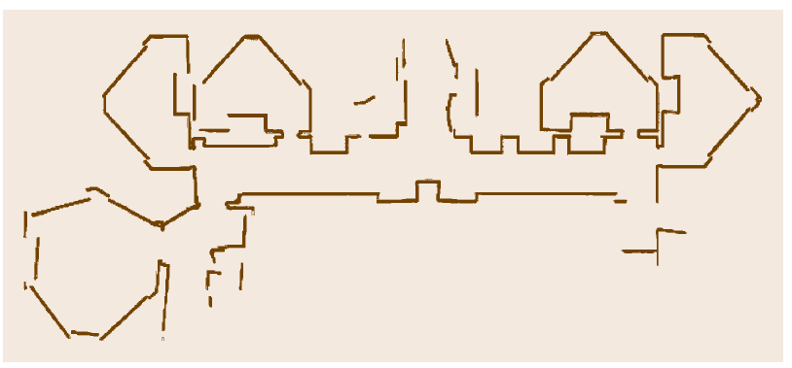
Line Map

Slide 32
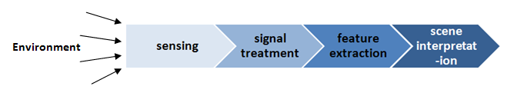
Feature Extraction
Sensors will always have uncertainty
There are two strategies for using uncertain sensor input to guide a robot’s behavior
  Use each measurement as a raw and individual value
  Feature extraction: extract information from one or more sensor readings first and generate a higher-level percept

Slide 33
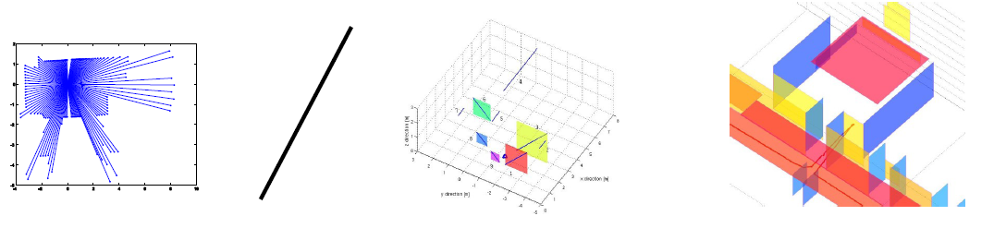
Why Features?
Raw data: huge amount of data to be stored
Compact features require less storage (e.g. Lines, planes)
Provides rich and accurate information
Basis for high level features (e.g. more abstract features, objects)

Slide 34
Sensor Data
…
…

Slide 35
Segmentation
Suppose we want to transform a bunch of points (distances) into lines.
  Why is this hard?
  Any ideas?

Slide 36
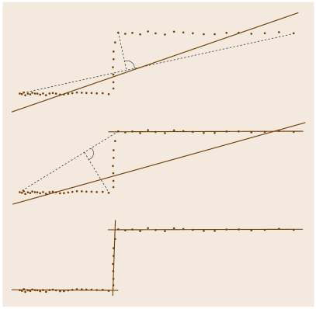
Segmentation
Split-and-merge algorithm
Fit a line to all the datapoints (minimize the squared distance to all points from this line)
Determine the point x₁ that’s furthest from the line
If dist(x₁) < τ, return the line
Determine the point x₂ that’s furthest from the line between the two endpoints
Divide the point set into two subsets. One contains all points up to x₂ and the other contains all the points after. Recursively call method on each subset.

Slide 37
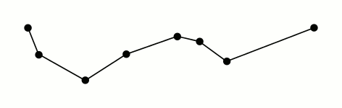

Slide 38
Improvements to Split-and-Merge
Problem: a single noisy reading introduces unnecessary split point
  Solution: split only when two consecutive points both have distances to the line greater than the threshold and are on the same side of the line
Problem: doing least-squares line fitting is too complicated or expensive
  Solution: construct lines by simply connecting the first and last point in the segment
Problem: Model isn’t optimal
  An expectation maximization (EM) approach can find a model that minimizes the squared distances of all data points

Slide 39
Problem: too many line segments due to noise
  Solution: throw out line segments that don’t meet minimum requirements for number of points or length
Problem: too many line segments for model size
  Solution: Find the distance between line segments and see if they’re less than some threshold. If so, merge them.

Slide 40
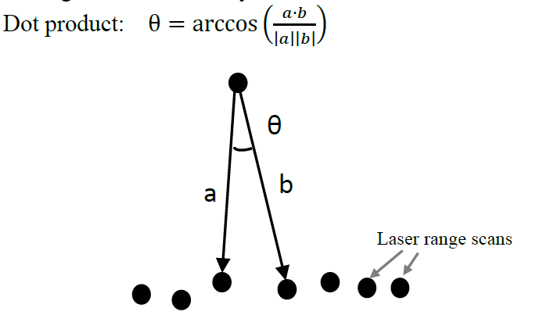
Corner Detection (version 1)
Check whether the dot product of two consecutive readings is lower than some threshold
  This is noisy, so if true, you should also check the neighboring readings as well

Slide 41
Corner Detection (version 2)
Test that the angle difference between two consecutive line segments is greater than some threshold

