Slide 1
http://www.uasvision.com/2013/10/09/dji-phantom-crashes-into-canadian-lake/

Slide 2
HW2
Under door by 11:59pm today
Via Angel by 11:59pm today
(or just hand it to me now)
Any questions? (Can also talk after class.)

Slide 3
Next Monday (10/14)
Tell Me About It: Language and Learning for Human-Robot Interaction
4:10pm, EME 52
Cynthia Matuszek is a Ph.D. candidate in Computer Science and Engineering at the University of Washington, studying with Drs. Dieter Fox and Luke Zettlemoyer. Her research focuses on how robots can interact robustly in unconstrained real-world settings.
Next Tuesday
Intro to HRI
Next Thursday
Reaction to “Camera-Based Navigation of a Low-Cost Quadrocopter”
Review
Next next Tuesday
Midterm
Remember, book is in lab if you want to study

Slide 4
Due by 11:59pm on Wednesday, 10/16
http://vision.in.tum.de/_media/spezial/bib/engel12iros.pdf
Reaction 1 paragraph to ½ a page
What did you find interesting?
What was confusing?
Summarize the paper
What questions does this paper raise?
Any ideas for a future project from this paper?

Slide 5
Overview
Histogram Filter
Discrete
Multimodal
Particle Filter
Continuous
Multimodal
Kalman Filter
Continuous
Unimodal

Slide 6
Example

Slide 7
Example
Right

Slide 8
Example

Slide 9
Example
Right

Slide 10
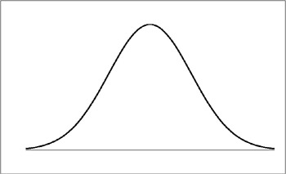
Kalman Filter Model
σ²
Area under the curve sums to $1$
$$μ$$
Gaussian
(in $1D$ for now)

Slide 11
Kalman Filter
Gain Information
Lose
Information
Sense
Move
Gaussian:
μ, σ²
Bayes Rule
(Multiplication)
Convolution
(Addition)
Initial Belief

Slide 12
Measurement Example
μ, σ²
v, r²
Prior Position Estimate $(μ,σ^{2})$
Measurement Estimate $(ν, r^{2})$

Slide 13
Measurement Example
μ, σ²
v, r²
Prior Position Estimate $(μ,σ^{2})$
Measurement Estimate $(ν, r^{2})$
Where is the new mean $μ′$?

Slide 14
Measurement Example
μ, σ²
v, r²
Prior Position Estimate $(μ,σ^{2})$
Measurement Estimate $(ν, r^{2})$
What is the new covarance $σ^{2}′$?
σ²’?

Slide 15
Measurement Example
μ, σ²
v, r²
Prior Position Estimate $(μ,σ^{2})$
Measurement Estimate $(ν, r^{2})$
New Estimate $(μ^{′},σ^{2}′)$
μ', σ²’
To calculate, go through and multiply the two Gaussians and renormalize to sum to 1
Also, the multiplication of two Gaussian random variables is itself a Gaussian

Slide 16
Multiplying Two Gaussians
μ, σ²
v, r²
Prior Position Estimate $(μ,σ^{2})$
Measurement Estimate $(ν, r^{2})$
(ignoring constant term in front)
To find mean, maximize function (i.e., take derivative)
4. Set equal to 0 and solve for x
… something similar for the variance:
(ignoring the constant term in front)
To find the mean, need to maximize this function (i.e. take derivative)
Set equal to and solve for
…something similar for the variance

Slide 17
Another point of view…
μ, σ²
v, r²
Prior Position Estimate $(μ,σ^{2})$
Measurement Estimate $(ν, r^{2})$
New Estimate $(μ^{′},σ^{2}′)$
: p(x)
: p(z|x)
: p(x|z)
μ', σ²’

Slide 18
Example
Prior Position Estimate $(10,4)$
Measurement Estimate $(12, 4)$

Slide 19
Example
Prior Position Estimate $(10,4)$
Measurement Estimate $(12, 4)$
Notes:
Sigma2 = 16*16 / (16+16) = 256/32 = 8 -> 2.83
Q=(10*16+12*16)/)=(160+192)/32)=11

Slide 20
Example
Prior Position Estimate $(10,8)$
Measurement Estimate $(13, 2)$
μ’=12.4
σ²’=1.6

Slide 21
Kalman Filter
Lose
Information
Sense
Move
Gaussian:
μ, σ²
Convolution
(Addition)
Initial Belief

Slide 22
Motion Update
For motion
Model of motion noise
u, r²
μ’=μ+u
σ²’=σ²+r²

Slide 23
Motion Update
For motion
Prior Position Estimate $(8,4)$
M$ovement Estimate (10, 6)$
Model of motion noise
u, r²
μ’=μ+u
σ²’=σ²+r²

Slide 24
Motion Update
For motion
Prior Position Estimate $(8,4)$
M$ovement Estimate (10, 6)$
Model of motion noise
u, r²
μ’=μ+u=18
σ²’=σ²+r²=10

Slide 25
Kalman Filter
μ’=μ+u=18
σ²’=σ²+r²=10
Sense
Move
Gaussian:
μ, σ²
Initial Belief

Slide 26
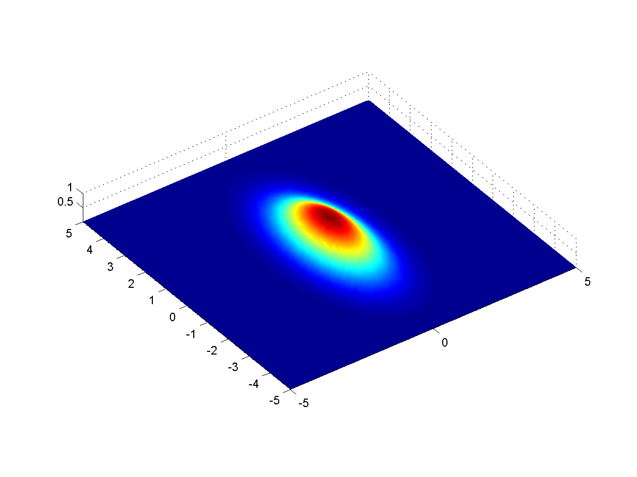
Kalman Filter in Multiple Dimensions
2D Gaussian

Slide 27
Implementing a Kalman Filter example
VERY simple model of robot movement:
What information do our sensors give us?

Slide 28
Implementing a Kalman Filter example
F
H
H = [1 0]

Slide 29
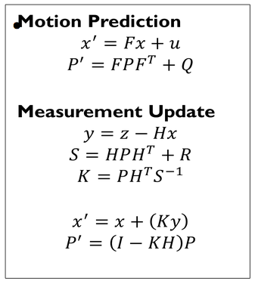
Implementing a Kalman Filter
estimate
P’ uncertainty covariance
state transition matrix
u motion vector
F motion noise
measurement
measurement function
measurement noise
identity matrix

Slide 30
Summary
Kalman Filter
Continuous
Unimodal
Harder to implement
More efficient
Requires a good starting guess of robot location
Particle Filter
Continuous
Multimodal
Easier to implement
Less efficient
Does not require an accurate prior estimate

Slide 32
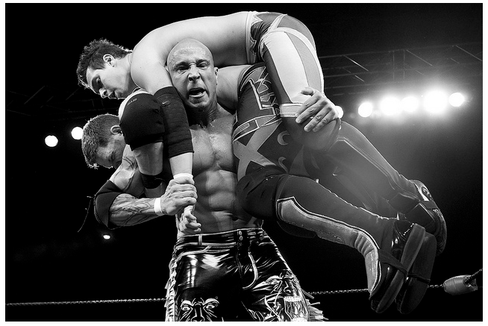
SLAM
Simultaneous localization and mapping:
Is it possible for a mobile robot to be placed at an unknown location in an unknown environment and for the robot to incrementally build a consistent map of this environment while simultaneously determining its location within this map?
http://flic.kr/p/9jdHrL

Slide 33
Three Basic Steps
The robot moves
increases the uncertainty on robot pose
need a mathematical model for the motion
called motion model

Slide 34
Three Basic Steps
The robot discovers interesting features in the environment
called landmarks
uncertainty in the location of landmarks
need a mathematical model to determine the position of the landmarks from sensor data
called inverse observation model

Slide 35
Three Basic Steps
The robot observes previously mapped landmarks
uses them to correct both self localization and the localization of all landmarks in space
uncertainties decrease
need a model to predict the measurement from predicted landmark location and robot localization
called direct observation model

Slide 36
How to do SLAM

Slide 37
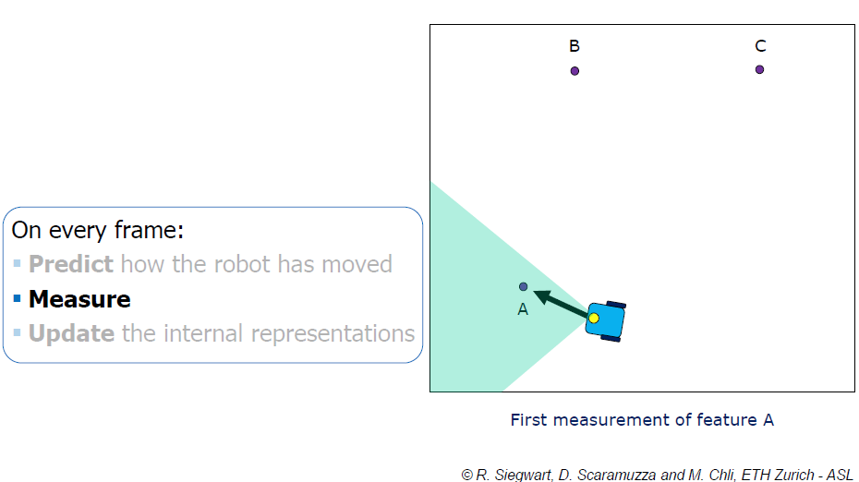
How to do SLAM

Slide 38
How to do SLAM

Slide 39
How to do SLAM

Slide 40
How to do SLAM

Slide 41
How to do SLAM

Slide 42
How to do SLAM

Slide 43
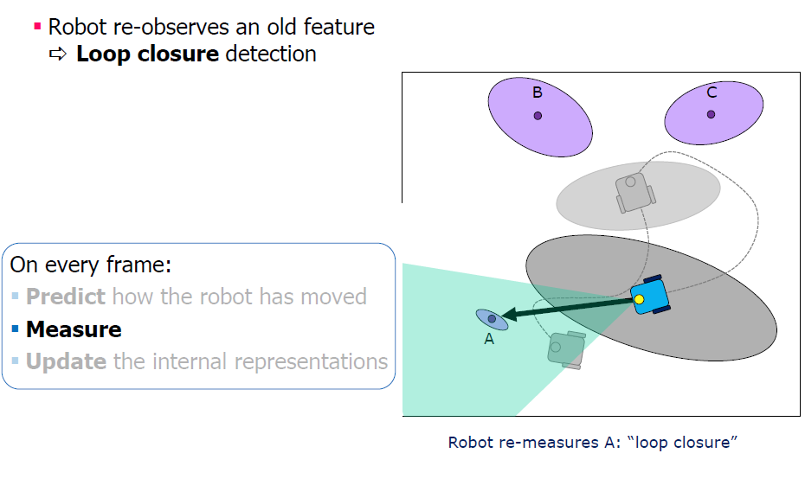
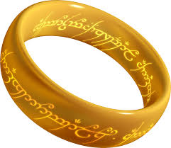
How to do SLAM

Slide 44
How to do SLAM

Slide 45
The Essential SLAM Problem

Slide 46
SLAM Paradigms
Some of the most important approaches to SLAM:
Extended Kalman Filter SLAM (EKF SLAM)
Particle Filter SLAM (FAST SLAM)
GraphSLAM

Slide 47
EKF Slam
Keep track of combined state vector at time t:
x, y, θ
m_{1,x}, m_{1,y}, s₁
…
m_{N,x}, m_{N,y}, s_{N}
m = estimated coordinates of a landmark
s = sensor’s signature for this landmark
Very similar to EKF localization, starting at origin

Slide 48
EKF-SLAM
Grey: Robot Pose Estimate
White: Landmark Location Estimate

Slide 49
Visual Slam
Single Camera
What’s harder?
How could it be possible?
Notes:
angle

Slide 50
GraphSLAM
SLAM can be interpreted as a sparse graph of nodes and constraints between nodes.

Slide 51
GraphSLAM
SLAM can be interpreted as a sparse graph of nodes and constraints between nodes.
nodes: robot locations and map-feature locations
edges: constraints between
consecutive robot poses (given by the odometry input u)
robot poses and the features observed from these poses.

Slide 52
GraphSLAM
Key property: constraints are not to be thought as rigid constraints but as soft constraints
Constraints acting like springs
Solve full SLAM by relaxing these constraints
get the best estimate of the robot path and the environment map by computing the state of minimal energy of this spring mass network

Slide 53
GraphSLAM

Slide 54
GraphSLAM

Slide 55
GraphSLAM

Slide 56
GraphSLAM
Build graph
Inference: solve system of linear equations to get map and path

Slide 57
Each observation (movement, sensing) adds a constraint to the matrix and vector through addition to the four elements of the matrix defined over those entities.
5
Ω ξ
x₁
 | x₁ | x₂ | x₃ | m₁ | m₂
x₁ | 1 | -1 | 0 | 0 | 0
x₂ | -1 | 1 | 0 | 0 | 0
x₃ | 0 | 0 | 0 | 0 | 0
m₁ | 0 | 0 | 0 | 0 | 0
m₂ | 0 | 0 | 0 | 0 | 0
x₂ = x₁ + 5
-5
5
0 | x₃
0
0
1. The equation is changed so that both $x$ terms are grouped together and the term,
corresponding to the source pose, has positive sign:
$$x_{1} − x_{2} = −5$$
Then, +1 and -1 coefficients are added to the matrix. The -5 constraint is added to the corresponding source pose element in the vector.
2. You do the same for the equation with positive sign for the destination pose:
$$x_{2} − x_{1} = 5$$
x₁ – x₂ = -5
x₂ - x₁ = 5

Slide 58
-4
5
$$x_{3}$$
Ω ξ
$$x_{2}$$
$$x_{1}$$
$$x_{3}=x_{2}−4$$
 | 1 | -1 | 0 | 0 | 0
 | -1 | 1 | 0 | 0 | 0
 | 0 | 0 | 0 | 0 | 0
 | 0 | 0 | 0 | 0 | 0
 | 0 | 0 | 0 | 0 | 0
-5
5
0
0
0
$$Ω$$
$$ξ$$

Slide 59
9
-4
5
$$x_{3}$$
$$x_{2}$$
$$x_{1}$$
 | x₁ | x₂ | x₃ | m₁ | m₂
x₁ | 1 | -1 | 0 | 0 | 0
x₂ | -1 | 2 | -1 | 0 | 0
x₃ | 0 | 2 | 1 | 0 | 0
m₁ | 0 | 0 | 0 | 0 | 0
m₂ | 0 | 0 | 0 | 0 | 0
$m_{1}−x_{2}$=9
-5
9
-4 | x₃
0
0
 | 1 | -1 | 0 | 0 | 0
 | -1 | 2 | -1 | 0 | 0
 | 0 | 2 | 1 | 0 | 0
 | 0 | 0 | 0 | 0 | 0
 | 0 | 0 | 0 | 0 | 0
-5
9
-4
0
0

Slide 60
Graph SLAM
$$μ=Ω^{−1}ξ$$
To solve for the position of the robot and landmarks, invert $Ω$and multiply by $ξ$.
Ωξ

Slide 61
Example
3 robot movements:
$$x_{0}=−3$$
$$x_{1}=x_{0}+5$$
$$x_{2}=x_{1}+3$$
Resulting $Ω$ and $ξ$:
$$Ω^{−1}ξ=μ$$
$$\left[\begin{matrix}2 & −1 & 0 \\ −1 & 2 & −1 \\ 0 & −1 & 1\end{matrix}\right]\left[\begin{matrix}−8 \\ 2 \\ 3\end{matrix}\right]$$
$$\left[\begin{matrix}1 & 1 & 1 \\ 1 & 2 & 2 \\ 1 & 2 & 3\end{matrix}\right]\left[\begin{matrix}−8 \\ 2 \\ 3\end{matrix}\right]=\left[\begin{matrix}−3 \\ 2 \\ 5\end{matrix}\right]$$

Slide 62
GraphSLAM
The update time of the graph is constant.
The required memory is linear in the number of features.
Final graph optimization can become computationally costly if the robot path is long.
Impressing results with even hundred million features.

