Slide 2
Communication
Piazza
Code
Email: Angel
Computers in Lab
Joined late
Be sure to email me to remind me!

Slide 3
Lab 2: Questions?
Video camera
Homework
Coming soon
Covering last material today & next Tue
Lab 3
Set height
Find marks
Fly towards
Land at certain distance

Slide 4
Power vs. Attainable Speed
# of actuators
Structural complexity
Control expense
Efficiency
Terrain
Motion of the masses
Losses

Slide 5
Leg Configurations
A minimum DOF required to move a leg forward?

Slide 6
Leg Configurations
A minimum of two DOF is required to move a leg forward
a lift and a swing motion
sliding free motion in more then only one direction not possible
Three DOF for each leg in most cases
Fourth DOF for the ankle joint
might improve walking
however, additional joint (DOF) increase the complexity of the design and especially of the locomotion control.

Slide 7
“Often clever mechanical design can perform the same operations as complex active control circuitry.”

Slide 8
Examples of 3 DOF Legs

Slide 9
Legged Robot Control
Gait control: Leg coordination for locomotion
The gait is the sequence of lift and release events for the individual legs.
For a robot with k legs, the total number of distinct event sequences N is:
N = (2k-1)!

Slide 10
Legged Robot Control
2 legs: N = 6
DD, UD, DD
DD, DU, DD
DD, UU, DD
UD, DU, UD, DU
UD, UU, UD
DU, UU, DU
6 legs: N = 11! =39,916,800

Slide 11
Gaits

Slide 12
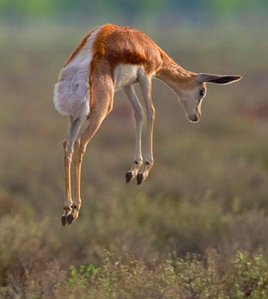
Stotting (also pronking or pronging)
Quadrupeds, particularly gazelles, where they spring into the air by lifting all four feet off the ground simultaneously.
Some evidence: honest signal to predators that prey animal is not worth pursuing.
Stot is a common Scots and Geordie verb meaning “bounce” or “walk with a bounce.”
Twerk is not a valid gait.

Slide 13
Legged Robot Control
Cost of transportation:
How much energy a robot uses to travel a certain distance.
Usually normalized by the robot weight
Measured in J/N-m.

Slide 14
Cost of Transportation

Slide 15
Legged Robot Control
Design to better exploit the dynamics
Natural oscillations of pendula and springs
Dynamics of a double pendulum
Springs can be used to store energy
Passive dynamic walkers
http://www.youtube.com/watch?v=WOPED7I5Lac
# of legs?
http://www.wimp.com/thelittledog/
Model inaccuracies
http://www.youtube.com/user/altiodaltiod?feature=watch

Slide 17
Wheeled Mobile Robots
Most popular locomotion mechanism
Highly efficient
Simple mechanical implementation
Balancing is not usually a problem.
A suspension system is needed to allow all wheels to maintain ground contact on uneven terrain.

Slide 18
Wheeled Mobile Robots
Focus is on
Traction
Stability
Maneuverability
Control

Slide 19
Wheel Designs
a) Standard wheels
2 DOF
b) Castor wheels
2 DOF

Slide 20
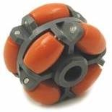
Wheel Designs
c) Swedish (Omni) wheels
3 DOF
d) Ball or spherical wheel
3 DOF
Think mouse ball
Suspension issue

Slide 21
Wheeled Mobile Robots
Stability of a vehicle is be guaranteed with 3 wheel
center of gravity is within the triangle with is formed by the ground contact point of the wheels.
Stability is improved by 4 and more wheels
Bigger wheels allow to overcome higher obstacles
but they require higher torque or reductions in the gear box.
Most arrangements are non-holonomic
require high control effort
Combining actuation and steering on one wheel makes the design complex and adds additional errors for odometry.
Notes:
however, this arrangements are hyperstatic and require a flexible suspension system.

Slide 22
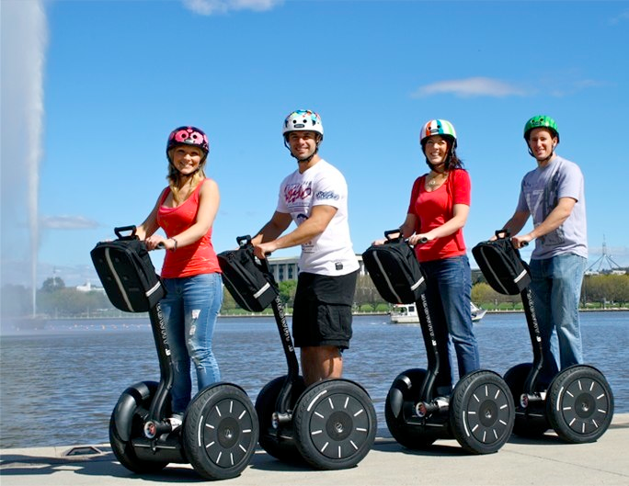
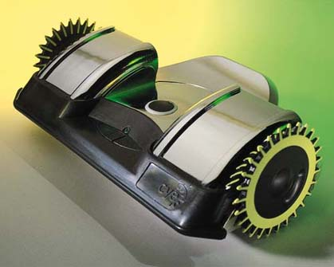
Static Stability with Two Wheels
Achieved by ensuring that the center of mass is below the wheel axis.
Or using fancy balancing

Slide 23
Motion Control
Kinematic/dynamic model of the robot
Model of the interaction between the wheel and the ground
Definition of required motion
Speed control
Position control
Control law that satisfies the requirements

Slide 24
Mobile Robot Kinematics
Description of mechanical behavior of the robot for design and control
Similar to robot manipulator kinematics
However, mobile robots can move unbound with respect to their environment:
There is no direct way to measure robot’s position
Position must be integrated over time
Leads to inaccuracies of the position (motion) estimate
Understanding mobile robot motion starts with understanding wheel constraints placed on the robot’s mobility

Slide 25
Configuration: complete specification of the position of every point of the system. Position and orientation. Also, called a pose
Configuration space: space of all possible configurations
Workspace: the 2D or 3D ambient space the robot is in.

Slide 26
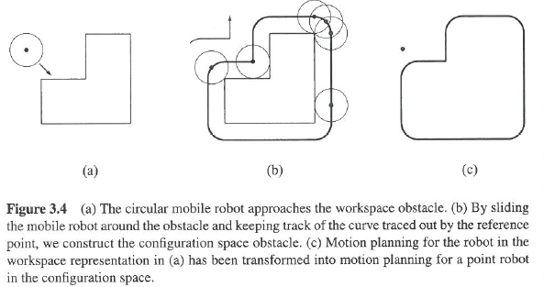

Slide 27
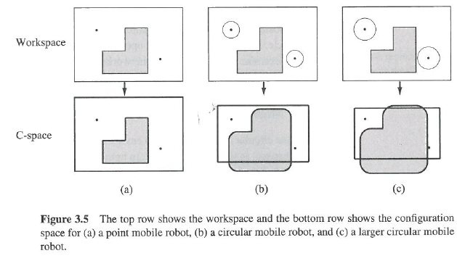

Slide 28
Kinematics
Borrowing slides from a related course at Brooklyn College (will also be on website).

