Slide 1
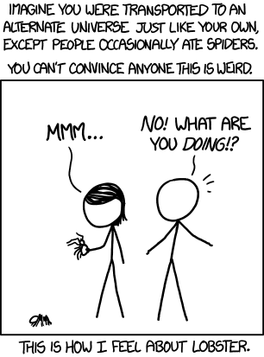

Slide 2
How are things going?

Slide 3
Core AI Problem
Mobile robot path planning: identifying a trajectory that, when executed, will enable the robot to reach the goal location
Representation
  State (state space)
  Actions (operators)
  Initial and goal states
Plan:
  Sequence of actions/states that achieve desired goal state.

Slide 4

4) Finding shortest path?

Slide 5
General Tree Search
Important ideas:
  Fringe
  Expansion
  Exploration strategy
Main question: which fringe nodes to explore?

Slide 6
Review: Depth First Search
a
G
Strategy: expand deepest node first
Implementation: Fringe is a LIFO stack
a
c
b
c
b
e
d
e
d
f
f
S
h
h
p
p
r
q
r
q
S
d
e
p
b
c
e
h
r
q
a
a
h
r
p
q
f
p
q
f
q
c
G
q
c
G
a
a

Slide 7
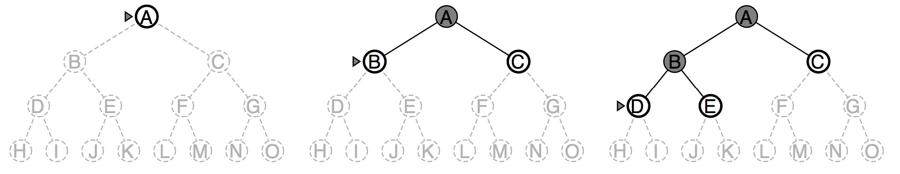
Depth-first search
Expand deepest unexpanded node
Implementation:
  fringe = LIFO queue, i.e., put successors at front
  (i.e. a stack)

Slide 8
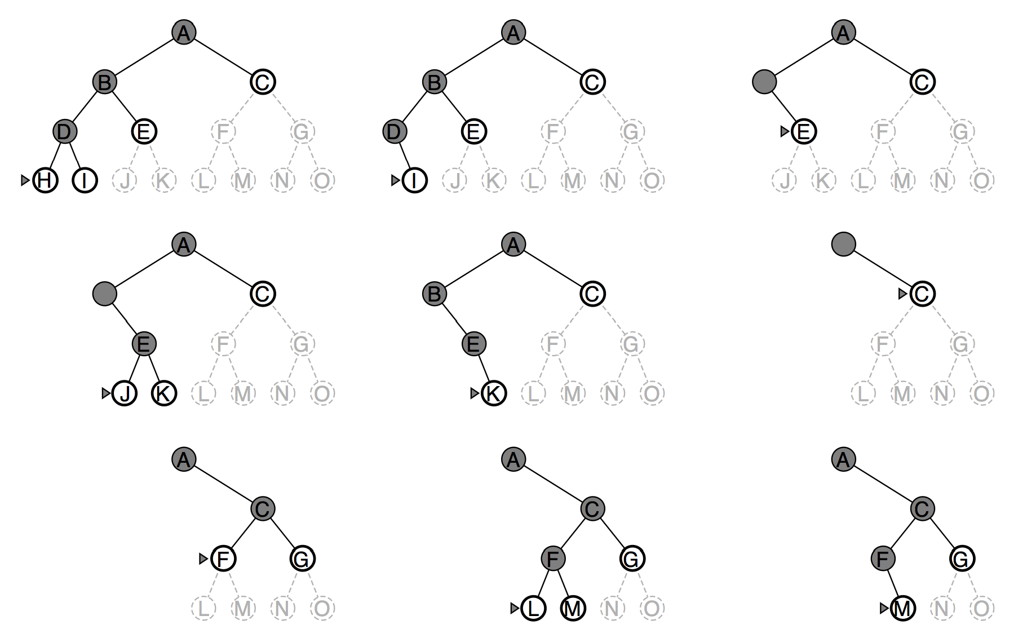
Depth-first search
DEMOS
Notes:
cd /Users/taylorm/Documents/pacman/published/demos
python pacman.py -l contoursMaze -p SearchAgent -a fn=dfs --frameTime -1
python pacman.py -p SearchAgent -a fn=dfs -l smallMaze --frameTime -1

Slide 9
Review: Breadth First Search
Strategy: expand shallowest node first
Implementation: Fringe is a FIFO queue
a
G
b
c
d
e
f
S
h
p
q
r
S
d
e
p
Search
Tiers
b
c
e
h
r
q
a
a
h
r
p
q
f
p
q
f
q
c
G
q
c
G
a
a

Slide 10
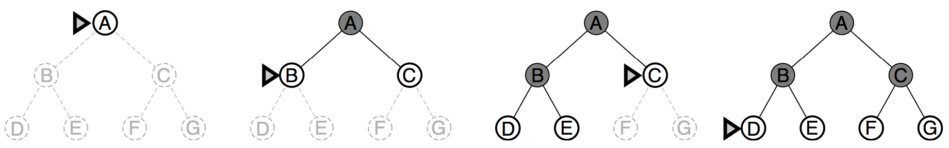
Breadth-first search
Expand shallowest unexpanded node
Implementation:
  Fringe is a FIFO queue, i.e., new successors go at end
DEMOS
Notes:
cd /Users/taylorm/Documents/pacman/published/demos
python pacman.py -l contoursMaze -p SearchAgent -a fn=bfs --frameTime -1
python pacman.py -p SearchAgent -a fn=bfs -l smallMaze --frameTime -1

Slide 11
DFS
Algorithm |  | Complete | Optimal | Time | Space
DFS | Depth First Search | N | N | O(B^{LMAX}) | O(LMAX)
N
N
Infinite
Infinite
b
START
a
GOAL
Infinite paths make DFS incomplete…
How can we fix this?

Slide 12
DFS
With cycle checking, DFS is complete.*
1 node
b
…
b nodes
b² nodes
m tiers
b^{m} nodes
Algorithm |  | Complete | Optimal | Time | Space
DFS | w/ Path Checking
Y
N
O(b^{m+1})
O(bm)
* Or with graph search version of DFS

Slide 13
BFS
When is BFS optimal?
Algorithm |  | Complete | Optimal | Time | Space
DFS | w/ Path Checking
BFS
Y
N
O(b^{m+1})
O(bm)
Y
N*
O(b^{s+1})
O(b^{s})
1 node
b
…
b nodes
s tiers
b² nodes
b^{s} nodes
b^{m} nodes

Slide 14
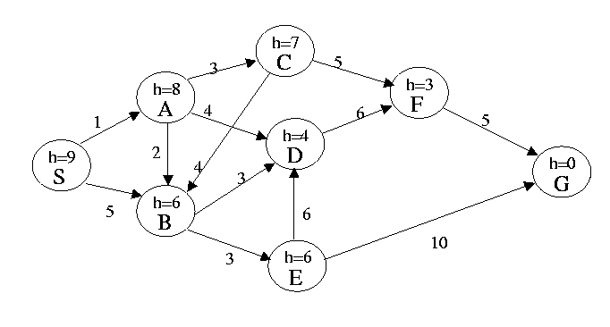
In this problem the start state is S, and the goal state is G. IGNORE the heuristic estimate, h, and the transition costs next to the edges. Assume that ordering is defined by, and ties are always broken by, choosing the state that comes first alphabetically.
What is the order of states expanded using Depth First Search? Assume DFS terminates as soon as it reaches G.
What is the order of states expanded using Breadth First Search? Assume BFS terminates as soon as it reaches G.
Notes:
SABDFG
SABCDEFG

Slide 15
Iterative Deepening
Iterative deepening uses DFS as a subroutine:
Do a DFS which only searches for paths of length 1 or less.
If “1” failed, do a DFS which only searches paths of length 2 or less.
If “2” failed, do a DFS which only searches paths of length 3 or less.
….and so on.
b
…
Algorithm |  | Complete | Optimal | Time | Space
DFS | w/ Path Checking
BFS
ID
Y
N
O(b^{m+1})
O(bm)
Y
N*
O(b^{s+1})
O(b^{s})
Y
N*
O(b^{s+1})
O(bs)

Slide 16
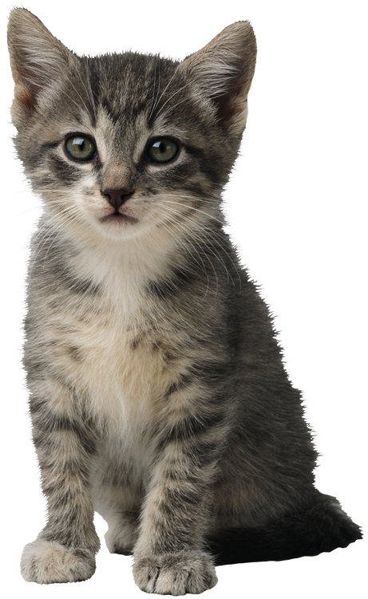
5) Finding shortest path with costs

Slide 17
Costs on Actions
a
GOAL
2
2
b
c
3
2
1
8
2
e
d
f
3
9
8
2
START
h
1
4
1
p
4
r
15
q
Notice that BFS finds the shortest path in terms of number of transitions. It does not find the least-cost path.
We will quickly cover an algorithm which does find the least-cost path.

Slide 18
Uniform Cost Search
2
G
a
b
1
8
c
Expand cheapest node first:
Fringe is a priority queue
2
2
e
3
d
f
9
8
1
S
h
1
1
p
q
r
15
S
0
d
3
e
9
p
1
b
4
c
e
5
h
17
r
11
q
16
11
Cost contours
a
6
a
h
13
r
7
p
q
f
p
q
f
8
q
c
G
q
c
a
11
G
10
a

Slide 19
Uniform-cost search
For graphs with actions of different cost
  Equivalent to breadth-first if step costs all equal
Expand least “total cost” unexpanded node
Implementation:
  fringe = queue sorted by path cost g(n), from smallest to largest (i.e. a priority queue)

Slide 20
Uniform Cost Issues
Remember: explores increasing cost contours
The good: UCS is complete and optimal!
The bad:
  Explores options in every “direction”
  No information about goal location
c ≤ 1
…
c ≤ 2
c ≤ 3
Start
Goal
DEMOS
Notes:
cd /Users/taylorm/Documents/pacman/published/demos
python pacman.py -l contoursMaze -p SearchAgent -a fn=ucs --frameTime -1
python pacman.py -p SearchAgent -a fn=ucs -l smallMaze --frameTime -1

Slide 21
In this problem the start state is S, and the goal state is G. The transition costs are next to the edges. IGNORE the heuristic estimate, h. Assume that ordering is defined by, and ties are always broken by, choosing the state that comes first alphabetically.
What is the order of states expanded using Uniform Cost Search? Assume algorithm terminates when reaches G.
Notes:
SABCDEFG

Slide 22
Breather
O Fortuna
http://www.youtube.com/watch?v=nIwrgAnx6Q8

Slide 23
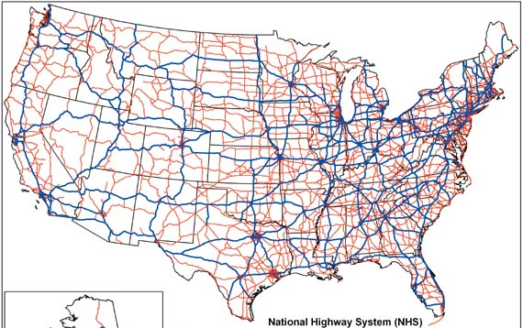
Informed Search
start
goal
Uninformed search
Informed search

Slide 24
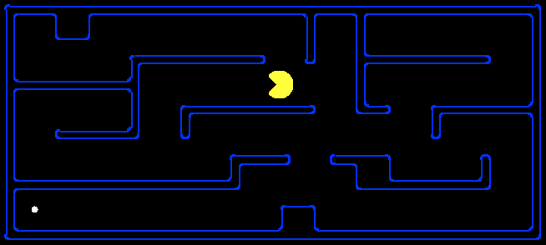
Search Heuristics
Any estimate of how close a state is to a goal
Designed for a particular search problem
Examples: Manhattan distance, Euclidean distance
10
5
11.2

Slide 25

Best-First Search
A*
Heuristics
  Admissible
  Quick to compute
  Inadmissible

Slide 26
Where are we?
Uninformed Graph Search
“Real World” to Graphs
Informed Graph Search

Slide 27
Configuration Space (C-Space)
Configuration Space: the space of all possible robot configurations.
  Data structure that allows us to represent occupied and free space in the environment

Slide 28
Configuration Space
Point robot (no constraints)
C
C_{free}
q_{goal}
C_{obs}
q_{init}
For a point robot moving in 2-D plane, C-space is

Slide 29
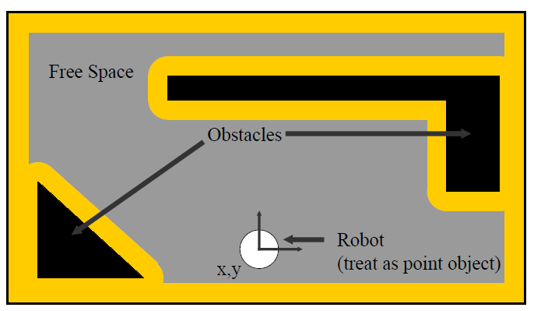
Example Workspace

Slide 30
Back to Path Planning…
Typical simplifying assumptions for indoor mobile robots:
  2 DOF for representation
  robot is round, so that orientation doesn’t matter
  robot is holonomic, can move in any direction

Slide 31
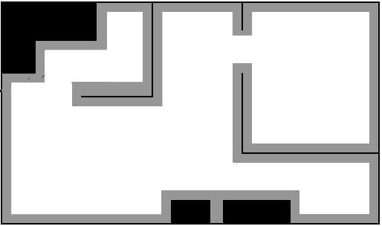

Back to Path Planning…
Now lets assume that someone gave us a map. How do we plan a path from $q_{init}$ to $q_{goal}?$
start
Fundamental Questions
goal
How is a plan represented?
How is a plan computed?
What does the plan achieve?
How do we evaluate a plan’s quality?

Slide 32
Occupancy Grid
start
goal

Slide 33
Occupancy Grid, accounting for C-Space
start
goal

Slide 34
Occupancy Grid, accounting for C-Space
start
goal
Slightly larger grid size can make the goal unreachable.
Problem if grid is “too small”?

Slide 35
Big Picture
Occupancy grids perform exhaustive search across the state space.
  Represent and evaluate a far greater number of world states than the robot would actually need to traverse
What can we do differently?

Slide 36
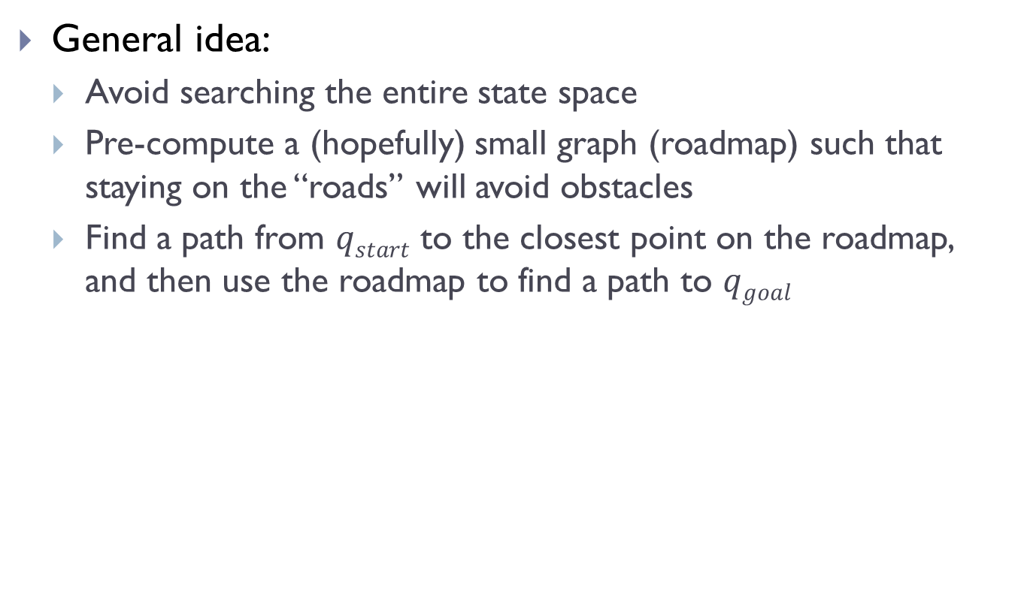
Roadmap Algorithms
General idea:
  Avoid searching the entire state space
  Pre-compute a (hopefully) small graph (roadmap) such that staying on the “roads” will avoid obstacles
  Find a path from $qstart$ to the closest point on the roadmap, and then use the roadmap to find a path to $qgoal$

Slide 37
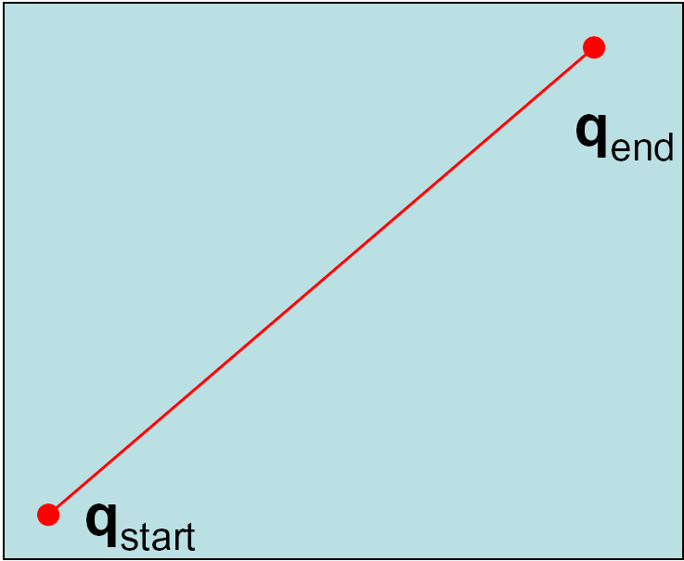
Shortest Path between Two Points

Slide 38
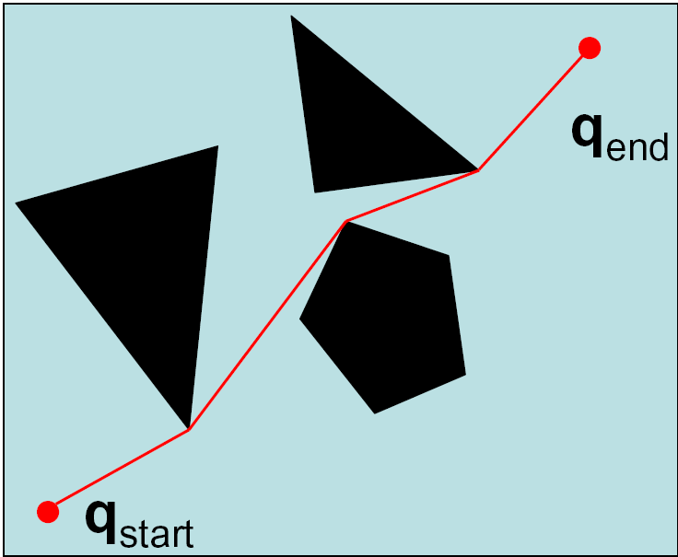
Shortest Path with Obstacles

Slide 39
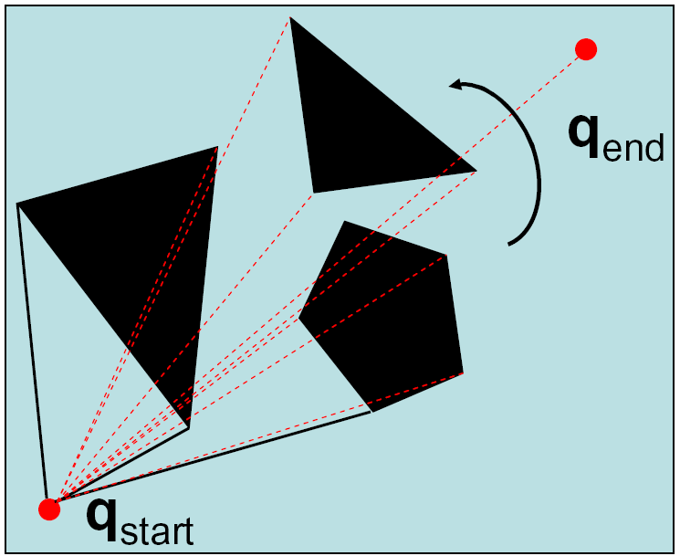
Sweep Algorithms

Slide 40
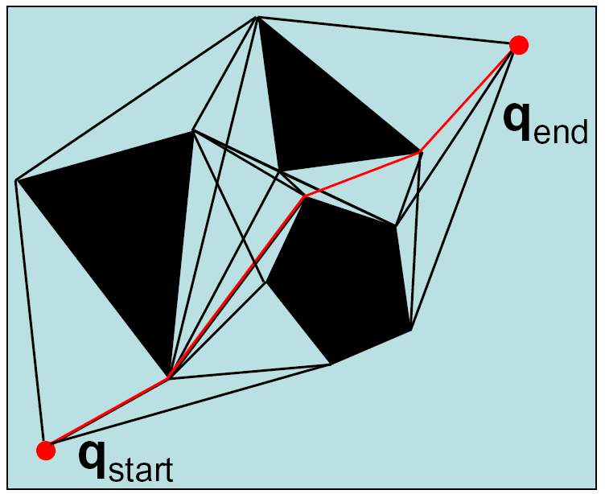
Visibility Graph

Slide 41
Visibility Graphs
Shortest path but…
  Stays as close as possible to the obstacles
  Deviations from path can lead to collisions
  Requires polygonal obstacles

Slide 42
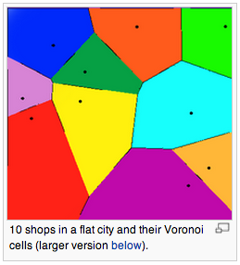
Other Alternatives…
What if we care more about keeping our robot safe than about optimality?
The other extreme: stay away from obstacles as far as possible.

Slide 43
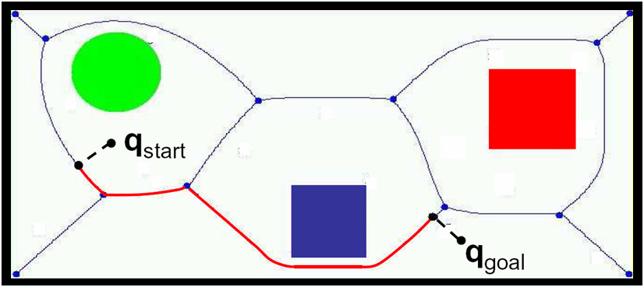
Voronoi Diagram
Control easy: stay equidistant away from closest obstacles
But… what if are too far away to see object?

Slide 44
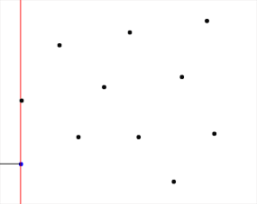

Voronoi Diagrams
Difficult to compute in higher dimensions
Staying away from obstacles is not necessarily the best heuristic
  Can lead to paths that are much too conservative
  Can be unstable: small changes in obstacle configuration can lead to large changes in the diagram
Fortune’s Algorithm

