Slide 1
Lab 4
Get an image into a ROS node
Find all the orange pixels (suggest HSV)
Identify the midpoint of all the orange pixels
Explore the findContours and simpleBlobDetection functions in OpenCV. Give a 1-2 sentence description of both, and then use one of them
Extra credit: use a video rather than an image

Slide 2
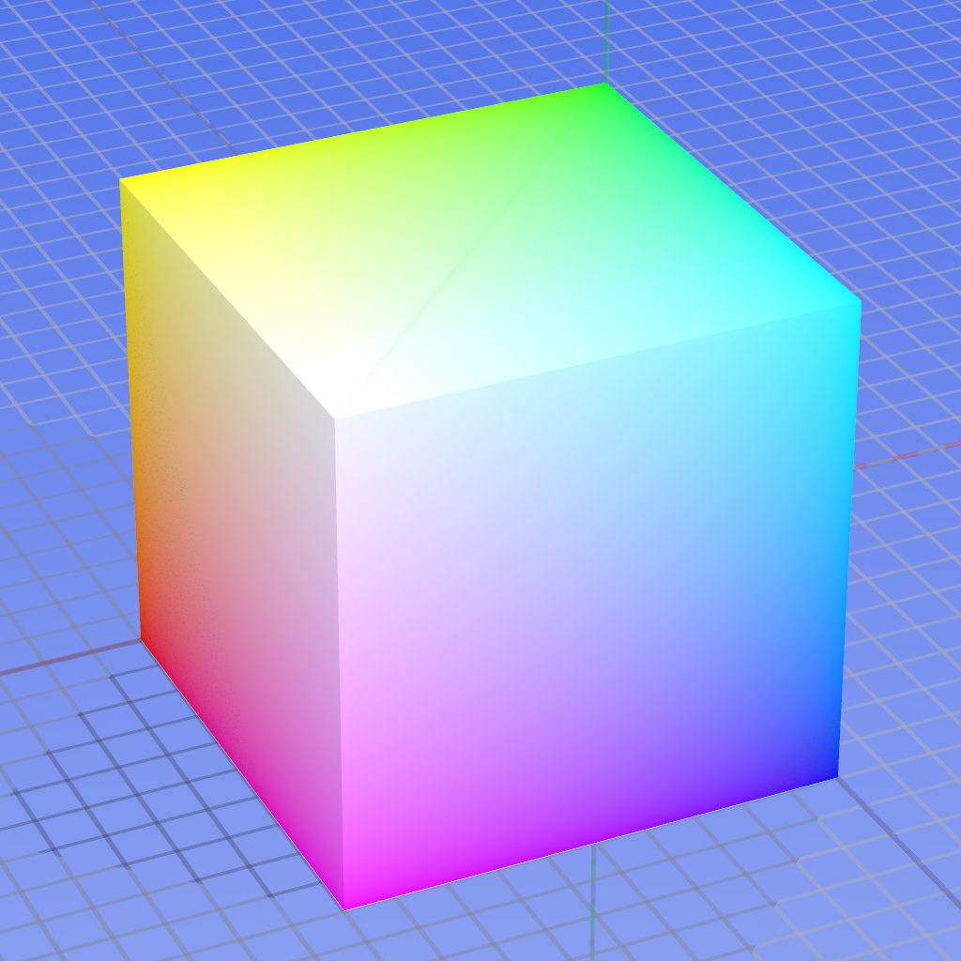
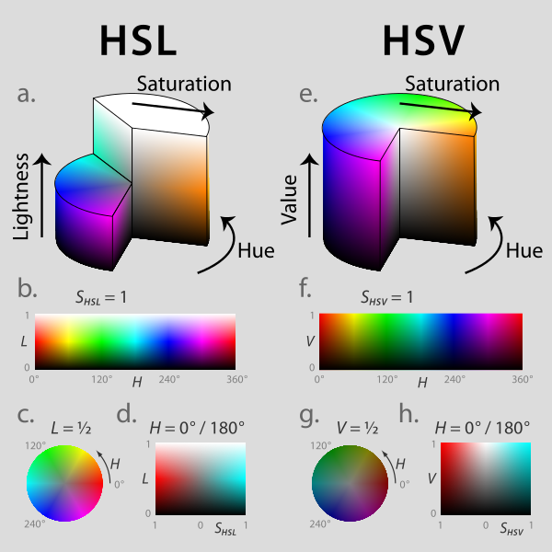
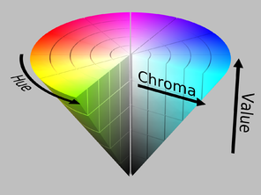

Slide 3
Matching
®
Where am I on the global map?
Local Map
obstacle
Global Map















®


…

®


…








…


















Examine different possible robot positions.

Slide 4
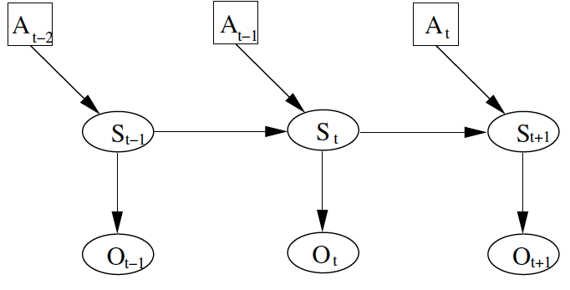
General approach:
A: action
S: pose
O: observation
Position at time t depends on position previous position and action, and current observation

Slide 5
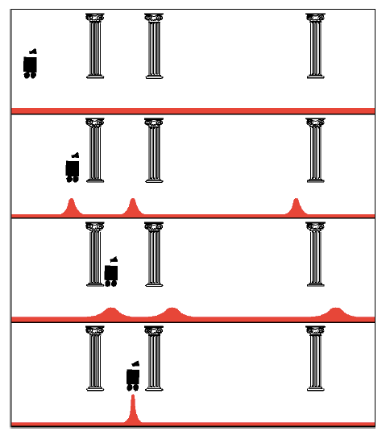
Uniform Prior
Observation: see pillar
Action: move right
Observation: see pillar

Slide 6
Localization
Gain Information
Lose
Information
Sense
Move
Initial Belief

Slide 7
Bayes Formula

Slide 8
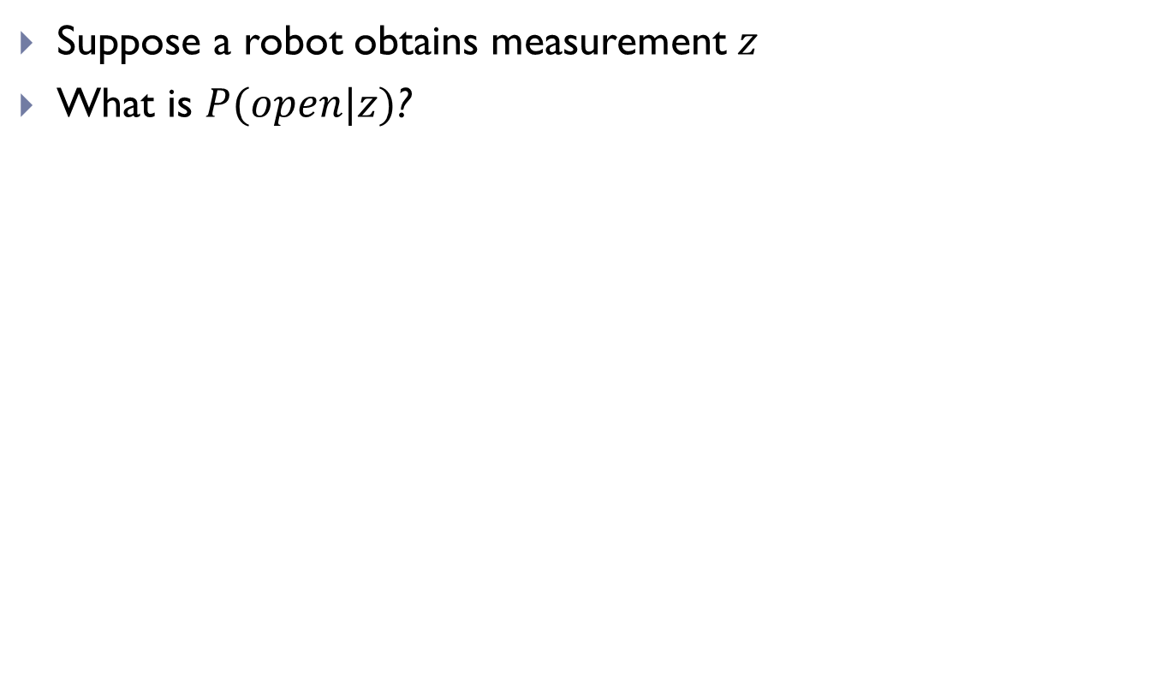
Simple Example of State Estimation
Suppose a robot obtains measurement $z$
What is $P(open|z)$?

Slide 9
Example
P(z|open) = 0.6 P(z|¬open) = 0.3
P(open) = P(¬open) = 0.5
$z$ raises the probability that the door is open.

Slide 11
Actions
Often the world is dynamic since
  actions carried out by the robot,
  actions carried out by other agents,
  or just the time passing by
change the world.
How can we incorporate such actions?

Slide 12
Typical Actions
Actions are never carried out with absolute certainty.
In contrast to measurements, actions generally increase the uncertainty.
(Can you think of an exception?)

Slide 13
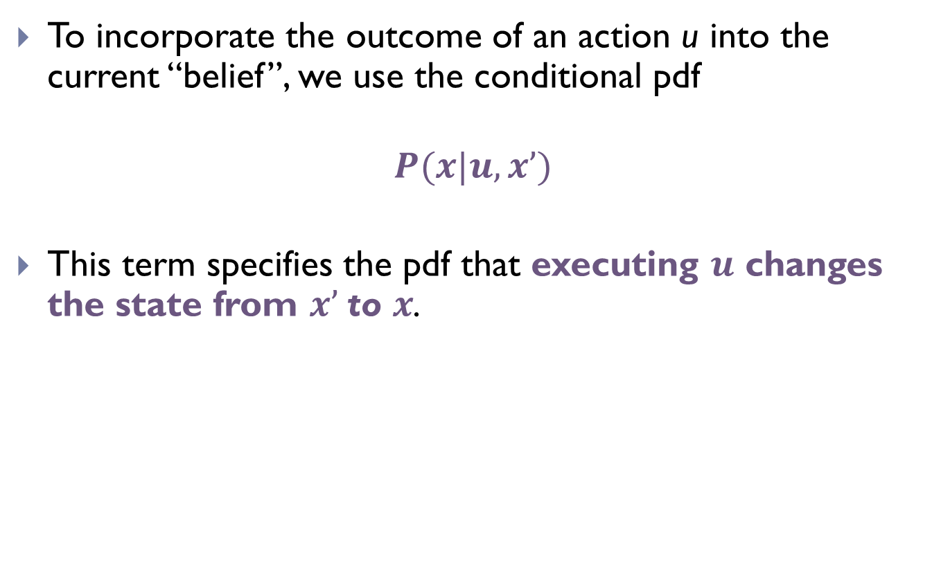
Modeling Actions
To incorporate the outcome of an action u into the current “belief”, we use the conditional pdf
$$P(x|u,x’)$$
This term specifies the pdf that executing $u$ changes the state from $x’$to $x$.

Slide 14
Example: Closing the door

Slide 15
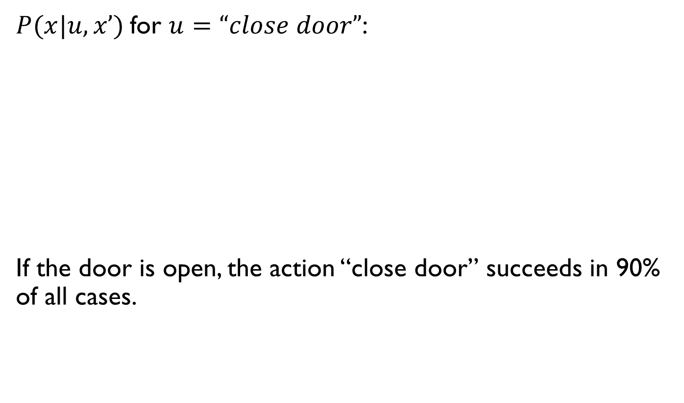
for :
If the door is open, the action “close door” succeeds in 90% of all cases.

Slide 16

Integrating the Outcome of Actions
Continuous case:
Discrete case:
$$P\left(closed | u\right)=P\left(closed | u,open\right)P\left(open\right)+$$
$P\left(closed | u, closed\right)P(closed)$
Applied to status of door, given that we just (tried to) close it?

Slide 17
Integrating the Outcome of Actions
Continuous case:
Discrete case:
$$P\left(closed | u\right)=P\left(closed | u,open\right)P\left(open\right)+$$
$P\left(closed | u, closed\right)P(closed)$
P(closed | u) = P(closed | u, open) P(open) + P(closed|u, closed) P(closed)

Slide 18
Example: The Resulting Belief

Slide 19
Example: The Resulting Belief
OK… but then what’s the chance that it’s still open?

Slide 20
Example: The Resulting Belief

Slide 21
Summary
Bayes rule allows us to compute probabilities that are hard to assess otherwise.
Under the Markov assumption, recursive Bayesian updating can be used to efficiently combine evidence.

Slide 22


Example

Slide 23
Example
P(s)
s

Slide 24
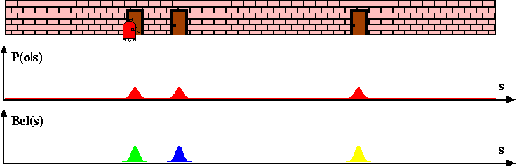
Example

Slide 25
Example
How does the probability distribution change if the robot now senses a wall?

Slide 26

Example 2
0.2 | 0.2 | 0.2 | 0.2 | 0.2

Slide 27
Example 2
0.2 | 0.2 | 0.2 | 0.2 | 0.2
Probability should go down.
Robot senses yellow.
Probability should go up.

Slide 28
Example 2
0.2 | 0.2 | 0.2 | 0.2 | 0.2
States that match observation
  Multiply prior by 0.6
States that don’t match observation
  Multiply prior by 0.2
Robot senses yellow.
0.04 | 0.12 | 0.12 | 0.04 | 0.04

Slide 29
Example 2
0.04 | 0.12 | 0.12 | 0.04 | 0.04
Sums to 0.36
!
Normalize (divide by total)
The probability distribution no longer sums to 1!
.111 | .333 | .333 | .111 | .111

Slide 30
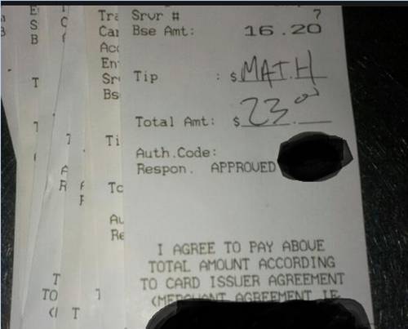
Nondeterministic Robot Motion
.111 | .333 | .333 | .111 | .111
R
The robot can now move Left and Right.

Slide 31
Nondeterministic Robot Motion
.111 | .333 | .333 | .111 | .111
R
The robot can now move Left and Right.
When executing “move x steps to right” or left:
.8: move x steps
.1: move x-1 steps
.1: move x+1 steps

Slide 32
Nondeterministic Robot Motion
0 | 1 | 0 | 0 | 0
Right 2
When executing “move x steps to right”:
.8: move x steps
.1: move x-1 steps
.1: move x+1 steps
The robot can now move Left and Right.
0 | 0 | 0.1 | 0.8 | 0.1

Slide 33
Nondeterministic Robot Motion
0 | 0.5 | 0 | 0.5 | 0
Right 2
When executing “move x steps to right”:
.8: move x steps
.1: move x-1 steps
.1: move x+1 steps
The robot can now move Left and Right.
0.4 | 0.05 | 0.05 | 0.4 | (0.05+0.05) 0.1

Slide 34
Nondeterministic Robot Motion
0 | 0.5 | 0 | 0.5 | 0
What is the probability distribution after 1000 moves?

Slide 35
Example

Slide 36
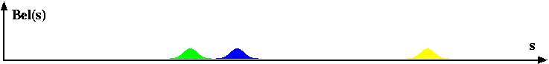
Example
Right

Slide 37
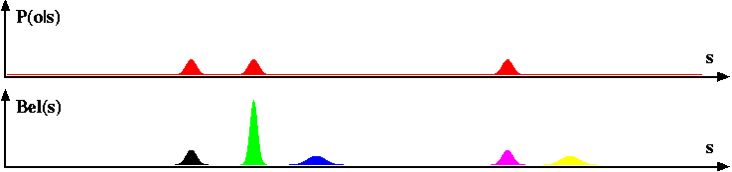
Example

Slide 38
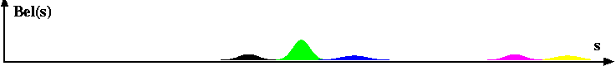
Example
Right

Slide 39
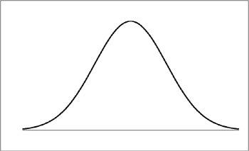
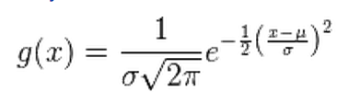
Kalman Filter Model
σ²
Area under the curve sums to $1$
$$μ$$
Gaussian
(in $1D$ for now)

Slide 40
Kalman Filter
Gain Information
Lose
Information
Sense
Move
Gaussian:
μ, σ²
Bayes Rule
(Multiplication)
Convolution
(Addition)
Initial Belief

Slide 41
Measurement Example
μ, σ²
v, r²
Prior Position Estimate $(μ,σ^{2})$
Measurement Estimate $(ν, r^{2})$

Slide 42
Measurement Example
μ, σ²
v, r²
Prior Position Estimate $(μ,σ^{2})$
Measurement Estimate $(ν, r^{2})$
Where is the new mean $μ′$?

Slide 43
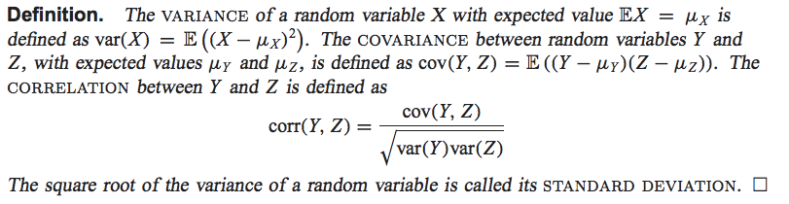
Measurement Example
μ, σ²
v, r²
Prior Position Estimate $(μ,σ^{2})$
Measurement Estimate $(ν, r^{2})$
What is the new covarance $σ^{2}′$?
σ²’?

Slide 44
Measurement Example
μ, σ²
v, r²
Prior Position Estimate $(μ,σ^{2})$
Measurement Estimate $(ν, r^{2})$
New Estimate $(μ^{′},σ^{2}′)$
μ', σ²’
To calculate, go through and multiply the two Gaussians and renormalize to sum to 1
Also, the multiplication of two Gaussian random variables is itself a Gaussian

Slide 45
Multiplying Two Gaussians
μ, σ²
v, r²
Prior Position Estimate $(μ,σ^{2})$
Measurement Estimate $(ν, r^{2})$
(ignoring constant term in front)
To find mean, maximize function (i.e., take derivative)
4. Set equal to 0 and solve for x
… something similar for the variance:
(ignoring the constant term in front)
To find the mean, need to maximize this function (i.e. take derivative)
Set equal to and solve for
…something similar for the variance

Slide 46
Another point of view…
μ, σ²
v, r²
Prior Position Estimate $(μ,σ^{2})$
Measurement Estimate $(ν, r^{2})$
New Estimate $(μ^{′},σ^{2}′)$
: p(x)
: p(z|x)
: p(x|z)
μ', σ²’

Slide 47
Example
Prior Position Estimate $(10,4)$
Measurement Estimate $(12, 4)$

Slide 48
Example
Prior Position Estimate $(10,4)$
Measurement Estimate $(12, 4)$
Notes:
Sigma2 = 16*16 / (16+16) = 256/32 = 8 -> 2.83
Q=(10*16+12*16)/)=(160+192)/32)=11

Slide 49
Example
Prior Position Estimate $(10,8)$
Measurement Estimate $(13, 2)$
μ’=12.4
σ²’=1.6

Slide 50
Kalman Filter
Lose
Information
Sense
Move
Gaussian:
μ, σ²
Convolution
(Addition)
Initial Belief

Slide 51
Motion Update
For motion
Model of motion noise
u, r²
μ’=μ+u
σ²’=σ²+r²

Slide 52
Motion Update
For motion
Prior Position Estimate $(8,4)$
M$ovement Estimate (10, 6)$
Model of motion noise
u, r²
μ’=μ+u
σ²’=σ²+r²

Slide 53
Motion Update
For motion
Prior Position Estimate $(8,4)$
M$ovement Estimate (10, 6)$
Model of motion noise
u, r²
μ’=μ+u=18
σ²’=σ²+r²=10

Slide 54
Kalman Filter
μ’=μ+u
σ²’=σ²+r²
Sense
Move
Gaussian:
μ, σ²
Initial Belief

Slide 55
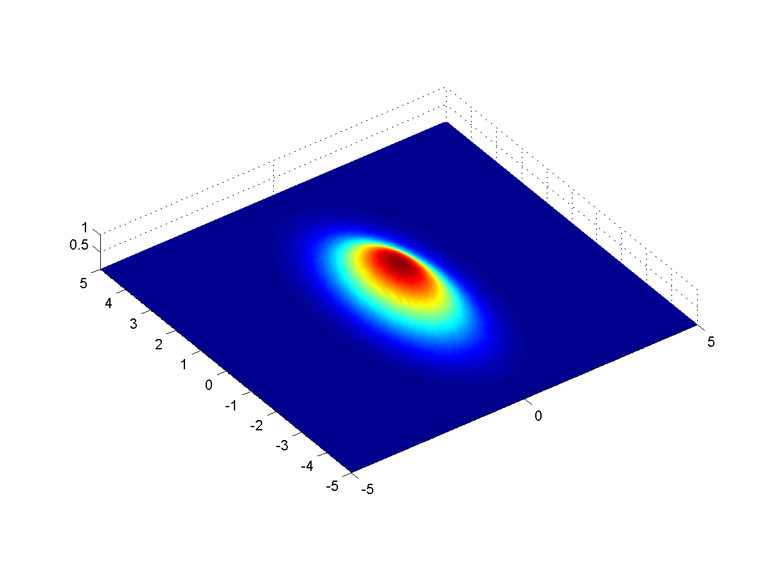
Kalman Filter in Multiple Dimensions
2D Gaussian

