Slide 1








Slide 2
Optimization and Learning

Slide 3
Parameter Optimization
Goal is to find the local maximum (or minimum)
Example:
  # seconds to spin wheels at 1.0 to move 2.0 meters.
  Others?

Slide 4
Parameter Optimization
Robotic systems have many parameters
  Control parameters
  Odometry parameters
  Kalman filter parameters
  Behavior primitives
  …
How can we optimize these in an efficient way?

Slide 5
Local Search
Operates by keeping track of only the current state and changing that state to (hopefully) improve performance
Often used for:
  Optimization problems
  Scheduling
  Task assignment
  …many other problem where the goal is to find the best state according to some objective function

Slide 6
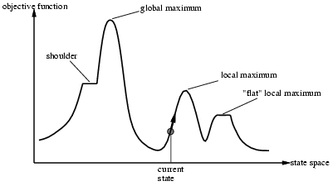
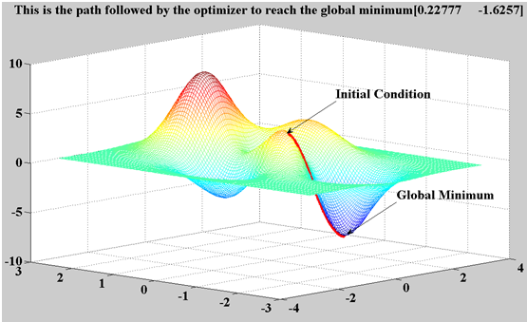
Local Search
Goal is to find the local maximum (or minimum)
Example:
  # seconds to spin wheels at 1.0 to move 2.0 meters.

Slide 7
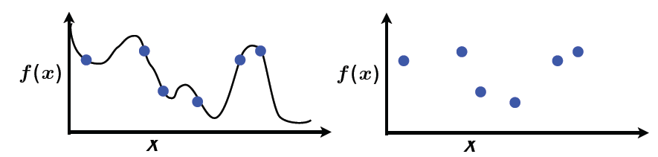
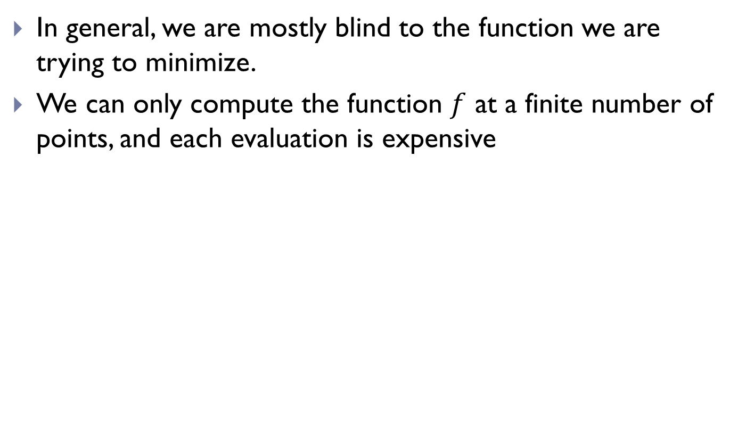
Local Search
In general, we are mostly blind to the function we are trying to minimize.
We can only compute the function $f$ at a finite number of points, and each evaluation is expensive
True Function
Observed Function

Slide 8
Gradient Descent
Minimum is found by following the slope of the function
“Like climbing Everest in thick fog with amnesia”

Slide 9
Gradient Descent
Start with a point (guess)
Repeat
  Determine a descent direction
  Choose a step
  Update
Until stopping criterion is satisfied

Slide 10
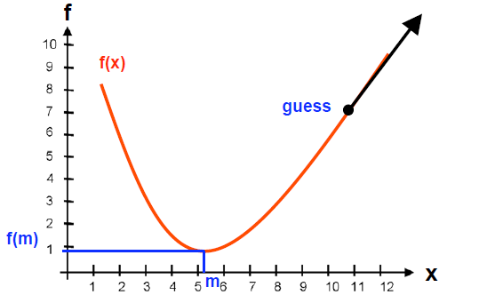

Slide 11
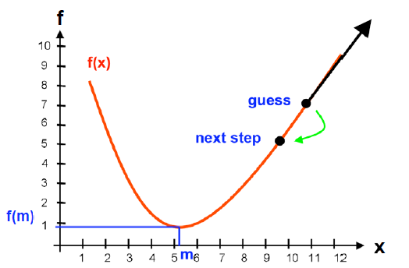

Slide 12
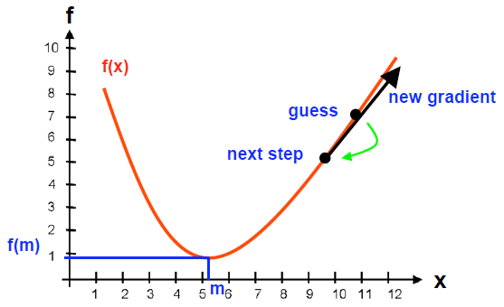

Slide 13
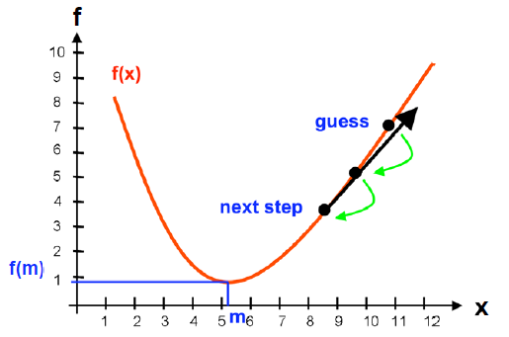

Slide 14
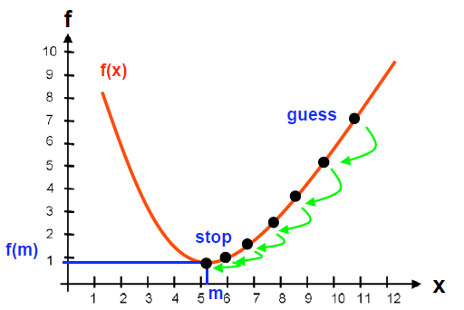

Slide 15
Parameters
Step size
  Small steps: ?
  Large steps: ?

Slide 16
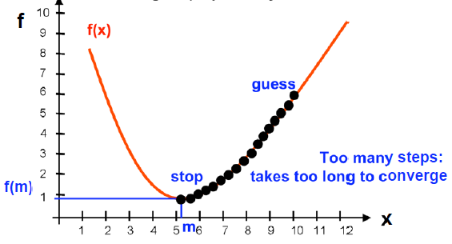
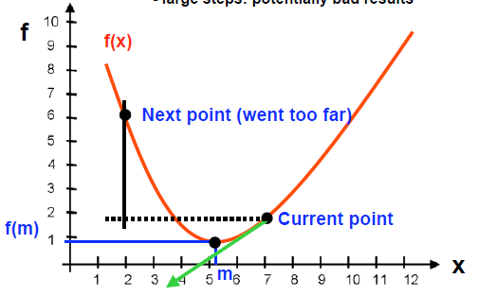
Parameters
Step size
  Small steps: inefficient
  Large steps: potentially bad results

Slide 17
Gradient Descent - Benefits
  Efficient for multidimensional domains (if you know the gradient)
  Well-suited for smooth objective and constraint functions

Slide 18
Gradient Descent - Drawbacks
  Convergence is only local; gets stuck at local minima and plateaus
    Mitigated by using multiple starting points to find multiple local minima, and hopefully the global minimum
    Other ideas for plateaus?
  What about discrete optimization?
    Other methods work better for discrete domains

Slide 19

What if we don’t know $f$ and the gradient?
Estimate the partial derivative w.r.t. each dimension using sampling
Take the current estimate at x
Create k new estimates
Evaluate each estimate using objective function f
Estimate gradient of objective function of f at x

Slide 20
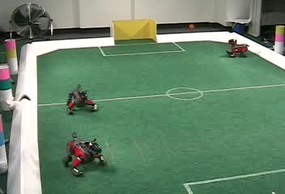
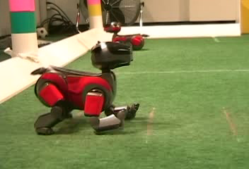
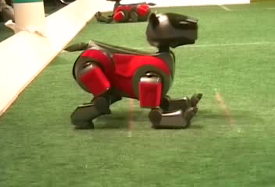
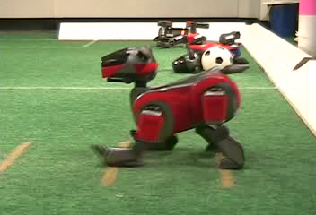
Robot Gait Learning through Gradient Descent
Experimental Setup
Initial Gait
Part Way Through
Final Gait

Slide 21
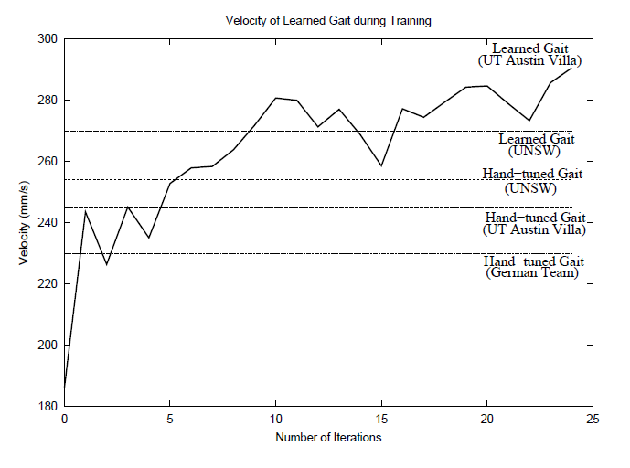
Learning Performance

Slide 22
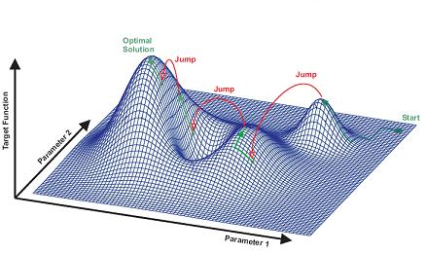
Simulated annealing search
Improves on gradient descent
Idea: escape local maxima by allowing some “bad” moves but gradually decrease their frequency

Slide 23
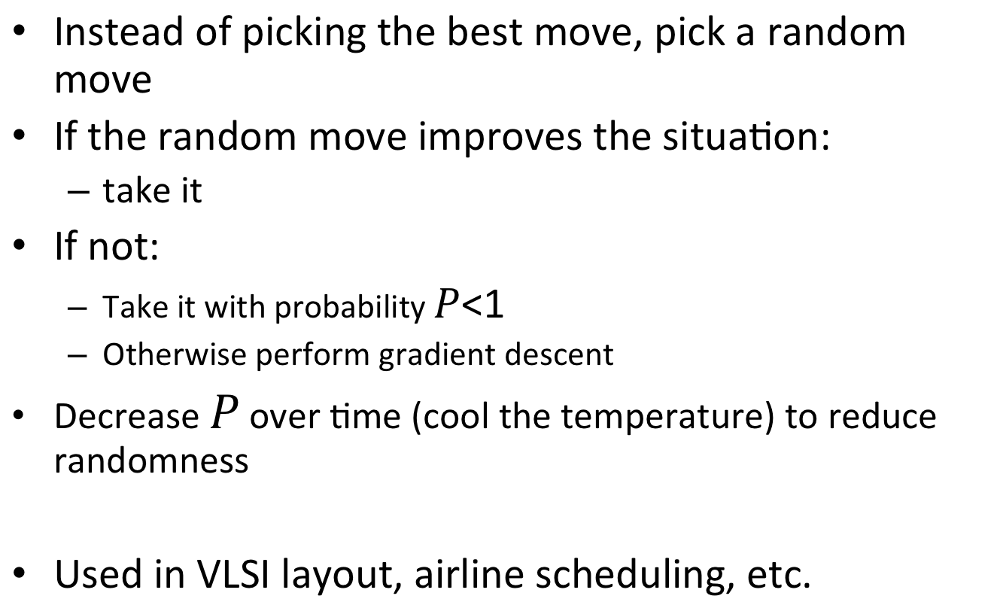
Simulated annealing search
Instead of picking the best move, pick a random move
If the random move improves the situation:
  take it
If not:
  Take it with probability
  Otherwise perform gradient descent
Decrease over time (cool the temperature) to reduce randomness
Used in VLSI layout, airline scheduling, etc.

Slide 24
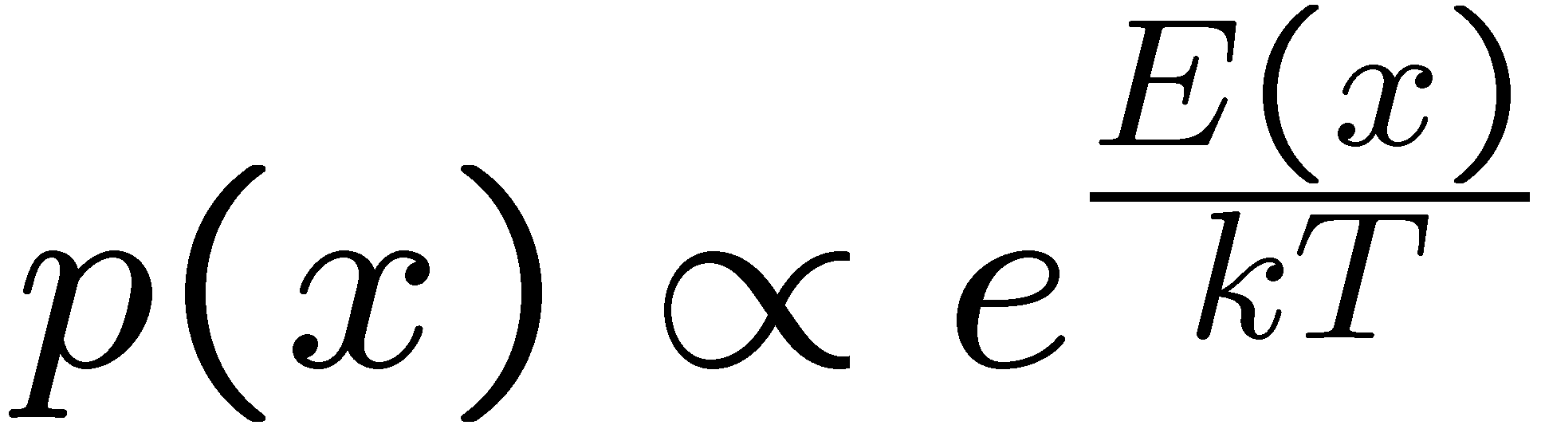
Simulated Annealing
Theoretical guarantee:
  Stationary distribution:
  If T decreased slowly enough,
  will converge to optimal state!
Is this an interesting guarantee?
Sounds like magic, but reality is reality:
  The more downhill steps you need to escape, the less likely you are to ever make them all in a row
  People think hard about ridge operators which let you jump around the space in better ways

Slide 25
“many real world problems have a landscape that looks more like a widely scattered family of balding porcupines on a flat floor, with miniature porcupines living on the tip of each porcupine needle, ad infinitum.”
    -Russell and Norvig

Slide 26
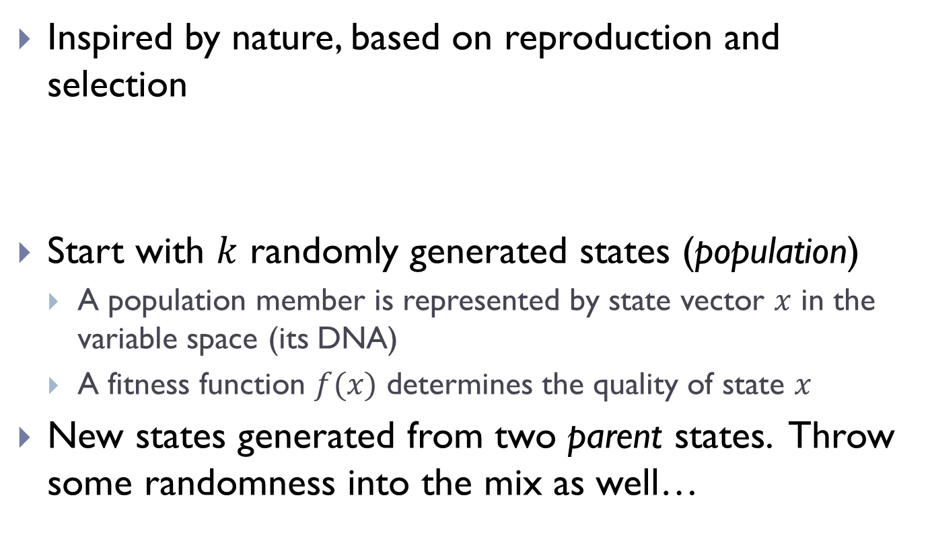
Genetic Algorithms
Inspired by nature, based on reproduction and selection
Start with randomly generated states (population)
  A population member is represented by state vector in the variable space (its DNA)
  A fitness function determines the quality of state
New states generated from two parent states. Throw some randomness into the mix as well…

Slide 27
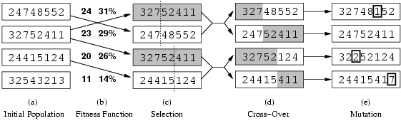
Genetic algorithms

Slide 28
Genetic algorithms
Normalized fitness function:
  24/(24+23+20+11) = 31%
  23/(24+23+20+11) = 29%
  … etc.

Slide 29
Genetic algorithms
Probability of selection is weighted by the normalized fitness function.

Slide 30
Genetic algorithms
Probability of selection is weighted by the normalized fitness function.

Slide 31
Genetic algorithms

Slide 32
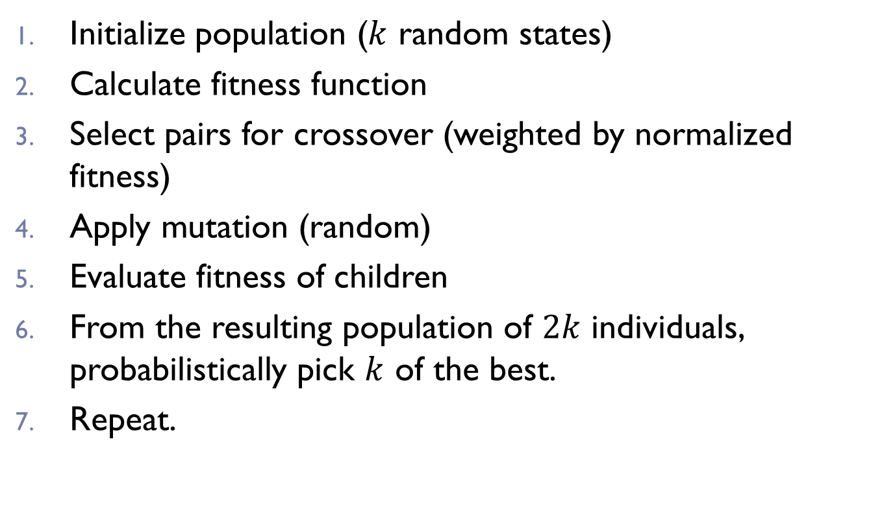
Genetic Algorithms
Initialize population ( random states)
Calculate fitness function
Select pairs for crossover (weighted by normalized fitness)
Apply mutation (random)
Evaluate fitness of children
From the resulting population of individuals, probabilistically pick of the best.
Repeat.

Slide 33
Example: N-Queens
Why does crossover make sense here?
When wouldn’t it make sense?
What would mutation be?
What would a good fitness function be?

Slide 34
Genetic Algorithms
Compared to gradient-based methods:
  Can perform similar random jumps to simulated annealing
  Greater coverage - multiple state estimates at a time
  Less sensitive to local optima
  Can be used for both continuous and discrete variables

Slide 35
Fitness function
Population, lots of parameters
Types of problems can solve
  http://nn.cs.utexas.edu/pages/research/rocket/
  http://nerogame.org/
Co-evolution
  http://www.cs.utexas.edu/users/nn/pages/research/neatdemo.html
  http://www.cs.utexas.edu/users/nn/pages/research/robotmovies/clip7.gif
Where will GAs not do as well in robotics (or in general)?

