Slide 1
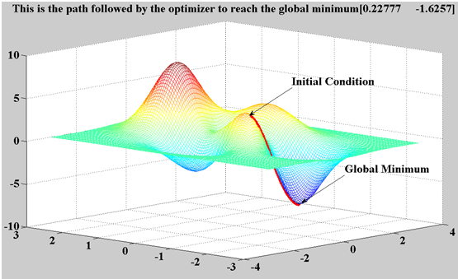
Gradient Descent
Minimum is found by following the slope of the function
“Like climbing Everest in thick fog with amnesia”

Slide 2
Robot Gait Learning through Gradient Descent
Experimental Setup
Initial Gait
Part Way Through
Final Gait

Slide 3
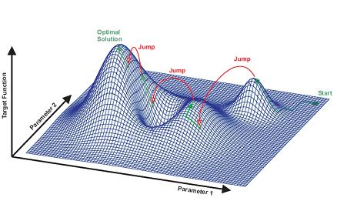
Simulated annealing search
Improves on gradient descent
Idea: escape local maxima by allowing some “bad” moves but gradually decrease their frequency

Slide 4
Fitness function
Population, lots of parameters
Types of problems can solve
http://nn.cs.utexas.edu/pages/research/rocket/
http://nerogame.org/
Co-evolution
http://www.cs.utexas.edu/users/nn/pages/research/neatdemo.html
http://www.cs.utexas.edu/users/nn/pages/research/robotmovies/clip7.gif
Where will GAs not do as well in robotics (or in general)?

Slide 5
Brainstorm
How could a human teach a robot?
What are the goals (why would this be useful)?
What would the human do?
How would the robot use this data?
Example applications
Flip a pancake
Play ping pong
Help build Ikea furniture

Slide 6
Keyframes
http://www.youtube.com/watch?v=S1wXI35GG7k

