Slide 1
12/16 Projects
Write-up
  Generally, 1-2 pages
  What was your idea?
  How did you try to accomplish it?
  What worked?
  What you could have done differently?
Video
  Show off your idea working
  Target audience: Junior/Senior EECS students who haven’t taken this class
Presentation
  10-15 minutes per group
  Summarize your write-up, show off your prototype

Slide 2
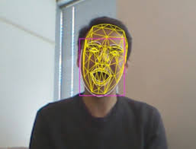
Bei, Derrick, Nan
AR Drone should be able to detect someone’s face and follow the detected person. We will use OpenCV to implement it.
Possible challenges:
The features of the face should be harder to catch than one object with specific color as we have done in the lab. Different people have different facial features like different hair style, wearing glasses or not etc. We have to decide some key features which are easy for the AR Drone to detect.
We need to develop a face detection algorithm which is applicable for the AR Drone to implement. The possible moving face may be one challenge since the AR Drone has to dynamically detect the face and follow it, which is some function we never develop in our labs.
Keep a safe distance away from people’s face, which will involve calculating the AR Drone’s distance away from the face, while still being able to move and follow the person.

Slide 3
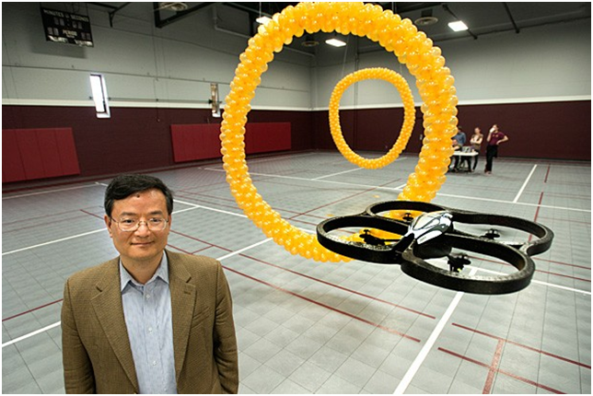
Duy, Justin, Jordan
Search for a hoop or ring positioned in the room and fly through it.

Slide 4
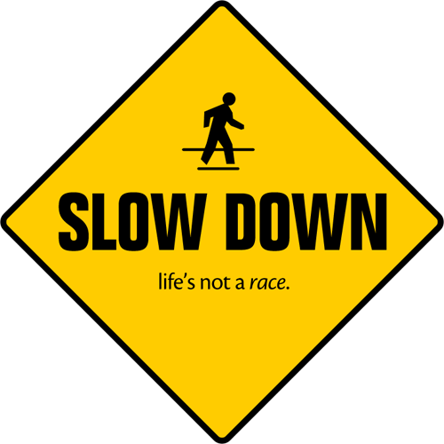

Joshua Clark
I propose to develop a way to read road signs. For the purposes of this class I will test using 3 signs. Two speed limit signs (similar signs) and a stop sign. All signs will be US DOT standard signs. I intend to have the robot react accordingly to the signs. This will be developed with the turtlebot in mind however if technical issues prevent the use of the turtlebot I will use the ardrone.
The end result will be a robot that adjusts speed based upon speed limit signs and stops at stop signs.

Slide 5
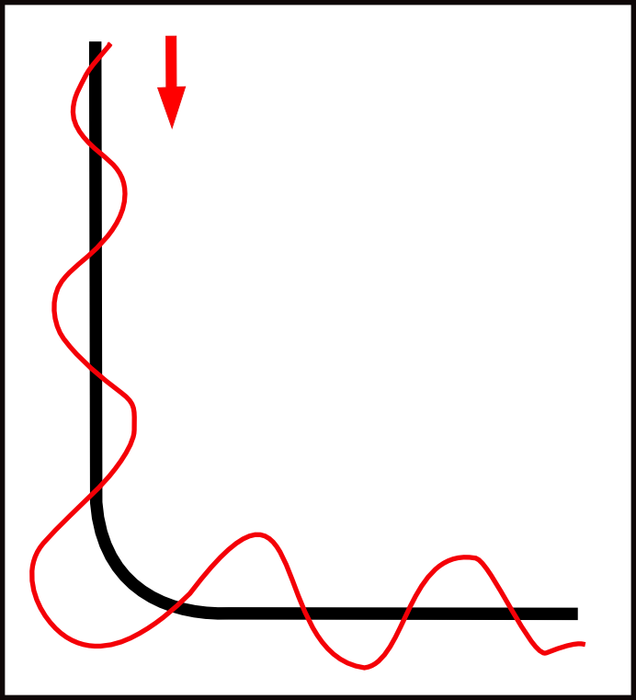
Kyle, Brooks, James
We would like to design in simulation, a path following program for the ARDrone. In Gazebo, we will use vision processing to follow a path of a given color until it reaches some sort of flag image that would trigger the command for the drone to land.
Secondary Goals:
Forcing the drone to search for the path rather than starting on the path
Upon successful simulations of the above goals, we would then attempt the same goals in lab with the physical drones.

Slide 6
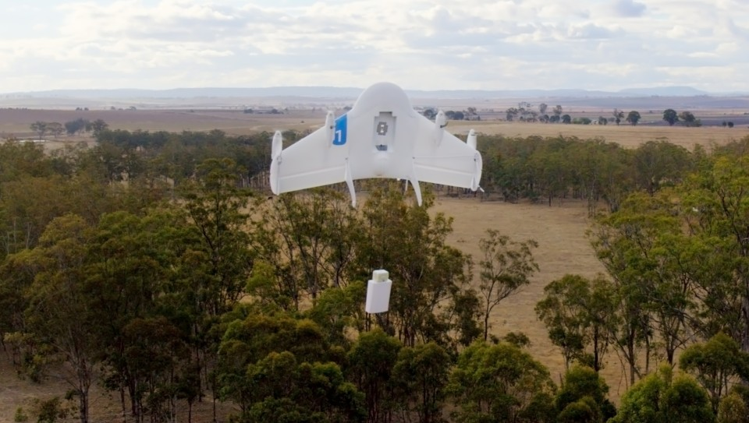
Andrew, Nick, Josh Woldstad
For the final project, our team is considering using the AR drone and OpenCV. Our plan is to use the AR drone to simulate a pick-up and delivery system.
We will mark an object with a tag to be picked up, and use the camera with opencv to detect the mark. The AR will find, pick-up, then drop off the marked object in a designated drop off zone.
This project will allow us to create a small-scale system that is similar to projects that companies such as Amazon and other delivery services are testing.

Slide 7
Nick Hayward
For my final project, I’d like to continue using the AR Drone and OpenCV.
I’m not 100% sure on exactly what I want to do, but In know the direction I would like to take. After doing some research online as well as discussion with my group, I would like to try design something with delivery or pickup in mind.
I’ll use the camera with opencv to detect the object I will pick up, or use it as the “drop off zone” either way I think this will be a fun project and will help me continue my skills with opencv as well as ROS.

Slide 8
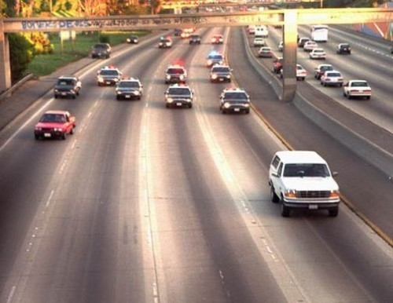
Chris, Karan, Mike
Our proposal is that the turtlebot simulates a person or thing that needs to be tracked for some reason (maybe lost, or under surveillance). The turtlebot moves in an arbitrary way, while the ardrone locates it, and follows it around.
We plan on doing this by putting a tag on top of the turtlebot and using the built in detection on the ardrone to keep track of the tag. Then we'll simply try to keep the tag in the midpoint of the ardrone's bottom camera (moving the drone to make this the case).
Our idea is that this will be kind of like a police helicopter following a car chase, or tracking a person stuck in some kind of disaster situation.

Slide 9
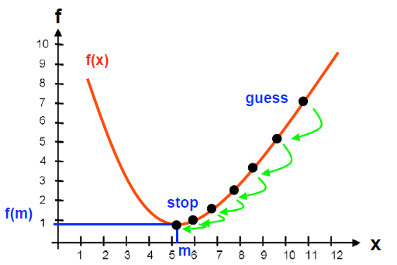
CptS 580: Reinforcement Learning
Graduate
or
Undergradate && (CptS 450 || Matt’s permission)
How can an agent learn to act in an environment?
No absolute truth
Trial and Error

Slide 10
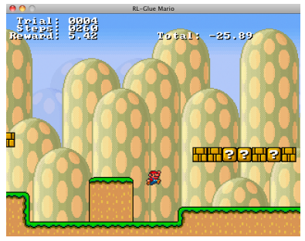
Example: Mario
Agent = Mario
Actions = Right, Left, Jump, Run, Shoot fireball
Reward = Score
Learning = Maximize score
State = ???
Can look at last year’s webpage for possible topics: http://www.eecs.wsu.edu/~taylorm/14_580/index.html

Slide 11
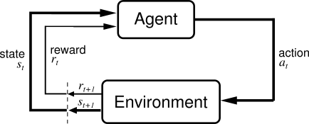
Reinforcement Learning
Basic idea:
  Receive feedback in the form of rewards
  Agent’s utility is defined by the reward function
  Must (learn to) act so as to maximize expected rewards

Slide 12
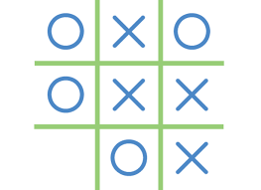
Sequential tasks
How could we learn to play tic-tac-toe?
  What do we want to optimize (i.e., what’s the reward)?
  What are the actions?
  How would we represent state?
  How would we figure out how to act (to maximize the reward)?

Slide 13
Reinforcement Learning (RL)
RL algorithms attempt to find a policy for maximizing cumulative reward for the agent over the course of the problem.
Typically represented by a Markov Decision Process
RL differs from supervised learning in that correct input/output pairs are never presented, nor sub-optimal actions explicitly corrected.

Slide 14
Grid World
The agent lives in a grid
Walls block the agent’s path
The agent’s actions do not always go as planned:
  80% of the time, the action North takes the agent North
  (if there is no wall there)
  10% of the time, North takes the agent West; 10% East
  If there is a wall in the direction the agent would have been taken, the agent stays put
Small “living” reward each step
Big rewards come at the end
Goal: maximize sum of rewards*

Slide 15
Grid Futures
Deterministic Grid World
Stochastic Grid World
 | X
 | X
E N S W
E N S W
?
 | X
X
 | X
 |  | X

Slide 16
Markov Decision Processes
An MDP is defined by:
  A set of states s ∈ S
  A set of actions a ∈ A
  A transition function T(s,a,s’)
    Prob that a from s leads to s’
    i.e., P(s’ | s,a)
    Also called the model
  A reward function R(s, a, s’)
    Sometimes just R(s) or R(s’)
  A start state (or distribution)
  Maybe a terminal state
  A discount factor: γ
MDPs are a family of non-deterministic search problems
  Reinforcement learning: MDPs where we don’t know the transition or reward functions

Slide 17


What is Markov about MDPs?
Andrey Markov (1856-1922)
“Markov” generally means that given the present state, the future and the past are independent
For Markov decision processes, “Markov” means:

Slide 18
Solving MDPs
In deterministic single-agent search problems, want an optimal plan, or sequence of actions, from start to a goal
In an MDP, we want an optimal policy π*: S → A
  A policy π gives an action for each state
  An optimal policy maximizes expected utility if followed
  Defines a reflex agent
Optimal policy
when R(s, a, s’) = -0.03
for all non-terminal s

Slide 19
Example Optimal Policies
R(s) = -0.01
R(s) = -0.03
R(s) = -0.4
R(s) = -2.0

