Slide 1
http://www.forbes.com/sites/alexknapp/2014/08/09/origami-robots-fold-themselves-and-walk-away/
Lab 1

Slide 2
How would you design the “architecture” for a robot?

Slide 3
Robot Software Architectures
Principled design for software modules that control a mobile robot system.
Advantages (Goals):
  Modularity
    code reuse and sharing
  Control localization within the architecture
    Individual component testing
    Optimization through learning

Slide 4
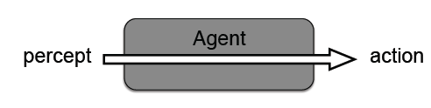
1) Reactive Architecture
Actions are directly triggered by Sensors
  no representations of the environment
  predefined, fixed response to a situation
  fast response to changes in the environment

Slide 5
Limitations of a Reactive Robot
Knowledge of the world is limited by the range of its sensors
Unable to count (how could you get around this?)
Unable to recover from actions which fail silently
Can not “undo” an incorrect action
Not possible to “plan ahead”
Can not coordinate with other robots in a reasonable way
many others ...

Slide 6
2) Deliberative Architectures
Organized by decomposing the required system functionality into concurrent modules or components.
  Map building
  Path planning
  Navigation
  …
Problems:
  overall complexity of the system may grow
  hard to offer real-time guarantees on performance:
    solving any given problem takes longer than an equivalent reactive implementation
    solving different problems takes different amounts of time

Slide 7
Aside: Architecture Decomposition
Decomposition allows us to modularize our control system based on different axes:
Temporal Decomposition
  Facilitates varying degrees of real-time processes
Control Decomposition
  Defines how modules should interact: serial or parallel?

Slide 8
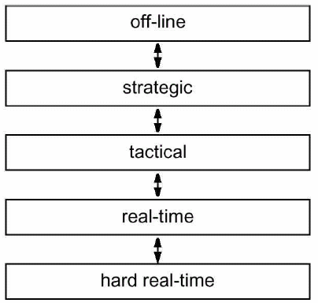
Temporal Decomposition
Distinguishes between processes that have varying real-time and non-real-time demands
Long response time
Global context
“Any failure to meet a hard real-time constraint simply means that the system is broken. The severity of the outcome when something is labeled ‘broken’ isn't material to the definition.”
Stackoverflow.com
Firm: missing is tolerable, but may degrade performance. Usefulness of result is zero after deadline.
Soft: Usefulness of result degrades after deadline
Wikipedia.org
Short response time
Local context

Slide 9
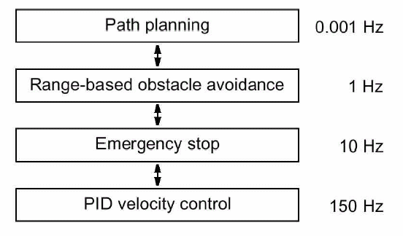
Temporal Decomposition
Example: Watchdog process

Slide 10

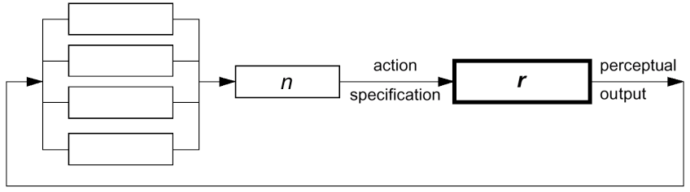
Control Decomposition
Models the way in which each module’s output contributes to the overall robot control outputs.
Pure serial decomposition:
Pure parallel decomposition:

Slide 11
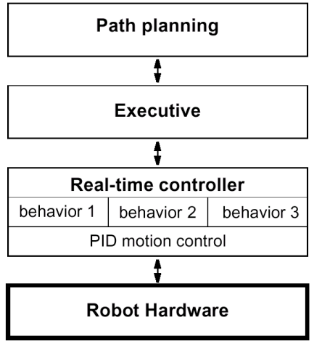
Example
Tiered mobile robot architecture based on a temporal decomposition
Strategic-level decision making
Controls the activation of behaviors based on commands from planner
Low level behaviors

Slide 12
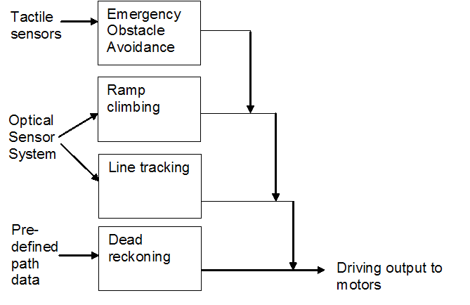
3) Subsumption Architecture
Formed using a collection of concurrent behaviors placed in layers.
The higher-level behaviors always, if triggered, subsume the output of lower behaviors and therefore have overall control.
Hard to have many layers, goals begin interfering with each other

Slide 13
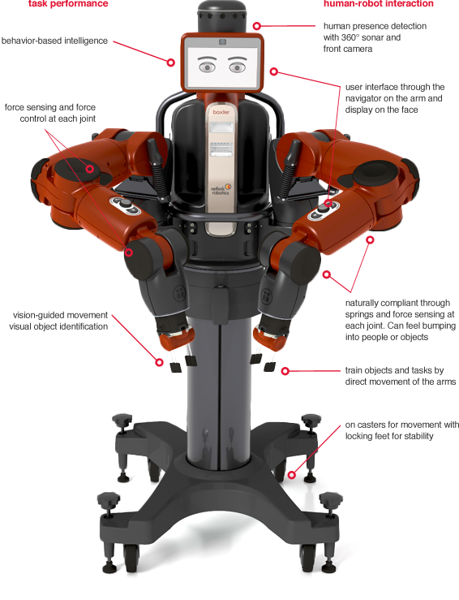

Rodney Brooks
Subsumption Architecture
iRobot (1990)
Rethink Robotics
  Baxter: 2012

Slide 14
Robot Components
Architecture Components
Perception
Planning
Obstacle avoidance
Stability control
Learning
Human-robot interaction
Short-term and long-term memory
Resources to be Controlled
Actuators
Communications
Chassis
Processor
Power
Payload

Slide 15
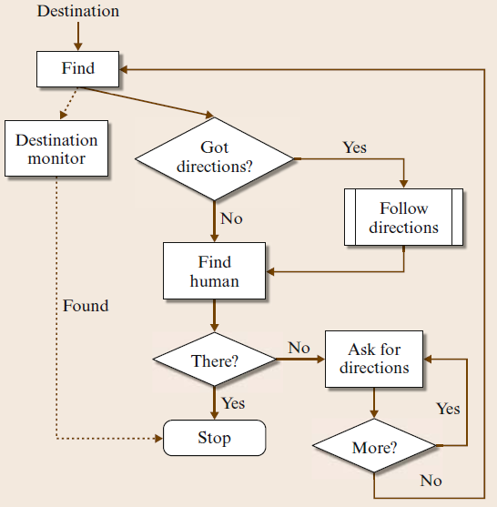
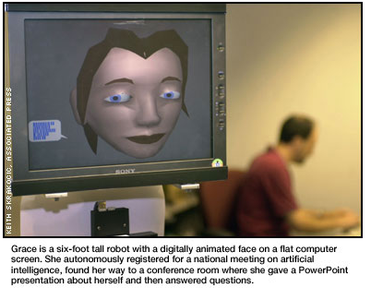
The Robot GRACE

Slide 16
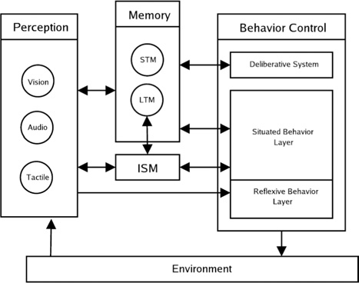
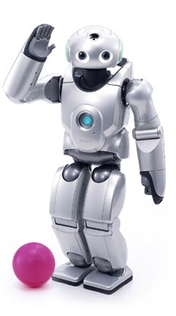
EGO Architecture for the Sony QRIO
Deliberative planning, control of sequential behaviors
Homeostatic behaviors
(sleep, rest)
Reactive behaviors
Internal State Module: nourishment, sleep, fatigue, vitality, etc.

Slide 17
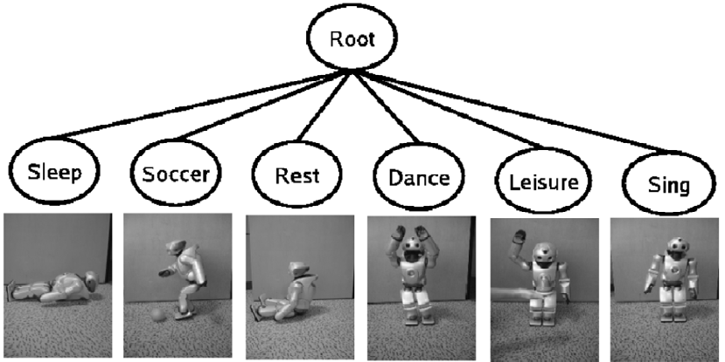
https://www.youtube.com/watch?v=qcJO3NY1C2I

Slide 18
Behavior Selection
Behavior cycle rate: 2 Hz
On each cycle
  every behavior calculates an activation level
  indicates the relevance of that behavior in the current situation
  Calculated via:
    external stimuli
    internal state of the robot
    intentional values provided by the Deliberative System
Behavior selection occurs is greedy:
  behavior with highest AL selected first
  other behaviors, from highest to lowest AL value, then selected for concurrent execution iff resource demands do not conflict with those already chosen

Slide 19
Designing a Robotics Architecture
What tasks required?
  long-term vs. short-term
  User-initiated vs. Robot-initiated
  Repetitive or different across time?
Actions necessary to perform tasks?
  Representation of actions
  Coordination of actions
  Speed of actions / how often changed
  Necessary speed for safety of robot

Slide 20
Designing a Robotics Architecture
Data
  What is required?
  How obtained?
  What sensors?
  What representation? How abstracted from sensors?
  Data update rate
    minimum required
    maximum possible

Slide 21
Designing a Robotics Architecture
What computational capabilities will the robot have?
What data will these computational capabilities produce?
What data will they consume?
How will the computational capabilities of a robot be divided, structured, and interconnected?
What is the best decomposition/granularity of computational capabilities?
How much does each computational capability have to know about the other capabilities?
Are there legacy computational capabilities (from other robots, other robot projects, etc.) that will be used?
Where will the different computational capabilities reside (e.g., on-board or off-board)?

Slide 22
Designing a Robotics Architecture
Who are the robot’s users?
What will they command the robot to do?
What information will they want to see from the robot?
What understanding do they need of the robot’s computational capabilities?
How will the user know what the robot is doing?
Is the user interaction peer to peer, supervisory, or as a bystander?

Slide 23
Designing a Robotics Architecture
How will the robot be evaluated?
  What are the success criteria? What are the failure modes? What is the mitigation for those failure modes?
Will the robot architecture be used for more than one set of tasks? For more than one kind of robot? By more than one team of developers?

Slide 24
References
Buede, Dennis M. The Engineering Design of Systems: Models and Methods, Second Edition. John Wiley & Sons. © 2009. Books24x7. http://common.books24x7.com/book/id_31904/book.asp
James Goodwin and Alan Winfield, “A Unified Design Framework for Mobile Robot Systems”, Workshop Proceedings of SIMPAR2008, Intl. Conf. on SIMULATION, MODELING and PROGRAMMING for AUTONOMOUS ROBOTS, Venice(Italy), 2008, November 3-4.
Siciliano, Khatib, Springer Handbook of Robotics, 2008.

Slide 26
Intermission
http://www.youtube.com/watch?v=gA5bwqVN5LM

Slide 27
Simple Vision
How would I find the red ball?

Slide 28
Simple Vision
How would I find the red ball?
What if it’s moving?

Slide 30
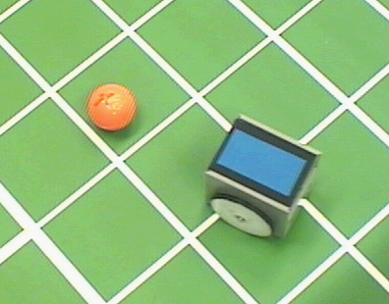
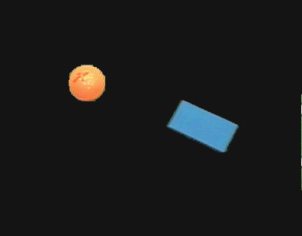
Color Tracking Sensors
4.1.8
Motion estimation of ball and robot for soccer playing using color tracking

Slide 31

How many black spots?

Slide 32
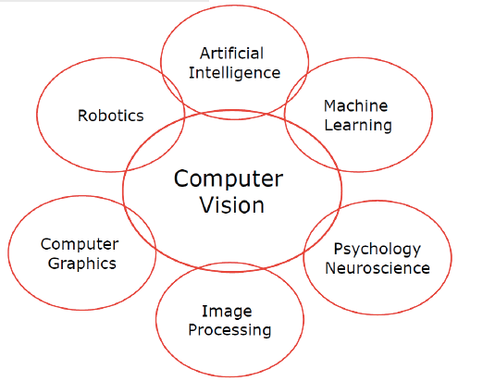

Slide 33
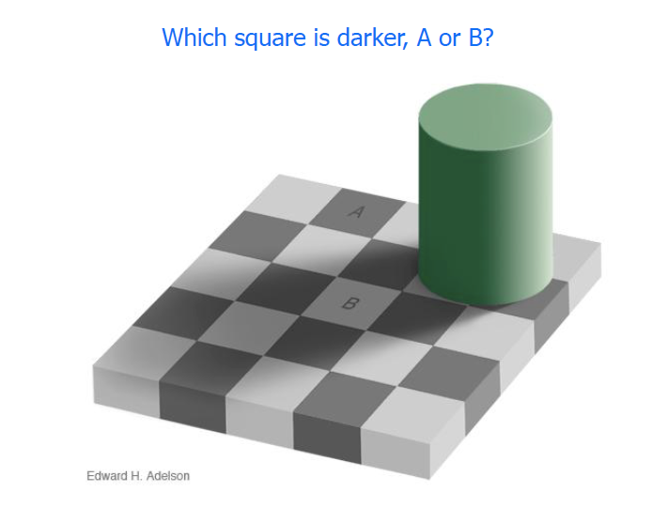

Slide 35


Slide 36
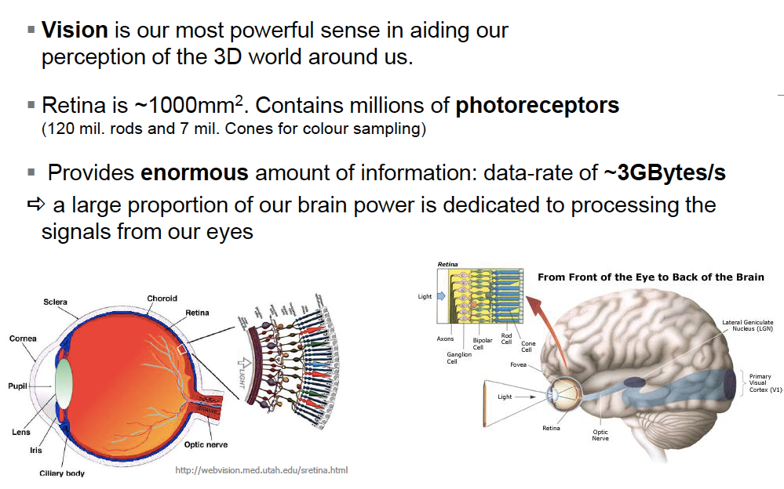

Slide 37
Perception
4
Sensors
Uncertainty
Features
Localization
"Position"
Cognition
Global Map
Environment Model
Path
Local Map
Perception
Real World
Motion Control
Environment

Slide 38
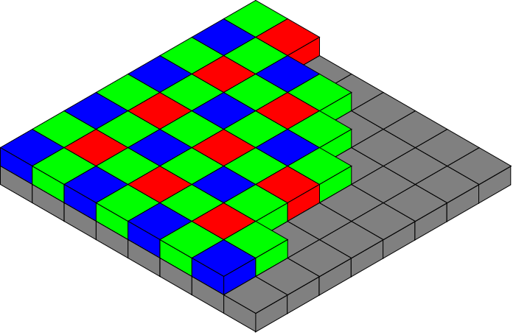
Vision-based Sensors: Hardware
4.1.8
CCD (light-sensitive, discharging capacitors of 5 to 25 micron)
  Charge-coupled device, 1969 at AT&T Bell Labs
CMOS (Complementary Metal Oxide Semiconductor technology) sensor
  Active pixel sensor
  Cheaper, lower power, traditionally lower quality
Notes:
Bayer pattern

Slide 39
Blob (color) detection
Edge Detection
  http://en.wikipedia.org/wiki/Edge_detection
SIFT (Scale Invariant Feature Transform) features
  http://www.aishack.in/2010/05/sift-scale-invariant-feature-transform/
Deep Learning
  http://deep.host22.com/
  http://deeplearning.net/

Slide 40
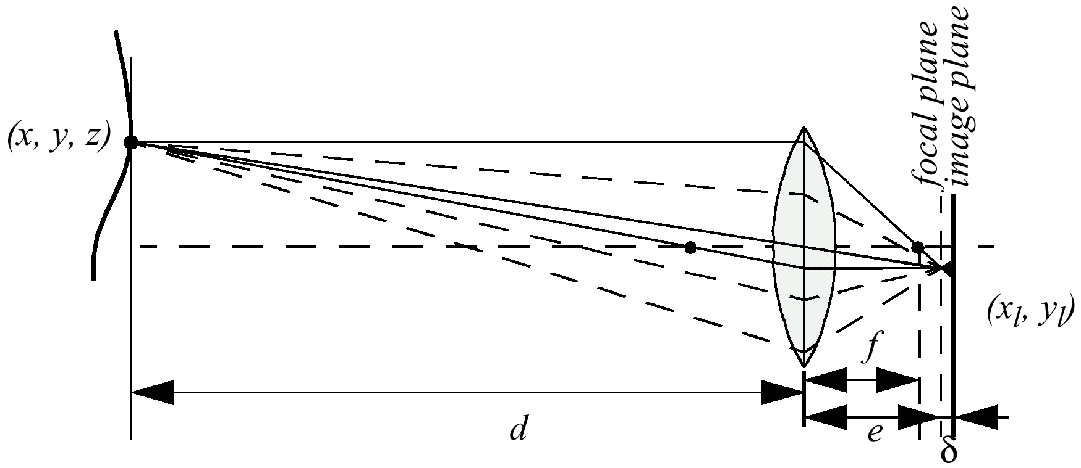
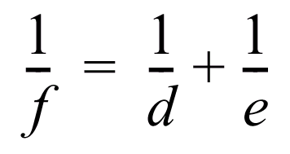
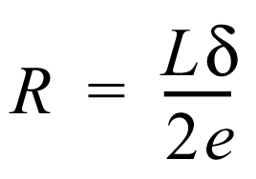
Depth from Focus (1)
4.1.8

Slide 41
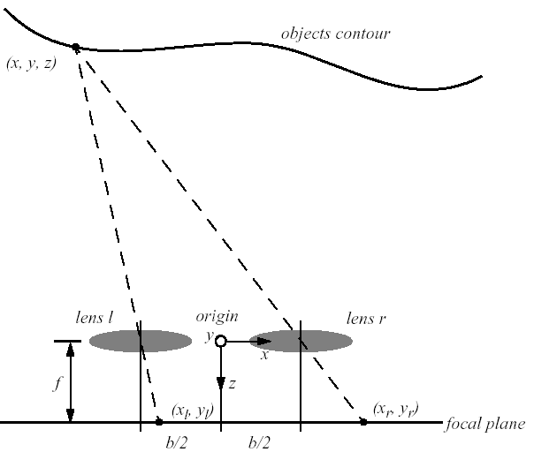




Stereo Vision
4.1.8
Idealized camera geometry for stereo vision
  Disparity between two images -> Computing of depth
  From the figure it can be seen that

Slide 42
Stereo Vision
4.1.8
Distance is inversely proportional to disparity
  closer objects can be measured more accurately
Disparity is proportional to b, horizontal distance between lenses
  For a given disparity error, the accuracy of the depth estimate increases with increasing baseline b.
  However, as b is increased, some objects may appear in one camera, but not in the other.
A point visible from both cameras produces a conjugate pair.
  Conjugate pairs lie on epipolar line (parallel to the x-axis for the arrangement in the figure above)

Slide 43
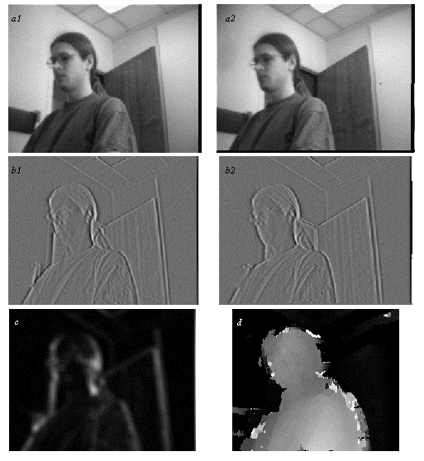
Stereo Vision Example
4.1.8
Extracting depth information from a stereo image
  a1 and a2: left and right image
  b1 and b2: vertical edge filtered
  left and right image;
  filter = [1 2 4 -2 -10 -2 4 2 1]
  c: confidence image:
  bright = high confidence (good texture)
  d: depth image:
  bright = close; dark = far
Artificial example: a bunch of fenceposts?

Slide 44
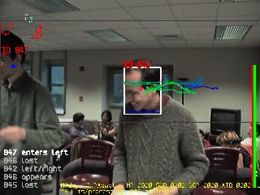
Adaptive Human-Motion Tracking
4.1.8

Slide 46
Classification of Sensors
4.1.1
Proprioceptive sensors
  measure values internally to the system (robot),
  e.g. motor speed, wheel load, heading of the robot, battery status
Exteroceptive sensors
  information from the robots environment
  distances to objects, intensity of the ambient light, unique features.
Passive sensors
  energy coming for the environment
Active sensors
  emit their proper energy and measure the reaction
  better performance, but some influence on envrionment

Slide 47
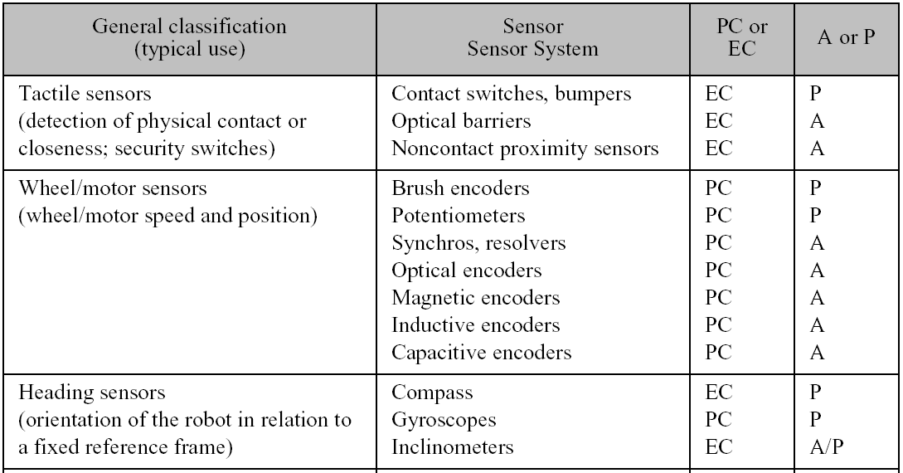
General Classification (1)
4.1.1

Slide 48
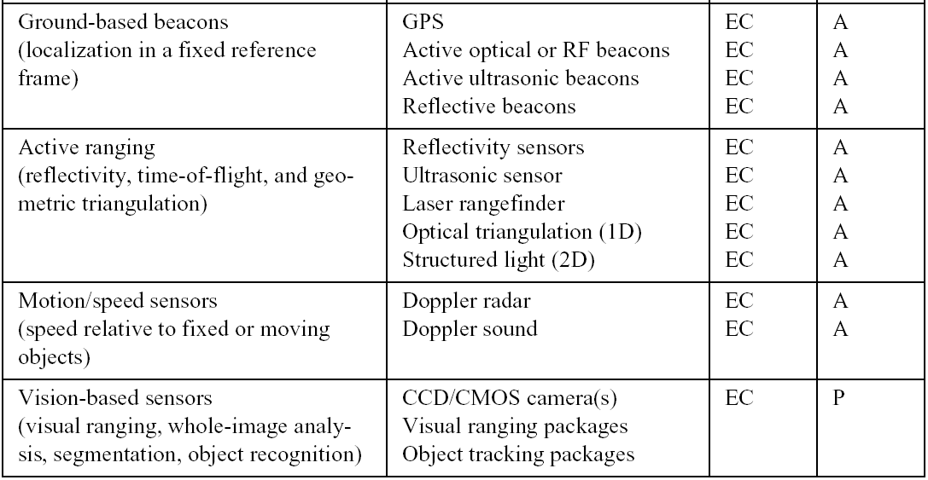
General Classification (2)
4.1.1

Slide 49
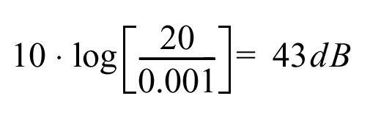
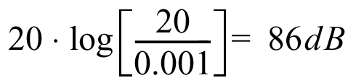
Characterizing Sensor Performance (1)
4.1.2
Measurement in real world environment is error prone
Basic sensor response ratings
  Dynamic range
    ratio between lower and upper limits, usually in decibels (dB, power)
    e.g. power measurement from 1 Milliwatt to 20 Watts
    e.g. voltage measurement from 1 Millivolt to 20 Volt
    20 instead of 10 because square of voltage is equal to power
  Range
    upper limit

Slide 50
Characterizing Sensor Performance (2)
4.1.2
Basic sensor response ratings (cont.)
  Resolution
    minimum difference between two values
    usually: lower limit of dynamic range = resolution
    for digital sensors it is usually the analog-to-digital conversion
      e.g. 5V / 255 (8 bit)
  Linearity
    variation of output signal as function of the input signal
    linearity is less important when signal is after treated with a computer
  Bandwidth or Frequency
    the speed with which a sensor can provide a stream of readings
    usually there is an upper limit depending on the sensor and the sampling rate
    Lower limit is also possible, e.g. acceleration sensor

