Slide 1
https://www.youtube.com/watch?v=cRTNvWcx9Oo

Slide 2
Simple Vision
How would I find the red ball?
What if it’s moving?

Slide 3
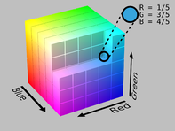
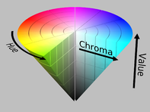
HSV
TurtleBot
  Driving around with keyboard
  Vision : red ball
  Mapping?

Slide 4
Classification of Sensors
4.1.1
Proprioceptive sensors
  measure values internally to the system (robot),
  e.g. motor speed, wheel load, heading of the robot, battery status
Exteroceptive sensors
  information from the robots environment
  distances to objects, intensity of the ambient light, unique features.
Passive sensors
  energy coming for the environment
Active sensors
  emit their proper energy and measure the reaction
  better performance, but some influence on envrionment

Slide 5
Free Write
What makes a good sensor?
How do you differentiate between sensors?

Slide 6
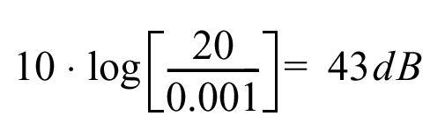
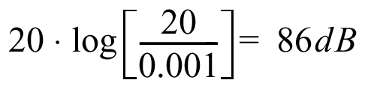
Characterizing Sensor Performance (1)
4.1.2
Measurement in real world environment is error prone
Basic sensor response ratings
  Dynamic range
    ratio between lower and upper limits, usually in decibels (dB, power)
    e.g. power measurement from 1 Milliwatt to 20 Watts
    e.g. voltage measurement from 1 Millivolt to 20 Volt
    20 instead of 10 because square of voltage is equal to power
  Range
    upper limit

Slide 7
Characterizing Sensor Performance (2)
4.1.2
Basic sensor response ratings (cont.)
  Resolution
    minimum difference between two values
    usually: lower limit of dynamic range = resolution
    for digital sensors it is usually the analog-to-digital conversion
      e.g. 5V / 255 (8 bit)
  Linearity
    variation of output signal as function of the input signal
    linearity is less important when signal is after treated with a computer
  Bandwidth or Frequency
    the speed with which a sensor can provide a stream of readings
    usually there is an upper limit depending on the sensor and the sampling rate
    Lower limit is also possible, e.g. acceleration sensor

Slide 8
Insitu
vs.
in situ

Slide 9

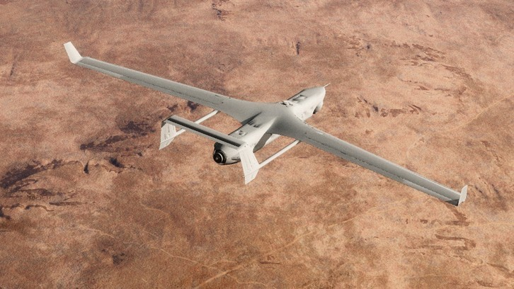
vs.
in situ
in its original place
"mosaics and frescoes have been left in situ”
in position
"her guests were all in situ"
In the aerospace industry, equipment on-board aircraft must be tested in situ, or in place, to confirm everything functions properly as a system. Individually, each piece may work but interference from nearby equipment may create unanticipated problems.

Slide 10
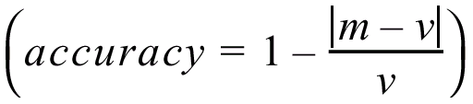
In Situ Sensor Performance (1)
4.1.2
Sensitivity
  ratio of output change to input change
  however, in real world environment, the sensor has very often high sensitivity to other environmental changes, e.g. illumination
Cross-sensitivity
  sensitivity to environmental parameters that are orthogonal to the target parameters (e.g., compass responding to building materials)
Error / Accuracy
  difference between the sensor’s output and the true value
m = measured value
v = true value
error

Slide 11

In Situ Sensor Performance (2)
4.1.2
Characteristics that are especially relevant for real world environments
Systematic error ➔ deterministic errors
  caused by factors that can (in theory) be modeled ➔ prediction
Random error ➔ non-deterministic
  no prediction possible
  however, they can be described probabilistically
Precision
  reproducibility of sensor results
Notes:
e.g. calibration of a laser sensor or of the distortion cause by the optic of a camera
e.g. Hue instability of camera, black level noise of camera ..

Slide 12
Characterizing Error: Challenges in Mobile Robotics
4.1.2
Mobile Robot: perceive, analyze and interpret state
Measurements are dynamically changing and error prone
Examples:
  changing illuminations
  specular reflections
  light or sound absorbing surfaces
  cross-sensitivity of robot sensor to robot pose and robot-environment dynamics
    rarely possible to model ➔ appear as random errors
    systematic errors and random errors may be well defined in controlled environment

Slide 13
Multi-Modal Error Distributions
4.1.2
Behavior of sensors modeled by probability distribution (random errors)
  usually very little knowledge about causes of random errors
  often probability distribution is assumed to be symmetric or even Gaussian
  however, may be very wrong….
    Sonar (ultrasonic) sensor might overestimate the distance in real environment and is therefore not symmetric
    Sonar sensor might be best modeled by two modes:
    1. the case that the signal returns directly
    2. the case that the signals returns after multi-path reflections
    Stereo vision system might correlate to images incorrectly, thus causing results that make no sense at all…

Slide 14
Wheel / Motor Encoders (1)
4.1.3
measure position or speed of the wheels
Integrate wheel movements to get an estimate of robots position ➔ odometry
optical encoders are proprioceptive sensors
  position estimation in relation to a fixed reference frame is only valuable for short movements
typical resolutions: 2000 increments per revolution.

Slide 15
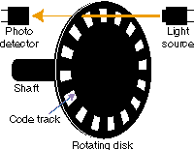
Wheel / Motor Encoders (2)
4.1.3

Slide 16
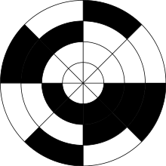
Wheel / Motor Encoders (2)
4.1.3

Slide 17
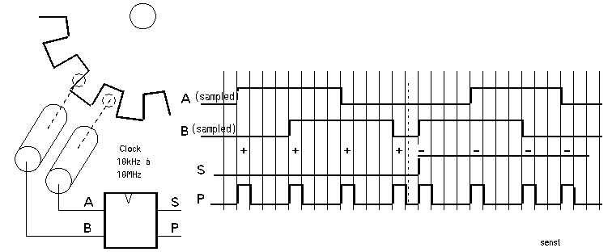
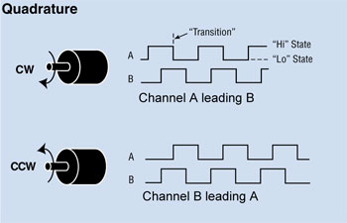

Wheel / Motor Encoders (3)
4.1.3

Slide 18
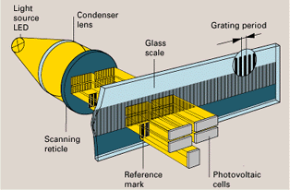
Wheel / Motor Encoders (2)
4.1.3
scanning reticle fields
scale slits
Notice what happen when the direction changes:

Slide 19
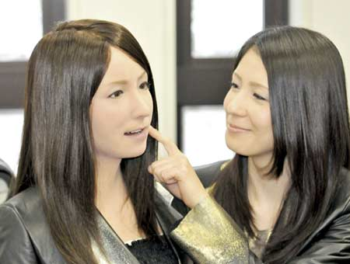
Heading Sensors
4.1.4
Proprioceptive (gyroscope, inclinometer) or Exteroceptive (compass)
Determine the robot’s orientation
Heading + velocity integrates to position estimate
  Dead reckoning (ships)
  Location + Orientation = Pose

Slide 20
Compass
4.1.4
~2000 B.C.
  Chinese suspended a piece of naturally magnetite from a silk thread and used it to guide a chariot over land
Magnetic field on earth
  absolute measure for orientation
Large variety of solutions to measure the earth magnetic field
Major drawbacks
  weakness of the earth field
  easily disturbed by magnetic objects or other sources
  not feasible for indoor environments

Slide 21
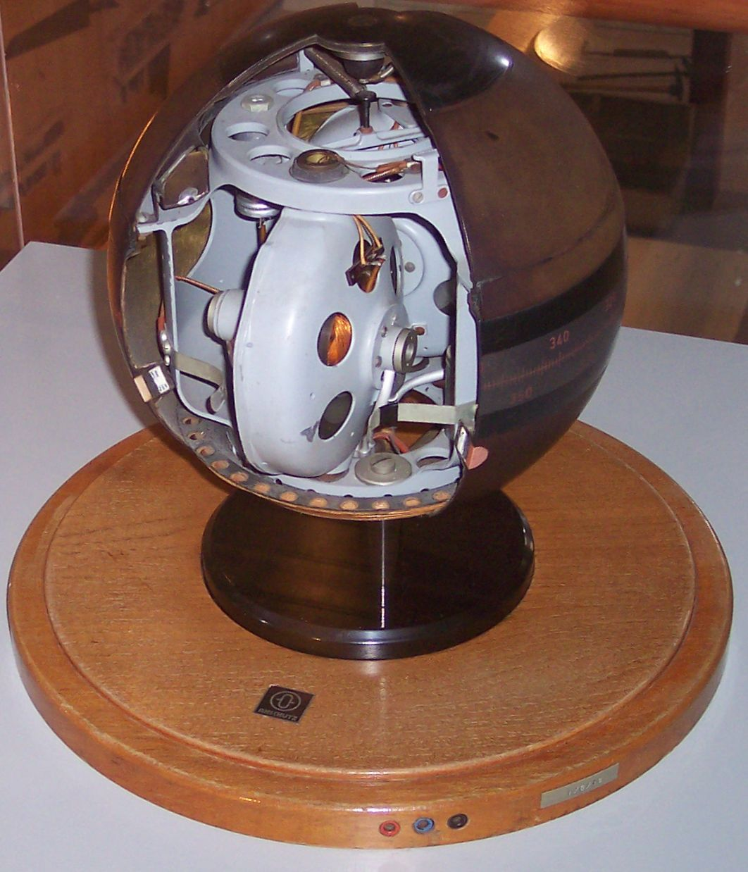
Gyrocompass
  Patented in 1885
  Practical in 1906 (Germany)
  Find true north as determined by Earth’s rotation
  Not affected by ship’s composition, variety in magnetic field, etc.

Slide 22
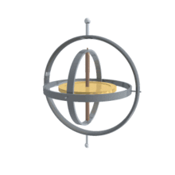
Gyroscope
4.1.4
Heading sensors keep the orientation to a fixed frame
  absolute measure for the heading of mobile system
Mechanical Gyroscopes
  Drift: 0.1° in 6 hours
  Spinning axis is aligned with north-south meridian, earth’s rotation has no effect on gyro’s horizontal axis
  If points east-west, horizontal axis reads the earth rotation
Optical Gyroscopes (1980s)
  2 laser beams in opposite direction
  around circle
  Bandwidth >100 kHz
  Resolution < 0.0001 degrees/hr

Slide 23
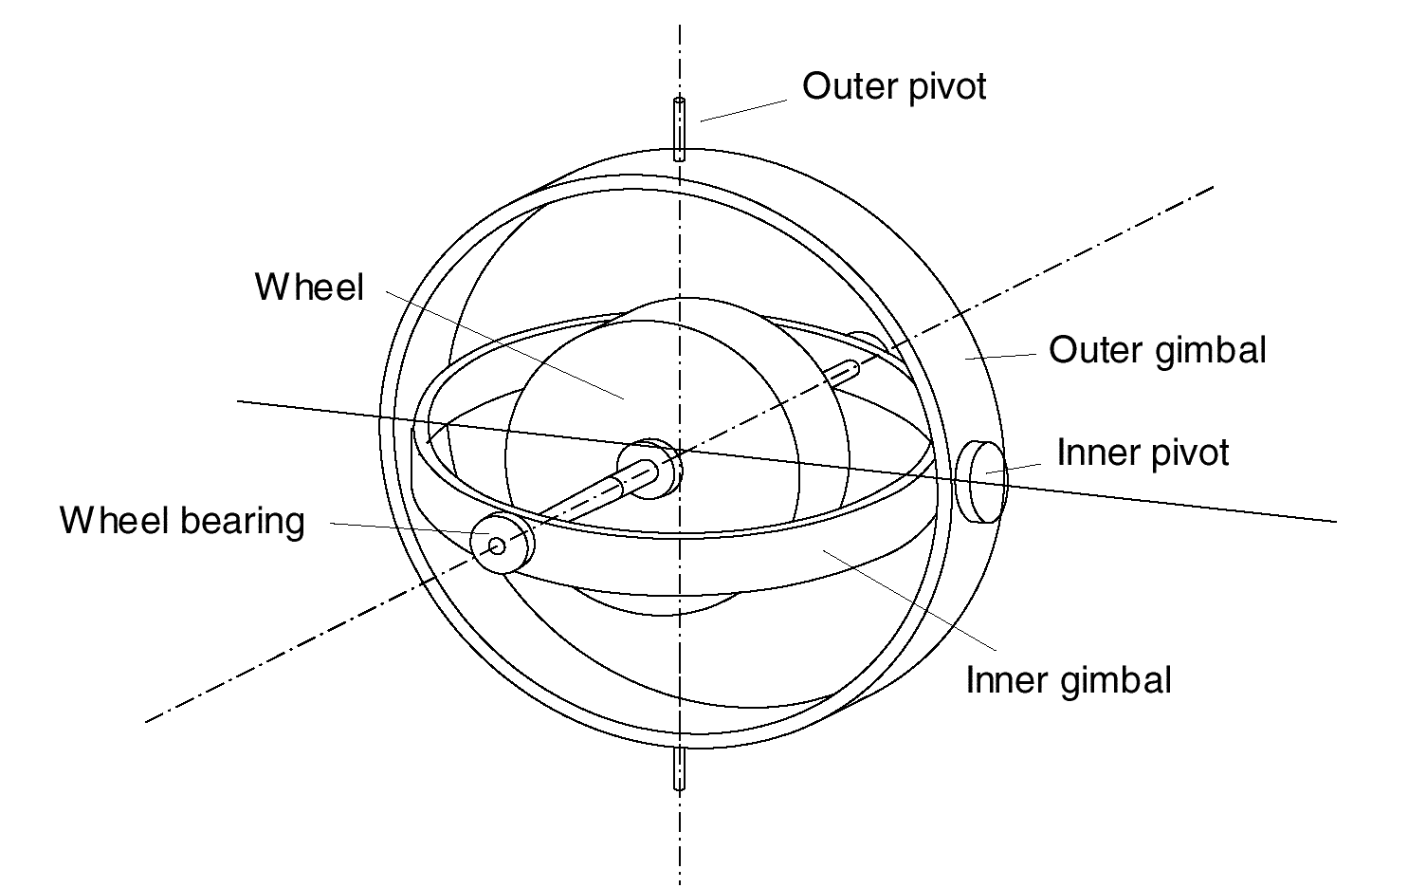
Mechanical Gyroscopes
4.1.4
Concept: inertial properties of a fast spinning rotor
  gyroscopic precession
Angular momentum associated with a spinning wheel keeps the axis of the gyroscope inertially stable.
Reactive torque tao (tracking stability) is proportional to the spinning speed w, the precession speed W and the wheels inertia I.
No torque can be transmitted from the outer pivot to the wheel axis
  spinning axis will therefore be space-stable
Quality: 0.1° in 6 hours
If the spinning axis is aligned with the
north-south meridian, the earth’s rotation
has no effect on the gyro’s horizontal axis
If it points east-west, the horizontal axis
reads the earth rotation

Slide 24
Rate gyros
4.1.4
Same basic arrangement shown as regular mechanical gyros
But: gimble(s) are restrained by a torsional spring
  enables to measure angular speeds instead of the orientation.
Others, more simple gyroscopes, use Coriolis forces to measure changes in heading.

Slide 25
Optical Gyroscopes
4.1.4
First commercial use started only in the early 1980 when they where first installed in airplanes.
Optical gyroscopes
  angular speed (heading) sensors using two monochromic light (or laser) beams from the same source.
On is traveling in a fiber clockwise, the other counterclockwise around a cylinder
Laser beam traveling in direction of rotation
  slightly shorter path -> shows a higher frequency
  difference in frequency Δf of the two beams is proportional to the angular velocity Ω of the cylinder
New solid-state optical gyroscopes based on the same principle are build using microfabrication technology.
MUCH more accurate than mechanical

Slide 26
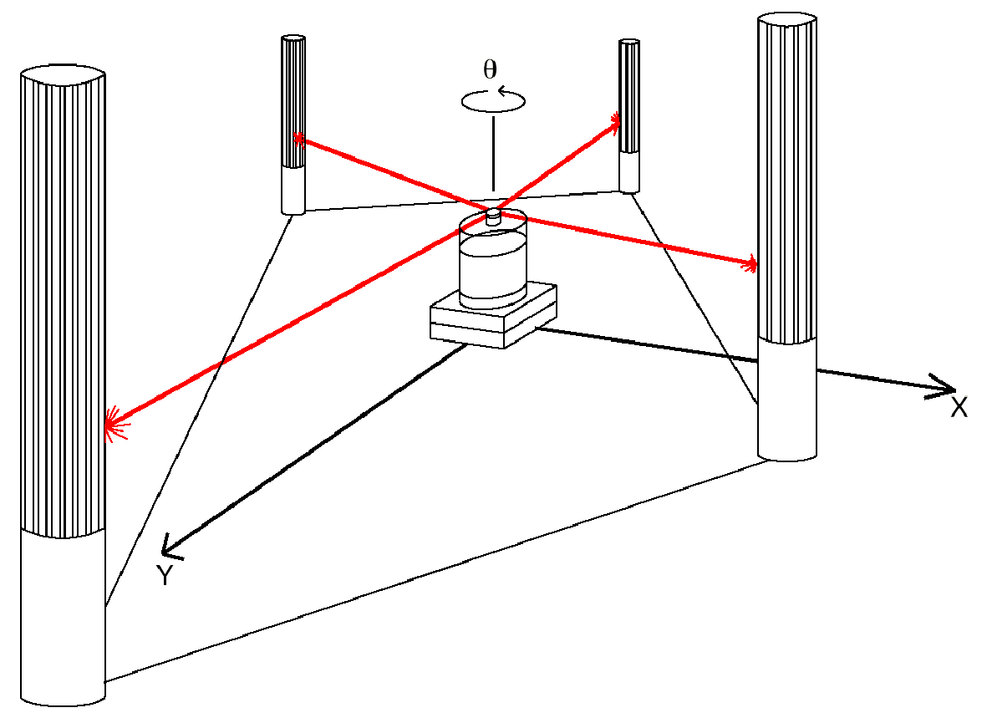
Ground-Based Active and Passive Beacons
4.1.5
Beacons are signaling guiding devices with a precisely known positions
Beacon-base navigation is used since the humans started to travel
  Natural beacons (landmarks) like stars, mountains, or the sun
  Artificial beacons like lighthouses
Global Positioning System revolutionized modern navigation technology
  key sensor for outdoor mobile robotics
  GPS not applicable indoors
Major drawback with the use of beacons in indoor:
  Beacons require environment changes: costly
  Limit flexibility and adaptability to changing
  environments
Key design choice in Robocup
  https://www.youtube.com/watch?v=Kc8ty9mog-I

Slide 27
Global Positioning System (GPS) (1)
4.1.5
Developed for military use, now commercial
  24 satellites (including three spares)
  Orbit earth every 12 hours at a height of 20.190 km
  Location of GPS receiver determined through time of flight measurement
Technical challenges:
  Time synchronization between individual satellites and GPS receiver
  Real time update of the exact location of the satellites
  Precise measurement of the time of flight
  Interferences with other signals

Slide 28
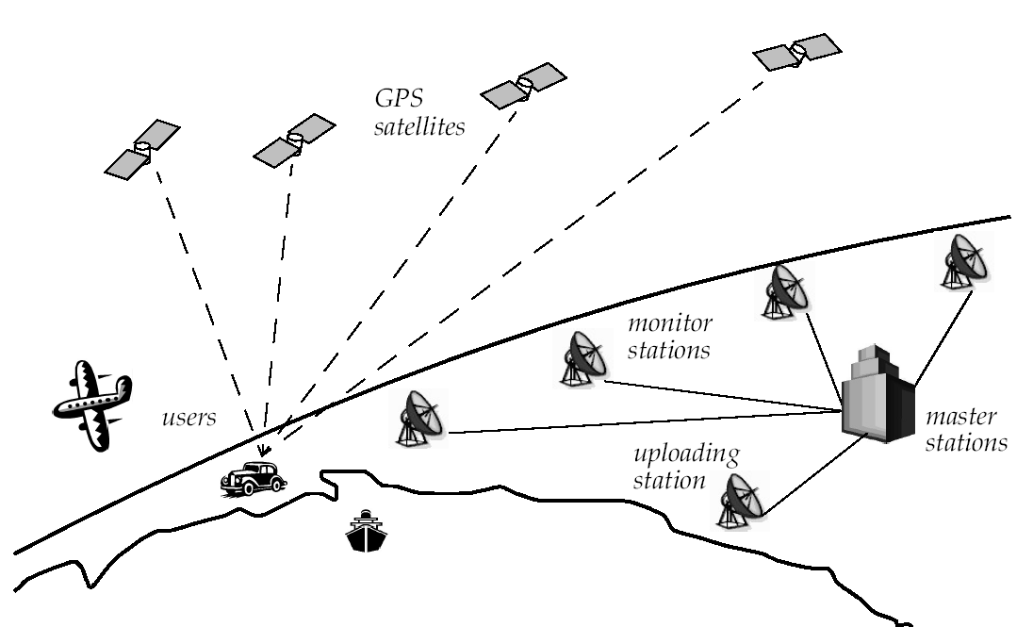
Global Positioning System (GPS) (2)
4.1.5
How many satellites do you need to see?

Slide 29
Global Positioning System (GPS) (3)
4.1.5
Time synchronization:
  atomic clocks on each satellite, monitored from different ground stations
  electromagnetic radiation propagates at light speed (0.3 m / nanosecond)
  position accuracy proportional to precision of time measurement
Real time update of exact location of satellites:
  Monitoring satellites from a number of widely distributed ground stations
  master station analyses all measurements & transmits actual position to each satellite
Exact measurement of the time of flight:
  quartz clock on the GPS receivers are not very precise
  four satellite allows identification of position values (x, y, z) and clock correction ΔT
Position accuracies down to a ~2 meters

Slide 30
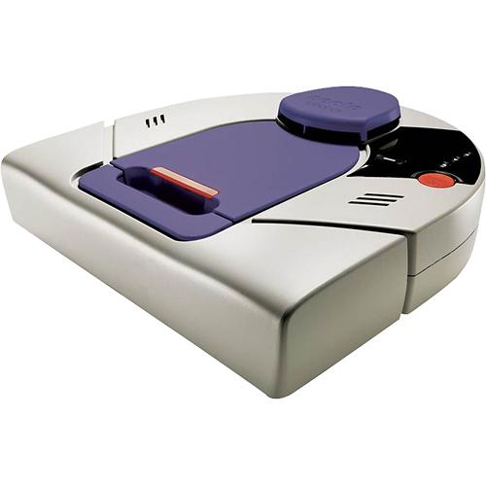
Neato
On-board Room Positioning System (RPS) technology
Maps with only one projector!

Slide 31
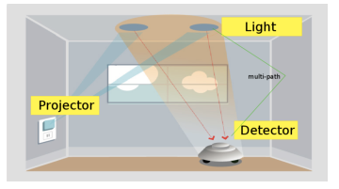
Neato
https://www.researchgate.net/publication/221070323_Vector_field_SLAM

Slide 32



Slide 33
Range Sensors (time of flight) (1)
4.1.6
Large range distance measurement: range sensors
Range information:
  key element for localization and environment modeling
  Ultrasonic sensors / laser sensors use propagation of speed of sound / electromagnetic waves respectively
  Distance = speed * time

Slide 34
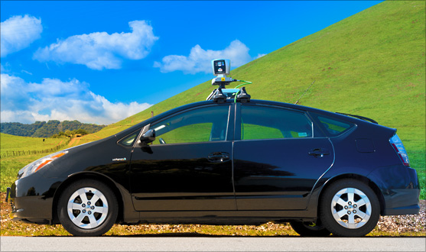
Range Sensors (time of flight) (2)
4.1.6
Propagation speed v of sound: 0.3 m/ms
Propagation speed v of of electromagnetic signals: 0.3 m/ns, one million times faster
3 meters
  10 ms ultrasonic system
  10 ns for a laser range sensor
time of flight t with electromagnetic signals is not an easy task
  laser range sensors expensive and delicate
Quality of time of flight range sensors manly depends on:
  Uncertainties about the exact time of arrival of the reflected signal
  Inaccuracies in the time of fight measure (laser range sensors)
  Opening angle of transmitted beam (ultrasonic range sensors)
  Interaction with the target (surface, specular reflections)
  Variation of propagation speed
  Speed of mobile robot and target (if not at stand still)

Slide 35
Ultrasonic Sensor (1)
4.1.6
Transmit packet of (ultrasonic) pressure waves
Distance d of the echoing object can be calculated based on the propagation speed of sound c and the time of flight t.
The speed of sound c (340 m/s) in air is given by
where
: ratio of specific heats
R: gas constant
T: temperature in degree Kelvin

Slide 36
Ultrasonic Sensor (2)
4.1.6
Wave packet
Transmitted sound
Analog echo signal
Threshold
Digital echo signal
Integrated time
Output signal
threshold
integrator
Time of flight (sensor output)
Threshold: high initially (avoid ringing) then decreases over time
Very close objects = trouble!

Slide 37
Ultrasonic Sensor (3)
4.1.6
typically a frequency: 40 - 180 kHz
generation of sound wave: piezo transducer
sound beam propagates in a cone like manner
  opening angles around 20 to 40 degrees
  regions of constant depth
  segments of an arc (sphere for 3D)
  Typical intensity distribution of a ultrasonic sensor

Slide 38

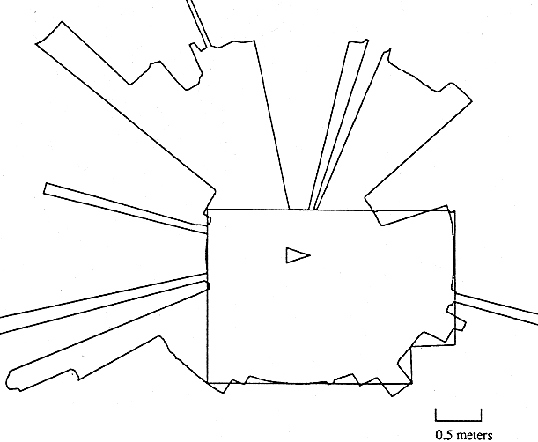
Ultrasonic Sensor (3)
4.1.6
Other problems for ultrasonic sensors
  Soft surfaces that absorb most of the
  sound energy
  Surfaces far from perpendicular to the
  direction of sound: specular reflection
360° scan

Slide 39
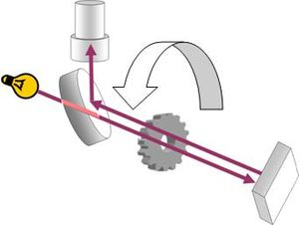
Speed of Light
Fizeau apparatus

Slide 40
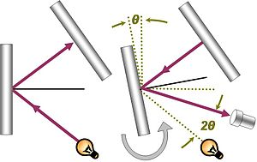
Speed of Light
Fizeau apparatus
Foucault apparatus

Slide 41
Laser Range Sensor (1)
4.1.6
Transmitted and received beams coaxial
Transmitter illuminates a target with a collimated beam
Received detects the time needed for round-trip
A mechanical mechanism with a mirror sweeps
  2 or 3D measurement

Slide 42
Laser Range Sensor (2)
4.1.6
Pulsed laser
  measurement of elapsed time directly
  resolving picoseconds
Beat frequency
  between a frequency modulated continuous wave and received reflection
Phase shift measurement produce range estimation
  technically easier than the above two methods

Slide 43
Laser Range Sensor (3)
4.1.6
Phase-Shift Measurement
Where
c: is the speed of light; f the modulating frequency; D’ covered by the emitted light is
  for f = 5 Mhz (as in the AT&T sensor), λ = 60 meters
λ = c/f

Slide 44
Laser Range Sensor (4)
4.1.6
Distance D, between the beam splitter and the target
θ: phase difference between the transmitted
Theoretically ambiguous range estimates
  since for example if λ = 60 meters, a target at a range of 5 meters = target at 35 meters
(2.33)

Slide 45
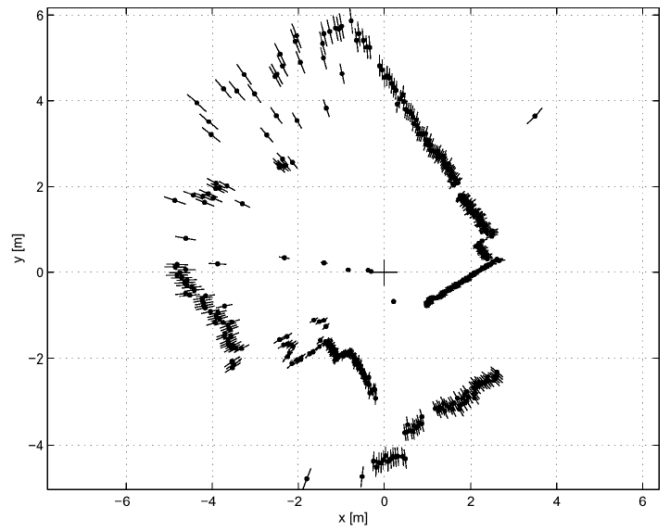
Example Laser Range Sensor
4.1.6
Length of lines through the measurement points indicate the uncertainties
http://www.youtube.com/watch?v=NC1F0TwJ_Q8

Slide 46
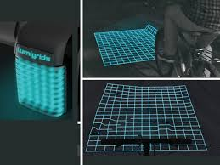
Triangulation Ranging
4.1.6
Geometrical properties of image establish a distance measurement
Project a well defined light pattern (e.g. point, line) onto the environment
  Reflected light captured by a photo-sensitive line or matrix (camera) sensor device
  Triangulation establishes distance

Slide 47
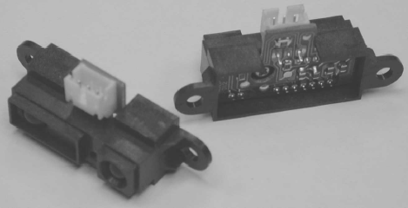
Laser Triangulation (1D)
4.1.6
D
Laser / Collimated beam
P
L
Target
x
Transmitted Beam
Lens
Reflected Beam
Position-Sensitive Device (PSD)
or Linear Camera
  Principle of 1D laser triangulation.
  distance is proportional to the 1/x

Slide 48
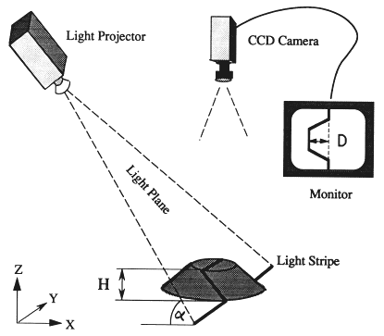
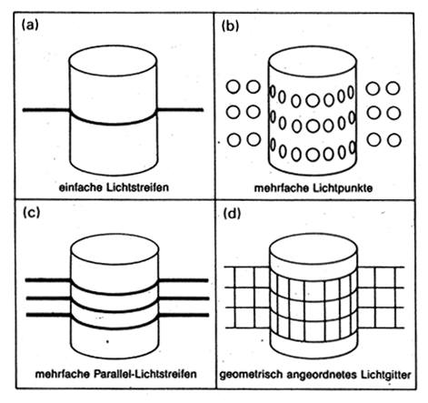
Structured Light (vision, 2 or 3D)
4.1.6
b
a
b
u
Eliminate correspondence problem by projecting structured light on the scene
Slits of light / emit collimated light (laser) by means of rotating mirror
Light perceived by camera
Range to an illuminated point can then be determined from simple geometry.

Slide 49
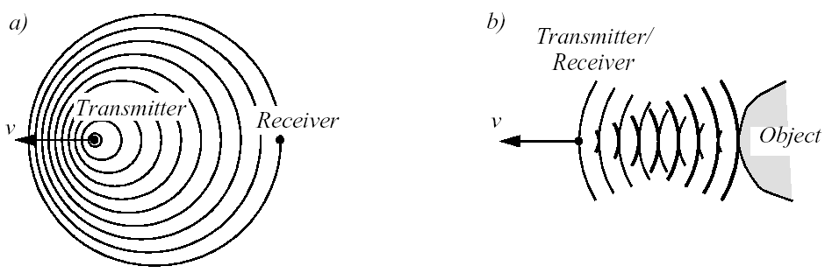




Doppler Effect Based (Radar or Sound)
4.1.7
a) between two moving objects b) between a moving and a stationary object
if transmitter is moving if receiver is moving
Doppler frequency shift relative speed
Sound waves: security, fish finding, measure of ground speed
Electromagnetic waves: vibration measurement, radar systems, object tracking

