Slide 1
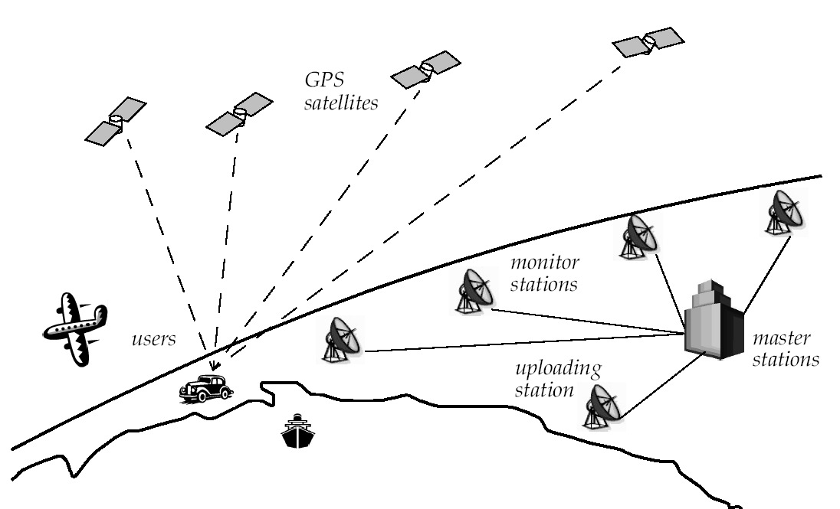
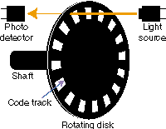
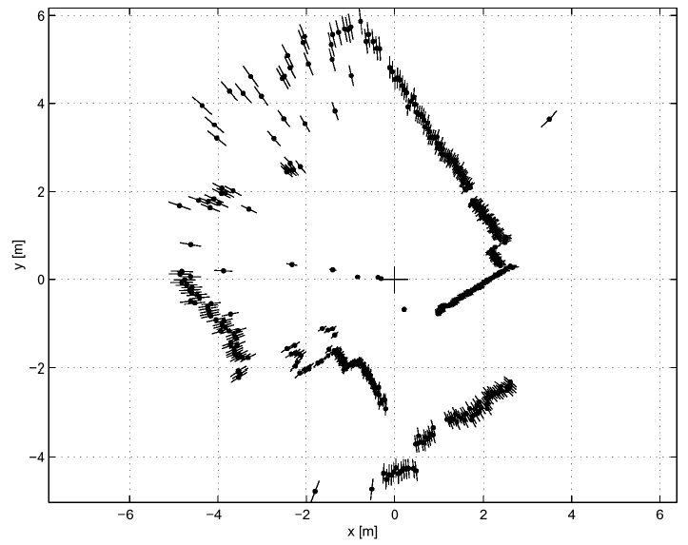

Slide 2
Locomotion: Chapter 1
Enabling robots to move
Many bio-inspired methods:
Walk, jump, run, slide, skate, swim, fly, roll
Exception: Powered wheel
Human invention
What’s the benefit?

Slide 3
Power vs. Attainable Speed
# of actuators
Structural complexity
Control expense
Efficiency
Terrain
Motion of the masses
Losses

Slide 4
Key Issues for Locomotion
Stability
number and geometry of contact points
center of gravity
static/dynamic stability
inclination of terrain

Slide 5
Key Issues for Locomotion
Characteristics of contact
contact point/path size and shape
angle of contact
friction

Slide 6
Key Issues for Locomotion
Type of environment
structure
medium
water
air
soft or hard ground

Slide 7
Legged Mobile Robots
Characterized by a series of point contacts between the robot and the ground.
Adaptability and maneuverability in rough terrain
Power and mechanical complexity
High degrees of freedom
Control system complexity
http://www.youtube.com/watch?v=xlOwk6_xpWo

Slide 8
AtlasProto by Boston Dynamics
http://www.youtube.com/watch?v=w40e1u0T1yg
The Atlas robots participated in the DARPA Robotics Challenge in 2013

Slide 9
Leg Configurations
Minimum DOF required to move a leg forward?

Slide 10
Leg Configurations
A minimum of two DOF is required to move a leg forward
a lift and a swing motion
Three DOF for each leg in most cases
Fourth DOF for the ankle joint
might improve walking
additional joint (DOF) increase complexity of design and locomotion control

Slide 11
“Often clever mechanical design can perform the same operations as complex active control circuitry.”

Slide 12
Examples of 3 DOF Legs

Slide 13
Legged Robot Control
Gait control: Leg coordination for locomotion
The gait is the sequence of lift and release events for the individual legs.
For a robot with k legs, the total number of distinct event sequences N is:
N = (2k-1)!

Slide 14
Legged Robot Control
2 legs: N = 6
DD, UD, DD
DD, DU, DD
DD, UU, DD
UD, DU, UD, DU
UD, UU, UD
DU, UU, DU
6 legs: N = 11! =39,916,800

Slide 15
Gaits

Slide 16
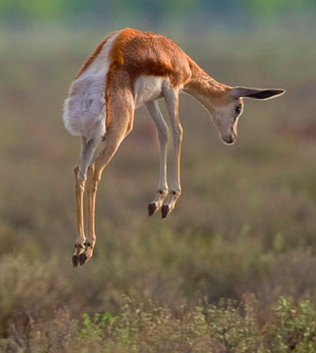
Stotting (also pronking or pronging)
Quadrupeds, particularly gazelles, where they spring into the air by lifting all four feet off the ground simultaneously
Some evidence: honest signal to predators that prey animal is not worth pursuing
Stot is a common Scots and Geordie verb meaning “bounce” or “walk with a bounce”
Twerk is not a valid gait

Slide 17
Legged Robot Control
Cost of transportation:
How much energy a robot uses to travel a certain distance
Usually normalized by the robot weight
Measured in J/N-m

Slide 18
Cost of Transportation

Slide 19
Legged Robot Control
Design to better exploit the dynamics
Natural oscillations of pendula and springs
Dynamics of a double pendulum
Springs can be used to store energy
Passive dynamic walkers
http://www.youtube.com/watch?v=WOPED7I5Lac
# of legs?
http://www.wimp.com/thelittledog/
Model inaccuracies
http://www.youtube.com/user/altiodaltiod?feature=watch

Slide 20
Wheeled Mobile Robots
Most popular locomotion mechanism
Highly efficient
Simple mechanical implementation
Balancing is not usually a problem
Suspension system needed to allow all wheels to maintain ground contact on uneven terrain

Slide 21
Wheeled Mobile Robots
Focus is on
Traction
Stability
Maneuverability
Control

Slide 22
Wheel Designs
a) Standard wheels
2 DOF
b) Castor wheels
2 DOF

Slide 23
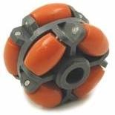
Wheel Designs
c) Swedish (Omni) wheels
3 DOF
d) Ball or spherical wheel
3 DOF
Think mouse ball
Suspension issue

Slide 24
Wheeled Mobile Robots
Stability of a vehicle is guaranteed with 3 wheel
center of gravity is within the triangle with is formed by the ground contact point of wheels
Stability is improved by 4 and more wheels
Bigger wheels allow to overcome higher obstacles
But require higher torque or reductions in the gear box
Most arrangements are non-holonomic
require high control effort
Combining actuation and steering on one wheel makes design complex and adds additional errors for odometry
Notes:
however, this arrangements are hyperstatic and require a flexible suspension system.

Slide 25
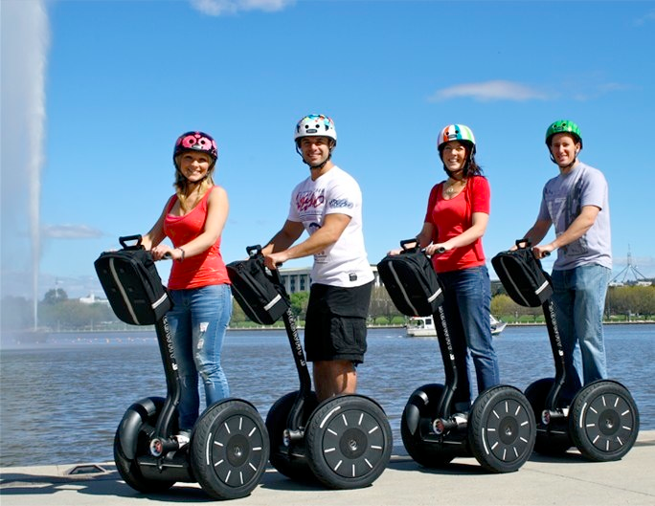
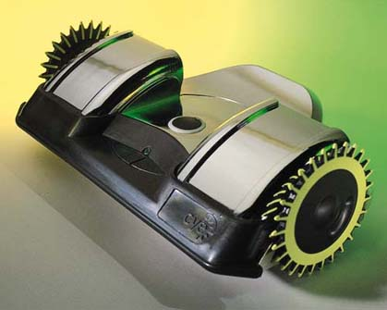
Static Stability with Two Wheels
Achieved by ensuring center of mass is below wheel axis
Or using fancy balancing

Slide 26
Motion Control
Kinematic/dynamic model of the robot
Model the interaction between wheel and ground
Definition of required motion
Speed control
Position control
Control law that satisfies the requirements

Slide 27
Mobile Robot Kinematics
Description of mechanical behavior of the robot for design and control
Similar to robot manipulator kinematics
However, mobile robots can move unbound with respect to their environment:
No direct way to measure robot’s position
Position must be integrated over time
Leads to inaccuracies of the position (motion) estimate
Understanding mobile robot motion starts with understanding wheel constraints placed on robot’s mobility

Slide 28
Configuration: complete specification of the position of every point of the system. Position and orientation. Also, called a pose
Configuration space: space of all possible configurations
Workspace: the 2D or 3D ambient space the robot is in.

Slide 29
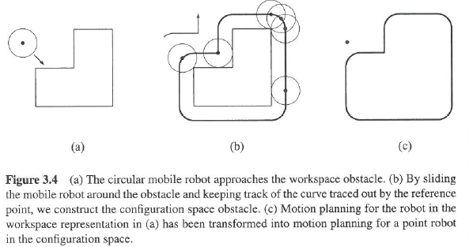

Slide 30
