Slide 1
Lab 3
How’d it go?

Slide 2
http://bgr.com/2014/09/29/mario-kart-oculus-rift-video/

Slide 3
Occupancy Grid
start
goal

Slide 4
4) Finding shortest path?

Slide 5
Iterative Deepening
Iterative deepening uses DFS as a subroutine:
Do a DFS which only searches for paths of length 1 or less.
If “1” failed, do a DFS which only searches paths of length 2 or less.
If “2” failed, do a DFS which only searches paths of length 3 or less.
….and so on.
b
…
Algorithm |  | Complete | Optimal | Time | Space
DFS | w/ Path Checking
BFS
ID
Y
N
O(b^{m+1})
O(bm)
Y
N*
O(b^{s+1})
O(b^{s})
Y
N*
O(b^{s+1})
O(bs)

Slide 6
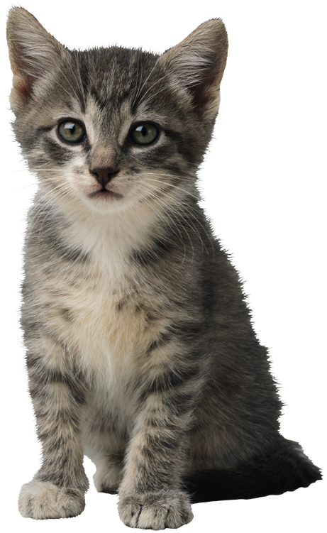
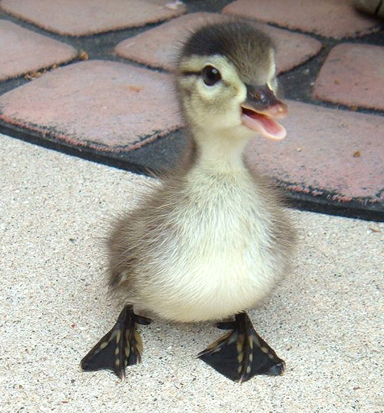
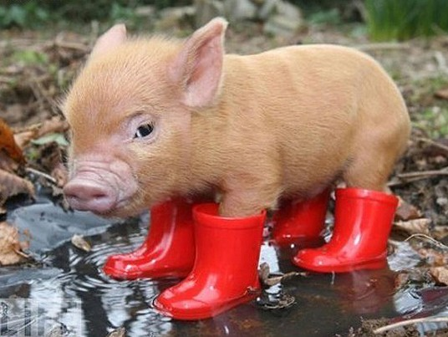
5) Finding shortest path with costs

Slide 7
Costs on Actions
a
GOAL
2
2
b
c
3
2
1
8
2
e
d
f
3
9
8
2
START
h
1
4
1
p
4
r
15
q
Notice that BFS finds the shortest path in terms of number of transitions. It does not find the least-cost path.
We will quickly cover an algorithm which does find the least-cost path.

Slide 8
Uniform Cost Search
2
G
a
b
1
8
c
Expand cheapest node first:
Fringe is a priority queue
2
2
e
3
d
f
9
8
1
S
h
1
1
p
q
r
15
S
0
d
3
e
9
p
1
b
4
c
e
5
h
17
r
11
q
16
11
Cost contours
a
6
a
h
13
r
7
p
q
f
p
q
f
8
q
c
G
q
c
a
11
G
10
a

Slide 9
Uniform-cost search
For graphs with actions of different cost
Equivalent to breadth-first if step costs all equal
Expand least “total cost” unexpanded node
Implementation:
fringe = queue sorted by path cost g(n), from smallest to largest (i.e. a priority queue)

Slide 10
Uniform Cost Issues
Remember: explores increasing cost contours
The good: UCS is complete and optimal!
The bad:
Explores options in every “direction”
No information about goal location
c ≤ 1
…
c ≤ 2
c ≤ 3
Start
Goal
DEMOS
Notes:
cd /Users/taylorm/Documents/pacman/published/demos
python pacman.py -l contoursMaze -p SearchAgent -a fn=ucs --frameTime -1
python pacman.py -p SearchAgent -a fn=ucs -l smallMaze --frameTime -1

Slide 11
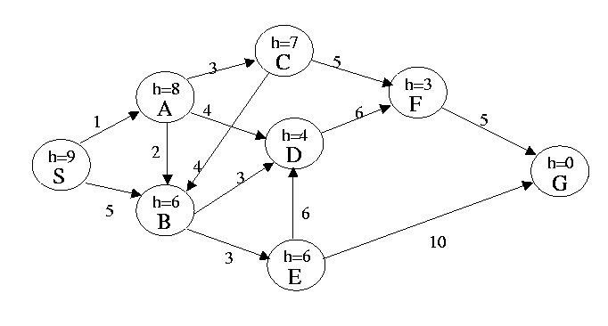
In this problem the start state is S, and the goal state is G. The transition costs are next to the edges. IGNORE the heuristic estimate, h. Assume that ordering is defined by, and ties are always broken by, choosing the state that comes first alphabetically.
What is the order of states expanded using Uniform Cost Search? Assume algorithm terminates when reaches G.
Notes:
SABCDEFG

Slide 12
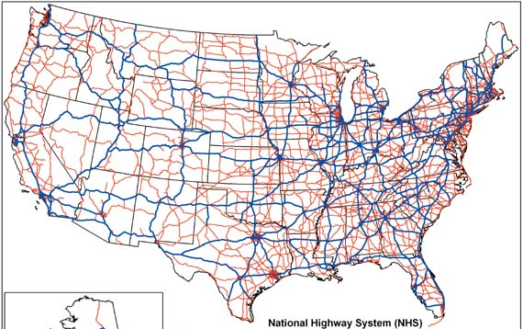
Informed Search
start
goal
Uninformed search
Informed search

Slide 13
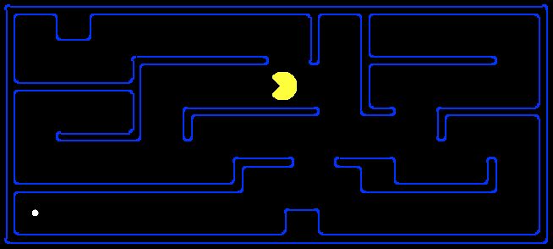
Search Heuristics
Any estimate of how close a state is to a goal
Designed for a particular search problem
Examples: Manhattan distance, Euclidean distance
10
5
11.2

Slide 14
Big Picture
Occupancy grids perform exhaustive search across the state space.
Represent and evaluate a far greater number of world states than the robot would actually need to traverse
What can we do differently?

Slide 15
Roadmap Algorithms
General idea:
Avoid searching the entire state space
Pre-compute a (hopefully) small graph (roadmap) such that staying on the “roads” will avoid obstacles
Find a path from $qstart$ to the closest point on the roadmap, and then use the roadmap to find a path to $qgoal$

Slide 16
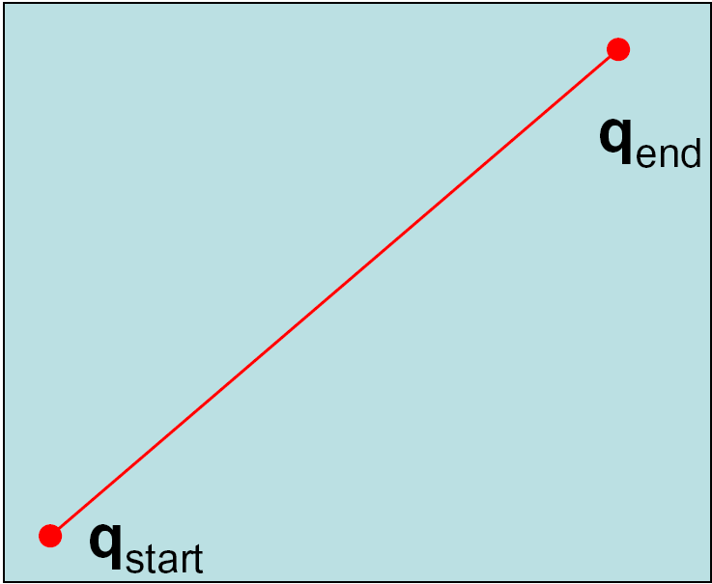
Shortest Path between Two Points

Slide 17
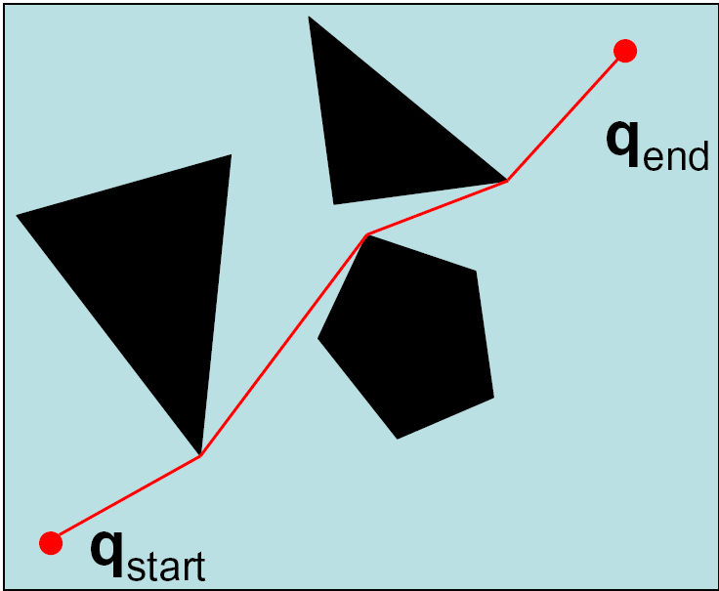
Shortest Path with Obstacles

Slide 18
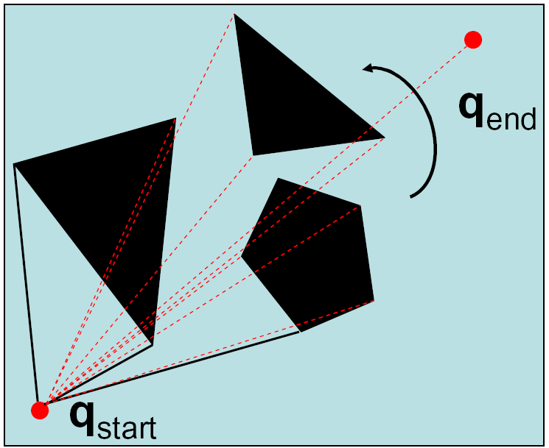
Sweep Algorithms

Slide 19
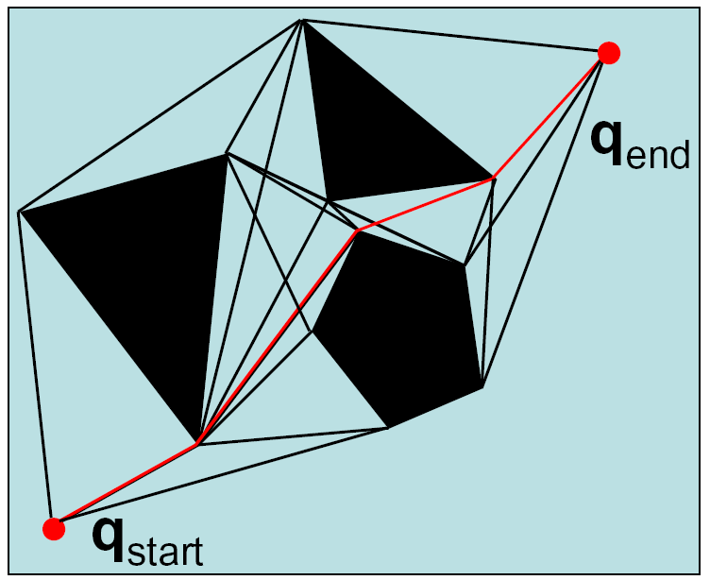
Visibility Graph

Slide 20
Visibility Graphs
Shortest path but…
Stays as close as possible to the obstacles
Deviations from path can lead to collisions
Requires polygonal obstacles

Slide 21
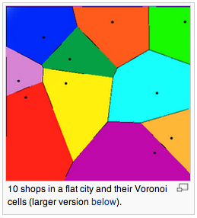
Other Alternatives…
What if we care more about keeping our robot safe than about optimality?
The other extreme: stay away from obstacles as far as possible.

Slide 22
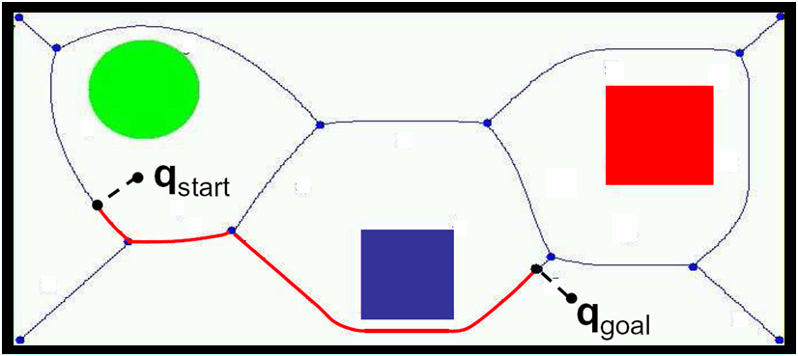
Voronoi Diagram
Control is easy:

Slide 23
Voronoi Diagram
Control is easy: stay equidistant away from closest obstacles

Slide 24
Voronoi Diagrams
Difficult to compute in higher dimensions
Staying away from obstacles is not necessarily the best heuristic
Can lead to paths that are much too conservative
Can be unstable: small changes in obstacle configuration can lead to large changes in the diagram
Fortune’s Algorithm

Slide 25
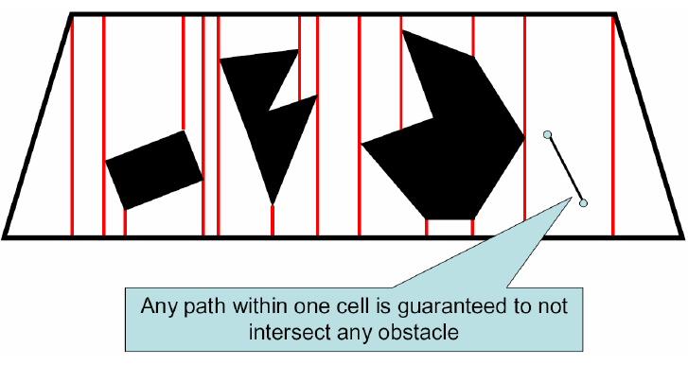
Exact Cell Decomposition
How would this be used?

Slide 26
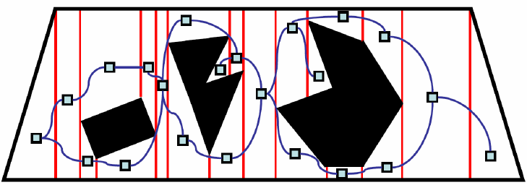
Exact Cell Decomposition
Identify adjacent cells

Slide 27
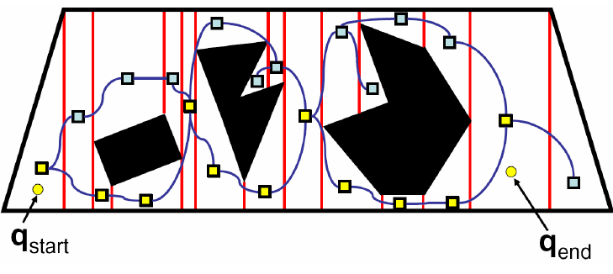
Exact Cell Decomposition
Plan over this graph
How can we improve the path?

Slide 28
Example of Adaptive Decomposition
Quadtrees

Slide 29
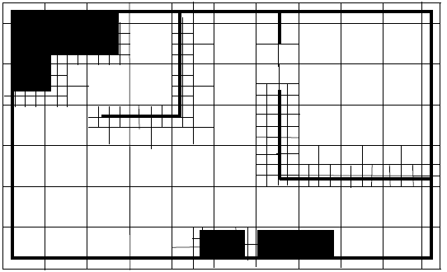
Example of Adaptive Decomposition
Quadtrees
Each internal node has 4 children
Recursively sub-divide space into quadrants

Slide 30
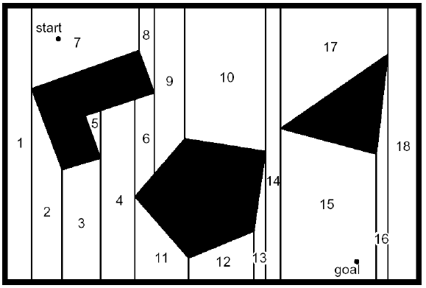
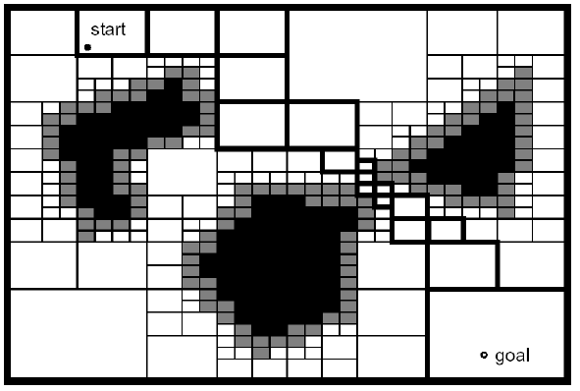
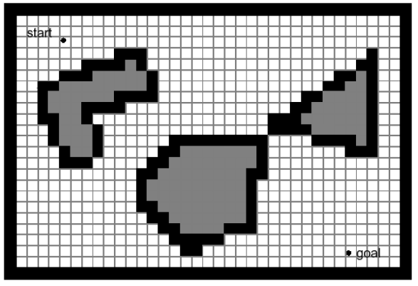
Exact vs. fixed vs. adaptive
Pros and Cons?

Slide 31
Considerations
Difficulty in constructing map
Computational complexity
Planning over map
Constructing map
Map Accuracy
Memory Needed

Slide 32
Kinematics
Move were you want to go
Navigation
Given a Map, and Path planning: Decide where you want to go, and then use Kinematics
Maps
Representation: Turn the real world into a map I can plan over
Localization
Given a map, how do I know where I am?
Map building
Oh man, how do I construct a map? Well, it probably depends on where I am and how I move….

Slide 33
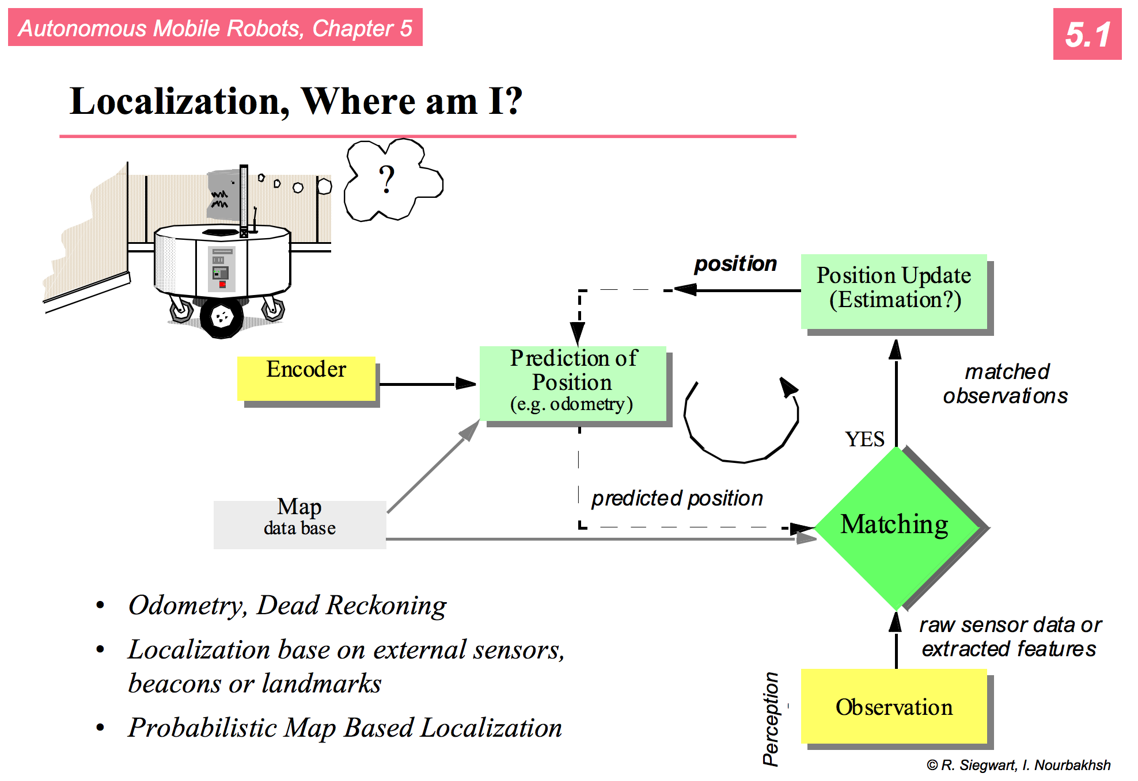

Slide 34
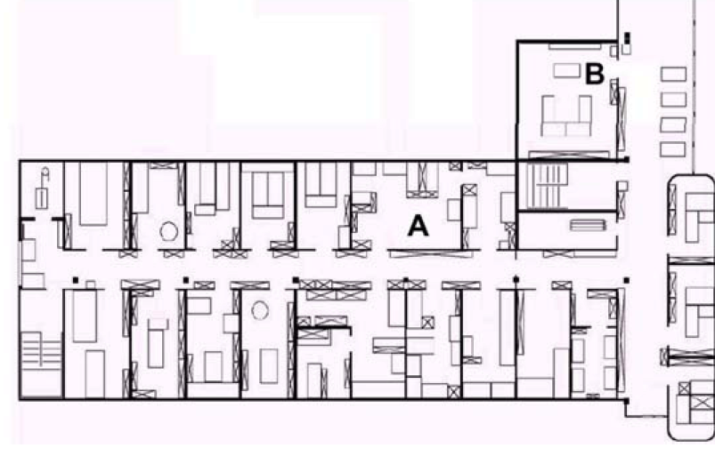
How to navigate between A and B?
Two components to this task:
Navigation without hitting obstacles
Detection of goal location
Possible by following always the left wall
How to detect that the goal is reached?
“behavior based navigation”
It can work in some environments but not in all

Slide 35
How to navigate between A and B?
Map based navigation relies on a map
Assuming that the map is known, at every time step the robot has to localize itself in the map.
How?
If we know the start position, we can use wheel odometry or dead reckoning.

Slide 36
Odometry and Mapping
Create a map as the robot is exploring the environment.
If we assume that our odometry is perfect, could get something like this:
Can’t trust odometry so we must localize as we’re mapping.

Slide 37
Challenges
Effector noise / Odometry Error
Distance movement estimation
Turn error: turning estimation
Drift Error: difference in error of wheels
Sensor noise
False positive readings, false negative readings, noisy readings
Sensor aliasing
Multiple locations appear the same to the sensors

Slide 38
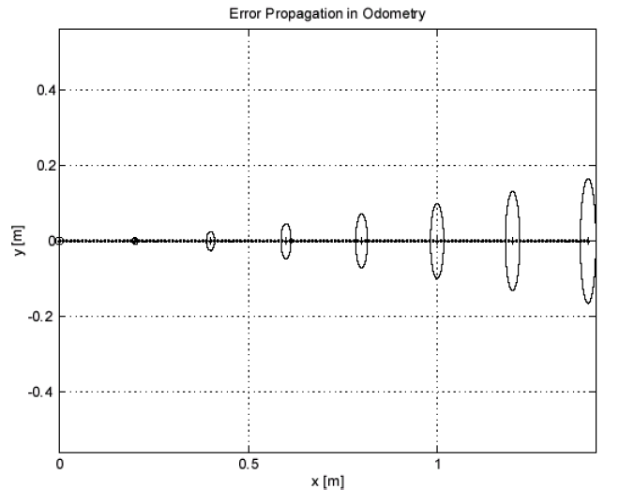
Simple error model from kinematics

Slide 39
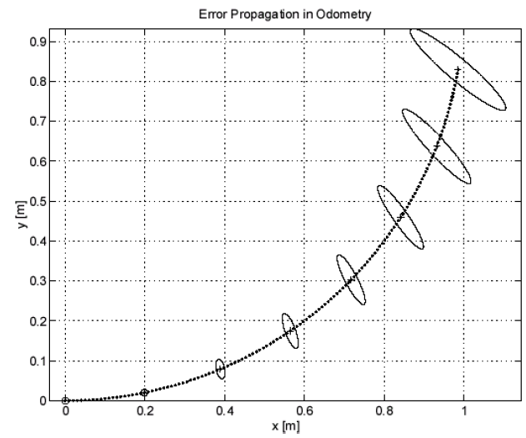
but now add in turning…

Slide 40
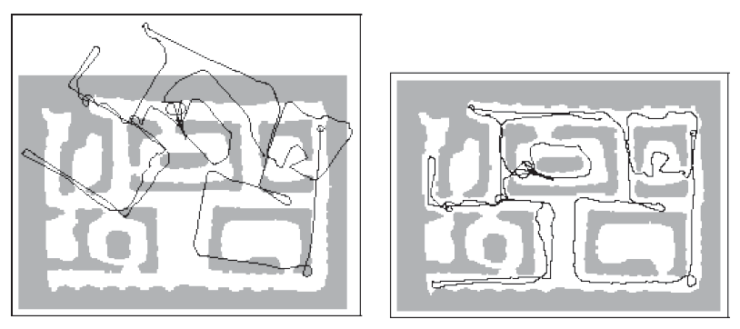
and this leads to things like
(Dieter Fox @ CMU)

