Slide 1
Class 2
Please read chapter 2 for Tuesday’s class (Response due by 3pm on Monday)
How was Piazza?
Any Questions?

Slide 2
Reinforcement Learning: a problem, not an approach
What if you learn perfectly for level 1 and go to level 2? Trial-and-error again? (Gabe)

Slide 3
Sequential Decision Making: RL
Markov Decision Process (MDP)
S: set of states in the world
A: set of actions an agent can perform
T: S×A → S (transition function)
R: S → ℜ (environmental reward)
π: S → A (policy)
Q: S×A → ℜ (action-value function)
Environment
Action
State
Reward
Agent
Notes:
In much of RL, and in what I’ll be discussing today, T & R are unknown

Slide 5
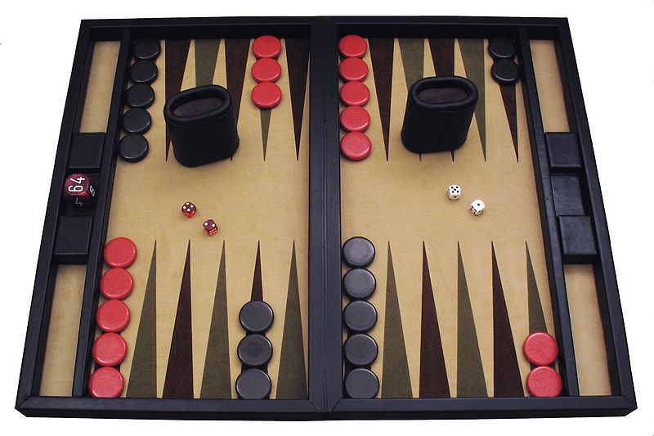
Reinforcement Learning (RL)
Basis in psychology (dopamine)
Very limited feedback
Delayed Reward
Very flexible
Possibly very slow / high sample complexity
Agent-centric
TD-Gammon Aibo Learned Gait:
Tesauro, 1995 Kohl & Stone, 2004
Aside: Self play with same algorithm or different ones? (Josh / Anthony)

Slide 6
Reinforcement Learning (RL)
Basis in psychology (dopamine)
Very limited feedback
Delayed Reward
Very flexible
Possibly very slow / high sample complexity
Agent-centric
TD-Gammon Aibo Learned Gait
Tesauro, 1995 Kohl & Stone, 2004

Slide 7
Tic-Tac-Toe example
Minimax
Dynamic programming
Evolutionary approach
entire policy, what happens during game is ignored
(Approximate) Value Functions
Exploration/exploitation
Greed is often good

Slide 8
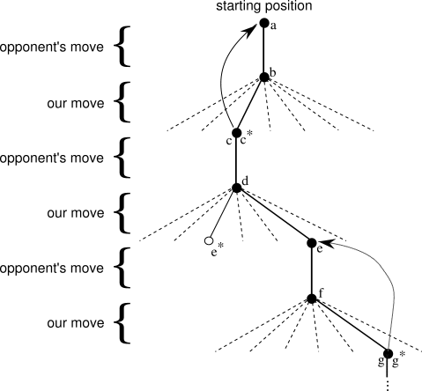
Tic-Tac-Toe example
Aside: Non-TD methods for learning value functions? (Bei)

Slide 9
Symmetries in tic-tac-toe (David)
Opponent modeling vs. optimal play (Anthony)

Slide 10
Chris: UCT
UCB1

Slide 11
Consider the following learning problem. You are faced repeatedly with a choice among n different options, or actions. After each choice you receive a numerical reward chosen from a stationary probability distribution that depends on the action you selected. Your objective is to maximize the expected total reward over some time period, for example, over 1000 action selections. Each action selection is called a play.

Slide 12
First, what is optimal policy if payoffs are deterministic?
Evolutionary Approach?
Value-based approach?
Explore vs. Exploit in this context?

