Slide 1
Thieves Use Heat-Detecting UAS to Target Cannabis Farms
http://www.uasvision.com/2014/04/18/thieves-use-heat-detecting-uas-to-target-cannabis-farms/

Slide 2
https://www.youtube.com/watch?v=bVT7QlYC7JQ

Slide 3
http://www.techfak.uni-bielefeld.de/~skopp/Lehre/STdKI_SS10/POMDP_tutorial.pdf

Slide 4
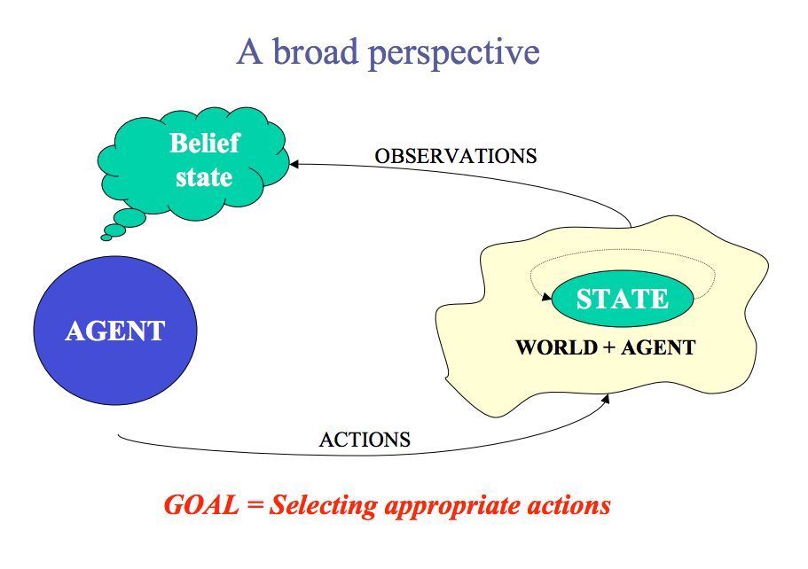

Slide 6
Tiger Problem
Actions:
Listen
Open Left Door
Open Right Door
Observations:
Hear tiger on Left
Hear tiger on Right
Reward:
Listen = -1
Wrong opening: -100
Correct opening: +10
States
S0: tiger on left
S1: tiger on right
Probabilities
P(o=TL | s0, listen) = .85
P(o=TR | s1, listen) = 0.15

Slide 10
Recall
Bayes’ Theorem

Slide 15
Survey
What were the best things about Matt making you lead one class discussion?
What were the worst things?
Do you think Matt should do this next year?
If Matt does it next year, how could he change it?

Slide 16
http://www.cs.mcgill.ca/~jpineau/talks/jpineau-dagstuhl13.pdf

Slide 21
Easiest Solution Method
Treat observations as states!

Slide 26
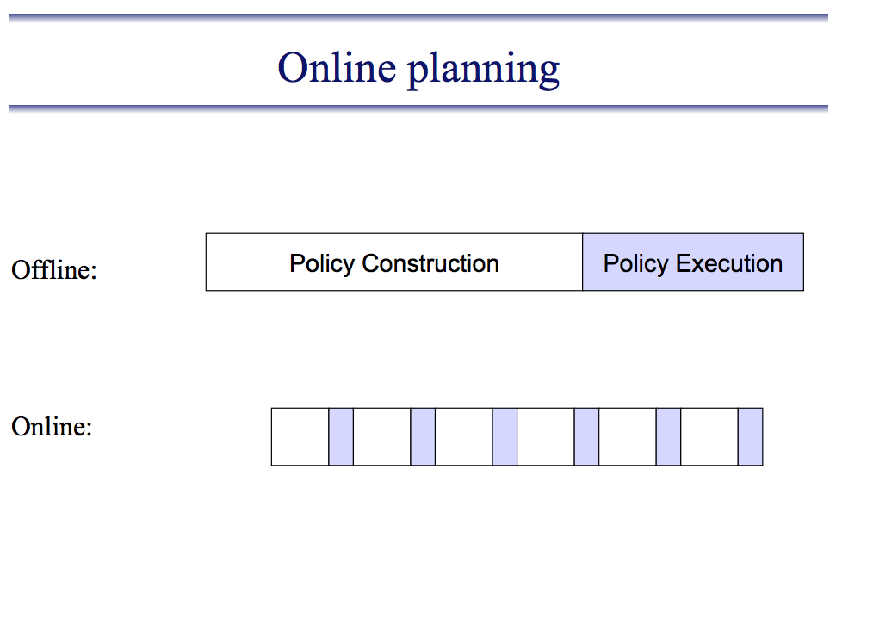

Slide 28
http://users.isr.ist.utl.pt/~mtjspaan/tutorialDMMS/tutorialAAMAS11.pdf

Slide 33
http://skylight.wsu.edu/s/11d19b5d-c8a7-4e69-93e3-2f110c2c6f07.srv

